Slide 1

Speaker -Vicki Lockwood
THE BEEKEEPERS INN / GOLDFIELDS HONEY

Slide 2
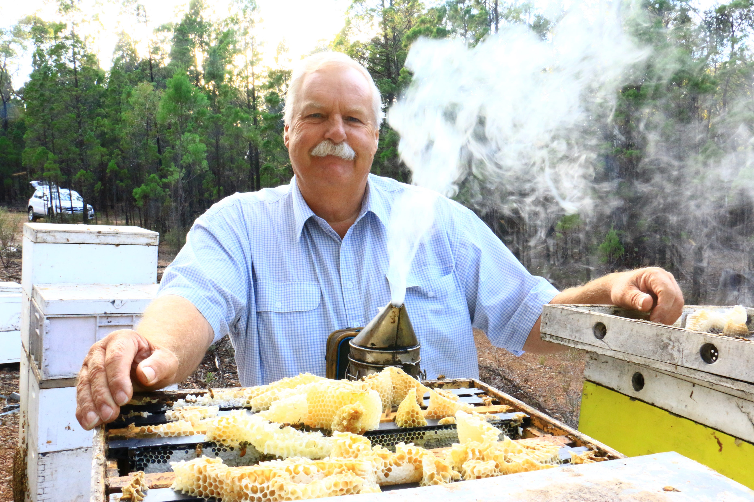
GRANT LOCKWOOD

Slide 3
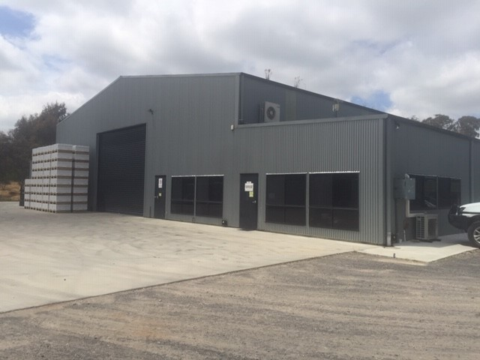
CURRENT FACTORY

Slide 4
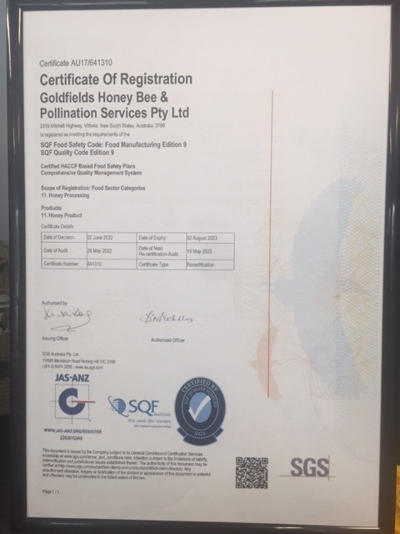
SQF (Food Safety) Accrediation

Slide 5
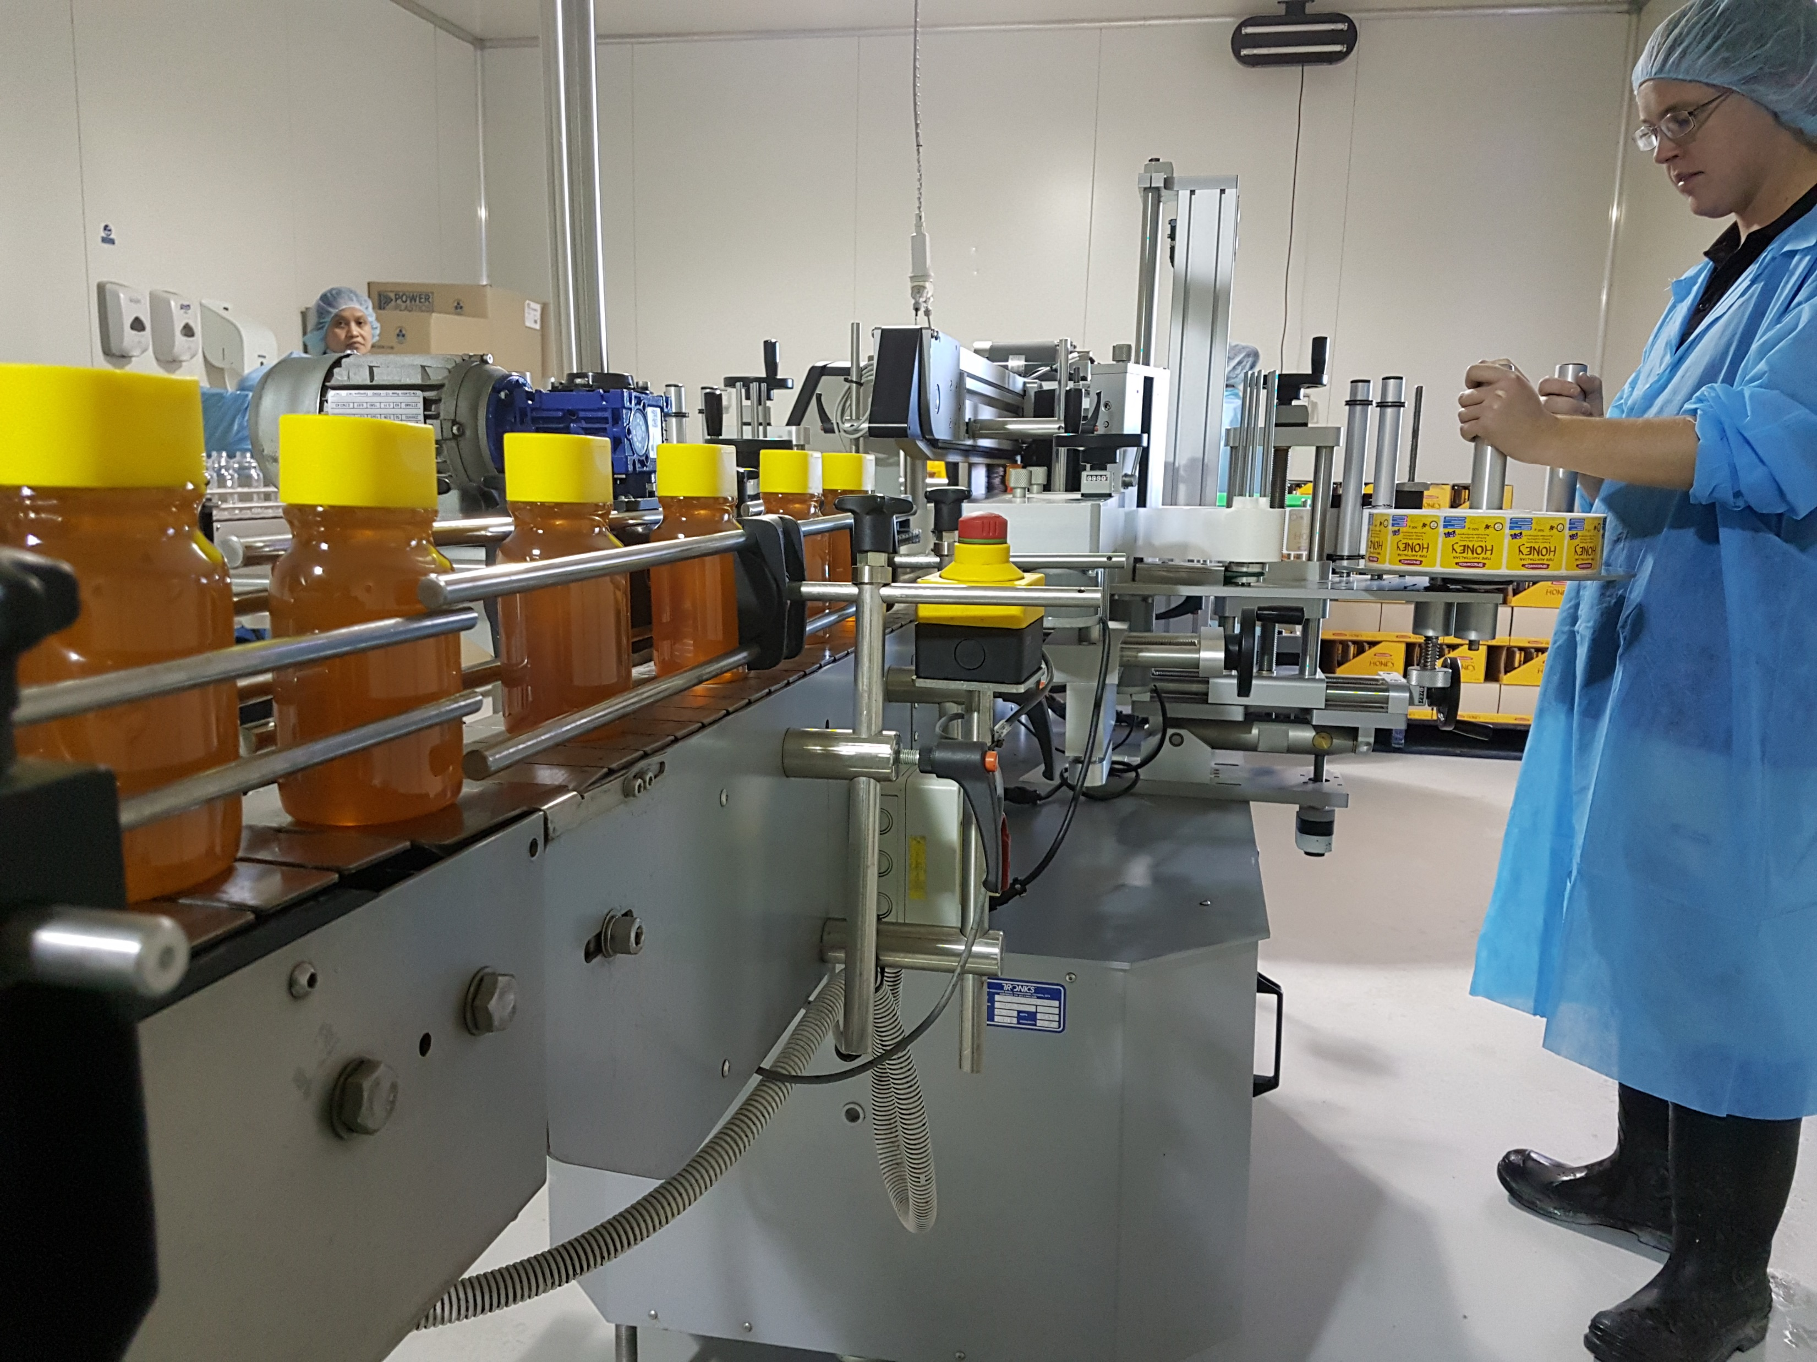
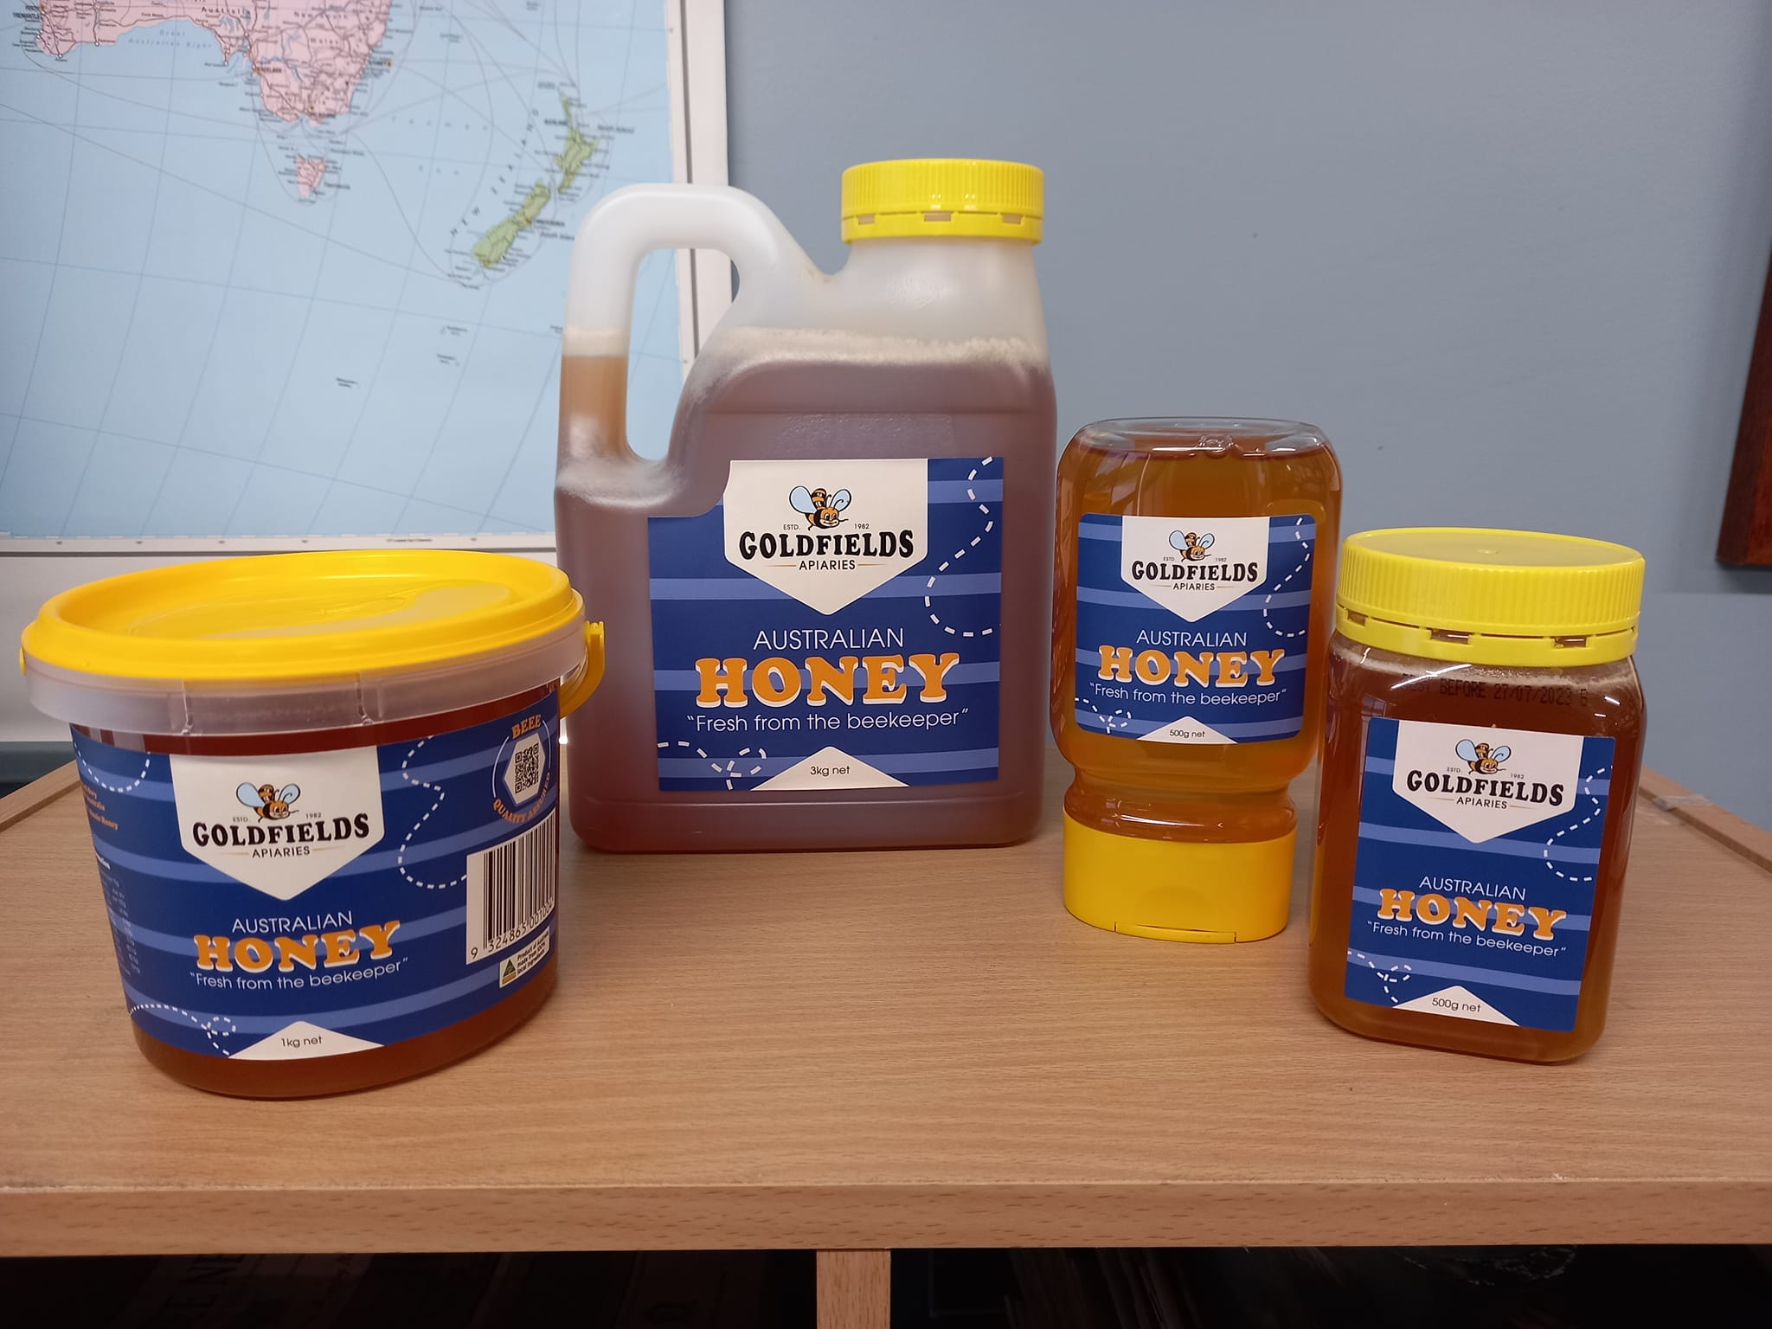
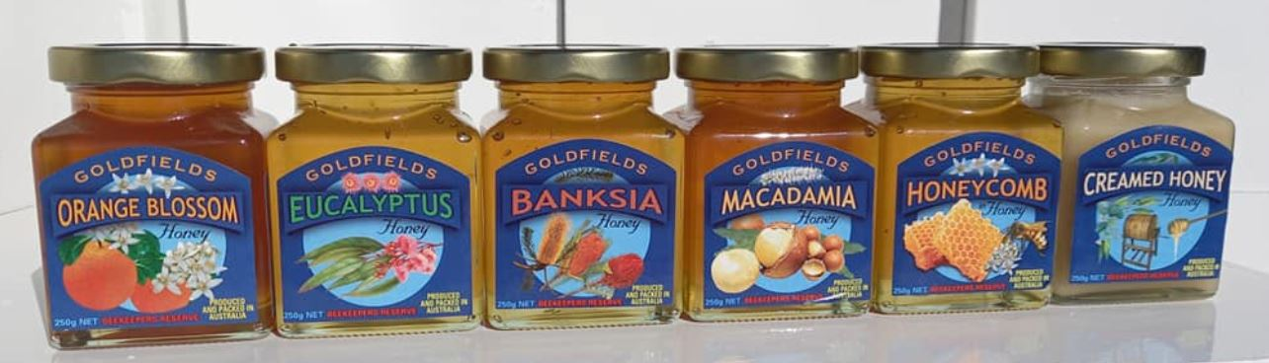
Packing Room Staff / Honey Products

Slide 6
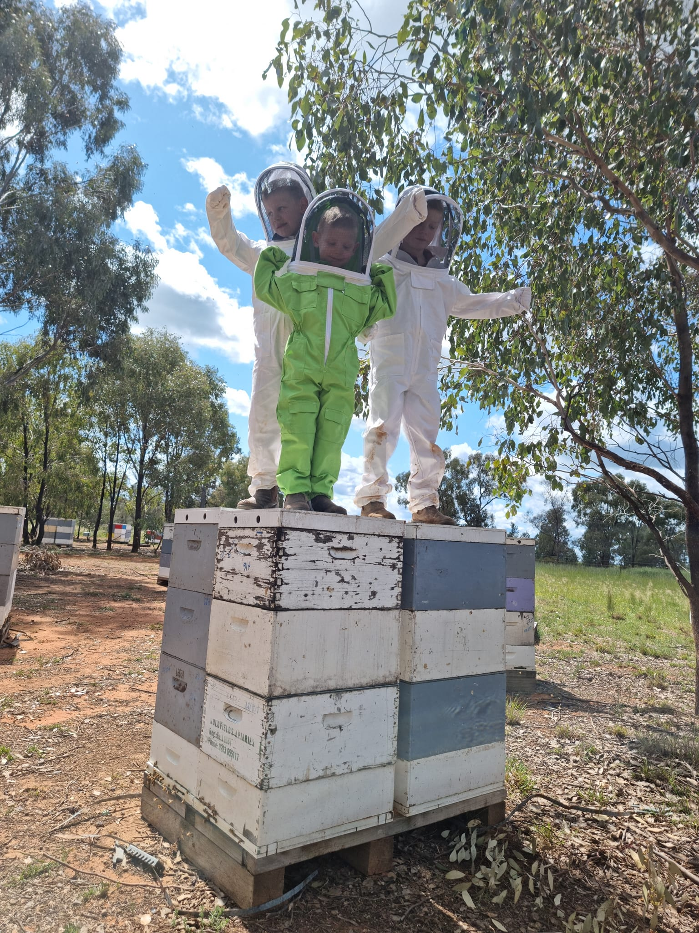
My grandchildren – the next generation of beekeepers

Slide 7
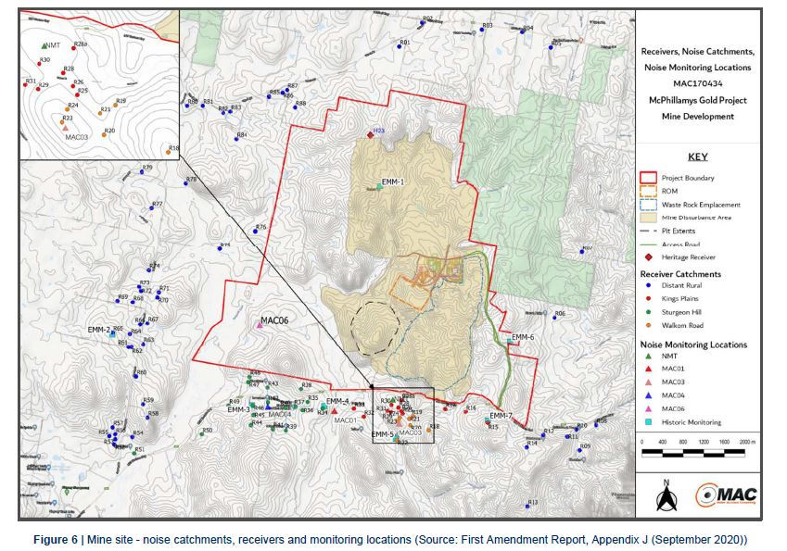
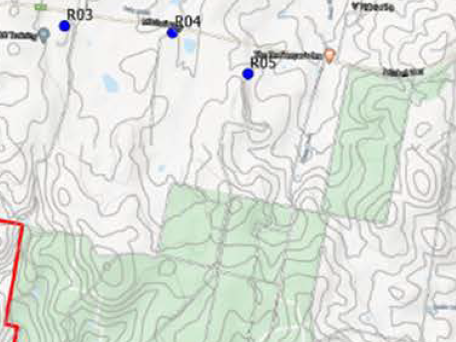
NOTE:
KALAMUNDA, GOLDFIELDS HONEY & BEEKEEPERS NOT ON MAP

Slide 8
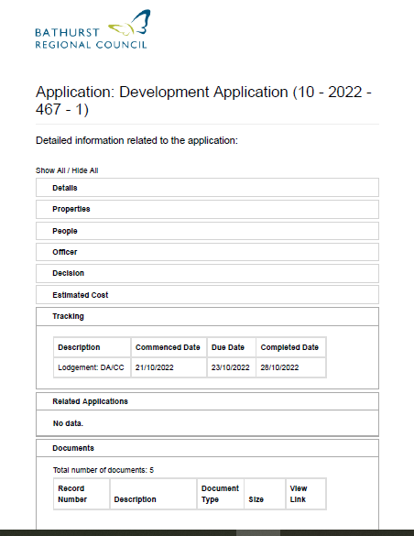
DA Application – Bathurst City Council

Slide 9
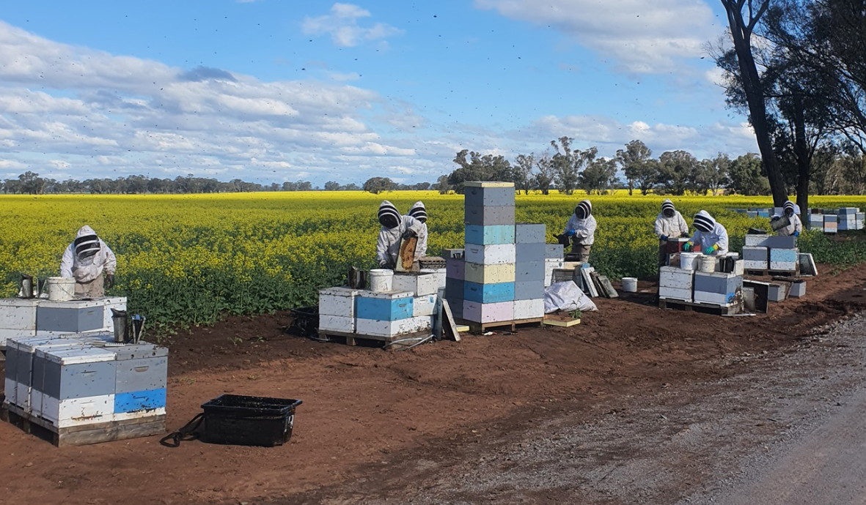
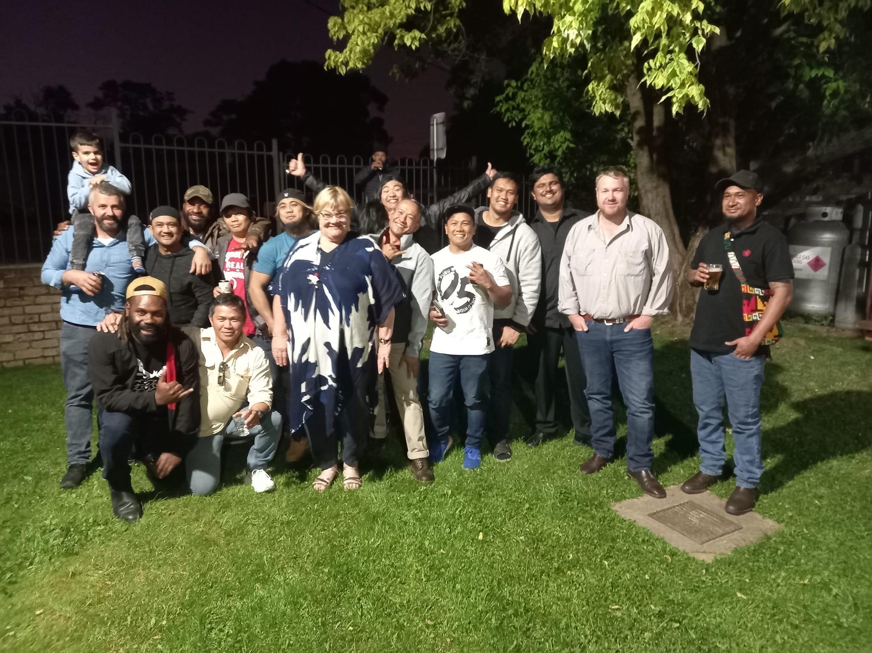
Beekeepers from PNG, Fiji, Philippines

Slide 10
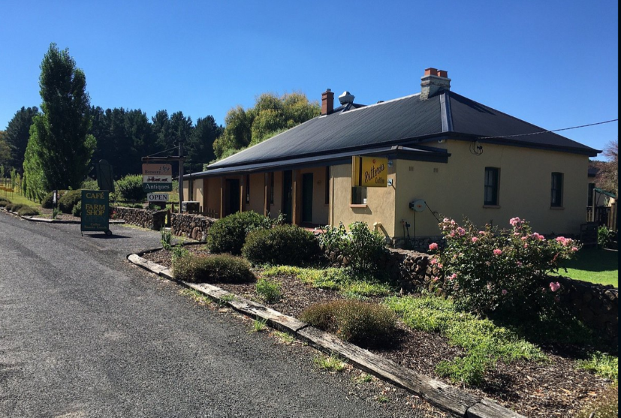
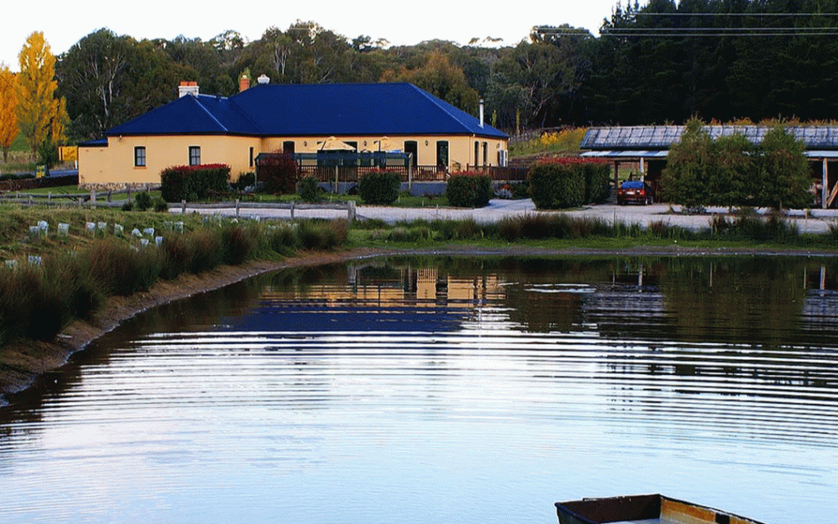
BEEKEEPERS INN

Slide 11
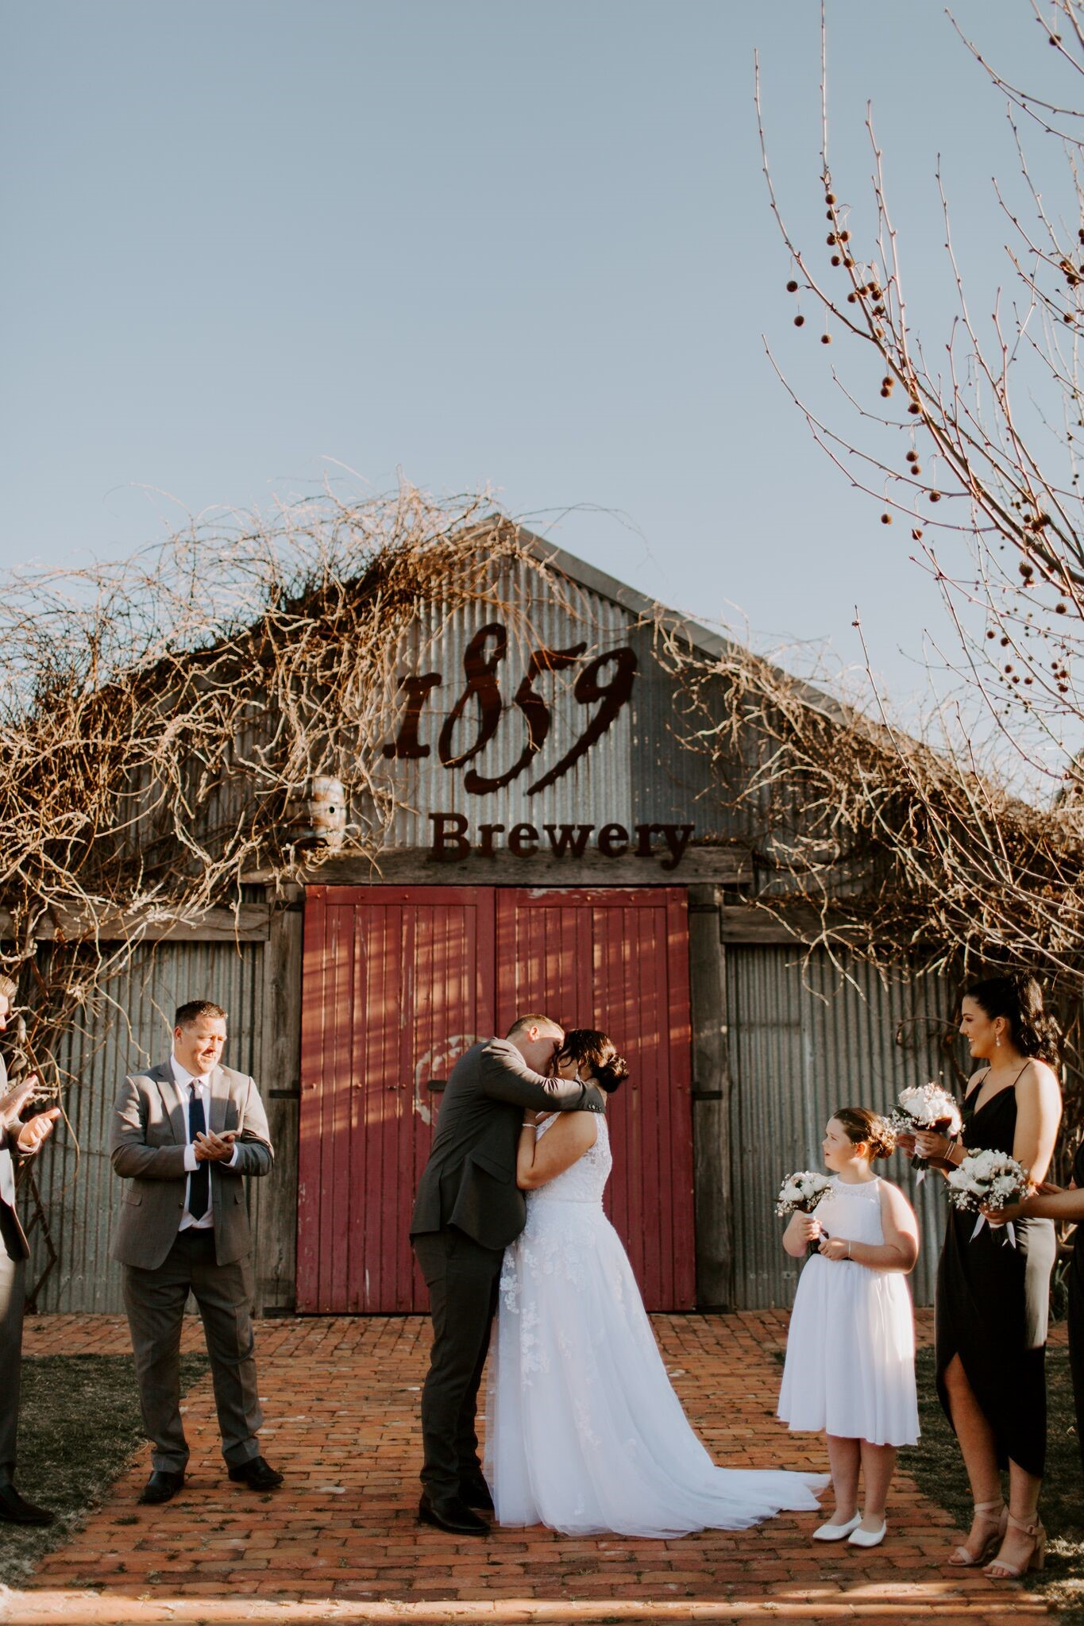
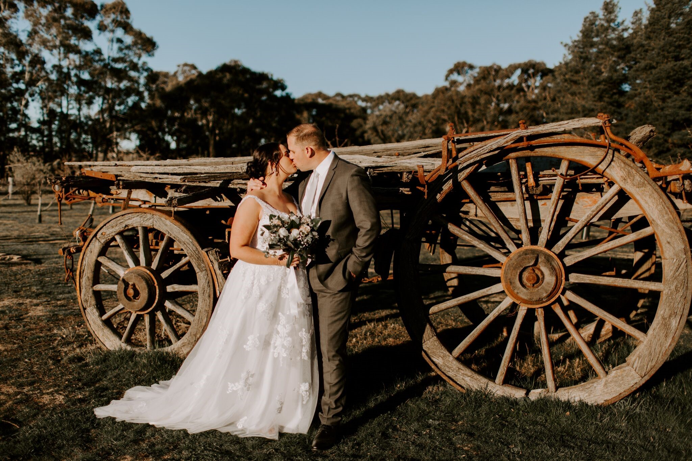
WEDDINGS
BEEKEEPERS INN

Slide 12
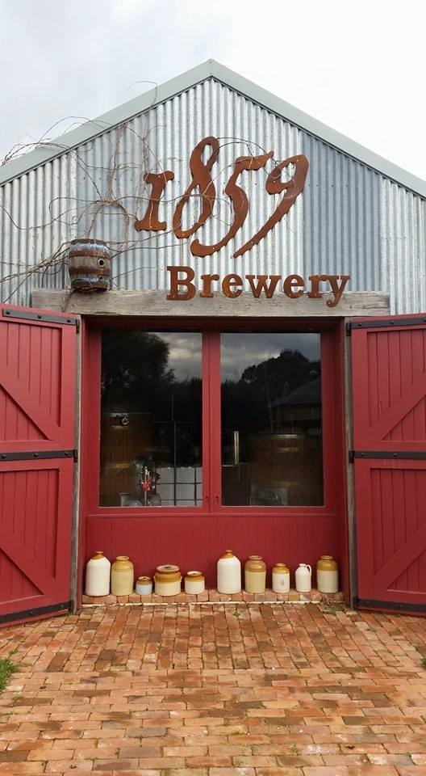
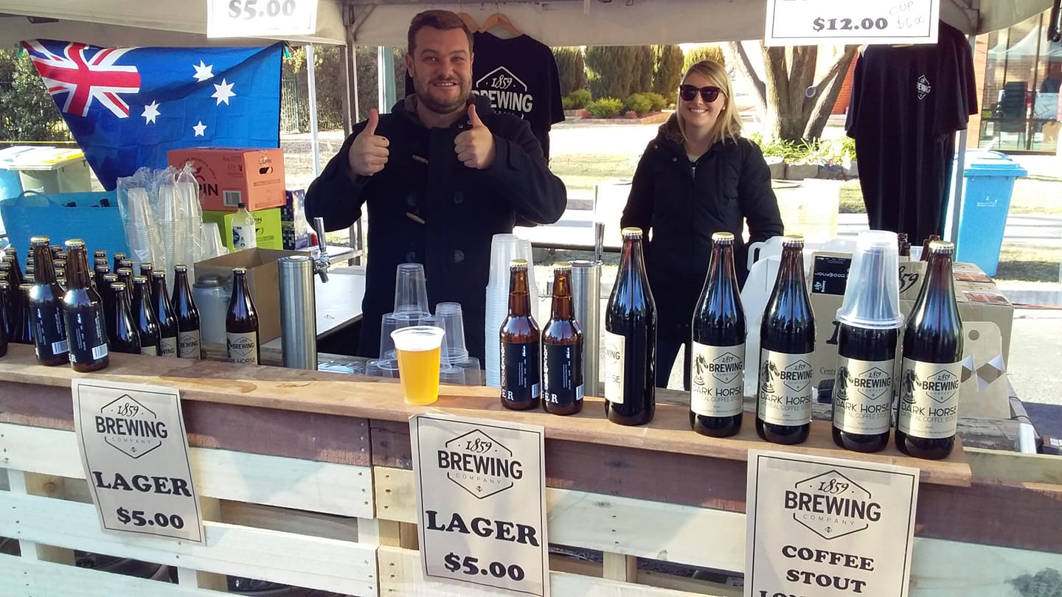
Central Ranges Brewing Company (1859 Brewery)

Slide 13
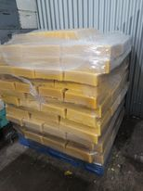
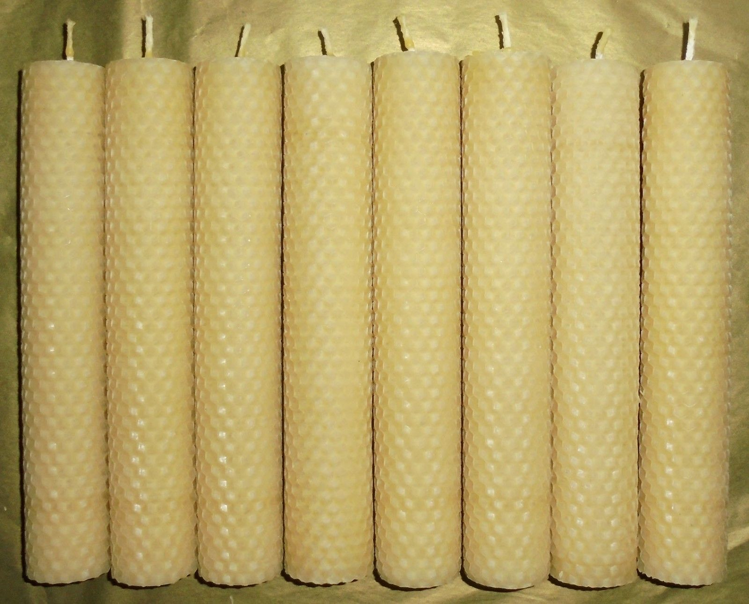
The Beeswax Factory

Slide 14
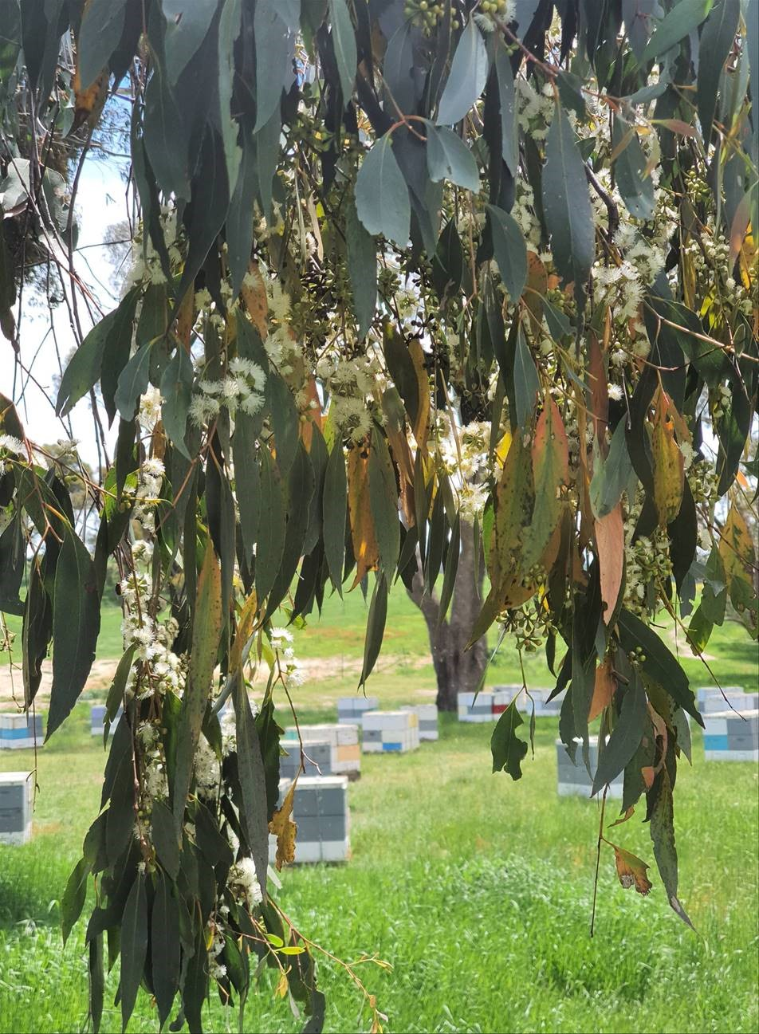
Goldfields beehives in Vittoria State Forest

