Slide 1

McPhillamys Gold Mine – EIS Review
Dr Ryan Vogwill
HydroGeoEnviro Pty Ltd

Slide 2
Outline
Positive Comments
Climate Change – Extreme Events
Conceptual Hydrogeology and Modelling
  Parameter uncertainty and non unique solutions in modelling
  Conceptual uncertainty
  Fractured rock verse porous media
Do model predictions match reality?
Implications at McPhillamys Mine

Slide 3
Positive Comments
In my opinion from a hydrological and hydrogeological perspective:
Pipeline construction is low impact risk
The mine site is located in a good area from a surface water perspective – High in the landscape with only small upgradient surface water catchments
Biodiversity and cultural assets are well catalogued. No assets of National significance (EPBC level) appear at serious risk based on their analysis but some local stakeholder’s interests will be impacted
In my opinion the EIS work is generally of a high standard (given the limited data) but some refinement is required …
The main impact risk relates to contamination of groundwater (including springs/seeps) and rivers receiving groundwater discharge

Slide 4
Climate Change – Extreme Events
Existing work at McPhillamys has tested the effect of the project under the observed range in climate. Climate change is predicted to cause more extreme events (droughts and floods) that will likely take our climate (including extreme events) outside of the observed range. I believe it is important to assess the impact of these “more extreme” events as well as the observed data range
https://www.ipcc.ch/report/ar6/wg2/downloads/outreach/IPCC_AR6_WGII_FactSheet_Australasia.pdf
  Increased drought frequency is projected for southern and eastern Australia and northern New Zealand (medium confidence).
  Increased heavy rainfall intensity is projected, with fewer tropical cyclones and a greater proportion of severe cyclones (medium confidence).
Important to test the impact in both surface water (high priority) and groundwater models (low priority)

Slide 5
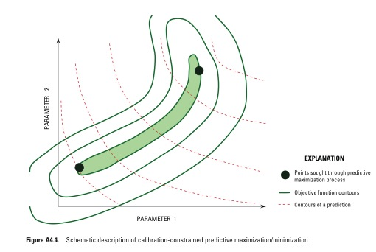
Modelling Uncertainty Analysis
Models have uncertainty from many sources
Analysis of the uncertainty associated with predictions, is fundamental to the use of modeling in support of decision making
Though the PEST software suite was initially developed as a tool for model calibration, recent developments have focused on the evaluation of model-parameter and predictive uncertainty
Transient calibration and aquifer testing help reduce uncertainty (as the model incorporates, and testing measures storage) and make the model more “unique”
But PEST and similar techniques alone cannot deal with conceptual uncertainty
PEST = Parameter ESTimation software,
which is also used for uncertainty analysis
Best Estimate
Doherty, J.E., Hunt, R.J., and Tonkin, M.J., 2010, Approaches to highly parameterized inversion: A guide to using PEST for model-parameter and predictive-uncertainty analysis: U.S. Geological Survey Scientific Investigations Report 2010–5211, 71 p

Slide 6
Model Boundary
Conceptualisations – Conceptual Uncertainty
Source: Innovative Groundwater Solutions (2022). Assessment of groundwater extraction from the Ammaroo Phosphate Project mine bore field. Final report prepared for Verdant Minerals. 23 June 2022.

Slide 7
“Bandwidth” of Predictions – Shows Uncertainty of Predictions Under a Reasonable Range
The key prediction at McPhillamys of 50m of contaminant seepage in 100 years needs more uncertainty context, including exploring conceptual uncertainty and impact of the fracture rock aquifer

Slide 8
Groundwater Flow - Fractured Rock vrs Porous Media Flow
Current modelling – Porous media flow
  Porous Media
    Typically “10s” of meters per year
  ‘Fractured’ Rock Aquifers
    “10s -100s” meters per day via individual fractures
    implication for contaminants travel times and mixing
‘High’ flow velocities occur in ‘fractures’– however, total volumetric flow rate (i.e. contaminant loading) generally lower as ‘fractures’ only occupy a small percentage of the geological formation

Slide 9
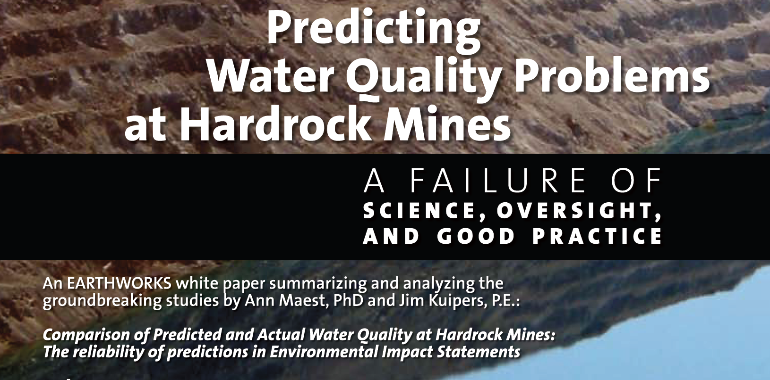
A study of 71 major hard rock mines in the US with a representative subset of 25 selected for detailed analysis Impacts from mining and tailings storage/disposal.
Maest A. and Kuipers J. (2006) Predicting water quality problems at hard rock mines – A failure of science, oversight and good practise, White Paper – Earthworks Publishing.

Slide 10
Do model predicted water quality impacts match reality?
The answer, in short, is no,
100 percent of mines predicted compliance with water quality standards before operations began
76 percent of mines studied in detail exceeded water quality standards due to mining activity
Mitigation measures predicted to prevent water quality exceedances failed at 64 percent of the mines studied in detail
Why?
Science is complex - there are knowledge gaps in site conditions, physical and chemical processes
Numerical modelling is an imprecise science and we need to get better at it and do it more transparently
Maest A. and Kuipers J. (2006)

Slide 11
Predictions vs. Reality: the inaccuracy of Predictive Modelling
73% of mines exceeded surface water quality standards despite predicting that mitigation would result in compliance. The other 4 mines didn’t predict the need for mitigation.
77% of mines that exceeded groundwater quality standards predicted that mitigation would result in compliance. The other 3 mines didn’t predict the need for mitigation.
Maest A. and Kuipers J. (2006).

Slide 12
Numerical Modelling needs to be transparent in impact assessment - Document and Present Uncertainty
Sources of uncertainty
The distribution of data and modelling methods used
  Model calibration methods used frequently lack any rigorous method of relating models to the calibration data and the predictions of interest
  The model is statistically “well calibrated” but is the model well calibrated for key predictions?
This uncertainty in data and models cascades through modelling, leading to uncertainty in estimated parameter values and predicted outcomes
Models are often misused, they are non unique solutions. Each solution will have different predictions, never rely on one model prediction (i.e. use predictive uncertainty analysis)
Recent papers on adaptive management (Thomann et al., 2022) highlight that pre approval predictive uncertainty analysis is critical to the adaptive management process
Thomann, J.A., Werner, A.D. and Irvine, D.J., 2022. Developing adaptive management guidance for groundwater planning and development. Journal of Environmental Management, 322, p.116052.

Slide 13
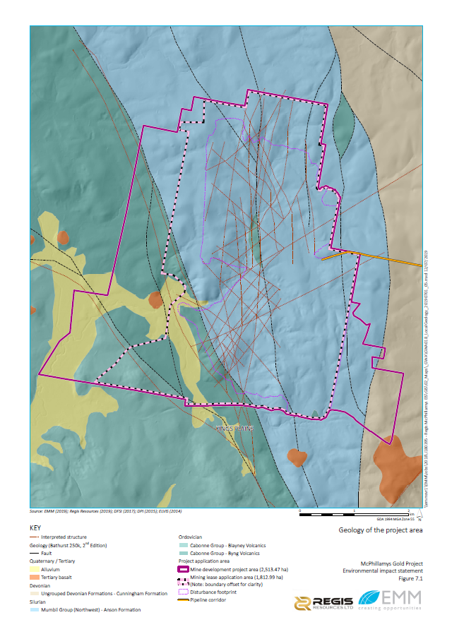
Implications at McPhillamys
Mining, tailings storage and disposal invariably will create impacts, the only question is their extent and are they acceptable to stakeholders? Once impacts start they are hard to stop (can’t turn off the tap)
Overreliance in a single model prediction will lead to uncertain impact assessment. There is considerable uncertainty in the current models predictions from multiple sources. Key issues:
  Prediction of 50m of contaminant seepage in 100 years needs expansion
  The status of the pit lake as a sink or throughflow system
Main concerns I have at McPhillamys
  Test the impact of climate outside of the observe range for all impacts (surface water and groundwater), I don’t anticipate major issues
  Surface water modelling has had only limited sensitivity analysis
  Groundwater modelling is better in terms of sensitivity analysis but has significant conceptual certainty associated with the fractured rock (->) nature of the aquifer. Needs transient calibration and aquifer testing to remove non uniqueness including predictive uncertainty analysis
Risk of regional impact is low but the risk of local scale impact (within a few kilometres downgradient) is high

