Slide 1
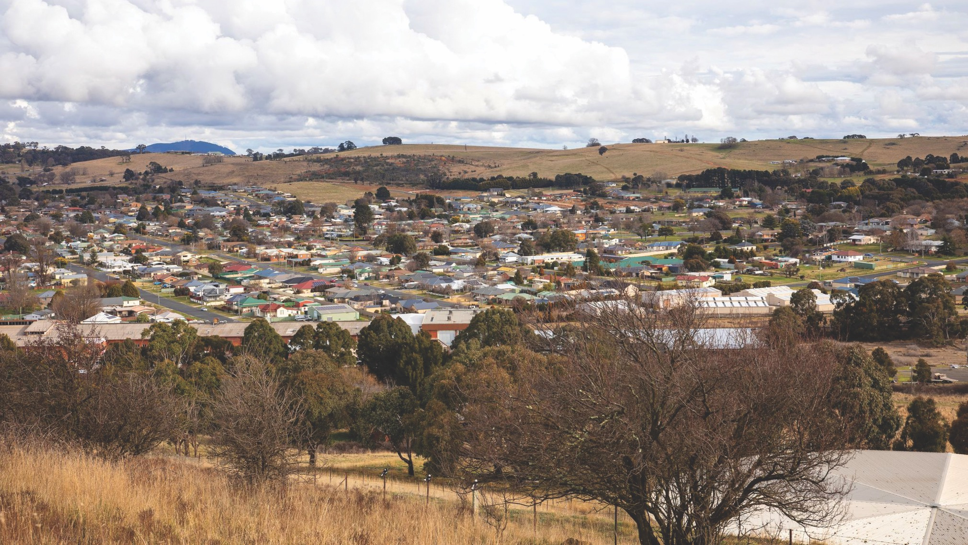

Independent Planning Commission - Public Hearing
Blayney Community Centre – Monday 6th February 2023

Slide 2
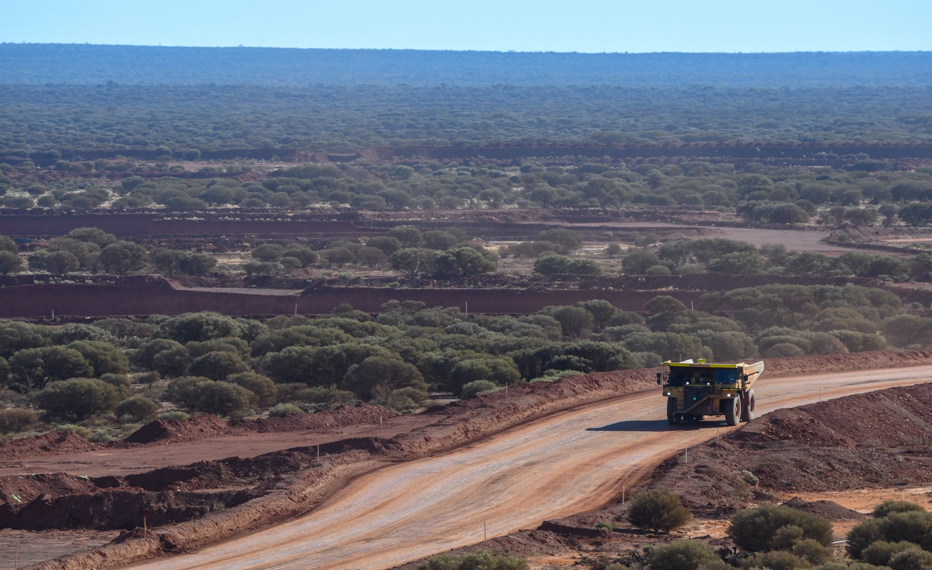
Regis Resources overview
Jim Beyer, Managing Director and Chief Executive Officer

Slide 3
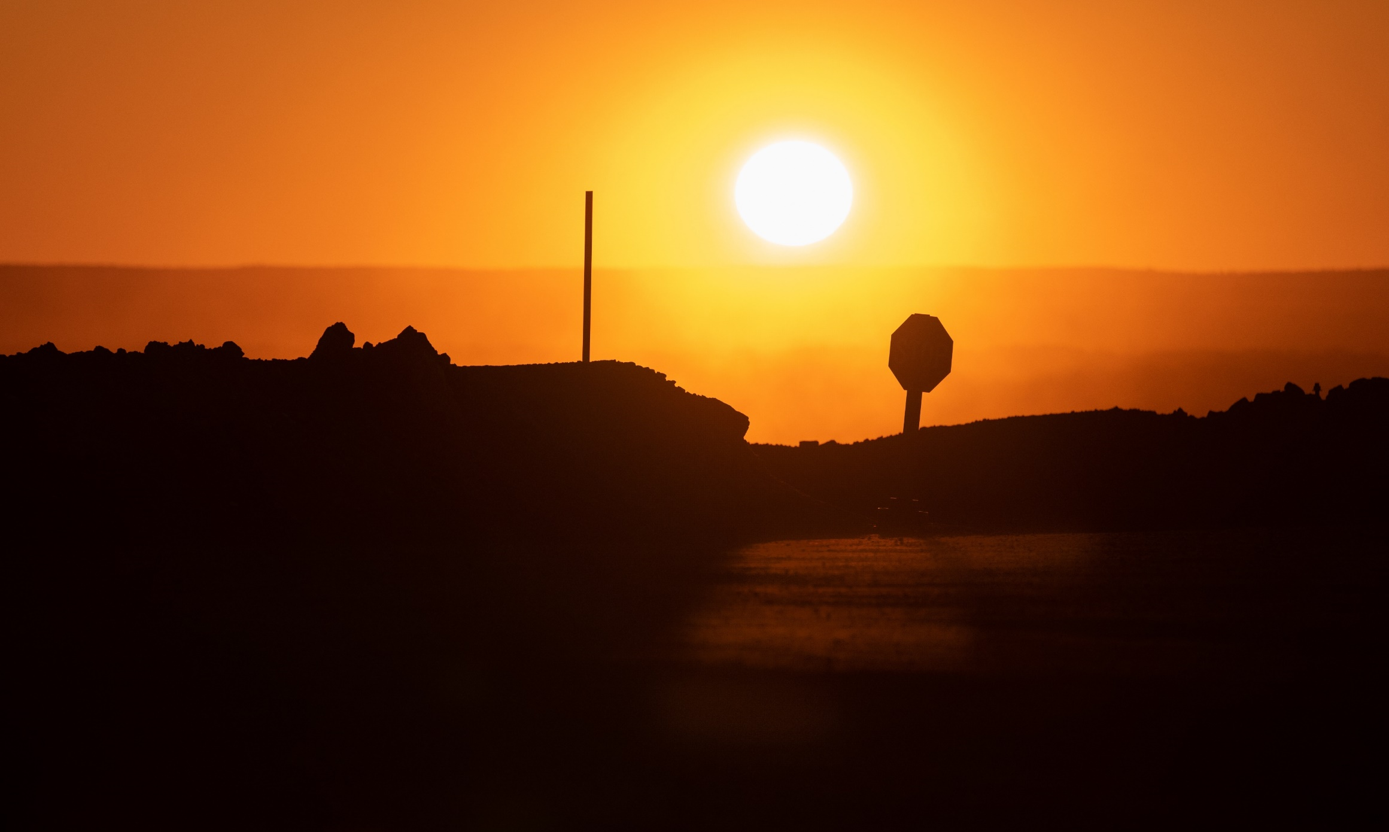
ACKNOWLEDGEMENT OF COUNTRY
The Board, Executive and Team at Regis Resources acknowledges the local Wiradjuri people along with Mantjintjarra Ngalia, Noongar, Spinifex and Wongatha people in Western Australia as the Traditional Custodians of the lands on which our Company currently operates and plans to develop new operations. We recognise their ongoing connections with land, waters and community, and pay our respects to elders past and present.

Slide 4
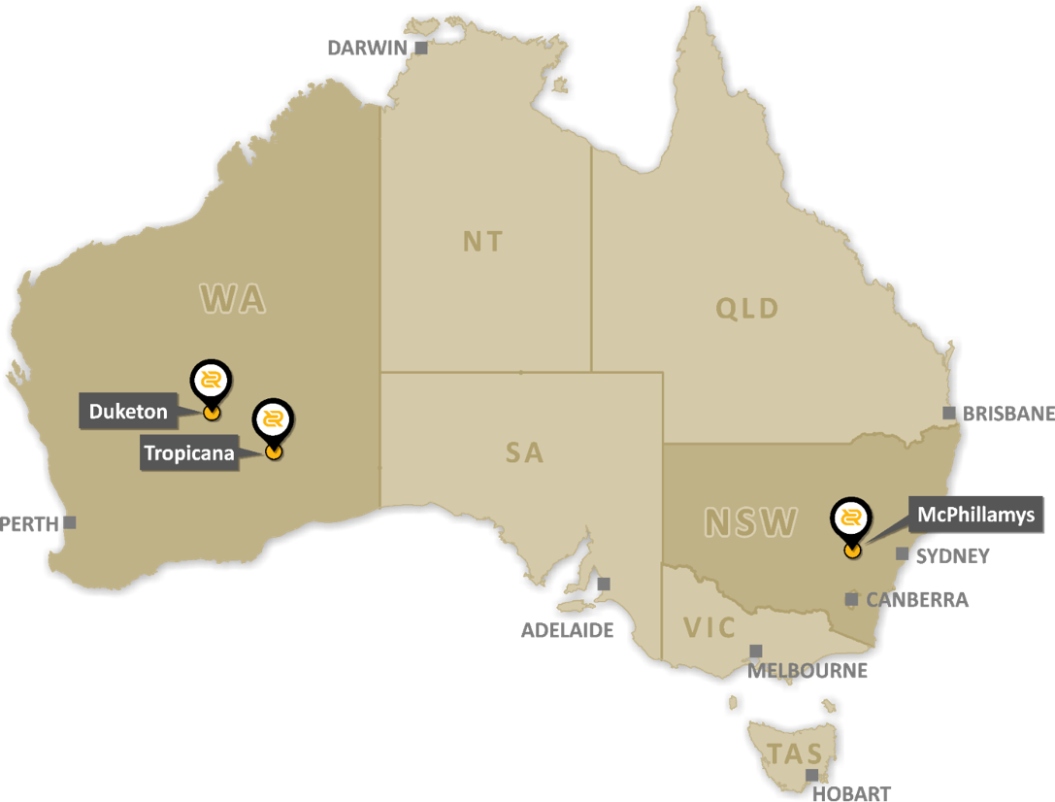
REGIS PURPOSE
3
To create value for our people, our communities and our shareholders by mining safely and responsibly.
Our Values: Respect - Integrity - Teamwork – Ownership - Courage
Australian Stock Exchange listed
4TH largest gold producer on the ASX
Proven track record
Duketon a stable operation approximately 12 years old and over 1,400 people employed
Tropicana is a Tier 1 long life asset jointly (30%) owned with Anglo Gold Ashanti that has been running for 9 years and over 1,000 people employed
McPhillamys
One of Australia’s largest undeveloped open-pittable gold deposits
Cornerstone of Regis’ future
150-year mining history
Alignment with Regional Plan

Slide 5





FY22 MAINTAINING OUR Licence TO OPERATE
4
Year on year progress in ESG performance across our existing operations
Group LTIFR reduced to 0.6
70% below industry average
Our People
398 direct employees (+1,600 indirect*)
$71m direct salary and wages in FY22
22% female employees - above industry average
Net Zero by 2050
Targets and plans for step change reduction by 2030 to be set in FY23
Physical and financial climate change risks factored into all investment decisions
32% increase in community investment and support
Implemented cultural heritage training
116% increase in rehabilitated land
Total rehabilitated to date land increased to 10.3%
Zero material environment incidents
* Equivalent after accounting for 30% Tropicana

Slide 6
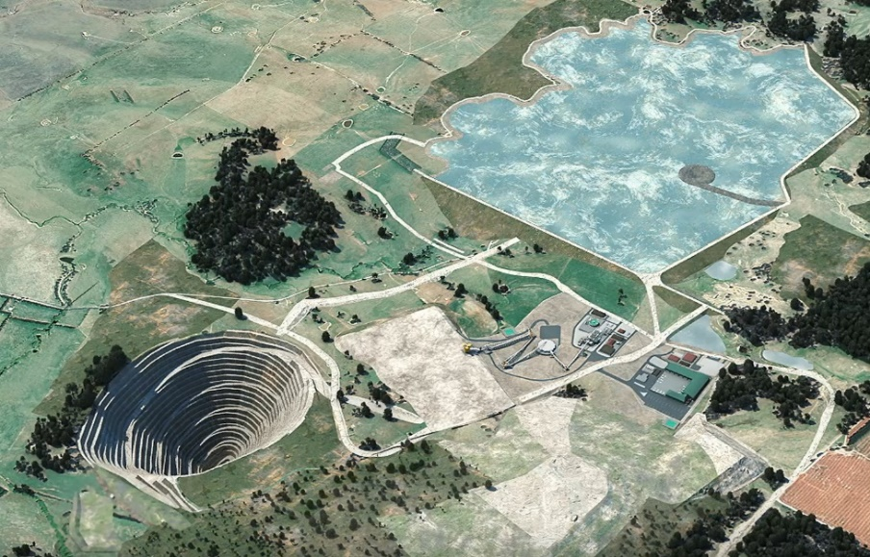
5
THE LENGTH OF TIME REFLECTS REGIS’ COMMITMENT
One of Australia’s largest undeveloped open pit gold deposits
Potential to produce up to 200koz/yr over 10+ years
Life-of-mine
10+
years
2012 | Regis acquires McPhillamys for ~$150M
2013 | Baseline investigations and monitoring commence
2014 | Regis announces large open-pittable gold resource
2017 | Infill drilling complete Reserve Estimate 2.0Moz
2018 | Preliminary Environmental Assessment (PEA)
2019 | Environmental Impact Statement (EIS)
2023 | Final Stages of Assessment and Determination
To date Regis has spent
~$300M on the project

Slide 7






BENEFITS FOR BLAYNEY, THE REGION AND NSW
6
Local employment
Blayney community investment
Local businesses
Benefits for NSW
Environment & water
Locals first recruitment

Slide 8





7
DPE’s ASSESSMENT REPORT AND DRAFT CONDITIONS
Regis has designed the project in a way to achieve a practical balance between maximising resource recovery and minimising associated impacts on the surrounding landholders and the environment through best practice contemporary practices and mitigation measures
The Department notes significance of the project’s resource, the increasing focus on minerals mining …growing demand for raw metals (including gold)
Amendments to
the project throughout the assessment process have resulted in substantial reductions to the project’s predicted amenity impacts at nearby residences as well as impacts on road safety, heritage and water resources

Slide 9
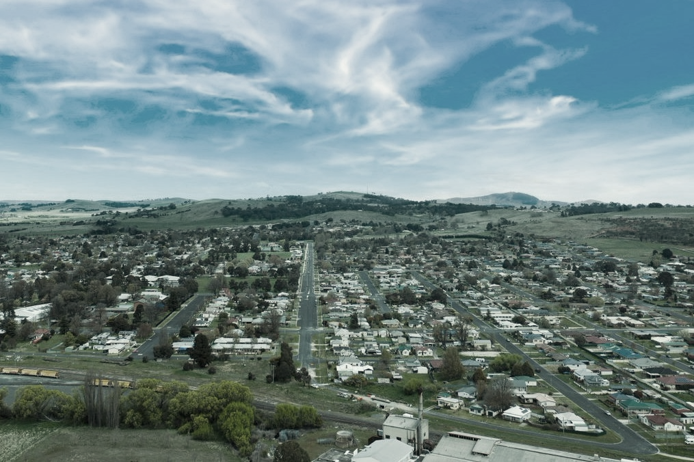
McPhillamys – responsive site design
Tony McPaul, Manager – Special Projects

Slide 10






9
COMMUNICATION AND CONSULTATION*
1,117
Individual meetings
98
Blayney Chronicle fortnightly updates
4,407
21 editions of community newsletter delivered to 4,407 households (Blayney LGA)
2,739
Phone calls
20
Community Consultative Committee meetings
40+
Community group presentations
*Since 2018

Slide 11
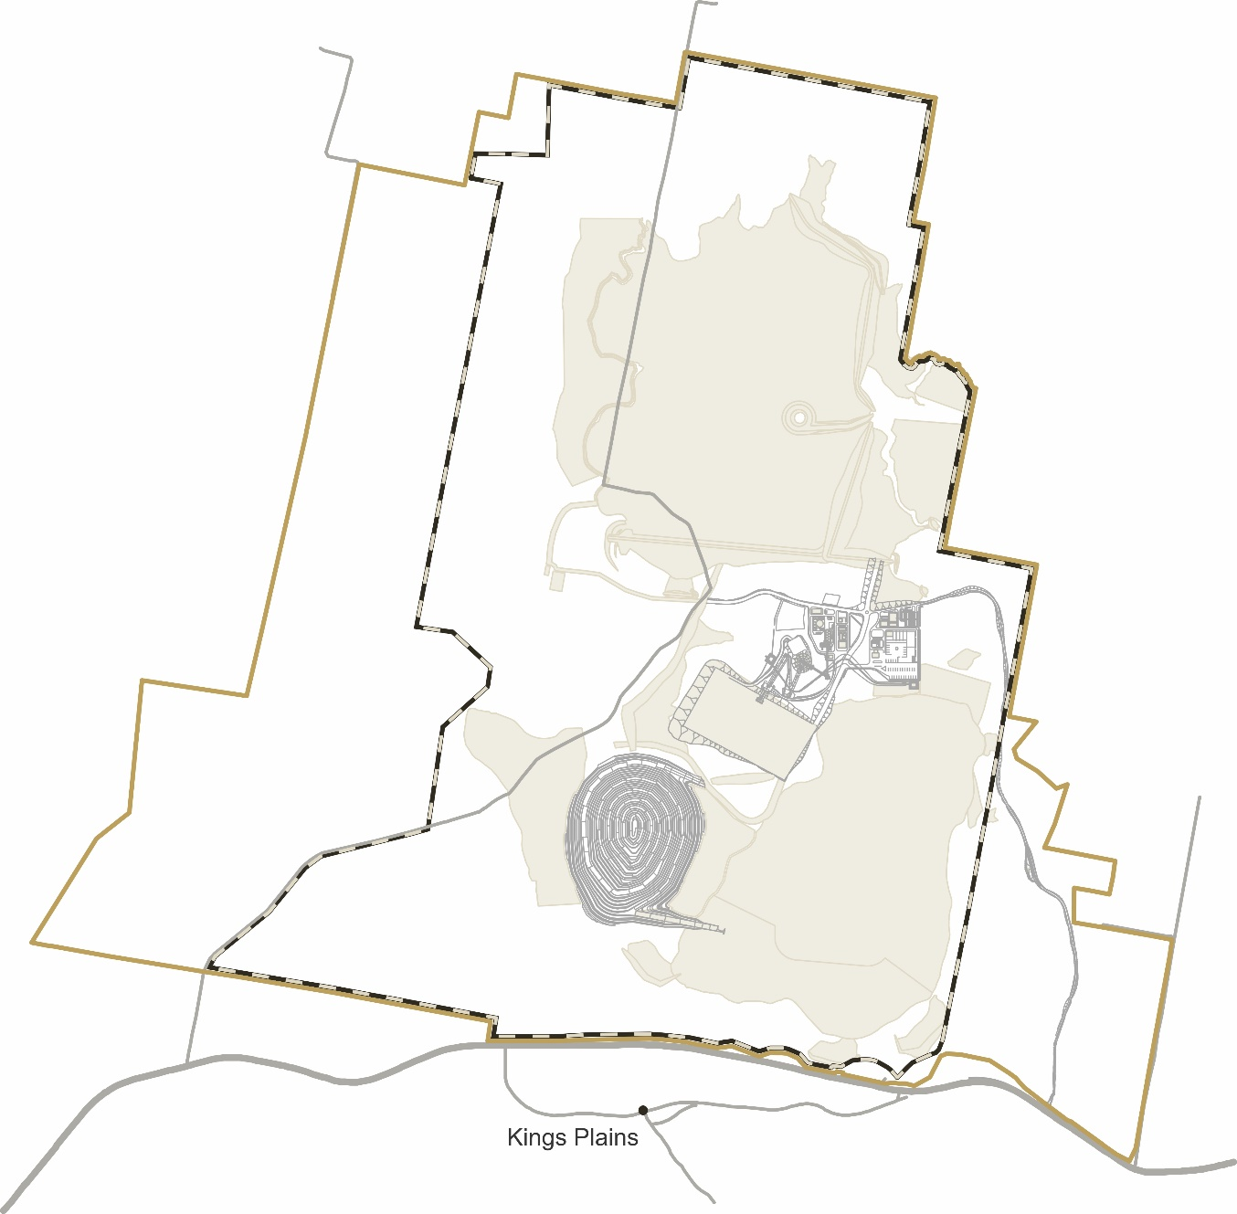
10
CONTINUALLY IMPROVED PROJECT DESIGN
​
​
Minimise impact on Box Gum Woodland through revised TSF design
Avoidance of historic “Hallwood” Farm Complex
Key areas where design has been refined and improved include:
  Waste rock emplacement
  Site access road
  Water management facilities
  Surface water management
  Open Pit Schedule
  Process plant layout
Amendments to maximise clean water diversion
Processing plant screened by topography
Avoidance of Biophysical Strategic Agricultural Land
Mining fleet with reduced noise levels
Removal of western waste rock emplacement and administration area
Revision of mine and waste rock emplacement schedule
Pit and southern amenity bunds
Avoid
Relocation of site access
Minimise
Mitigate

Slide 12





11
MANAGEMENT OF OTHER KEY COMMUNITY CONCERNS
Noise:
  Individual mitigation agreements
  Activity restrictions/equipment/design
  Monitoring and reporting commitment
Biodiversity:
  3 areas of focused biodiversity improvement
    Box Gum area tree planting for bee foraging and koala habitat
    Belubula river improvement programme
    Aziel property improvements e.g. tree planting
Visual Amenity
  100,000+ trees to be planted with 10,000 to date
  Individual mitigation agreements
  Rehabilitation planning
Aboriginal Cultural Heritage:
  Consultation and surveys undertaken with local Indigenous community
  All identified sites assessed and recorded
  Management, monitoring and reporting commitment
Air Quality
  Progressive rehabilitation
  Dust suppression controls
  Individual mitigation agreements
  Monitoring and reporting commitment

Slide 13
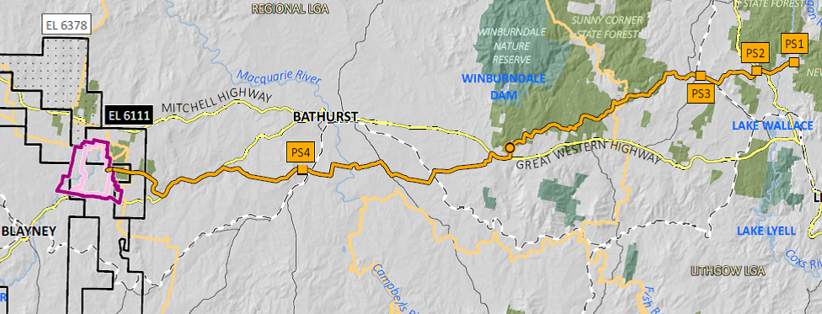
12
WATER
During operation, McPhillamys does not need water from the local catchment
The water supply pipeline is capable of supplying all operational requirements
As a nil discharge site, all rainwater that falls on disturbed areas at the mine will be recycled
NSW Government confirms there is a pathway to secure all required water licences under NSW water legislation

Slide 14

CLOSURE & A POSITIVE LEGACY
13
  Major improvements to biodiversity in three areas:
    384ha to the south of Blayney (Aziel)
    105ha on the Belubula River within the project area
    22ha of Box Gum Woodland
          Closure & final landform
    Create a safe, stable, & non-polluting landform suitable for grazing in combination with some woodland areas
    94% of the disturbed area will be returned to agriculture
“The Department considers that, subject to conditions, the project could be undertaken in a manner that would result in acceptable short-term impacts on biodiversity values and the proposed offsets would result in improved biodiversity outcomes in the medium to long term.”

Slide 15
BENEFITS FOR BLAYNEY, THE REGION AND NSW
14
Local employment
480 construction jobs
260 mine operation jobs
120 pipeline construction jobs
Blayney Community investment
$80,000 invested in local groups 21/22
>$200,000 invested since 2016
$4m+ VPA for local infrastructure and services
Multi-$million contribution through shire rates
Local businesses
Procurement opportunities
Flow on benefits from
$67m direct and indirect household income
Benefits for NSW
$244m net benefit to NSW
$56m royalties to NSW
Federal taxes
Environment & Water
+100,000 trees to be planted 10,000 to date
Strengthened Biodiversity outcomes
Legacy infrastructure eg water pipeline
Locals first recruitment
Education and training
Job ready support
Keep locals in Blayney

Slide 16
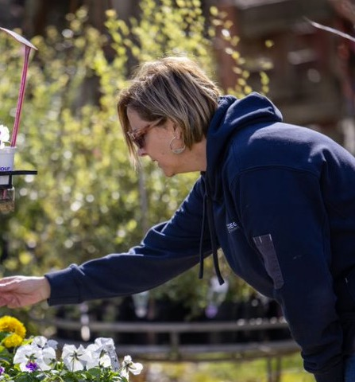
15
STRONG COMMUNITY SUPPORT
Hundreds of positive written submissions from people in the Blayney LGA
Community sentiment research in October 2022
It showed that, after being given information about McPhillamys:
  70% of Blayney LGA participants supported or strongly supported the project
  15% of Blayney participants were neutral
  15% of Blayney participants were opposed
“…more jobs, stimulating the economy and giving back to the community in general…it'll be good for the future of the area…”
Participant comment

Slide 17
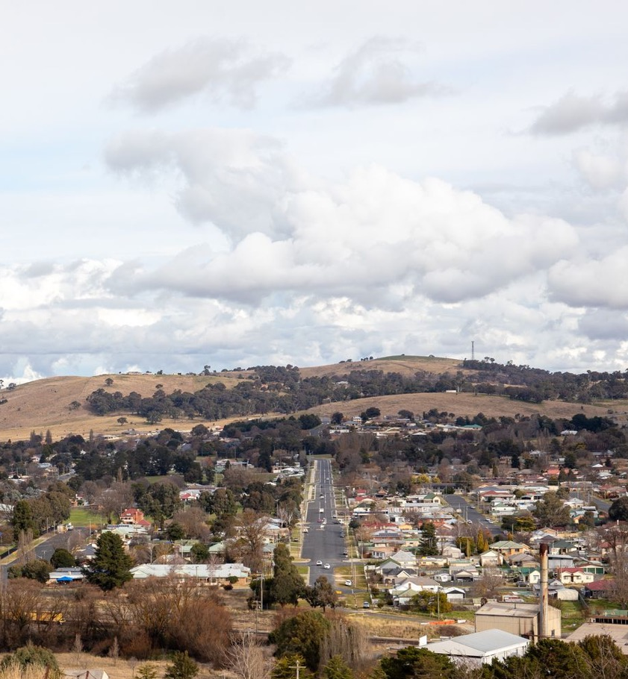
McPHILLAMYS GOLD PROJECT
16
We will provide significant benefits to the local region and the State of NSW
Our design has evolved through our continuous improvement approach including feedback from community and government agencies
We value the strong community support and are committed to working together for the long-term
Regis looks forward to creating value for our people, our communities and our shareholders by mining safely and responsibly.

Slide 18
17
ASSESSMENT REPORT CONCLUSION
“On balance, the Department considers the benefits of the project outweigh its residual costs and that the project is in the public interest and is approvable, subject to the strict conditions of consent.”
– DPE Assessment Report Executive Summary

