Slide 1
Goldfields Honey: Trace element analysis in honey bees, honey, soil, dust and water
Honorary Professor Mark Patrick Taylor
Macquarie University
markpatricktaylor@gmail.com

Slide 2
My position:
“The truth is:
the natural world is changing. And we are totally dependent on that world. It provides our food, water and air. It is the most precious thing we have and we need to defend it.”
Sir David Attenborough, 28 October 2012

Slide 3
Environmental protection
Prevent rather than rehabilitate.
Make industry/community central to preventing harm.
No safe levels.

Slide 4
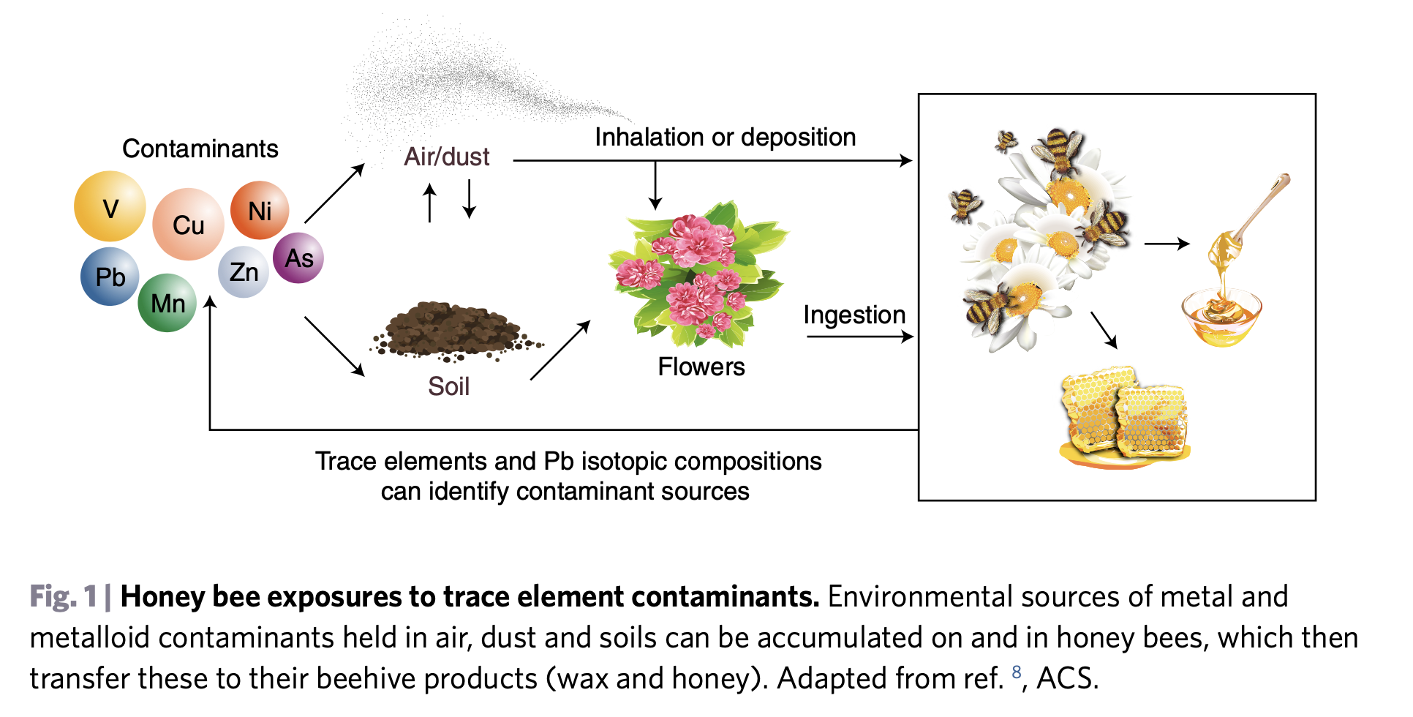
Environmentally-sourced trace elements are remobilised in bees and honey
Source: Taylor, M.P. 2019. Invited commentary. Bees as Biomarkers. Nature Sustainability, 2, 169-170. https://doi.org/10.1038/s41893-019-0247-9.

Slide 5
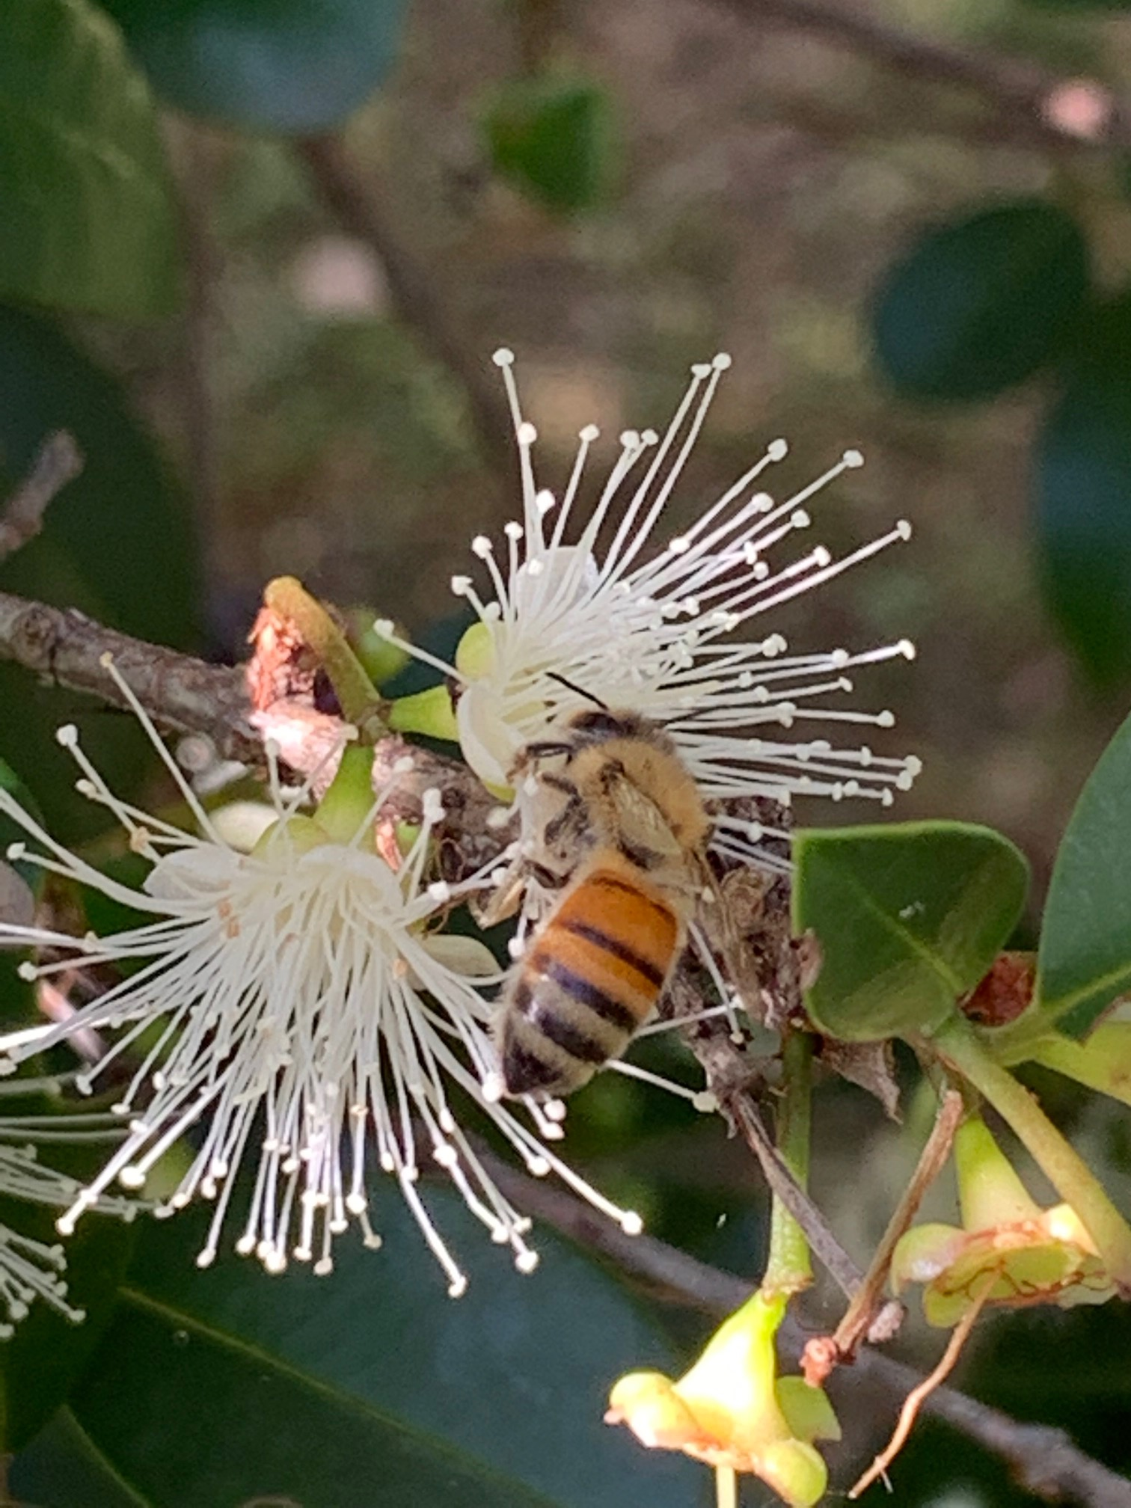
Key points from the baseline study
Goldfields tanks is clean and no major concerns for:
  bees
  Honey.
What does this matter?
No mine site does not have off site pollution; values likely to change.

Slide 6
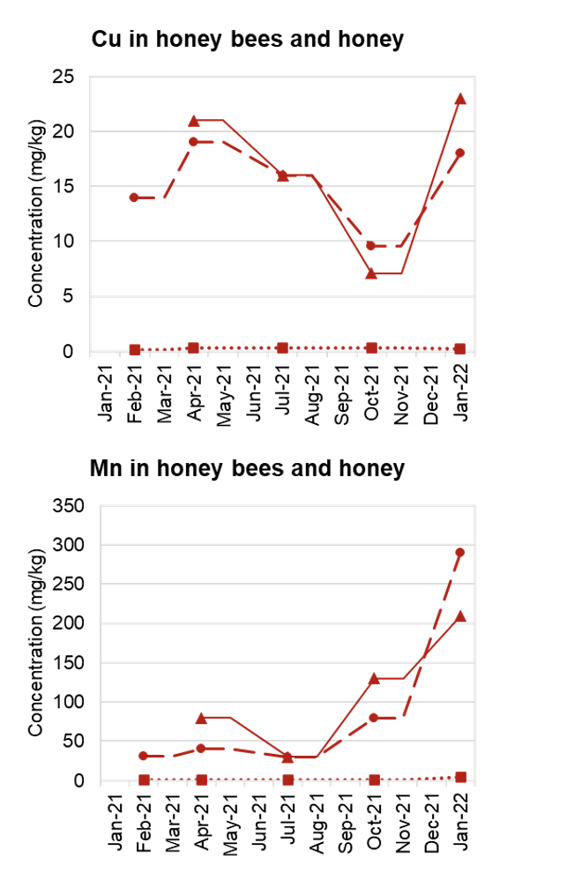
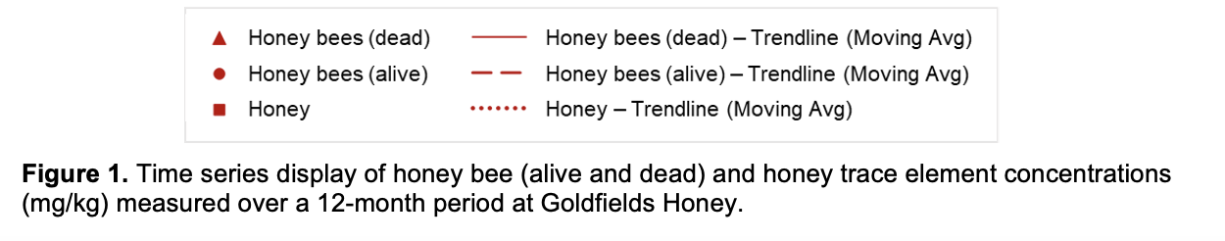
Baseline Goldfields data shows that bee display seasonal variations in trace elements
Variations and exposure will be accentuated under dusty mine conditions
Source: Taylor M.P. and Fry K.F. 2022. Baseline environmental monitoring for Goldfields Honey. Trace element analysis in honey bees, honey, soil, dust and water. Macquarie University, NSW, Australia.

Slide 7
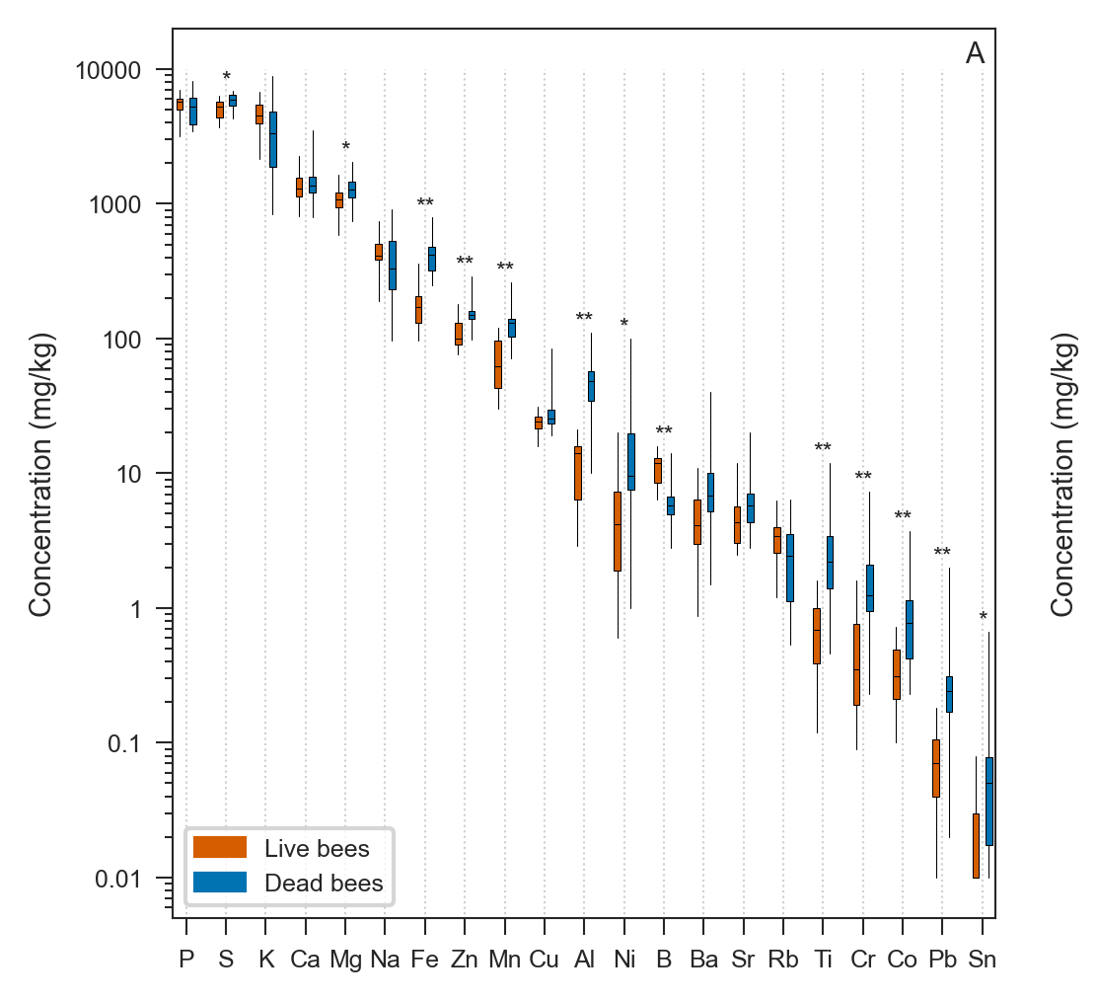
Future dust control will be critical
Noumea bees
Dust will be a key because:
environment is dry;
dry/drying climate will exacerbate dust and increase challenge of keeping it under control;
bees are exposed from the environment as they age;
trace elements are toxic to bees and this impairs their foraging capacity;
for early all contaminants there is no safe level; just an acceptable threshold;
Exposure effects are proportionally greatest at the lowest exposure levels.

Slide 8
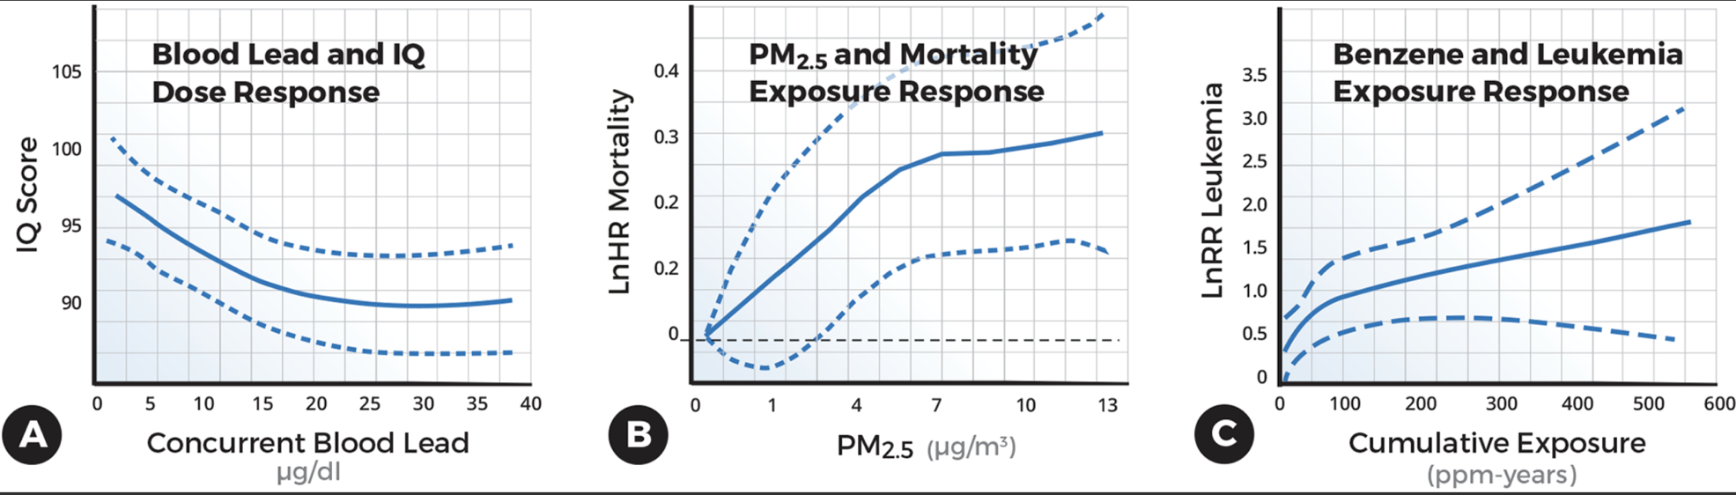
Why prevention?
Low-level toxicity of chemicals: No acceptable levels?
Source: Lanphear 2017, PLOS Biology.
Notes:
Delete this slide after reading.

Slide 9
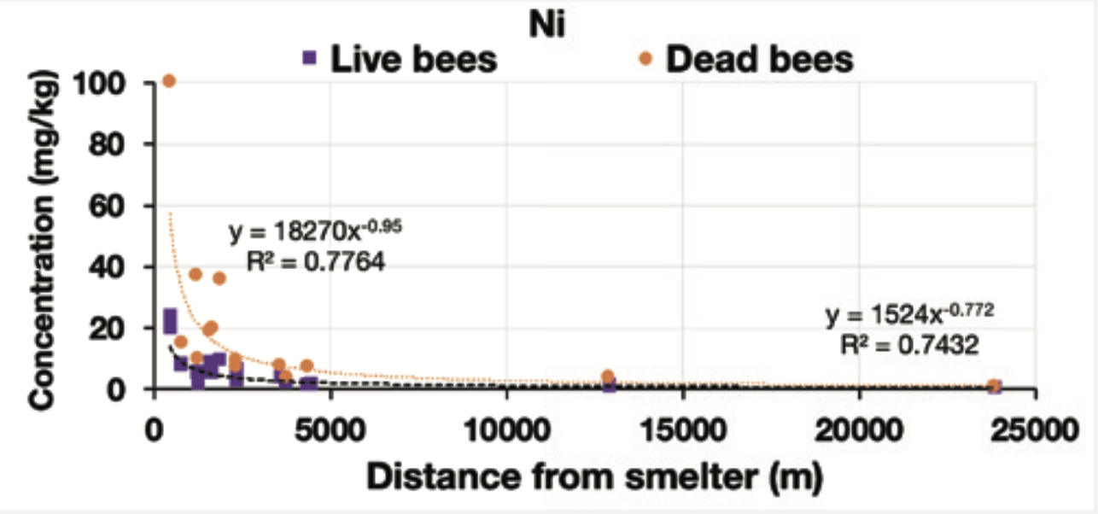
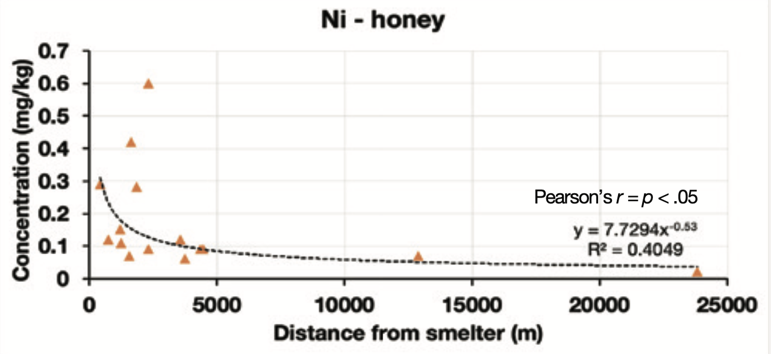
Nickel in bees and honey – Noumea, New Caledonia
Contamination in bees and honey unequivocally linked to the polluting nickel smelter source.
Source: Taylor, M.P., Isley, C., Fry, K., Gillings-Mclennan, M. 2019. Tracing anthropogenic trace element contamination of natural and human systems in the South Pacific using honey bees as a key biomarker. Poster presentation AGU Fall Meeting 9-13 December 2019, San Francisco. Available at: https://doi.org/10.1002/essoar.10501957.1.

Slide 10
Why do contaminants in bees matter?
Accumulation of potential toxic trace elements shown to have adverse impacts on honey bee foraging (Monchanin et al. 2021; Søvik et al. 2015).
Honey bees cannot sense harmful concentrations of trace elements in food sources (Monchanin et al. 2022).
Our recent research from the nickel smelter city of Nouméa, New Caledonia showed that:
  Trace element concentrations in soil were an order of magnitude (10 times) greater than trace elements in honey bees.
  Honey bee trace elements were an additional order of magnitude (10 times) greater than trace elements found in the honey.
The biggest potential impact from the proposal is on the bees and their foraging capacity, which in turn presents a risk of harm to Goldfields productivity and produce quality.
Sources: Monchanin, C., Drujont, E., Devaud, J.-M., Lihoreau, M. & Barron, A. B. 2021. Metal pollutants have additive negative effects on honey bee cognition. Journal of Experimental Biology. https://doi.org/10.1242/jeb.241869
Søvik, E., Perry, C. J., LaMora, A., Barron, A. B. & Ben-Shahar, Y. 2015. Negative impact of manganese on honeybee foraging. Biology Letters, 11, 20140989. https://doi.org/10.1098/rsbl.2014.0989.

Slide 11
Unaddressed matters
Can the operations guarantee there will be no off site impacts?
No safe / acceptable level is established for bees (absence of evidence is not evidence of absence).
Honey is a natural product and should be free of contamination – will that remain the case?
The proposal has not quantified the short and long costs of distress and worry (mental health and wellbeing) on the impacted communities.

