Slide 1
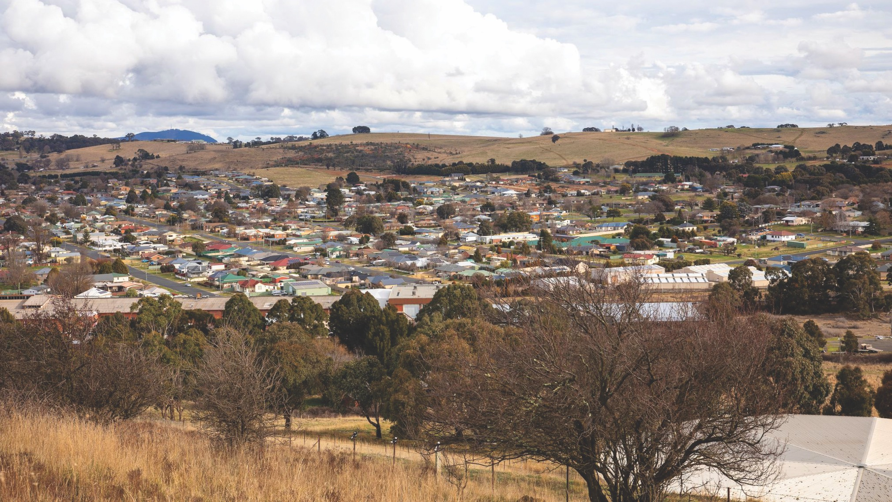

Public hearing – Closing presentation
Wednesday 8th February 2023
Notes:
Speaker: Jim
Once again - Acknowledgement of Country

Slide 2
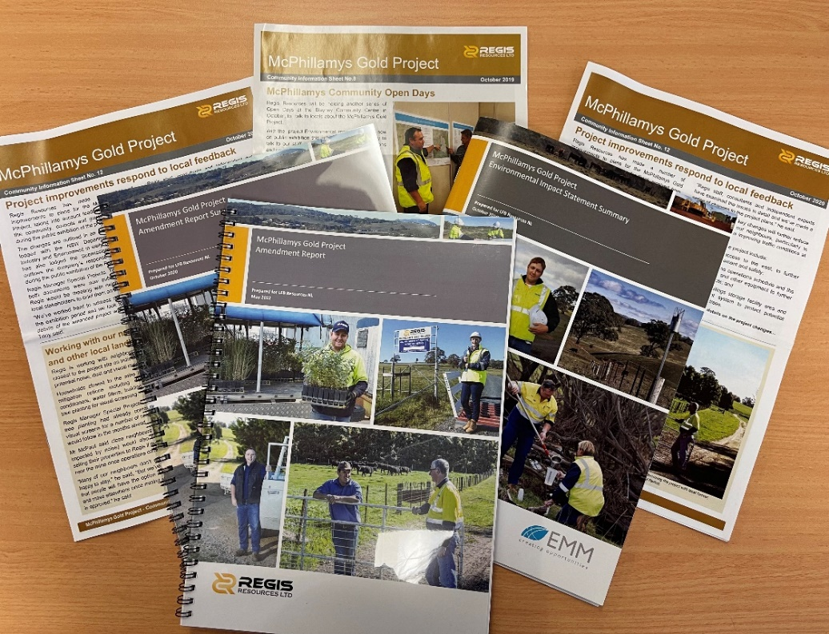
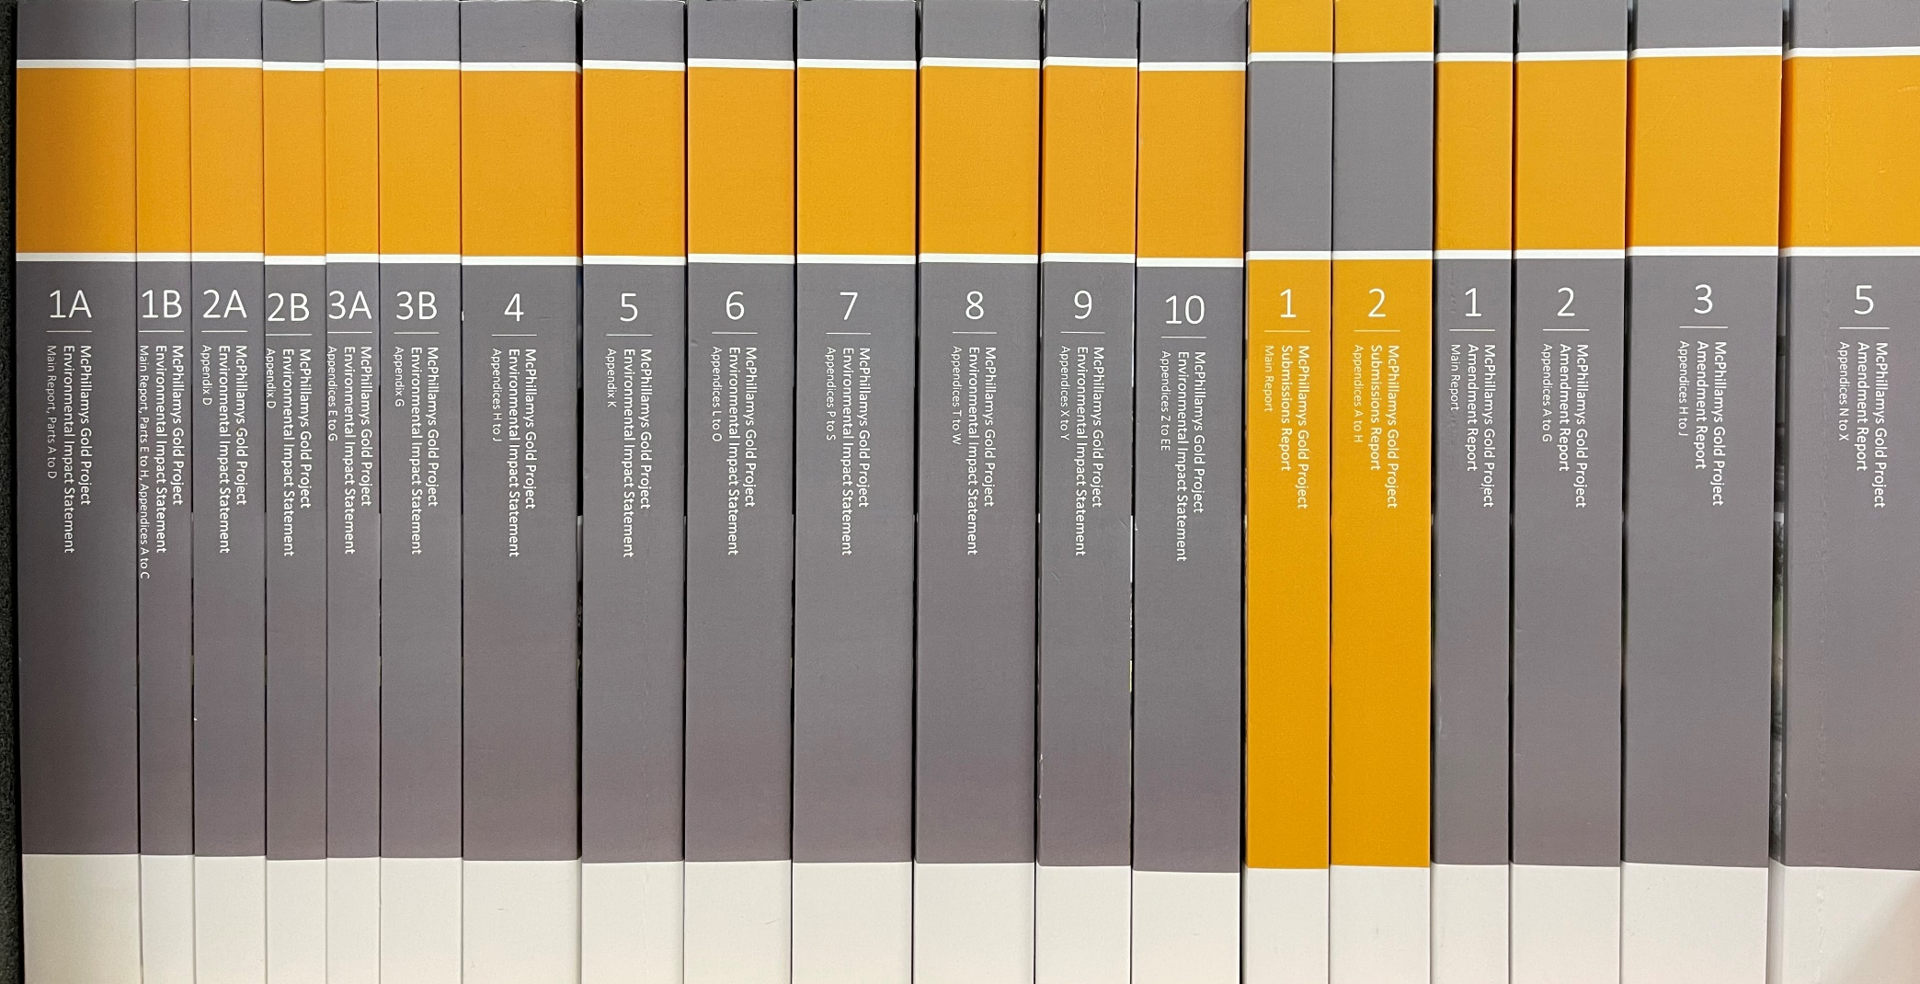
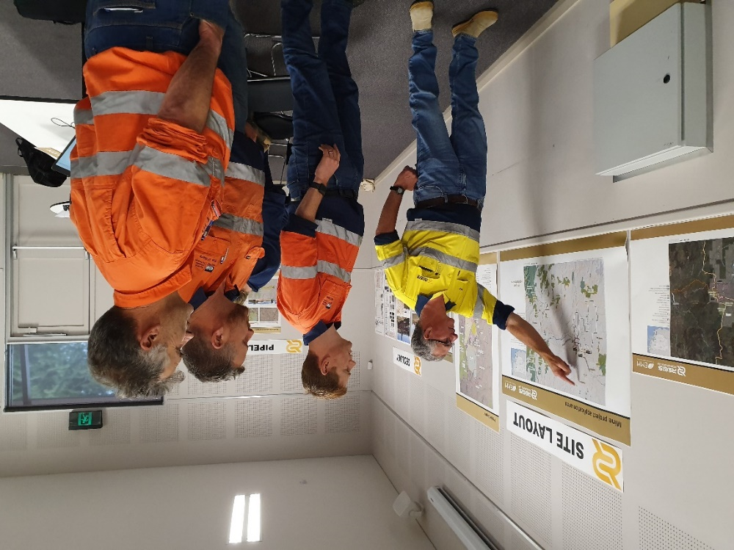
TECHNICAL OBSERVATIONS

Slide 3
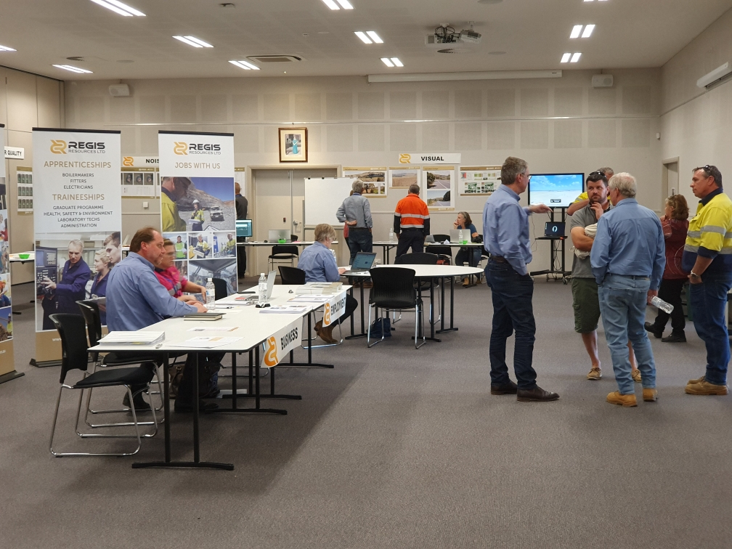
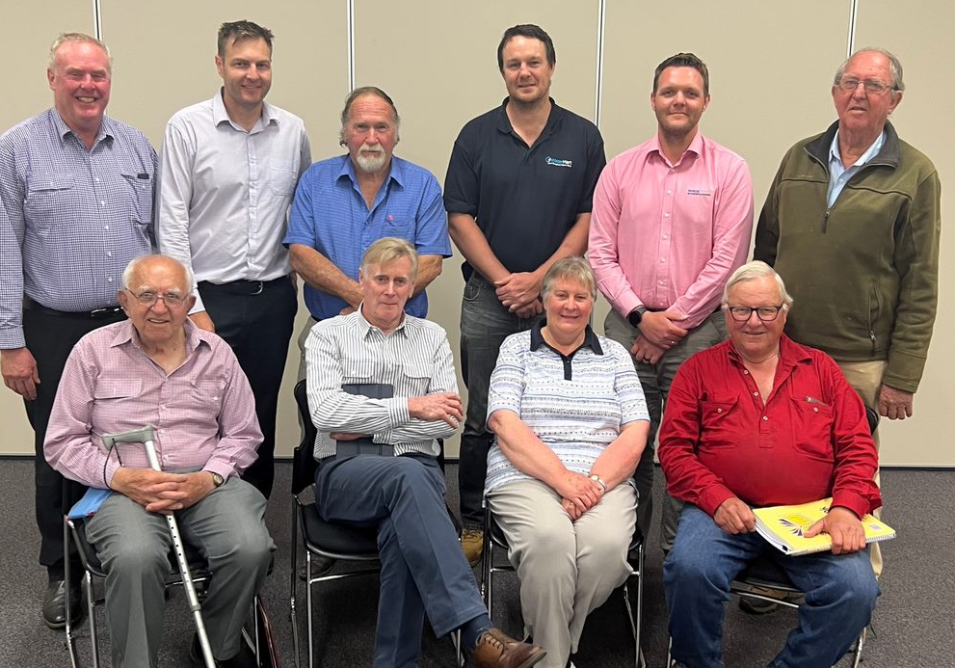
COMMUNITY ENGAGEMENT
Community Open Days
Community Consultative Committee

Slide 4
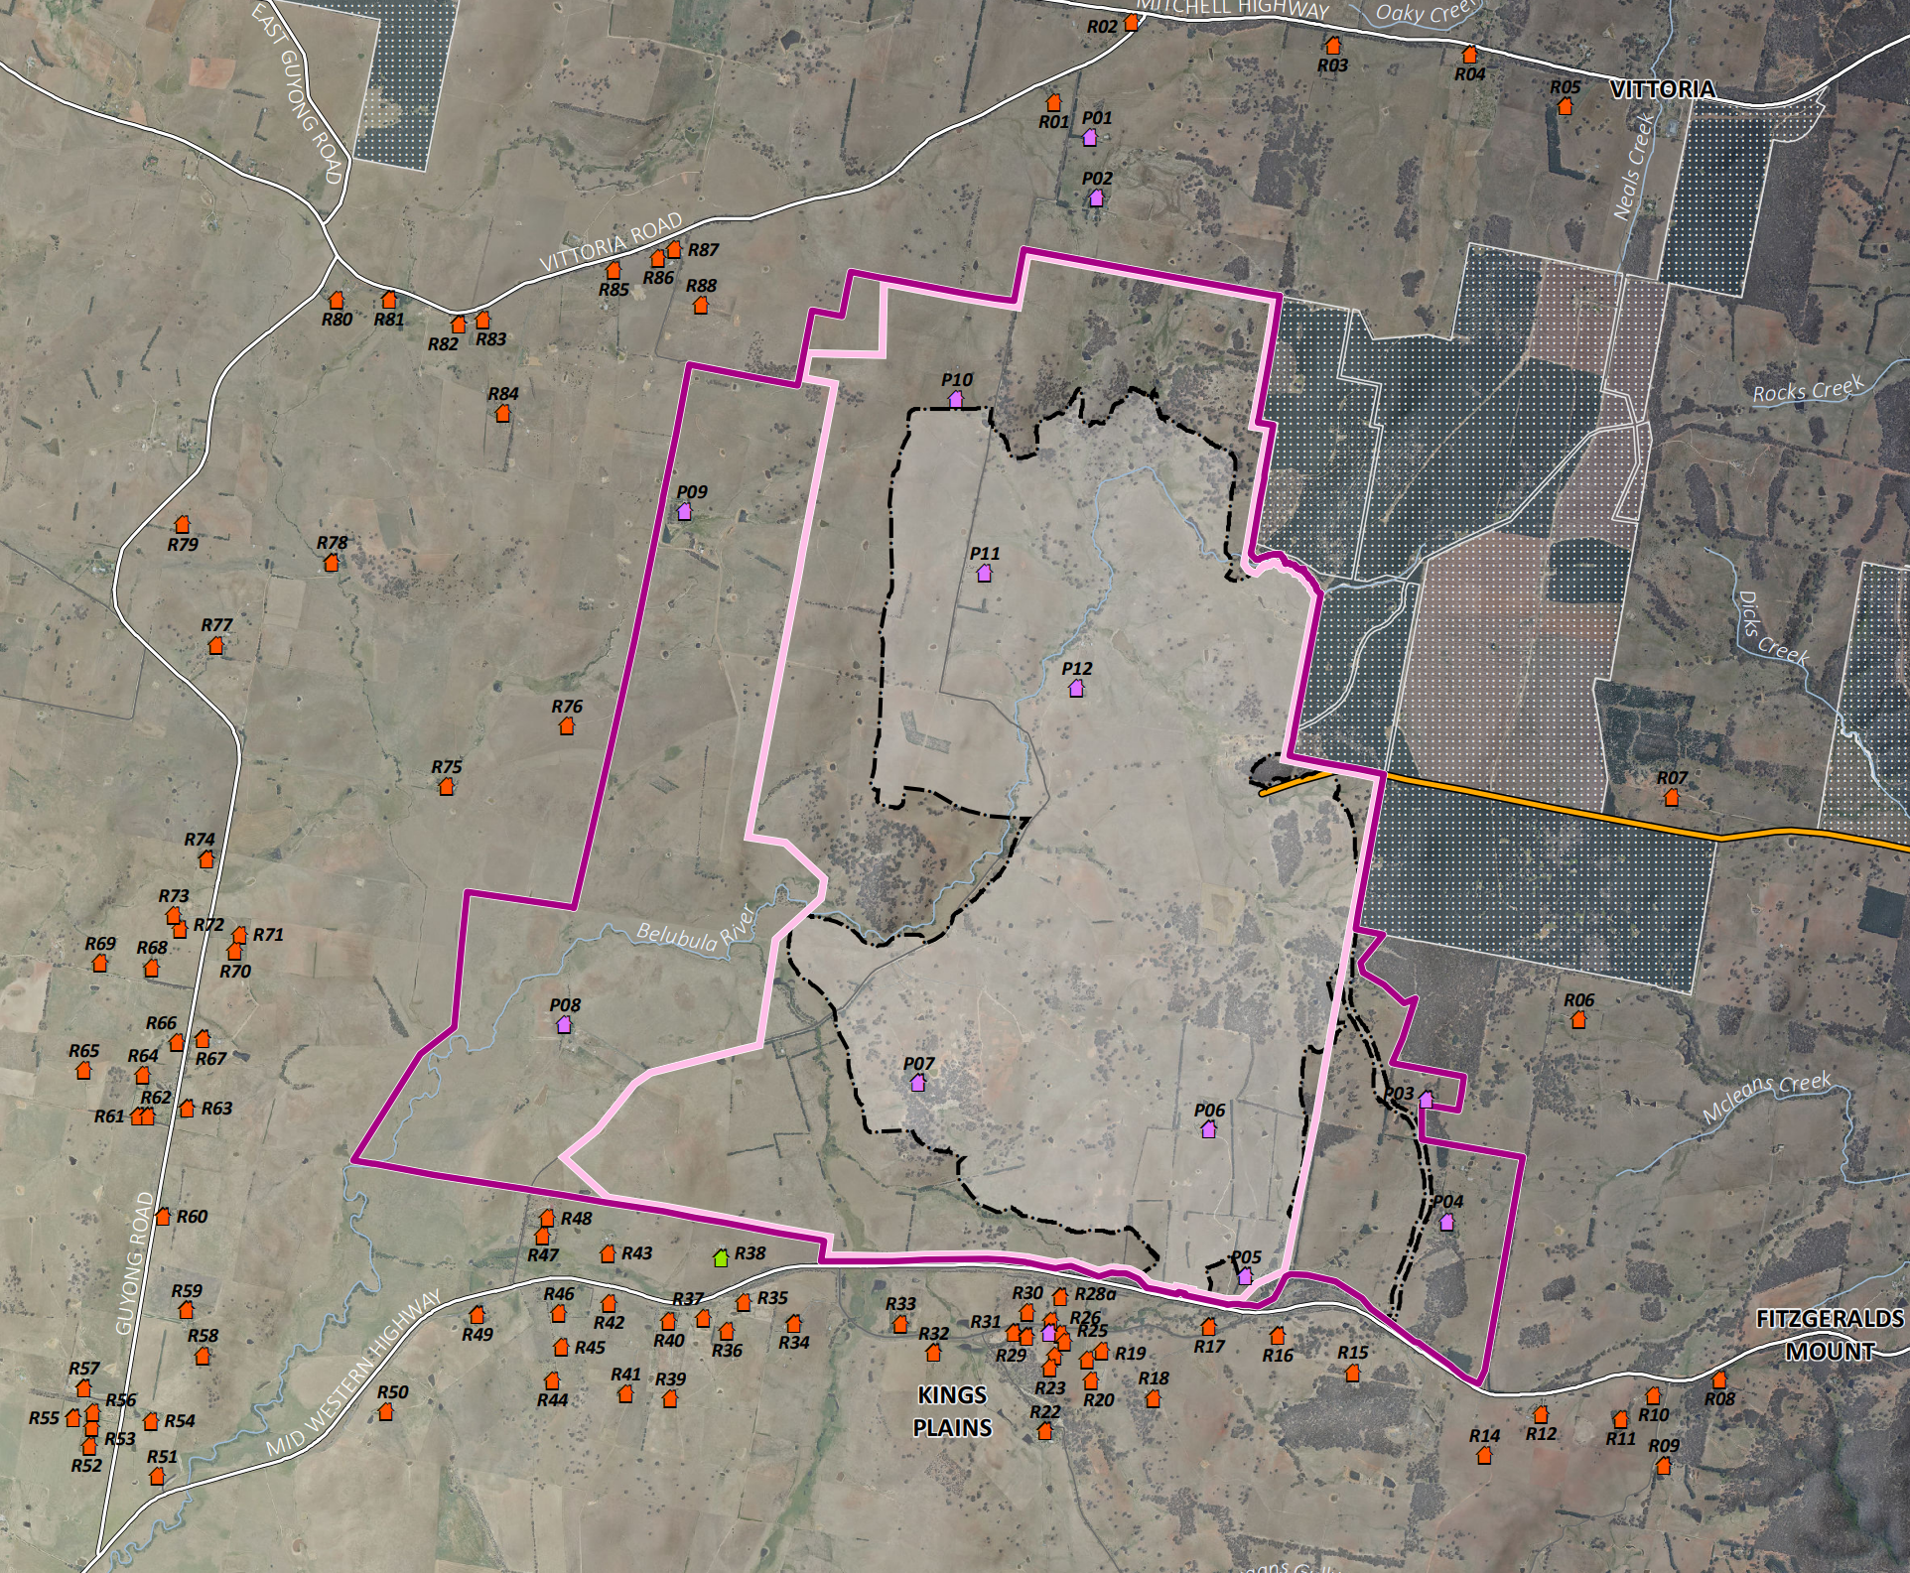
RESIDENCES ASSESSED

Slide 5
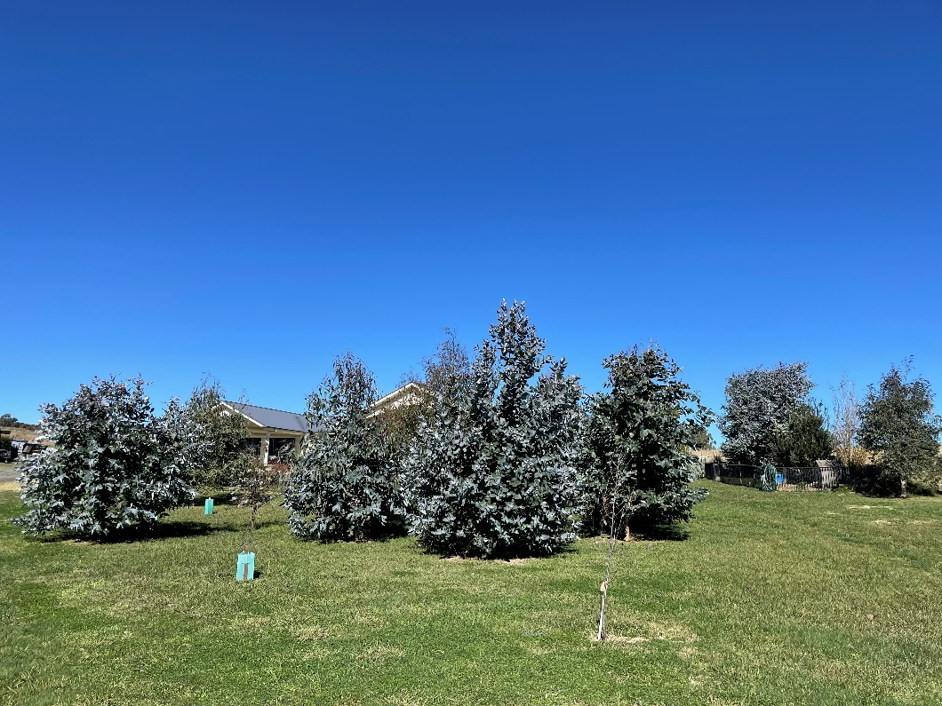
NEGOTIATED AGREEMENTS
Visual Tree Screening at Private Property

Slide 6
SPRINGS
WES4866A - April 2019
WES4866A - November 2019
Basalt spring schematic
WES4866A – March 2020

Slide 7
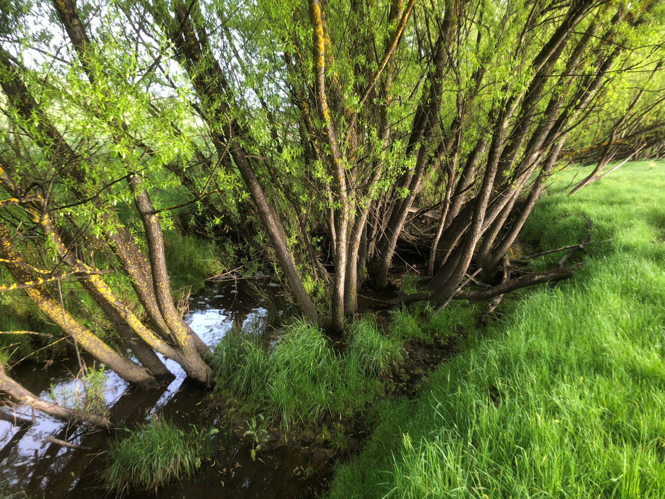
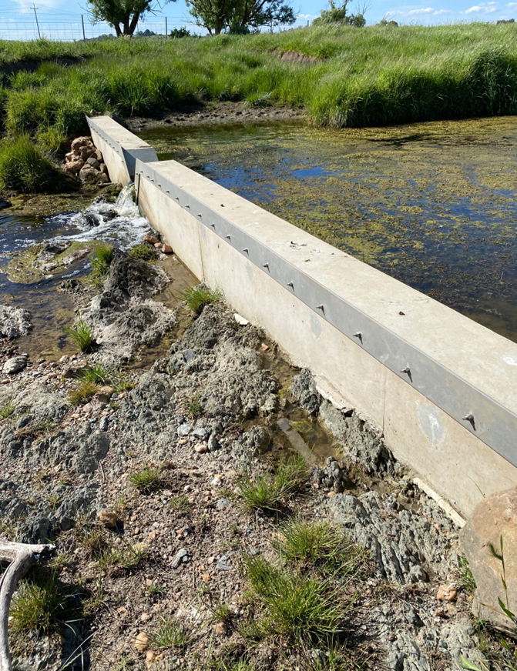
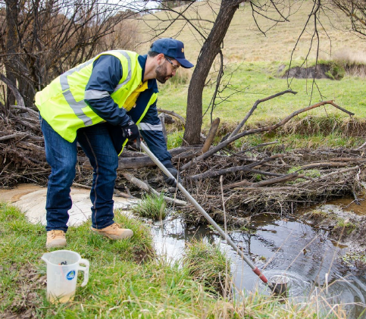
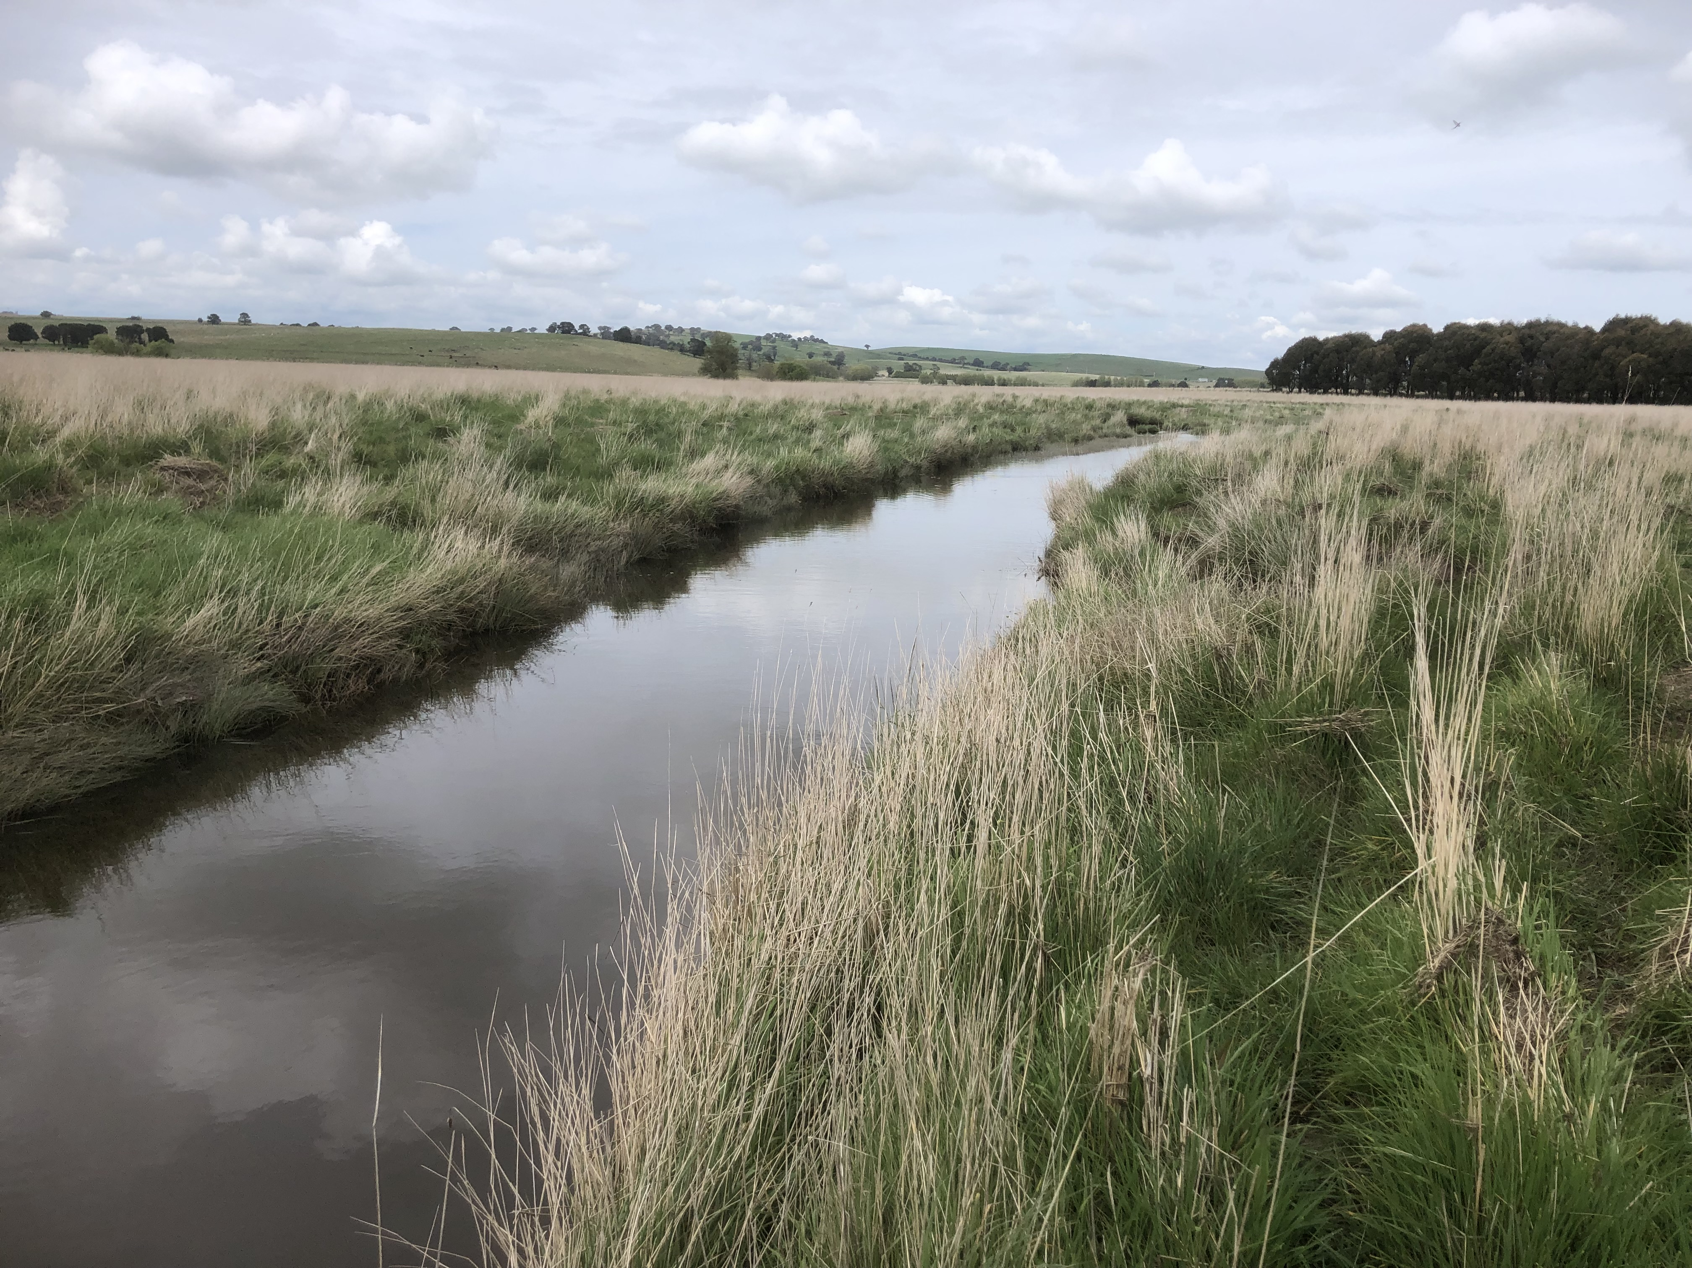
7
WATER
Water quality sampling
V-notch weir flow gauging station
Belubula River, various locations

Slide 8
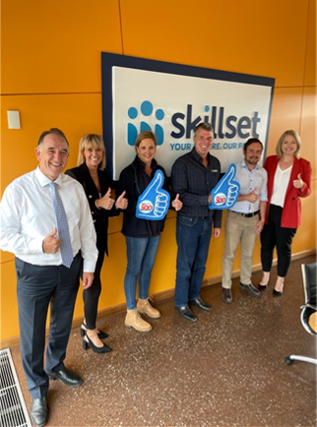
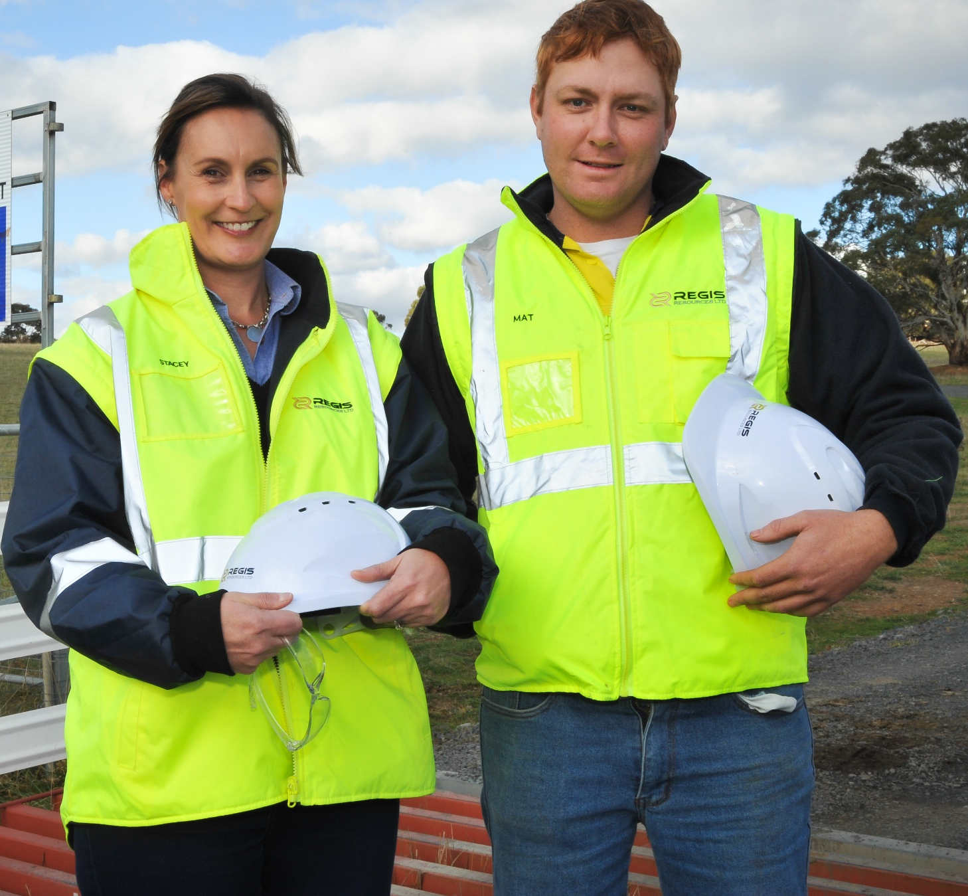
EMPLOYMENT

Slide 9
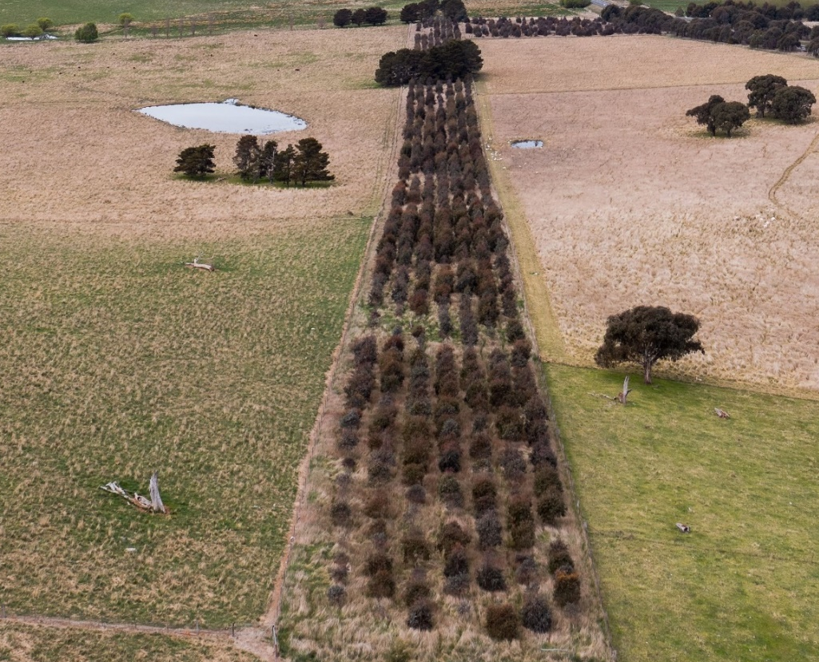
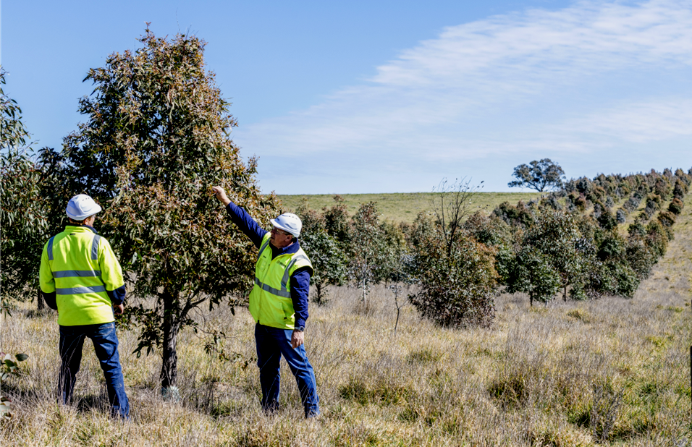
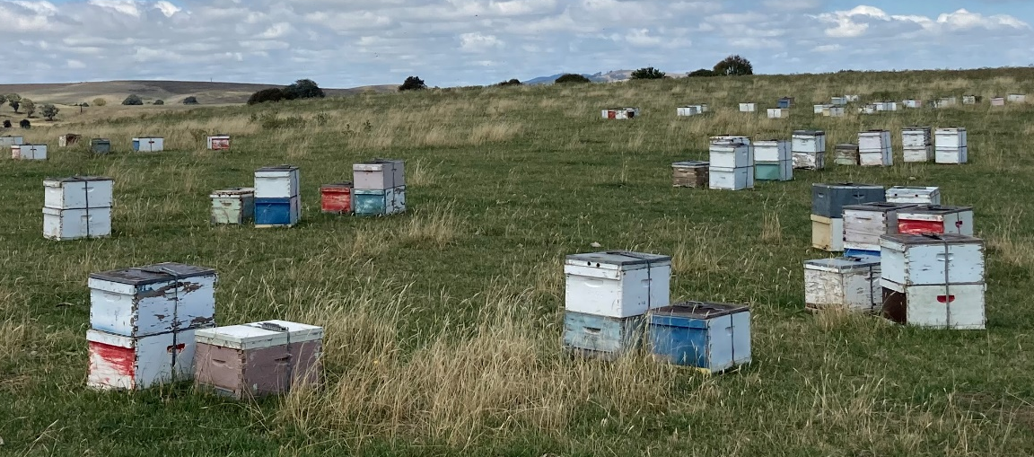
BEES AND LOCAL HONEY PRODUCERS

Slide 10
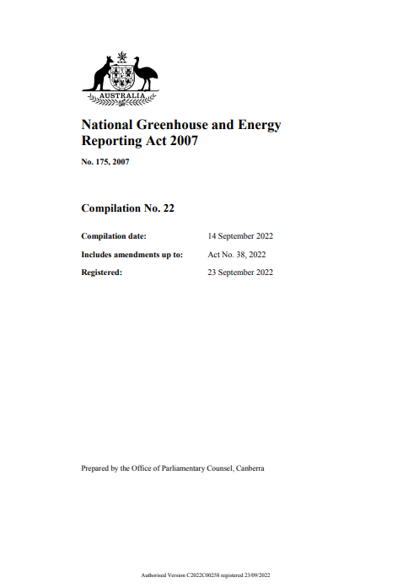
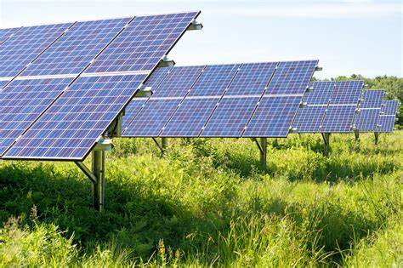
GREENHOUSE GAS EMISSIONS

Slide 11
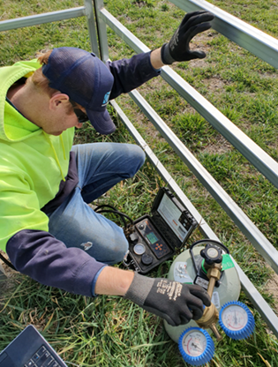
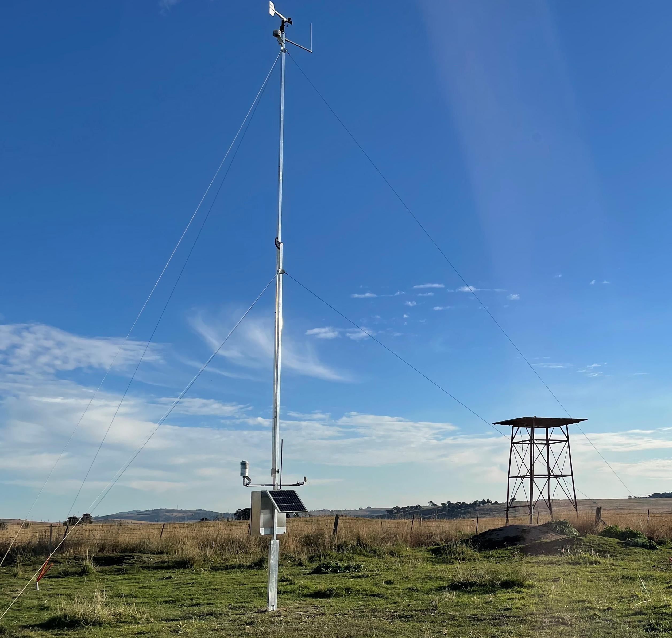
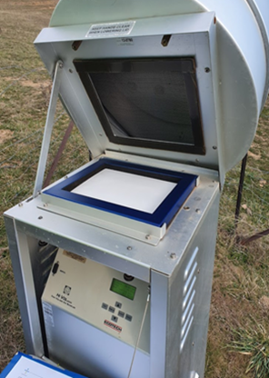
MANAGEMENT AND MONITORING
Existing Baseline Monitoring
Existing Belubula River Monitoring Locations

Slide 12
“On balance, the Department considers the benefits of the project outweigh its residual costs and that the project is in the public interest and is approvable, subject to the strict conditions of consent”
“Regis has designed the project in a way to achieve a practical balance between maximising resource recovery and minimising associated impacts on the surrounding landholders and the environment through best practice contemporary practices and mitigation measures”
– DPE Assessment Report

Slide 13







BENEFITS FOR BLAYNEY, THE REGION AND NSW
13
Local employment
480 construction jobs
260 mine operation jobs
120 pipeline construction jobs
Community investment
$80,000 invested in local groups 21/22
>$200,000 invested since 2016
+$4m VPA for local infrastructure and services
Multi-$million contribution through shire rates
Local businesses
Procurement opportunities
Flow on benefits from
$67m direct and indirect household income
Benefits for NSW
$244m net benefit to NSW
$56m royalties to NSW
Federal taxes
Environment & Water
+100,000 trees to be planted 10,000 to date
Strengthened biodiversity outcomes
Legacy infrastructure eg water pipeline
Locals first recruitment
Education and training
Job ready support
Keep locals in Blayney

Slide 14

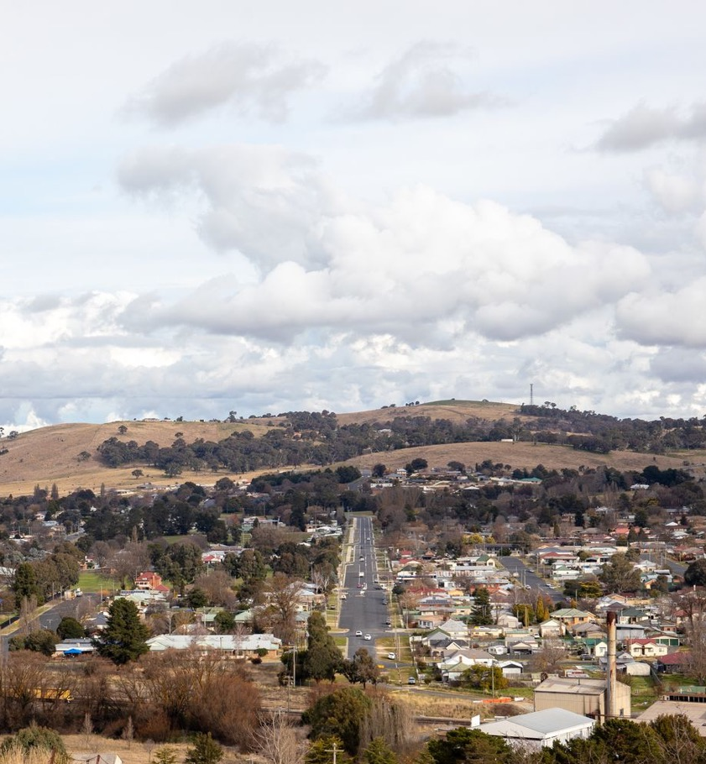
McPHILLAMYS GOLD PROJECT
“We are fully committed to this project and to run the project to the highest standard which is what the conditions require, and in fact, consistent with our values will work to be better than that, and beyond the conditions”

Slide 15
ASSESSMENT REPORT CONCLUSION
“On balance, the Department considers the benefits of the project outweigh its residual costs and that the project is in the public interest and is approvable, subject to the strict conditions of consent.”
– DPE Assessment Report Executive Summary

Slide 16
Thank You
Wednesday 8th February 2023
Notes:
Speaker: Jim

