Slide 1
Presentation to the
Independent Planning Commission
Julia Imrie
19 June 2019
ULAN Coal Mine Limited
MOD 4 expansion

Slide 2

Each mine modification represents an expansion that prolongs and places additional pressure on the water system and biodiversity ……. a slow death by a thousand cuts
The cumulative impact is more than the incremental effects
as presented in the mine’s assessments
Only opportunity for the public to shine a light on the environmental and social impacts of these developments
And comment on the effectiveness of current Mine conditions of approval and Environmental Protections Licences.
Notes:
Basis I will be looking at impacts to the groundwater system
.

Slide 3
OUTSTANDING ISSUES
Depressurisation and lowering of groundwater systems by mining creates a ‘regional sink’
Permanent loss of low flows in the Goulburn River during extended dry periods
1000’s tonnes of salt created by the mining process is currently exported off-site into the Goulburn River every year
East pit is a time bomb – high risk of connectivity via remnant alluvium between the pit and the Goulburn River
The permanent long term protection the groundwater source that feeds The Drip gorge
Notes:
Ulan Coal Mine has not proven that the groundwater system that feeds The Drip GDE will not be affected by the long term depressurisation of the regional groundwater system that includes mining in the MOD 4 which will extend the length of time that the groundwater will be drawdown beneath UG3

Slide 4
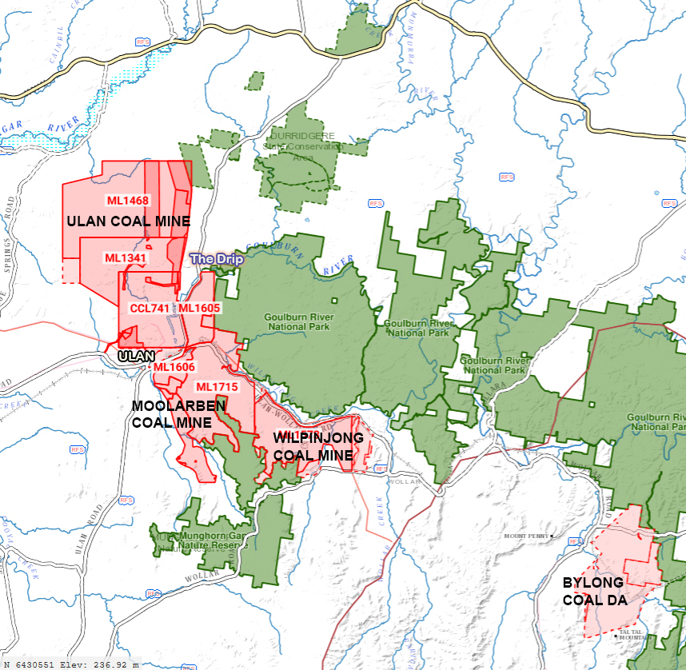
Coal Mines cover > 180 square kilometres
Notes:
65 km2 open cut and 124 km2 underground
Goulburn River travels 225 kms to Hunter River

Slide 5
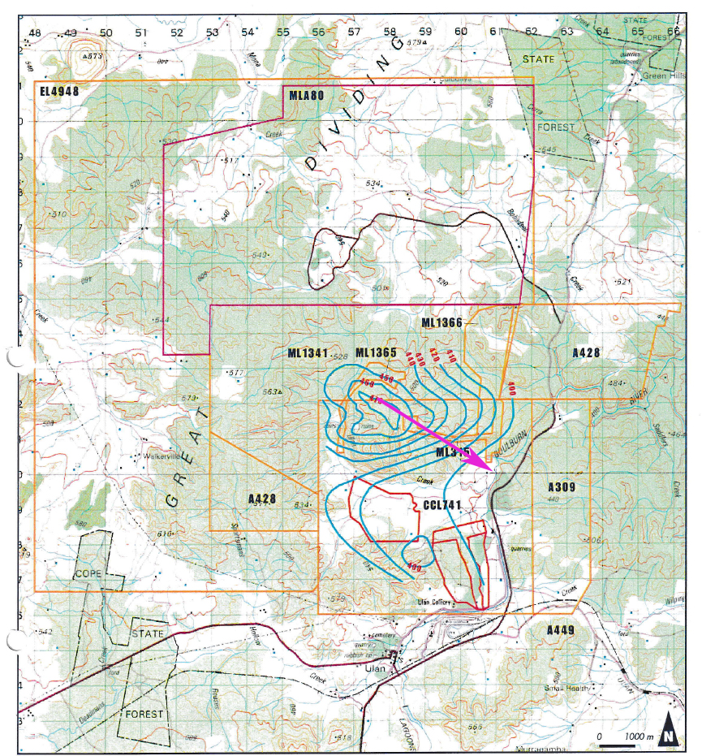
Water table levels – 1982 pre-mining
Source: Woodward-Clyde 1995 (Figure 2.2)
Notes:
Source: Woodward-Clyde 1995 Water Management Study Figure 2.2 ULAN COAL Mining Lease Application No. 80
Groundwater levels were 400 mAHD – adjacent to the river and flow was to the river

Slide 6
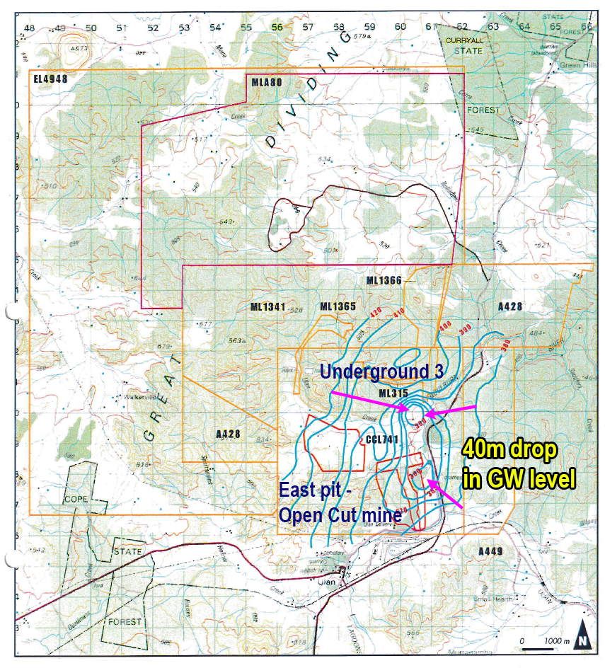
1990 Groundwater levels - decline 40m
Source: Woodward-Clyde 1995 (Figure 2.3)
Notes:
Loss of base flow to river
GW levels remain suppressed, they cannot be allowed to recover until mining ceases.

Slide 7
MOD 4 underground expansion is hydraulically down-dip from all previous workings (LW31-33)
Continued mining results in the lowering or suppression of groundwater levels over the whole underground
extending the depressurisation of the groundwater system will overtime increase the likelihood of permanent irreversible damage to the river and Drip GDE
Notes:
Regional groundwater levels should be allowed to recover at the soonest opportunity.
further delay in the recovery of groundwater levels and restoration of river base flows

Slide 8
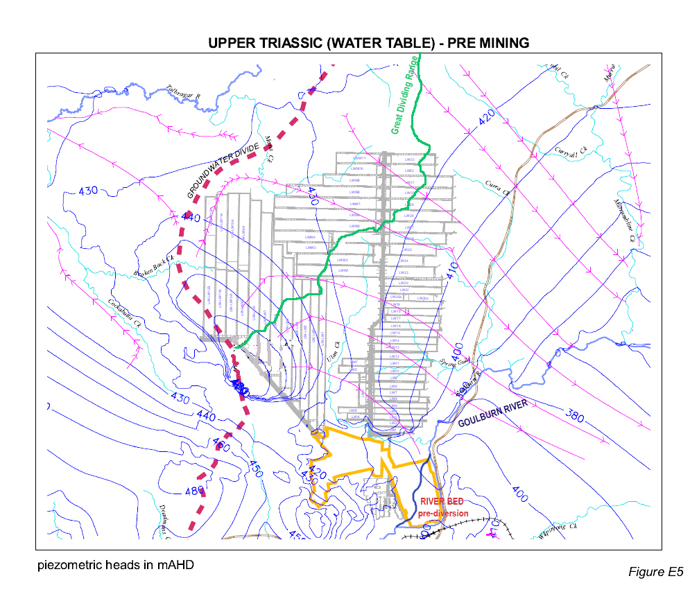
Pre-mining upper Triassic water table
Notes:
Position of groundwater divide (red ) as opposed to the Great Dividing Range (Green)
Pink is direction of GW flows (hydraulic gradient) – GW contours
As you can see this map shows that most of the GW would have originally reported to the Goulburn River.
It is unclear how mine modelling handles this inconsistency. When considering the true impacts to the Goulburn River system. It appears reality has been ignored
The take from the G R Extraction Management Unit is clearly underestimated
5.1.6. Groundwater above Ulan West and UG3 original hydraulic gradient is to the Goulburn River.
This system extends further to the west than the Great Dividing Range.
Underground mining in this area has distorted GW flows than previously flowed towards the river. This affects the estimated loss of base flows to Goulburn River (aside from the licensing requirements under WSPs).
Source: Appendix 3 Groundwater Assessment – Modifications to Ulan West Mine Plan 2015 – Mackie Environmental Research

Slide 9
Complete dewatering and desaturation of strata over long wall panels
= loss of groundwater flow to river
RtS MOD 4 report on Subsidence predicts…
‘Mining induced fractures to the surface are expected’….
…depressurisation of groundwater through the full section between the mining horizon and the surface … as a result of increased vertical conductivity
…. past monitoring indicates it may occur gradually and take several years’
Groundwater Peer review – Dr Kalf also raises the potential for the complete drawdown & desaturation of Jurassic and Triassic aquifers and ephemeral creeks
… calls for close monitoring and regular review of modelling
Notes:
p. 13 & p. 20 App D – Ulan Continued Operations – MOD 4 EA - SCT Operations
RtS Peer Review – App c KA p.7
Already occurred over mined LW panels causing a loss of base flow in river.
And will also happen over Moolarben UG4

Slide 10
This has already occurred over previously mined long wall panels causing a loss of base flow in river (> 0.05 ML/day predicted).
In 1995, 2006 , 2009 and more recently for a 4 month period between December 2017, and early April 2018 the river flows ceased when UCML stopped discharging water
Flow data (1956-1982) at the Ulan stream gauge on the Goulburn River (210046) indicates permanent low flows persisted pre-mining throughout the1980s drought.
Notes:
The discharge of mine water to maintain environmental low flows in the Goulburn River must be given priority and written into the approval conditions.
The RTS analyses historical (pre-mining) stream flow in the Goulburn River downstream from Ulan Creek based on gauges at Coggan (110 kms downstream ) and Sandy Hollow (225 kms downstream). The GR in a highly variable system, the assessment of low flows at the lower gauges are unreliable due to their wide sand sediment base and distance from Ulan.
The discharge of mine water to maintain environmental low flows in the Goulburn River must be given priority and written into the approval conditions.

Slide 11
Comparison of Goulburn River flow and daily mine discharge (2014)
Notes:
Strong correlation between Stream flow in the Goulburn and Mine water discharge
River flow now regulated and dependent on mine water discharge during dry periods.
Discharge is determined by the vagaries of mine operational needs with regular mine discharges masking the underlying loss of baseflow.
Indicates a loss in base flow from the cumulative loss in both alluvial and fractured rock GW inflows
some never reaching the DS gauge indicating stream bed leakage

Slide 12
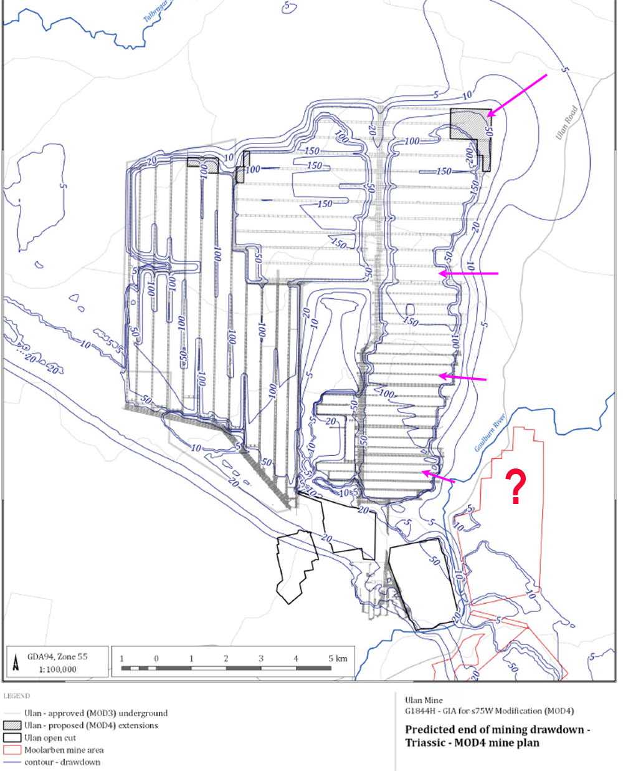
Notes:
Curious why 5-10 meter drawdown only in the top NE corner
Flow towards regional sink – capturing diverting GW
GE UCML – MOD 4 GIA Fig A3.10 Predicted end of mining drawdown Triassic
Next slide on Curryall creek and Private bores

Slide 13
Groundwater Interaction with
fault lines ????
Notes:
Curryall Creek and Green Hills Fault – insufficient assessment of these faults
GE UCML – MOD 4 GIA Fig A3.10 Predicted end of mining drawdown Triassic
Next slide on Curryall creek and Private bores - show gneral area

Slide 14
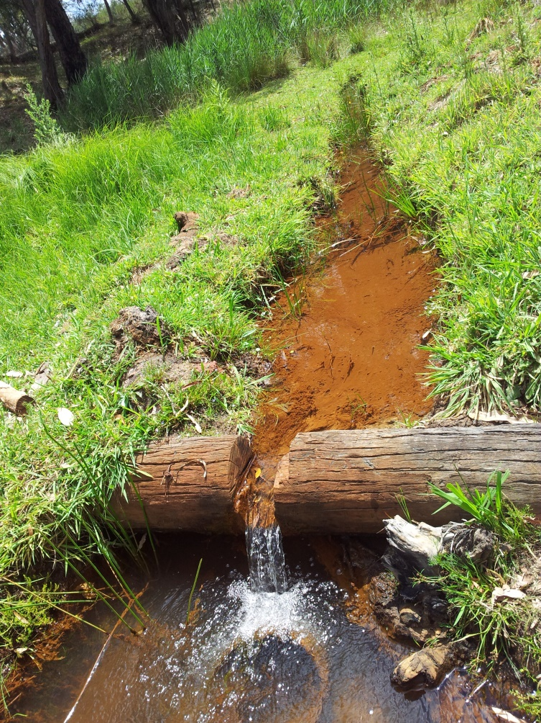
Impact of MOD 4 expansion on private bores and permanent spring fed creek
Landowners have already reported loss and decline in productivity of private bores in the north
(SWL drop ~10 m ?)
Feasibility of installing a new bore as reliable, productive and of equal water quality?
Curryall creek? This is a permanent spring fed water source that is a drought proof water supply to the community & readily accessible from Ulan road – also used by RFS
Will it survive a 5-10 metre drop in groundwater levels across its catchment?
Loss of these water sources sterilizes the land in this area for future use.
Curryall Creek, Green Hills
(EC 640 µS/cm pH = 7.2)
Notes:
Road/chair – people frequently pump from this source – water sample tested May 2013 and Nov 2014
Land is useless without permanent water …. More so with climate change
Impacts to Curryall Creek has not been adequately investigated
PB Bores - Curryall Creek is a permanent spring fed creek providing good quality potable water that is easily accessible by locals and RFS from the Ulan Road at Green Hills.
A 5-10 m drawdown in the upper aquifer system is likely to destroy this valuable community assess. There appears to be no assessment of this spring fed creek or the significance of the Green Hills and Curra Creek fault to groundwater flow and storage
Curryall Creek Ca Mg Na K CO₃ HCO₃ Cl SO₄ TDS EC pH
May-13 5 19 76 2 < 1 47 160 4 415 610 7
Nov-14 7 22 74 2 0 67 170 2 456 671 7.3
June -19 640 7.1
RTS 5.1.4 Curra Creek Fault line (adjacent to LW 32/33) – RTS “there is little knowledge of these faults’ is clearly an inadequate response, the relationship between these faults and groundwater system requires greater analysis prior to any mining approval

Slide 15
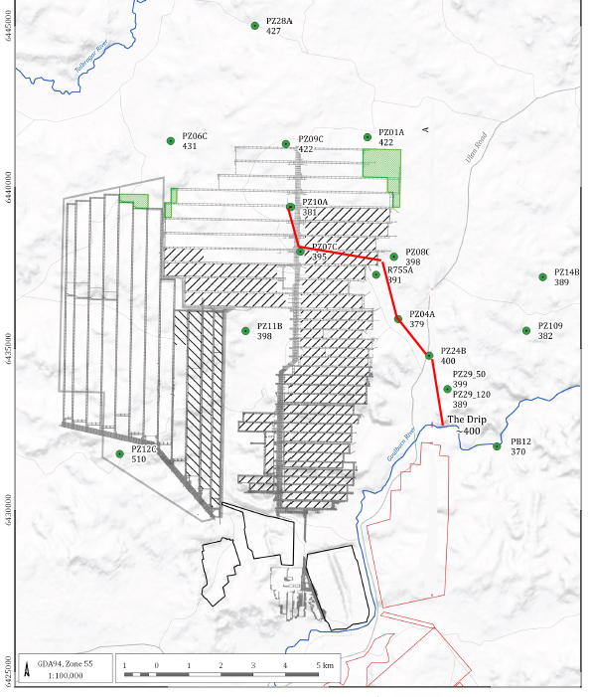
N
B
Decline in Triassic groundwater levels
2005 - 2018
A - B line
A
Notes:
Decline in GW levels 2005-2018, NO monitoring between river and Long walls would help to est. base flow impacts?
Should have base line data going back to 1982. on groundwater levels

Slide 16
Decline in Triassic groundwater levels 2001- 2018 north west of The Drip due to mine depressurisation
A
B
South
North
Notes:
2-40 meter decline in SWLs – potential to spread and radiate outwards over time

Slide 17
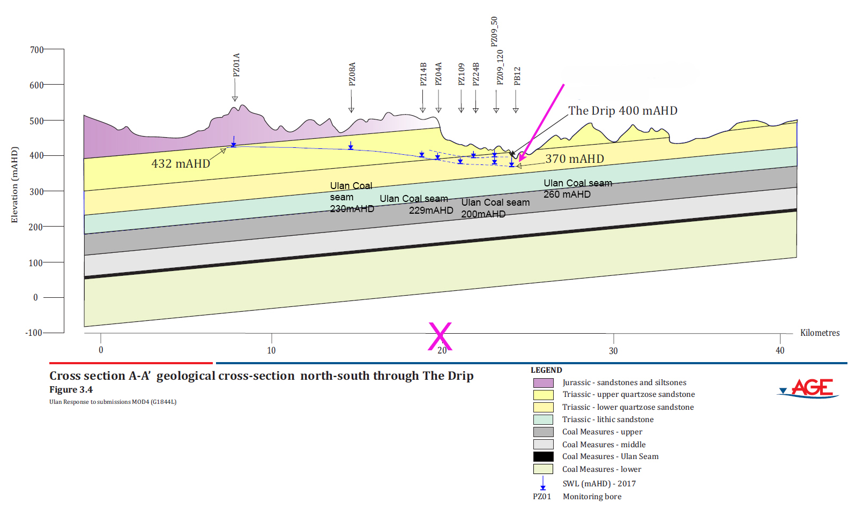
N
S
Notes:
Reverse to my graph above
Inclusion of PB12 spurious – Gleniston bore is on south side of river 3 kms downriver – connected to river alluvium
AGE RtS Figure 12 /3.4 The conceptual geological cross-section N-S through the Drip is carelessly drawn and of dubious use.
The two Drip seepage lines lie at ~ 381-392 that is below 400 mAHD shown The bottom scale (kms) is incorrect, bores are mislabelled (PZ09), dip of strata is a grossly over simplified (and incorrect based on known log data) and the depiction of groundwater flows are questionable.
Private bore (PB12) lies on the southern side of the river 3 kms downstream from the Drip and as such is not relevant to GW on the northern side of the river well to the west.
The Ulan Coal argument around The Drip water character is not consistent or conclusive. The water quality data has been misinterpreted.
The hydrochemical character (water type) of The Drip groundwater is similar to (NOT different from) groundwater to the north of the river which flows towards the river (and Drip). The Drip water is much more complex than rainfall driven 'fresh' water. It suggests longer residence time and the influence of basalt geology to the north. This indicates that TheDrip is fed not only by a perched aquifer, but also by the regional ground water system.

Slide 18
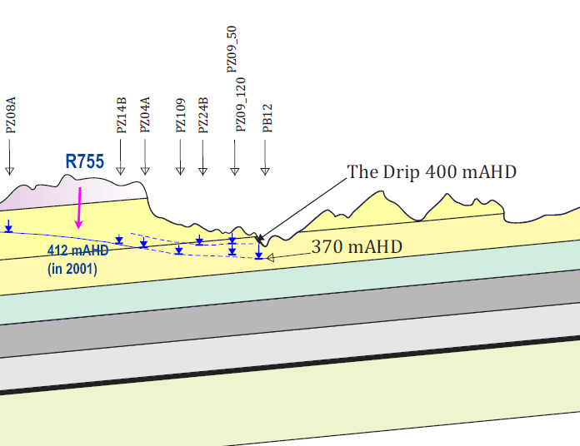
389 - 400 mAHD
N
S
PZ29
381 – 387.5 X
River bed @ The Drip ~380 mAHD
This diagram is inconclusive and does not prove …”the potential for the regional groundwater table to be hydraulically disconnected from the Drip”
Notes:
RtS Figure 12 /3.4 - The conceptual geological cross-section N-S through the Drip is carelessly drawn and of dubious use.
– m AHD River bed not included
- Scale/Depth of Ulan seam/Dip of strata grossly over simplified
- Bores mislabelled (PZ 09 is actually PZ 29) The Drip seep is at ~ 381-387 (not 400 mAHD as depicted)
- Connection to PB12 is spurious – Gleniston bore is on south of river, 3 kms downriver AND discharges TO the lowest point i.e THE RIVER or The Drip which cuts across the water bearing strata.
This diagram does not prove that …the potential for the regional groundwater table to be hydraulically disconnected from the Drip”
The Ulan Coal argument around The Drip water character is not consistent or conclusive. The water quality data has been misinterpreted.
The Drip and the bed of the Goulburn River are both is located within the 2km drawdown range.

Slide 19
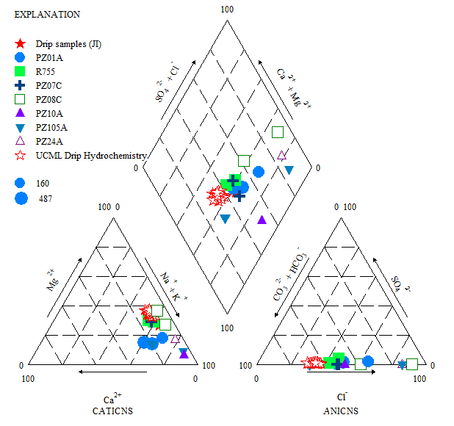
HYDROCHEMISTRY Drip seep water compared to North Monitoring network
Dominant water type Na, Mg>Ca, HCO₃ >Cl >>SO₄
~ similar to regional Triassic groundwater piezometers R755, PZ07C, PZ01A
% mEq/L
Notes:
Disagree with the conclusion by Age – left out the PR755 , PZ07C
The Drip groundwater (red stars) has a distinct bicarbonate water type (exhibiting Na, (Mg) HCO3, dominance more typical of the regional Triassic groundwater type.
An elevated Ca, HCO3 is typical of basalt derived water (R752).
Alternatively fresh rainfall recharged Triassic springs fed from very local sources exhibit a Na Cl type water. They are located more often at higher elevations closer to the Great Dividing Range (Munghorn Gap and Wollar).
The character or water type of The Drip groundwater has similarities with regional Triassic groundwater to the north - R755, PZ07C PZ01A.
The hydrochemistry of PZ24B has altered since installation in 2001

Slide 20
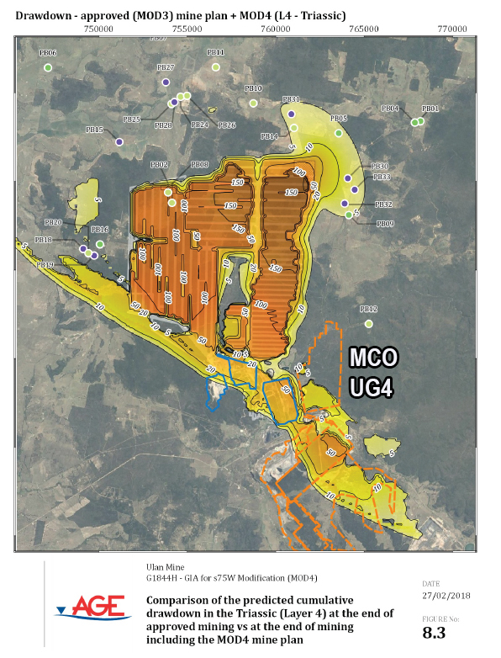
Cumulative impacts not included?
Moolarben CM?
Notes:
Note blow out and PB Bores in top right corner
Limited extent of draw down to the east??
NO EVIDENCE for what is is happening between the river and the edge of the “conceptual” drawdown?

Slide 21
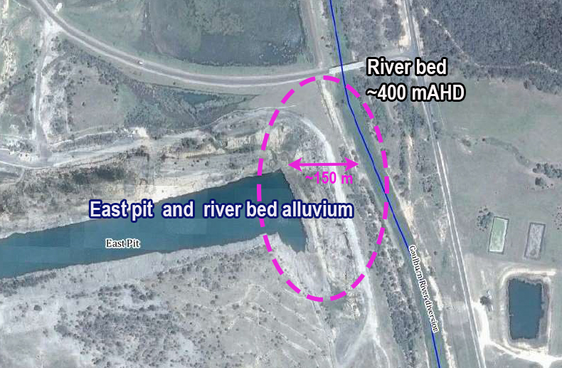
River bed
~ 400 mAHD
East pit mix of groundwater, rainfall and waste brine from RO plant
– levels actively maintained below 370 mAHD, EC ~ salt 3000 - 4000 µS/cm
Notes:
Claim there is no relevance to MOD 4 – however this is where the RO waste and groundwater is sent that is produced by UG3
The RtS (3.9 p. 17) does not mention all inputs/outputs
1. Saline waste water concentrate from the Reverse Osmosis (RO) plant is pumped to the East pit for disposal (RTS)
2. East pit water is discharged into Ulan Creek/ Goulburn River (after RO treatment) mixed with excess groundwater
3. SWLs in the East pit are being kept below 370mAHD by active pumping to reduce leakage to coal seam (that is below the bed of the River ~ 400mAHD)
Paradoxically water is also pumped out of the East pit for discharge into Ulan Creek/Goulburn River. In order to do this UCML reduces the EC levels by mixing it with fresher groundwater (extracted from the UG workings) to lower the EC below the 900 level required by EPL394. The aim is to maximise the amount of salt discharged off-site into the Goulburn River. And due to the Goulburn’s wide sand sediment bed and shallow meandering flow, this discharge water is subject to evaporation and concentration in the 225 kilometre journey downstream to the Hunter River.

Slide 22
Groundwater monitoring and reporting of East Pit?
Map alluvium between the east pit and river bed
Investigate possible saline seepage from old open cut one and river diversion, may explain some unusual spikes in EC
Who is Dept. Planning compliance officer for this area?
Notes:
(EPL394)
Was Chris Schultz – resigned March 2019

Slide 23
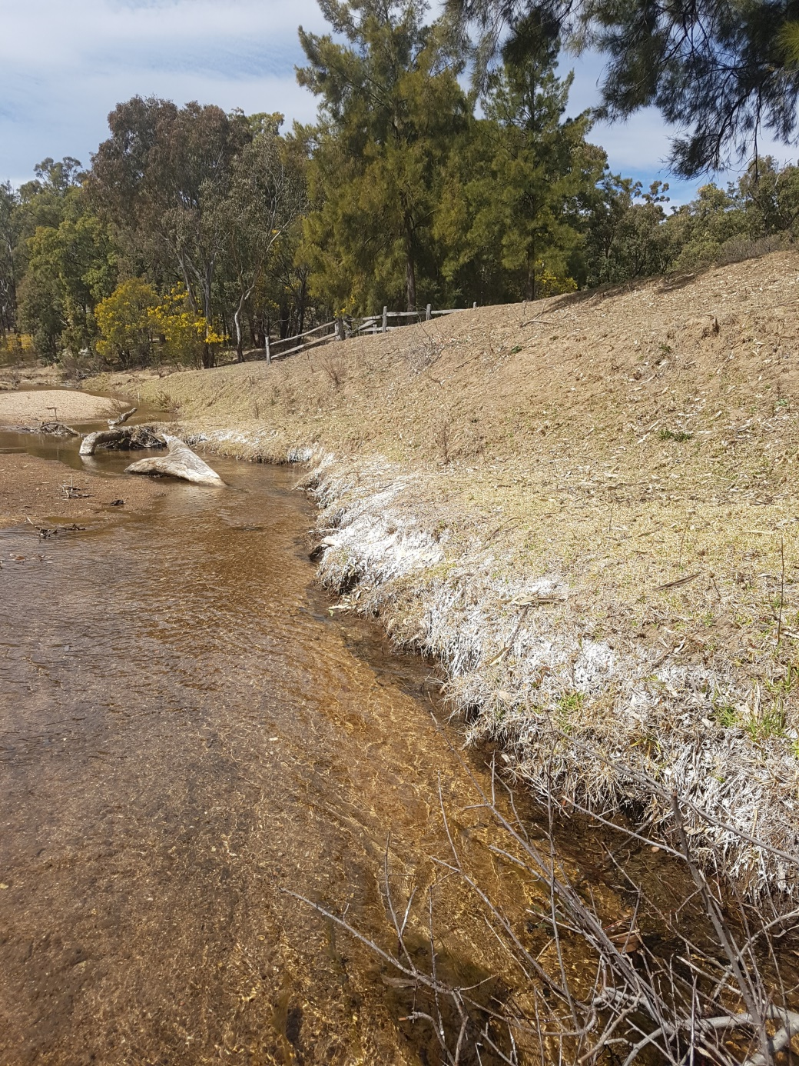
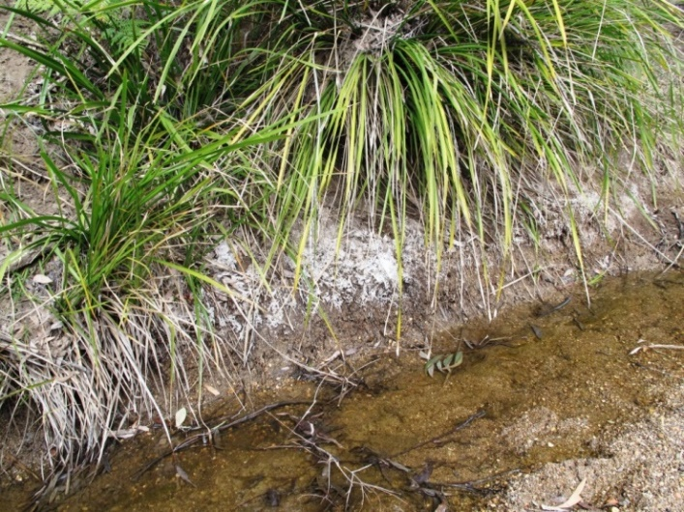
Salt deposits on river bank downstream – 2013 & 2017
Salt levels in the river have increased 450 ~ 800EC
Notes:
Encrustations – capillary action salt deposits from mine discharge water
SL – 12,850 tonnes 2012-2016
UCML disposed of over 3, 000 tonnes of salt in 2017. into the Goulburn River.
The salt is directly activated by mining operations.

Slide 24
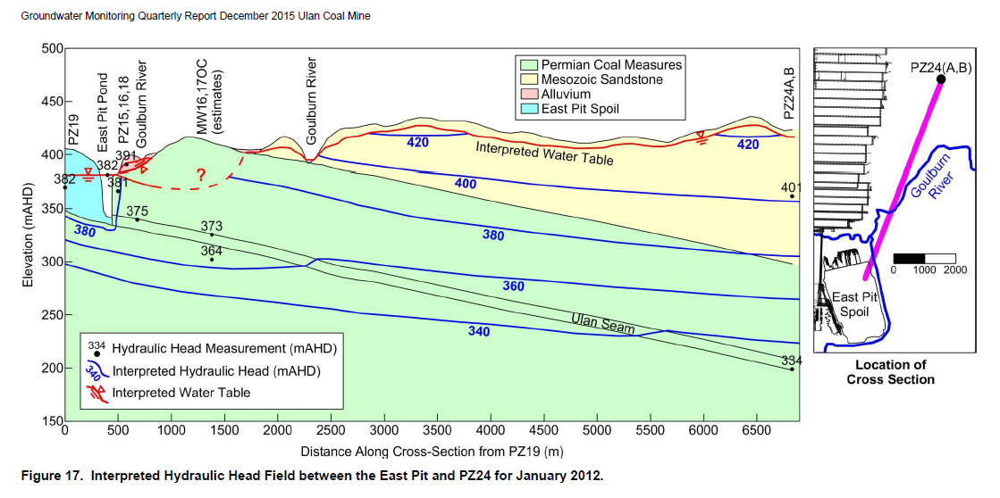

Possible interaction (leakage) between River and east pit?
Notes:
Raises many questions about the potential interaction between the East pit and the River?

Slide 25
Approval of Mod 4 would require significant
improvements to current water management
Lowering EC of discharge water to background levels 500 µS/cm
Prioritise river ecology over irrigation and mine operational needs – low base flows in the river must be sustained during dry conditions as was the situation pre-mining.
East pit is an environmental time bomb – management of water and water quality in the East pit – requires long term solutions
Disposal of RO saline wastewater into the East pit cannot continue.
A plan for post-mining water management and an overall vision for the mined site to take us through to the post-coal era is urgently required
Notes:
Basing flow patterns at Ulan on intermittent gauged data at Coggan and Sandy Hollow 100s kms downstream is flawed.
connectivity with the river through the alluvium has occurred previously when water levels rose.
Disposal should to an area separate from the groundwater system.

Slide 26
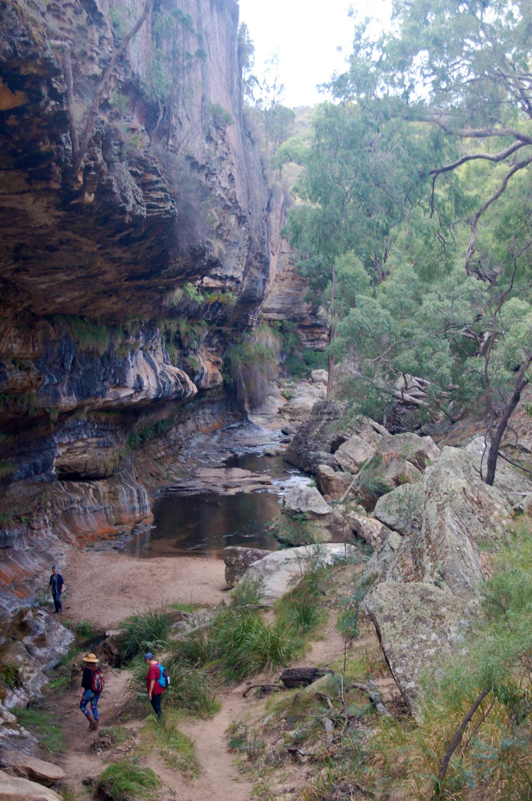
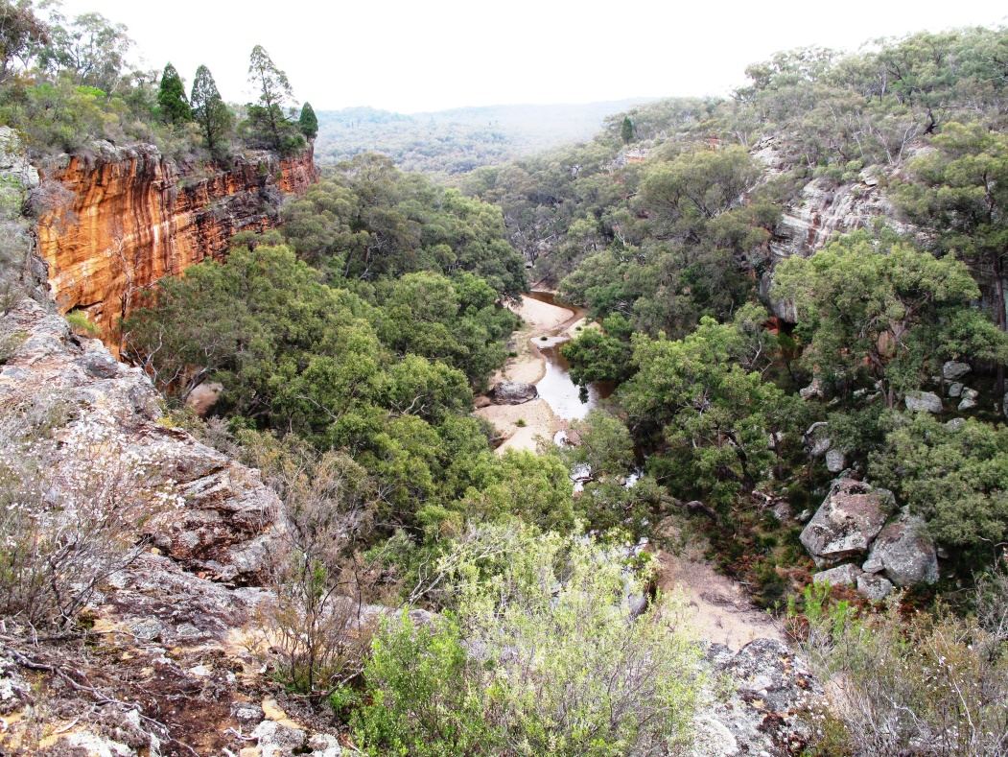
The proposed modification and expansion directly conflicts United Nations
High Level Panel on Water who recommend action
to value and protect our rivers and connected groundwater systems
Notes:
For IPC – to see photos of the Drip & Corner gorge

Slide 27
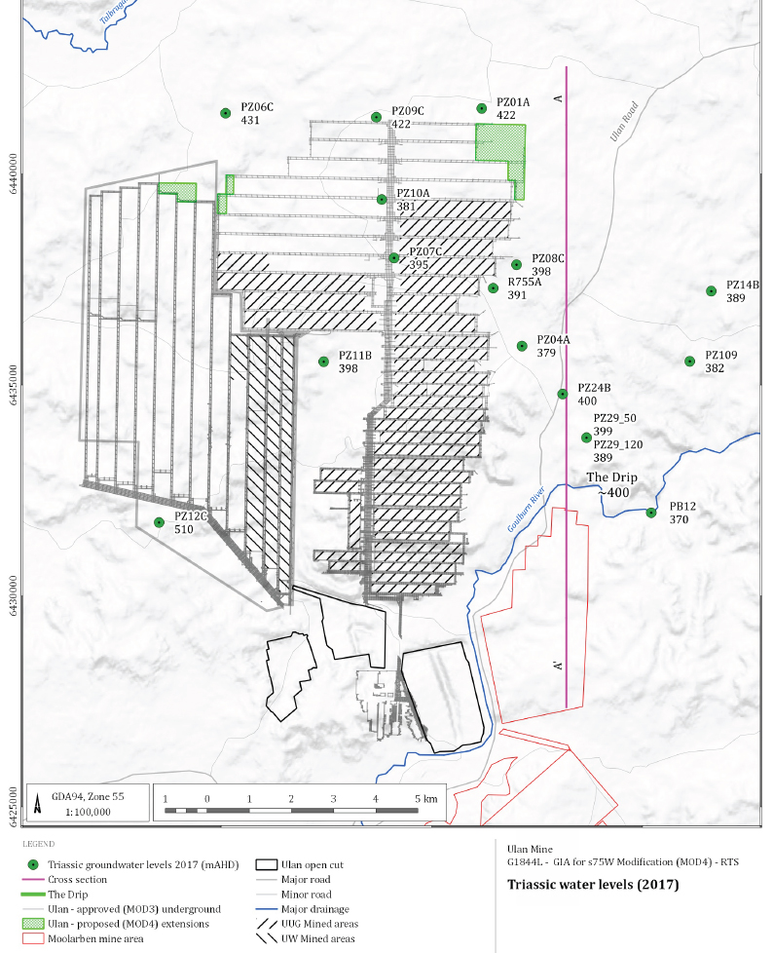
N
B
Triassic Water levels (mAHD) 2017 –
A - B line SWLs
River bed at The Drip ~ 380 mAHD

Slide 28
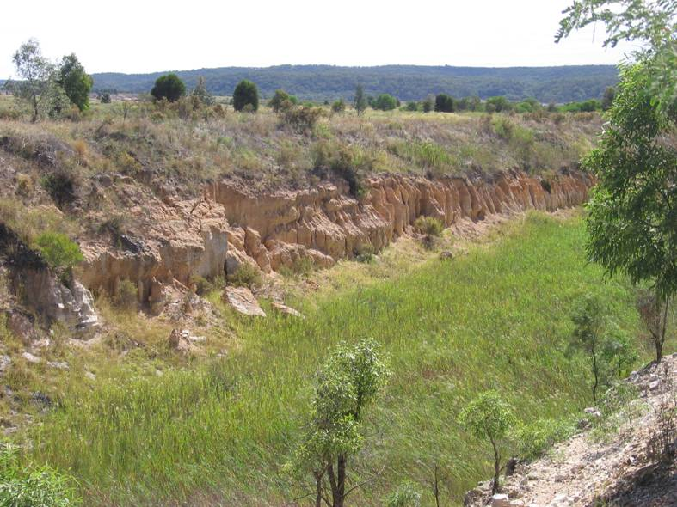
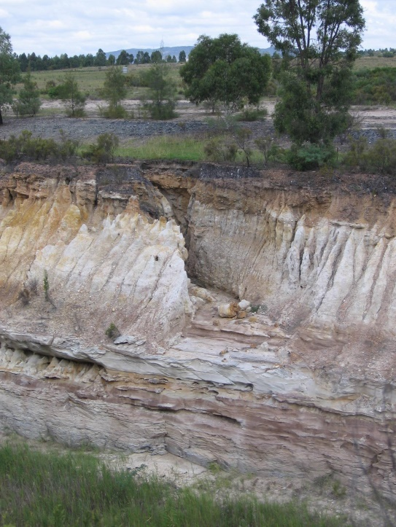
Goulburn River diversion
Notes:
Removal alluvial flats and connection with river
Lowering of alluvial GW – 3-40 meters – yield < 10 - 1 L/s
UG expansion in NW – fractured porous rock GW
Increasing Water surplus – discharge EC only limited after 2006
Elevated levels of salinity have been recorded in the sediments along the base of the diversion channel. Unexplained spikes in EC levels
UCML GW inflows 480 ML in 1988, 1020 ML in 1995 and 6,800 ML/year in 2014
(Table 2.). The increasing water-make is coming from the fractured, porous rock groundwater system in the Permo-Triassic strata Mine modelling predicts water make will reach 10,220 ML/year in 2023.
UCML March CCC & December 2018 Community Consultation Committee meeting, UCML Environment Manager comments, 33,000 EC in soils associated with the GRD

