Slide 1
Ulan Continued Operations Project Modification 4
Independent Planning Commission Presentation
19 June 2019

Slide 2
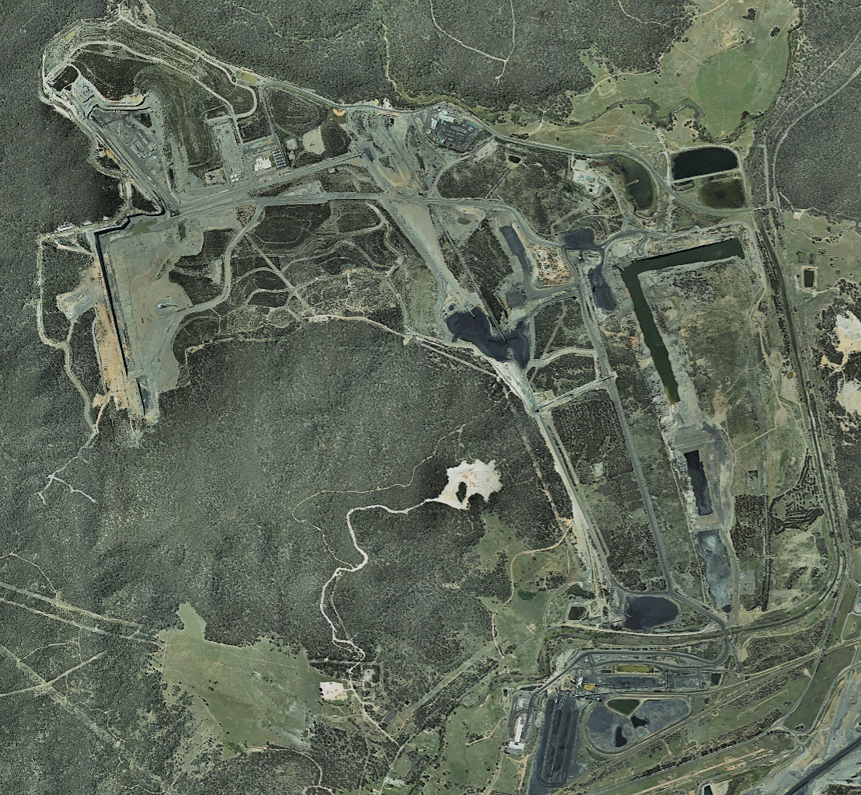
About UCML
Glencore’s Ulan Complex comprises Ulan Underground (UUG), Ulan West (ULW) and Ulan Surface Operations (USO) and is located 45km north of Mudgee and 25km north east of Gulgong.
Our Ulan operations employ over 700 people directly and 1,000 indirectly.
Mining has been undertaken in the Ulan Area since the early 1920’s. UUG and USO have operated since the 1980’s and ULW since 2012.
Ulan produce an export quality thermal product which is railed to the port of Newcastle
Our current Project Approval term ends in 2033
ULW
UUG
USO

Slide 3
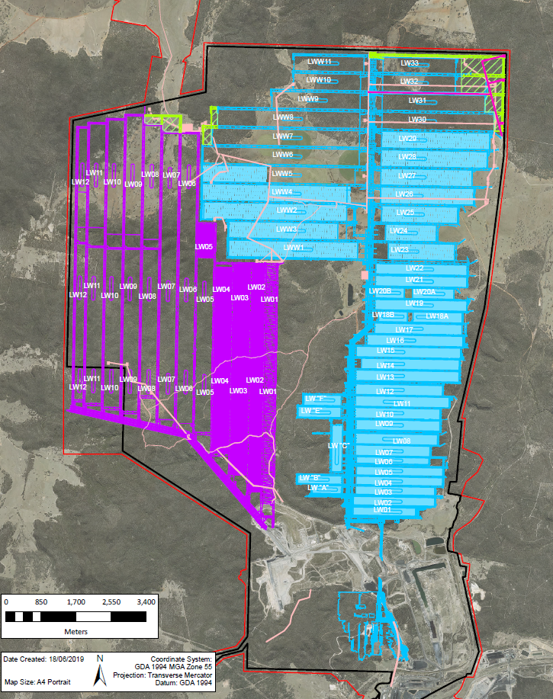
UCML will be Seeking
We are seeking a modification (Mod 4) to our current Project Approval PA 08_0184
Mod 4 would provide access to an additional 6.4 million tonnes of coal shared between our UUG and ULW operations
An approved Mod 4 would not change:
maximum workforce numbers
limits on extraction
coal handling and preparation
train movements
water management practices
impacts to State or Federally listed threatened communities
progressive rehabilitation of disturbed areas
Project approval term
The proposed Mod 4 area lies wholly within our existing approval and Mining Lease boundaries

Slide 4
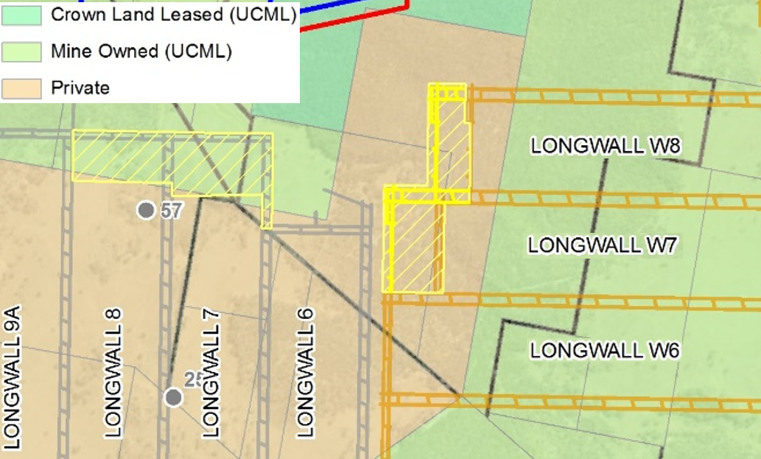
Mod 4 Overview
Mod 4 includes:
Extension of UUG Longwalls 30 to 33 and Longwalls W7 and W8
Widening of Longwall 33
Extension of ULW Longwalls 7 and 8
Installation of supporting infrastructure
No new Longwalls are proposed
Why we are seeking Mod 4:
Geological information gathered during the ongoing exploration process indicates additional mineable resource
Modelling shows that the extended panels can be adequately ventilated
A coal barrier between UUG LW28 and LW29 is no longer required and was removed. As a result LW33 can be widened
Notes:
Whilst MOD 4 will provide for revised locations of previously approved surface dewatering facilities based on changes to the UUG Mine Plan, there will be no changes to:
The mine life
Current limits on extraction
Operating hours
Workforce numbers
Mining method
Coal Handling and Preparation Plant
Coal Transportation movements
Conservation areas

Slide 5
Mod 4 update
As part of our Environmental Assessment
Ministerial Consent to apply for the Modification was granted by National Parks and Wildlife Service (NPWS)
Mod 4 will allow us to reduce the number of dewatering facilities from 5 to 3
The Department of Environment and Energy confirmed that Mod4 is ‘Not a Controlled Action’ under the Environment Protection and Biodiversity Conservation Act 1999
Response to Submissions
Additional design work and a commitment to bury pipes and power lines in the Durridgere State Conservation Area (SCA) reduced disturbance by 2.2 ha
Office of Environment and Heritage requested and Ulan agreed to a voluntary Biodiversity Offset for the net difference in disturbance for Mod 4 – 1.42ha
Additional Heritage, Subsidence and Shallow Aquifer Assessments were completed at the request of the private property owner
Sufficient Water Licenses for entire mine life (to 2033), including the proposed Mod 4 were acquired in late 2018
An Occupation Licence is required to install, operate and maintain infrastructure within Durridgere SCA. The Occupation Licence is being prepared in consultation with the NPWS

Slide 6
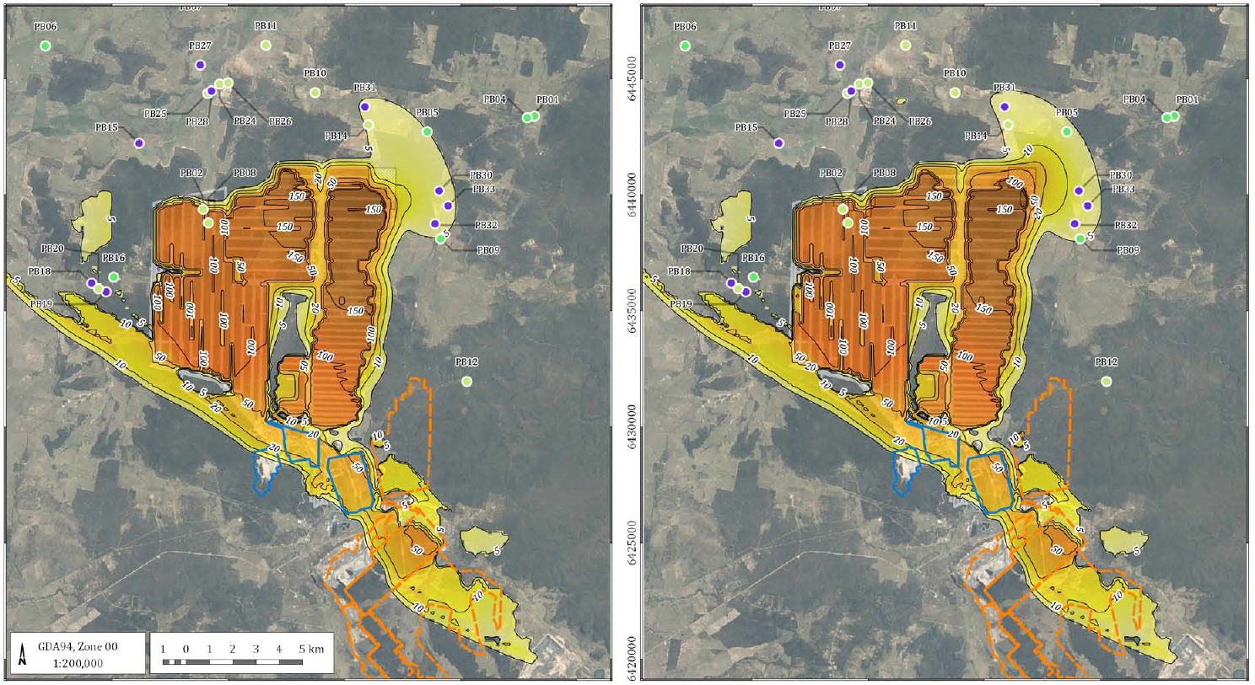
Groundwater
Approved
Proposed Mod 4
The Groundwater model was subject to independent Peer Review
Groundwater drawdown from the proposal will not affect any additional private bores
The groundwater assessment considered cumulative impacts of the Ulan and Moolarben mine plans
Additional baseflow losses have been modelled as less than 2 Megalitres per year
Notes:
Groundwater assessment concluded:
Increase in base flow losses (~1ML/year in each catchment), not measurable in practical terms
No additional private bores will be affected by groundwater drawdown
Drawdown impacts meet the minimal impact criteria provided in the NSW Aquifer Interference Policy
Peer Review concluded that the hydrogeological description, conceptualisation, model design, simulations and reporting have been conducted in an adequate manner
DoEE determined that project is not a Controlled Action under the Environment Protection and Biodiversity Conservation Act 1999
Licences are held to cover base flow losses and water extraction for the life of the Project
Subsidence Remediation and Alternative Water Supply Agreements are sought with owners of potentially impacted properties prior to impacts occurring
Modelling indicates that the only areas that show a change in the predicted drawdown are those areas immediately adjacent the proposed (Mod 4) mine plan
Modelling predictions indicate Mod 4 will have no impact on the Drip given:
The Drip is located ~ 7.5km from the proposed MOD 4 area
Hydro-geochemical assessment shows fundamental differences in water quality that indicate a different geological source to the Triassic water that is subject to drawdown as a result of mining activities

Slide 7
Ulan Coal’s Economic Contributions to Mid-West Region LGA in 2018
More than 500 full time employees live locally
Approximately $80 million in Wages and Salaries is paid to these employees
We deal with almost 300 local suppliers
Goods and services purchased from these suppliers totalled $71 million
Ulan Coal Mine Modification 4

