Slide 1
Presentation to the
NSW Government
Independent Planning Commission concerning the
D562-19 – Ulan Coal Mine MOD 4
Determination
by: Geoffrey Miell
19 June 2019

Slide 2
BP Statistical Review of World Energy 2019: “an unsustainable path”
On 11 June 2019, BP released the 68th annual edition of the BP Statistical Review of World Energy, the most comprehensive collection and analysis of global energy data.
“The longer carbon emissions continue to rise, the harder and more costly will be the necessary eventual adjustment to net-zero carbon emissions.”
“There is a growing mismatch between societal demands for action on climate change and the actual pace of progress, with energy demand and carbon emissions growing at their fastest rate for years. The world is on an unsustainable path.”
Bob Dudley, BP group chief economist, at the BPSRoWE-2019 launch
Source: https://www.bp.com/en/global/corporate/news-and-insights/press-releases/bp-statistical-review-of-world-energy-2019.html

Slide 3
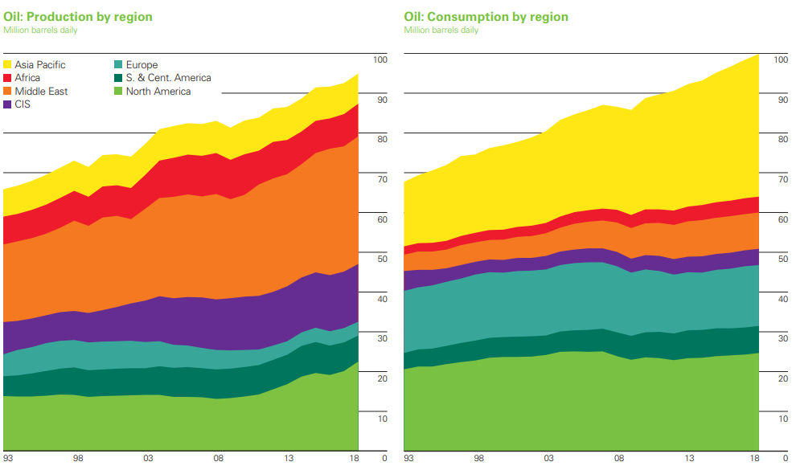
Global oil production and consumption was still increasing in 2018
In 2018, global oil production increased by 2.2 million b/d. Growth was heavily concentrated in the US (2.2 Mb/d), Canada 0.41 Mb/d) and Saudi Arabia (0.39 Mb/d) while Venezuela (-0.58 Mb/d) and Iran (-0.31 Mb/d) declined sharply. Global oil consumption grew by an above average 1.4 Mb/d. China (0.68 Mb/d) and the US (0.50 Mb/d) accounted for the majority of this year’s growth in consumption. Source: BP Statistical Review of World Energy 2019, p22

Slide 4
2018 world oil + top 5 country rankings
Crude Oil in year 2018 | World | Rank #1 Country | Rank #2 Country | Rank #3 Country | Rank #4 Country | Rank #5 Country
Reserves (proved) (x10⁹ barrels) (% world share) R/P (years) | 1 729.7 100 50.0 | Venezuela 303.3 17.5 >500 | Saudi Arabia 297.7 17.2 66.4 | Canada 167.8 9.7 88.3 | Iran 155.6 9.0 90.4 | Iraq 147.2 8.5 87.4
Production (x10³ barrels/d) (% world share) | 94 718 100 | USA 15 311 16.6 | Saudi Arabia 12 287 13.0 | Russian Fed. 11 438 12.1 | Canada 5 208 5.5 | Iran 4 715 5.0
Consumption (x10³ barrels/d) (% world share) | 99 843 100 | USA 20 456 20.5 | China 13 525 13.5 | India 5 156 5.2 | Japan 3 854 3.9 | Saudi Arabia 3 724 3.7
In year-2018, the top 5 oil countries held: 62.0% share of global Proved Reserves; 51.7% share of global Production; and 46.8% share of global Consumption.
Other Reserves: #6 Russian Fed. 6.1%, R/P 25.4 years; #7 Kuwait 5.9%, R/P 91.2 years; #8 UAE 5.7%, R/P 68.0 y; #9 USA 3.5%, R/P 11.0 years; #10 Libya 2.8%, R/P 131.3 y.
Reserves include gas condensate and NGLs as well as crude oil. Production (annualised average/day) includes crude oil, shale oil, oil sands and NGLs. Consumption (annualised average/day) includes international aviation and marine, biofuels, Coal-to-Liquids and Gas-to-Liquids.
Source: BP Statistical Review of World Energy 2019, pp14, 16, 20.
Production rate isn’t sustainable

Slide 5
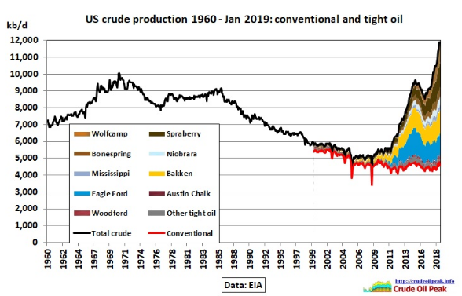
US conventional and shale (tight) oil
The EIA predicts further shale oil growth but this may be too optimistic, especially if there is another credit crunch or oil prices drop further because of a global recession.. The Norwegian consultancy Rystad Energy calculated that only 10% of US shale oil companies are cash flow positive. Note: graph excludes natural gas liquids (NGLs)
Source: https://crudeoilpeak.info/world-crude-production-outside-us-and-iraq-is-flat-since-2005

Slide 6
US shale (tight) oil’s major limitations
US shale oil is a light oil, not easily converted to diesel, which is the most important transportation fuel, nowadays. It’s also ill-suited for producing aviation turbine (jet) fuel and the higher-octane grades of gasoline fuels for high-performance vehicles, unless extensively blended with “heavy” crude oils.
The oil industry has been converting more and more “heavy” oil into diesel fuel, leading to diesel fuel becoming scarcer and more expensive, to the point that its production may have peaked globally in 2015.
Additionally, there’s a dearth of heavy oil, the fuel of choice for marine transportation.
US shale oil output is surging, but US refineries can’t process much more light crude, per a Morgan Stanley research note.
There are limited export opportunities for US shale, meaning light oil may soon have to trade at a discount to compete.
Outputs from heavy crude producers Venezuela and Mexico are falling, and pipeline bottlenecks are restricting flows from Canada.
Sources: 1) https://cassandralegacy.blogspot.com/2018/12/peak-diesel-or-no-peak-diesel-debate.html
2) https://www.cnbc.com/2018/04/17/shale-oil-has-a-refining-problem-and-morgan-stanley-smells-opportunity.html
3) https://www.desmogblog.com/2018/04/24/octane-surprising-reason-shale-oil-makes-poor-fuel-high-tech-cars-and-trucks

Slide 7
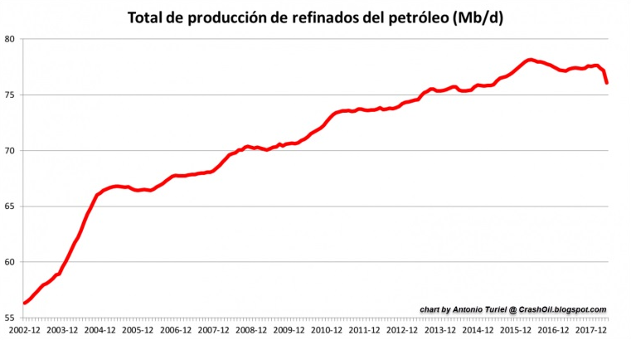
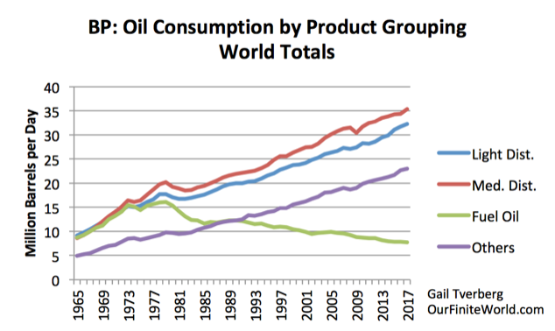
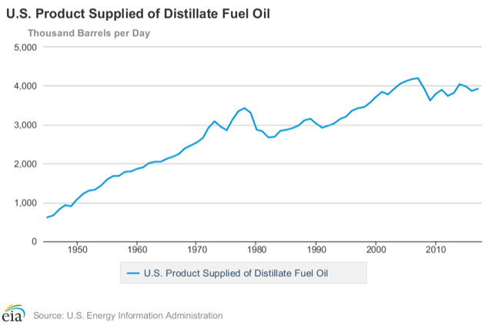
Have diesel fuel supplies peaked?
Has global peak diesel supply already arrived? It’s perhaps too early to tell conclusively.
Rather than waiting for declining global oil supplies being forced upon us, humanity needs to leave oil before oil leaves us.
Scarcer and costlier diesel fuel supplies will likely increase Ulan’s coal mining & transportation costs.
Graphs: https://cassandralegacy.blogspot.com/2018/12/peak-diesel-or-no-peak-diesel-debate.html

Slide 8
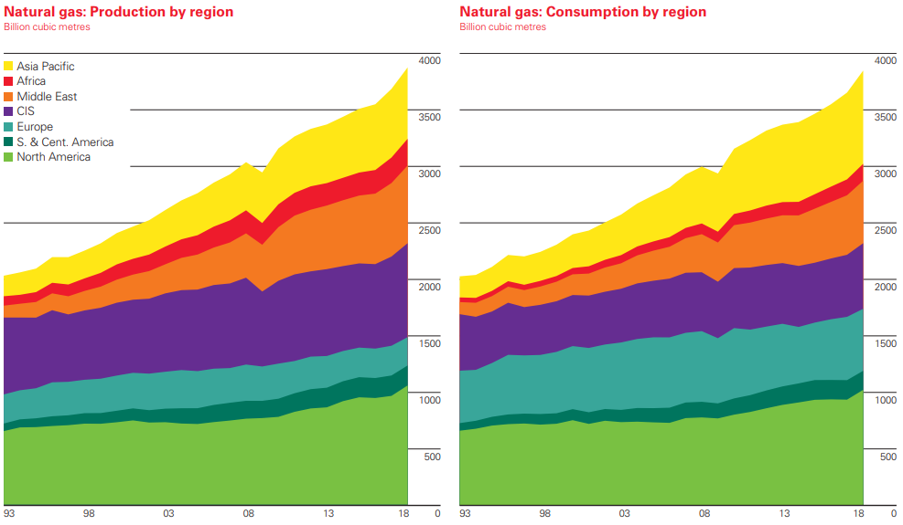
Global gas production and consumption registered record-high growth in 2018
In 2018, global gas production and consumption registered record-high volumetric increases. Production increased by 5.2%, the highest rate since 2010 and more than double the 10-year average growth rate of 2.3%. US (86 bcm) and Russia (34 bcm) accounted for almost two-thirds of global growth. Similarly, gas consumption increased by 5.3%, with the US (78 bcm) registering the strongest growth on record. Source: BP Statistical Review of World Energy 2019, p36

Slide 9
2018 world gas + top 5 country rankings
Natural Gas in year 2018 | World | Rank #1 Country | Rank #2 Country | Rank #3 Country | Rank #4 Country | Rank #5 Country
Reserves (proved) (x10¹² m³) (% world share) R/P (years) | 196.9 100 50.9 | Russian Fed. 38.9 19.8 58.2 | Iran 31.9 16.2 133.3 | Qatar 24.7 12.5 140.7 | Turkmenistan 19.5 9.9 316.8 | USA 11.9 6.0 14.3
Production (x10⁹ m³ in 2017) (% world share) | 3 867.9 100 | USA 831.8 21.5 | Russian Fed. 669.5 17.3 | Iran 239.5 6.2 | Canada 184.7 4.8 | Qatar 175.5 4.5
Consumption (x10⁹ m³ in 2017) (% world share) | 3 848.9 100 | USA 817.1 21.2 | Russian Fed. 454.5 11.8 | China 283.0 7.4 | Iran 225.6 5.9 | Japan/Canada 115.7 ea. 3.0 ea.
In year-2018, the top 5 gas countries held: 64.4% share of global Proved Reserves; 54.3% share of global Production; and 52.3% share of global Consumption.
Other Gas Producers: #6 China 4.2%, R/P 37.6 years; #7 Australia 3.4%, R/P 18.4 yrs; #8 Norway 3.1%, R/P 13.3 y; #9 Saudi Arabia 2.9%, R/P 52.6 y; #10 Algeria 2.4%, R/P 47.0 y.
Production includes gas consumed for Gas-to-Liquids transformation, excludes gas flared or recycled. Consumption includes derivatives of coal and gas for Gas-to-Liquids transformation, excludes gas converted to liquid fuels.
Source: BP Statistical Review of World Energy 2019, pp30, 32, 34.
Production rate isn’t sustainable

Slide 10
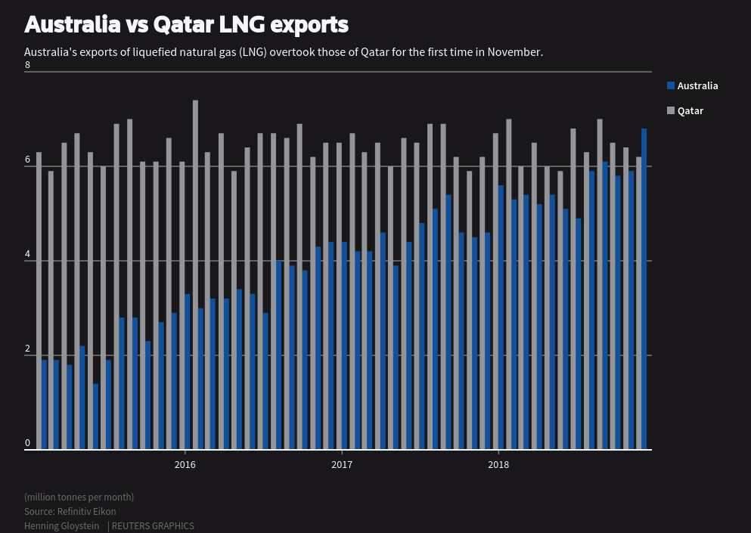
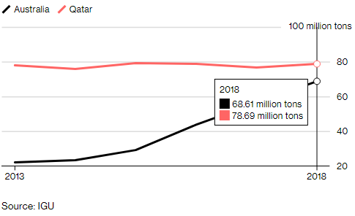
Australia vs Qatar LNG exports
In June 2019, Australia is now reaching for the LNG export crown as the last large Australian LNG export mega-project shipped its first cargo.
With Prelude now onstream, Australia is on track to export more than 80 million tons per year of LNG, surpassing Qatar as the largest global LNG producer.
Source: https://www.bloomberg.com/news/articles/2019-06-11/shell-s-prelude-floating-lng-project-ships-first-cargo-to-asia
In November 2018, Australia loaded 6.5 million tonnes of liquefied natural gas (LNG) for exports while Qatar exported over 6.2 million tonnes.
Source: https://www.reuters.com/article/us-australia-qatar-lng/australia-grabs-worlds-biggest-lng-exporter-crown-from-qatar-in-nov-idUSKBN1O907N

Slide 11
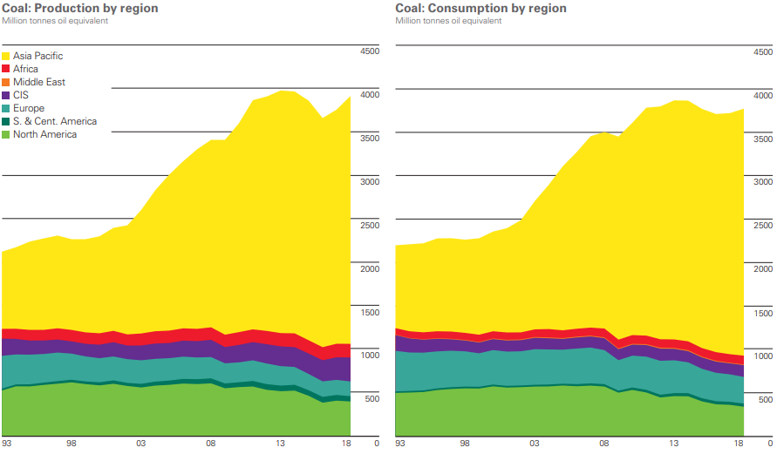
Global coal production and consumption in 2018 grew for a second year
In 2018, global coal production increased by 4.3%, significantly above the 10-year average. Production growth was concentrated in Asia-Pacific (163 Mtoe) with China accounting for half of growth and Indonesia production up by 51 Mtoe. Global coal consumption increased by 1.4% in 2018, the fastest growth since 2013. Growth was driven by Asia-Pacific (71 Mtoe), and particularly by India (36 Mtoe).
Source: BP Statistical Review of World Energy 2019, p46

Slide 12
2018 world coal + top 5 country rankings
(all coal: anthracite, bituminous, sub-bit. & lignite)
All coal in year 2018 | World | Rank #1 Country | Rank #2 Country | Rank #3 Country | Rank #4 Country | Rank #5 Country
Reserves (proved) (x10⁶ tonnes) (% world share) R/P (years) | 1 054 782 100 132 | USA 250 219 23.7 365 | Russian Fed. 160 364 15.2 364 | Australia 147 435 14.0 304 | China 138 819 13.2 38 | India 101 363 9.6 132
Production (Mtoe in 2017) (% world share) | 3 916.8 100 | China 1 828.8 46.7 | USA 364.5 9.9 | Indonesia 323.3 8.3 | India 308.0 7.9 | Australia 301.1 7.7
Consumption (Mtoe in 2017) (% world share) | 3 772.1 100 | China 1 906.7 50.5 | India 452.2 12.0 | USA 317.0 8.4 | Japan 117.5 3.1 | Russian Fed. 88.0 2.3
In year-2018, the top 5 coal countries held: 75.7% share of global Proved Reserves; 79.8% share of global Production; and 76.4% share of global Consumption.
The global coal industry is heavily concentrated among only a few key countries.
Mtoe = million tonnes oil equivalent = 41.87 petajoules (IEA); R/P = Reserves-to-Production.
Source: BP Statistical Review of World Energy 2019, pp42, 44, 45.
Production rate isn’t sustainable

Slide 13
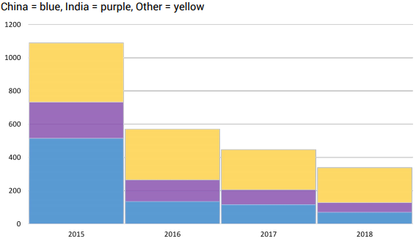
The pipeline of proposed new coal power capacity is shrinking quickly
Planned coal power capacity in pre-construction status has declined from 1,090 GW in 2015 to 339 GW in 2018, with the biggest drops in China and India. Japan has cancelled over 7 GW of proposed coal capacity since 2017, while South Korea has stopped issuing permits for new coal plants.
Source: https://endcoal.org/wp-content/uploads/2019/03/BoomAndBust_2019_r6.pdf

Slide 14
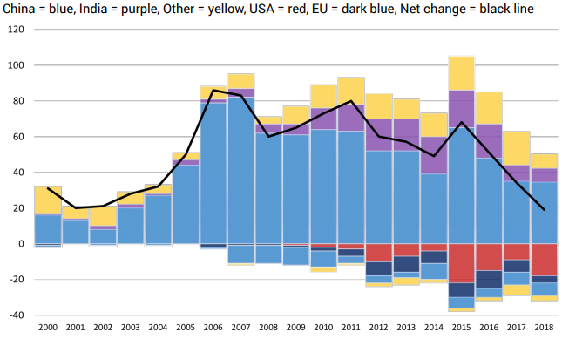
Near record coal-fired power capacity retirements were led by the US
If trends continue, the global coal power fleet capacity will begin to shrink, perhaps as early as 2020.
2020
Coal power capacity additions (above 0 GW) and retirements (below 0 GW) between 2000 and 2018 (coloured columns) and global net change (black line) shown above (in gigawatts). While total coal capacity continues to go up, net annual additions to the global coal power fleet (i.e. new capacity minus retired capacity) continue to decline. Net new global coal power was 19 GW in 2018 – the slowest rate of growth on record, and the fourth straight year of decline.
Source: https://endcoal.org/wp-content/uploads/2019/03/BoomAndBust_2019_r6.pdf

Slide 15
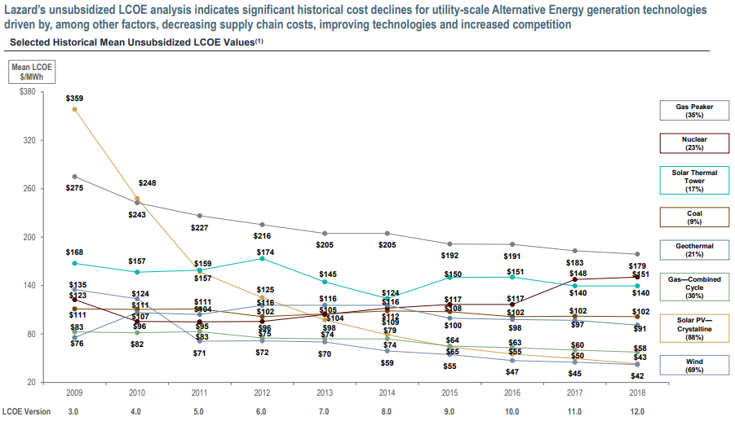
New renewables are now cheaper than new nuclear, coal & gas technologies
Source: https://www.lazard.com/media/450784/lazards-levelized-cost-of-energy-version-120-vfinal.pdf

Slide 16
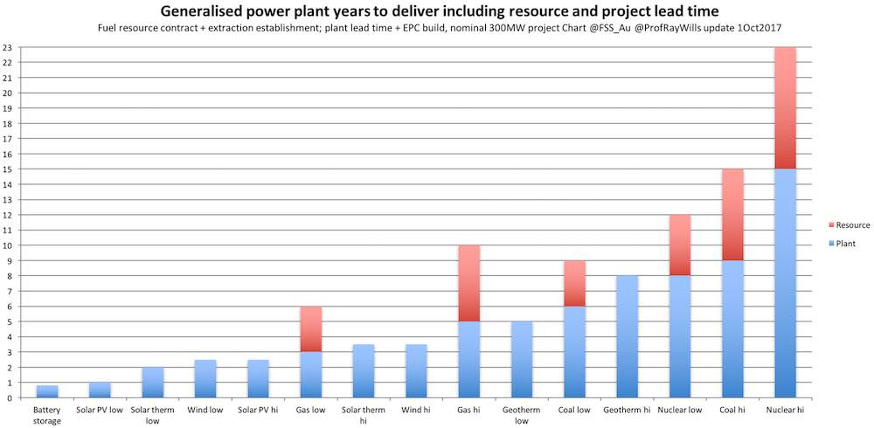
Energy technology deployment: wind fast, solar faster, batteries fastest
Source: https://reneweconomy.com.au/graphs-day-wind-fast-solar-faster-batteries-fastest-68311/

Slide 17
IPCC SR1.5°C warns: Climate change is an existential threat to humanity
Countries that accept or ‘ratify’ the Paris Climate Agreement submit pledges for how they intend to address climate change. Current pledges are not on track to limit global warming to 1.5°C above pre-industrial levels.
A world that is consistent with holding warming to 1.5°C would see greenhouse gas emissions rapidly decline in the coming decade, with strong international cooperation and a scaling up of countries’ combined ambition beyond current Nationally Determined Contributions (NDCs). In contrast, delayed action, limited international cooperation, and weak or fragmented policies that lead to stagnating or increasing greenhouse gas emissions would put the possibility of limiting global temperature rise to 1.5°C above pre-industrial levels out of reach. Source: IPCC SR1.5°C FAQ 2.1
Approving the Ulan Coal Mine MOD 4 contributes to increasing an existential risk to humanity. Why risk our families’ futures; our lives?
If Australia does nothing to reduce emissions, why should anyone else do anything? The IPCN has a fiduciary duty to protect us.

Slide 18
Can we think in new ways about the existential climate-related risks?
A foreword to a policy paper on existential climate and security risks, released on 30 May 2019 by think-tank Breakthrough, was written by Retired Admiral Chris Barrie, who was Chief of the Australian Defence Force from 1998 to 2002. It includes:
This policy paper looks at the existential climate-related security risk through a scenario set thirty years into the future. David Spratt and Ian Dunlop have laid bare the unvarnished truth about the desperate situation humans, and our planet, are in, painting a disturbing picture of the real possibility that human life on earth may be on the way to extinction, in the most horrible way.
A doomsday future is not inevitable! But without immediate drastic action our prospects are poor. We must act collectively. We need strong, determined leadership in government, in business and in our communities to ensure a sustainable future for humankind.
Source: http://www.climatecodered.org/2019/05/can-we-think-in-new-ways-about.html

Slide 19
A 2050 scenario: global human-caused GHG emissions don’t peak until 2030
By 2030, CO₂ levels have reached around 437 parts per million – which is unprecedented in the last 20 million years – and warming reaches 1.6°C.
Emissions peak in 2030, and start to fall consistent with an 80% reduction by 2100 (compared to 2010 energy intensity). This leads to warming of at least 2.4°C by 2050.
Sea levels rise 0.5 m by 2050, with a likely 2-3 m rise by 2100, eventually rising >25 m.
By 2050, 35% of global land area, and 55% of the global population, are subject to more than 20 days per year of lethal heat conditions, beyond the threshold of human survivability.
Deadly heat conditions persist for more than 100 days per year in West Africa, tropical South America, the Middle East and South-East Asia, contributing to more than a billion people being displaced from the tropical zone.
Water availability decreases sharply in the most affected regions at lower latitudes (dry tropics and subtropics), affecting about 2 billion people worldwide. Agriculture becomes nonviable in the dry subtropics.
Food production is inadequate to feed the global population and food prices skyrocket, as a consequence of a one-fifth decline in crop yields, a decline in the nutrition content of food crops, a catastrophic decline in insect populations, desertification, monsoon failure and chronic water shortages, and conditions too hot for human habitation in significant food-growing regions.
Source: Existential climate-related security risk: A scenario approach, https://www.breakthroughonline.org.au/papers

Slide 20
A 100% renewable energy system is cheaper than the current global energy supply and is possible before 2050.
The energy transition is not a question of technical feasibility or economic viability, but one of political will.
See: http://energywatchgroup.org/wp-content/uploads/EWG_LUT_100RE_All_Sectors_Global_Report_2019.pdf
Stop Ulan Coal Mine MOD 4
Please don’t ignore the existential risks this project contributes toward dangerous climate change, for (y)our families’ futures

