Slide 1


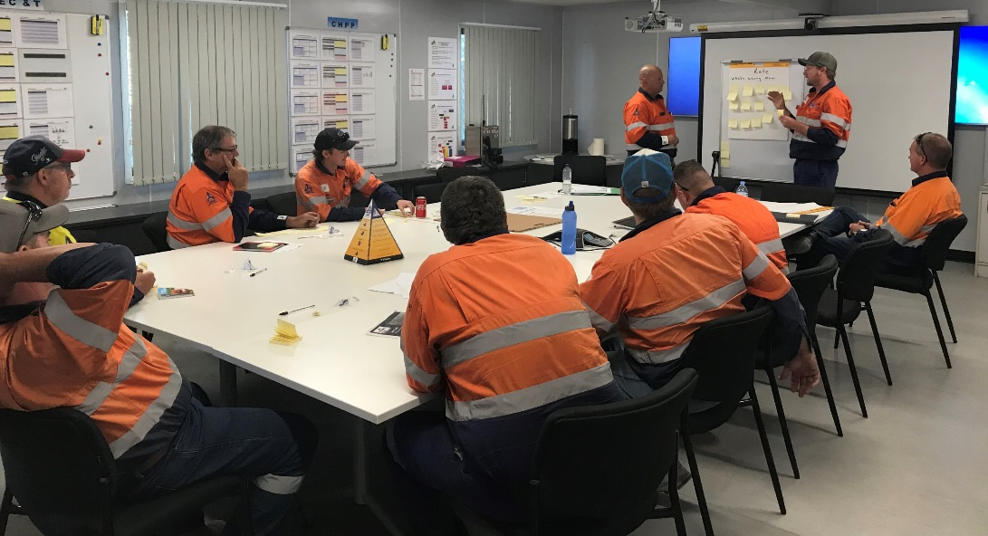
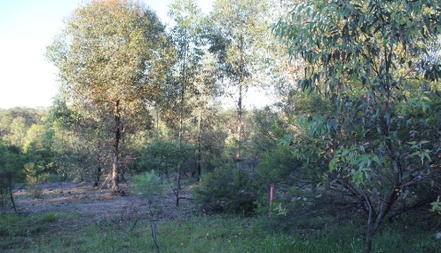
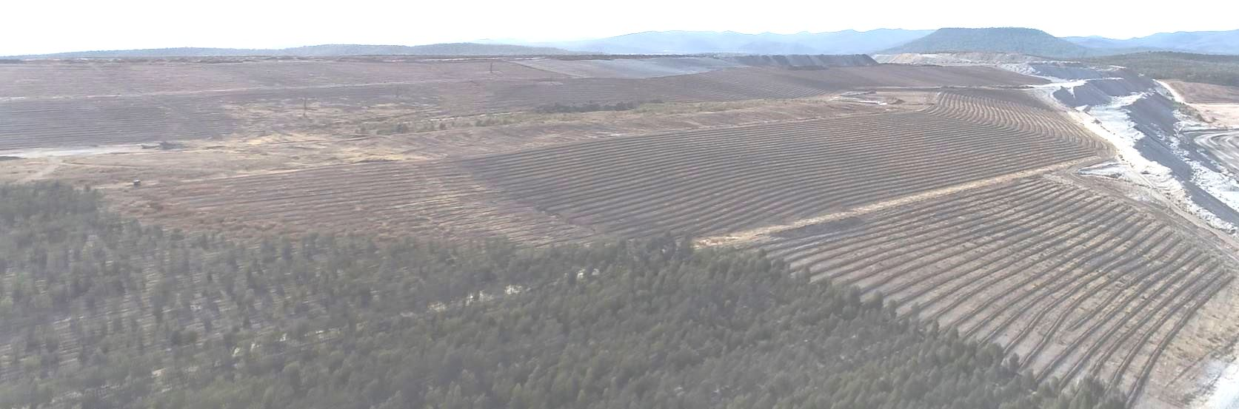
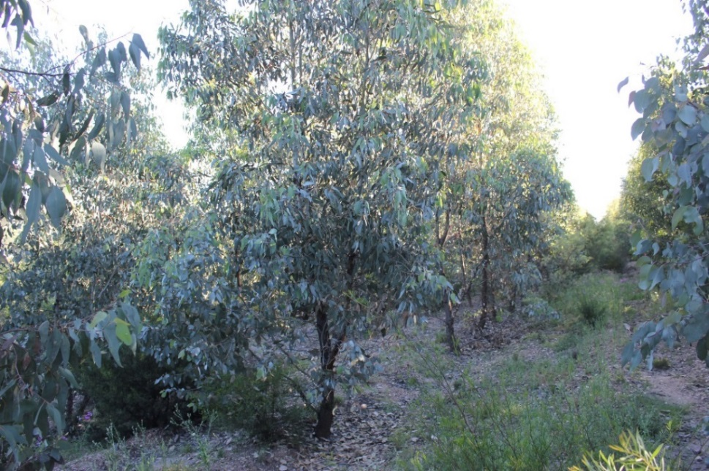

Modification 7
We do what we say

Slide 2
Introduction
Process commenced February 2018
The key outcome being sort is about clarity of conditions, importantly
  These are administrative adjustments to address legal and operational changes
  No increase in coal output from this application amendments
  No increase in environmental impacts
  This will allow us to deliver on our environmental commitments in a clear, transparent and unambiguous manner

Slide 3
MOD 7 - Overview
The 5 key aspects of Mod 7:
Secure biodiversity offsets through alternative mechanisms;
Use an approved stockpile area for Boggabri rather than Tarrawonga coal;
Include the approved exploration activities as part of the current project approval;
Transport small tonnages of coal by road for testing/marketing, and
Clarify the common approval boundary with Tarrawonga Coal Mine (TCM).

Slide 4
Biodiversity Offset Security
The current project approval limits the security mechanism available to secure biodiversity offsets.
Since the project was approved the Biodiversity Conservation Act 2016 has been enacted.
This includes
Biodiversity Stewardship Agreements
Conservation Agreements
These options are not currently available to BCO under the project approval which limits Boggabri Coals ability to provide the most effective mechanism or mechanisms to meet the Biodiversity Offset requirements

Slide 5
Biodiversity Offset Security
What is the proposed modification?
Amending the biodiversity offset security condition to include, as well as National Parks mechanism, that
  Biodiversity Stewardship Agreement; and
  Conservation Agreement.
  be made available.
Related to the above, an extension to the date by which the offset security agreement is required to be finalised until February 2020 to arrange for the alternative options to be explored and finalised.

Slide 6
Biodiversity Offset Security
What are the impacts of the modification?
Contrary to some special interest group's representations, the proposed modification will not change, alter or diminish Boggabri Coal's offset obligation and there will be no change to the biodiversity impacts of the Project Approval.

Slide 7
Biodiversity Offset Security
What is the Agencies' feedback?
The OEH supports the modification.
  "OEH agrees that this (extension to finalising the security arrangement until February 2020) is a reasonable timeframe to secure the offsets through these additional security options"
  "The Department and OEH consider that the additional security mechanism options would strengthen the statutory protection of the offsets”

Slide 8
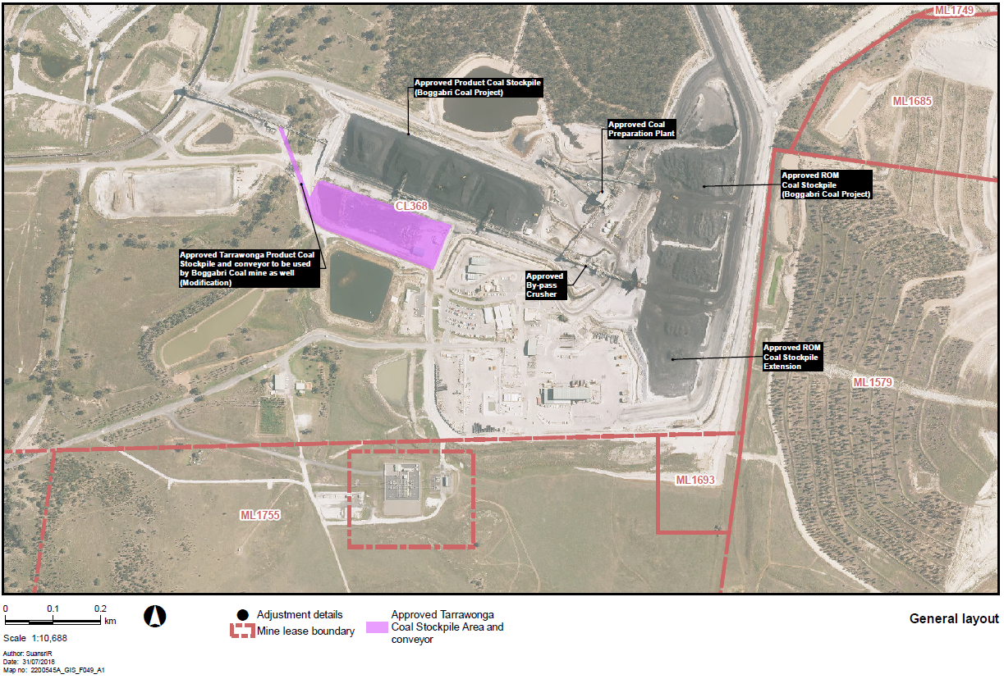
Coal Stockpile Area

Slide 9
Coal Stockpile Area
What is the proposed modification?
Enable the approved TCM stockpiling area to be used for Boggabri coal
Allows operational flexibility
What are the impacts?
No additional coal above the current limit of 8.6 Mtpa is proposed be handled through the Infrastructure Facilities Area.
The impacts of the stockpile area were assessed and approved (Mod 2).
What is the Agencies' feedback?
No objections

Slide 10
Drilling and Exploration Activities
What is the proposed modification?
To expressly include the exploration activities (i.e. drilling, sampling and geophysical exploration) within the approved disturbance area which are permitted by Boggabri Coal's mining and exploration licences and (implicitly) permitted by the Project Approval.
Incorporate the Environmental Assessment for Mod 7 in the Project Approval's list of documents.
What are the impacts?
None.
The exploration activities are already managed by the existing environmental management plans and conditions of approval
What is the Agencies' feedback?
No objections.

Slide 11
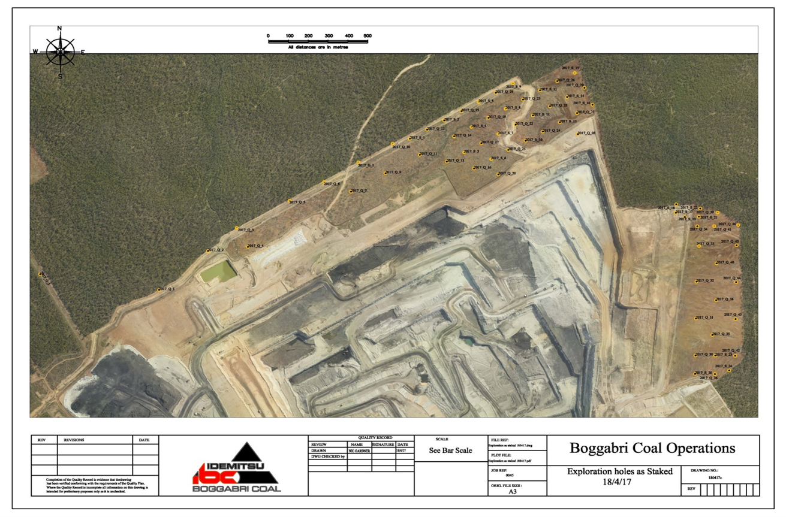
Drilling and Exploration Activities

Slide 12
Transportation of Coal Samples by Road
What is the proposed modification?
To allow a small tonnage (less than 200 tonnes/year or 10 heavy vehicles per year) of coal to be transported by road for testing and marketing purposes (currently all coal is required to be transported by Rail) via the mine's private access road and the Kamilaroi Highway.
What are the impacts?
Negligible impact to traffic. Increase to the annual traffic on the Kamilaroi Highway by about 0.01%.
What is the Agencies' feedback?
No objections.
Narrabri Shire Council did not object but raised concern about the volume of sample coal to be transported and recommended annual limits should be imposed and should be transported via the mine owned private haul road to the Kamilaroi Highway
The Department's response:
  Proposed number of vehicles is very small compared to the approved traffic for project;
  Boggabri Coal would be required to comply with existing noise and air quality criteria and to manage any impacts in accordance with its approved traffic, air quality and noise management plans; and
  Given the very small increase in traffic, the modification would result in negligible impacts on the capacity, efficiency and safety of the approved road network.

Slide 13
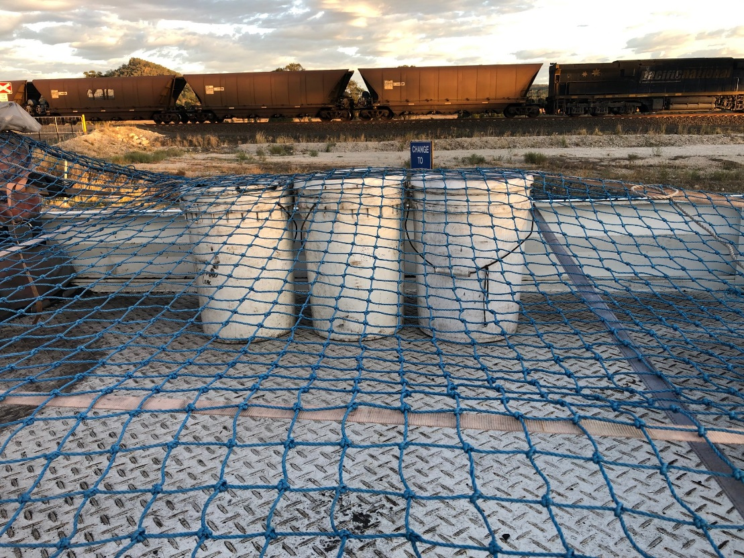
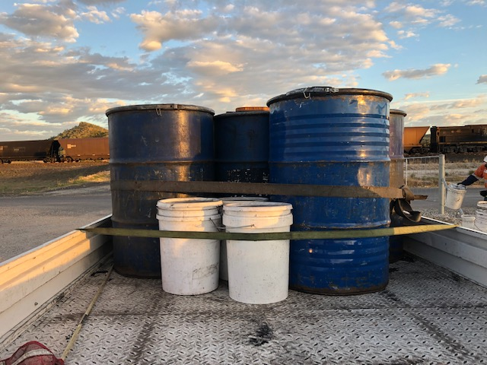
Transportation of Coal Samples by Road
Examples

Slide 14
Project Boundary Adjustment
What is the proposed modification?
To realign a small portion of the project boundary which overlaps with TCM
What are the impacts?
None.
The modification will be of benefit as it will ensure clear delineation of responsibility between the two mines.
What is the Agencies' feedback?
No objections.
The EPA noted that Boggabri Coal will need to apply to change its Environmental Protection Licence (EPL).

Slide 15
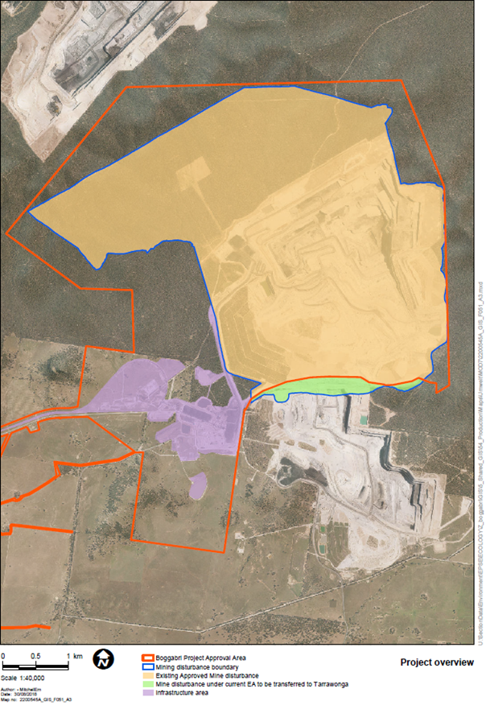
Project Boundary Adjustment
Proposed project boundary adjustment
– green area only
Current project boundary

Slide 16
DPE’s Evaluation of Impacts
Modification | DPE's Evaluation of Impacts
Biodiversity Offset Area | …the changes to the biodiversity offsets security mechanism are administrative in nature and would not change the impacts of the proposal. The additional biodiversity security mechanisms strengthen the existing requirements…
Coal Stockpile Area | The impacts…have already been assessed and approved, and the Department is satisfied that storing coal from Boggabri coal mine instead of the Tarrawonga coal mine would not change the impacts…
Drilling and Exploration Activities | ...exploration and drilling activities within the approved project disturbance area may be considered part of standard mining operations. Any change to the approved impacts of the project resulting from these activities would be negligible and could be managed under the existing management plans for the mine.
Transportation of Coal Samples by Road | Very minor increase in traffic, and any additional impacts associated with this traffic would be negligible.
Project Boundary Adjustment | …the realignment o f the boundary ….is an administrative in nature and would not result in any changes to the approved impacts.

Slide 17
Response to Representations
Issue | Response
Lock the Gate. Concern regarding assessment under former part 3A | The Modification Application is a s75W application because it was lodged in February 2018 with the consent of the Minister prior to the 'cut-off' date. The Department has considered the nature of the proposed modification and is satisfied that it is within the scope of the Act
Biodiversity Security. Concern the alternative security option will provide less statutory protection for the offsets | The offsetting obligations do not change as a result of including alternative security mechanisms
Concerns raised that the Modification was not publicly exhibited | Department decision. However Boggabri Coal actively engaged with the local community and Narrabri Shire Council prior to the lodgement and through the process as part of the quarterly meetings with its Community Consultative Committee. There were also no new impacts to engage on

Slide 18
Summary
Mod 7 is a tidy up modification with no new environmental impacts
Provides greater certainty than the current approval in respect of biodiversity offset security,
Clarifies regulation of exploration activities
Delineates responsibilities between BCM and TCM
Removes unnecessary operational constraints
THANK YOU

