Slide 1
Hume Coal
IPC Hearing

Slide 2
I own a Land Surveying & Town Planning business with offices in Newcastle, Sydney, Muswellbrook & Gunnedah

Slide 3
I come from a place where coal has been very dominant for over a century.
Is coal finished?
or does coal have some ‘unfinished business’

Slide 4
Hume has about the highest grade coal in the world
55% will be used to make steel
Do we need steel?
We can’t live without it

Slide 5
If you like:-
Drinking coffee
Drinking beer or wine
Eating with a knife, fork, spoon
Driving a car
Catching a train
- then we must have steel

Slide 7
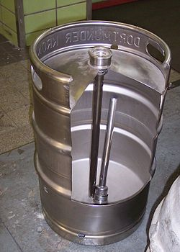

Slide 8
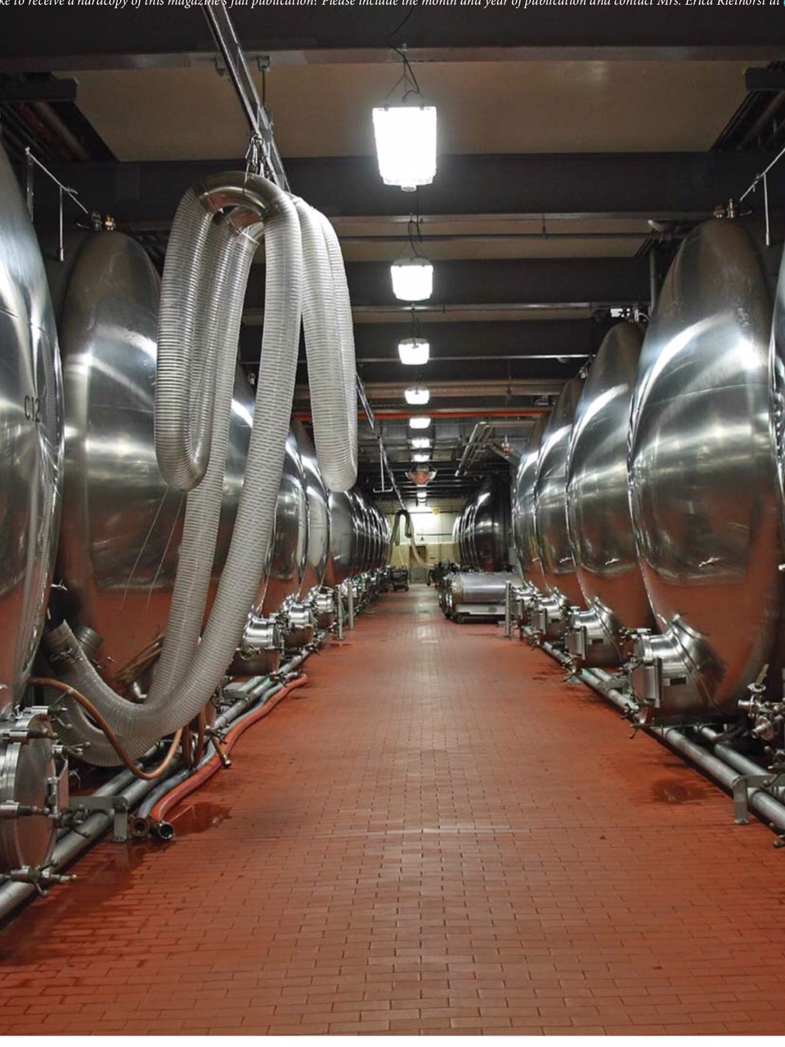

Slide 9
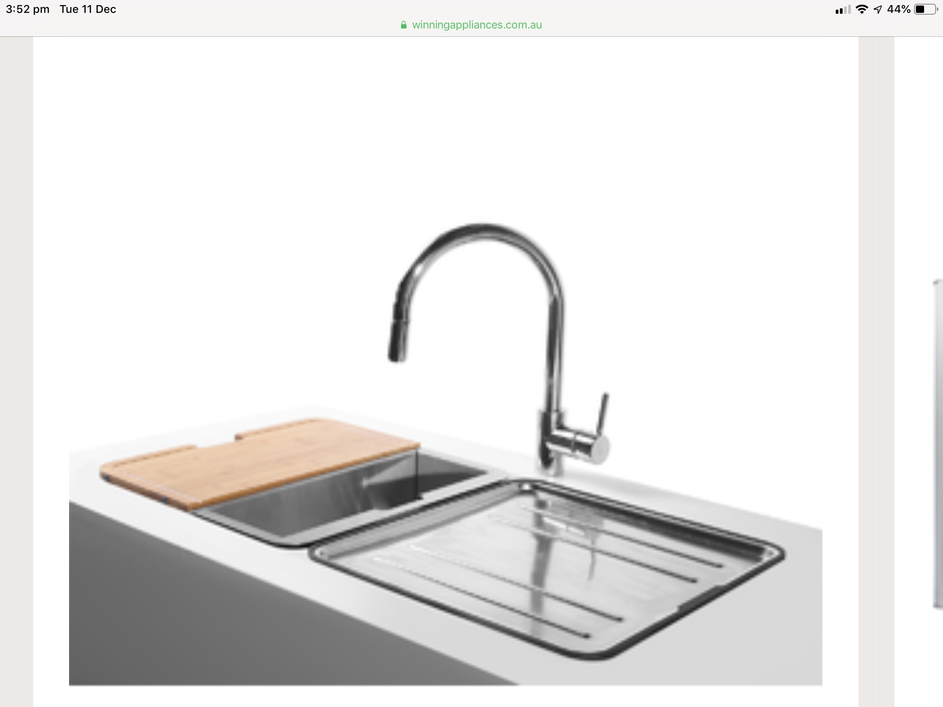

Slide 11
High quality Hume coal will be used to make high quality steel

Slide 12
45 % of Hume Coal for energy generation
Is Australia & the world transitioning away from coal?

Slide 13
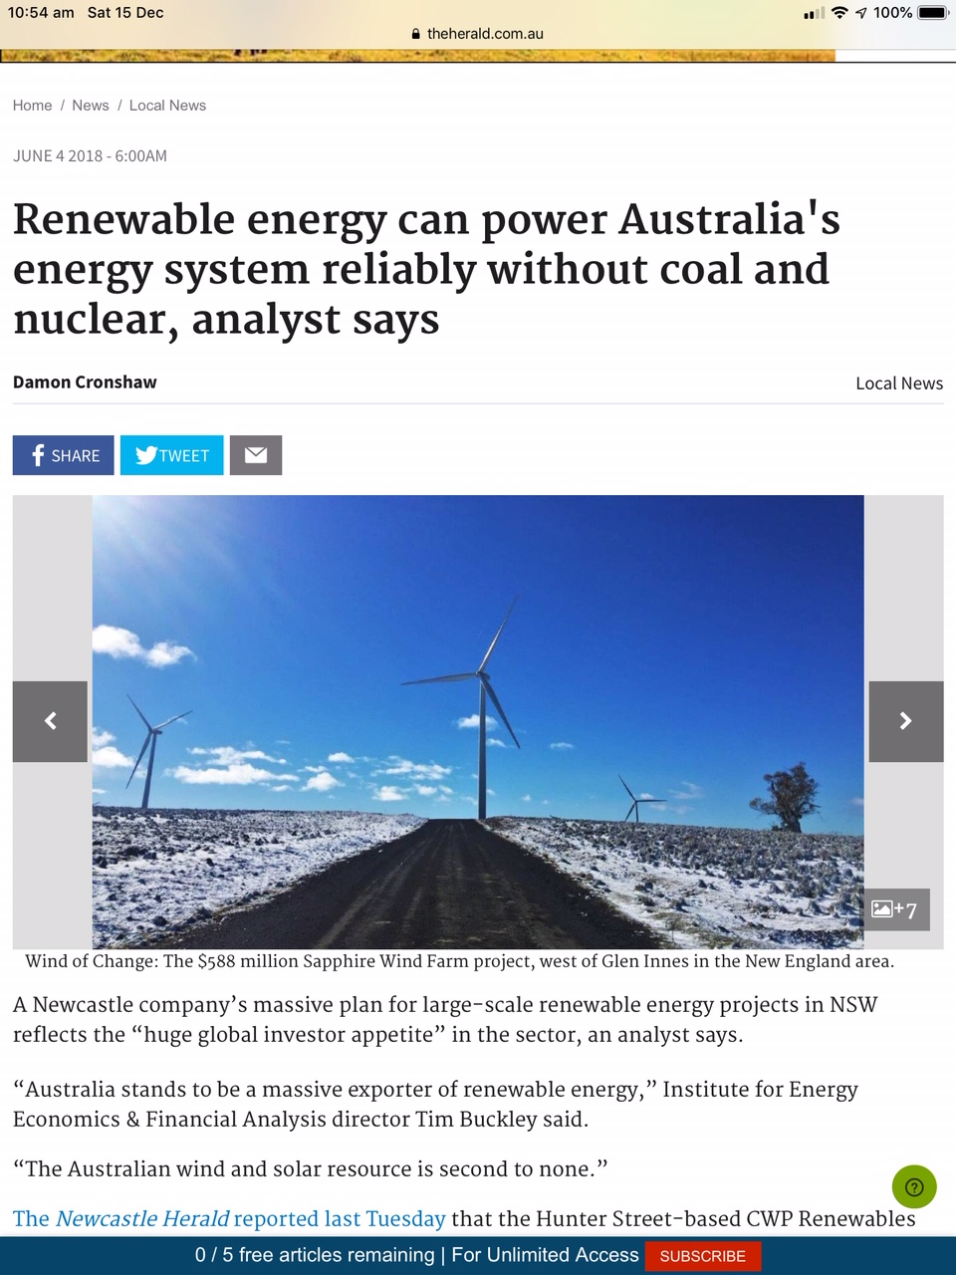

Slide 14
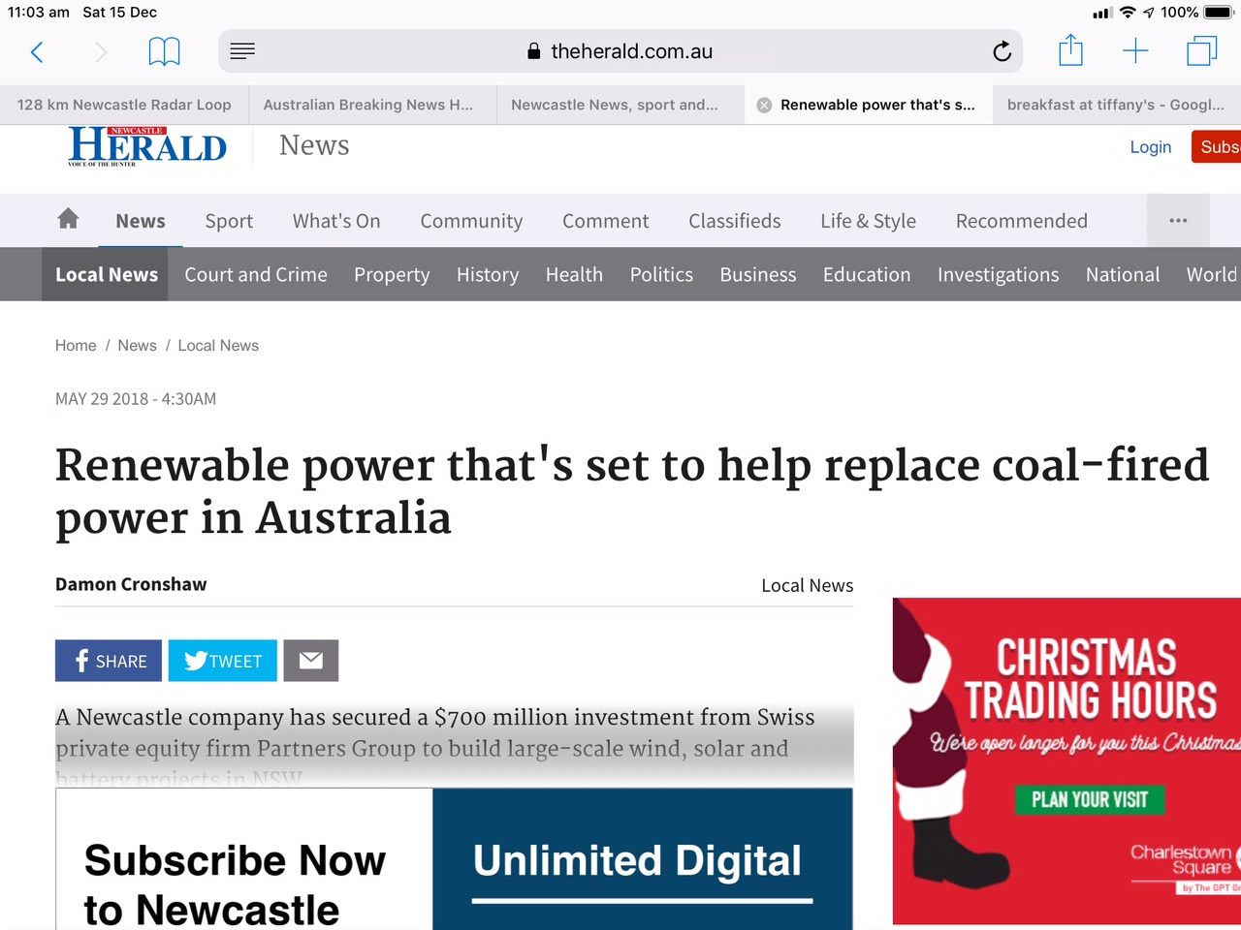

Slide 16
Australian Electricity Sources
Australia’s generation capacity (not output):-
Wind & Solar - 16,000 Megawatts (33%)
Coal & Gas - 32,000 Megawatts (67%)

Slide 17
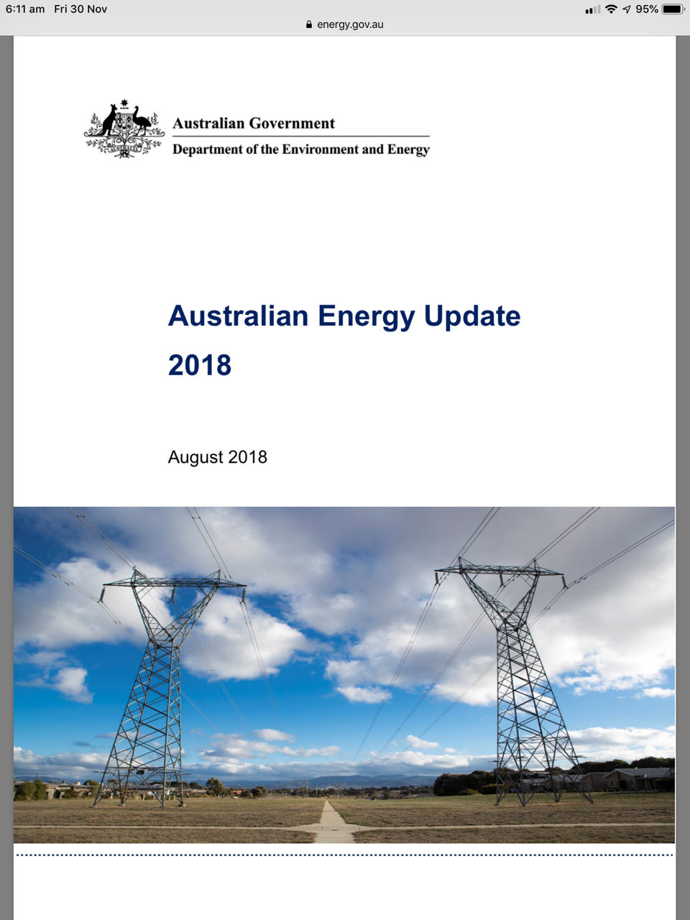

Slide 18
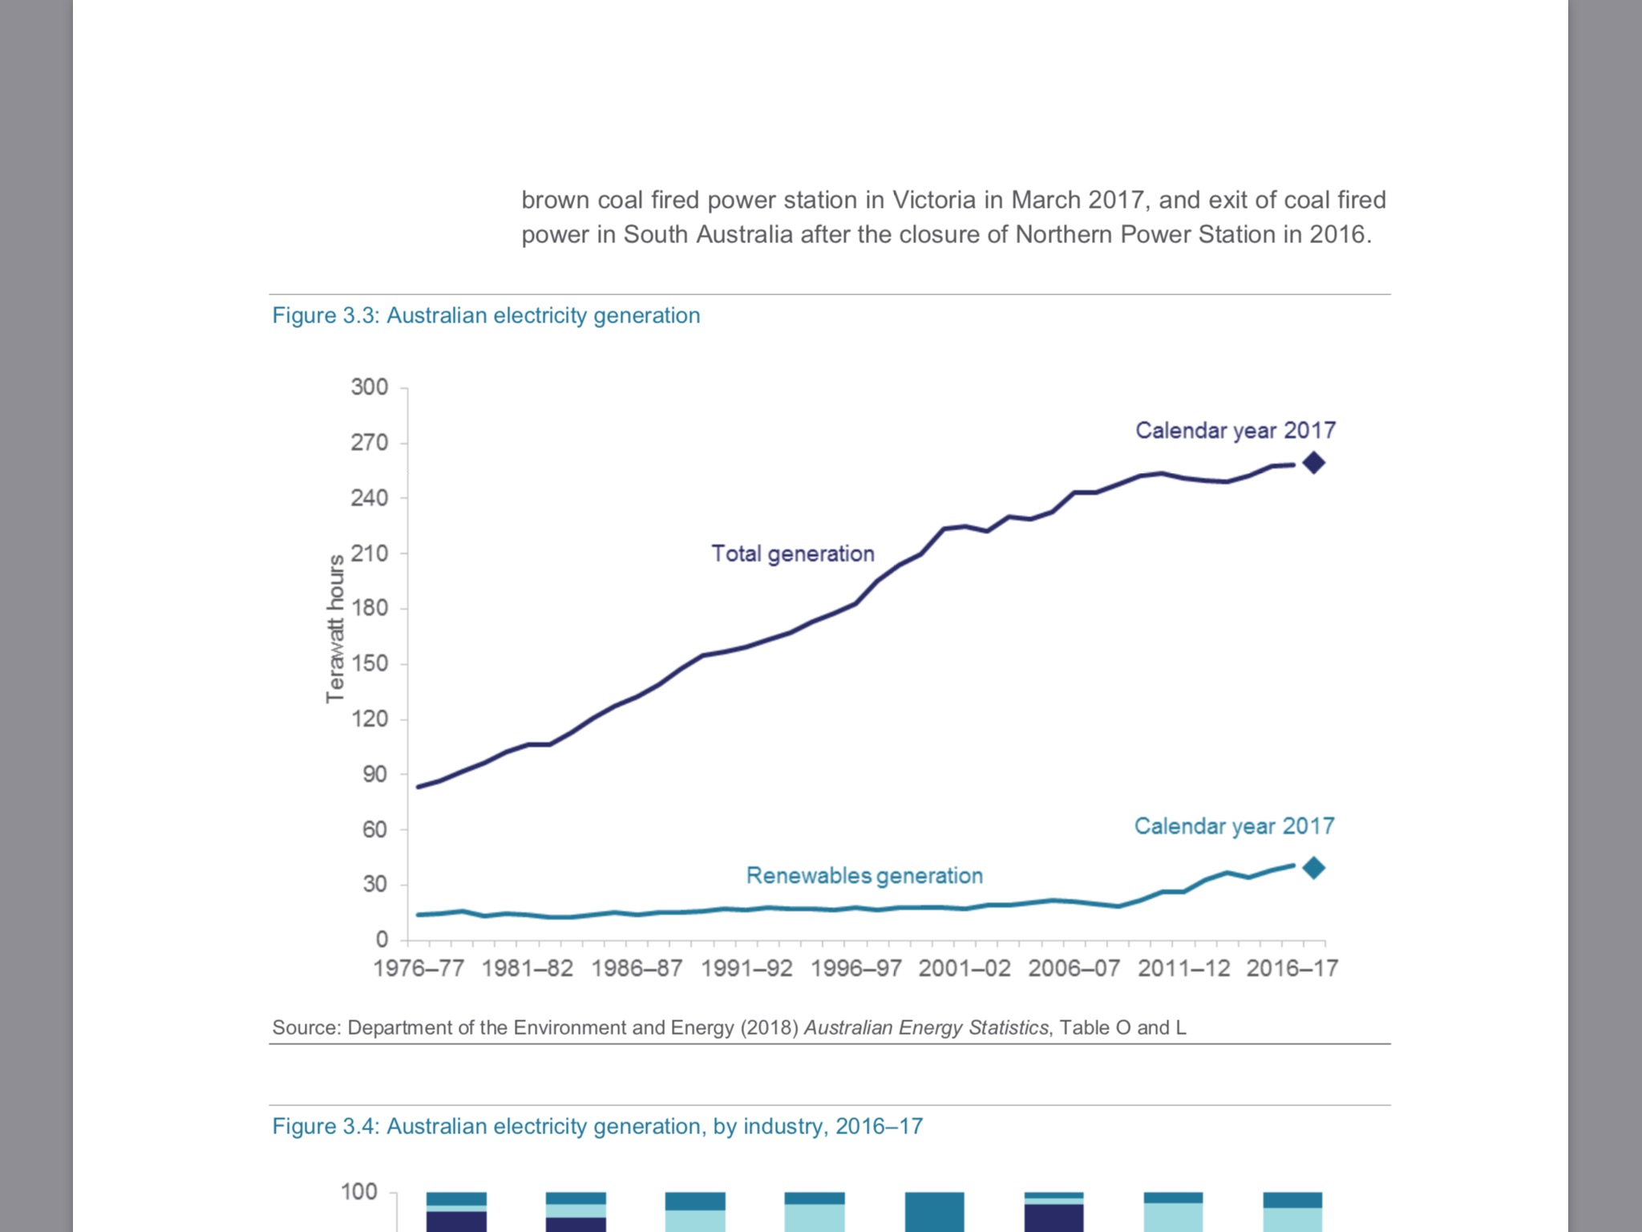
In 2017 Electricity Generation Wind & Solar made up 8%

Slide 19
The wind doesn’t always blow
The sun doesn’t always shine

Slide 20
Our existence and standard of living are totally dependent on electricity.

Slide 21
Every hour of every day Australians consume
between 20,000 and 30,000 Megawatt hours of electricity
We must have reliable power sources
Google – Live Australian Electricity Generation Statistics

Slide 22
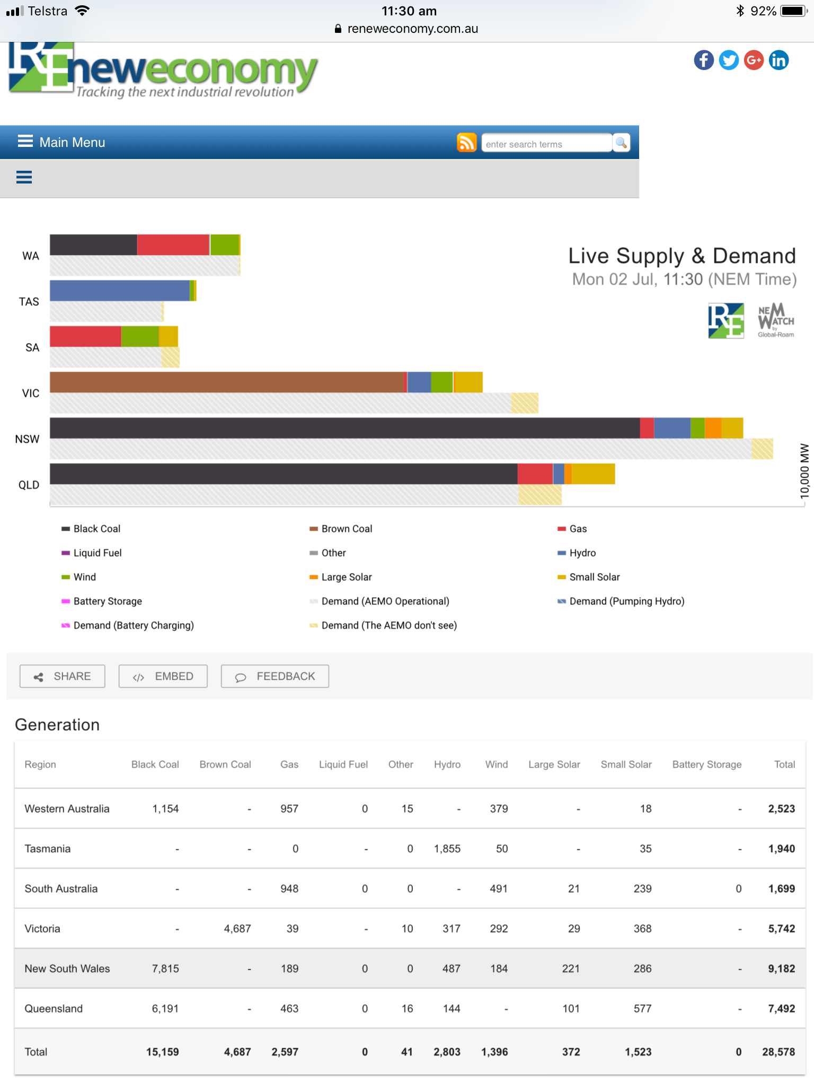
11:30am 29,000 MWh Coal & Gas 88% Wind & Solar 11% Hydro 1%

Slide 23
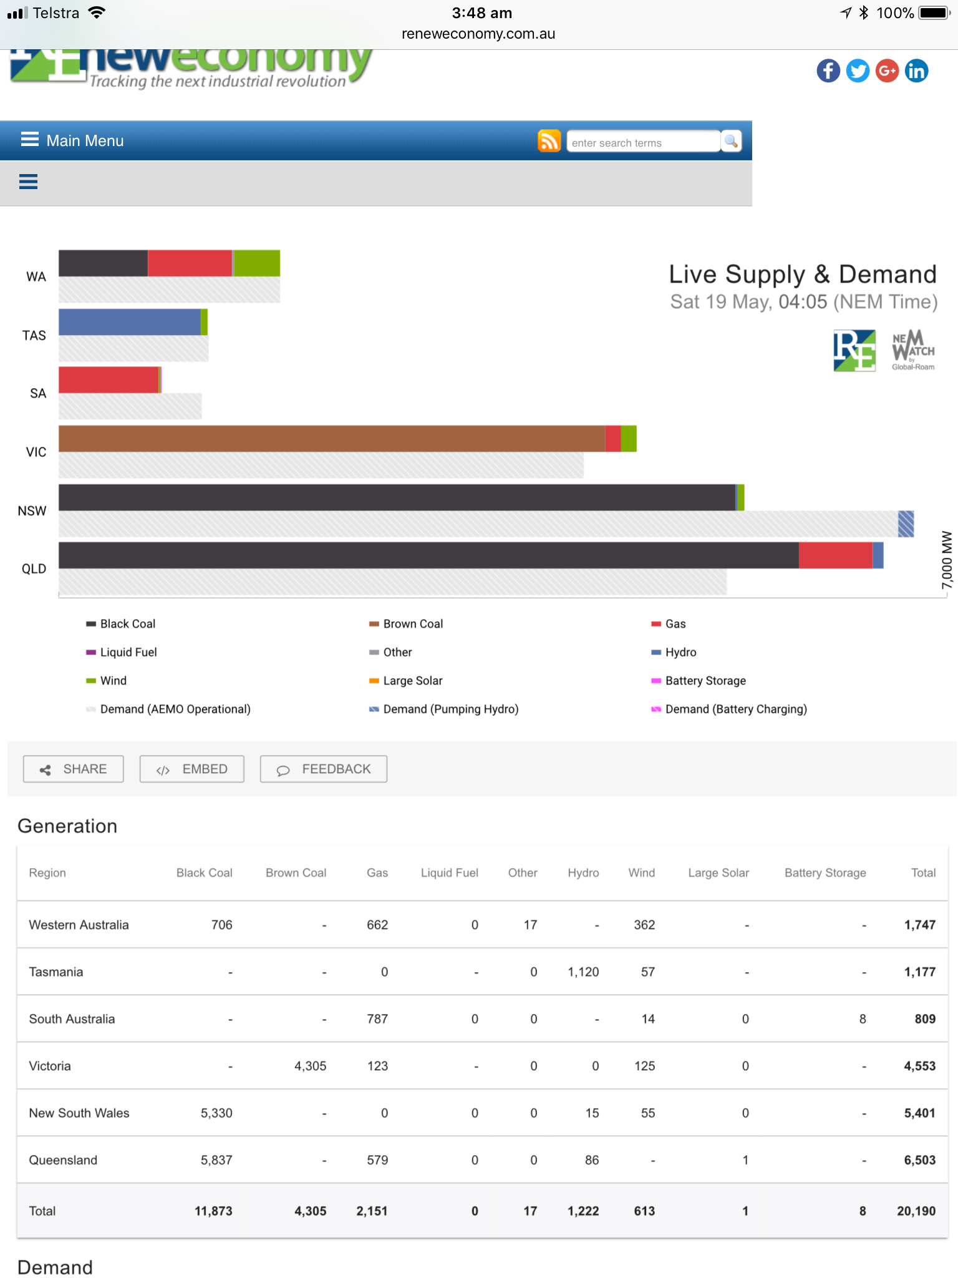
4am 20,000MWh Coal & Gas 91% Wind & Solar 3% Hydro 6%

Slide 24
What would happen in NSW if we removed coal as a
generation source?
Let’s look at South Australia – where all coal fired power stations have been shut down and they are wanting to rely on renewables

Slide 26
South Australia January 24 9pm Consuming 3000MWh Producing 2800MWh Gas 83% Diesel 14% (80,000 Litres/hour) Wind 3% Solar 0% Batteries 0% (Elon Musk’s 100MW battery would have lasted 2 minutes)

Slide 27
24 January 9pm - price of electricity per megawatt:-
NSW - $104
Queensland - $100
South Australia - $3360 – diesel is the most expensive and dirtiest form of electricity generation
And they say renewables will lead to cheaper electricity

Slide 28
Diesel generators in front of a former coal power station This could be Liddell Power Station after its closure in 3 years time

Slide 29
SA Govt website advising people how to install diesel generators for homes and businesses

Slide 30
Advising on the risk of carbon monoxide poisoning

Slide 31
Diesel generator sales are booming

Slide 32
With a moratorium on coal seam gas & with only 8% of our electricity coming from renewables
NSW’s choice is to burn coal or diesel
What would be the best choice to help Australia reduce its 1.3% contribution to global greenhouse gases

Slide 33
Unfortunately at present:
There is no such thing as reliable renewable energy and
There no such thing as totally clean reliable energy

Slide 34
COAL IS A GLOBAL ISSUE
International Energy Agency (IEA) has 30 member countries including:
Australia, France, Germany, Belgium, Canada, Finland, Greece, Hungary, Ireland, Italy, Poland, Portugal, Spain, Sweden, United Kingdom, United States, Turkey, Japan, New Zealand, Mexico, Switzerland
IEA is the world’s leading authority on energy generation and consumption

Slide 35
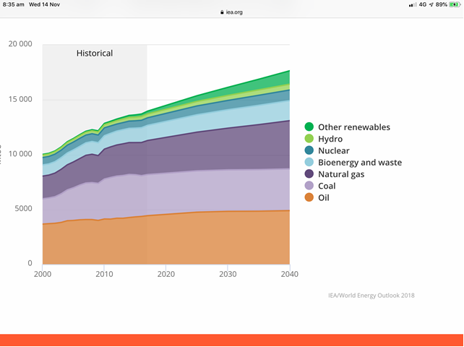
IEA’s 2018’s ALL ENERGY REPORT 2000 Fossil Fuels 79% Coal 20% Wind & Solar 1% 2018 Fossil Fuels 79% Coal 21% Wind & Solar 3% 2040 Fossil Fuels 75% Coal 22% Wind & Solar 7%

Slide 36
Global Issue
What is the rest of the world doing to ensure reliable power?
1600 coal fired power stations are being built in 62 countries including:-
Japan – 45
China – 300
India – 132
Vietnam – 23
They want Australia’s coal – Why?

Slide 37
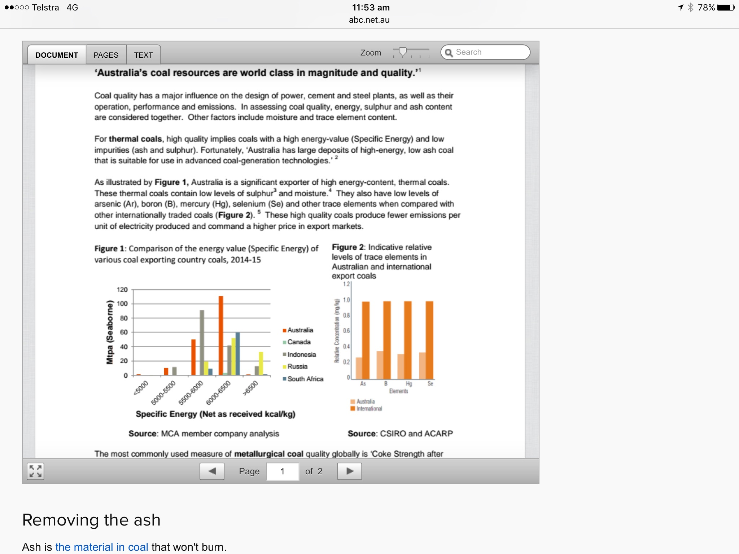
CSIRO says our coal is 5 times cleaner than the rest of the worlds Our coal has the highest energy ratio in the world

Slide 38
Global Issue
What do these modern coal fired power stations look like?

Slide 39
Isogo Power Plant Yokohama 9 years old Burns 20% less coal and emissions are 30% less than Australian power plants

Slide 40
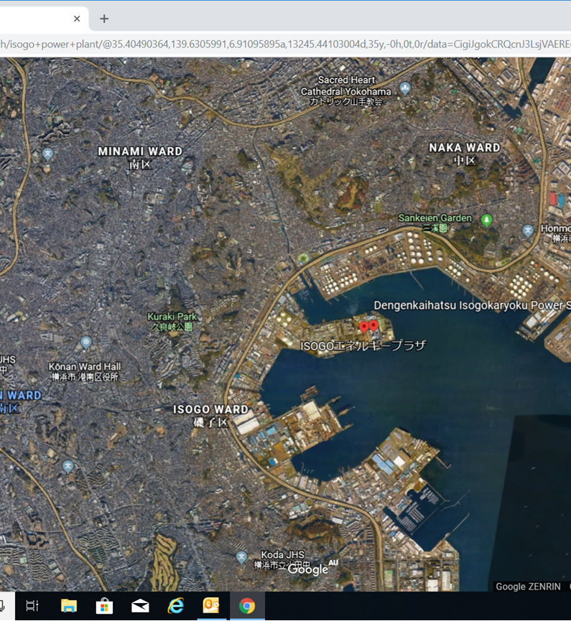
Isogo on Yokohama Bay 3.5kms from CBD

Slide 41
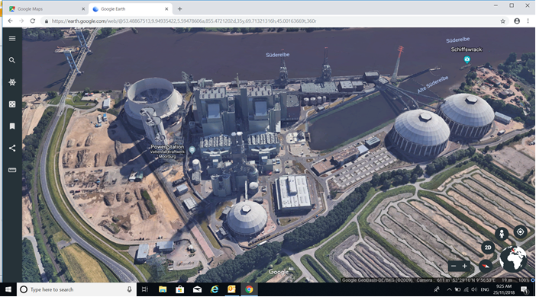
Moorburg Power Plant - Hamburg 2 years old 75% reduction in Carbon Dioxide emissions

Slide 42
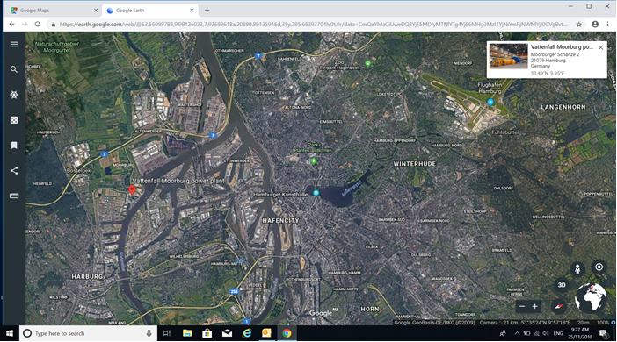
Moorburg 6.5 kms from Hamburg’s CBD

Slide 43
Global Issue
Coal is still a major global energy source
The world needs Hume’s coal otherwise the world will burn inferior coal

Slide 44
The mining of Hume coal will mean we will be able to continue to:
Drink coffee, beer & wine
And keep the lights on
Australia needs to replace its ageing coal powered stations with modern ones.

Slide 45
Thank you

