Slide 1
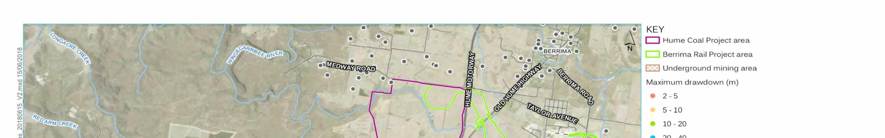
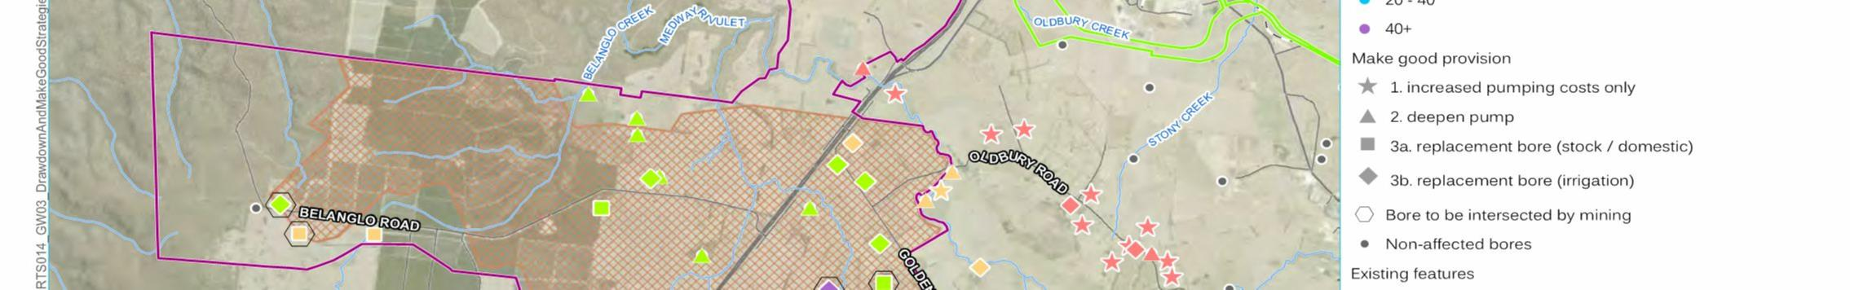
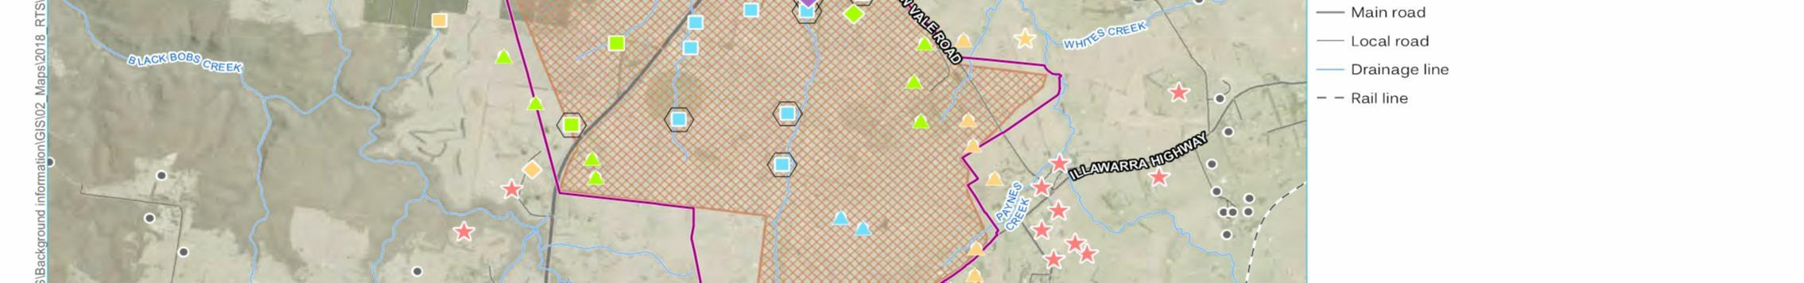
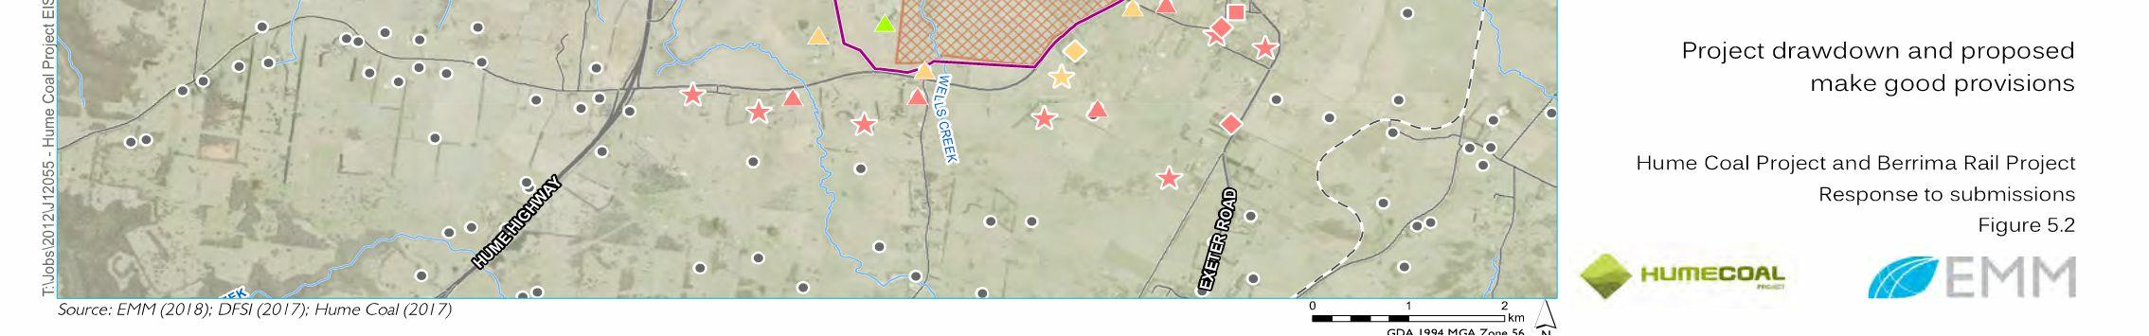

'ROSEDALE' BORE
EIS FIG 5.2
Hydroilex Pty Ltd
www.hydroilex.com.au
UTM: -
Jan-19
Drawn: RJL
Approved: RJL
Bore GW107535 - 'Rosedale', Sutton Forest
SLIDE 1
Drawdowns in Landholder Bores in Relation to Mine Footprint

Slide 2
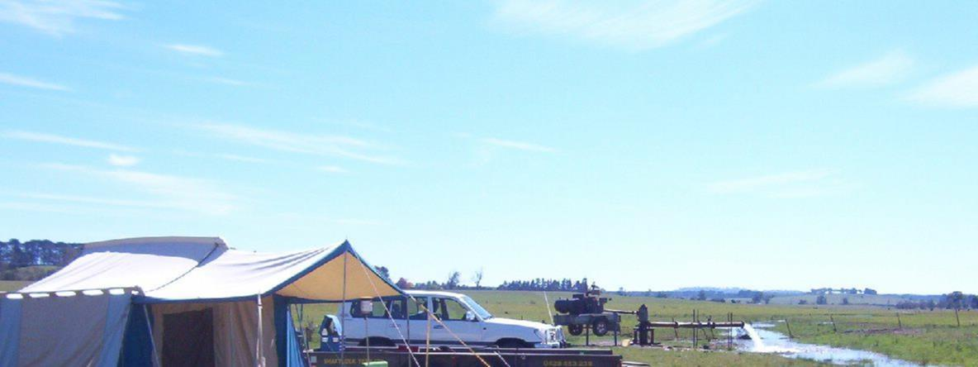
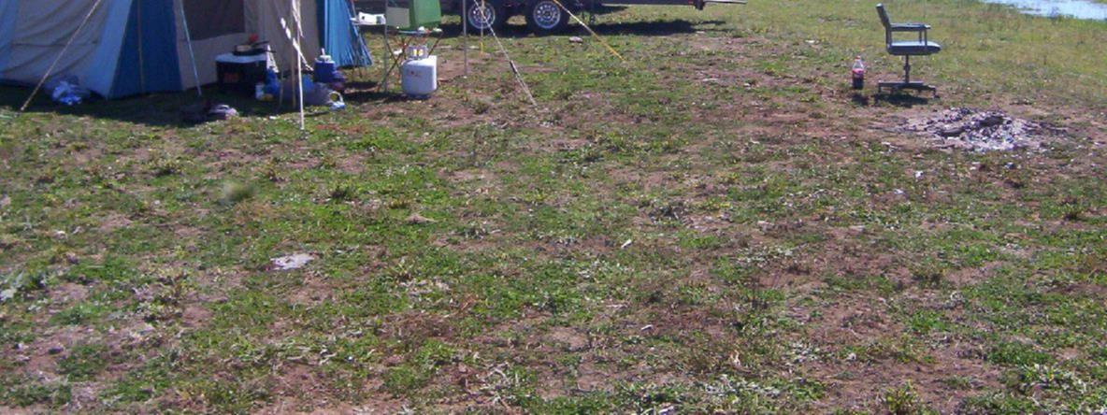
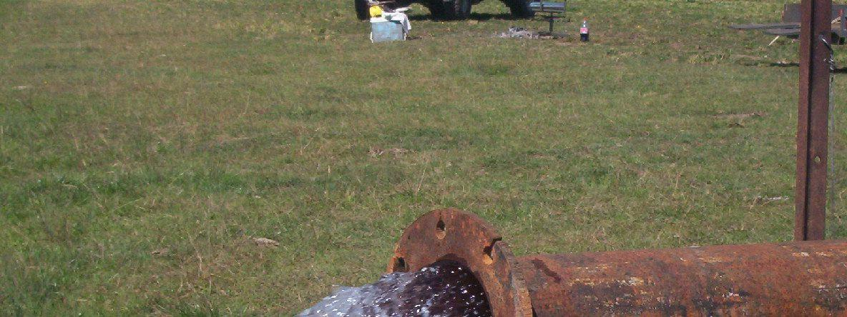
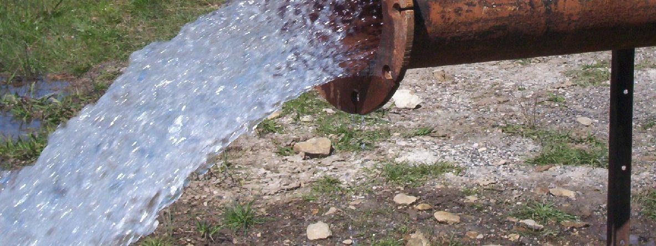

N
Hydroilex Pty Ltd
www.hydroilex.com.au
UTM: -
Jan-19
Drawn: RJL
Approved: RJL
ROSEDALE BORE
SLIDE 2
Testing at 42 L/s max pump flow May 2005

Slide 3
HYDROGEOLOGY & AQUIFER DISTRIBUTION IN ROSEDALE BORE
Depth
Yield
L/s
Stratigraphy
Groundwater
Potential
12_
_SWL
WIANNAMATTA GROUP
(SHALE)
POOR
SALINE
20_
W
28_
M
MITTAGONG FMN.
POOR
AVAILABLE DRAWDOWN
UNIT
C
UNIT
B
FAIR
50_
7
C
PUMP
62_
>50
B
Fracture
GOOD
Cavity
>30?
66%
HAWKESBURY SANDSTONE
A
Coarse
Porous
Sandstone
UNIT
A
EXCELLENT
>30?
109_
113_
NARRABEEN GROUP
ABSENT
COAL
ILLAWARRA COAL MEASURES
GOOD
Shoalhaven
Group dom. Shale
SHOALHAVEN GROUP
POOR
BARREN
TESTED @ 42 L/s - max pump flow
DRAWDOWN 8.68m
LICENSE 400 ML/annum
POT'L YIELD ~100 L/s
Note: Not to scale
Hydroilex Pty Ltd
www.hydroilex.com.au
UTM: -
Jan-19
Drawn: RJL
Approved: RJL
ROSEDALE BORE
SLIDE 3
HYDROGEOLOGY & TESTING & STRATIGRAPHY

Slide 4
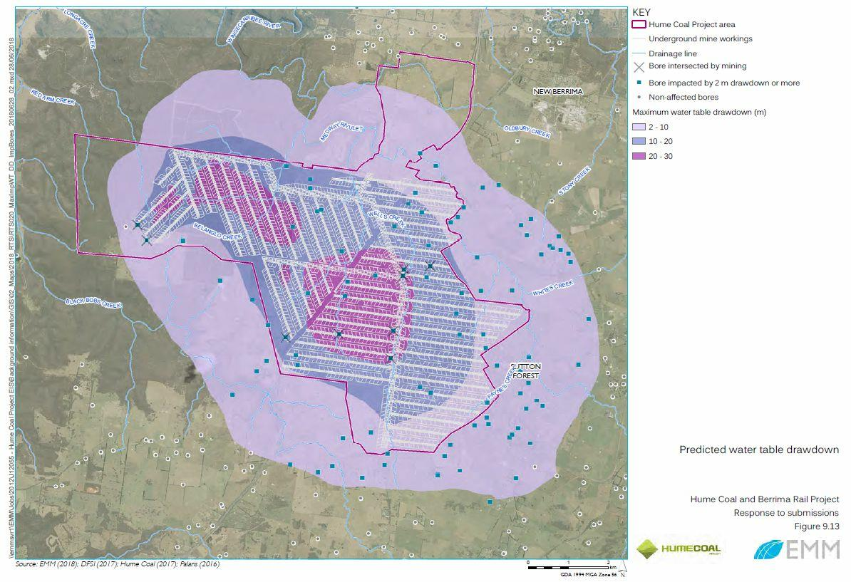
Intersected by mining
ROSEDALE BORE - TO BE
INTERSECTED BY MINING
Hydroilex Pty Ltd
www.hydroilex.com.au
UTM: -
Jan-19
Drawn: RJL
Approved: RJL
ROSEDALE BORE
SLIDE 4
Rosedale in relation to mine

Slide 5
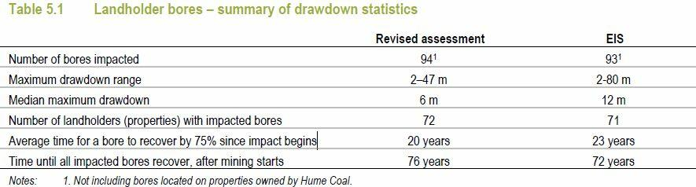
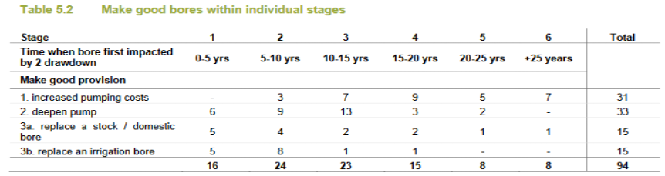
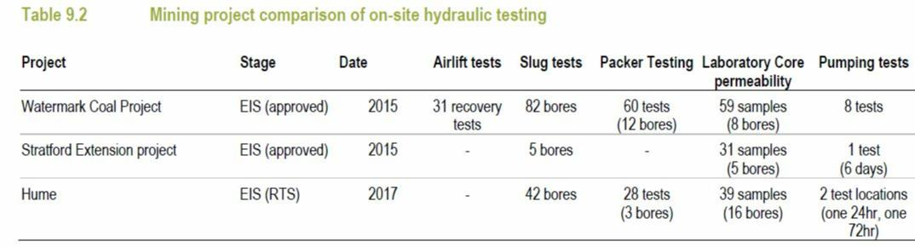
Hydroilex Pty Ltd
www.hydroilex.com.au
UTM: -
Jan-19
Drawn: RJL
Approved: RJL
ROSEDALE BORE
SLIDE 5
Summary of Impacted bores & Testing - RTS MODEL

Slide 6
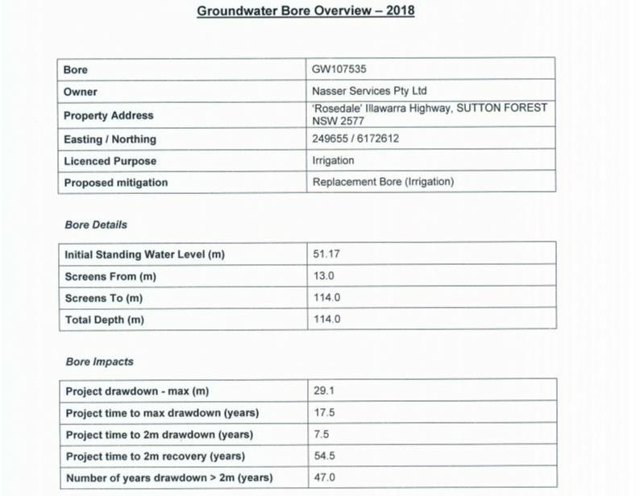
HUME COAL INFORMATION PROVIDED TO LANDHOLDER
June 2018
JUNE 2018 - RTS MODEL
MAY 2017
COFFEY MODEL
Actually 12.77m published by WaterNSW
52
40.0
58.0
Open hole 58-114
**
Is that 29.1 below 51.17 or 12.77m ??
58.6
20
13.5
** To what SWL?
52.9
39.4
N
Hydroilex Pty Ltd
www.hydroilex.com.au
UTM: -
Jan-19
Drawn: RJL
Approved: RJL
ROSEDALE BORE
SLIDE 6
Review of Hume Coal Notice Advice to Landholder

Slide 7
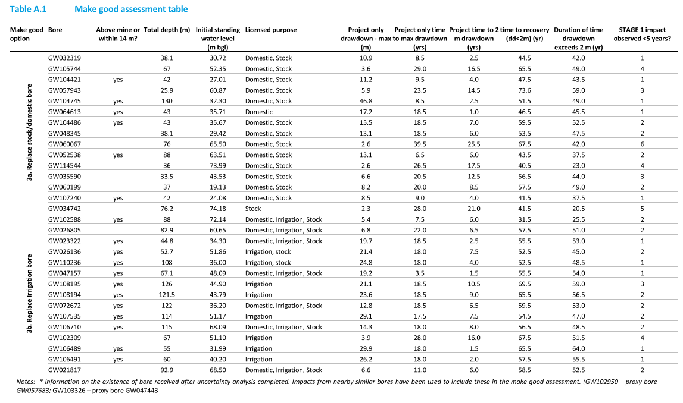
ARTIFICIAL SWL'S
GENERATED BY
HUME COAL VS RECORDED SWL
56
ND
7.6
ND
17
ND
28
24
24
12.77
35
45
5
5
54.8
DDL
80.27
ND = No Data recorded in WaterNSW database
Rosedale Bore
Comfort Hill Bore
Hydroilex Pty Ltd
www.hydroilex.com.au
UTM: -
Jan-19
Drawn: RJL
Approved: RJL
Replacement Bores
SLIDE 7
STATIC WATER LEVEL ISSUES

Slide 8
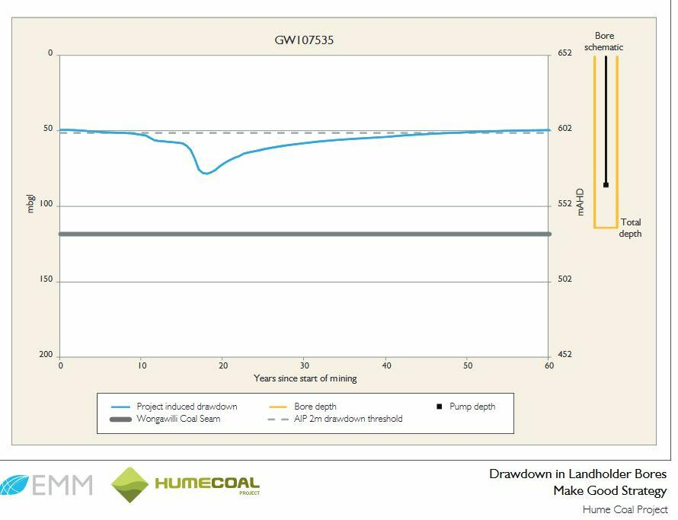
12.8
SWL - ACTUAL
29m
CURVES GENERATED IN RTS MODEL
BASED ON A COMPUTED SWL
N
Hydroilex Pty Ltd
www.hydroilex.com.au
UTM: -
Jan-19
Drawn: RJL
Approved: RJL
ROSEDALE BORE
SLIDE 8
Hume Coal Hydrograph - Rosedale Bore

Slide 9
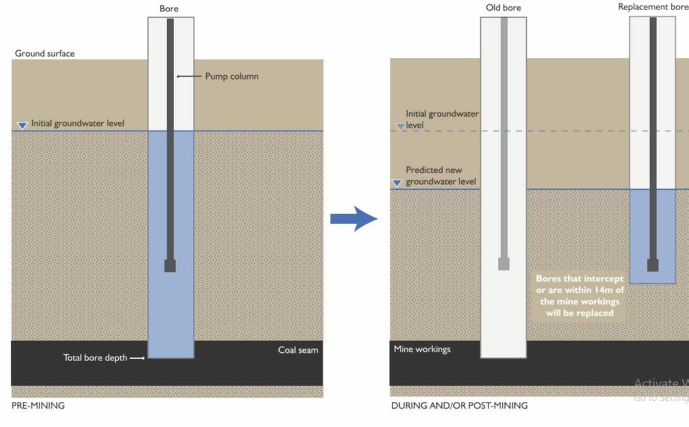

ROSEDALE BORE - PROPOSED OPTIONS - RTS MODEL 2018
Hume 9/18
' BORE FIX' ?
Yield
L/s
ACTUAL
Actual SWL
12_
_SWL
20_
W
28_
M
AVAILABLE DRAWDOWN
Hume SWL 51m
50_
7
C
PUMP
62_
>50
B
Fracture
Cavity
>30?
66%
Hume DDL
REMAINING AD
80m
A
Coarse
Porous
Sandstone
>30?
Hume- set plug here
PLUG
109_
113_
COAL
Shoalhaven
Group dom. Shale
BARREN
HUME COAL GENERIC 'MAKE GOOD' CONSTRUCTION DIAGRAM FOR REPLACEMENT BORE
The following is proposed by Hume:
1. Reduce the depth of the bore by setting a plug at the base
2. Draw the water down to below the deepest level below 80m
3. This allows only about 10m of water column
TESTED @ 42 L/s - max pump flow
DRAWDOWN 8.68m
LICENSE 400 ML/annum
POT'L YIELD ~100 L/s
UTM: -
Jan-19
Drawn: RJL
Approved: RJL
ROSEDALE BORE -' Make Good Strategy'
Hydroilex Pty Ltd
www.hydroilex.com.au
SLIDE 9
HUME COAL PROPOSED BORE REMEDIATION VS ACTUAL DATA

Slide 10
      SUMMARY OF MAIN ISSUES
Initial SWL’s are erroneous, artificially lowered to reduce apparent impacts
Initiation of AIP trigger levels are consequently false
Dewatering of WAL holder aquifer license ‘conditions of approval’ of drawdown limits are not respected, where aquifer dewatering rules are breached
Assumptions in ‘make good provisions’ are invalid:
- Pumps are usually installed at the level of the main aquifer, or shallower (not at 75% of total bore depth), but designed to provide maximum drawdown, sufficient pump submergence, and effective cooling, with minimal cascading water;
  - If only 20% of the hydraulic head is remained after lowering of the water table, then aquifer loss and reduced ‘available drawdown’ will vary the viability, depending on the discharge rate;
  Deepening a bore will unlikely increase the yield, unless the bore is initially shallow;
  Bore deepening into the Shoalhaven Group is not feasible;
  Relocating a bore does not necessarily replicate the same yields;
All bores to be modified or replaced need WaterNSW approvals, which may also affect setbacks;
Aquifer depletion, cementation, and cascading water induces bore plugging, cementation, iron precipitation and leakage of inferior water;
Cost of deepening, disruptions to supplies, changes in pump ratings, power supply, infrastructure and associated management of 94 sites is a horrendous burden & intrusion on the users; SLIDE 10

