Slide 1
HUME AND BERRIMA RAIL SSD PROJECTS
Ian Wiskin

Slide 2
Why am I here?
Ian Wiskin
Local resident and part time adviser to POSCO/Hume Coal.
Strategic adviser and advocate for significant job creation projects – in the resources, energy (current & future), recycling, manufacturing, water/agribusiness and defence industries
Experience with large scale irrigation, agribusiness and CSG projects, water model analysis, water trading and compensatory water (‘make good’) agreements.
I speak for those not in this room today – the ‘Forgotten Employed’ – over 600 applicants for Hume positions.
The comments in this presentation are my own, based on a review of the available evidence, and not necessarily those of Hume Coal.
POSCO is the largest non-government purchaser of Australia’s exports – some $7 billion per annum. I am pleased to support a business that underpins our economic choices.

Slide 3
Social Licence: Environmental Approval is balancing costs/benefits, weighing competing interests for the community as a whole
Social Licence is not the sole preserve of he ‘loud and the noisy’.
Some say, that if landowners object to and refuse access to land for a development, then planning approvals should be refused by government.
If landholder opposition, or ‘noisy’ objections, were the threshold test for approval, the following SSD projects in NSW would not exist:
Nth Parkes Gold Mine - Parkes
Cadia/Ridgeway Gold Complex – Orange
Lake Cowel Gold Mine (West Wyalong)
Visy Pulp & Paper Mill – Tumut
Bengalla Mining Complex – Hunter Valley
Mt Arthur Mine – Hunter Valley
Mandalong Mine – Hunter Valley
Austar Mine – Cessnock
Moolarben (Stage2 ) Mudgee
Also applies to government projects: WestConnex, Light Rail, Sydney Gateway and the M12 motorway.

Slide 4
Balanced Assessment
Planning Authorities have a responsibility to make a balanced assessment.
Apply the law, including by the EP&A Act and the Mining SEPP 2007, requiring consideration of:
Proper resource management, promoting social and economic welfare;
comparing existing land uses, compatibility and relative public benefits; and
resource significance, environmental mitigation, emission profile, resource recovery, transport and rehabilitation.
DPE Assessment Report was unhelpful in assessing the project against the Mining SEPP criteria.
Clause 4.15 of the EP&A Act also requires consideration of any VPA offer(Lodged with DPE - 6 Sept 2017)

Slide 5
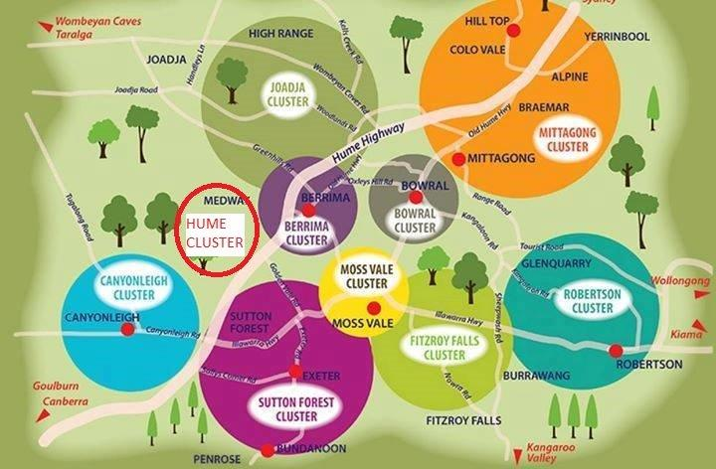
Existing Land Use Compatibility
Project area land use is very restricted to agricultural pursuits, lifestyle properties and small scale farm stays.
Many proposed activities, such as ‘clusters’ for agritourism, artisan food/produce, on site cafes/ restaurants, roadside stalls etc are prohibited.
43% of Wingecarribee LGA zoned E3.
Hume is equally affected by E3 zoning and requires use of Clause 7 of Mining SEPP.

Slide 6
DPE Assessment Report
DPE ‘cherry picked’ submissions, and expert evidence, to fit a predetermined narrative.
DPE equated ‘political interest’ with ‘public interest’.
DPE failed to deal adequately with differences of expert opinion (including interest groups) – mine design and water.
DPE was misleading in its use of the term ‘high risk activity’.
DPE misunderstood proven mine use technology to improve safety and minimise risk (human and environment).
DPE misused the ‘Precautionary Principle’ in a totally inappropriate manner.
DPE downplayed the economic significance of the project.

Slide 7
Economic Contribution (Discounted)
Discounted Cost- Benefits
 | DIRECT | INDIRECT | TOTAL
Net Benefit to NSW (NPV) | $373 m | $119 m | $492 m
Local Area Benefits (NPV) | $107 m | $54 m | $162 m
Royalties to NSW (NPV) |  |  | $132 m

Slide 8
Economic Contribution (UnDiscounted)
 | TOTAL OVER PROJECT LIFE (Construction + Operation) | TYPICAL YEAR BENEFITS (Post Ramp up)
Initial Capital | $650 million (Hume +Berrima Rail)
Total Operating Expenditure | $2.89 billion | $104 million/annum
Royalties | $345 million | $18 million av/annum
Wages/Salaries | $764 million | $ 32 million av/annum (24 Years) ($46m/annum during mine operation alone)
Undiscounted (Cash) Benefits A$2018 adjusted
Includes payroll/land taxes and Wingecarribee Shire rates ($1million)

Slide 9
Economic Contribution to NSW Revenue
The Hume Coal, if approved, will be the largest contributor to NSW government revenue of any local business, and possibly more than all other businesses in the Wingecarribee Shire combined.

Slide 10
Why did DPE get it wrong?
Inappropriate use of NSW Treasury Cost-Benefit Guidelines
“The purpose of this Treasury policy and guidelines paper is to provide guidance and promote a consistent approach to appraisal and evaluation of public projects, programs and policies across the NSW Government”. Public projects regard labour as a 100% cost to the taxpayer.
DPE Assertion:
“employment benefits and associated tax benefits….should not be included in the cost-benefit analysis. This is based on NSW Treasury Guidelines…..that labour should be considered a cost rather than a benefit”. (DPE Assessment Report p.35)

Slide 11
Why did DPE get it wrong?
DPE downgraded the NPV economic contribution from $373m to $127m on a false premise or a lack of understanding of the Treasury Guidelines.
By dismissing $764 million in wages for a private sector regional project as not being a benefit is arrant nonsense and economic lunacy.
DPE Assertion:
“employment benefits and associated tax benefits….should not be included in the cost-benefit analysis. This is based on NSW Treasury Guidelines…..that labour should be considered a cost rather than a benefit”. (DPE Assessment Report p.35)

Slide 12
Its all about the wages paid!
ABS average weekly earnings show mining average weekly pay of $2765 ($60.60 per hour)
Australia’s lowest-paid industry was accommodation and food services, just over $616 a week ($25.90 per hour).
Hume wages will be over 4X the Wingecarribee median employee income.
Statistical Area (SA3 level) | Median Total Employee Income
Southern Highlands (Wingecarribee) | $44,250
Wollondilly | $52,092
Goulburn/Mulwarree | $46,597

Slide 13
Strategic Significance of Hume Resource
DPE wrong and misleading about the Southern Coalfield.
Coal Production for the Southern Coalfield
DPE Assertion:
“The department does not consider that there is any existing shortage of coking and thermal coal that needs to be filled. The Southern Coalfield already produces up to 15 million tonnes of coking coal per year……” DPE Assessment Report p.35
Calendar Year | Saleable Coal (MT) | Raw Coal (MT)
CY2016 | 11.7 | 14.7
CY2018 | 7.9 | 9.8
Tonnage Reduction | 3.8 | 4.9

Slide 14
Strategic Significance of Hume Resource
ACCC says Southern Coalfield is its own market for competition reasons and essential for Australian steel making.
Imported coal (Qld) imposes significant additional costs to steel producers.
Lack of new entrants (environmental restrictions) reduces competitiveness.
Domestic user interest to acquire Hume product.
If exported, all Hume coal suitable for blending in POSCO FINEX steel process – reduced emissions C0², NOX and SOX. (endorsed by Institute for Energy Economics and Financial Analysis).

Slide 15
Elephant in the Room: WATER
Disconnect between DPE water expert report and DPE Assessment Report.
Failure to provide DPE expert groundwater report to DI Water – inexcusable.
Difference between depressurisation and desaturation. – ‘no plug in the bathtub’.
No shortage of groundwater in the Nepean groundwater source – 76% of sustainable yield unassigned.
93% licence acquisition by Hume – despite CFSH and DI Water claims. Willing sellers.
Local irrigation bores are not metered or part of the governments real time monitoring – Hume no threat to water availability or the groundwater system.
No impact on yield or quality of inflows to SWC.

Slide 16
Nepean Gnd Water Source Sustainable Yield (Long Term Average Annual Extraction Limit - LTAAEL)
The NSW Government provides 99.5GL for extraction and use (Sustainable Yield). Of that:
76 percent ‘unassigned’ – 75 GL
0.01% (11ML) to Local Water Utilities (not used)
<6 percent allocated for basic landholder rights (stock/domestic)
25 percent (25GL/year) allocated to tradable access licences (12 GL in Zone 1)
HUME COAL REQUIRES JUST OVER 2GL OF LICENCES IN ZONE 1 (16%) TO MEET ITS MAXIMUM AIP REQUIREMENTS IN YEAR 17
93% OF ALL LICENCES ALREADY OBTAINED FROM THE OPEN MARKET.

Slide 17
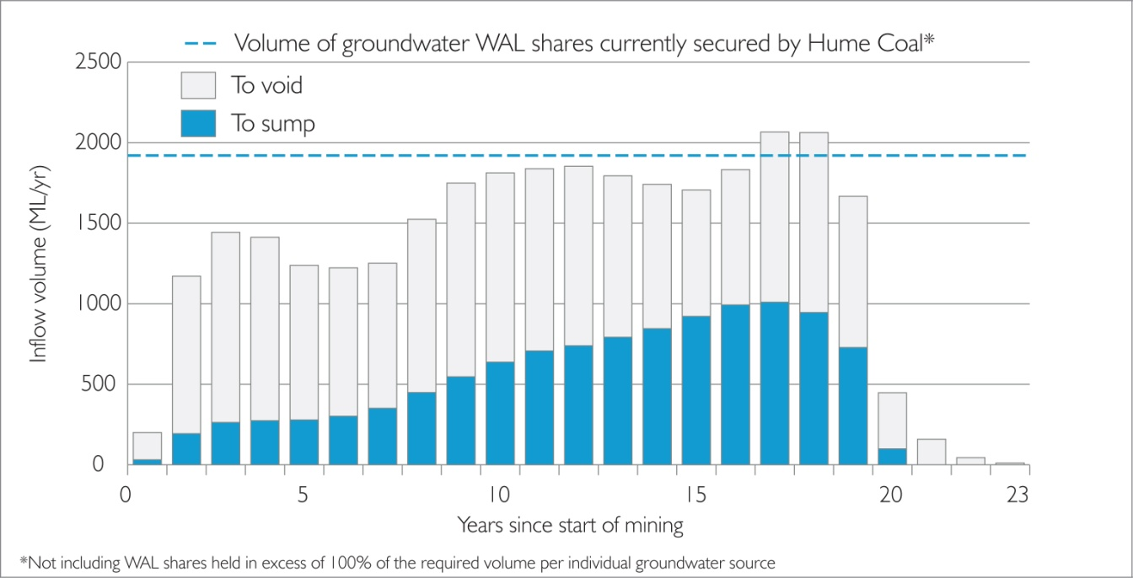
Understanding the Groundwater Issue
Expected Inflow Volumes to sealed panels (void) and active mine workings (sump) over mine life
Contrast Mining water v Agricultural water

Slide 18
Understanding the Groundwater Issue
Depressurisation causing ‘drawdown’

Slide 19
Make Good Arrangements
Many mine approvals have been granted with ‘compensatory water conditions – ‘Make Good’.
No record of DPE being involved in dispute adjudication between landholders and companies. Therefore no problem.
Similar Make Good policy framework can be applied to that of noise and dust mitigation measures. These are opt in measures that are offered and actioned upon voluntary request . No Opt In - No Dispute. (See Submission Attachment A)
The influence of the Hume project on water bores is temporary, reversible and occurs at different times for different landholders throughout the life of the mine.

Slide 20
Make Good Arrangements

Slide 21
Make Good Arrangements
SCHEDULING
STAGES | 1 | 2 | 3 | 4 | 5 | 6 | Total
Time when bore first impacted by 2 drawdown (years) | 0-5 | 5-10 | 10-15 | 15-20 | 20-25 | +25
Make Good good provision
Increased pumping costs | - | 3 | 7 | 9 | 5 | 7 | 31
Deepen pump | 6 | 9 | 13 | 3 | 2 | - | 33
Replace a stock or domestic bore | 5 | 4 | 2 | 2 | 1 | 1 | 15
Replace an irrigation bore | 5 | 8 | 1 | 1 | - | - | 15
 | 16 | 24 | 23 | 15 | 8 | 8 | 94

Slide 22
Rehabilitation: Underground Water Storage
FINAL REHABILITATION – MAJOR PUBLIC BENEFIT
After mining (20 years) there is sufficient void space for 20GL of stored water.
UG storage volume is equivalent to 80% of current capacity of Wingecarribee Reservoir (9GL lost in 1998 swamp slump).
UG storage would be equal to one-fifth of annual evaporation losses from Sydney water storages (100GL annually).
Cost of an above ground 20GL storage is estimated at $200- $300 million (even if land is available).
Hume will hold 2GL of annual water extraction licences – a mechanism to provide emergency water supply groundwater recovery, without impacting on existing users

Slide 23
CONCLUSION
The Hume Coal project is the most benign of any resource project to which I have been associated, both in terms of balancing the extraction of coal for the benefit of the State and dependent industries, against impacts on environmental assets and directly impacted communities.
Given the level of impact mitigation undertaken within the project design and inherent environmental protections, I support the project being approved, with appropriate conditions, to minimise “the likely impacts of that development, including environmental impacts on both the natural and built environments, and social and economic impacts in the locality” and is in the public interest.

