Slide 1
Hume Coal & Berrima Rail Projects
NSW Independent Planning Commission
Public Hearing
26 February 2019

Slide 2
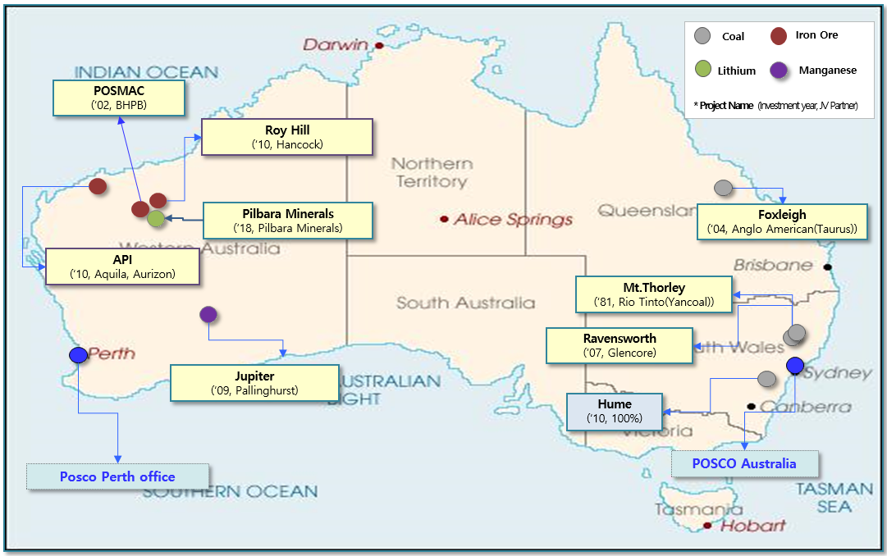
POSCO in Australia
Since 1981
Joint Ventures: 9
Invested more than $5bn by end of 2018.
Purchase $7bn of Raw materials p.a
Purchase about $500m of coal from NSW p.a.

Slide 3
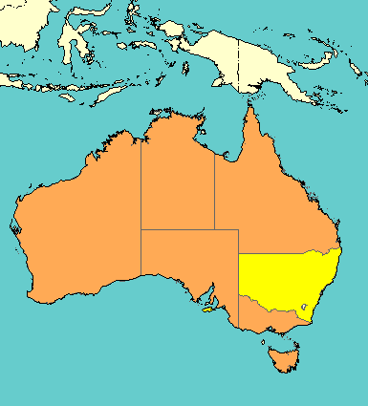
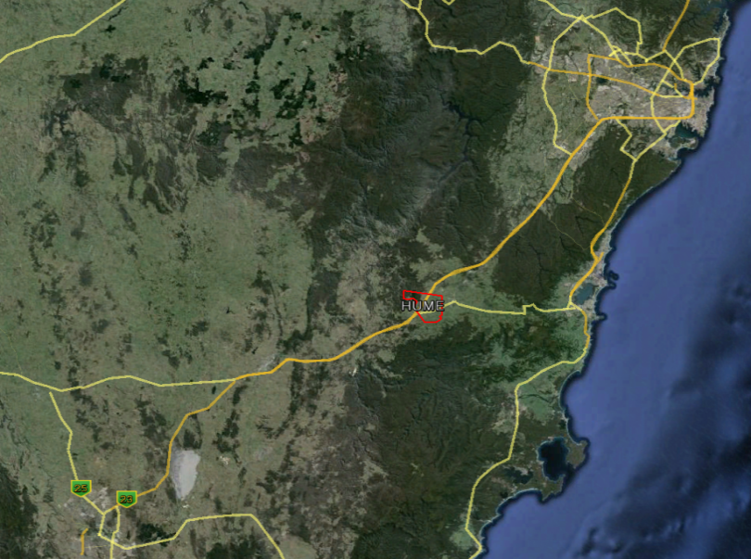
POSCO–Hume Coal Project
Acquired as part of a JV in 2010
Acquired 100% in 2013
Will have invested more than $200m by end of 2019
WA
QL
NSW
Sydney
160KM
HUME
Coal Project
65KM
Port Kembla
Canberra

Slide 4
Project Description - Hume Coal Project
  Low impact underground coal mine:
    50Mt ROM coal from the Wongawilli Seam
    39Mt of saleable coal over 23yr mine life
    55% metallurgical & 45% thermal coal
    Nominal 3Mtpa coal for sale
    $373m NPV of Direct benefits to NSW
    $161m NPV of benefits to local area
    400 construction jobs, 300 operational jobs
    600 individuals and business registered expression of interest

Slide 5
Project Description - Berrima Rail Project
  A new 1km rail spur and loop connecting to existing rail infrastructure:
Coal will be railed to Port Kembla
Up to 4Mtpa of rail capacity is available
Port Capacity 18Mtpa, 13.3Mtpa unused
Up to 5 train movements per day (3Mtpa)
Covered coal wagons will be utilised

Slide 6
Project History
1985
Exploration Licences consolidated into current title
2010
Hume Coal acquires the Exploration Lease
2011
Exploration & Environmental baseline studies commence
2015
PEA lodged with DP&E
March 2017
Development application lodged
December 2018
DP&E Issue PAR
IPC Referral
1956
Exploration Leases Awarded
Commercial in confidence

Slide 7
Project Location
Rail links to the Port Kembla Coal Terminal, currently an under-utilised asset that is ready to accept coal from the Hume Coal Project.
Close to the Moss Vale Enterprise Corridor, an area established by the local council to encourage an increase in industrial and employment generating land uses in the area.
The surface infrastructure area situated on predominantly cleared land to avoid sensitive environmental features, and is in an area with limited neighbouring sensitive receivers.
Due to the underground, non-caving nature of the mine, existing land uses will continue across 98% of the project area, without impacts from mine-induced subsidence.
Commercial in confidence

Slide 8
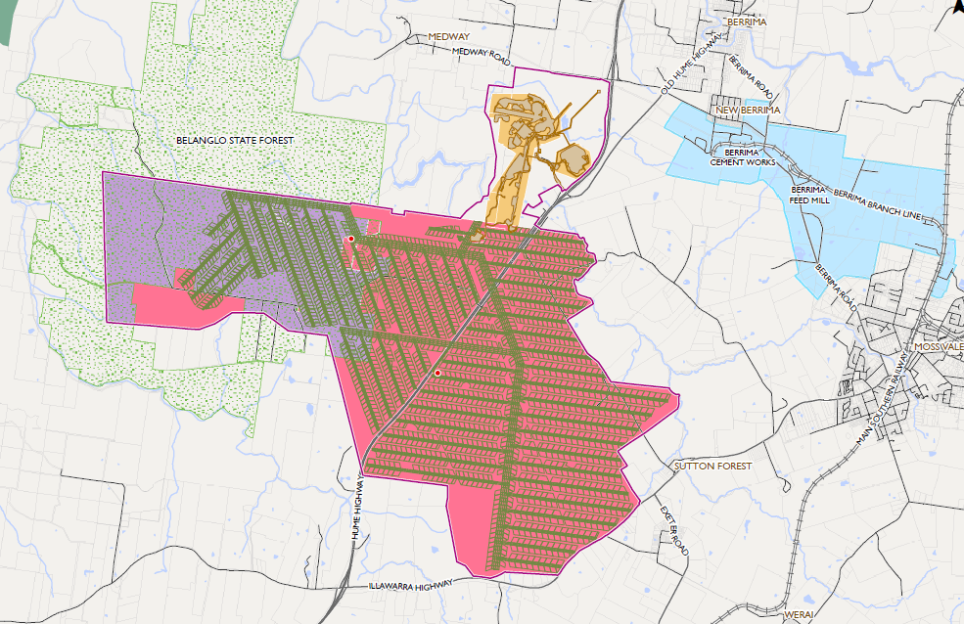
Project Layout

Slide 9
Best Practice Impact Mitigation
The project’s design includes features that exceed the normal practices used in Australian coal mines and go beyond minimum regulatory standards, particularly:
A low impact underground coal mine resulting in negligible subsidence which greatly reduces surface and groundwater impacts
Sealing panels with bulkheads after extraction and reject backfilling, which allows the early recovery of groundwater levels.
Rejects will be placed underground, removing the need for a permanent surface emplacement.
Full and empty coal wagons travelling to and from the mine will be covered.
Commercial in confidence

Slide 10
DP&E Assessment
DP&E assessed the potential impacts including:
  Noise & Vibration
  Air Quality & Greenhouse Gas Emissions
  Traffic
  Biodiversity
  Heritage
  Agriculture
  Rehabilitation
  DP&E concluded that “these potential impacts would be similar to, or less than, other approved underground mining projects. The Department accepts that these potential impacts are likely to be able to be managed, mitigated or offset to achieve an acceptable level of environmental performance”

Slide 11
Community
31% of the individual community submissions were in support of the projects, and 69% objected
The majority of the individual community submissions from the Wingecarribee LGA opposed the project
Majority of submissions from the LGAs of Wollongong, Shellharbour, Kiama, Goulburn-Mulwaree and Wollondilly support the project
Vast majority of objections were in ‘form letter’ format (92%)
~40% of form letters came from Sydney

Slide 12
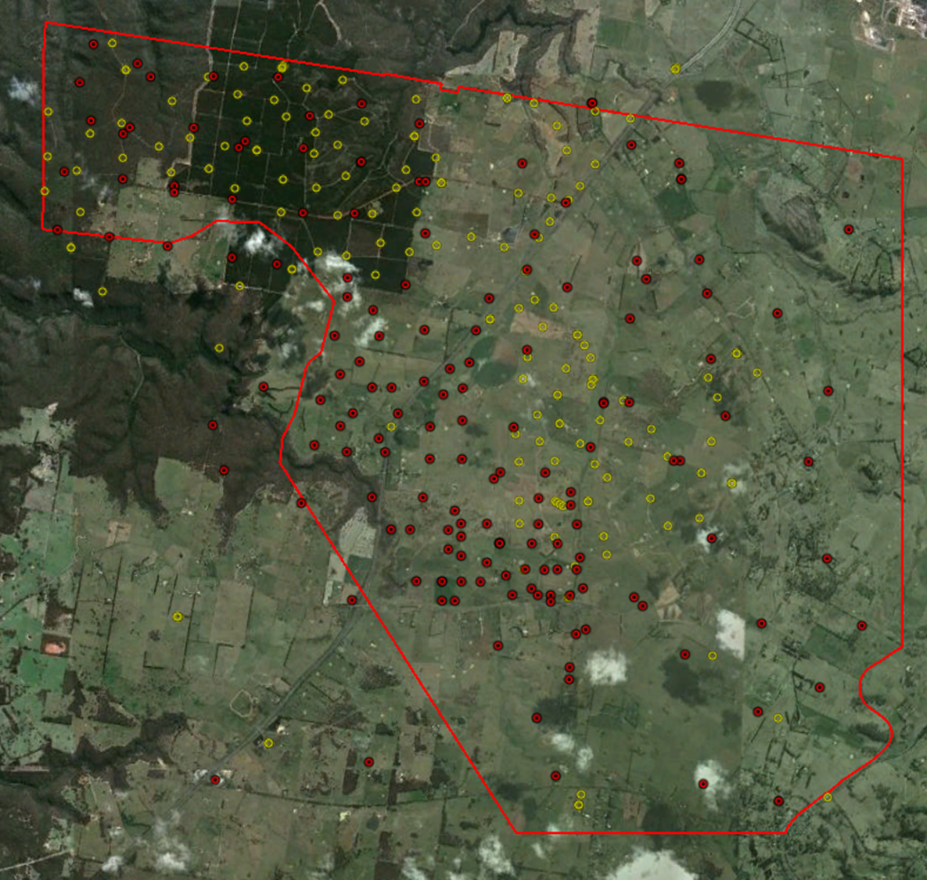
Mine Design- Exploration
345 holes in EL Area
179 in Mine Area
EL Area 89km²
MLA area 35km²

Slide 13
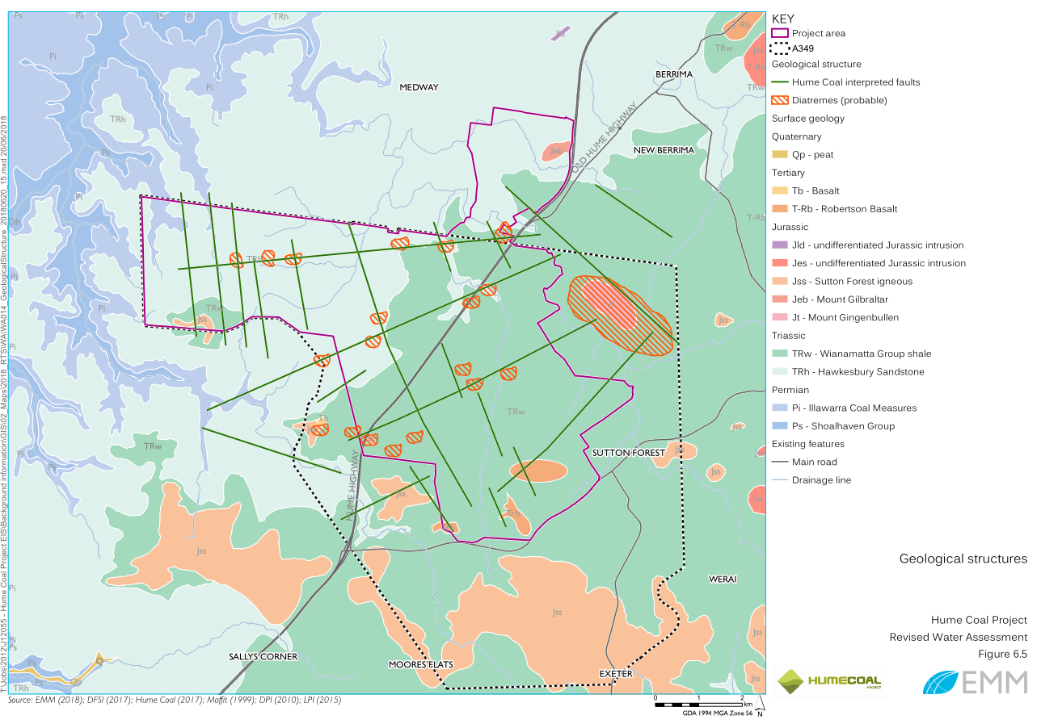
Mine Design- Geological Structure

Slide 14
Mine Design- Key Considerations
No overburden caving - overburden fracturing to be either prevented or at worst maintained at insignificant levels to minimise groundwater inflows.
Completed mine workings must remain accessible by persons and be suitably stable for CHPP reject emplacement and disposal.
The mine layout can be sub-divided into discrete mining panels that can be permanently sealed soon after mining in a panel is complete so as to allow the workings to become flooded as soon as possible.

Slide 15
Mine Design- Key Considerations

Slide 16
Mining System Design Process
Presentation of concept to DP&E (December 2014)
Conceptual project development plan review by DRE
Risk assessment workshops (March 2015)
Update presented to DP&E (May 2015)
Adequacy Review of EIS by DP&E (Nov 2016)
Risk assessment reviews
DP&E review by independent experts (November 2017)
3D numerical modelling (validated updated design)
Results of 3D modelling provided to DP&E’s experts (March 2018)

Slide 17
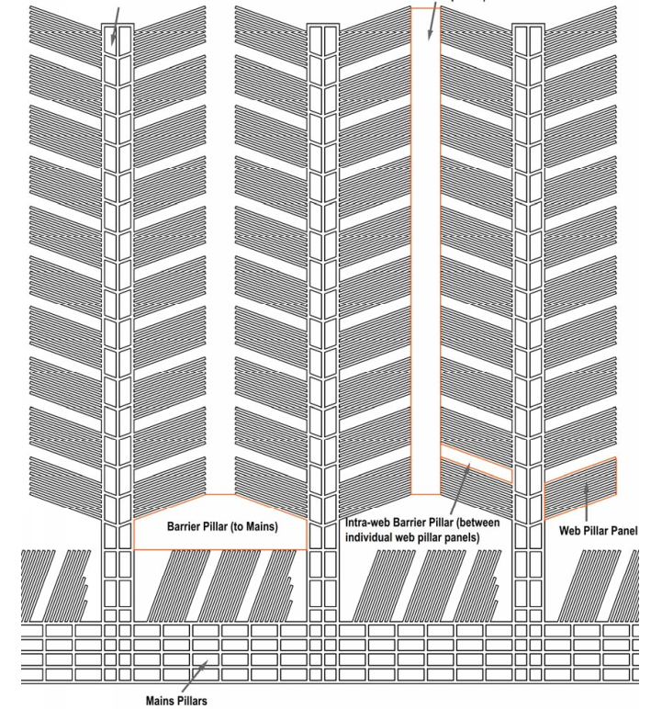
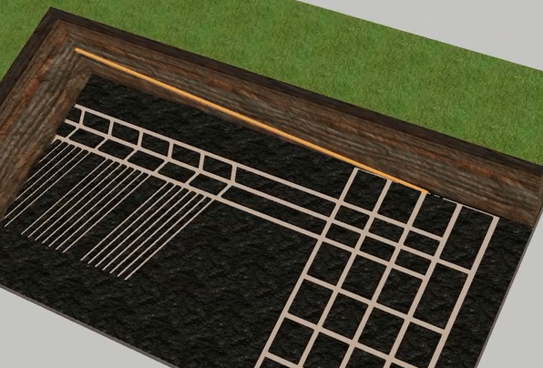
Mine design
“This method of mining is a variation of the Wongawilli Pillar Extraction method.” Resource Regulator

Slide 18
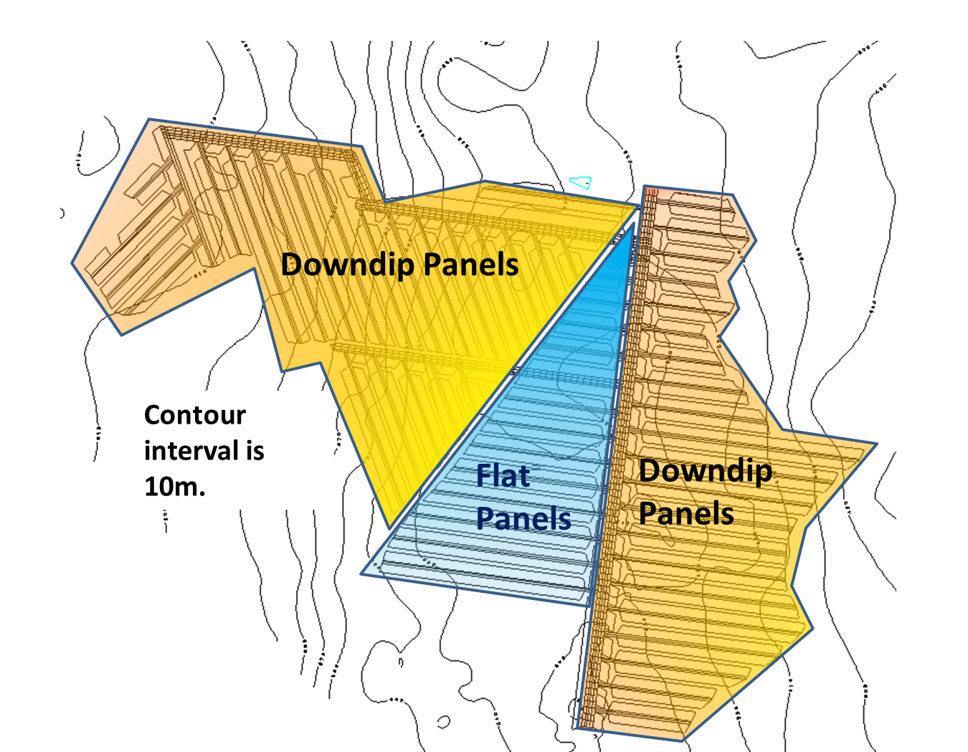
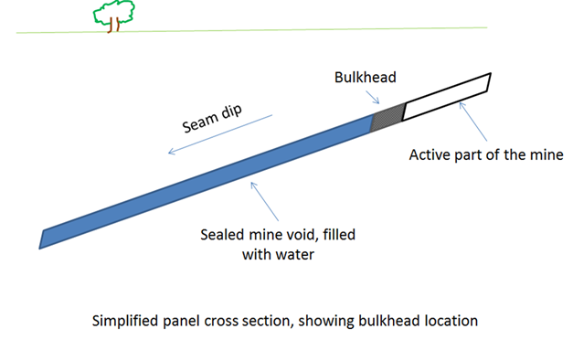
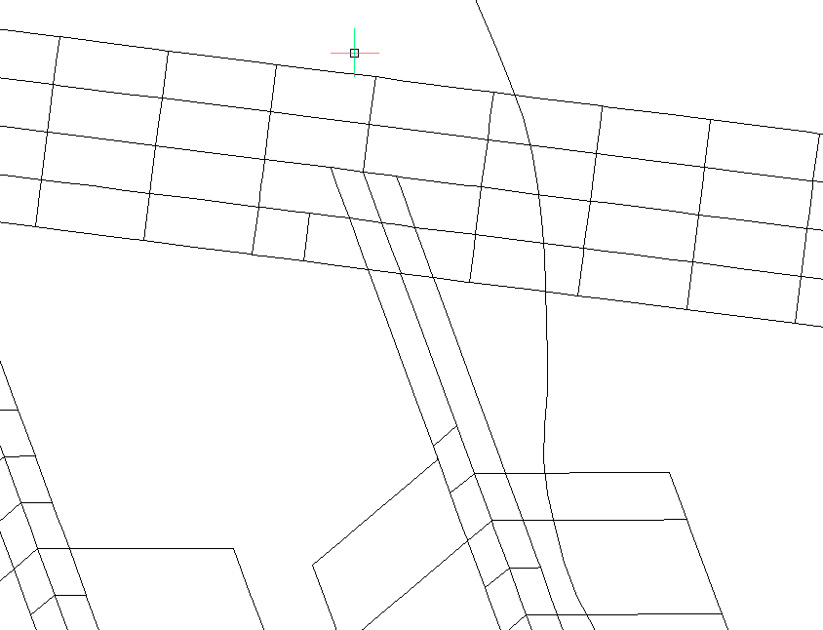
Mine Design- Bulkheads Location
A majority of panels are designed to be down-dip of bulkhead sites,
Remedial work would not require pumping of the panel
Bulk heads are located in long term stable areas of the mine
INSET
Bulkhead locations

Slide 19
High Risk Activities
Mine | Location | Mining method | Stores water underground? | Electrical work on energised electrical equipment | Development of a new mine entry (including by sinking a shaft or drift or raise boring) | Working in inrush control zone | Single entry development of a roadway or drift for more than 250 metres without an intersection | Shotfiring if it has not been undertaken within a year before the intended time of shotfiring | Sealing (other than emergency sealing) | Conduct hot work in a hazardous zone | Driving underground roadway that is wider than 5.5 metres | Use of high voltage plant and cables in a hazardous zone if the plant or cable: • is associated with longwall mining and has a voltage greater than 4000 volts, or • in any other case, has a voltage greater than 1200 volts. | Formation of non-conforming pillars | Coal extraction by any of the following methods: • secondary extraction by longwall mining, shortwall mining or miniwall mining • pillar extraction • pillar splitting • pillar reduction. | Mining operations in outburst control zones. | First applications of explosion inhibitors | Use of explosives designed for use in coal mines if the explosive has previously been used in the state. | Use of an explosive not designed for use in coal mines | First use of an explosion barrier other than a water barrier or bagged stone dust | Emplacement areas - the establishment, operation or decommissioning of an emplacement area
1 | Gunnedah Basin | longwall | Not deliberately | y | y | n | y | y | y | y | y | y | n | y | y | y | y | y | y | y
2 | Hunter Valley | longwall | Not deliberately | y | y | n | y | y | y | y | y | y | y | y | n | y | y | n | y | y
3 | Hunter Valley | longwall | Not deliberately | y | y | n | y | y | y | y | y | y | n | y | n | y | y | y | y | y
4 | Hunter Valley | longwall | Not deliberately | y | y | y | y | y | y | y | y | y | n | y | n | y | y | n | y | y
5 | Newcastle Coalfields | Top coal caving | Not deliberately | y | y | n | y | y | y | y | y | y | y | y | n | y | y | n | y | y
6 | Newcastle Coalfields | miniwall | Not deliberately | y | y | n | n | y | y | y | y | y | n | y | n | y | y | n | y | n
7 | Newcastle Coalfields | longwall | old workings - flooded | y | y | y | y | y | y | y | y | y | y | y | n | y | y | y | y | n
8 | Newcastle Coalfields | bord and pillar- partial extraction | old workings – flooded | y | y | n | n | y | y | y | y | y | n | y | n | y | y | n | y | n
9 | Southern Coalfields | longwall | yes - old workings | y | y | n | y | y | y | y | y | y | y | y | y | y | y | n | y | y
10 | Southern Coalfields | longwall | yes | y | y | n | y | y | y | y | y | y | y | y | n | y | y | u | y | y
11 | Southern Coalfields | longwall | uncemented reject- trial only | y | y | n | y | y | y | y | y | y | y | y | y | y | y | n | y | y
12 | Southern Coalfields | longwall | old workings - flooded | y | y | n | y | y | y | y | y | y | y | y | y | y | y | n | y | y
13 | Southern Coalfields | longwall | old workings - flooded | y | y | n | y | y | y | y | y | y | y | y | y | y | y | n | y | y
14 | Southern Coalfields | bord and pillar- partial extraction | yes | y | y | y | y | y | y | y | y | y | n | y | n | y | y | n | y | y
15 | Western Coalfields | bord and pillar, miniwalls | unknown | y | y | n | n | y | y | y | y | y | n | y | n | y | y | u | y | n
16 | Western Coalfields | Partial pillar extraction using FCT | yes | y | y | n | n | y | y | y | y | y | n | y | n | y | y | u | y | n
17 | Western Coalfields | longwall | yes | y | y | n | y | y | y | y | y | y | n | y | n | y | y | n | y | n
18 | Western Coalfields | longwall | yes | y | y | n | y | y | y | y | y | y | y | y | n | y | y | n | y | y
19 | Western Coalfields | longwall | yes | y | y | n | y | y | y | y | y | y | n | y | n | y | y | y | y | y
20 | Western Coalfields | longwall | Not deliberately | y | y | n | y | y | y | y | y | y | n | y | n | y | y | n | y | y
HRAs are carried out by all underground mines either on a day to day basis or intermittently.

Slide 20

Water Management- Level of impact
DPE state that:
…’the project is predicted to have significant impacts in a highly productive groundwater aquifer’…
The depressurisation and drawdown extent from Hume is modest compared to many other assessed mining projects in NSW
The Aquifer Interference Policy defines highly productive aquifers as those that yield in excess of 5L/sec
The NSW Government database reports the average yield of bores within 9km of the Hume project having a yield of 2L/sec
Based on this, the aquifer cannot be defined as a highly productive aquifer
…’drawdown impacts on this aquifer would be the most significant for any mining project that has ever been assessed in NSW’…
This statement is false, as shown by the following slides

Slide 21
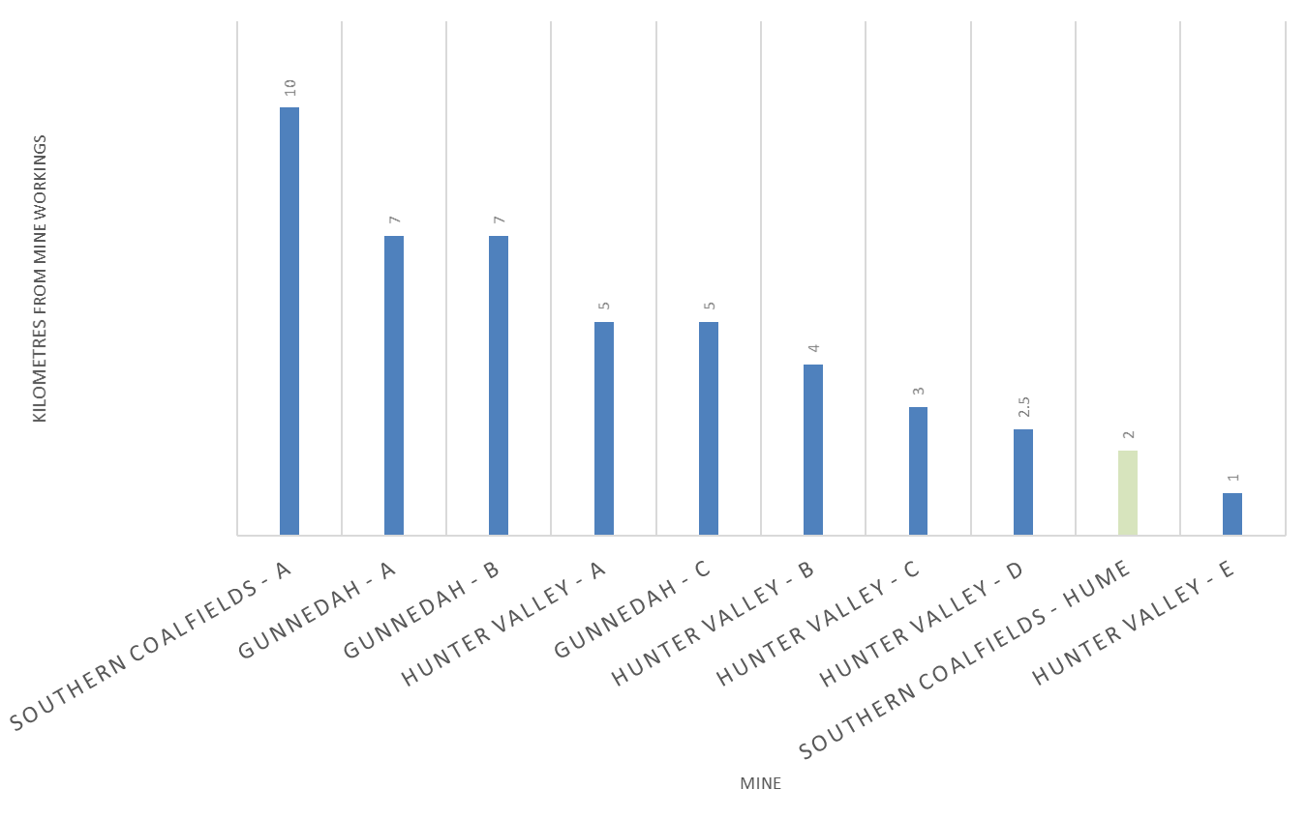
Comparison to other mines
Distance to 2m drawdown from edge of mine workings
Water Management- Level of impact
`

Slide 22
Comparison to other mines
Groundwater inflow to open cut or underground workings
Water Management- Level of impact
`

Slide 23
Make Good - staged strategy
Hume proposed a detailed make good assessment and approach that is:
Make good staged in 5 years lots (other operations do this in line with extraction management plans)
Strategy is flexible and suitable arrangements made for each individual landholder
‘Make Good’ is a landholder entitlement – if they don’t choose to exercise that right, then there is no dispute. It is an ‘opt in’ arrangement
Only 16 bores in first 5 years
64 bores (68% of all affected bores) made good with minor strategies such as increased pumping costs and lowering pumps
Time when bore first impacted by 2 m drawdown | 0-5 yrs | 5-10 yrs | 10-15 yrs | 15-20 yrs | 20-25 yrs | +25 years | Total
1. increased pumping costs | - | 3 | 7 | 9 | 5 | 7 | 31
2. deepen pump | 6 | 9 | 13 | 3 | 2 | - | 33
3a. replace stock / domestic bore | 5 | 4 | 2 | 2 | 1 | 1 | 15
3b. replace an irrigation bore | 5 | 8 | 1 | 1 | - | - | 15
Totals | 16 | 24 | 23 | 15 | 8 | 8 | 94

Slide 24
Net Direct Economic Benefits
Mine | Net direct benefits (A$M) | DP&E Comments
Hume | $373 million | “relatively low” economic benefits
Springvale | $200 million | “major” economic benefits
Moolarben | $311 million | “extensive” benefits
Airly | $125 million | “significant” economic benefits
Wongawilli (S. Coalfield) | $57 million | “significant” economic benefits
Metropolitan (S. Coalfield) | $436 million | “The Department is satisfied”
Compared to other coal mining operations, Hume Coal will deliver
Significant Economic Benefits for Minimal Environmental Impacts

