Slide 1

Tracking Carbon:
Exploring the myths about carbon offsets
Professor Will Steffen
The Climate Council of Australia
The Australian National University
CANWin Guest Speakers Forum, Bowral, 14 February 2014

Slide 2
Outline of Talk
The global carbon cycle
Human-driven changes to the carbon cycle
Why fossil fuel emissions cannot be “offset” by
storing carbon in land systems.
Vulnerabilities in the carbon cycle
Carbon maths: the bottom line

Slide 3
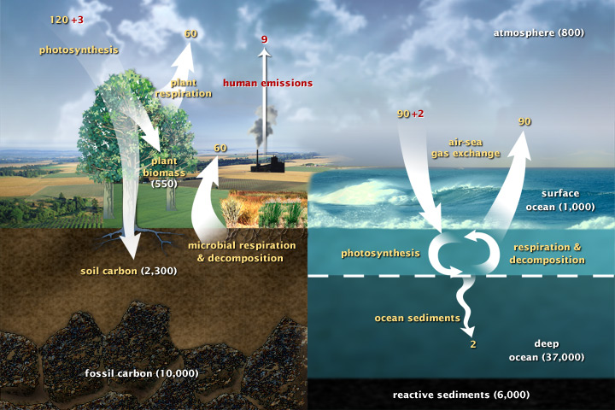
1. The Global Carbon Cycle
Source: NASA

Slide 4
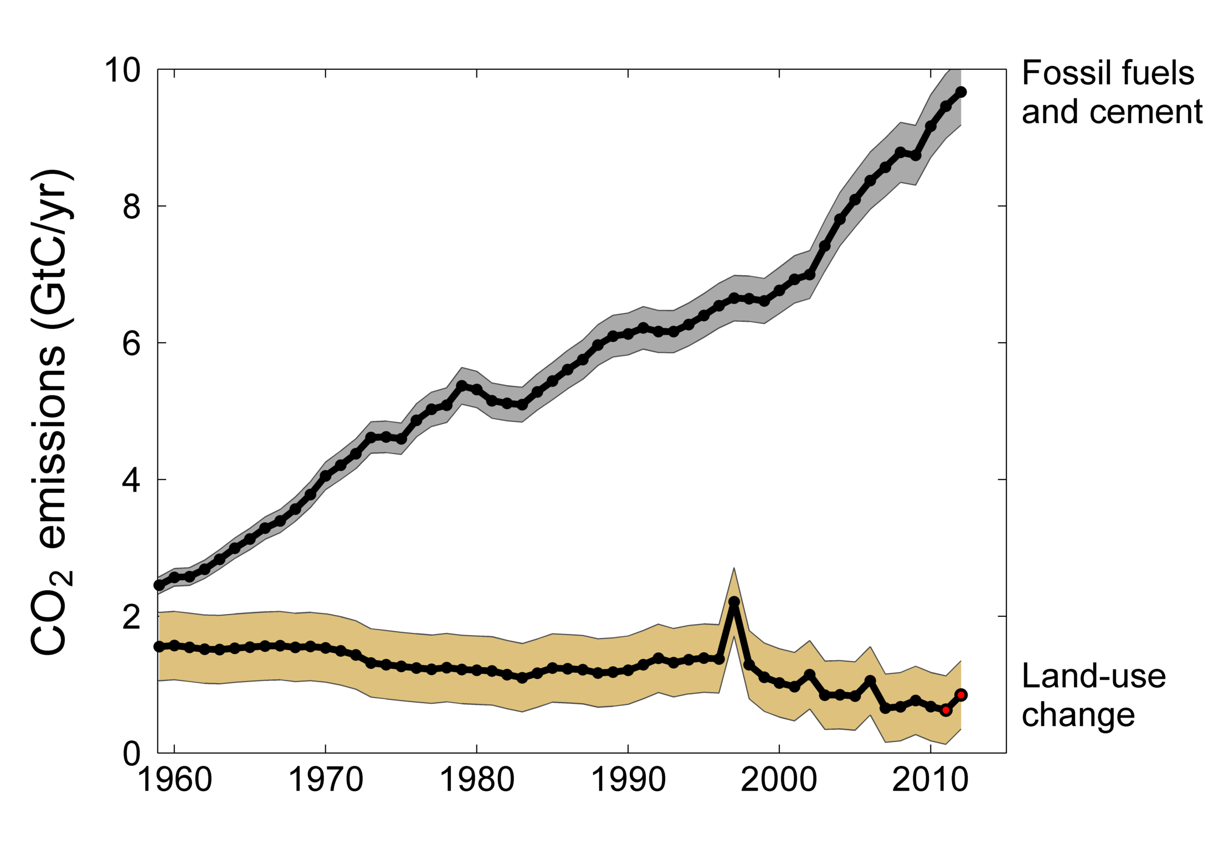
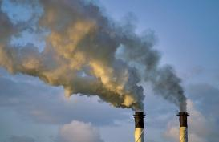
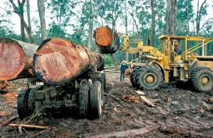
2. Human-driven changes to the carbon cycle
Total global emissions: 10.5 ± 0.7 GtC in 2012, 43% over 1990
Percentage land-use change: 38% in 1960, 17% in 1990, 8% in 2012
Land use emissions in 2011 and 2012 are extrapolated estimates
Source: Le Quéré et al 2013; CDIAC Data; Houghton & Hackler (in review); Global Carbon Project 2013

Slide 5
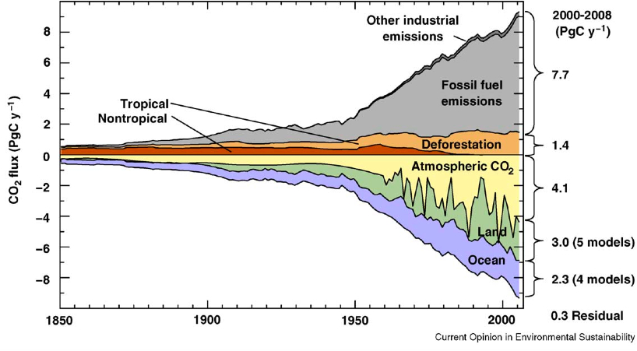
Change in the Global Carbon Cycle
Terms in the global carbon budget for 1850 - 2008
Source: Raupach and Canadell 2010;
Global Carbon Project

Slide 6
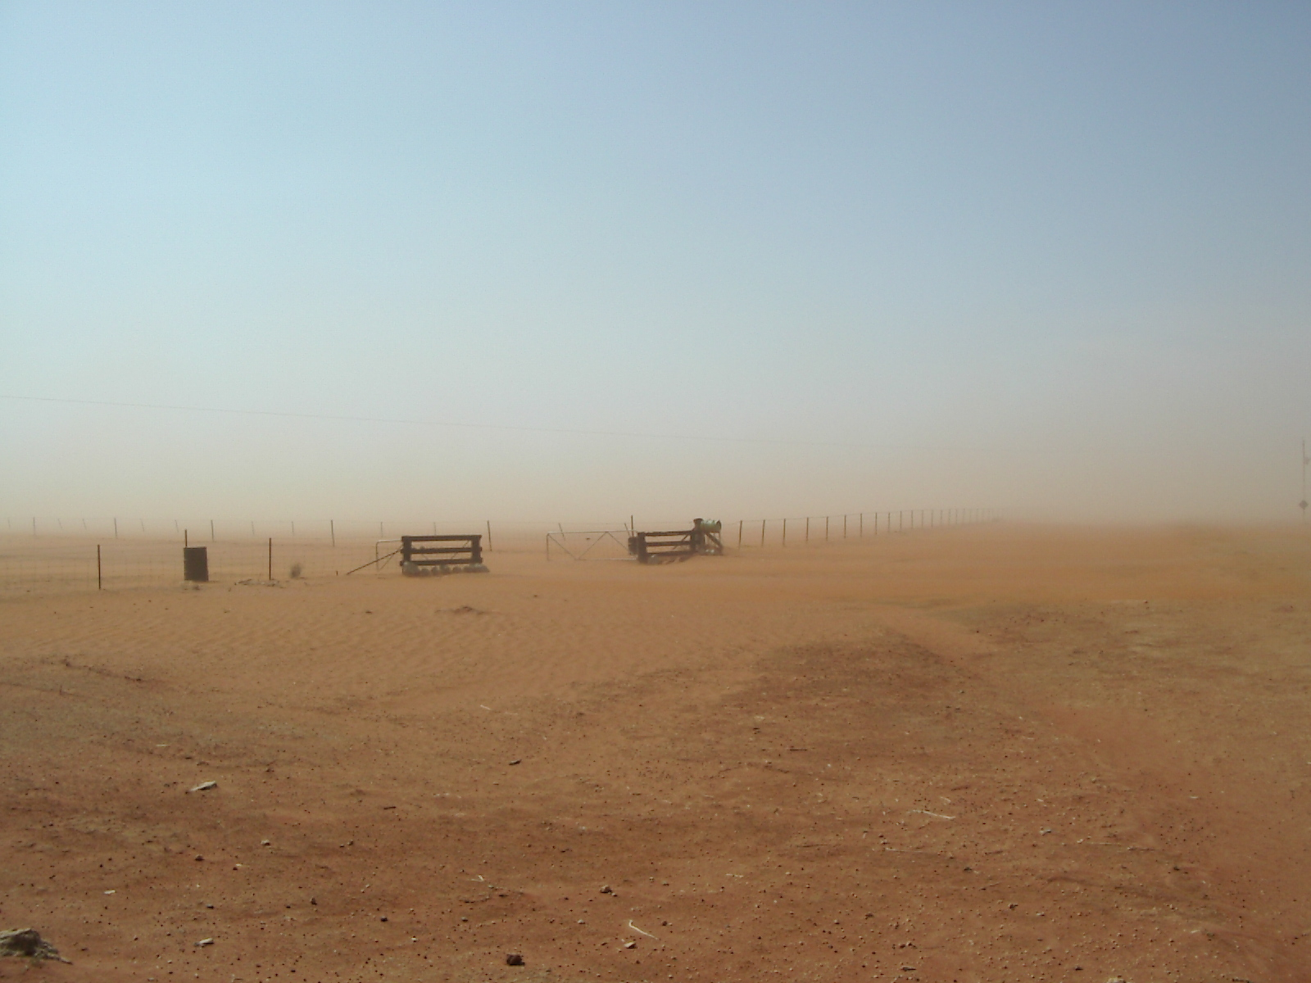
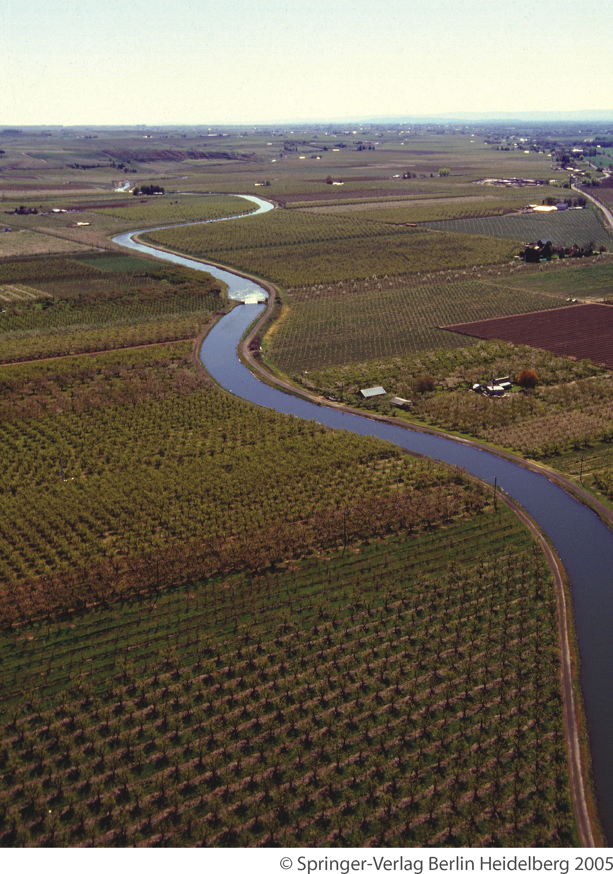
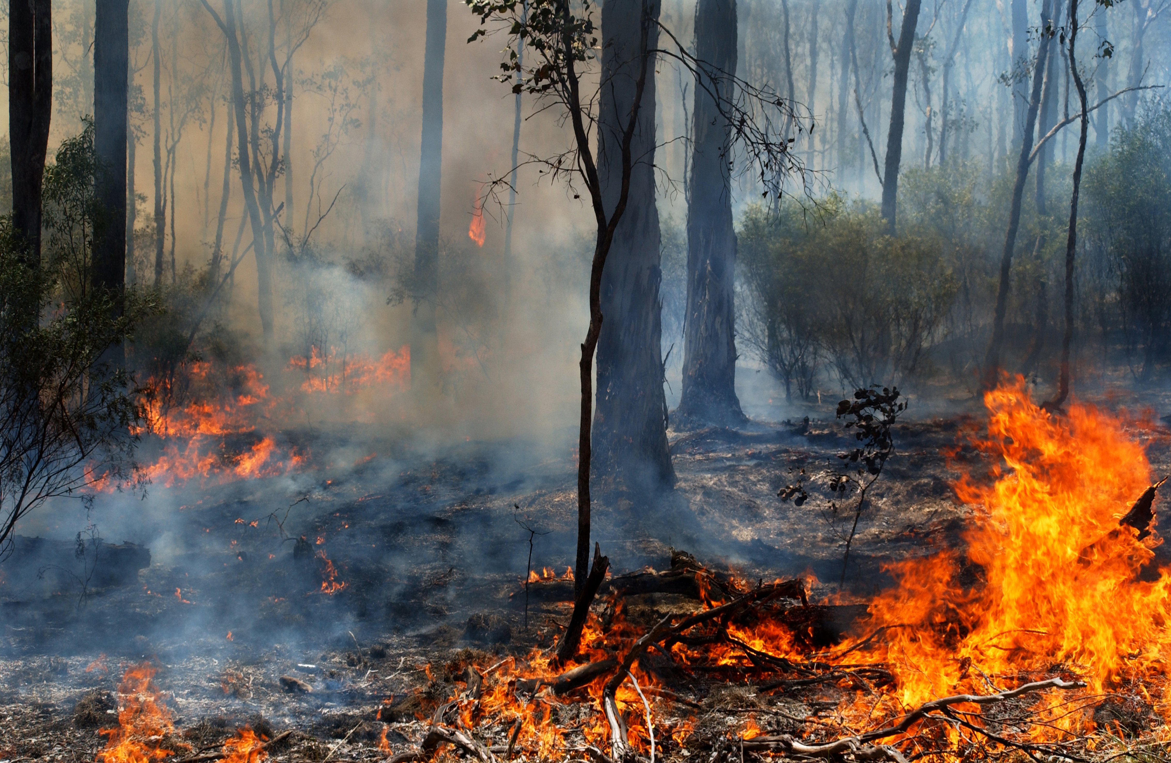
Why fossil fuel emissions cannot be “offset”
by storing carbon in land systems

Slide 7
1
Pre-Human/Hunter-Gatherer Carbon Cycle
Fossil Fuels
Atmosphere
Land
Surface Ocean
Deep Ocean

Slide 8
2
Early Agriculture Carbon Cycle
nn
Fossil Fuels
Atmosphere
Surface Ocean
Land
Deep Ocean
N.B. Figure is only indicative of relative stock sizes

Slide 9
3
Contemporary (post-industrial) Carbon Cycle
Fossil Fuels
Atmosphere
Stock loss
Surface Ocean
Land
Deep Ocean

Slide 10
4
Fossil fuel “offset” approach is physically impossible
B
Fossil Fuels
Additional carbon in
the active system that
came from burning
fossil fuels which is not offset in reality
Atmosphere
Stock re-filled
Hypothetical refilling of land buffer plus some CO2 fertilisation
Surface Ocean
Land
Natural ocean buffering of some fossil fuel CO2
Deep Ocean

Slide 11
In any case, the land buffer can only be partially re-filled due to competing land uses
5
Fossil Fuels
Atmosphere
Stock re-fill
Un-refilled stock due to
“fixed” land use especially food
Surface Ocean
Surface Ocean
Land
Deep Ocean

Slide 12
Biosequestration in land systems
Best considered as returning legacy carbon from the atmosphere
to land systems.
Natural ecosystems maximise carbon storage. Reducing
emissions from conversion of natural ecosystems should be
highest priority in the land sector.
Biosequestration schemes require careful architectures - deliver
co-benefits and avoid perverse outcomes (e.g., biodiversity).
Carbon stored in land systems is vulnerable to rapid return to the
atmosphere - fires, heatwaves, insect attacks, rising T.
Scientifically, biosequestration should be in addition to
reduction of fossil fuel emissions, not instead of or an offset for…
Source: Mackey et al. 2013

Slide 13
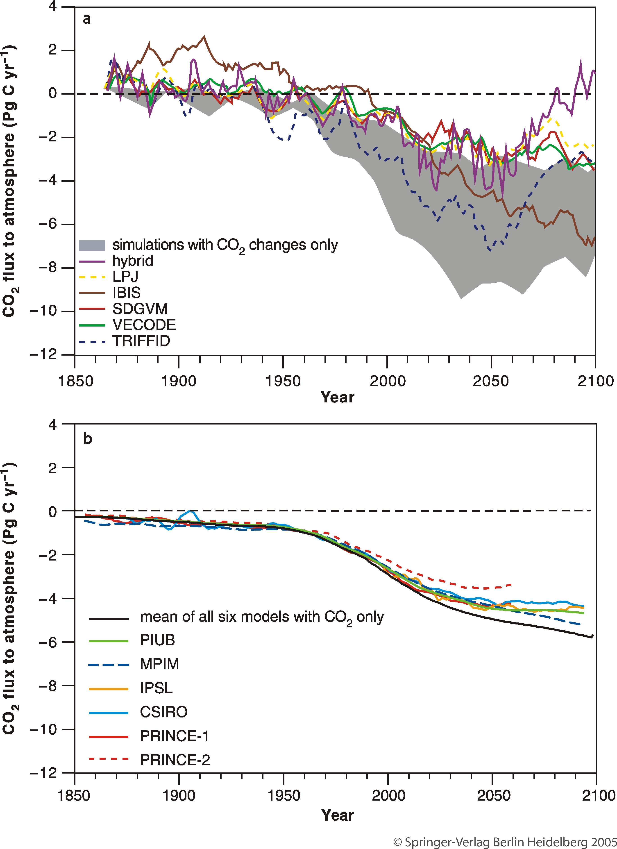
4. Vulnerabilities in the global carbon cycle
Friedlingstein et al. 2006

Slide 14
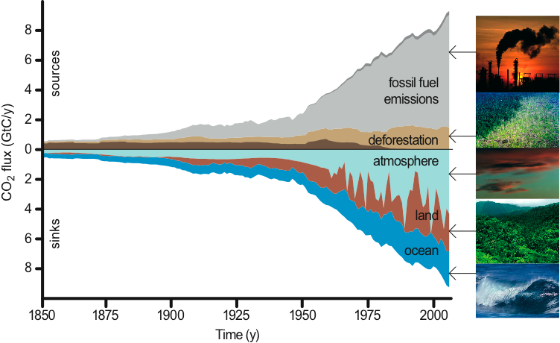
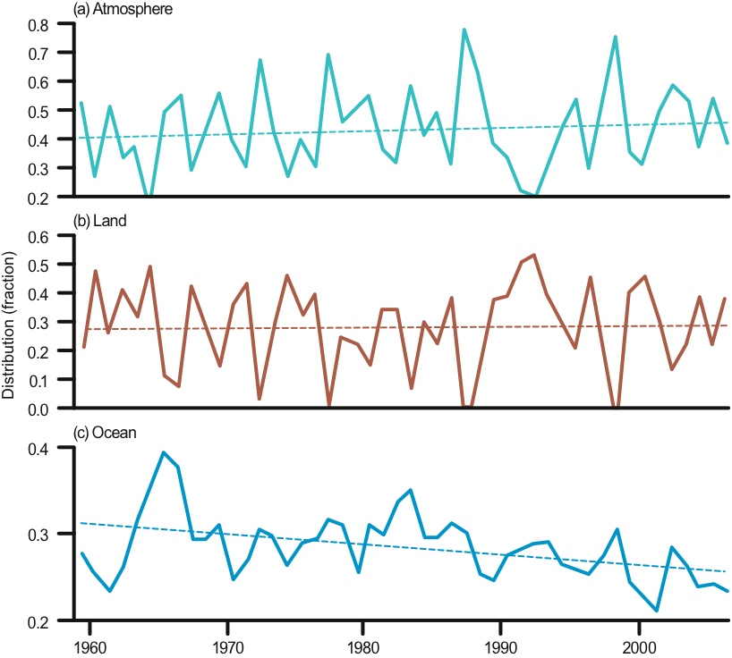
Changes in the carbon sinks
Canadell et al. 2007; Global Carbon Project
Canadell et al. 2007

Slide 15
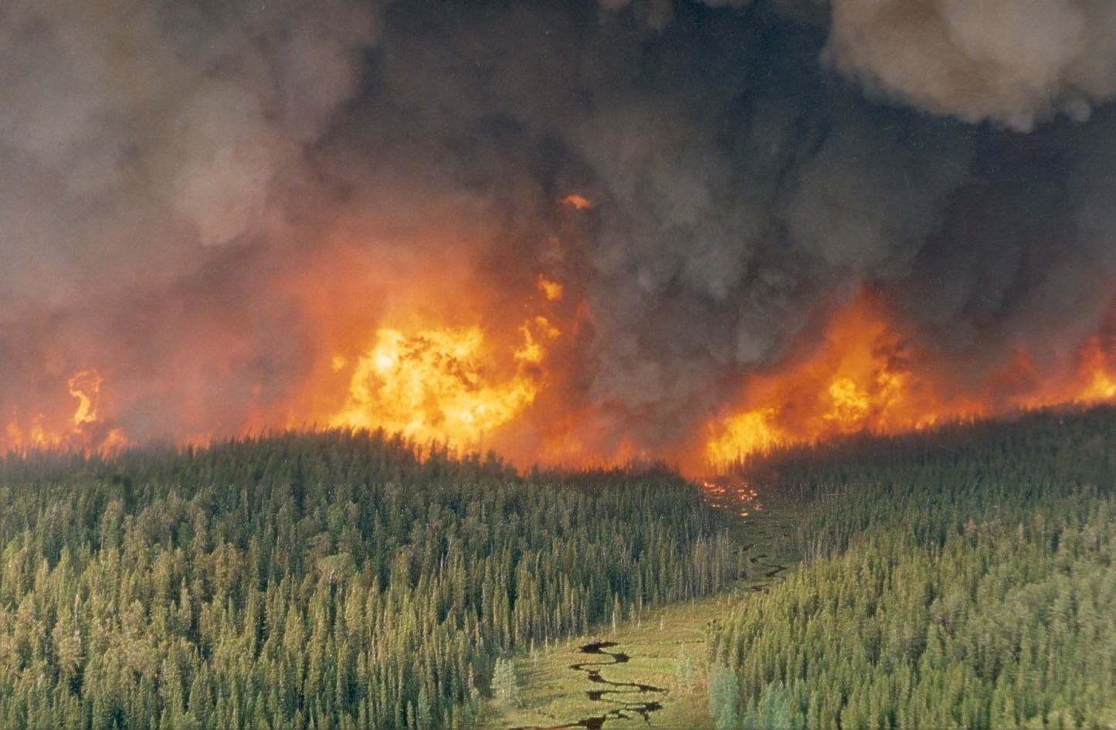
Canadian Forests:
Disturbances
Photo: Brian Stocks

Slide 16
Disturbances in Canada’s forests [1920 –1995]
Increase after 1970
10
8
6
Area (million ha)
4
2
0
1920
1940
1960
1980
2000
ClearCut
Fire
Insects
Total
Source: Kurz & Apps 1999

Slide 17
Net ecosystem C fluxes in Canada
[1920 – 1995]
400
Decrease after 1970
300
Sink
200
Tg C / yr
100
0
-100
Source
-200
1920
1940
1960
1980
2000
Variable Temp
Constant Temp
Source: Kurz & Apps 1999

Slide 18
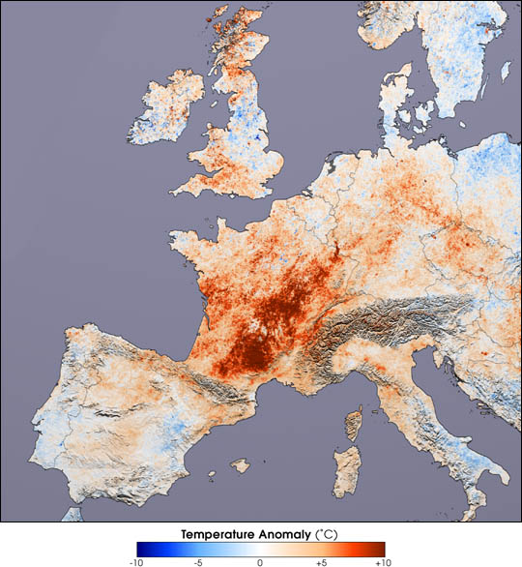
Heatwaves and the carbon cycle
The 2003 European heatwave

Slide 19
Independent tree ring verification
A. Granier pers. Comm

Slide 20
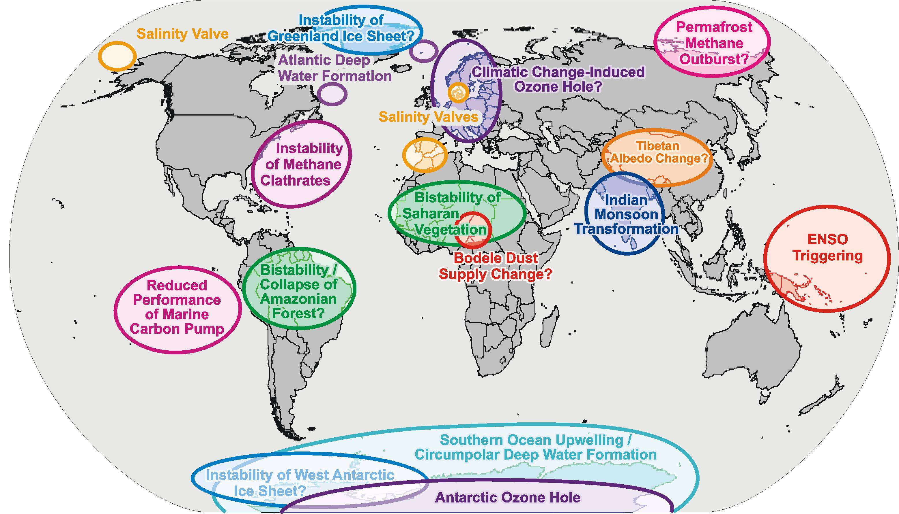
Tipping Elements in the Earth System
Source: Schellnhuber, after Lenton et al, PNAS, 2008

Slide 21
Tipping Elements in the Earth System
Source: Schellnhuber, after Lenton et al, PNAS, 2008

Slide 22
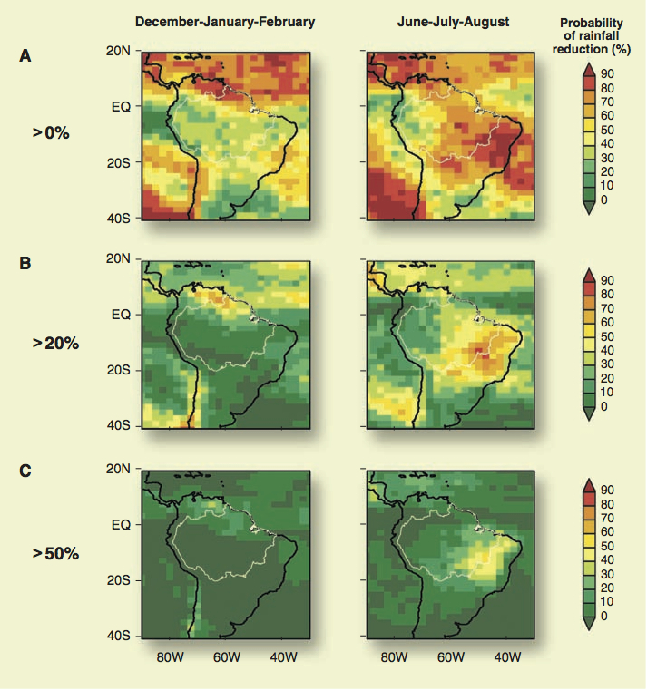
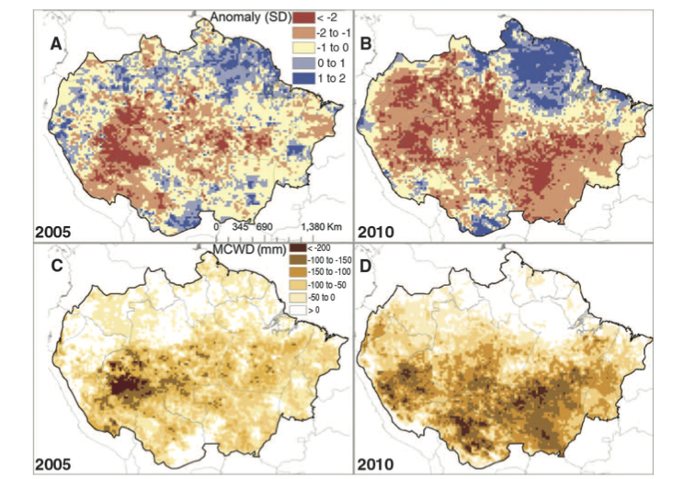
Stability of the Amazonian Forest?
Carbon storage losses of 1.6
(2005) and 2.2 (2010) Pg C
Offsets about 10 years of C
sink activity.
Malhi et al. 2008
IGBP Brazil Office
Lewis et al. 2011

Slide 23
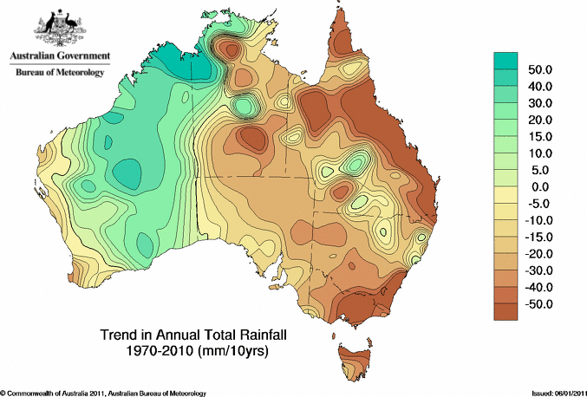
Rainfall changes in Australia
Observed changes in rainfall (1970-2005) and possible causes
We don’t know;
no convincing
evidence yet for
climate change
signal
Strong evidence of a climate change signal
Possible climate change
signal, but evidence is not
yet conclusive
Source: Steffen 2009

Slide 24
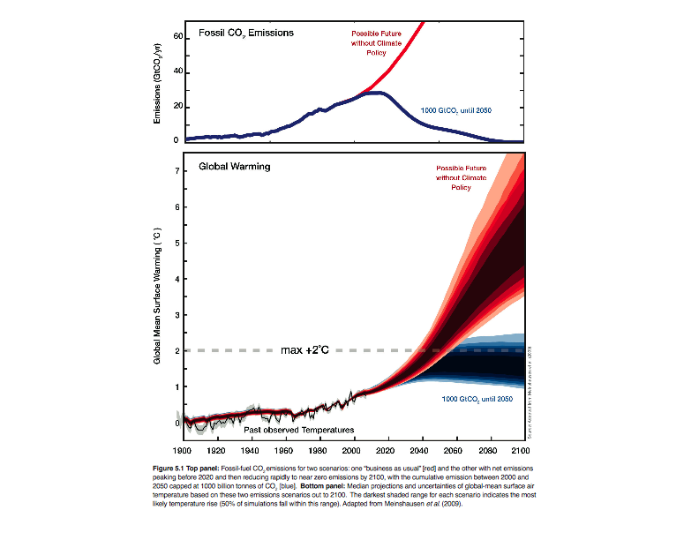
5. Carbon maths: the bottom line
Meinshausen et al. 2009

Slide 25
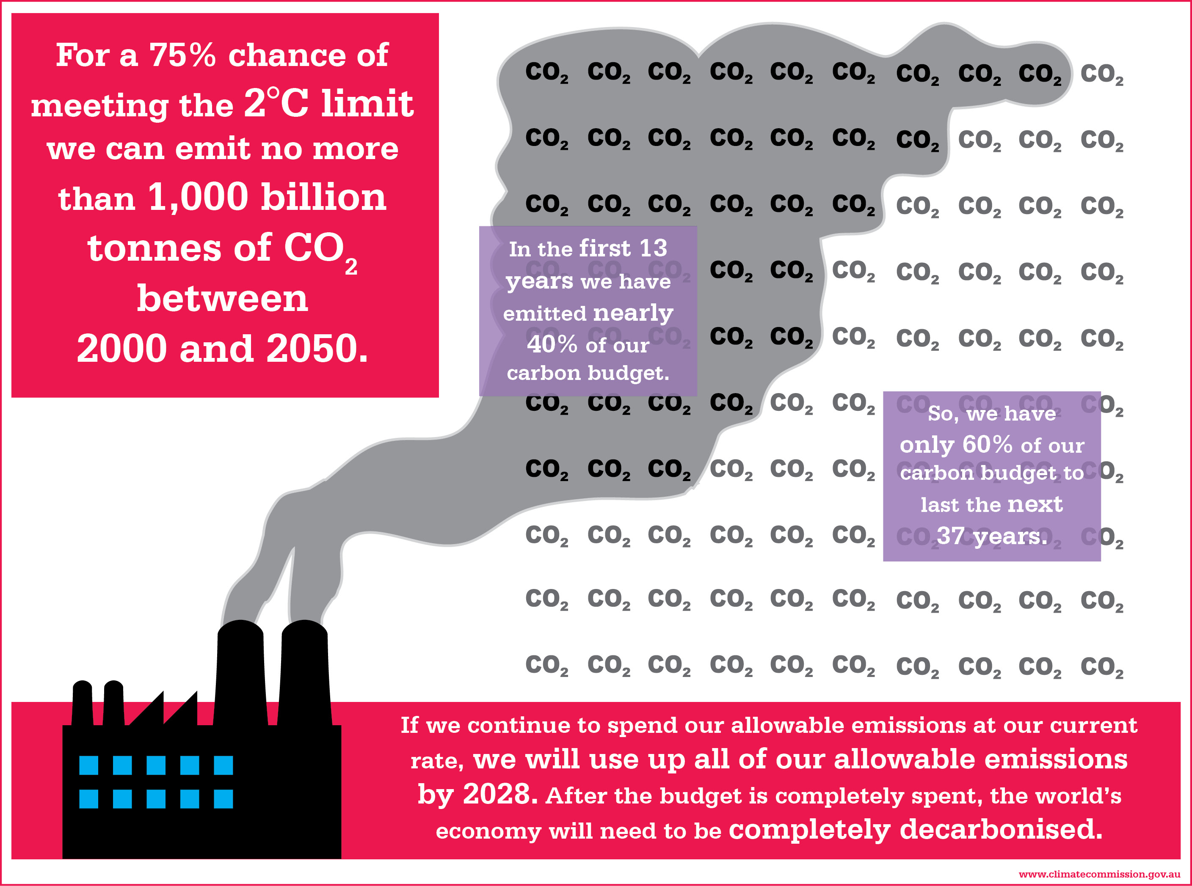
Overspend in the carbon budget

Slide 26
The fossil fuel equation
The remaining global budget for CO₂ emissions from fossil fuel combustion is about 600 billion tonnes if we are to stay within the 2ºC limit.
The world’s indicated fossil fuel reserves (coal, oil and gas), if all were burnt, would emit nearly 3,000 billion tonnes of CO₂ (IEA 2012).
This means that we can burn only about 20% of the world’s known fossil fuel reserves. Most will have to stay in the ground.
Australia’s coal reserves represent about 51 billion tonnes of CO₂ emissions, about one twelfth of the world’s allowable budget.

Slide 27
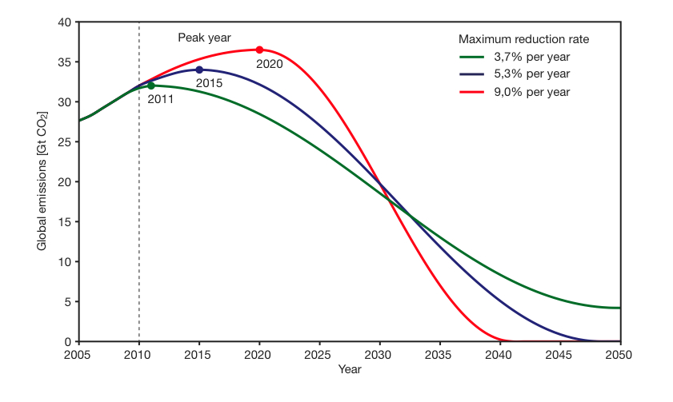
Emission trajectories for 2 C limit
WBGU 2009

Slide 28
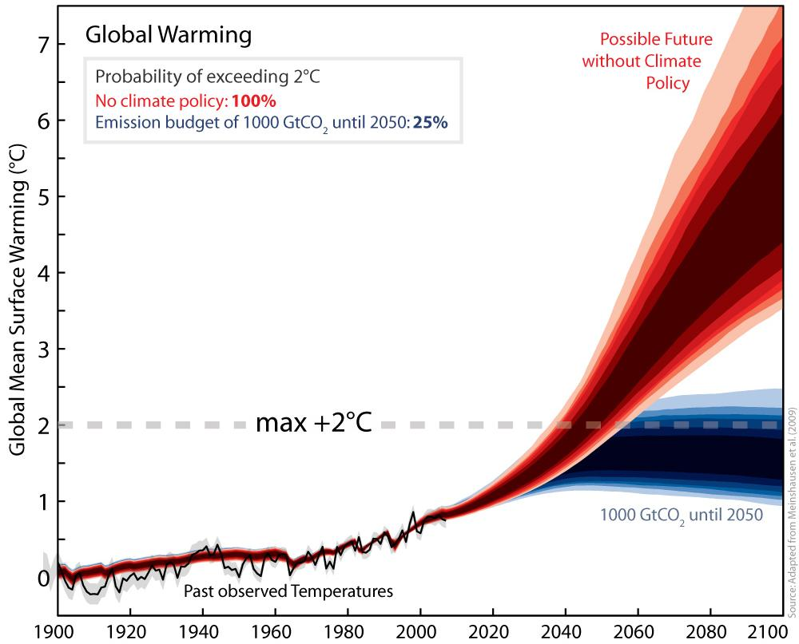
This is the critical decade for action
My grandkids?
Prof Lesley Hughes
My kids
Me

Slide 29
Climate change: the bottom line
The evidence for climate change is overwhelming and clear. It is beyond reasonable doubt that the burning of fossil fuels is the primary cause.
We are already seeing the social, economic and environmental impacts of a changing climate, especially extreme events. The risks rise as climate shifts further.
To stabilise the climate at a manageable level, most of the world’s fossil fuel reserves must stay in the ground.
This is the critical decade. Decisions we make from now to 2020 will determine the severity of climate change our children and grandchildren experience.

