Slide 1
Australian Standard AS 1470-1986
Health and safety at work- Principles and practices (AS 1470-1986)
Clause 5.7.2 - planning for safe methods of working should provide adequate guidelines that relate to, amongst other things:
• consideration, at the design stage, of safe working methods and procedures.

Slide 2
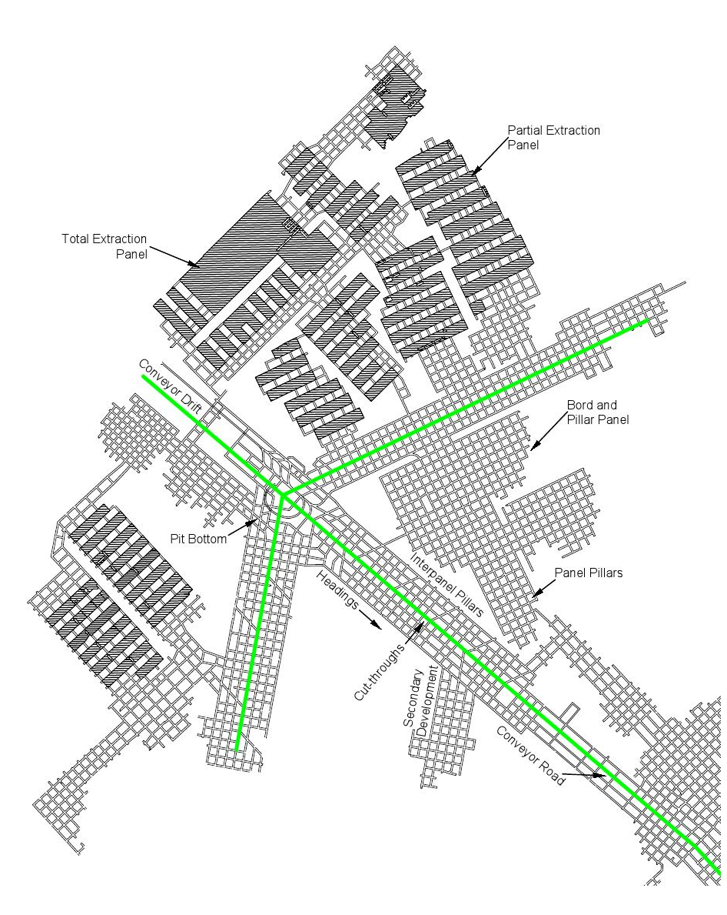
Galvin, J. M. (2016). Ground Engineering: Principles and Practices for Underground Coal Mining. Switzerland: Springer.

Slide 3
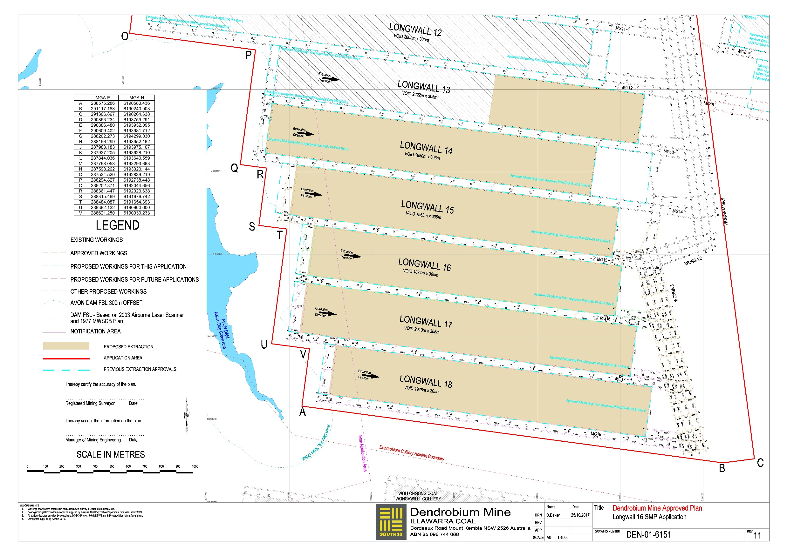

Slide 4
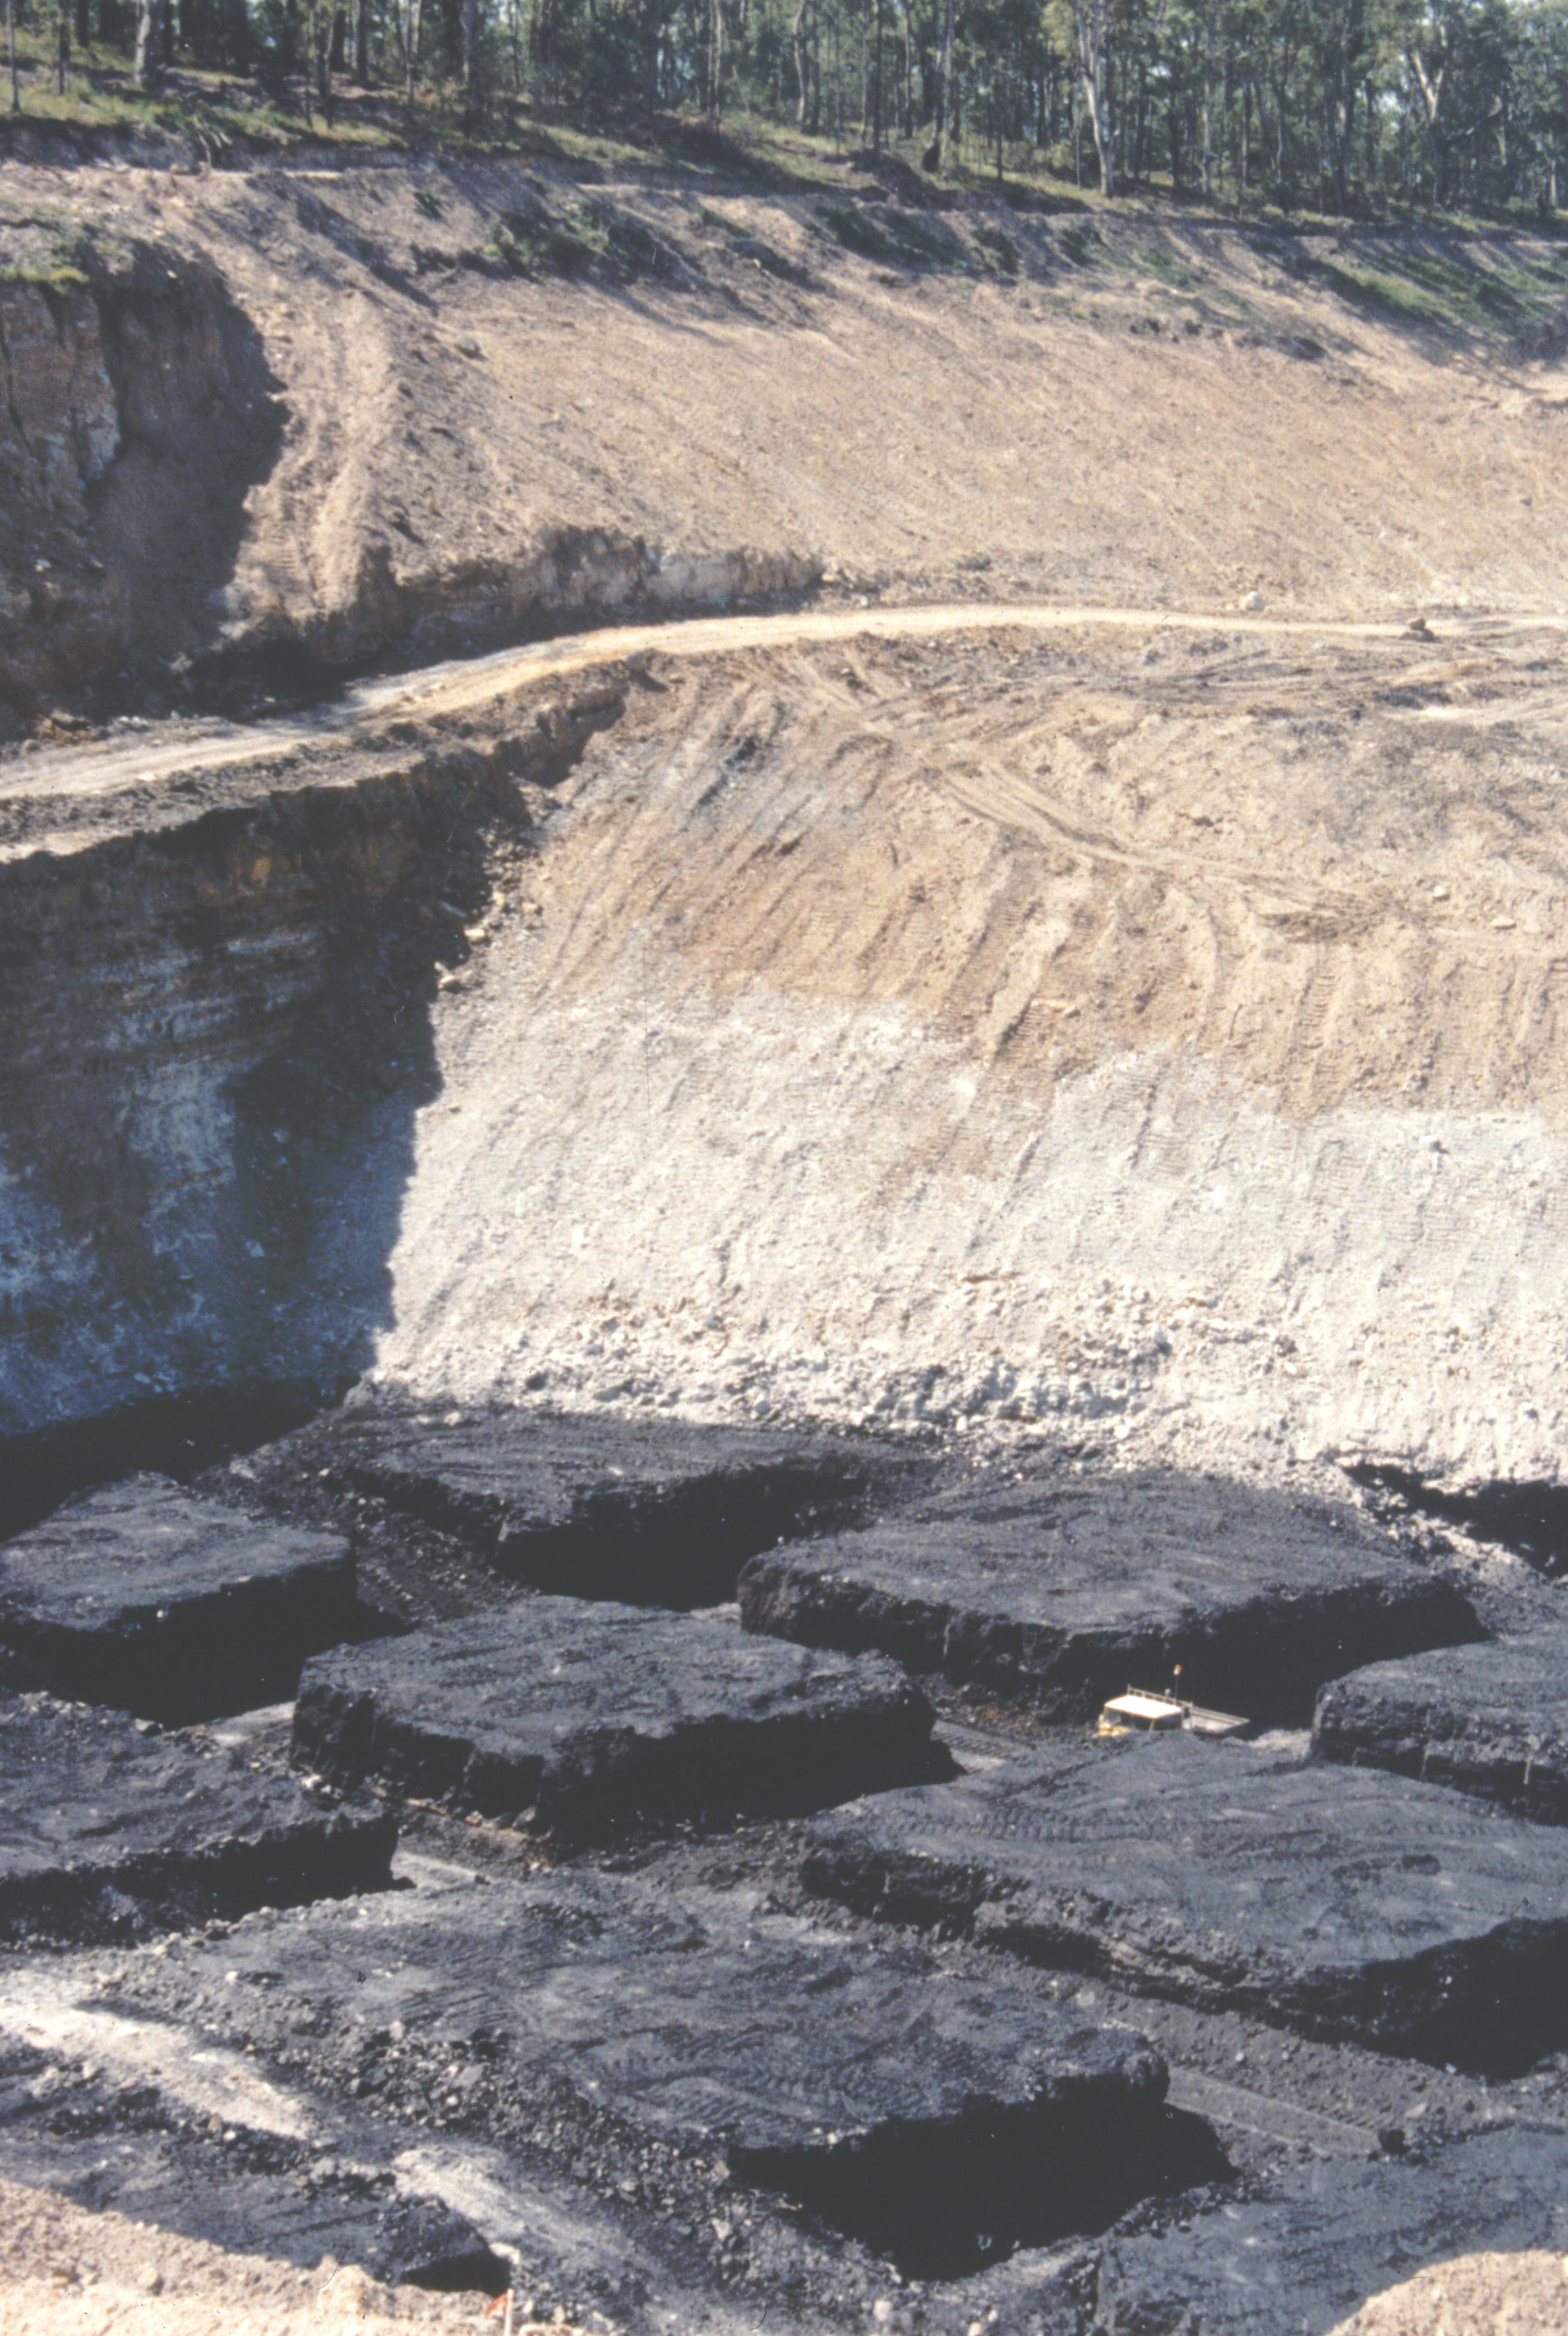

Slide 5
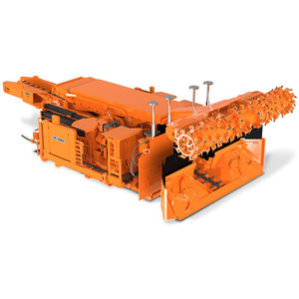

Slide 6
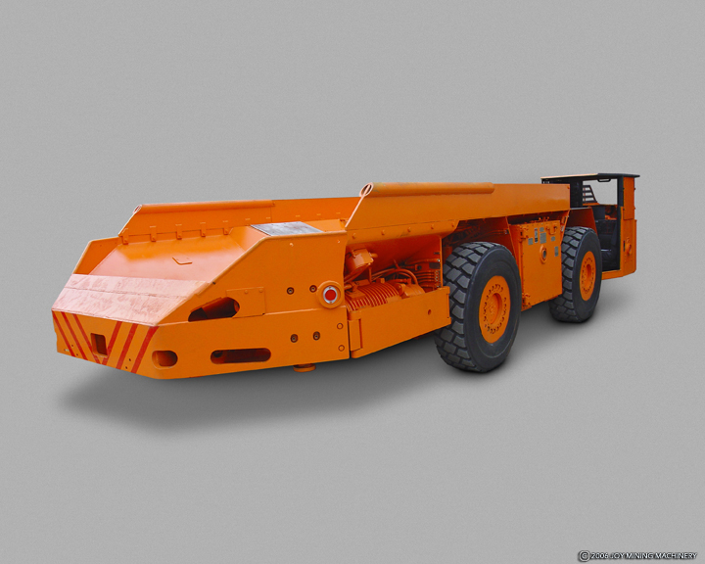

Slide 7
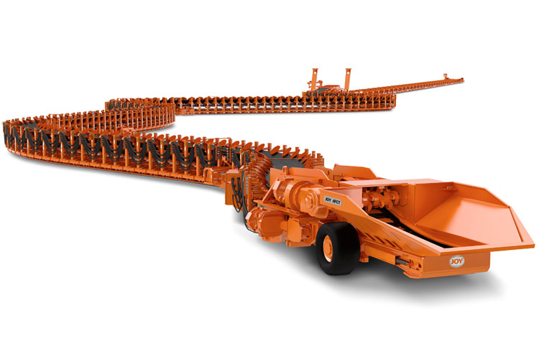

Slide 8
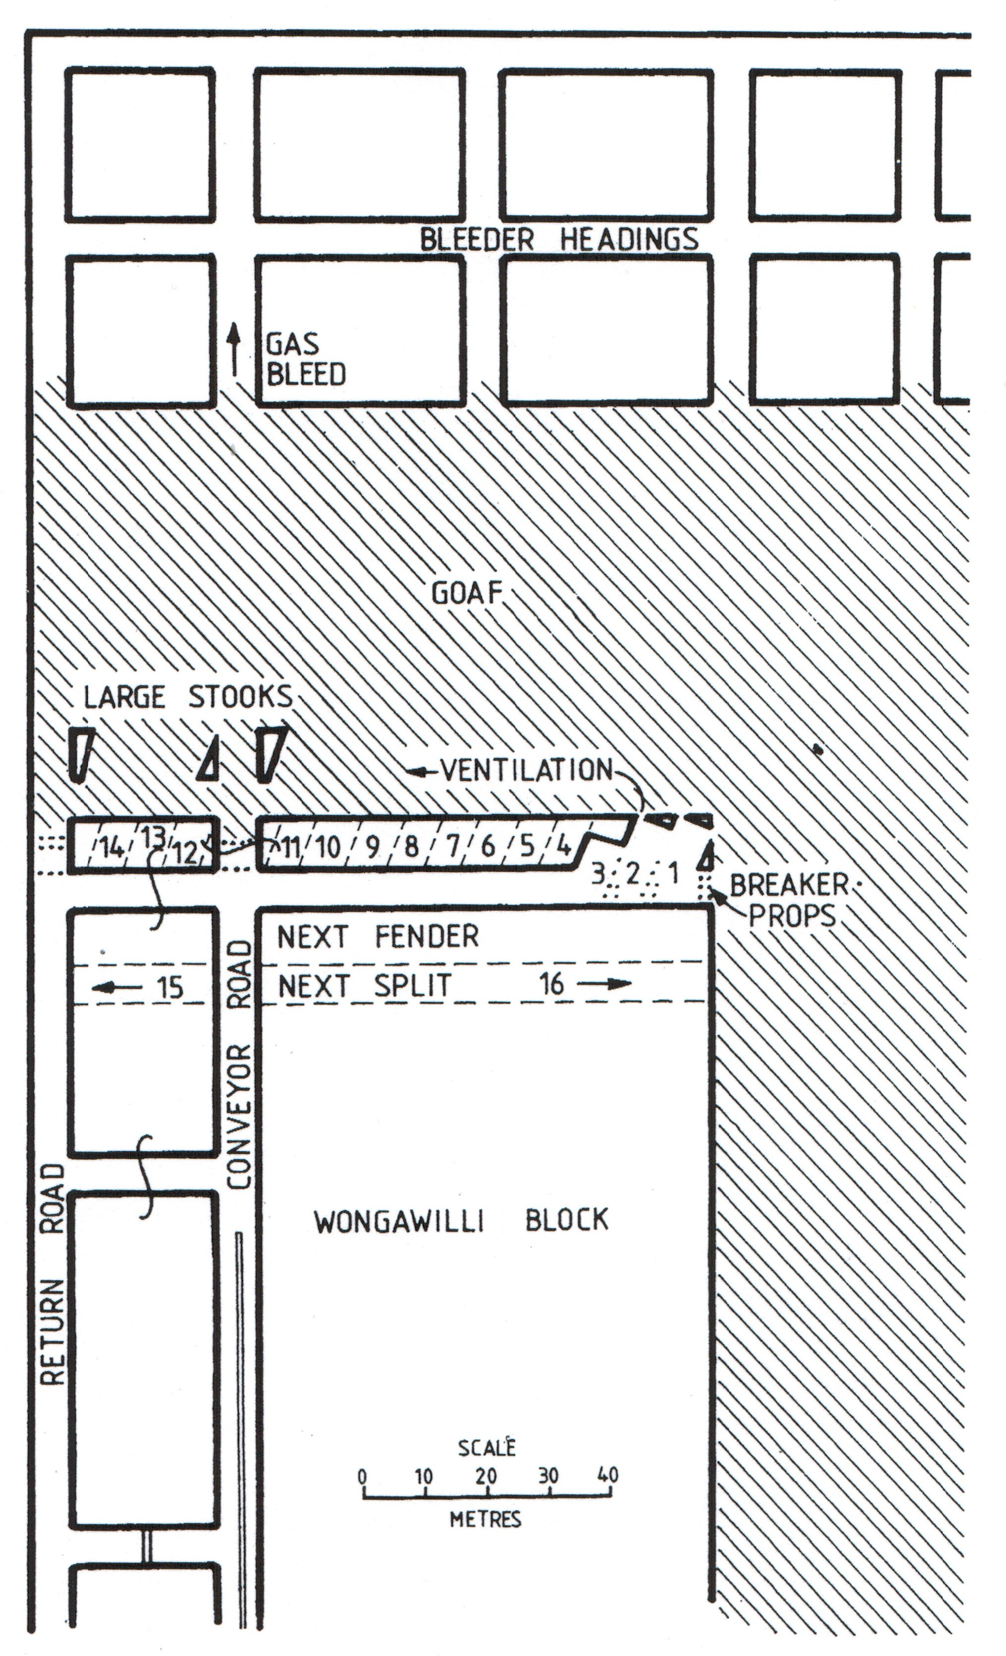

Slide 9
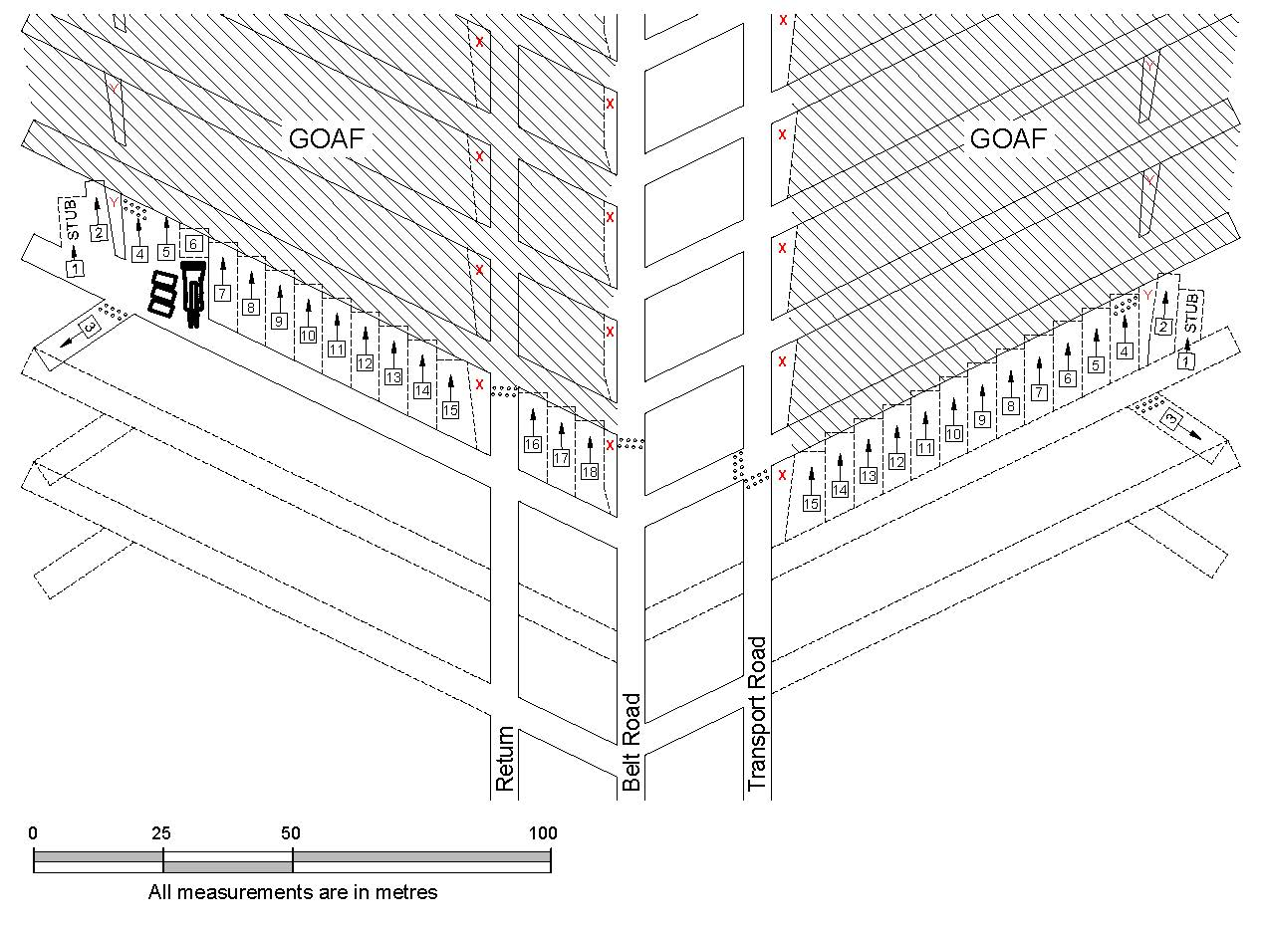
(b) An example of an Australian pillar extraction layout and sequence plan when utilising continuous haulage (Galvin, 2016).
Figure 8.11: Wongawilli method of pillar extraction (after Sleeman, 1993).

Slide 10
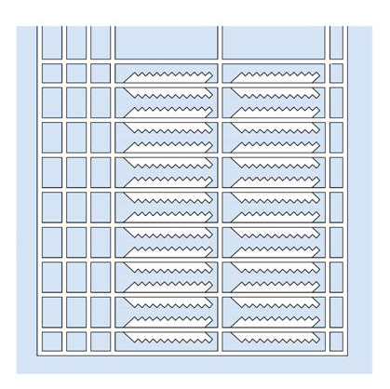
Concept of lifting left and right on two sides to form the final pillar size, based on a mine layout employed at Cooranbong Colliery, Australia (Galvin, 2016)

Slide 11
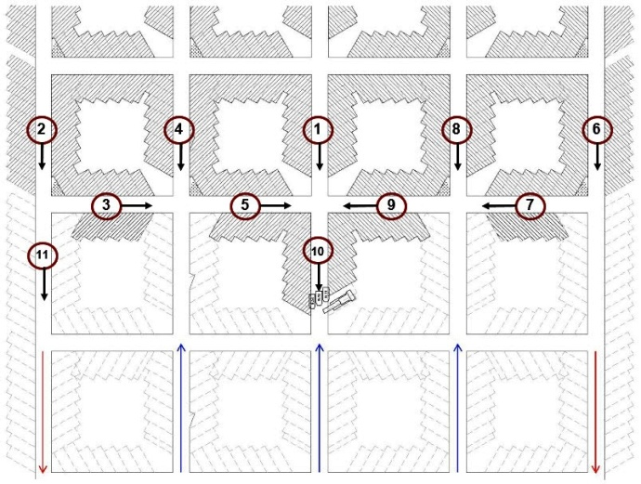
Concept of lifting left and right on two sides to form the final pillar size, based on a mine layout employed at Cooranbong Colliery, Australia (Galvin, 2016)
Lifting left and right on four sides to form the final pillar size, Tasman Mine, Australia (after Tyler & Sutherland, 2011)

Slide 12
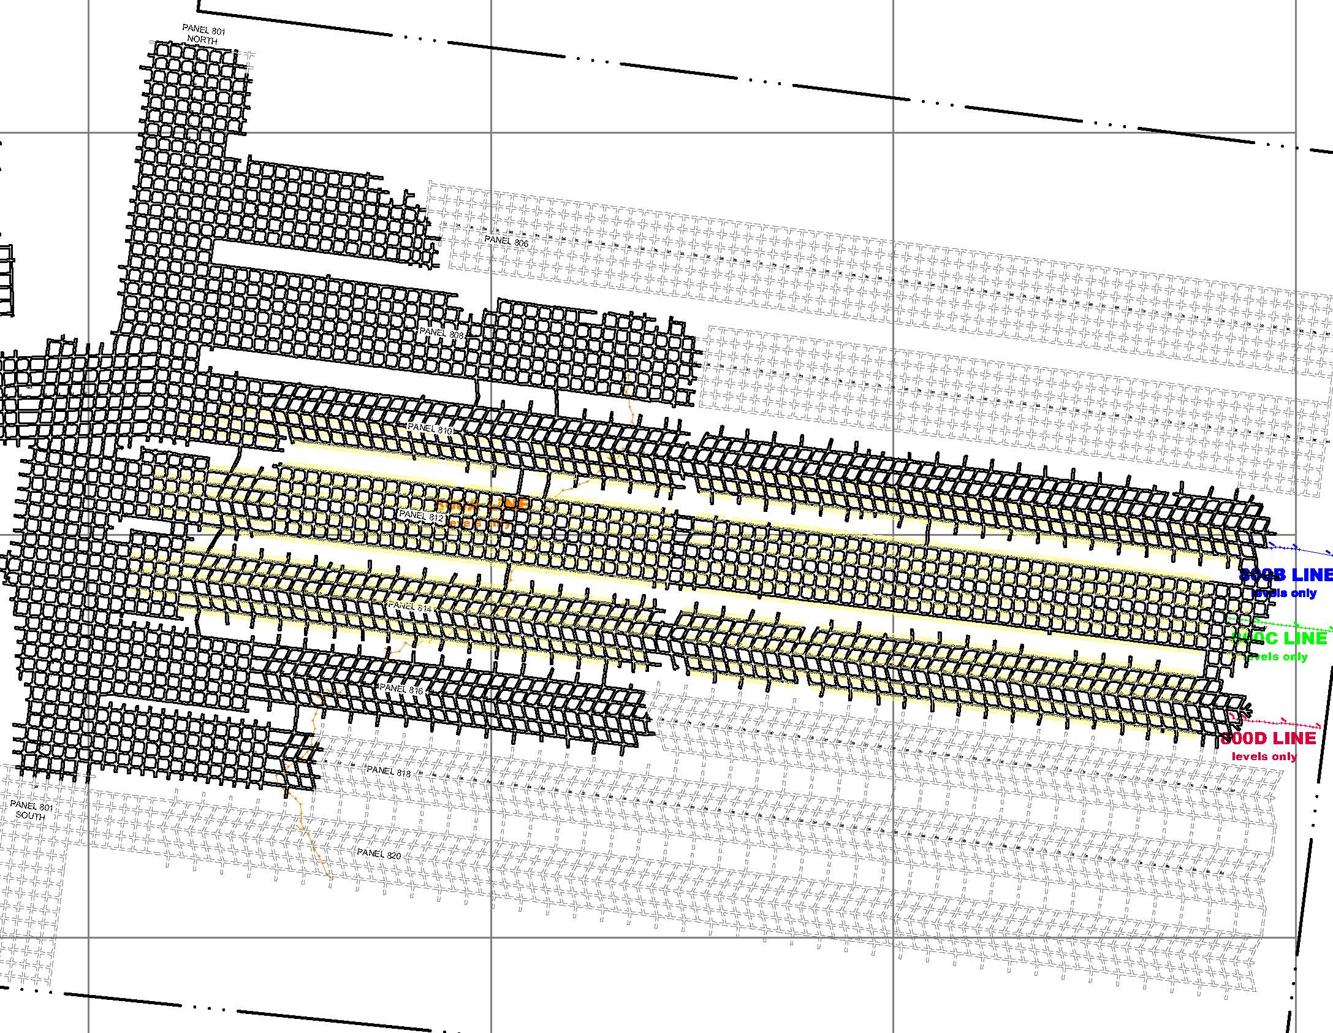
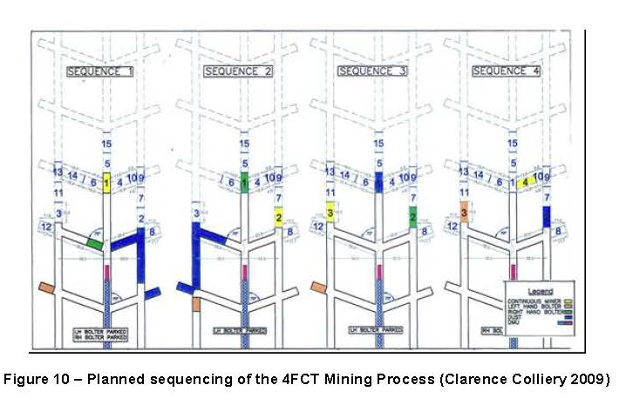

Slide 13
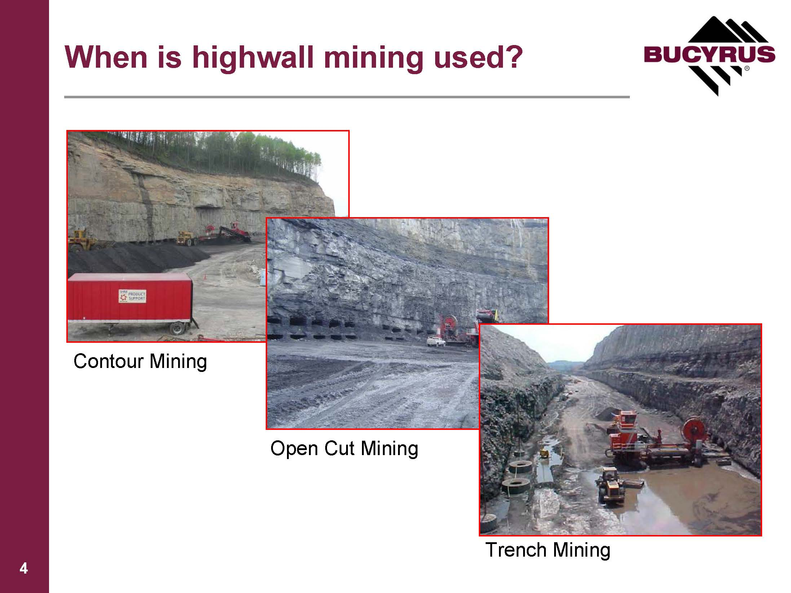

Slide 15
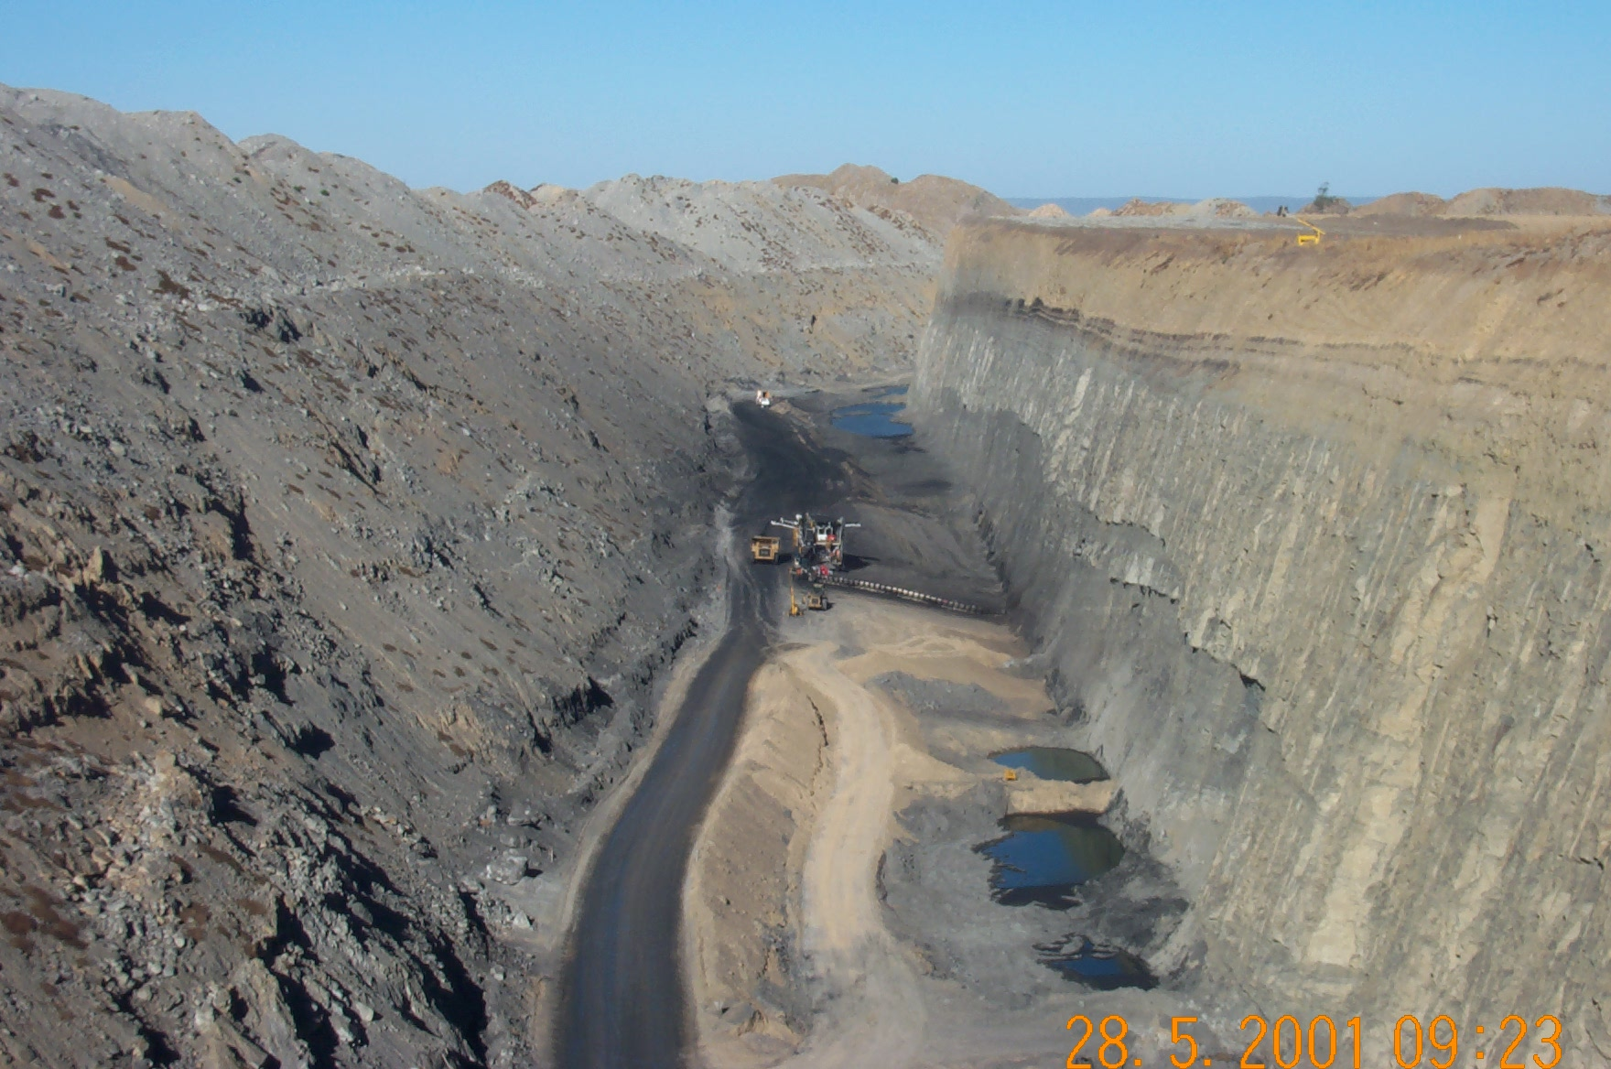

Slide 16
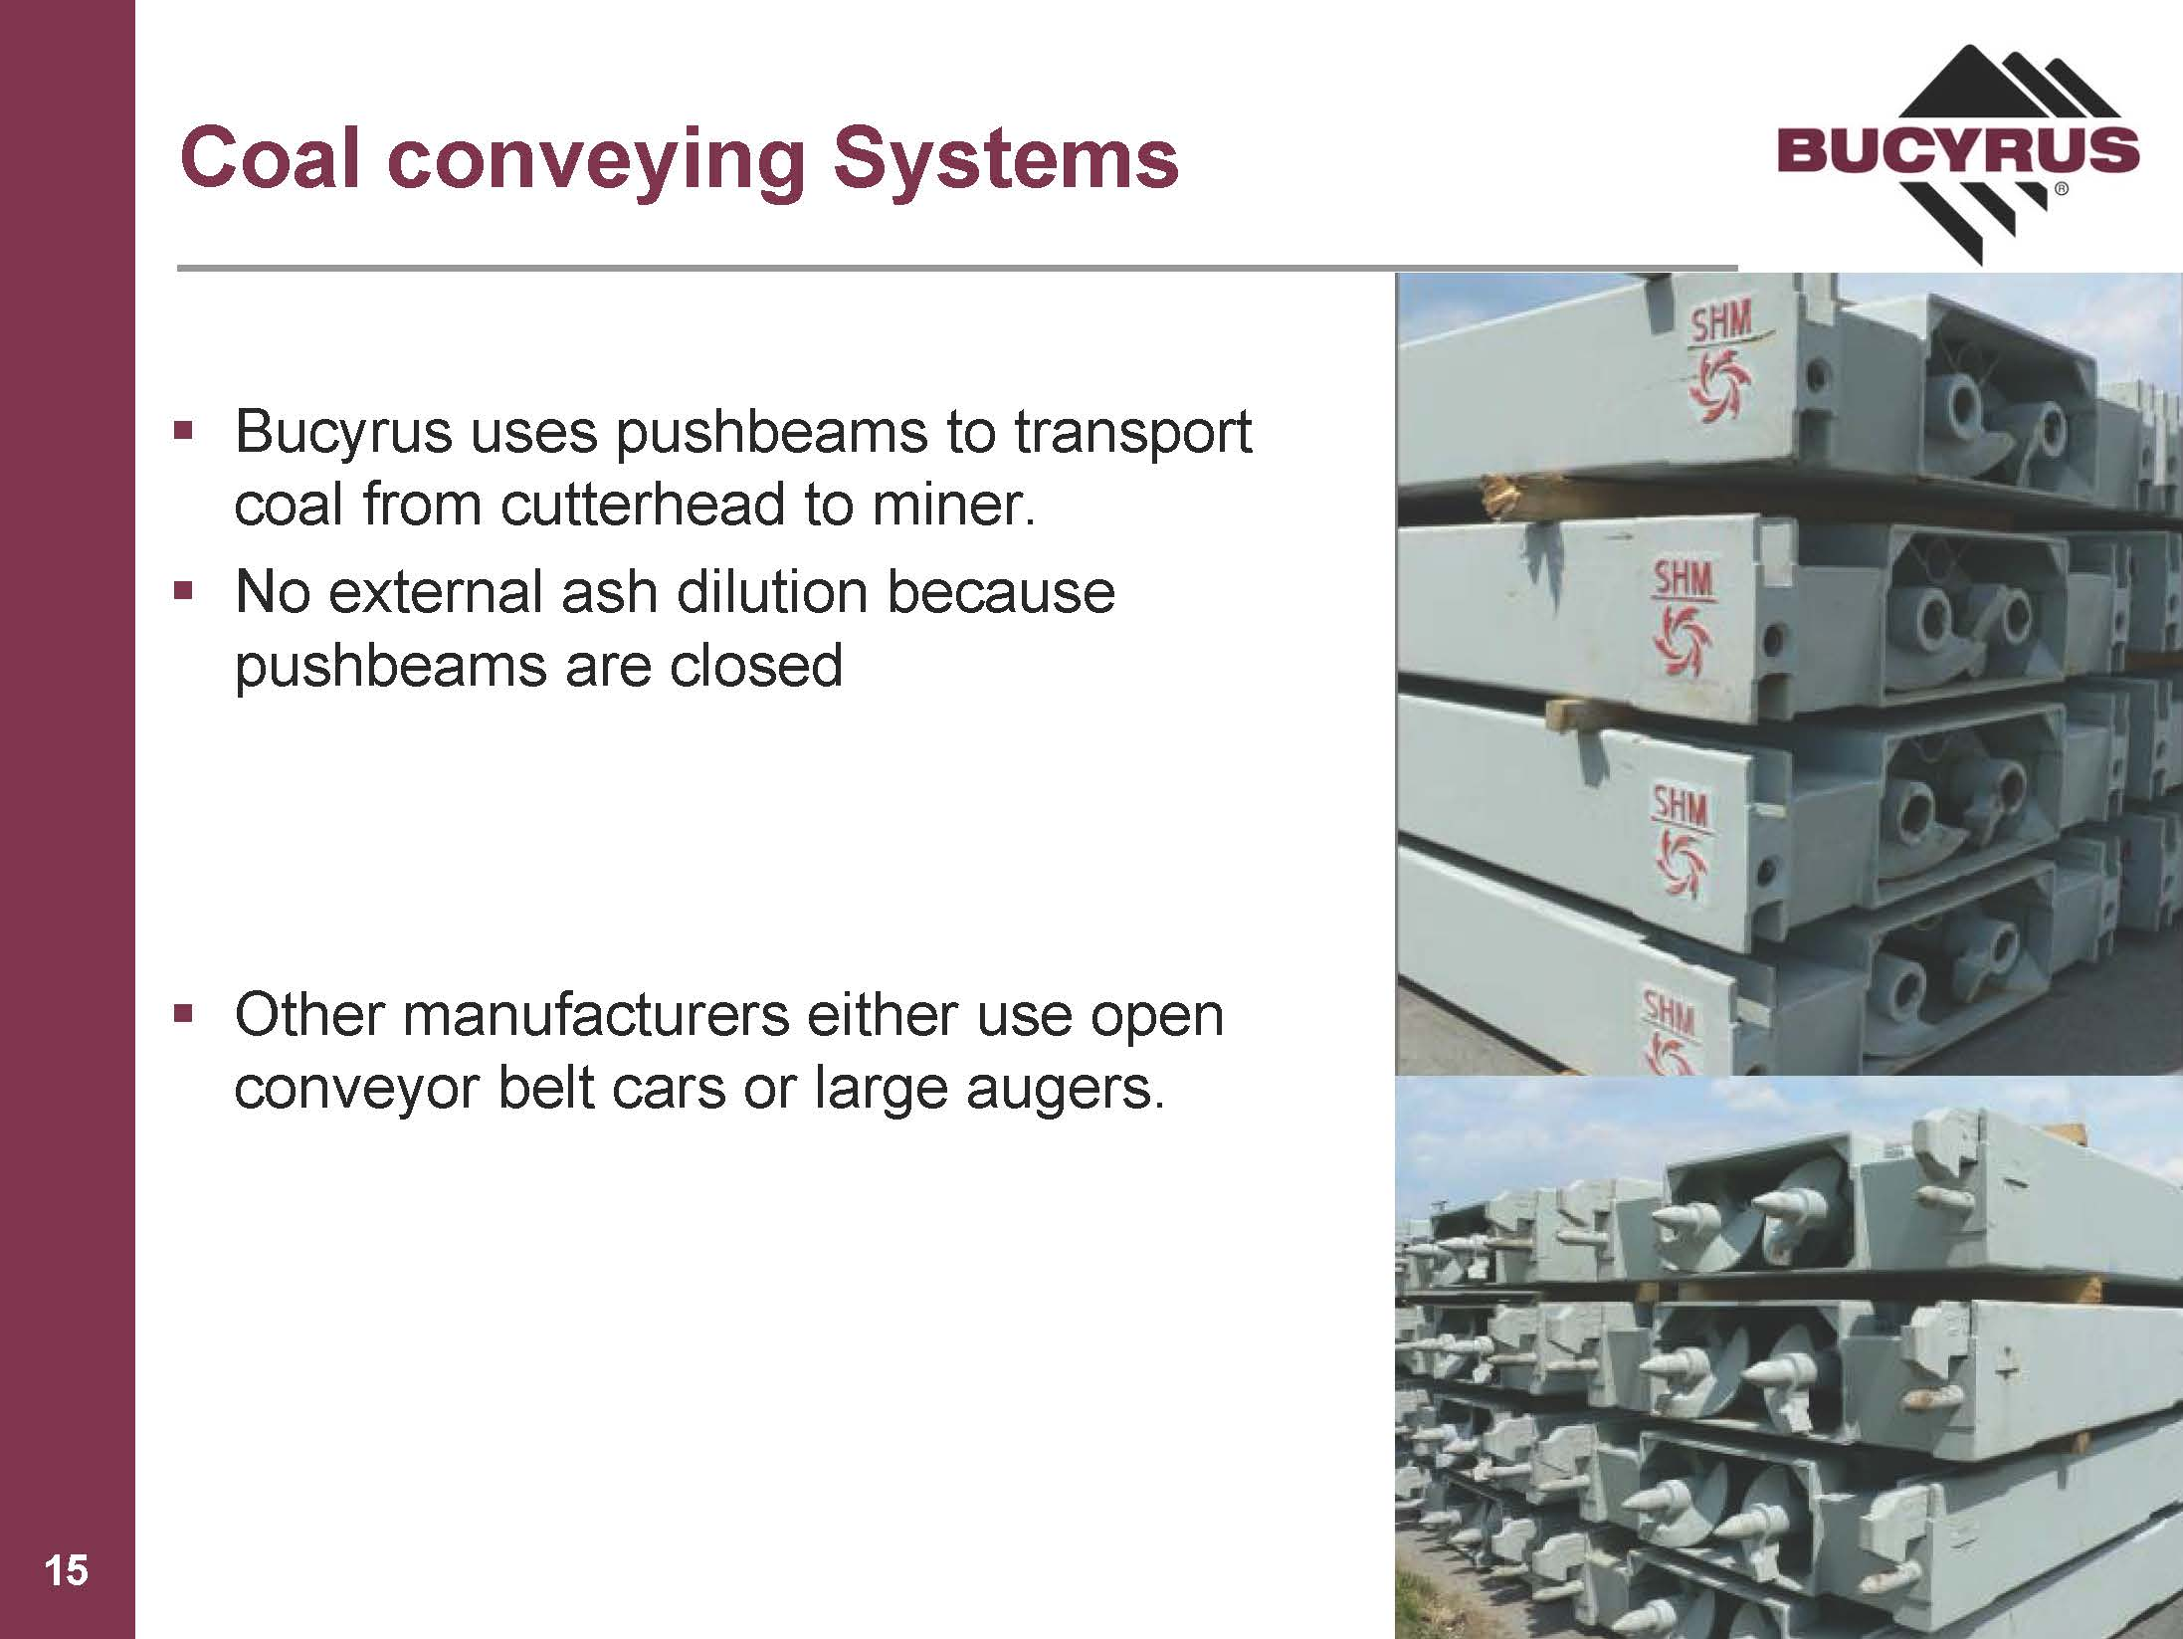

Slide 17
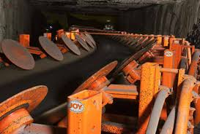

Slide 18
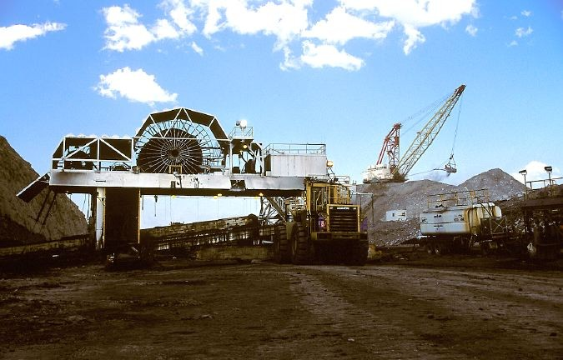

Slide 19
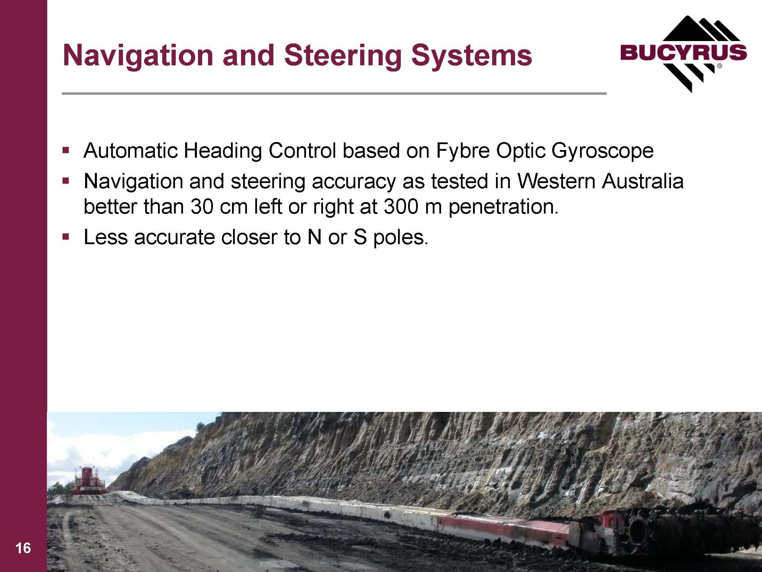

Slide 20
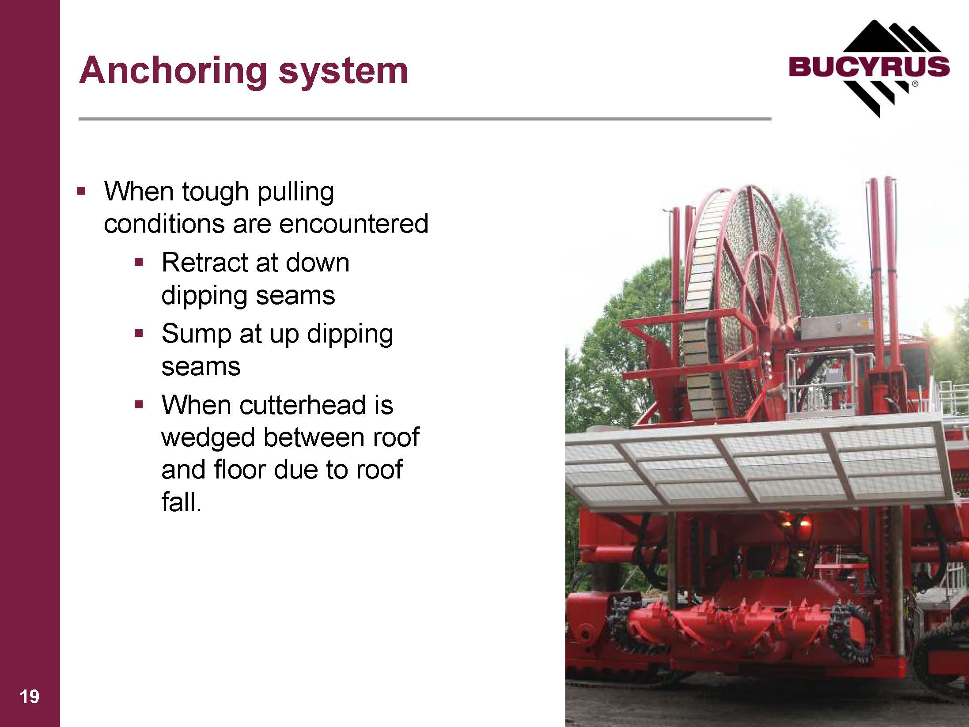

Slide 21
Galvin, J. M. (2016). Ground Engineering: Principles and Practices for Underground Coal Mining. Switzerland: Springer.

Slide 22
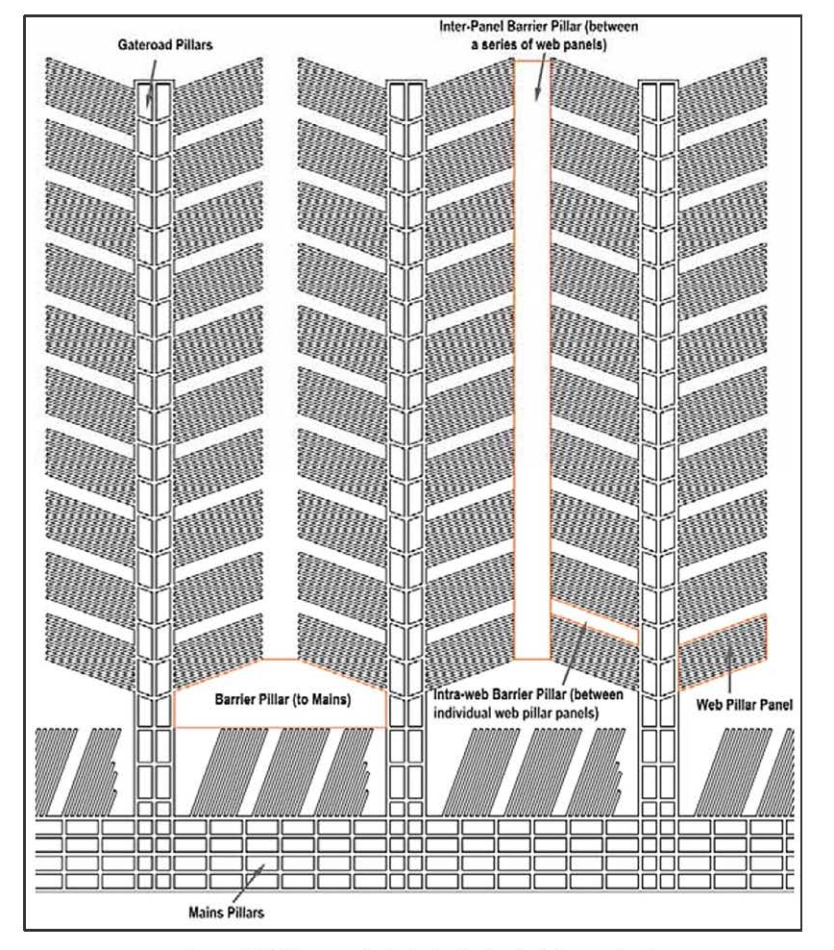
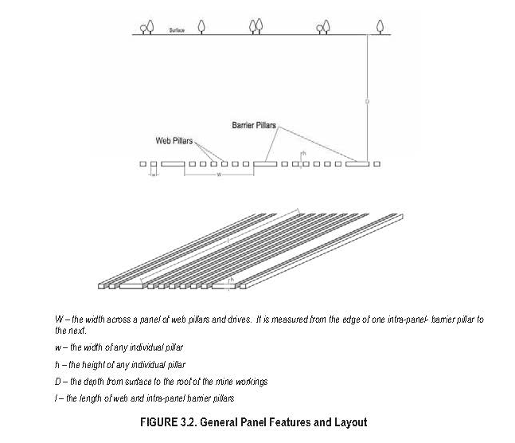

Slide 23
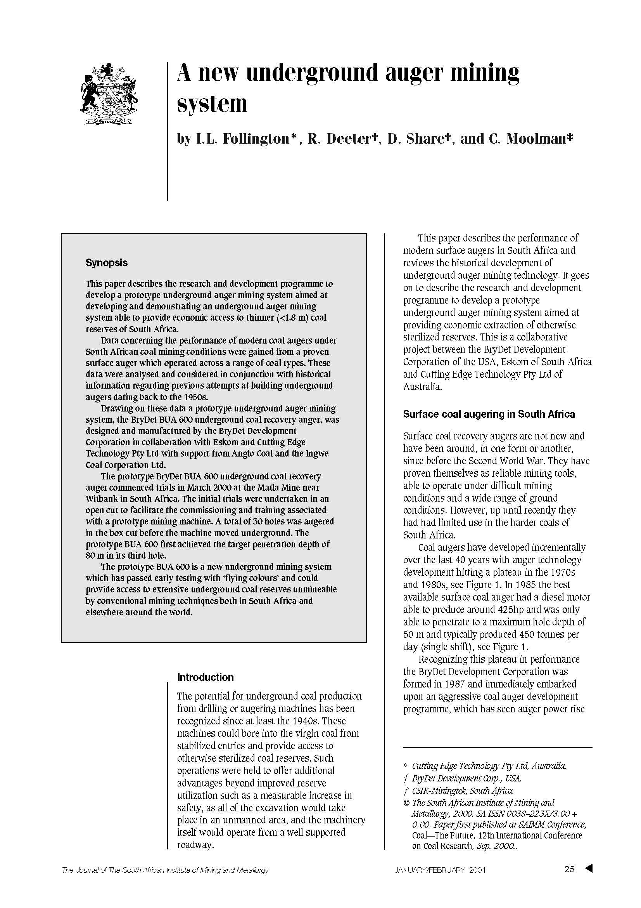
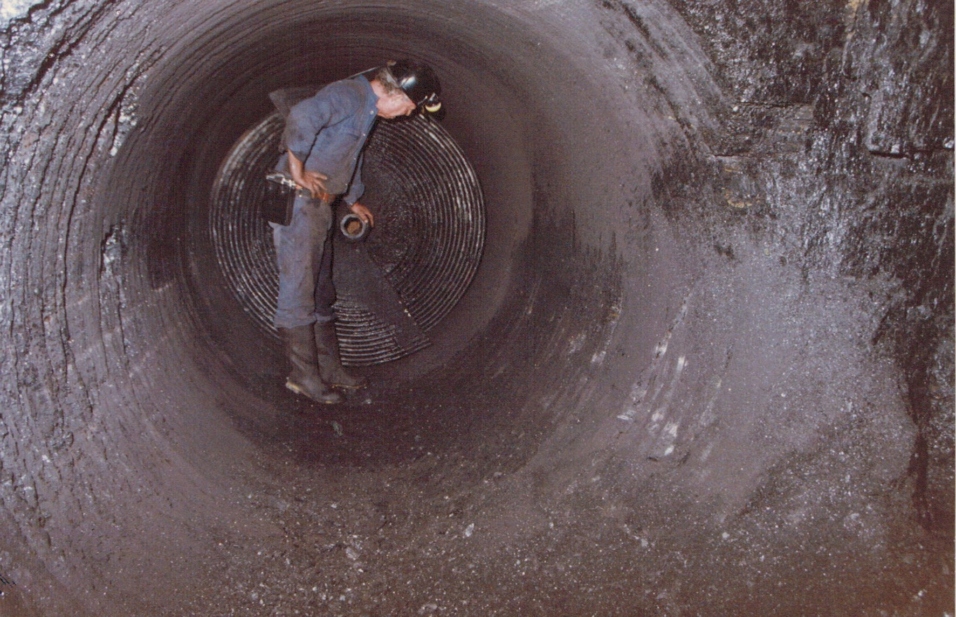

Slide 24
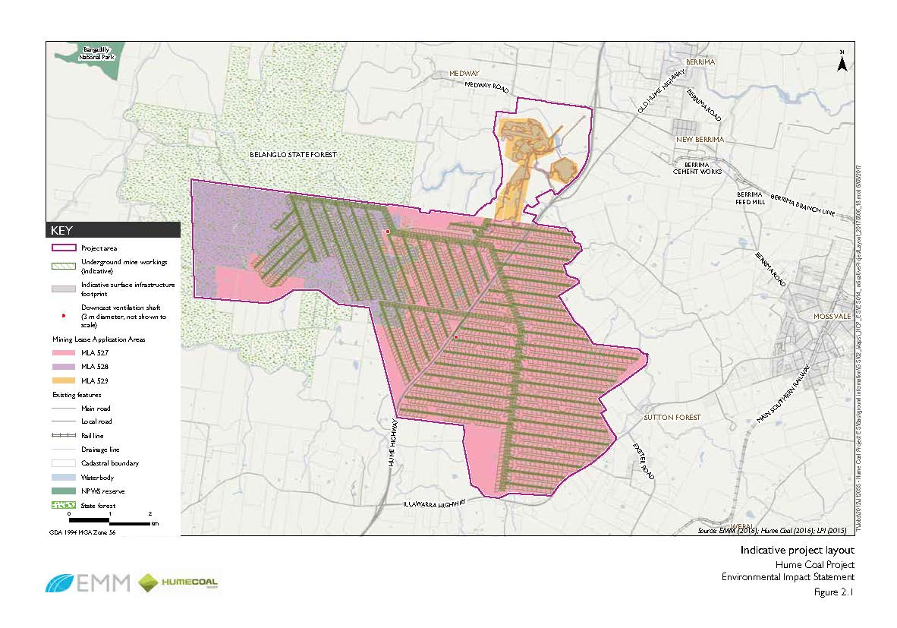

Slide 25
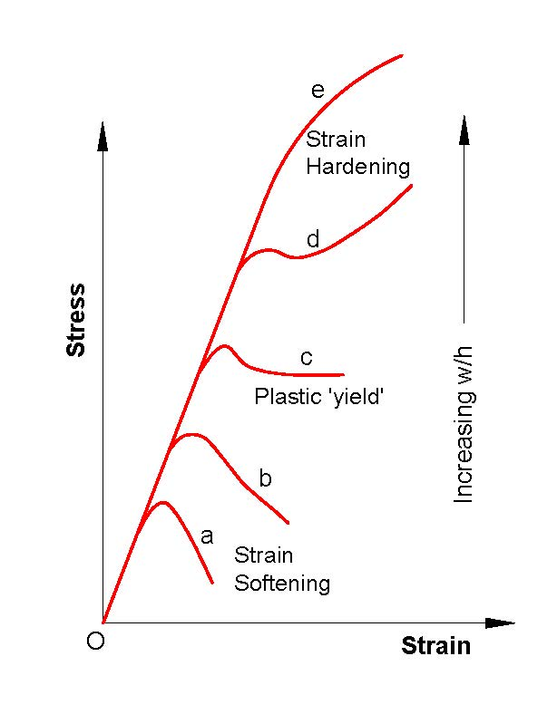

Slide 26
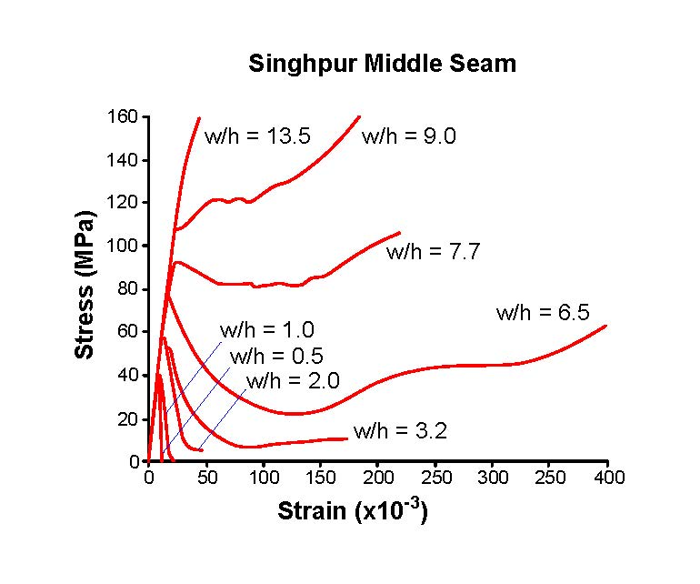

Slide 27
