Slide 1
Whitehaven Coal Limited
Vickery extension project | EIS
Independent planning commission Briefing
25 February 2019

Slide 2
Project Justification
The majority of Project coal is coking coal for steel making
The proposed increase from 4.5 to up to 10 Mtpa would facilitate:
More efficient extraction of resources
Provides justification to invest in an on site CHPP and rail spur
The cessation of coal transport on public roads and operations of the Gunnedah CHPP (the Project rail spur is unlikely to be economically viable at 4.5 Mtpa)
Site is a former mining precinct, but known to contain highly sought after coal
When compared with the Approved Mine:
Open cut mining is no closer to the Namoi River
The Western Emplacement is no closer to the Namoi River
No significant change in predicted amenity and dust impacts from mining operations
The number of final voids would decrease from 2 to 1

Slide 3
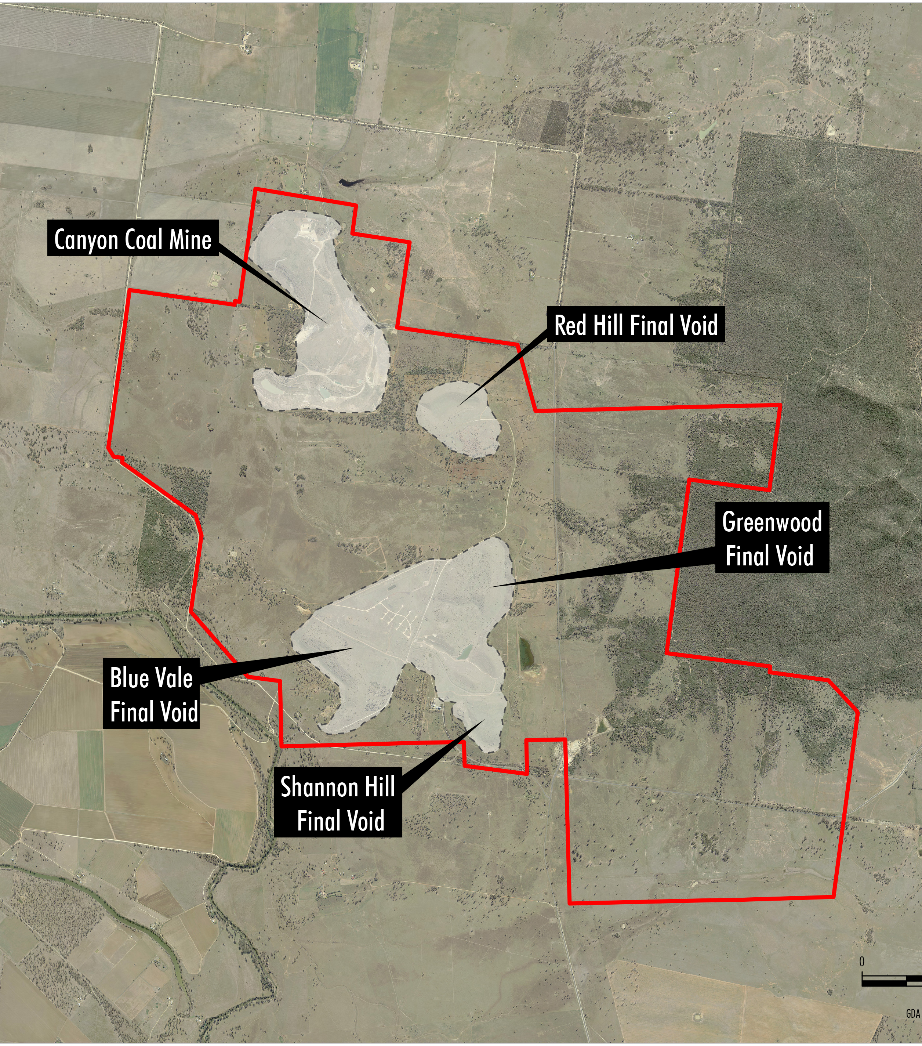
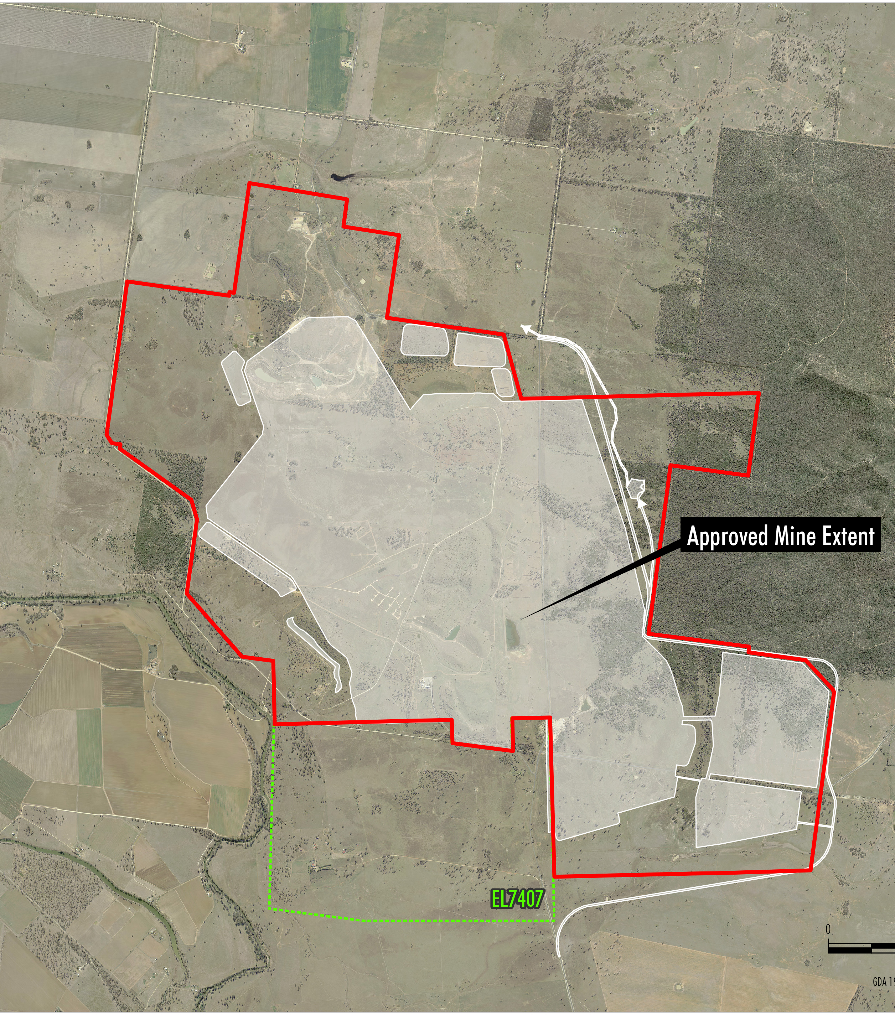
Project Site – History of Mining
Historic Mining
Approved Mine
Notes:
Historic mining conducted since 1980s.
Multiple final voids remain in the landscape.
Vickery Coal Mine, referred to as the ‘Approved Mine’ was approved in 2014.
Approved Mine has not been developed.
Whitehaven gave priority to other developments.
Acquisition of Vickery South Project from Coal Works (EL 7407) triggered revised mine planning for the Project
Coal quality is very good.
High energy / low ash coal which can be used for metallurgical as well as thermal coal.
Approved Mine will physically commence in 2019.

Slide 4
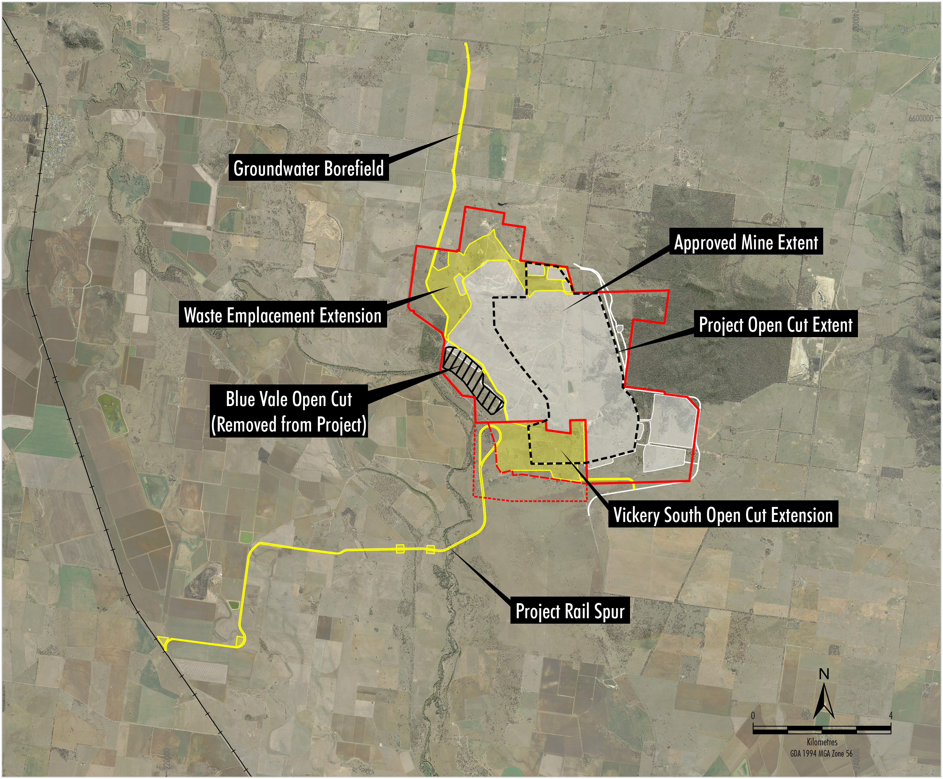
Project – Builds on Existing Approval
Notes:
The Vickery Extension Project is an extension to the Approved Mine. The extension areas are shown in yellow, comprising extensions to the open cut and waste emplacement areas, a rail spur, infrastructure area and a groundwater supply borefield.
The VEP concept allows for road trucking of coal and processing of it on the edge of Gunnedah to be discontinued which is considered to be a very positive outcome.
The Blue Vale open cut, shown in black, was originally included within the Project, but has been removed following consultation with the community.

Slide 5
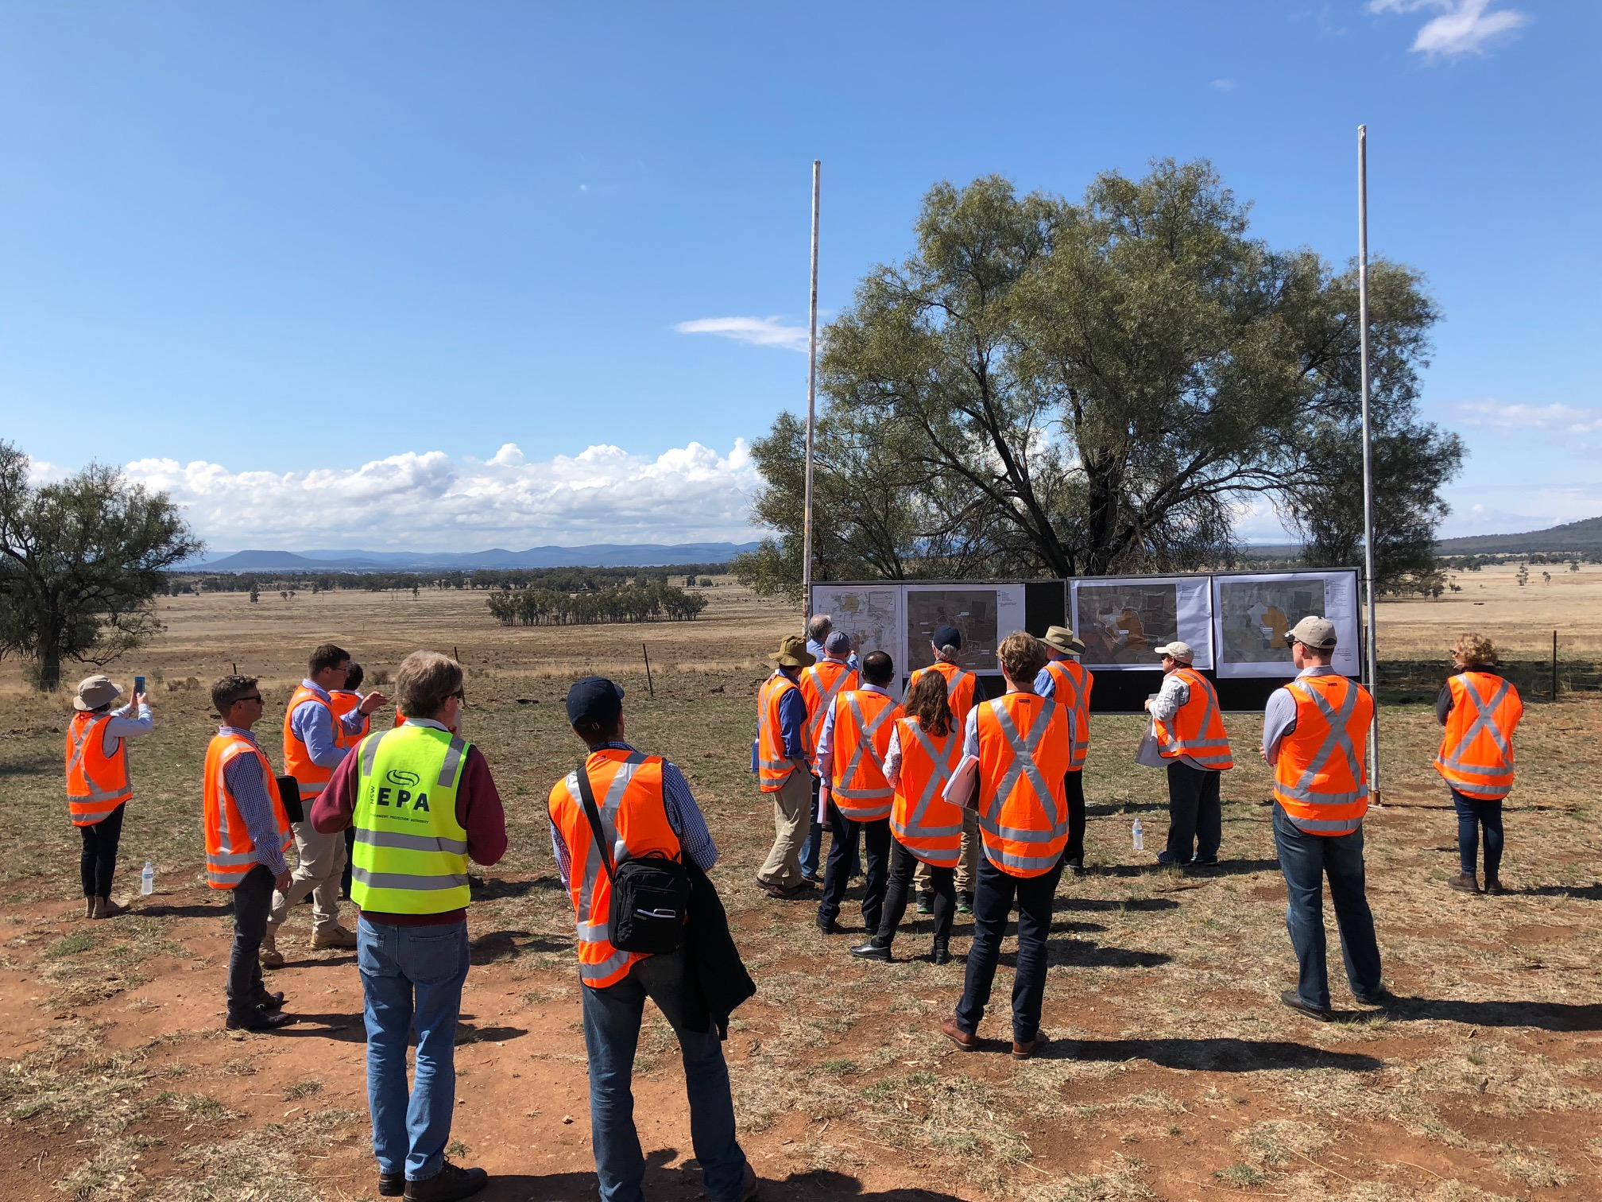
Extensive Community Consultation
Face-to-face meetings with locals and businesses
Community information sessions
Digital communications campaign
Individual landholder packages
Newsletters
Site tours
Social Impact Assessment
5 years of qualitative and quantitative baseline research on community views
Notes:
Whitehaven has undertaken considerable consultation with members of the local community and business over the past few years.
Community information sessions have been conducted in Boggabri and Emerald Hill as well as on site and Gunnedah.
Whitehaven holds regular Community Consultation Committee sessions under the Approved Mine Development Consent.
During the EIS Exhibition Period copies of the EIS were provided to interested landholders.
Also extracts from the EIS were provided to landholders within the local environs of the Project.
To further assist landholders and interested members of the public digital communication campaign was conducted.
Five years of quantitative and qualitative baseline research into community sentiment has been conducted.
A Social Impact Assessment conducted in general accordance with the DP&E Assessment Guideline

Slide 6
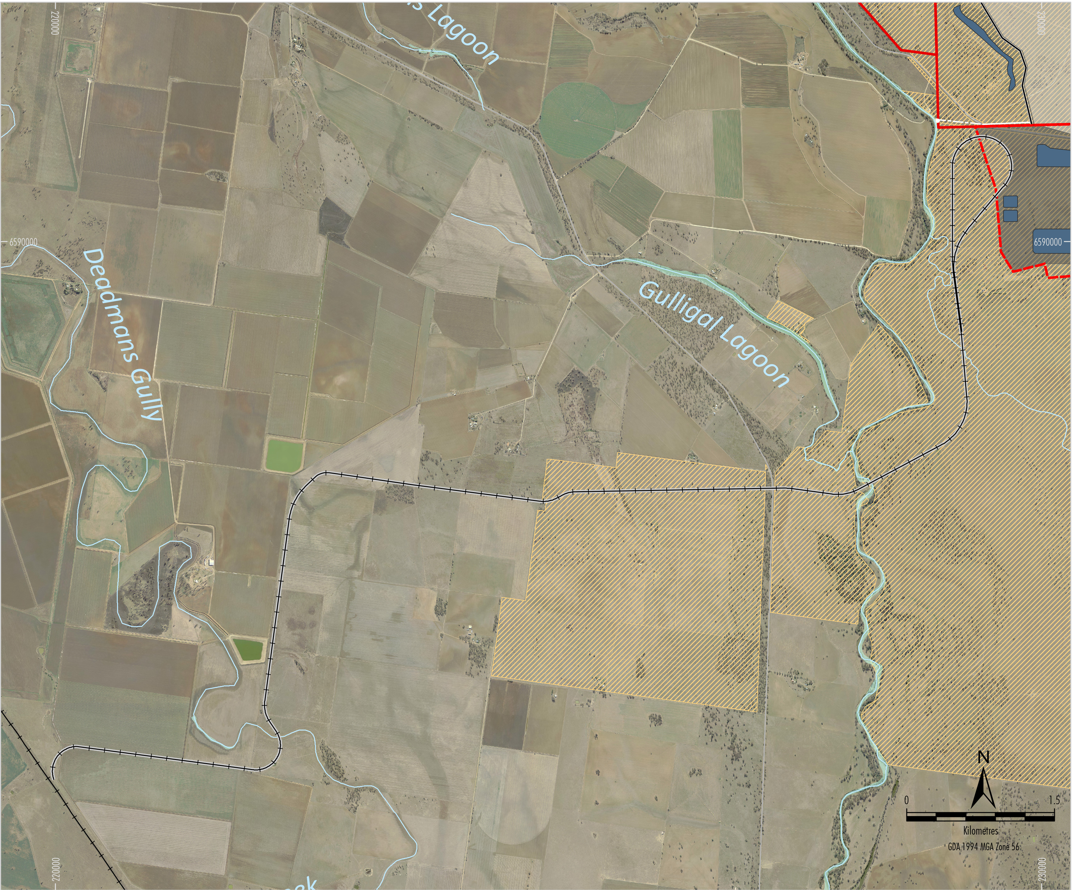
Project Rail Spur
Notes:
A key Project benefit will be the removal of haul trucks from public roads following construction of the Project rail spur.
Located on Whitehaven land or where land access agreements in place.
Alternative rail corridors considered including corridor to the north.
A range of issues arose with connecting to the Boggabri Maules Creek Rail spur which made it not feasible and significantly less economic, including:
Congestion on the common section of the Boggabri Maules Creek rail spur.
Disturbance of an existing biodiversity offset area.
Increased train movements through the town of Boggabri.
Increased travel distance between the mine and port.
Also additional trains would pass through Boggabri

Slide 7
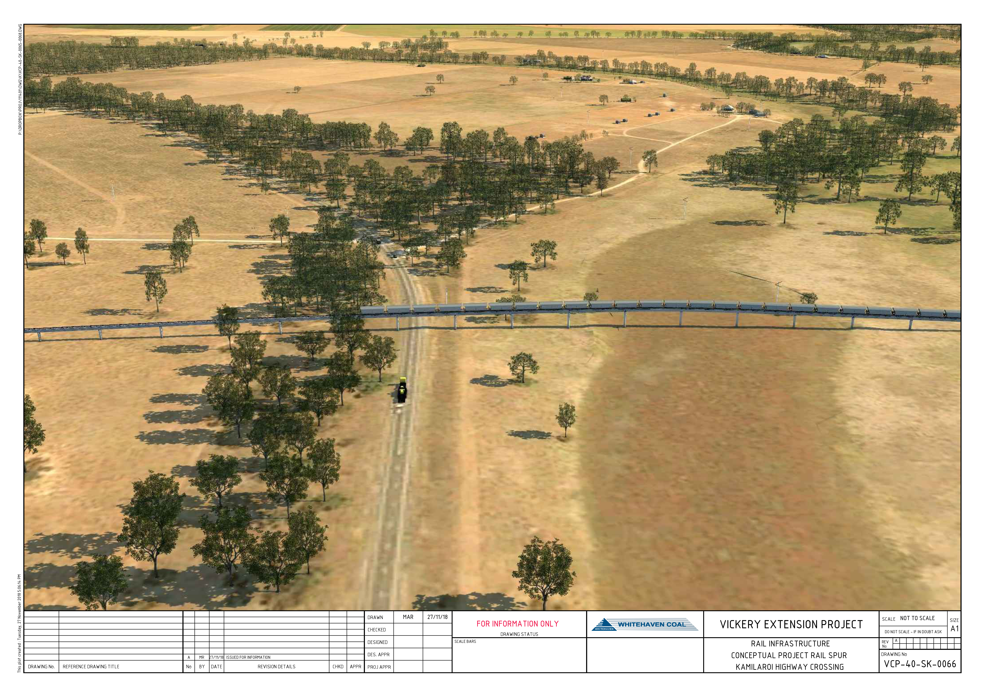
Rail Spur – Designed to Avoid Flood Impacts
Notes:
Rail spur superstructure similar to the existing Maules Creek rail spur.
Located on property boundaries to minimise disruption to existing agricultural enterprises.
Closest existing dwellings (~500 m and ~750 m) located on one property with all other dwellings located more than ~800 m from the rail spur.
Compliance with relevant noise criteria for private rail spurs predicted at all existing private dwellings.
Designed to comply with the Namoi Floodplain Management Plan.

Slide 8
Improved Final Landform
Reduction in final voids (2→1)
Reduction in final void catchment area (490ha→250ha)
Final void to act as a groundwater sink with no risk of overtopping
Small indirect groundwater inflows which would be licenced
Backfill not considered reasonable or feasible
Progressive rehabilitation to native vegetation and agricultural areas
Macro-relief to integrate with Vickery State Forest landforms
Micro-relief to stabilise landform
100m lower than Vickery State Forest
Detailed design of final landform to be developed in Rehabilitation Strategy with DRG
Notes:
Improved final landform, compared with Approved Mine, including a major reduction in the number of final voids.
Compared with Approved Mine which has two final voids of 490ha, VEP has on final void of 250ha.
Modelling confirms the final void would act as a groundwater sink and will capture salinity.
DPE states “the proposed final void appears to be a considerable improvement on the approved final landform, in terms of the number and catchment area of the voids, and the long-term groundwater inflows”.
Micro-relief incorporated into landform design to assist in developing a stable landform.
Landform to be progressively rehabilitated to native vegetation and areas suitable for agriculture.
Height of over burden dump less than height of ridgeline in the Vickery State Forest.

Slide 9
IPC Questions
Notes:
Next specialists engaged by Whitehaven to conduct assessments will present a summary of the work undertaken.

Slide 10
Details of the assessment of all rail options & particularly the northern loop, providing assumptions and specific reasons for conclusions
Whitehaven considered a number of options for the rail spur, in particular the:
Project rail spur presented in the EIS
Northern rail spur
In assessing the options the factors considered included:
Land ownership
Construction (comparative lengths, watercourse and road crossings, upgrades to existing infrastructure)
Logistics and congestion (capacity of the existing Maules Creek-Boggabri Spur, cycle times, requirement for new passing loops)
Environmental (e.g. floodplain management, Boggabri offsets, biodiversity, Aboriginal heritage)
Relative costs (capital, operational, above/below rail)
An economic analysis of the two options indicated that the rail spur options proposed delivered in excess of $150m of value when compared with the northern option
Notes:
Next specialists engaged by Whitehaven to conduct assessments will present a summary of the work undertaken.

Slide 11
More explicit arguments need to be provided re the infeasibility of the northern route (e.g. the 2014 EIS indicates that Tarrawonga was to share the Boggabri Mine loading facilities but no commercial agreement could be reached, suggesting that the route can technically carry more coal than its current usage). Are there engineering issues or economic, or something else?
The Common Section of the Maules Creek-Boggabri rail spur has six participants (Whitehaven is one of the six)
When the original joint venture was formed, the capacity of the rail spur was stated to be 28 Mtpa
Maules Creek Mine has an approved rail output of 12.4 Mtpa
Boggabri Coal has an approved rail output of 10 Mtpa
Therefore currently allocated is 22.4 Mtpa
Spare capacity 5.6 Mtpa (shared between each of the six participants)
Railings from the Project up to 11.5 Mtpa
Capacity increase would necessitate significant improvements in infrastructure (e.g. new passing loops, floodplain crossing) and new above rail plant.
Notes:
Next specialists engaged by Whitehaven to conduct assessments will present a summary of the work undertaken.

Slide 12
Specific timing of rail commissioning
Specific timing is dependent on Project approval
Expect construction period to first railing of approximately twelve months
Full commissioning (e.g. destressing, signaling, defect rectification) approximately another six months
Specific timing of CHPP commissioning.
Specific timing is dependent on Project approval
A construction period of approximately twelve months
It assumes that long lead time equipment is ordered in advance
Commissioning of the plant usually takes six to nine months
Notes:
Next specialists engaged by Whitehaven to conduct assessments will present a summary of the work undertaken.

Slide 13
Details of the assessment of all options & assumptions for the location of the CHPP and reasons for the proposed positioning.
Location of CHPP related to the rail spur location
Proposed rail spur approaches mine from south west – lends itself to similar location of the CHPP
Location clear of flood zone
Alternative location was to the north west of the mine
It impacted on vegetation
Also rail spur would be required to traverse the full western boundary of the mine.
Notes:
Next specialists engaged by Whitehaven to conduct assessments will present a summary of the work undertaken.

Slide 14
Can the CHPP be bunded to reduce noise impacts on local landowners (e.g. extension of the western emplacement to surround the CHPP).
There is insufficient space between the extent of mining tenure and the pit to construct a bund of sufficient size to be effective
Noise impacts under adverse weather conditions at the closest residences to the south west (apart from 127c) are ‘negligible’ (under VLAMP definition) or compliant with the NSW Noise Policy for Industry noise limits
An acoustic treatment package has been developed for 127c and has been shared with the owners
Whitehaven will continue to consult with the owners of property 127
Notes:
Next specialists engaged by Whitehaven to conduct assessments will present a summary of the work undertaken.

Slide 15
The EIS indicates that rehabilitation will be progressive with soils from newly cleared areas being used on rehabilitated areas. Significant parts of the north and the west of the proposed mine are previously rehabilitated sites and no soil data about the reconstructed soil properties in these previously rehabilitated areas have been provided in the report. Is data available which demonstrates that the soils from these previously rehabilitated areas will be suitable as source materials for progressive soil profile reconstruction.
Soil testing conducted for the Approved Mine and Project included test pits within previously mined areas
The soil tests confirm there is sufficient soil of appropriate properties to support the Project rehabilitation objectives
Can the outer batters of the emplacements be made to blend into the local topography with a more natural drainage lines and hill/valley (e.g. Geofluv type design)?
The rehabilitation strategy proposed for the Project includes the application of macro and micro profiling to deliver a natural topography of the overburden dump
This is an improved outcome in comparison to the Approved Mine
Notes:
Next specialists engaged by Whitehaven to conduct assessments will present a summary of the work undertaken.

Slide 16
What plans do Whitehaven have for Kurrumbede that would be of value to the local community?
The rail spur alignment and other infrastructure has been developed to have minimal impact on Kurrumbede
None of the buildings in the Kurrumbede complex are on or near the rail spur alignment
Whitehaven has committed to developing a Conservation Management Plan for Kurrumbede
Whitehaven has also committed a significant financial contribution for enhancement of the grounds of Kurrumbede with the view to being able to provide for some access to the grounds in the future
The proposal has been shared with the Mackellar Memorial Society for comment and input to the process
Notes:
Next specialists engaged by Whitehaven to conduct assessments will present a summary of the work undertaken.

Slide 17
If Vickery Mining is now an independent entity from Whitehaven can they provide guarantees re decommissioning of the southern Blue Vale Road coal transport and the Gunnedah CHPP?
Vickery Mining is a wholly owned subsidiary of Whitehaven
Such a structure is consistent with the corporate structure of other Whitehaven mines
Economic necessity will mean that as soon as the rail spur and CHPP are fully commissioned, Whitehaven will utilise the infrastructure that it has invested in as rail transport and processing through a new, modern on site CHPP is considerably more cost effective than road transport and processing through an older more costly to operate plant.
Notes:
Next specialists engaged by Whitehaven to conduct assessments will present a summary of the work undertaken.

Slide 18
Groundwater

Slide 19
Vickery Extension Project Groundwater Assessment
IPC Briefing - 25 February 2019
www.HydroSimulations.com
PO Box 241, Gerringong. NSW

Slide 20
Introduction
Groundwater Assessment:
Dr Noel Merrick, Senior Principal Hydrogeologist - HydroSimulations
Over 45 years’ experience in groundwater management issues and policy
Peer Review:
Dr Frans Kalf, Principal - Kalf and Associates
Over 45 years’ experience in hydrogeological modelling and impact assessments
DPE Peer Reviewer:
Hugh Middlemis, Senior Principal Modeller – HydroGeoLogic
Over 37 years’ experience in hydrological and hydrogeological engineering and policy
Experience in peer reviews for DPE

Slide 21
Groundwater Model
Based on model developed for the Approved Mine:
Updated 2016 for conversion from Modflow to Modflow-USG (operational scenarios 2016-2018)
Incorporation of additional data (groundwater investigation programs and monitoring data)
Model domain:
957 km² (approximately 33 km by 27 km)
1.34 million cells
14 layers
Calibration of the model to historical groundwater levels, historical stresses to the groundwater system (e.g. Canyon and Rocglen Coal Mines) and mine inflows.
Groundwater Model Extent
Dr Frans Kalf, in his peer review of the Project Groundwater Assessment (refer to Attachment 4 of the EIS), appraised the groundwater model calibration as “very good”.
Mr Hugh Middlemis, in his peer review for DPE, stated:
“The model has a good history match calibration in steady state and transient modes to the data record 2006-2011, with subsequent verification to 2012-2017. This is consistent with best practice and is well-executed to establish the validity of the model a sound predictive tool.”

Slide 22
Groundwater Assessment
Assessment Objectives
Assess potential impacts of the Project to the quantity and quality of the region’s groundwater resources, including the Namoi River, its associated alluvium and other groundwater users
Key Conclusions
2 m groundwater drawdown predicted by the model would not extend from the Maules Creek Formation into the Namoi River alluvium
The final void would act as a permanent groundwater sink
Compliance with the ‘Level 1’ minimal impact criteria in the AIP:
<< 2 m drawdown at privately-owned bores and the Boggabri town water supply bore
Groundwater quality – no change in beneficial use; no increase in Namoi River salinity
Predicted groundwater inflows during and post-mining are within licences held by Whitehaven for the Project
The Project borefield designed in accordance with Water Sharing Plan rules causes <0.2 m predicted drawdown at the closest private bore (cumulatively with mining)

Slide 23
Bores

Slide 24
Peer Review Comments
Dr Frans Kalf’s peer review concluded:
“Model pre-mine and end-of-mine conceptualisation for the Vickery Extension Project by HS is considered suitable as well as the model layering configuration. A total of 14 layers were used which is adequate for the five main coal seams and separation interburden units simulated including the basal Boggabri volcanics represented in layer 14 and alluvium, regolith and overburden represented in Layers 1 and 2.”
Mr Middlemis’ peer review (on behalf of DPE) concluded:
“… the Vickery Extension hydrogeological and groundwater modelling assessment is fit for the purpose of mine dewatering environmental impact assessment (including cumulative impacts) and informing management strategies and licensing.”
…
“The recommended monitoring program and ongoing hydrogeological investigations are well-designed and will provide additional data for future model refinements and improvements in performance, and for comprehensive uncertainty analysis.” [Note: modelling pre-dates IESC uncertainty guidelines: draft Feb.2018; final Dec.2018]
Whitehaven’s Response to Submissions will include detailed responses to each of DPE’s Peer Review comments, and 7 IPC questions – summary responses follow…

Slide 25
IPC Questions

Slide 26
What is the stratigraphy used in the groundwater model? What data is it based on?
The 14 model layers represent the lithologies within the model domain
Lithologies within the model domain have been identified based on:
Published regional data (e.g. government geological mapping)
Government hydrogeological studies and models (e.g. Upper Namoi Groundwater Flow Model) – alluvium thickness determined by drilling and seismic refraction surveys in late 1960s
Review of regional bore logs
Review of local geological and groundwater monitoring data (e.g. historical Vickery mine and Canyon, Rocglen, Tarrawonga Coal Mines)
Site specific hydrogeological investigations (e.g. alluvial definition drilling; TEM)
Site geological model from exploration drilling

Slide 27
What are the hydro-geological functional parameters for the stratigraphy (i.e. storativity, specific yield, hydraulic conductivities, any anisotropy)? What data are they based on?
Modelled hydraulic parameters are based on a combination of published and monitored data
Site-specific test work included core tests, pumping tests and slug tests
The adopted hydraulic parameters were refined as part of the calibration process for consistency with measured groundwater levels – considered ‘good’ by peer reviewers
The IESC notes that the “specific storage” values used in the alluvial areas of model Layer 2 “could be unrealistically high”:
The basis for this statement is not provided by the IESC – presumably Rau et al. (2018) who advocate a range from 2.3E-7 to 1.3E-5 /m.
Reported values are Storage Coefficient NOT Specific Storage. The equivalent Specific Storage value for Layer 2 would vary from 3E-5 to 1E-4 /m. McNeilage (2012; DoI Water) estimated 1E-4 to 1E-3 /m – maps in formal response.
The 2 m drawdown contour does not extend from the Maules Creek Formation into the Namoi River alluvium. The difference from the Rau maximum value would not have a significant effect on predictions. A reduction in modelled alluvial storage values would not increase the risk of drawdown >2 m at water supply works in the Namoi River alluvium.

Slide 28
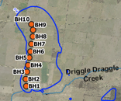
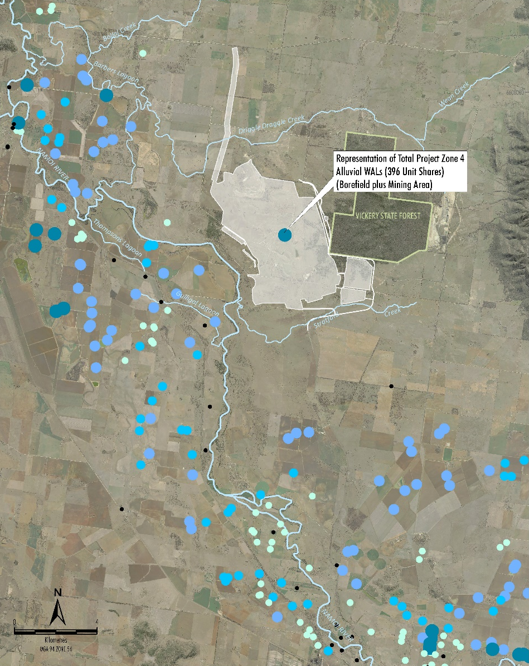
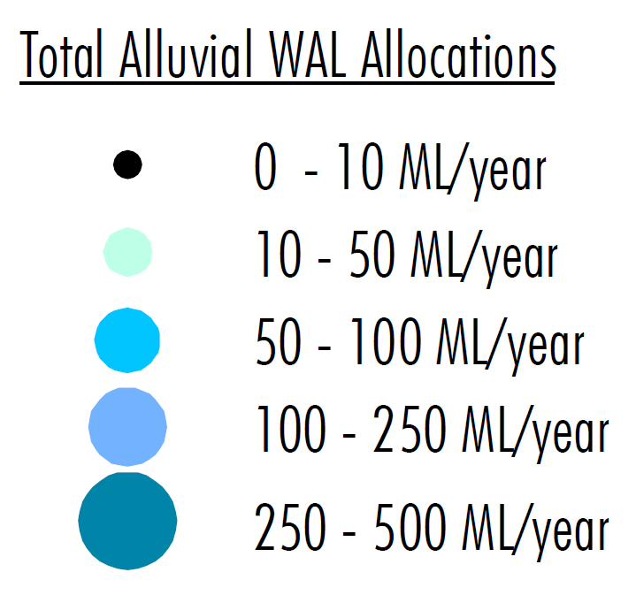
What is the reliability of the predictions for the bore field (particularly given no test wells were drilled to the north of the site)? Specifically, what sensitivity studies were performed and what was the rationale for those sensitivity studies that were performed and those that were not?
2 m Drawdown Contour
The borefield would be required only when rainfall captured on-site and Namoi River general security licensed allocations are insufficient to meet Project water demands
The borefield design & operation is to be consistent with Water Sharing Plan licensing requirements:
Whitehaven’s total alluvial licences are insignificant in the context of the total quantity available under the Water Sharing Plan.
Individual bores would be positioned in accordance with the rules of the Water Sharing Plan.
The key predictions for the borefield are based on ultra-conservative modelling of 600 ML/a continuous production, including cumulatively with Project mining.
Alluvium properties at the borefield are well defined through calibration and are consistent with the DoI Water model – maps in formal response.
The risk of an impact on the nearest production bores is too low to warrant sensitivity analysis. The predictions for the borefield are reliable.
<400 ML/a

Slide 29
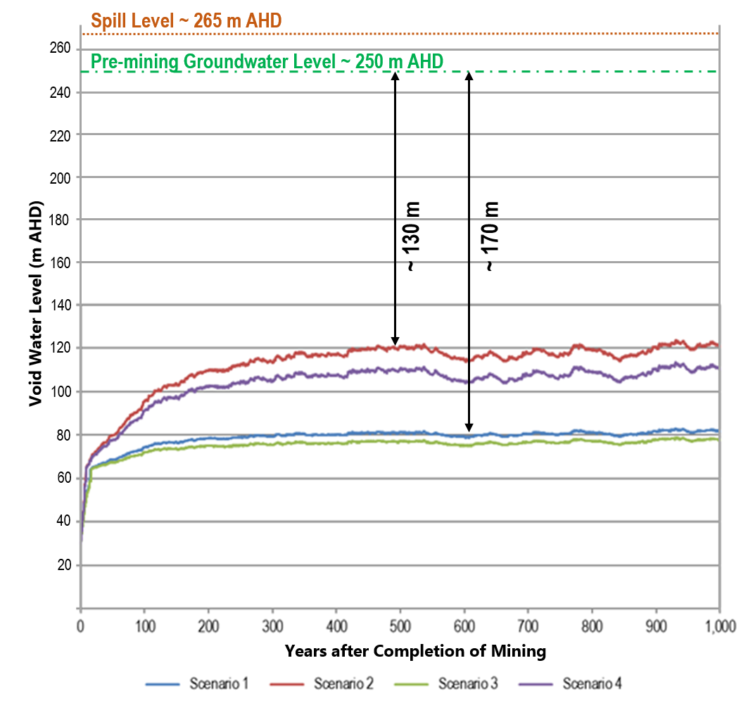
The reports note that post-rehabilitation that groundwater transients are observed for 300 years. Please present results of drawdowns and flow directions for 300 years as the report only shows them for 100 years for the entire domain modelled, not just in the immediate locale of the mine. Justify that the pit lake will be a sink for the entire site for the entire transient period, and at equilibrium.
The final void will be a sink under all predicted scenarios.
Groundwater modellers defer to surface water modellers for better representation of spatial and temporal scale, final landform, incorporation of runoff and stochastic climate, and salinity calculations.
The Surface Water Assessment has assessed the final void pit lake elevation for:
A period of 1,000 years.
Four scenarios to test the sensitivity of predictions under IPCC climate change scenarios.
The groundwater model provides input to the Surface Water Assessment in the form of a discharge-stage curve.
Finding: Long-term, the pit lake would be at least 130 m below the surrounding groundwater table.
Running the groundwater model for 300 years (adopting the pit lake level from the surface water model) would still demonstrate the void to be a strong sink
– an extra 10-20m would not change the appearance of the 100yr map. Additional modelling is therefore not considered warranted.

Slide 30
What is the sensitivity of the equilibrium pit lake elevation to changes in the groundwater parameter assumptions? Do all aquifers drain into the lake or can some be recharged (and thus polluted) by the equilibrium pit lake water level?
To what extent does the increasing concentration of solutes in the void with time pose a serious threat to groundwater quality in the region?
As the final void remains a strong sink, groundwater flow would be to the final void preventing the migration of water from the void. There is negligible risk for water in the void recharging the groundwater system.
The pit lake elevation is not considered sensitive to groundwater parameter assumptions because:
Inflows are minor compared to rainfall and evaporation.
Changes in regional groundwater system properties in general would have a negligible effect on the discharge-stage curve input to the surface water model.
The discharge is controlled by adopted spoil properties. The model uses Kx=1 m/d and Kz=0.1 m/d (Mackie, 2009). Spoil properties would have a slight effect on the discharge-stage curve, as the hydraulic gradient through the spoil would alter.
For current final landform design there is negligible risk of the final void not acting as a permanent sink.

Slide 31
What is the sensitivity of the results to potential climate change impacts both during and post-mining?
The Groundwater and Surface Water Assessments have considered potential changes in rainfall and evaporation to account for climate change predictions over the life of mining and post-mining.
Post-mining:
The sensitivity of the final void pit lake equilibrium level has been tested by Advisian (2018) for various IPCC climate change scenarios.
During mining:
NarClim, CCiA and CSIRO modelling predictions have been reviewed for Project mining and post-mining periods, for each of four seasons.
The pit inflow predicted by the groundwater model was found to be insensitive to recharge variation predicted by CCiA climate change models.
The site water balance predicts water supply demands could be met (within Whitehaven’s licensed allocations) and that the water management system would operate satisfactorily to contain rainfall runoff.
Groundwater and Surface Water Assessment have been peer reviewed (for the EIS and by / on behalf of DPE)

Slide 32
THE END
www.hydrosimulations.com
32

Slide 33
Surface Water

Slide 34
Vickery Extension Project Surface Water Assessment
Relevant image needed
Independent Planning Commission Briefing
Chris Thomas
Senior Principal Practice Lead – Water Resources
25 February 2019

Slide 35
Vickery Extension Project Surface Water Assessment
Introduction
Chris Thomas (B.Eng., M.Eng.Sc.), Principal, Water Resources, Advisian
30 years experience as a Water Resources Engineer practicing in all facets including catchment and flood hydrology, surface water management, surface water-groundwater interaction, water balance, dam design and water quality analysis
Principal Hydrologist responsible for Surface Water Assessments for a range of NSW coal mining projects (Ashton, Moolarben, Mt Arthur)
Peer Review of Surface Water Assessments including Bylong Coal Project
Immediate past chair and longstanding member of the Sydney Diversion Water Panel of Engineers Australia
Peer review by Emeritus Professor Thomas McMahon, University of Melbourne

Slide 36
Vickery Extension Project Surface Water Assessment
Incremental Impacts due to Extension of Approved Mine
Extension of the Approved Mine into the Vickery South area has minimal impact on the surface water management regime.
Western Emplacement no closer to the Namoi River.

Slide 37
Vickery Extension Project Surface Water Assessment
Introduction
ASSESSMENT OBJECTIVES
Develop a water management system and water balance for the Project life which:-
- demonstrates there is sufficient water to meet mining needs
- demonstrates water inflows can be effectively managed
Assess the impacts of any changes to water flow and quality in the receiving environment
KEY CONCLUSIONS
Water management system designed in accordance with relevant guidelines which prevents the release of ‘mine water’ off-site
Water balance demonstrates Whitehaven holds sufficient licences for life of mine
Potential downstream impacts on water flow and quality considered to be negligible

Slide 38
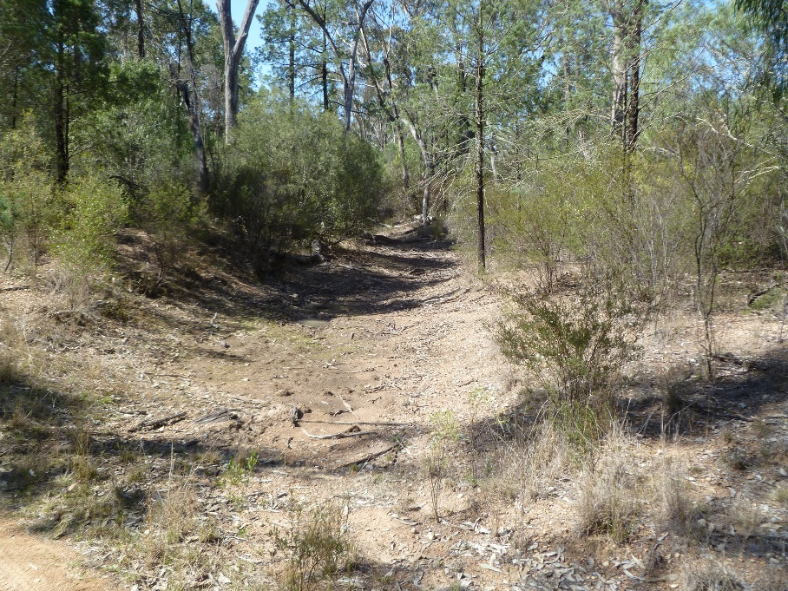
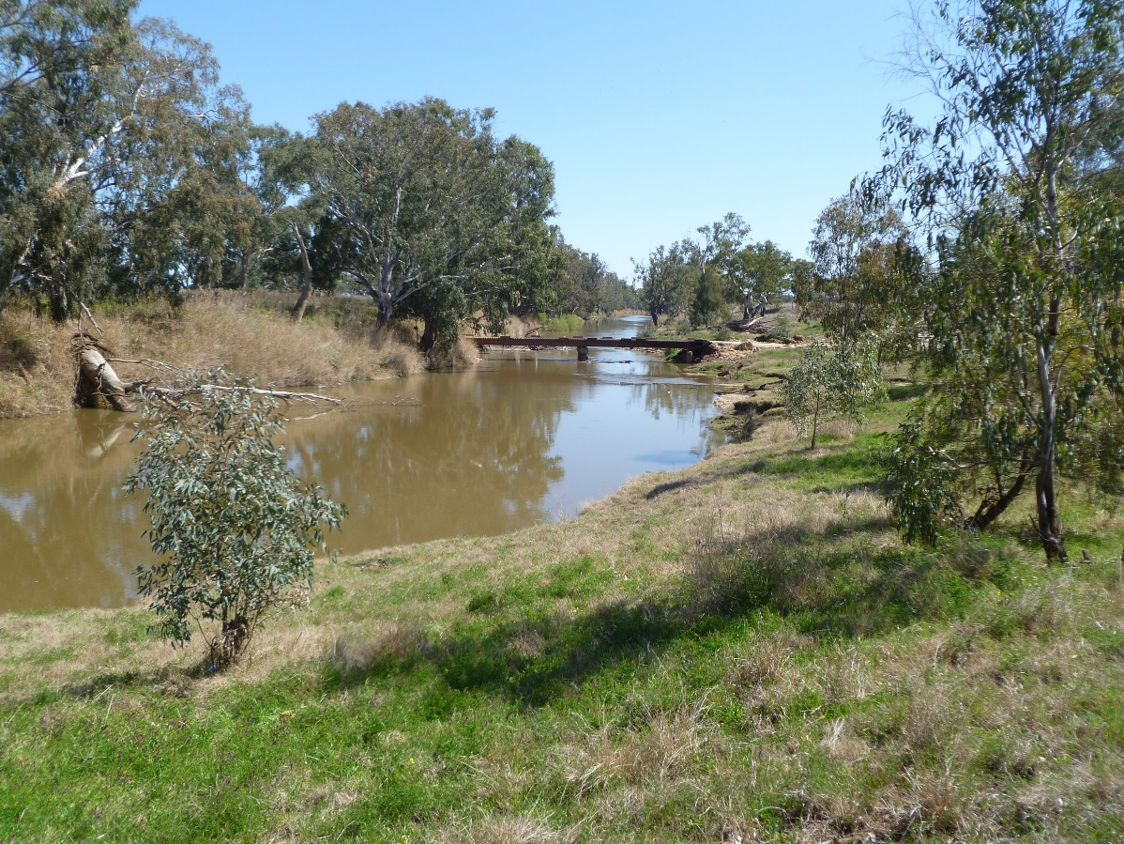
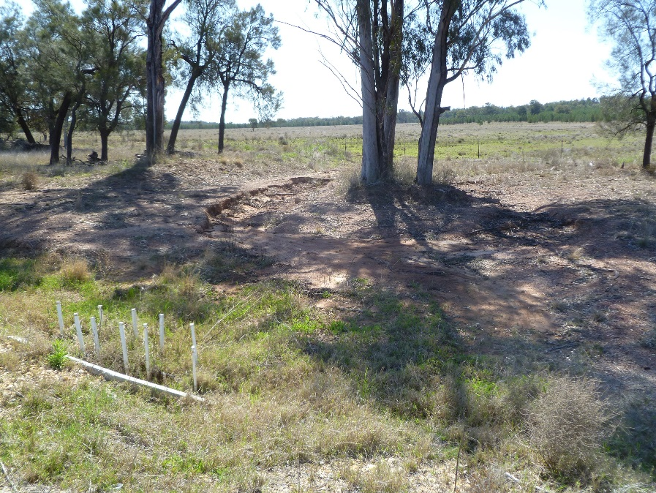
Vickery Extension Project Surface Water Assessment
Existing Environment – Water Flow and Quality
North-west Drainage Line
Namoi River
South Creek
Notes:
Flow within the Naomi River is regulated by three major water storages
Chaffey Dam
Keepit Dam
Split Rock Dam
A number of intermittent streams drain across or rise within the Project area. All streams within the Project mining area are ephemeral and some are so intermittent that they are difficult to identify within the landform. These streams rarely flow.
Water quality monitoring by a number of mining companies
Low EC (salinity)
pH consistent with ANZECC 2000 Guidelines
Low TSS, with occasional significantly higher values

Slide 39
Vickery Extension Project Surface Water Assessment
Water Balance Model
Analysis undertaken to assess the performance of the water management system in terms of:
Security of water supply for operational purposes
Frequency and volume of discharge of water from the mine site
Water balance monitoring and management
Separate water balance analysis undertaken to assess the long-term water level and salinity in the final void following mine closure

Slide 40
Vickery Extension Project Surface Water Assessment
Water Balance Modelling Results
As per the Approved Mine water management system operates effectively and meets the water requirements for coal processing and dust suppression
System is capable of operating with no discharge of water that has been in contact with coal ==> Nil Discharge Mine
Sediment dam releases to restore dam capacity within five days of a rainfall event exceeding the design capacity would occur as controlled discharge, in accordance with Landcom (2004) and contemporary Environmental Protection Licence conditions
No significant changes to the quantity or quality of surface water available to third party users or the environment
No risk of overflow from the final void following mine closure
Salinity in the final void is expected to increase progressively with the accumulation of salt

Slide 41
Vickery Extension Project Surface Water Assessment
Summary of Assessment Findings
Namoi River
Catchment reduction of up to 2.5 km² during mining and 2.4 km² following completion of mining ➔ = 0.01% of total catchment
Approximately 9 km² of rehabilitated waste rock emplacement area would drain towards the Namoi River
No perceptible or measurable change in the flow regime expected
Similar to the Approved Mine no change in the overall water quality of the Namoi River is expected due to the measures being taken to protect the quality of the water in the watercourses surrounding the site

Slide 42
Vickery Extension Project Surface Water Assessment
Summary of Assessment Findings
Water Quality in Off-Site Watercourses
All water in contact with coal (“mine water”) would be retained on site in mine water dams
Sediment that may be carried by runoff would be controlled by:
Sediment dams (note: sediment dams do not hold mine water)
Prior to a controlled discharge of water from the dam, water would be allowed to settle (aided by a flocculent if necessary) to ensure SS concentration < 50 mg/L
Wet weather discharges and discharges to restore sediment dam capacity would by undertaken in accordance with an EPL which would specify water quality requirements and limits, including monitoring and discharge requirements
Treatment of areas of the final waste rock emplacement face that exhibit some erosion with gypsum
Implementation of the sediment control measures would ensure that any controlled discharge would have minimal impact on the water quality of local creeks

Slide 43
Vickery Extension Project Surface Water Assessment
Monitoring and Licensing
Water Management Plan (similar to the Approved Mine)
Climate monitoring
Site surface water monitoring and discharge
Ambient surface water quality
Water balance monitoring and management
Environmental Protection Licence for conditions for water quality monitoring and sediment dam discharge

Slide 44
Vickery Extension Project Surface Water Assessment
IPC Questions
Notes:
Independent peer review of the assessment has been undertaken by Professor Tom McMahon, and Martin Giles of BMT who conducted their review on behalf of the DPE.
Both peer reviewers confirmed the methodology undertaken for the assessment was fit for purpose, noting that BMT suggested additional detail.
Whitehaven will provide a detailed response to BMT as part of the Responses to Submissions.

Slide 45
Vickery Extension Project Surface Water Assessment
In the light of the Giles review, what does the Whitehaven Coal consider to be a reasonable range on analytes to be monitored in surface water surrounding the mine and in water released from the mine to ensure no damage to the surrounding environment?
Negligible impact to the surrounding water quality is predicted because “mine water” is not proposed to be released from the Project
Water captured in the mine water management system will be re-used on-site to reduce demands from external water sources
Recommended analytes to be monitored informed by the Project Geochemistry Assessment (GEM, 2018) and are as follows:
Runoff from ROM Coal Stockpile
➔ NIL, as no water is proposed for release from this area
Runoff from Reject Material
Dewatered reject material to be co‑disposed in locations such that runoff and infiltration reports to the mine water management system
Groundwater quality to be monitored by testing from bores installed in waste rock emplacement. Testing of pH, DO, EC, TDS, iron, aluminium, arsenic, magnesium, molybdenum, selenium, calcium, sodium, chloride, sulphate
Runoff from Overburden / Interburden
pH, EC, total alkalinity/acidity, sulphate, aluminium, arsenic, molybdenum, selenium and TSS in sediment dams capturing runoff from the waste emplacement
Notes:
Independent peer review of the assessment has been undertaken by Professor Tom McMahon, and Martin Giles of BMT who conducted their review on behalf of the DPE.
Both peer reviewers confirmed the methodology undertaken for the assessment was fit for purpose, noting that BMT suggested additional detail.
Whitehaven will provide a detailed response to BMT as part of the Responses to Submissions.

Slide 46
Vickery Extension Project Surface Water Assessment
Giles has adversely commented on the amount of information available on baseline surface water monitoring in the Vickery EIS and the adoption of appropriate trigger values. If approved, what steps would Whitehaven take to obtain adequate baseline surface water quality data before commissioning of the plant, especially given its failure to do so to date in the project that was approved in 2014?
There is extensive baseline data available for the Namoi River, however, the collection of recent monitoring data from local streams inhibited by intermittent flow and drought conditions
As there is nil discharge of mine water there is limited potential for changes in downstream water quality – therefore limitations on local stream baseline data due to drought conditions not an assessment issue
Baseline surface water quality data was drawn from:
NSW Department of Industry (Water) database
Monitoring of nearby streams conducted by Whitehaven
Monitoring of mine water dams, sediment dams and final void water bodies for other mining operations in the region
Data compiled previously for the original Vickery Coal Mine EIS
Proposed Baseline Surface Water Monitoring leading up to commissioning:
Sediment dams
Controlled discharge from sediment dams
Ephemeral streams
Monitoring will continue throughout the Project life
Notes:
Independent peer review of the assessment has been undertaken by Professor Tom McMahon, and Martin Giles of BMT who conducted their review on behalf of the DPE.
Both peer reviewers confirmed the methodology undertaken for the assessment was fit for purpose, noting that BMT suggested additional detail.
Whitehaven will provide a detailed response to BMT as part of the Responses to Submissions.

Slide 47
Vickery Extension Project Surface Water Assessment
Given the proposed use of untreated mine water for process applications, is there a possibility of solute build-up in water on the site and a concomitant threat to surrounding surface and groundwater? Is there a case for treating process water to remove solutes and to make excess water available for beneficial purposes?
Solute “build-up” in water on site
Potential considered to be low
No risk to surrounding surface or groundwater because:
Solute will be “lost” as coal moisture during processing
Any residual process water will make its way to the final void where it will be retained over the life of the project with negligible risk of recharging the groundwater system
Treatment of process water to remove solutes and make excess water available for (external) beneficial purposes
Water captured in mine water dams, coal contact water dams and sediment dams will be preferentially used to meet on‑site water demands
This water is critical to site water management and the site water balance
No plans for off-site beneficial re-use as this because:
Mine designed to be a NIL Discharge Mine
Off-site Transfer of Mine Water would increase requirement for use of external water sources (e.g. Namoi River and Project borefield)
Notes:
Independent peer review of the assessment has been undertaken by Professor Tom McMahon, and Martin Giles of BMT who conducted their review on behalf of the DPE.
Both peer reviewers confirmed the methodology undertaken for the assessment was fit for purpose, noting that BMT suggested additional detail.
Whitehaven will provide a detailed response to BMT as part of the Responses to Submissions.

Slide 48
Vickery Extension Project Surface Water Assessment
Reviewers have suggested that the available storage for mine water needs to be increased to prevent the risk of an inadvertent damaging discharge during prolonged inclement weather. Could Whitehaven comment on the need or otherwise for this?
Sediment Dam design is inherently over-designed to account for maximum catchment area over the Project life and reuse of water on-site
Mine designed to be a NIL Discharge Mine
➔ No mine water or coal contact water will be discharged from the site
Sediment dams will collect sediment-laden runoff from active waste rock emplacement and rehabilitation areas…..
➔ but NOT mine or coal contact water
Sediment dams conceptually designed according to standard practice
➔ Based on guidelines in “the Blue Book” (Landcom, 2004)
Frequency of discharge will actually be less than prescribed by the Blue Book, because:
Sediment dams would be over designed and constructed at the start of the Project for their maximum reporting catchment, which would increase over the Project life
Water captured in sediment dams would be preferentially used to meet on‑site water demands which would reduce the likelihood of overflow
Notes:
Independent peer review of the assessment has been undertaken by Professor Tom McMahon, and Martin Giles of BMT who conducted their review on behalf of the DPE.
Both peer reviewers confirmed the methodology undertaken for the assessment was fit for purpose, noting that BMT suggested additional detail.
Whitehaven will provide a detailed response to BMT as part of the Responses to Submissions.

Slide 49
Flooding

Slide 50
Vickery Extension Project Flood Assessment
IPC Briefing – 25 February 2019

Slide 51
introduction
Greg Roads (B.Eng.), Director, WRM Water & Environment
30 years experience as a Water Resources Engineer specialising in floodplain management
10 years at NSW Dept. Water Resources and Dept. Land and Water Conservation in Rural Flood Group
Currently undertaking Flood Management Plans for Narrabri and Moree Plains council’s
Currently undertake peer reviewer for NSW Office of Water and
Peer review by Rohan Hudson (B.Eng., M.Eng.Sci.), Senior Water Resources Engineer, Royal HaskoningDHV
18 years experience as a Water Resources Engineer
Experience in peer reviews for Government
Notes:
Would prefer to do this without a slide

Slide 52
INTRODUCTION
ASSESSMENT OBJECTIVES
Assess potential impact of the Project on existing flooding characteristics of the Namoi River floodplain and adjacent tributaries
Assist in developing a conceptual design of the Project rail spur that achieves compliance with Floodplain Management Plan criteria
KEY CONCLUSIONS
Project mining area located beyond Namoi River floodplain
Project rail spur conceptual design complies with relevant FMP criteria:
Negligible afflux
Negligible change in velocity; and
Negligible change in distribution of flows

Slide 53
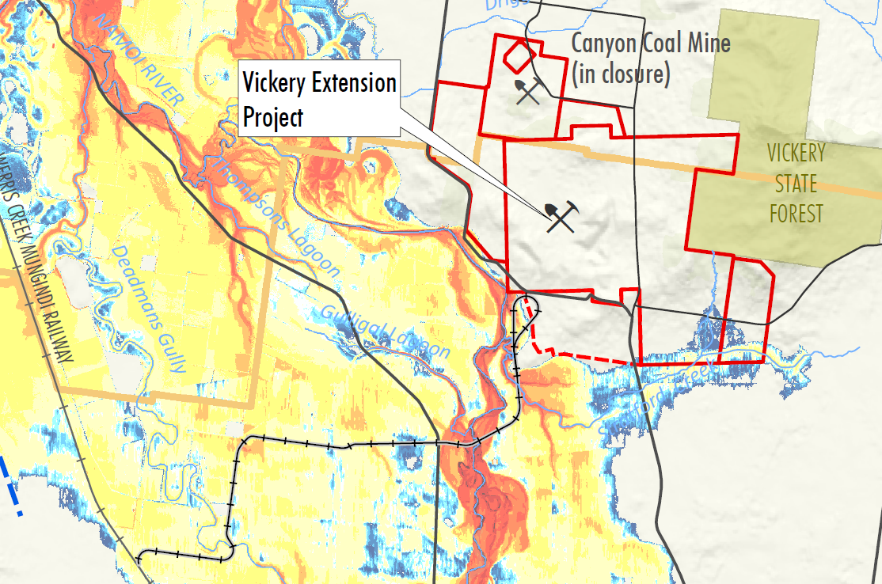
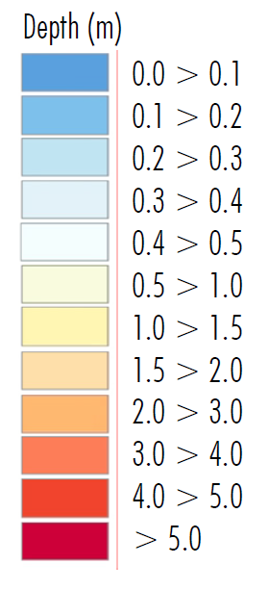
Flood modelling
Notes:
The flood models prepared for the Project are extensive. Namoi River model extends from Gunnedah to Boggabri, and includes the minor Namoi River tributaries near the Project, including Collygra Creek, Deadmans Gully and Stratford Creek. Second model prepared of Driggle Draggle and Bollol creeks to the north.
Namoi River flood peaks some 1 to 2 days after the rainfall event (17,100km² catchment). Local creeks peak within 6 to 12 hours of rainfall event (105-250 km² catchment) so catchment flood peaks unlikely to coincide
Namoi River floodplain flood levels generally <1.5m for 1% AEP event. River levels up to 8 m deep. Flood velocities generally low (<1m/s). Floodplain becomes active for 20% AEP event
Local catchment tributaries of Stratford and Driggle Draggle Creek have limited to no channel capacity with runoff draining as overland flows (broad and shallow) for all events.

Slide 54
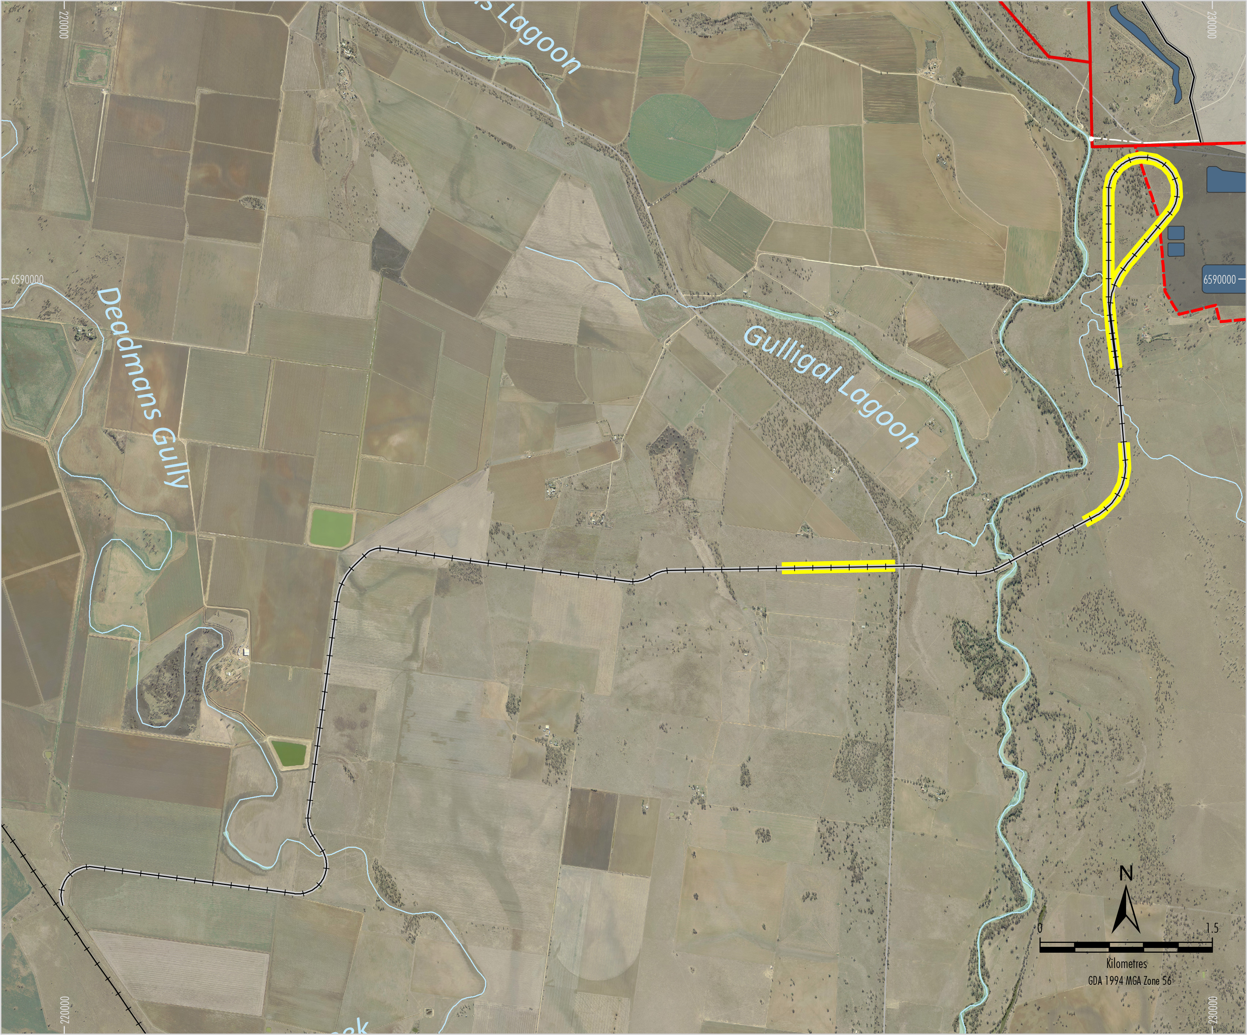
Rail spur – conceptual design
Embankment/culverts
Embankment
Namoi River
Elevated structure
Kamilaroi Highway
Notes:
The conceptual design assessed in the EIS included a combination of elevated structures and embankments along the rail spur length.
The superstructure was modelled to be above the 1% AEP event, with freeboard.
Embankments were conceptually located on Whitehaven-owned land where flood depths were shallow (elevated areas of floodplain) for Design flood event.
The structure was elevated on pillars in all other locations to avoid changes to flood characteristics on privately owned land.
The elevated structure assumes blockage of 5% of flood flows. By way of an example, this could represent a 1 metre wide pier spaced every 20 metres.
DPE’s peer reviewer considered the representation of the elevated and embankment structures in the model to be appropriate.

Slide 55
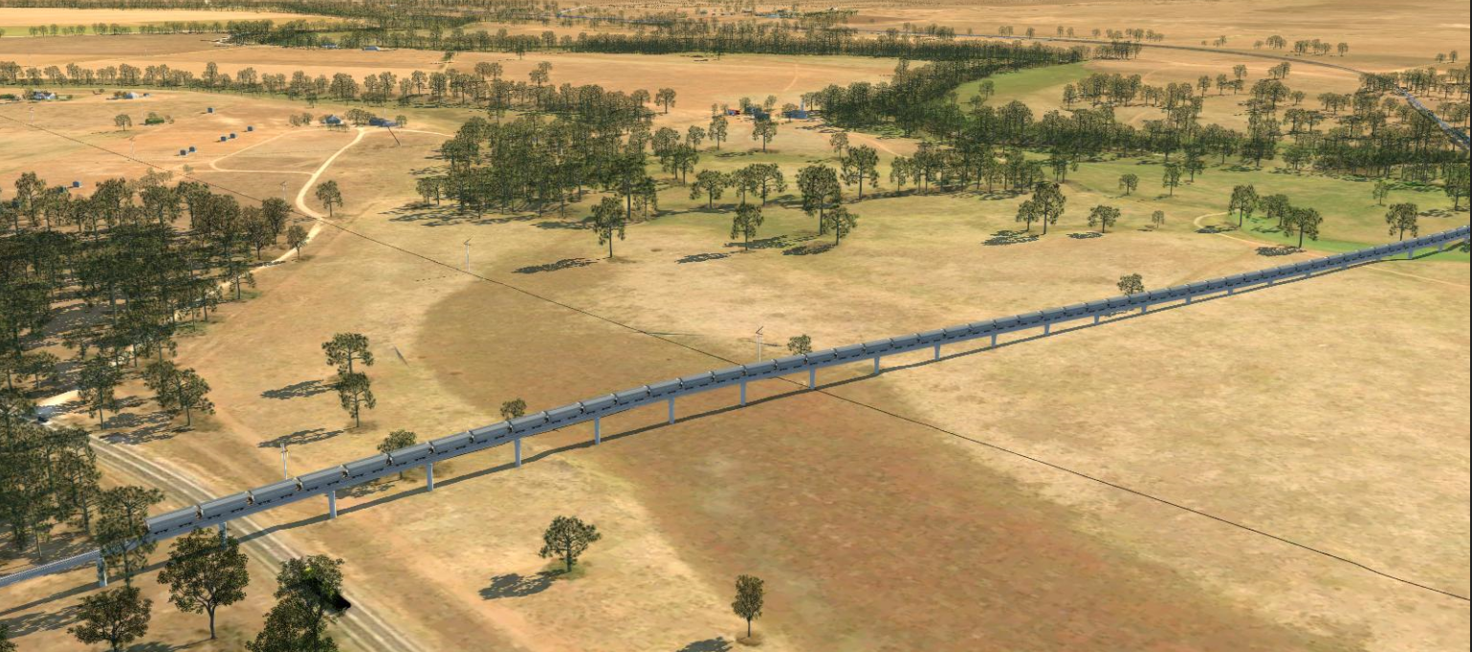
Rail spur – conceptual design
Concept Design
Notes:
This slide shows a conceptual illustration of the rail spur. This shows how the rail spur superstructure would be elevated on piers above the 1 in 100 year flood level, beyond those small sections where it would be located on embankments on Whitehaven-owned land.

Slide 56
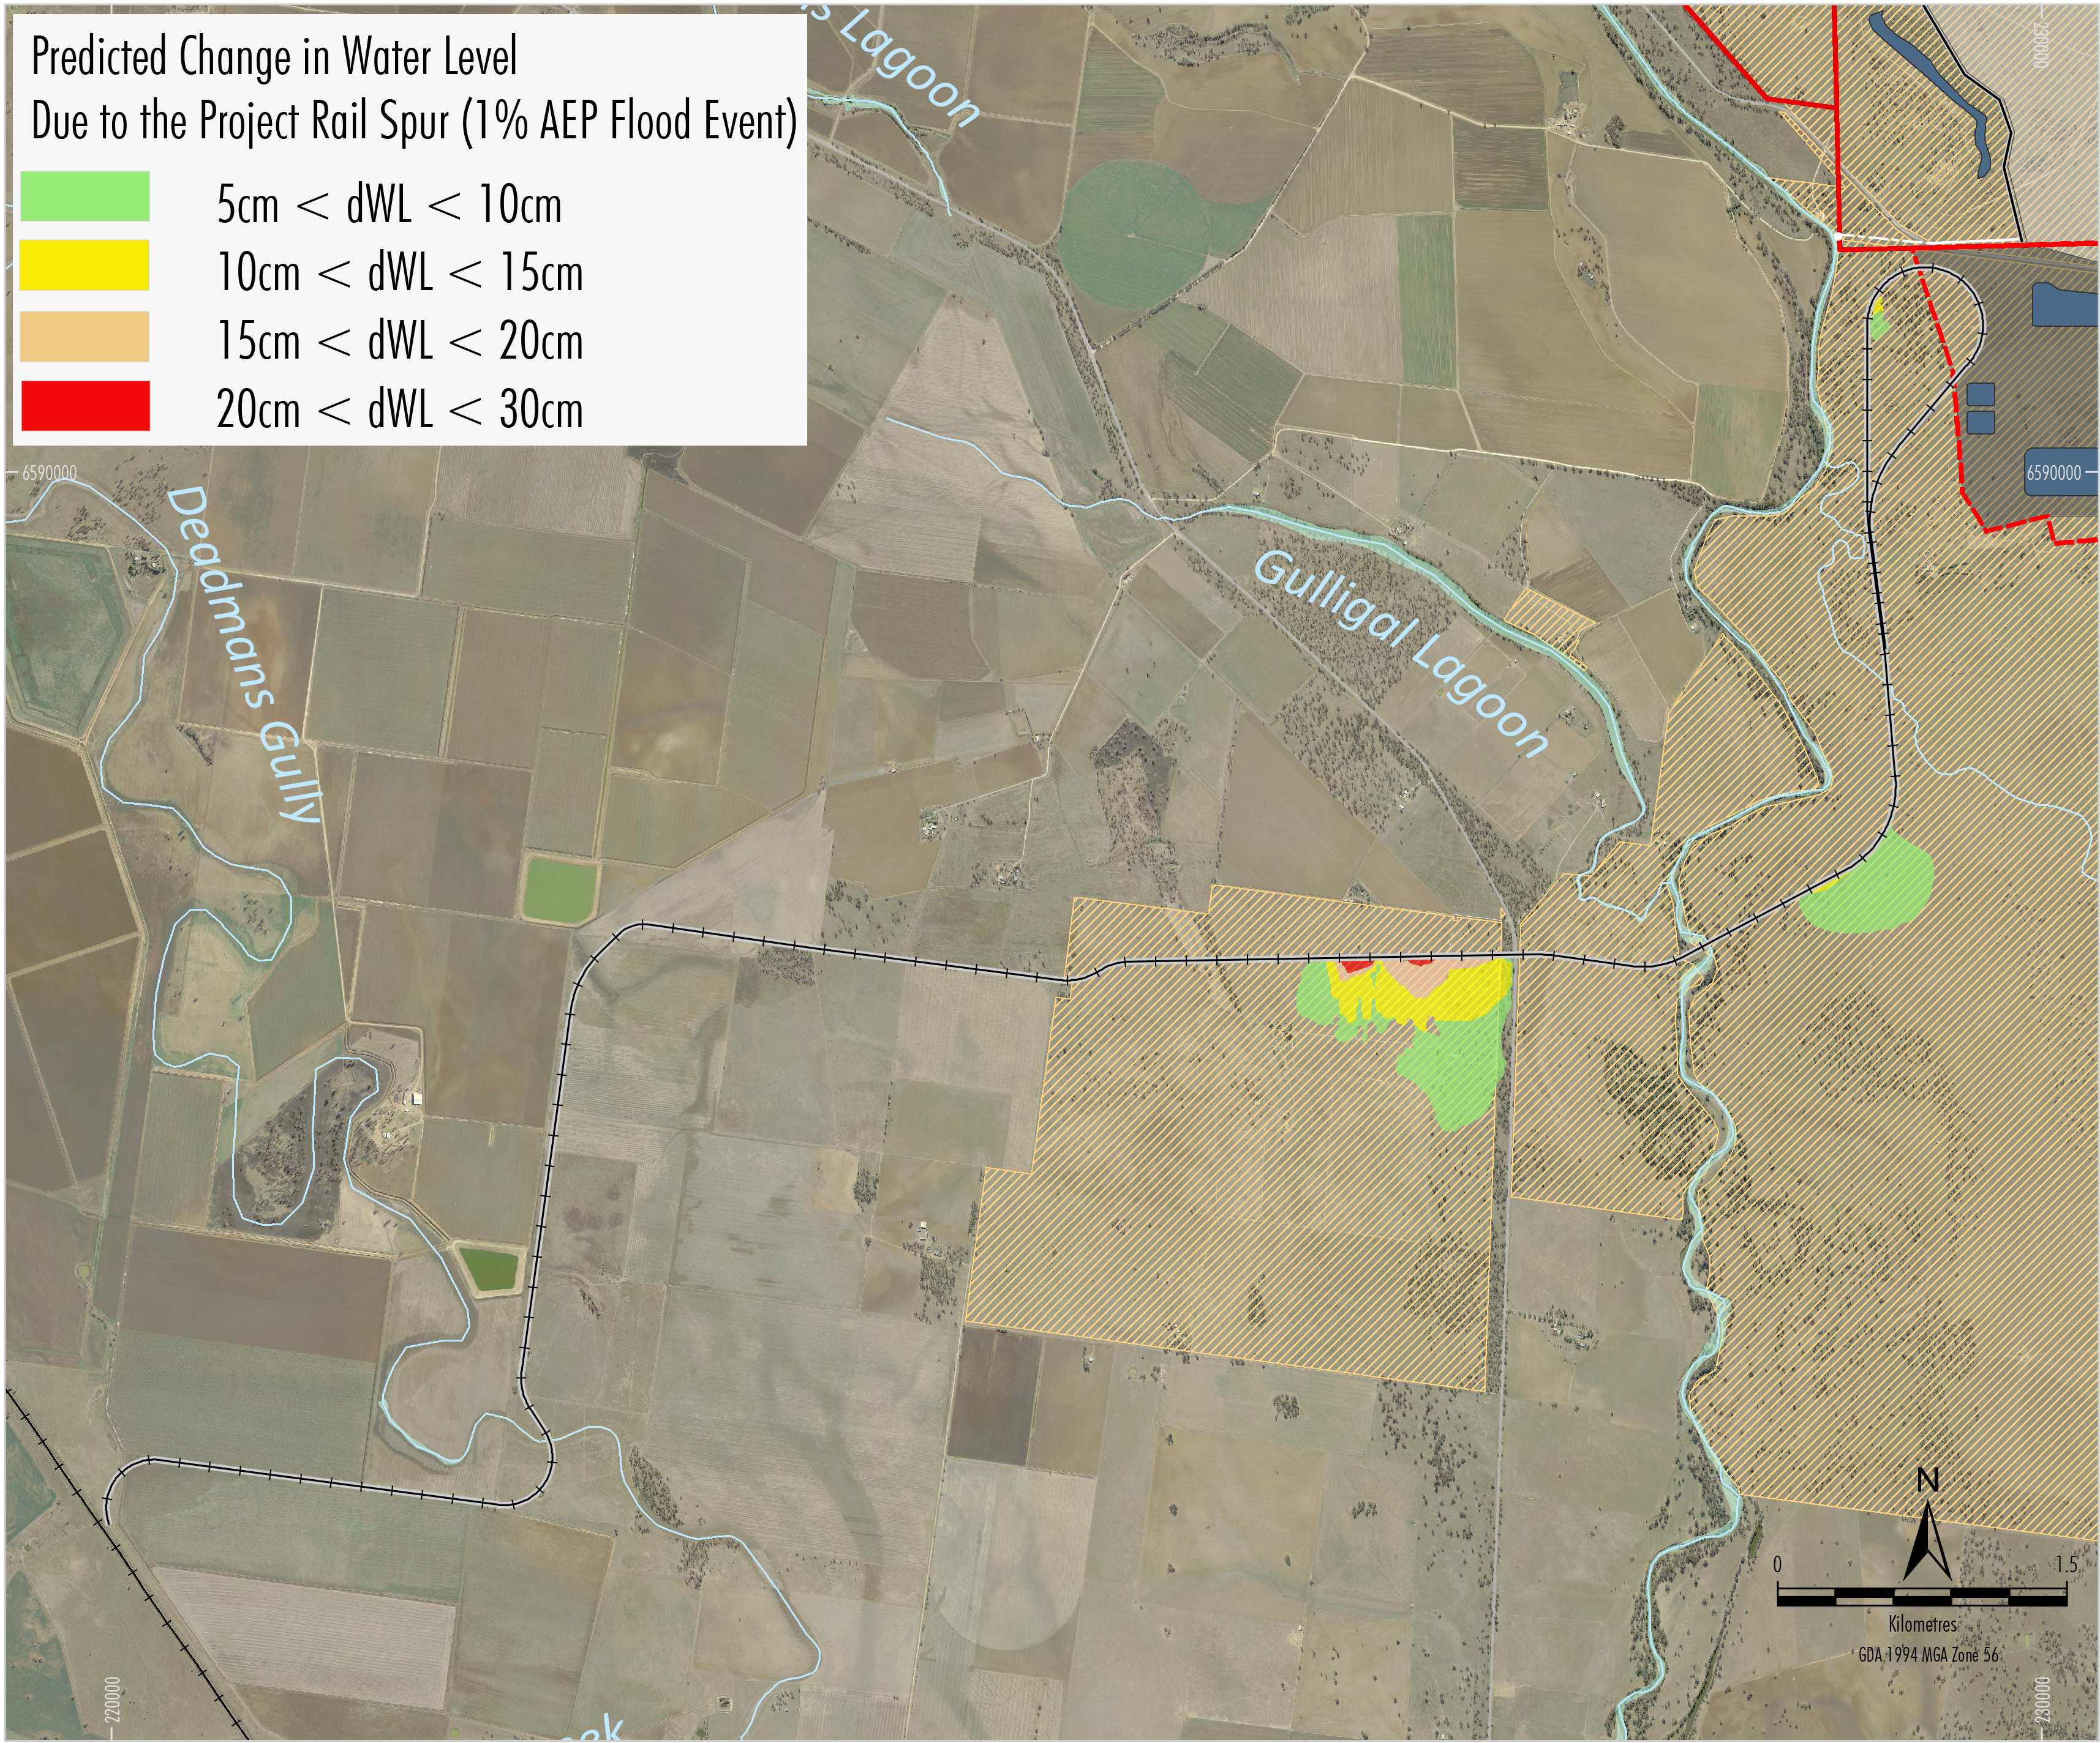
Rail spur – predicted flood impacts
Afflux only on WHC owned land
Notes:
The results of the flood modelling show that, during a 1 in 100 year flood event, there would be no change in flood levels, velocities or distribution of flow on privately-owned land.
On Whitehaven owned land, there would be generally less than 20 cm afflux.
The predicted changes to the existing flood characteristics are negligible and comply with the relevant Floodplain Management Plan criteria.

Slide 57
Rail spur – detailed design
Detailed design of the rail spur will meet the requirements of the FMP criteria (both 2006 Carroll to Boggabri FMP and 2016 Draft Upper Namoi Floodplain FMP.
Following modelling of the conceptual design, Whitehaven has decided to elevate the rail spur west of the Namoi River on piers, based on constructability considerations.
The final height and the size of the spans, piers and embankments will be determined during the detailed design stage
Detailed design to be prepared in consultation with OEH
Notes:
2006 Carroll to Boggabri FMP –(1984 flood used as design flood ÷15 year ARI) 5% change in flow distribution, increase in flood level of <0.1m on other landholders property, <0.01m increase at house, more than 50% increase in velocities up to 0.5m/s.
2016 Draft Upper Namoi Floodplain FMP applies different management rules to various floodplain zones (floodways and floodplain storage, flood fringe).

Slide 58
Flood modelling – review comments
Royal HaskoningDHV’s peer review concluded:
“… the WRM (2018) assessment was undertaken using best-practice techniques…”
WMAWater’s peer review confirmed the flood assessment was:
“… undertaken in accordance with industry best practice…”
Whitehaven’s Response to Submissions will include detailed responses to each of the DPE’s Peer Reviewer comments.

Slide 59
IPC Questions

Slide 60
The questions below are predicated on the verbal promise by Whitehaven that the entire rail spur will be on viaduct across the floodplain.
Whitehaven’s overarching design principle of the Project rail spur is to comply with the objectives of the Draft Floodplain Management Plan for the Upper Namoi Valley Floodplain 2016 (Draft FMP) and the Carroll to Boggabri Floodplain Management Plan 2006 (FMP)
West of the Namoi River the rail spur would be elevated above the 1 in 100 year flood level on a viaduct structure (except for a small section where the viaduct transitions to the main line)
Design may include an embankment to the east of the Namoi River (on Whitehaven owned land)

Slide 61
What is the sensitivity of the predicted incremental flood levels (above or below that would occur without the rail spur) at the CHPP and junction with the North-west main line to changes in the flood plain hydraulics parameters?
Project CHPP is located outside the extent of the event that is three times the Namoi River 1 in 100 year design flood event
North-west main line is not overtopped at the proposed junction with the Project rail spur for this event
Flood modelling showed peak flood levels not overly sensitive to changes in floodplain roughness
No chance that changes in floodplain roughness would impact on the flood immunity of the Project CHPP or the North West main line

Slide 62
What is the sensitivity of the incremental flood levels if the peak discharges for the local tributaries all occur at the same time?
The 1 in 100 year flood event peak discharge from Stratford Creek and Collygra Creek (combined) is approximately 5% of the peak discharge from the Namoi River
The increase in peak flood levels (with or without the rail) would be negligible if the two events peaked at the Project mining area at the same time
The chance of the two catchments peaking at the same time is very low and would produce an event more rare than the adopted design event (more rare than 1 in 100 year ARI)

Slide 63
Air Quality

Slide 64
Vickery Extension Project Air Quality
25 February 2019

Slide 65
Introduction
Aleks Todoroski
28 years experience in air quality, including hundreds of new and modified mine approval projects
Director – Todoroski Air Sciences (2011 to present)
Principal Technical Policy Advisor (Air) – EPA (10 years)
Conducted numerous peer reviews on behalf of the Department
Peer review of Vickery Extension Project AQ Assessment (prepared by Ramboll)

Slide 66
Objectives and Conclusions
Objectives
Identify appropriate mitigation measures
Predict potential impacts and compare to recognised criteria
Conclusion
Compliance with criteria predicted at all privately-owned dwellings

Slide 67
Modelled Air Quality Controls
Haul road dust suppression – consistent with industry benchmarking
Use of large vehicles to reduce the number of trips required
Restricted speed limits on haul roads
Progressive rehabilitation of disturbed areas
Minimisation of pre-strip areas
Sprinklers at CHPP

Slide 68
Predicted Results
Compliance with criteria predicted at all privately-owned dwellings
No adverse air quality impacts are predicted due to coal train dust, diesel emissions, blast emissions
Township of Boggabri is significantly further away from the Project (approx. 15 km) and would be well out of reach of any tangible air quality effects from the Project
Annual average TSP | ✓
Annual average PM₁₀ | ✓
Annual average PM_{2.5} | ✓
24-hour average PM₁₀ | ✓
24-hour average PM_{2.5} | ✓
Dust deposition | ✓

Slide 69
Operational Monitoring
Real-time proactive air quality management system
Meteorological forecasting and monitoring to identify adverse weather conditions
Real-time dust monitoring
Trigger levels set below criteria identify if additional at-source controls required to manage 24-hour average concentrations when daily background levels are elevated
Management and documentation via Air Quality Management Plan

Slide 70
IPC Questions
The following provides a brief summary of the detailed response to questions raised by the IPC.

Slide 71
The dust modelling does not include impacts of extra traffic on local unsealed roads. What is the extra impact? What would be the impact of sealing all roads leading to the project
Access to the Project is via sealed roads, and not via local unsealed roads
Whitehaven’s terms of engagement prevent employees and contractors from using unsealed roads to access the Project
Use of local unsealed roads by the Project (e.g. a light vehicle for environmental monitoring) would be very infrequent and would thus not have any tangible effect
Dust from existing use of local unsealed roads is part of the dust measured in the historic monitoring data, and is therefore considered as part of the cumulative air quality modelling assessment for the Project by Ramboll (2018)

Slide 72
Modelling assumptions & outputs, specifically comparing the Approved mine with the Extension Project, including mine extraction, load & haul operations, CHPP, transport, overburden handling, rehabilitation & inputs from other Whitehaven mines
For both the Project and the Approved Mine annual emissions were estimated based on peak years of waste rock and ROM coal movement, exposed areas and proximity of operations to sensitive receivers
The key difference in emissions inventories is that the Project adopts a best practice control level for haul roads of 90% whereas the Approved Mine assumed 75%
Haul roads are the most significant contributor to annual emissions
Since the Air Quality Assessment for the Approved Mine (2012) the EPA implemented its Dust-Stop Program, which required all NSW mining operations to demonstrate at least 80% control on haul roads
Numerous mines (including Whitehaven mines) demonstrated 90% control or greater
Accordingly 90% control was adopted for the Project
Further detail will be provided in the written response

Slide 73
Details confirming the scenarios modelled include worst case. Details of the definition of worst case
‘Worst case’ refers to a situation where the maximum likely dust level would arise
Three potential worst case scenarios assessed to represent:
The maximum amount of material (waste rock and ROM coal) is moved, and hence the maximum amount of dust is generated
The exposed areas are large and hence wind erosion may be greater (note wind erosion is a small source)
The activity is nearest receptors, and thus has most scope for impacts
As the mine moves relative to several groups of receptors, several worst case scenarios are used to ensure maximum impacts at any receptor are assessed

Slide 74
Results on any model calibration with the existing operating mines in the locality
It is unusual to do this, especially in this case where the nearest mines are a significant distance away, are located in significantly different terrain, and the ambient monitoring data includes dust from many variable sources and not just the mines
Unlike some other environmental models, air quality dispersion modelling is conducted using approved regulatory models, which are designed to not under predict impacts
These models are calibrated with synthetic tracer gas during extensive validation trails (in this case by the US EPA, for the AERMOD/CALPUFF models used by Ramboll [2018])
Inputs to the model (emissions) and outputs (predicted concentrations at receptors) have been benchmarked and are consistent with expectations

Slide 75
Dust impacts on agricultural activity, particularly cotton
This has been considered in the Project Agricultural Impact Statement
Andrews and Skriskandarajah (1992) found cattle were insensitive to coal dust at levels of approximately 120 to 240 g/m²/month
Farmer (1993) found that the lowest rate of dust deposition observed to cause an effect to crops is approximately 15 g/m²/month, significantly higher than the maximum predicted level of deposited dust for the Project of 1 g/m²/month (i.e. less than half the incremental criteria and a quarter of the cumulative criteria)
Coal dust is a fraction of deposited dust emitted from the Project, and the Project dust itself is a fraction of all dust at cotton crops, hence, there is limited scope for any significant discoloration of cotton by coal dust. The predicted levels of coal dust deposition at the most impacted receptor (127b) are 0.3 g/m²/month

Slide 76
Consideration of covered coal wagons
The outcomes of numerous studies, including the studies commissioned by the EPA all confirm that the risk of adverse impacts from fugitive coal dust emissions associated with coal transport along the Project rail spur is very low
The cost and logistics of covering wagons for this Project are not considered reasonable in the context of there being no likely risk of adverse impacts arising

Slide 77
Consideration of the establishment of an air quality monitoring station at Boggabri
An extensive regional monitoring network is already in place
Data from the OEH network monitors at Narrabri, Gunnedah, Tamworth, Maules Creek, Breeza and Wil-gai (i.e. Project site) are reported weekly on the EPA website
In its latest monitoring report, OEH says dust levels in the Namoi Region were “Very good”, “Good” and “Fair” (i.e. below air quality criteria) 97% of the time from May 2017 to July 2018, and attributes levels above criteria to dust storms and winter wood smoke, in common with almost all country towns
The OEH Network is in addition to mine-specific monitors designed to demonstrate compliance with air quality limits
Boggabri is too distant from the Project to register any measurable level of dust due to the mine
Dust would be measured at an air quality monitoring station established closer to the mine, where there is potential to detect the contributed dust from the mine, and thus confirm compliance at that location and further afield

Slide 78
Noise

Slide 79
VICKERY EXTENSION PROJECT NOISE & BLASTING ASSESSMENT
25 February 2019

Slide 80
Introduction
Noise and Blasting Assessment – Wilkinson Murray:
John Wasserman – Director Wilkinson Murray
Over 25 years experience in acoustics and vibration
Formerly – Manager Noise Assessments for the NSW EPA
Conducted numerous peer reviews on behalf of DPE
Peer Review – SLR Consulting:
Glenn Thomas – Director SLR Consulting
Over 25 years experience in mining noise impact assessment
Numerous peer reviews on behalf of DPE
Notes:
Ladies and Gentlemen
By way of introduction my name is John Wassermann. I’m a Director of Wilkinson Murray.
I have over 25 years experience in acoustics and vibration. Prior to being a noise consultant I was Manager Noise Assessments for the EPA and worked in the Department of Planning in the assessments area. So I have both consulting and regulatory experience in noise.
Wilkinson Murray was engaged by Whitehaven as the Principal Acoustic Consultant for the Vickery Expansion Project to prepare a Noise and Blasting Assessment.
To be sure that the noise and blasting assessment was conducted rigorously, SLR Consulting was engaged by Whitehaven to undertake a peer review. Specifically Glenn Thomas from SLR was commissioned. Glenn has over 25 years experience in the assessment of noise from coal mines, including at the request of the Department

Slide 81
Objectives and Conclusions
Noise:
Identify reasonable and feasible mitigation
Predict noise levels at sensitive receivers and compare to criteria
Conclusion: No additional noise affected properties compared to the Approved Mine
Blasting:
Confirm compliance human comfort and building damage criteria
Dwellings and heritage sites
Conclusion: Compliance with criteria predicted
Notes:
The main objectives of the noise assessment were to identify reasonable and feasible mitigation, so that these could be adopted in the noise model. The noise model was used to predict noise levels at sensitive receivers and compare the predicted noise levels to criteria specified in various NSW policy documents
The key Conclusion of the noise modelling was that there would be no additional noise affected properties compared to the Approved Mine
For blasting, the objectives of the assessment were to confirm compliance human comfort and building damage criteria at dwellings and confirm compliance with building damage criteria at heritage sites
The blasting assessment concludes that compliance with criteria can be achieved

Slide 82
Reasonable and Feasible Mitigation
Iterative approach:
Preliminary noise modelling
Identify potential for noise exceedances
Evaluation of combinations mitigation options to assess effectiveness
Review of feasibility by Whitehaven
Adoption of reasonable mitigation by Whitehaven for the Project
Notes:
The impacts presented in this report represent the culmination of an Iterative approach designed to determine feasible and reasonable noise mitigation measures.
The steps were:
Preliminary noise modelling of scenarios representative of the maximum noise emissions
Evaluation of various combinations of noise management and mitigation measures
Review of the effectiveness of these measures and assessment of their feasibility
Adoption of reasonable management and mitigation measures by Whitehaven

Slide 83
Reasonable and Feasible Mitigation
Key mitigation:
Procurement of low noise fleet
Modelled sound power levels based on measurements
Significant recent improvements in noise performance technology
Treatment of infrastructure items
Refinements to waste rock emplacement and open cut progression to provide for shielding of operations
Notes:
As a result of this iterative approach modifications to the mine plan were undertaken in order to improve acoustic performance
The key reasonable and feasible mitigation to be adopted for the Project is as follows
Procurement of low noise fleet items.
The modelled sound power levels are based on data from measurements of existing mining equipment. Also, there have been significant technological improvements in noise performance of mining equipment in recent years
Other important mitigation measures are the:
b. Treatment of a selection of mobile plant and infrastructure items to reduce emitted noise levels.
c. Refinements to waste rock emplacement and mine progression to provide opportunities for shielding of operations

Slide 84
Operational Noise Assessment
Noise criteria are lowest levels (most stringent) under the NPfI
Methodology predicts conservative outcomes
Compliance with criteria predicted all privately-owned receivers except three closest properties (IDs 131, 132, 127)
Property IDs 131 and 132
“Negligible” exceedances (1-2 dB above criteria)
NSW noise policy describes 1-2 dB is imperceptible compared to compliance
Property ID 127
“Marginal”/”Moderate” (3-5 dB) and “Significant” (>5 dB) exceedances
Owners have acquisition upon request rights for the Approved Mine
Notes:
Now summary of the operational noise impact assessment:
The noise criteria adopted for the assessment are the most stringent that can be applied under the Noise Policy for Industry
With the adopted mitigation measures in place compliance with criteria is predicted all privately-owned receivers, except at three closest properties (IDs 131, 132, 127)
For properties 131 and 132 only “negligible” exceedances as defined in the Noise Policy for Industry are predicted, with this level of exceedance unlikely to be perceptible.
Property 127 is the closest property to the Project. The owners of this property have the right to acquisition upon request under the current consent for the Approved Mine and it is expected these rights would also apply to the Project.

Slide 85
Comparison to Approved Mine
Improvement in noise mitigation technology since assessment for the Approved Mine
Increased number of fleet items for the Project (reflects increased production rate)
Decrease in overall site sound power level
Noise benefits compared to the Approved Mine:
Cessation of road traffic noise along the Approved Road Transport Route
Cessation of noise from the Whitehaven CHPP in Gunnedah (for receivers proximal to the Whitehaven CHPP, as opposed to those surrounding the Project)
Removal of Approved Mine Eastern Emplacement
Notes:
Submission received on the EIS queried why there are no significant increases in noise predictions for the Project when compared to the Approved Mine.
The main reason is the improvements in noise mitigation technology since assessment for the Approved Mine.
That is, while the Project requires an increased number of fleet items, noise performance improvements have resulted in a decrease in the total sound power level of all equipment.
In addition, the Project will reduce noise when compared to the Approved Mine as
The Project rail spur will result in the cessation of road traffic noise along the Approved Road Transport Route and the cessation of noise from the Whitehaven CHPP in Gunnedah.
And the Removal of Approved Mine Eastern Emplacement will reduce noise impacts for receivers to the south of the Project.

Slide 86
Rail Noise
Compliance with criteria predicted at all existing private receivers for trains travelling on the Project rail spur
Locomotives idling on the rail loop included in operational noise modelling
Recent noise measurements of locomotive noise taken
Trains on the main line assessed cumulatively with existing/approved train movements
Notes:
The assessment considered train noise along the Project rail spur, with compliance with criteria predicted at all existing private receivers
Note that noise associated with locomotives idling on the rail loop is also considered and is included in the operational noise modelling results, as discussed above.
Project trains, once on the Main Line, are also separately assessed cumulatively with other trains

Slide 87
Blasting Assessment
Compliance with human comfort criteria (vibration and overpressure) predicted at all privately-owned receivers
Compliance with building damage criteria at Kurrumbede homestead
Notes:
The removal of competent overburden (and interburden) material at the Project would be undertaken using a drill and blast programme.
The blasting assessment predicted compliance with human comfort criteria for vibration or overpressure at all privately-owned receiver.
In addition blasting is not predicted to result in any building damage at the Kurrumbede homestead with compliance with building damage criteria predicted

Slide 88
Operational Noise Management
Noise
Proactive and real-time noise monitoring and management:
Meteorological forecasting and real-time monitoring
Real-time noise monitoring
Trigger levels set below noise criteria
Alarms sent to mine personnel to manage activities as required
Management measures documented in a Noise Management Plan
Blasting
Monitoring of all blasts
Notes:
With regard to the management of noise from the mine, it will be managed to its Project noise limits typically specified in Development Consent / EPL.
A proactive and real-time noise monitoring and management would be used on site using:
Meteorological forecasting and real-time meteorological monitoring to identify potentially noise enhancing weather conditions.
Real-time noise monitoring.
Alarms levels will be set below noise criteria.
Alarms will be sent to mine personnel to review data and manage activities as may be required.
Management measures would be documented in a Noise Management Plan.
Similarly blast limits are expected to be specified in conditions of approval. Monitoring of all blasts would be undertaken to confirm compliance with criteria.

Slide 89
IPC Questions
Notes:
With regard to the management of noise from the mine, it will be managed to its Project noise limits typically specified in Development Consent / EPL.
A proactive and real-time noise monitoring and management would be used on site using:
Meteorological forecasting and real-time meteorological monitoring to identify potentially noise enhancing weather conditions.
Real-time noise monitoring.
Alarms levels will be set below noise criteria.
Alarms will be sent to mine personnel to review data and manage activities as may be required.
Management measures would be documented in a Noise Management Plan.
Similarly blast limits are expected to be specified in conditions of approval. Monitoring of all blasts would be undertaken to confirm compliance with criteria.

Slide 90
Questions have been raised about the noise modelling contours. Can the proponent demonstrate that their approach gives valid results for similar scenarios at their other local mine sites (i.e. show that their modelling works)? What is the sensitivity of the predictions to changes in noise assumptions
The modelling and assessment methodology under the NSW Noise Policy for Industry is inherently conservative
Modelling was conducted using the Environmental Noise Model (ENM) which is a regulatory approved model
Key inputs to the modelling provide certainty for results:
Equipment sound power levels (based on measurements of manufacturer specifications)
Mine topography and source locations (based on 3D mine plans)
Surrounding topography (based on government topographic data and/or project surveys)
Meteorology (based on data from the on-site meteorological station)
Wilkinson Murray has conducted noise validation studies for ENM which found monitoring was within 1-2 dB of modelled levels
Maximum noise predictions are for the most adverse meteorological conditions – analysis indicates noise levels would be lower than maximum for >90% of the time

Slide 91
Can potential noise from the elevated rail spur be ameliorated (e.g. sound barriers on the viaduct)
Sound barriers are not considered to be reasonable given:
No exceedances of the relevant criteria are predicted at existing privately-owned receivers
Noise from the Project rail spur would be minimised by incorporation of the following:
Restrictions on train speed
Measures to minimise rail squeal
Use of best practice rolling stock, including locomotives approved to operate on the NSW rail network in accordance with EPLs issued by the EPA

Slide 92
Modelling assumptions & outputs, specifically comparing the Approved mine with the Extension Project, including mine extraction, load & haul operations, CHPP, transport, overburden handling, rehabilitation & inputs from other Whitehaven mines
As described in the previous slide, the key difference in noise model results is due to significant improvements in mining equipment sound power levels in recent years
This was described during the public hearings by the representative of WesTrac-Caterpillar
As a result, the Project requires more equipment but the overall site sound power level is less than what was modelled for the Approved Mine
A detailed response to this query will be provided in the written response

Slide 93
Details confirming the scenarios modelled include worst case. Details of the definition of worst case
Three operational scenarios were modelled to represent the maximum potential for noise impacts
The scenarios account for:
Proximity of operations to receivers (e.g. Year 3 for receivers to the south-west)
Maximum elevation of mine topography (elevation increases noise propagation due to decreased likelihood of intervening topography)
Maximum fleet numbers
Noise results (for all Years modelled) consider adverse meteorological conditions (e.g. inversions and source to receiver winds)

Slide 94
Modelling of staged infrastructure & handling of imported coal from other Whitehaven sites & how is it considered in the noise assessment scenarios
The operational scenarios consider the CHPP and rail loop when it is fully operational
Haul trucks on the Mine Access Road associated with transport of ROM coal from Tarrawonga/Rocglen are explicitly included in the modelling
Noise from Project construction, including the CHPP, rail loop and rail spur has also been modelled

Slide 95
Timing of overburden placement & worst-case noise emissions
Waste rock emplacement would occur 24 hours per day
As above, the noise modelling has considered mining equipment operating in exposed/elevated locations
In practice the proactive and real-time noise monitoring and management would be used to inform working locations (if necessary)

Slide 96
Details of any further mitigation measures considered/modelled & not included in the results
The noise modelling has considered various reasonable and feasible mitigation (as described previously in this presentation)
The modelling does not include the pro-active noise management system, which provides an additional layer of management and mitigation to achieve compliance with noise limits
Pro-active noise management is successfully used throughout the mining industry to manage noise levels within compliance limits.

Slide 97
Economics

Slide 98
Vickery Economic Assessment
25 February 2019

Slide 99
Introduction
Economic Assessment
Dr Stephen Beare – Director – AnalytEcon
Former chief economist at the Australian Bureau of Agricultural and Resource Economics (ABARE) in Canberra
Sabine Schnittger – Director Principal Economics (assessment team)
Peer Review
Dr Brian Fisher
Managing Director – BAEconomics
Expert for UN and IPCC

Slide 100
Objectives and Conclusions
Objectives
Estimate net benefits of the Project to NSW and regional economies
Conclusions
“…Project will make a large net contribution to the economy of New South Wales should it be approved...”
- Dr Brian Fisher, Peer Review Report (1 August 2018)

Slide 101
General Approach
Identify and estimate the benefits and costs that accrue directly or indirectly to the State of NSW and local region from the Project under two alternative scenarios:
‘No mining operations’
‘Operate the Approved Mine’
Using a framework that is consistent with NSW:
Guidelines for the economic assessment of mining and coal seam gas proposals
Gross state product accounting

Slide 102
Net Benefits – NSW
Direct benefits:
$1,208M (‘No mining operations’) including:
$671M in royalties [DRG calculated $695M in its submission due to higher assumed coal price]
$271M in employment benefits (disposable income)
Others (e.g. taxes, profit to NSW shareholders)
Flow on benefits:
Employment and disposable income increase of:
316 FTE and $146M (‘No mining operations’)
Estimated increase in value added to NSW Gross State Product of:
$322M (‘No mining operations’)

Slide 103
Net Benefits – Local economy
Direct benefits:
Employment and disposable income
188 FTE and $224M (‘No mining operations’)
Flow on employment and disposable income benefits:
181 FTE and $92M (‘No mining operations’)

Slide 104
DPE Peer Review (Marsden-Jacobs)
“…Overall the AnalytEcon report robustly applies the guidelines for the assessment of economic costs and benefits…“
“…indicative estimates broadly align with our expectations…”
“…benefits and costs identified on the whole appear identified and categorised appropriately…”
Whitehaven’s Responses to Submissions will include detailed responses to Mardsen-Jacobs’ peer review letter.

Slide 105
A Conservative View
Assumptions and methods used are not prone to over-stating either benefits or costs of the Project including:
Only 20 per cent of employment considered as new jobs
The use of first round as opposed to cumulative input-output multipliers
Attributing only unambiguous benefits to the local economy
This view is indirectly supported by the DRG Submission which:
Estimates greater royalties to NSW due largely to higher coal price assumption
Greater flow-on benefits to NSW in terms of employment

Slide 106
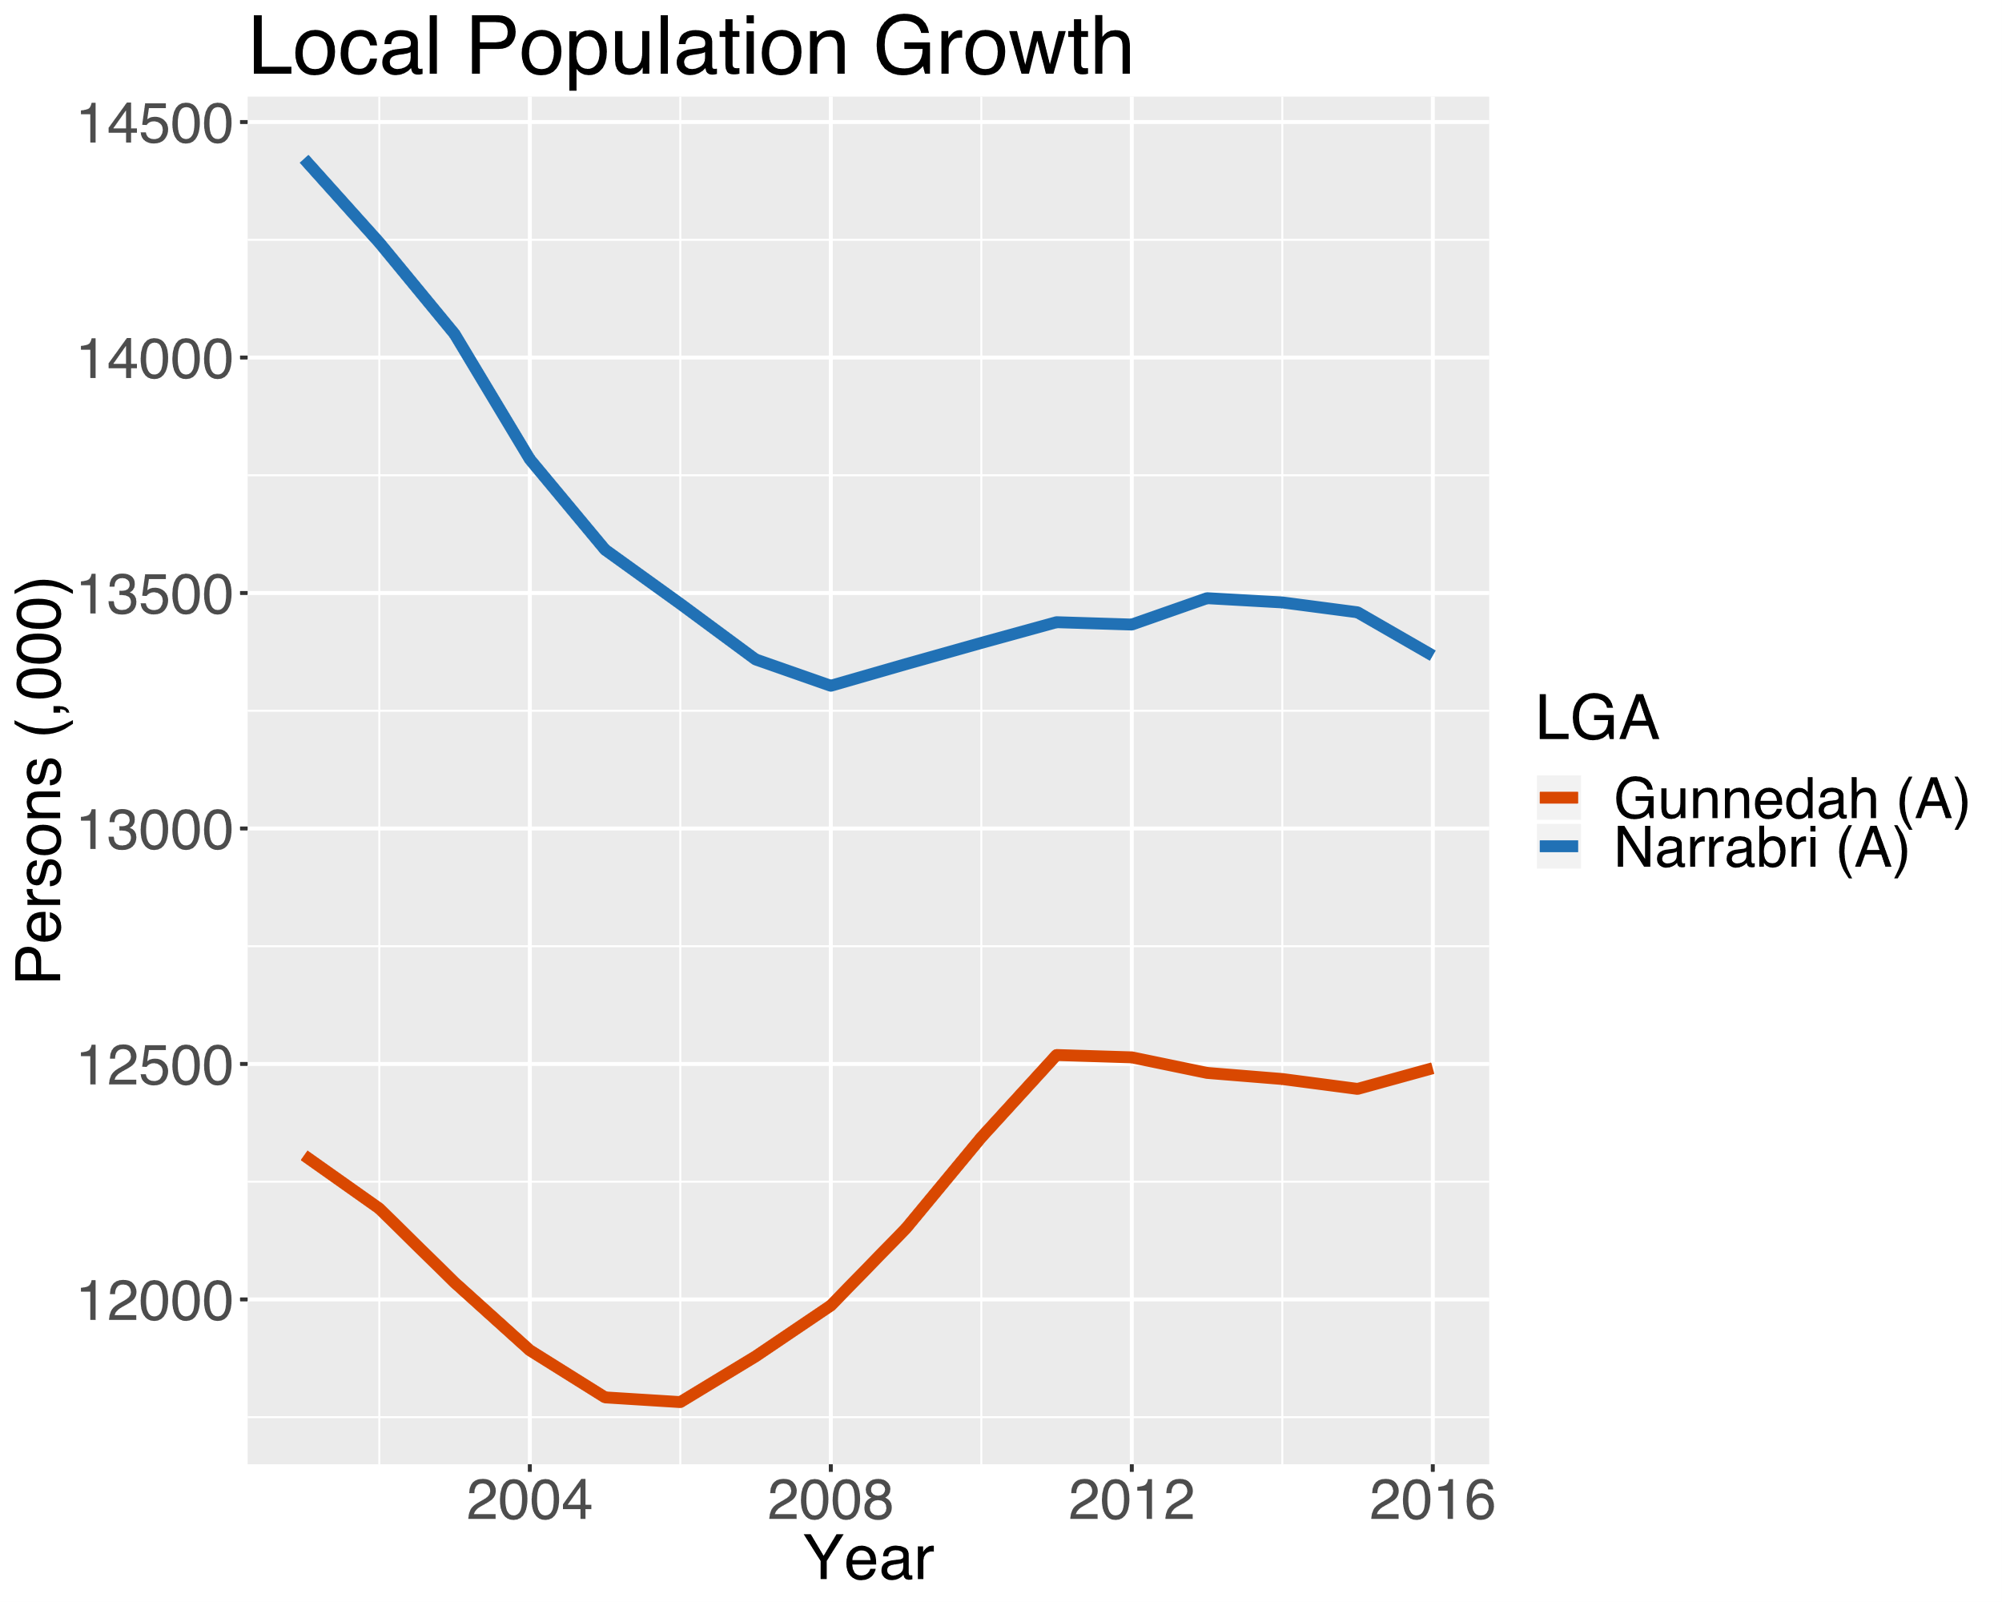
Agriculture
EIS submissions raised concerns in regard to competition for labour – particularly from agricultural sectors
In rural Australia agriculture is the primary source of employment
Over the last twelve years agricultural employment has fallen by almost 19%
Regional Australia is not immune from other downward employment trends in manufacturing and retail trade
This has and will see declines in rural population growth

Slide 107
Mining
In Gunnedah and Narrabri coincident increases in mining employment appear to have curtailed population decline (or increased population)
Sustained / sustainable increases in LGA population can have associated economic and socio-economic benefits
Gunnedah has strong employment growth in the service sector
Narrabri has seen a recovery in its service sector

Slide 108
Project Summary
Negligible change to flood characteristics
Negligible impact to Namoi River flows and water quality
Negligible drawdown at private groundwater bores
Cessation of road transport of coal to, and operations at the Whitehaven CHPP
Improved final landform
No additional ‘noise affected’ properties
Compliance with air quality criteria predicted
Significant employment opportunities
Significant economic benefits

