Slide 1

Submission to the
Independent Planning Commission 20 May 2019
DELIVERY OF OPEN SPACE
St Leonards South Planning Proposal
John Southwood
17 Mitchell St Greenwich
jsouthwood@spectrafin.com.au
M: 0412 137 080

Slide 2
IPC Terms of Reference – Landscape, Green Space and Open space
KEY REFERENCES IN THE ST LEONARDS CROWS NEST 2036 DRAFT PLAN DOCUMENTS TO OPEN AND GREEN SPACE ARE:
“Delivery of new high quality open space”
“A coordinated approach to the delivery of social infrastructure to support the well being of existing and future communities”
Source: Arup Report Section 1.1 Social Infrastructure and Open Space Study pg. 2
“Enough open space to support growth within the area”
Source: St Leonards and Crows Nest Draft Character Statement pgs. 4, 7, 13, 14
“Opportunities to provide more open space are important to the locals”
Source: St Leonards and Crows Nest Draft Character Statement pg. 14

Slide 3
St Leonards South Planning Proposal Landscape Plan (SLSLP)
For forecast residents of 4,800 accommodated in 2,400 new units the SLSLP proposes for the following NEW open space:
3,775 sqm for new local park
1,250 sqm for new “pocket parks”
5,025 sqm Total
SLSLP Equates to 0.105 Ha per 1,000 –forecast total residents
LCC LGA 2.9 ha per 1,000 residents
Beware Double Counting of Newlands Park, Gore Hill Oval, Gore Hill Cemetery etc.

Slide 4
Although SLSLP is demonstrably Inadequate for proposed new residential density can It Be Delivered?
Fact The SLS Landscape Plan in integral to the LCC’s Planning Proposal
Fact: The SLS Planning Proposal cannot proceed without it

Slide 5
FEASIBILITY OF DELIVERY OF OPEN SPACE IN SLS
HILLPDA PREPARED THE INDEPENDENT ECONOMIC REVIEW OF SLS Feasibility in February 2015 for LCC
HILL PDA concluded that a 30% uplift on the then market value of properties would incentivise home owners to sell, and that with a base FSR of 2.75 : 1 development would occur
At that time this equated to average land cost of $4,036 per sqm across their sample of sites. Refer slide 6
Acceptable Developer returns at “industry standards” were demonstrated in their report based on this land cost assumption and other inputs

Slide 7
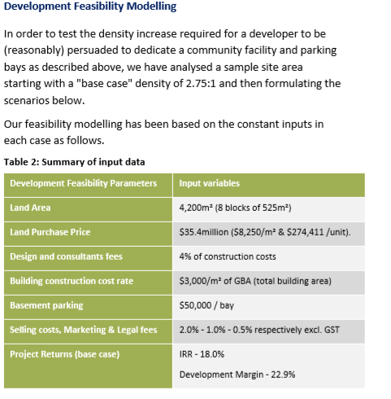
Review of Feasibility 20 July 2017 - HillPDA Letter to LCC Community Facilities

Slide 8
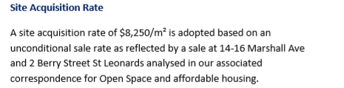
Review of Feasibility 20 July 2017 – HillPDA Letter to LCC (Cont.)
Unconditional Sales referenced:
2 Berry St $11,691 psm
14 Marshall Ave $7,846 psm
16 Marshall Ave $7,814 psm
14 and 16 Marshall Ave are “outliers”
Refer Slide 11

Slide 9
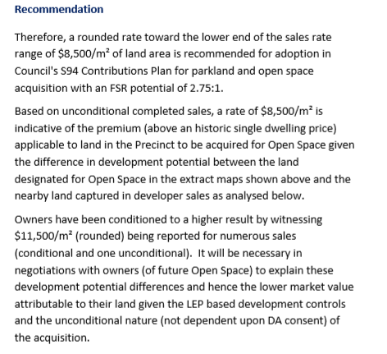
Feasibility HillPDA Letter of 12 July 2017 to LCC – Re S94

Slide 10
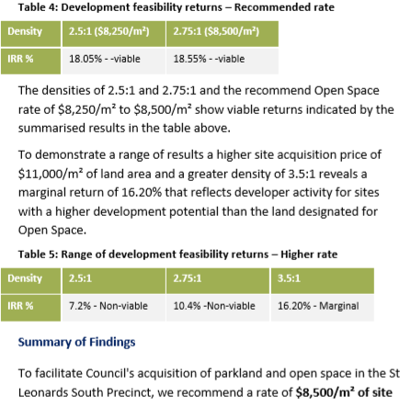
Extract Viability – HillPDA – 12 July 2017 Letter to LCC
NOTE
The Subject land is the proposed 3,775 sqm open space
LOT SIZE FOR DEVELOPMENT IS NOT AN ISSUE TO THIS CONCLUSION
ORIGINAL HILLPDA FEASIBILITY WAS BASED ON A LOT SIZE OF 1,671 SQ M
(Pg. 26 Independent Review of Viability of Planning Controls – February 2015)

Slide 11
COMPLETED SALES PRIOR TO JULY 2017
27 Properties at Average $11,439 psqm

Slide 12
The Issue
Original feasibility done on $4,036 per sqm (average) on sites assessed by HillPDA
Owners achieved $ 11,495 per sqm average on HillPDA sites
HillPDA in its advices to LCC in July 2017 calculated development not feasible where land cost exceeded $11k per sqm at FSR 2.75:1 for both Open space and Community Facilities
HillPDA inferred developers were expecting a higher FSR than 2.75:1
http://ecouncil.lanecove.nsw.gov.au/TRIM/documents_TE/765148517/TRIM_HillPDA%20advice%20on%20S94%20Open%20Space%20contribution%20August%202017_1183436.PDF
http://ecouncil.lanecove.nsw.gov.au/TRIM/documents_TE/765148520/TRIM_HillPDA%20advice%20on%20Community%20facilities%20uplift%20-%20July%202017_1193642.PDF

Slide 13
Unconditional Residential Home Sales To Date

Slide 14
Reality v Assumed Land Prices
HillPDA February 2015 Feasibility Assumptions not realised
Actual Sales Price | = |  | 285%
HillPDA Base Market Valuation +30%
Actual Sales Price | = |  | 370%
HillPDA Base Market Valuation

Slide 15
Council Resolved to Progress the Plan in 23 October 2017
http://ecouncil.lanecove.nsw.gov.au/TRIM/documents_TE/942789661/TRIM_REPORT%20-%20St%20Leonards%20South%20Draft%20DCP%20%20LMP%20and%20S94_1201403.PDF
There is no mention of financial feasibility in the Council’s online Meeting Papers. The HillPDA July reports do not appear to have been included as appendices to the report to Councillors and actual market sales evidence appears to have been overlooked or discounted

Slide 16
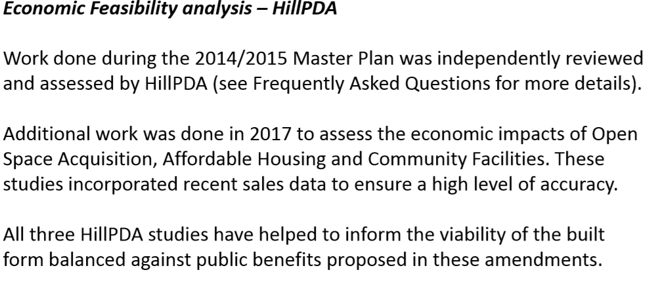
Extract From Council Presentation 16 Nov 2017 to Public
THESE COMMENTS SEEM CONTRARY TO HILLPDA JULY FINDINGS RE VIABILITY at FSR of 2.75:1 and AVAILABLE MARKET SALES EVIDENCE
THERE WAS NO REVIEW CONDUCTED OF OVERALL FEASIBLITY OF THE DEVELOPMENTS OR THEIR CAPACITY TO S 7.11 CONTRIBUTIONS IN JULY 2017

Slide 17
Why the Planning Proposal with the Landscape Plan cannot be delivered
Developers paid top land prices at the top of the market before re-zoning
Unit sales values have collapsed because of:
  Over supply of completed units in the district and throughout Sydney
  Further units in course of construction (Mirvac) or yet to come out of the ground in the LCC LGA (Landmark and JQZ) will >1,900 units
  Pre- sales market has collapsed – Opal Project problems
  Bank credit tightened for both construction finance and end owner finance
  Chinese Government reporting restricting capital flows
  Increased construction costs due to competing (national) infrastructure projects
  Developers can’t afford S.711 or an SIC and maintain financial viability
  THIS THE REALITY COUNCIL FACES

Slide 18
The Developers Position
All developers in the same boat and made re-zoning assumptions -R4 Hi Density proposal.
Majority of land bought at pretty much uniform prices >$11k per sqm
Two Planning Proposals and Concept DAs for 3 developments in SLS
One rules out S7.11 cash payments
One wishes to negotiate S7.11 payments
Both rule out an SIC payment
One Offered to share Estate Master feasibility with Council to prove their lack of capacity to make infrastructure contributions

Slide 19
LCC’s Problem is of its own making – it should have not proceeded with the Plan after July 2017
LCC needs cash to acquire 3,775 sqm of space for a park
LCC in responding to the St Leonards Crows Nest 2036 Draft Plan does not want an SIC applied to any SLS development. (But note IPC Submission)
REASON
LCC wants to approach IPART to apply S7.11 charges above the legislated $20k max – up to $36.3k for 3 br units (Source GLN S. 94 Report February 2015 Pg. 7)
Council Management appears to have overlooked available market evidence and advice in July 2017 that the developments were not feasible based on the agreed base (pre-incentive) FSR of 2.75:1 that was put to and approved by Councillors in October 2017

Slide 20
Although SLS Landscape Plan is demonstrably Inadequate for the proposed new residential density can It Be Delivered?
No!

Slide 21
PLEASE
ADVISE THE MINISTER TO NOT APPROVE THIS PLAN AS IT IS NOT FINANCIALLY FEASIBLE AND THE NEW OPEN SPACE IS TOTALLY INADEQUATE FOR THE DENSITY PROPOSED
WORK WITH THE COMMUNITY TO DEVELOP SUSTAINABLE, WELL PLANNED SOLUTIONS
ENSURE ADEQUATE INFRASTRUCTURE, BASED ON SENSIBLE POPULATION DENSITY THAT ACHIEVES EQUITABLE OUTCOMES FOR BOTH EXISTING, NEW AND ADJACENT RESIDENTS.

Slide 22
THANKYOU!
John Southwood

