Slide 1

Greenwich Community Association Inc
Submission to Independent Planning Commission
Planning Proposal for the St Leonards South Residential Precinct
20 May 2019

Slide 2
GCA resolution 7 December 2017
The GCA calls on Councillors to resolve to: a. cancel the Master Plan and put the community first, including by providing community consultation and not allowing more density without more infrastructure. b. to include consultation with residents in all of East Ward that have been excluded to date and work with
(i) the whole community,
(ii) other LGAs and
(iii) NSW government authorities to formulate a sustainable and liveable precinct that does not place unacceptable pressure on the infrastructure, amenity and character of Greenwich and all other areas included in the St Leonards/Crows Nest Planning Precinct.

Slide 3
Term of reference:-
“to consider the scale of residential development contained in the (St Leonards South Residential Precinct) proposal and whether the whole site needs to be rezoned to meet housing targets identified by the Greater Sydney Commission”.
To consider also whether Lane Cove Council is required to deliver housing within the St Leonards and Crows Nest Station Precinct (Planned Precinct), being the area the subject of the St Leonards and Crows Nest draft 2036 Plan and whether Lane Cove is required to deliver housing by virtue of its inclusion in an Urban Renewal Area in the GSC’s North District Plan.

Slide 4
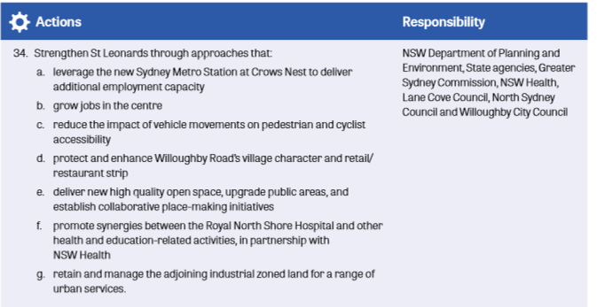

Slide 5


Slide 6
There is no requirement in the GSC’s North District Plan to include housing in SLS in the St Leonards and Crows Nest draft 2036 Plan.

Slide 7
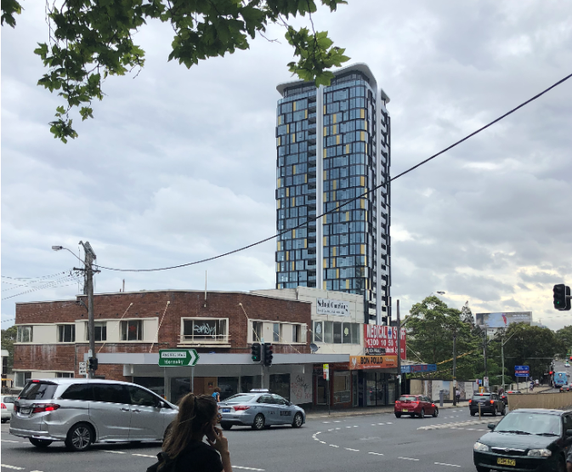
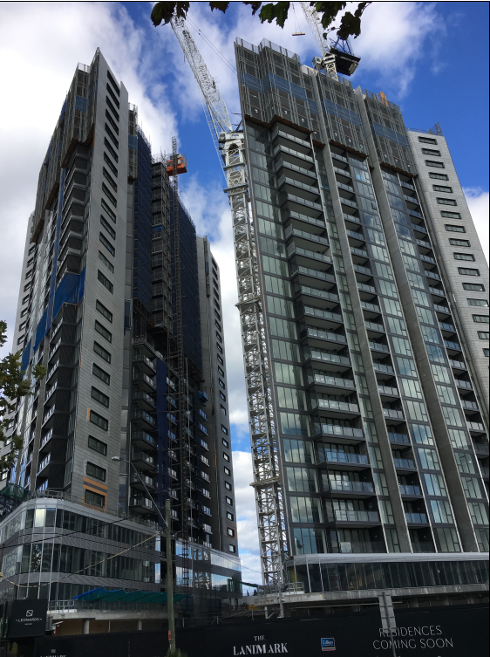
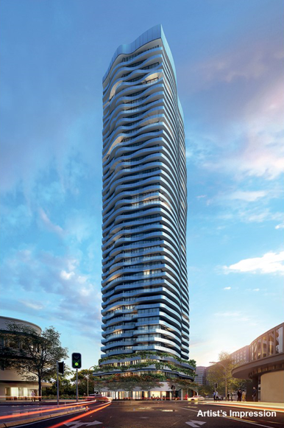
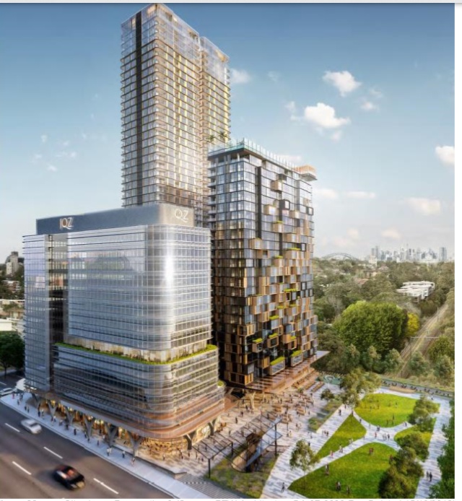
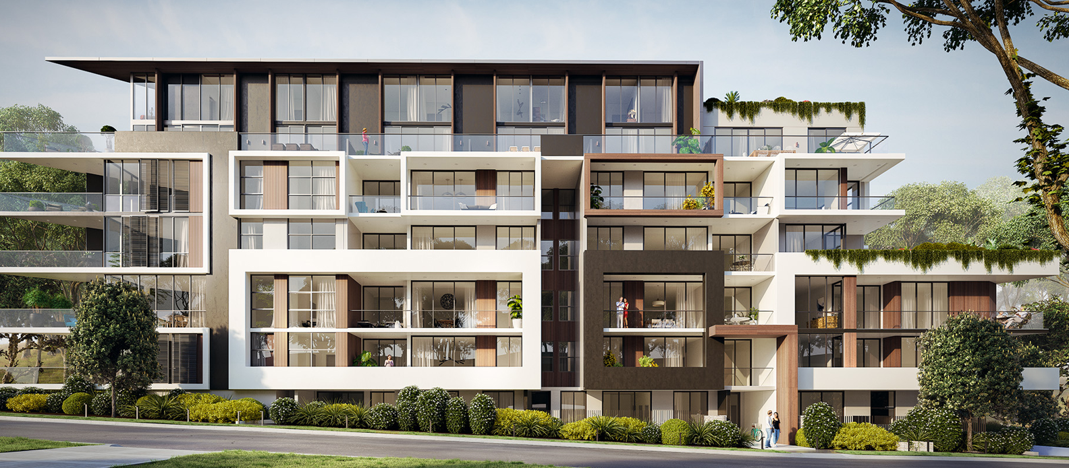

Slide 8
In the light of the lack of developer contributions towards infrastructure for an area already under significant infrastructure stress, the delivery of 2400 apartments, additional to 1900 apartments already in the pipeline, will render the SLS Plan site inappropriate as an Urban Renewal Area.

Slide 9
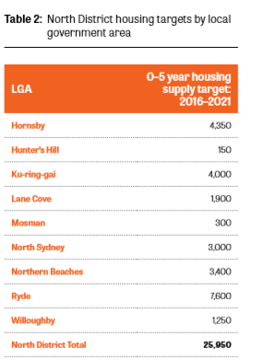
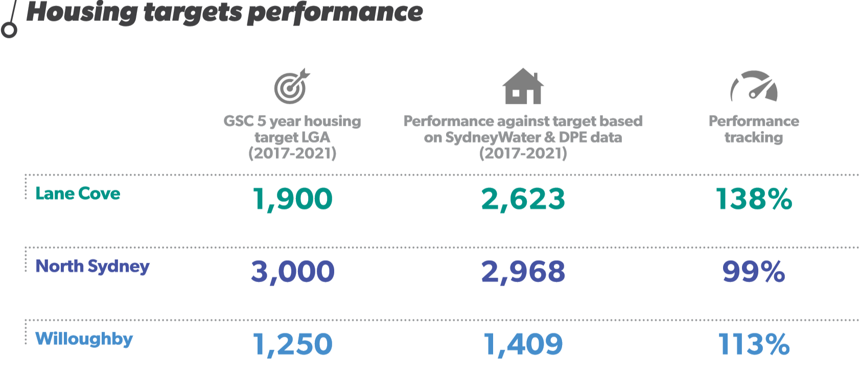

Slide 10
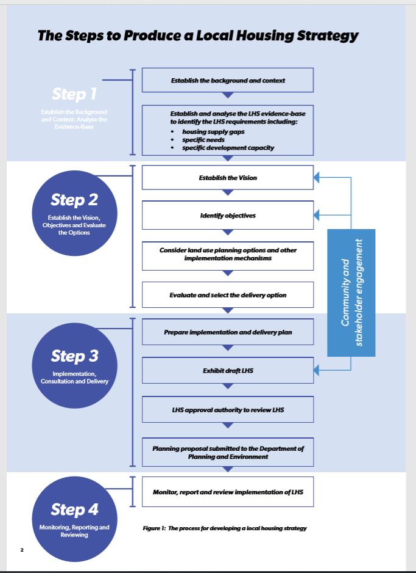
Housing need
Diversity (of dwelling type)
Market preferences
Alignment of infrastructure
Displacement
Amenity
Engagement (with community)
Efficiency
SLS does not address the highlighted principles, much less satisfy them.

Slide 11
The SLS Plan is not needed to meet Lane Cove Council’s housing target to 2021.
It cannot be justified on the grounds of future targets that do not exist.
And, for the same reasons, staging of the proposal is not supportable.

