Slide 1
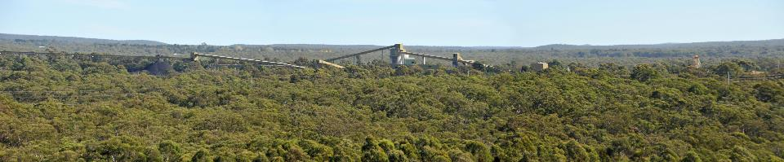
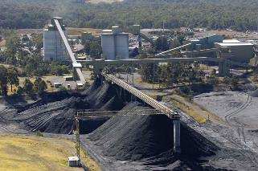
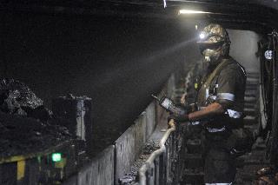
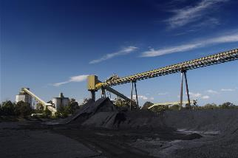
Tahmoor North – Modification 4 (DA 67/98)
Independent Planning Commission
26 September 2018

Slide 2
Agenda
Overview of Modification 4 Proposal
Status of Tahmoor Mine and Longwalls
Subsidence Modelling
Subsidence Impacts
Consultation & Stakeholder Engagement

Slide 3

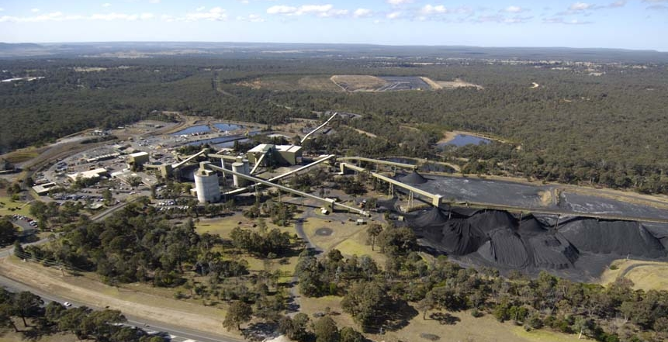
Tahmoor Coking Coal Operations
www.simec.com/mining

Slide 4
Tahmoor Coking Coal Operations
Tahmoor Coking Coal Operations (TCCO) is an underground coal mine that began operations in 1979.
TCCO has approval to produce up to three million tonnes of Run of Mine (ROM) coal per annum.
Coal is mined from within the Bulli seam, producing hard coking coal for steel production and minor thermal coal. Product coal is transported via rail to Port Kembla for Australian domestic customers, including Bluescope Port Kembla and Liberty Primary Steel at Whyalla and export customers.
Current mining operations, in the Tahmoor North lease area, are forecast to continue until around 2022, when the mining operations will move to a new mining Domain (Tahmoor South) at Bargo.
TCCO currently employs approximately 380 employees and contractors.
The mine supports many local and regional businesses and services.
TCCO is a proud supporter of local charities and service organisations through its sustainable development program and sponsorships.

Slide 5




An Integrated Approach
4

Slide 6
Liberty House Group
Liberty House Group has five main divisions:
  Liberty Commodities - A global solutions provider to the international steel and non-ferrous metals industries.
  Liberty Recycling - Liberty Recycling operates across the metals recycling supply-chain providing abundant high-quality ferrous and non-ferrous metals across the UK, Australia (Rooty Hill), USA and continental Europe.
  Liberty Steel - Liberty Steel is a global supplier of engineered steels. It has an integrated offering ranging from liquid steel made from recycled raw materials through to high value products and associated services, sold around the world. Includes the Liberty Primary Steel Whyalla steelworks.
  Liberty Aluminium - Liberty owns the only remaining primary aluminium smelter in the United Kingdom which manufactures 48,000 tonnes of sheet ingot and sow pans every year.
  Liberty Engineering - Liberty Engineering delivers a wide spectrum of design, engineering, manufacturing and fully integrated solutions to customers in the automotive, general engineering, construction, motorsport, aerospace and other sectors.
6

Slide 7
SIMEC Group
SIMEC has 5 major divisions which focus on Shipping, Infrastructure, Mining, Energy and Commodities.
  SIMEC Shipping is centered around the chartering, leasing and ownership of vessels as well as port ownership and processing.
  SIMEC Infrastructure owns and operates commercial ports, railway stock and marine fleets as well as storage facilities provide which provide the Alliance with the ability to extend services to customers and support the delivery of its own value-added activities.
  SIMEC Mining is a globally focused business with iron ore assets in South Australia’s Middleback Ranges and coking coal asset at Tahmoor NSW supplying feed material for GFG’s Whyalla Steelworks and other GFG Alliance’s business as well as third party customers.
  SIMEC ZEN Energy is a fast growing producer of renewable power, with a portfolio of assets across hydro and bio power as well as waste to energy, on- and off-shore wind, solar and pumped hydro.
  SIMEC Commodities specialises in the trade of energy and energy related commodities.
7

Slide 8
Modification 4
www.simec.com/mining

Slide 9
Overview
Modification to permit low levels of subsidence within an area where subsidence is not currently permitted to occur under Condition 6(i) of DA 67/98.
DA 67/98 extraction excepted areas identified in Condition 6(i) of the 1999 consent without a separate approval or modification of existing approval.
Improvements in subsidence monitoring and modelling methodologies enable greater accuracy in the prediction of subsidence impacts, in particular in areas near the outer edge of measurable subsidence effects.
Modification 4 Area comprises approximately 11 hectares of land within the predicted 20 millimetre subsidence contour, inclusive of 49 dwellings and 64 structures within the Picton High School.
Without the proposed modification, LW32 will not be able to be extracted in an efficient and viable manner and require a LW step around with loss of coal reserves.

Slide 10
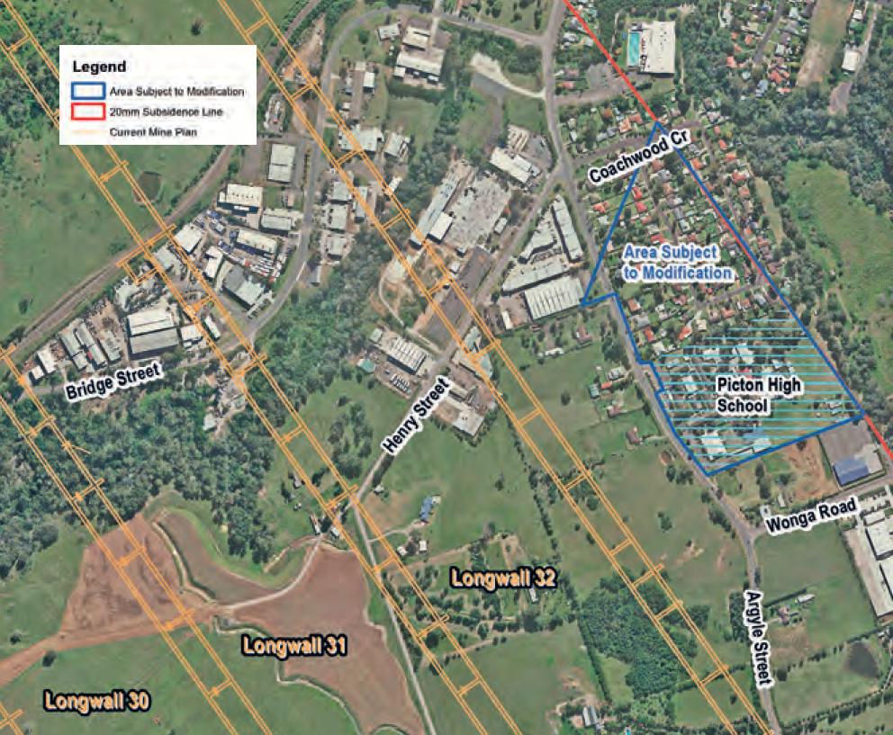
Area

Slide 11
Details
No changes to approved mining operations, associated surface facilities or production rates are proposed.
No significant environmental features within the Modification 4 area, including no water courses, alluvial land, steep slopes or substantial remnant vegetation.
Subsidence impact assessment concludes that Modification 4 subsidence is likely to result in nil to negligible impacts on the land surface, natural and built features and on existing land uses.
Assessment concludes nil to negligible impact is primarily due to:
  Very low levels of subsidence predicted.
  Substantial depth of cover above the coal seam.
  Overlying site characteristics.
  Continued implementation of existing subsidence monitoring, management and mitigation measures.

Slide 12
Tahmoor Mine
Status
www.simec.com/mining

Slide 13
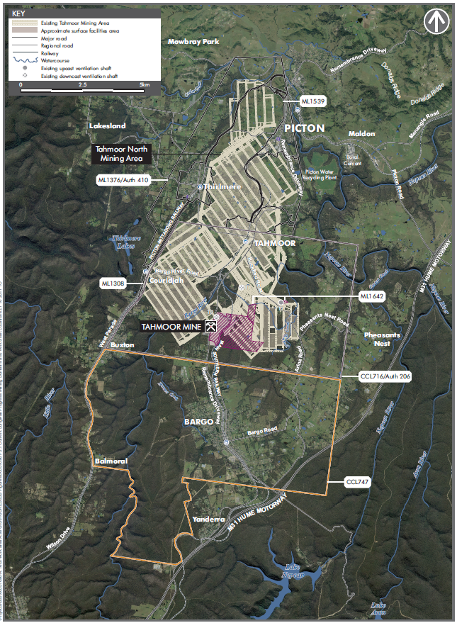
Tahmoor north
Longwall mining and first workings in the Bulli Seam
Up to 3Mt of ROM coal produced per annum
  Primarily hard coking coal sold to Australian domestic and international customers for steel production
  A small amount of export thermal coal is produced
Coal processing occurs on site at the CHPP and waste to onsite REA
Rail transport of product coal to Port Kembla and occasionally Newcastle
Existing life of operations is 2021/22
Tahmoor North
Tahmoor
Tahmoor South

Slide 14
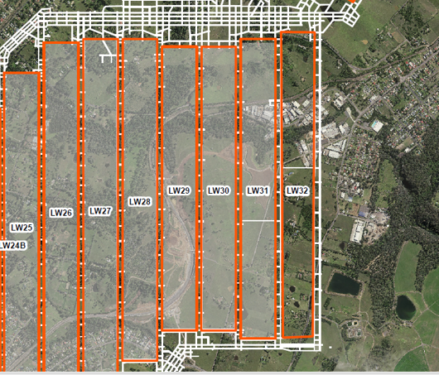
Current Status
Longwall 31
LW31 was completed on 17 August 2018
Longwall mined directly under Picton Industrial Area
Mined directly under the Main Southern Railway Line
Subsidence impacts within predicted range
Longwall 32
Whole block proposed approx. 2,440 m
HRA notification 8 June 2018
Subsidence Approval issued 19 September 2018
  Approval for Stage 1 initial 1,100 m
LW32 commencement proposed during late October 2018
  LW32 start delayed due to winder outage
Picton Industrial Area (PIA)
DA67/98 requires that second workings not be undertaken under land that was zoned Industrial 4(a) unless binding Compensation Agreement in place.
34 CA/PSMPs required
  3 signed
  11 with property owner
  20 being prepared

Slide 15
Proposed LW32 Staging
LW32 proposed to be staged to accommodate the timing for Modification 4 and the PIA Compensation Agreement process.
Stage | Chainage | Comments
Stage 1 | 0 – 1,100 m | Start of LW32 to eastern edge of Modification 4 area
Stage 2 | 1,100 - 1,400 m | Start of Modification 4 area to eastern edge of PIA
Stage 3 | 1,400 – 2,000 m | Start of PIA to western edge of PIA
Stage 4 | 2,000 – 2,440 m | Western edge of PIA to End of LW32

Slide 16
LW32 Approvals Required
Picton Industrial Area (1,400 – 2,000 m)
“zoned Industrial 4a”
Compensation Agreements and Property Subsidence Management Plans LW32 Picton Industrial Area.
Modification 4 Area (1,100 - 1,400 m)
“zero subsidence area”
Red line is boundary of LW32 20 mm subsidence contour.
Property Subsidence Management Plan for Picton High School
Front of house risk screening completed
PMIs and Subsidence Hazard Inspections offered to residences
Notes:
DA mod is required to mine adjacent to the Residential Zone (red shaded area). Risk Assessment was progressed this morning (UMWELT) in order to meet the submission schedule - Q4 2017
21 Compensation Agreements required for LW32 PIA

Slide 17
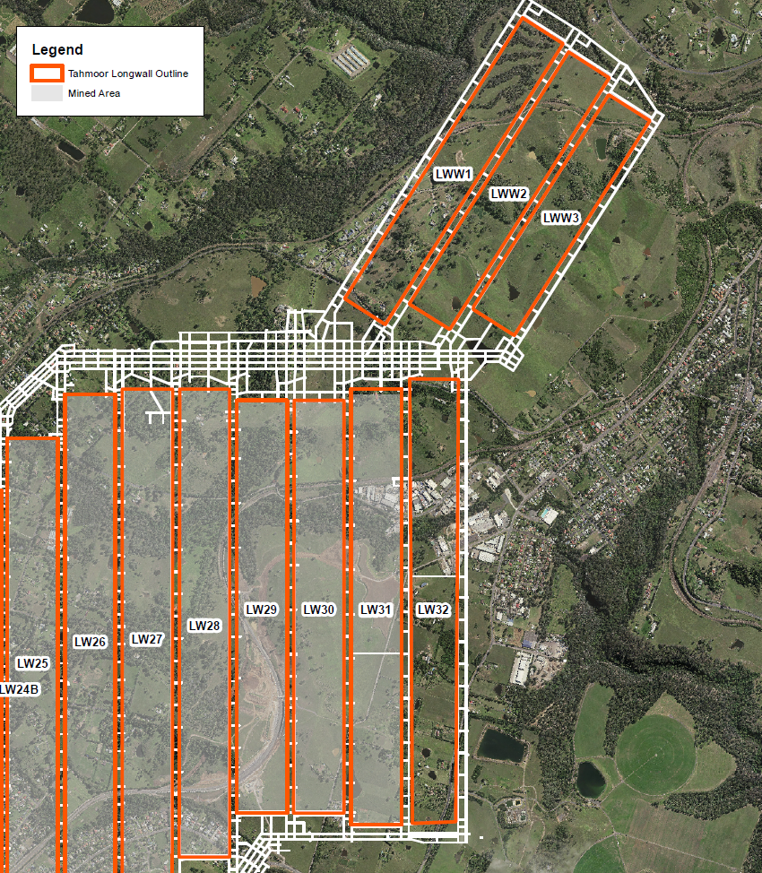
Western Domain
LWs 33 to 35
Three LWs (LW33 to 35) currently proposed within Western Domain
Extraction time frame 2019 to 2021
Extraction Plan secondary approval
LW 36 & 37
Investigating two additional LWs (LW36 to 37)
Potential 1 to 2 years additional extraction time frame
Extraction Plan secondary approval

Slide 18
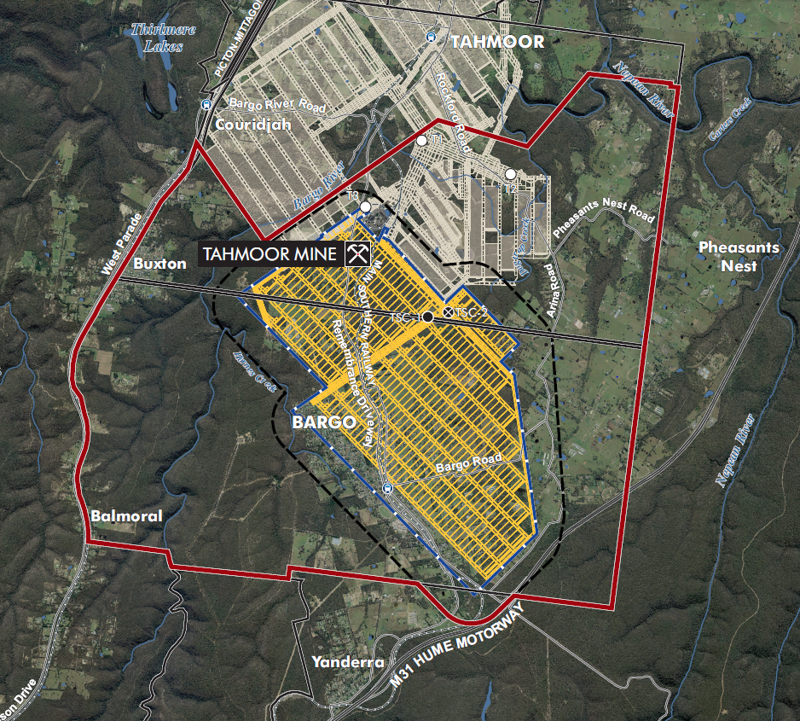
Tahmoor South Project
Key project components:
  Commencement after completion of Tahmoor North longwalls in 2022
  Mine extension for 13 years to 2035
  Longwall mining in the central domain
  Extraction of up to 4 Mt of ROM coal per annum
  Mine development, including underground redevelopment, pre-gas drainage and service connection
  Expansion of the REA
  Limited upgrades to existing surface facilities
  Continued rail transport of product coal to Port Kembla and Newcastle (from time to time)

Slide 19
Subsidence Modelling
www.simec.com/mining

Slide 20
1998 EIS Methodology
Tahmoor North Project EIS was completed in 1998.
The 1998 EIS impact assessments for residences and built structures was based upon the statistical distribution of measured strains over TCCO Longwalls 3 to 7 and 9 and statistical distribution of buildings within particular length ranges.
This method provided a statistical distribution of likely overall impacts due to the proposed extraction of longwalls directly beneath a group of houses.
However, the Modification 4 area is located more than 200 metres from the nearest edge of the proposed mining area.
The method adopted at the time of preparing the EIS was not designed to be applied in this situation.

Slide 21
Current Methodology
Probabilistic assessment of impacts on houses based on findings of two parallel studies
  ACARP Research Project C12015
  Study for Tahmoor Mine at request of DPI (now Resources Regulator)
Over 1000 buildings experienced subsidence movements during mining of LWs 22-24, with impacts at 150 houses.
Statistical analysis of various factors (subsidence movements, structure type, age).
Mining-induced curvature and structure type selected as parameters for probabilistic assessment method.
A second check on probabilistic method also applied for Mod 4 application
  Plot of actual claims to date beyond edges of longwalls
  No impacts reported at offset distances equivalent to Mod 4 area

Slide 22
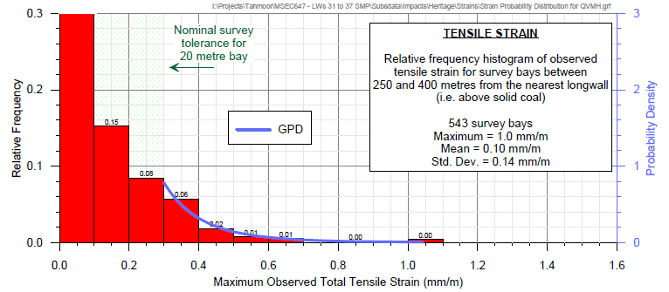
Tensile Strain

Slide 23
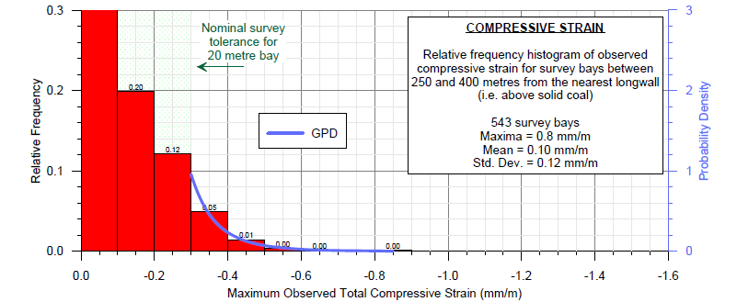
Compressive Strain

Slide 24
Subsidence Impacts
www.simec.com/mining

Slide 25
Subsidence Predictions

Slide 26
Dwellings
No. of Dwellings | Maximum Predicted Subsidence (mm) | Maximum Predicted Tilt (mm/m) | Maximum Predicted Hogging Curvature (1/km) | Maximum Predicted Sagging Curvature (1/km)
7 | 20 | <0.5 | <0.01 | <0.01
16 | 30 | <0.5 | <0.01 | <0.01
13 | 40 | <0.5 | <0.01 | <0.01
7 | 50 | <0.5 | <0.01 | <0.01
4 | 60 | <0.5 | <0.01 | <0.01

Slide 27
Dwellings Repair Categories Assessment
Category of Impacts | Dwelling Impact Description | Likelihood
Category 0 | Nil or negligible impacts | 95%
Category 1 to Category 2 | Very slight to slight impacts | 4%
Category 3 to Category 5 | Moderate to very severe impacts | 1%

Slide 28
Picton High School
No. of Building Structures | Maximum Predicted Subsidence (mm) | Maximum Predicted Tilt (mm/m) | Maximum Predicted Hogging Curvature (1/km) | Maximum Predicted Sagging Curvature (1/km)
8 | 20 to 30 | <0.5 | <0.01 | <0.01
12 | 30 to 40 | <0.5 | <0.01 | <0.01
16 | 40 to 50 | <0.5 | <0.01 | <0.01
16 | 50 to 60 | <0.5 | <0.01 | <0.01
12 | 60 to 70 | <0.5 | <0.01 | <0.01

Slide 29
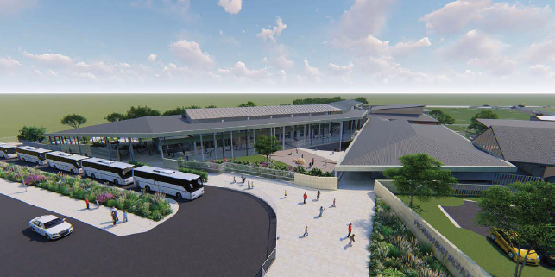
Picton High School
Implementation of management measures will ensure all structures, including dwellings and school buildings, will remain safe and serviceable at all times and the ongoing use of school buildings for educational purposes will not be affected.
Picton High proposed to be redevelop with current school being relocated into demountables over 2018/2019 school holidays
Existing school proposed to be demolished from January 2019
New school construction program over 18 months with completion mid 2020

Slide 30
Consultation
www.simec.com/mining

Slide 31
Community Consultation
Modification 4 Specific
Modification 4 Community Information Day on 21 September 2017
Modification 4 Newsletter – September 2017
Modification 4 Letter to Residents dated 15 September 2017 and 7 November 2017
LW 32 Specific
LW 32 Newsletter – June 2018
LW 32 Letter to Residents dated 10 July 2018
LW 32 Community Information Day on 20 September 2018

Slide 32
Stakeholder engagement
DPE briefing on 26 October 2016
Picton High School briefing on 19 July 2017
DPE briefing on 03 August 2017
Picton High School briefing on 30 August 2017
Wollondilly Shire Council briefing on 07 September 2017
TCCCC briefing on 07 September 2017
NSW Member for Wollondilly briefing 22 September 2017
Picton High School P&C briefing on 25 October 2017
Picton High School briefing on 1 May 2018
Picton High School briefing on 15 June 2018
Picton High School briefing on 15 August 2018

