Slide 1

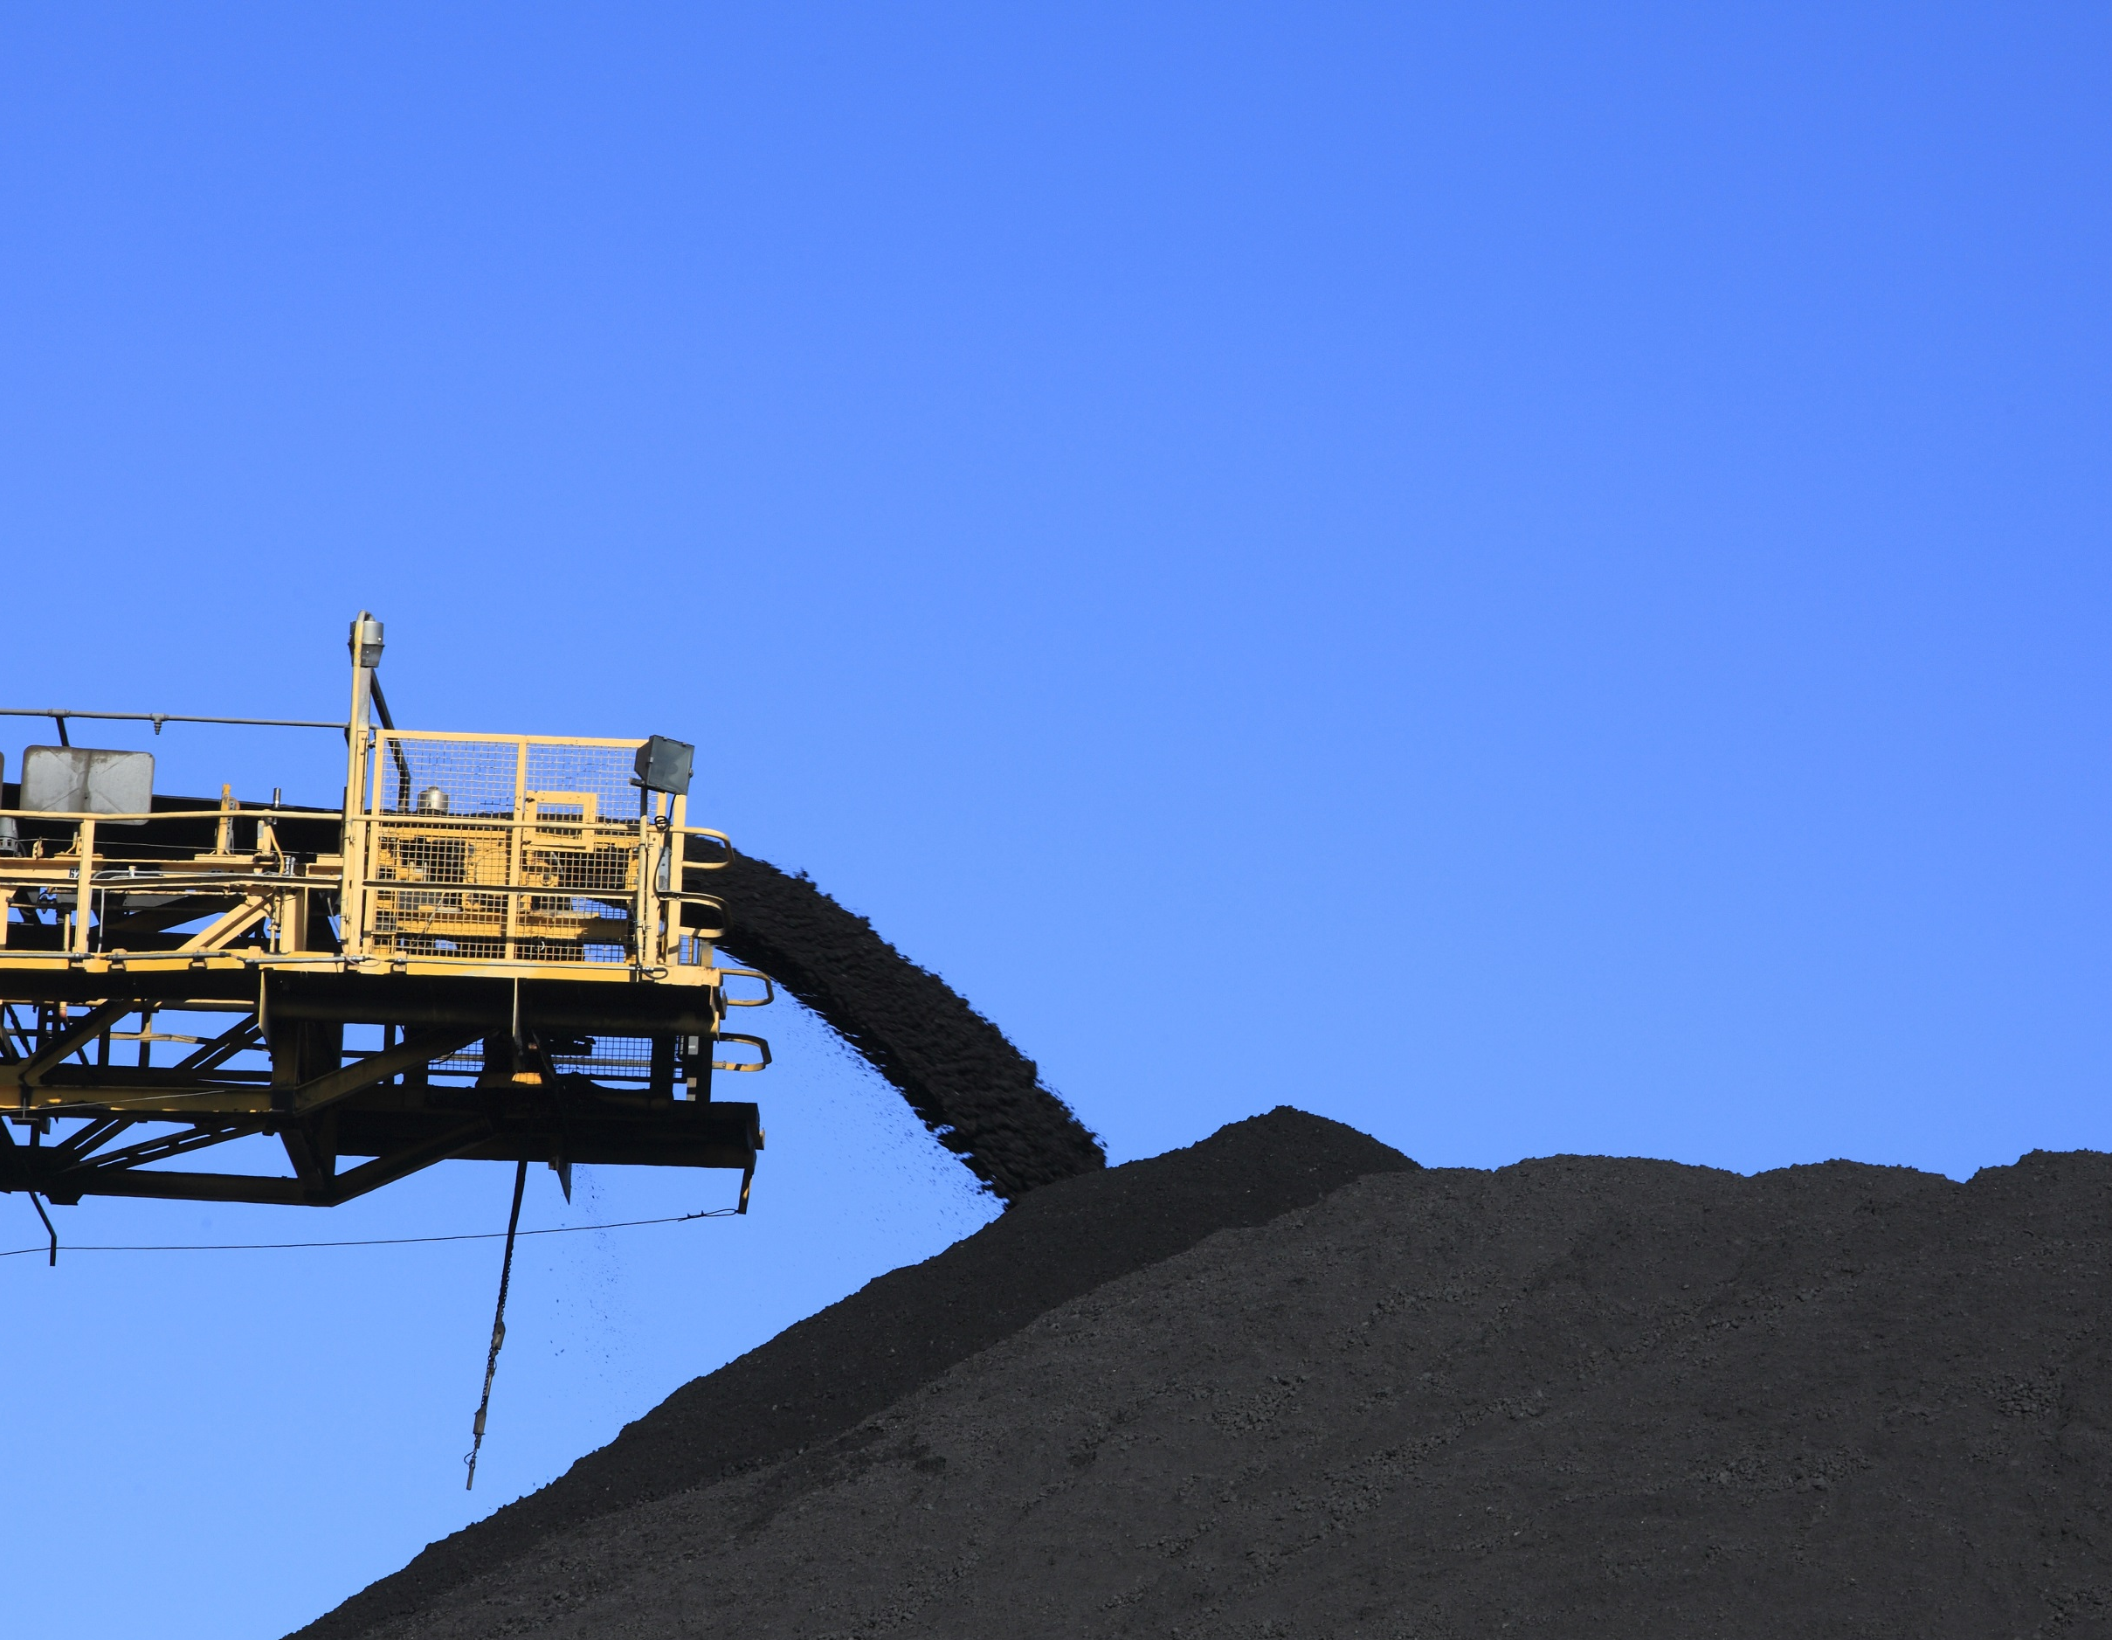
IPC Briefing – Mine Optimisation Modification (Mod 3)
26 June 2018

Slide 2
  MACH Energy Representatives
Ferdian Purnamasidi Managing Director | 15 years business experience across a range of industries with primary focus in the resources sector Senior Corporate Development Manager of the Salim Group & Director of Mining Projects Division Director of ASX listed company, KGL Resources Bachelor of Commerce and Diploma of Business Management from Curtin University, Western Australia
Darren Yeates Chief Operations Officer | 30 years mining industry experience, most recently as CEO of Hancock Coal 22 years with Rio Tinto, including roles of Chief Operating Officer and Acting Managing Director of Rio Tinto Coal Australia. Extensive experience managing mining operations in the NSW Hunter Valley. Bachelor of Engineering (Mining), Grad Diploma in Management, Grad Diploma in Applied Finance and Investment, Executive MBA, Fellow of AICD.
Chris Lauritzen General Manager – Resource Development | 35 years experience in the international coal industry in technical and general management roles – exploration, project development, mine planning, contract mining management and operational improvement Accountable for Major Approvals and Strategic Planning Bachelor of Science (Geology), Fellow of AusIMM, Graduate of AICD.

Slide 3
Agenda
Key Agenda Items | Slide
MACH Energy overview and history | Slides 3 to 4
Project context | Slides 5 to 6
Overview of the Modification | Slide 7
Relationship to other MACH Energy planning applications | Slide 8
The Modification and environmental assessment | Slides 9 to 18
Key issues raised in submissions | Slides 19 to 22
Conclusion/Questions | Slide 23

Slide 4







MACH Energy Overview
MACH is part of the Salim Group, one of Indonesia’s largest conglomerates

Slide 5
MACH’s History
MACH was founded to acquire and develop the tier-one Mt Pleasant thermal coal asset
Mt Pleasant acquired and feasibility study completed
Strategic partnership with JCDA
MACH founded
In Aug-16, MACH completed the acquisition of the Mt Pleasant asset from Rio Tinto. The company also completed a feasibility study for the project
MACH signs strategic partnership with JCDA involving a 5% investment by JCDA and 3-year initial term offtake and marketing arrangement
Domestic
Sales
MACH was founded in September 2015 to facilitate the purchase of Mt Pleasant, a tier-one thermal coal asset
Construction commenced
MACH signs coal sales contract with AGL
On-site construction commenced in Nov-16
Sep-15
Jan-16
Aug-16
Nov-16
Nov-17
May-18
Sep-18
On Jan-16, MACH signed a sale agreement and purchase agreement to acquire 100% of the Mt Pleasant thermal coal asset from Rio Tinto for a total consideration of US$221 million plus royalty payments
Competitive tender processes commenced resulting in a number of contracts being awarded beginning in late 2016. Final mining rates were significantly lower than estimated in the Feasibility Study, with average all-in FOB cash costs at ~US$31.1 per tonne for the first 20 years
Mining at Mt Pleasant commenced
MACH is on track to deliver first coal in September 2018
Mining commenced
Targeted first coal
Acquisition
Awarding of key contracts

Slide 6
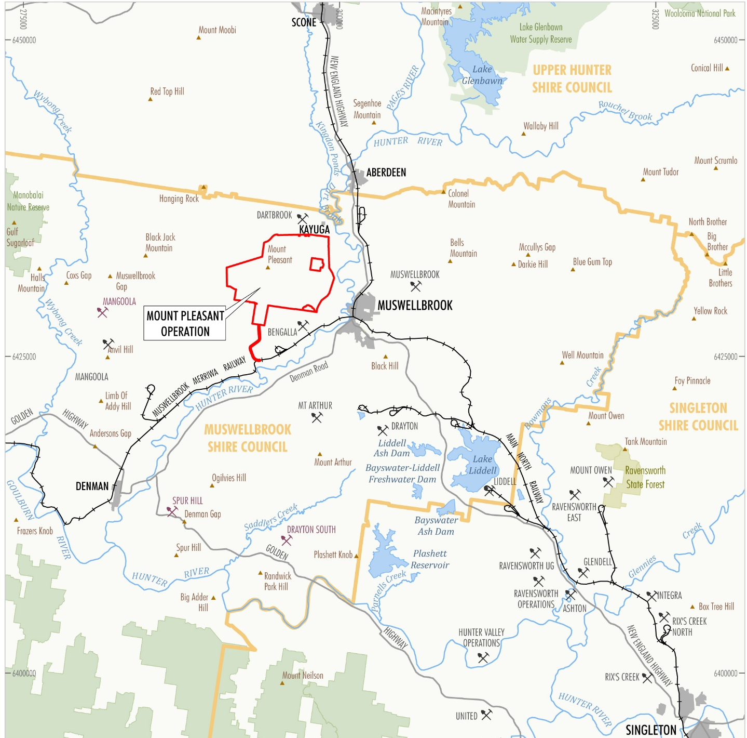
Project Context

Slide 7
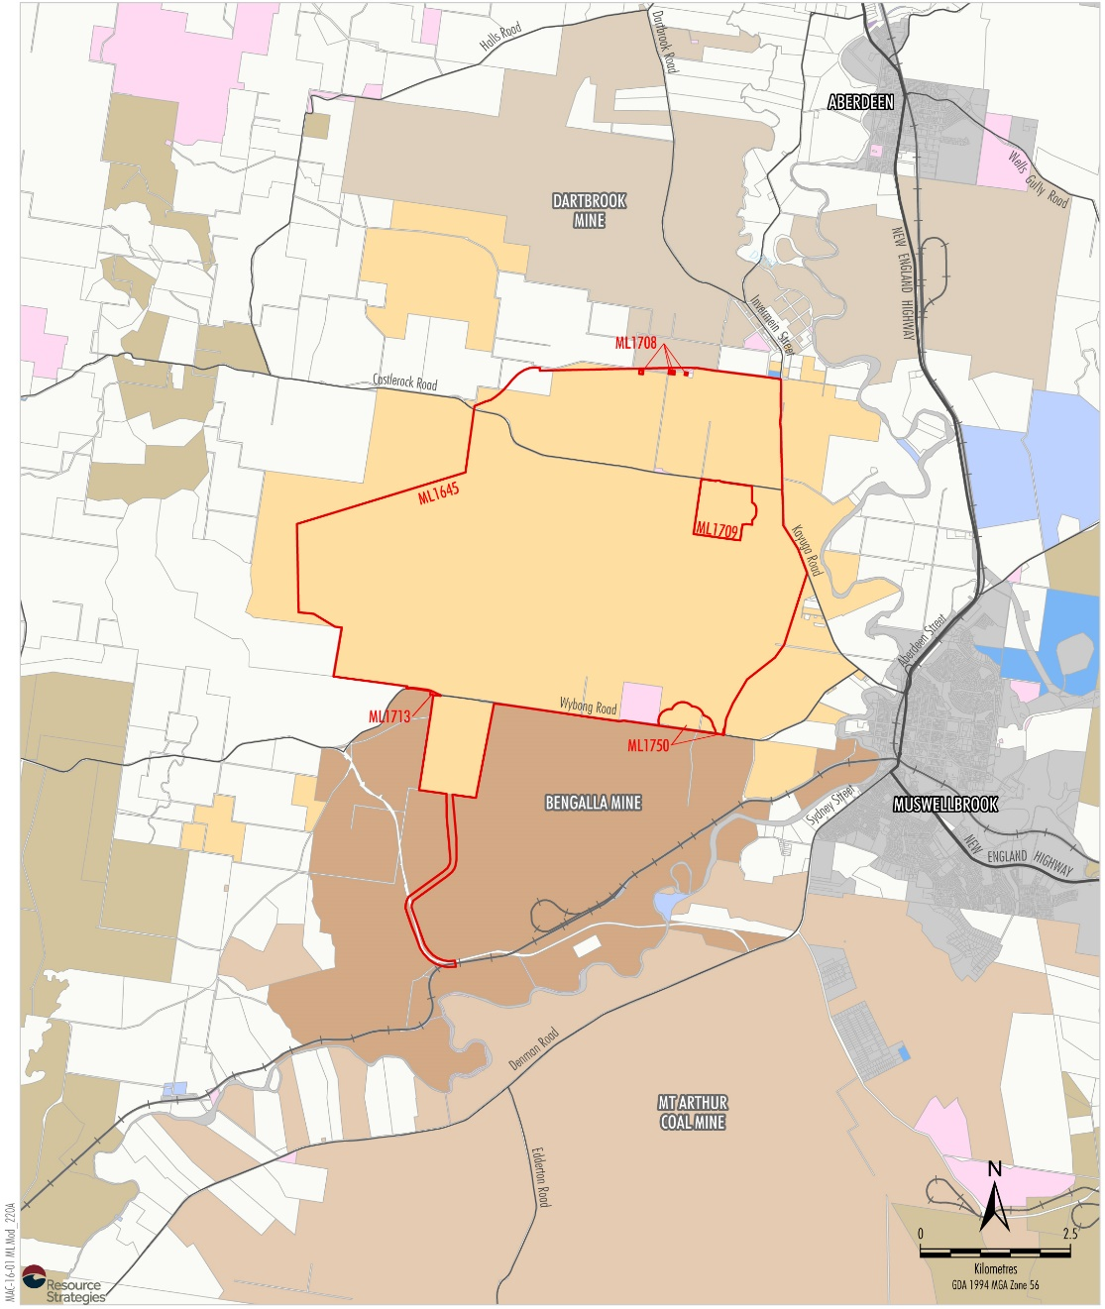
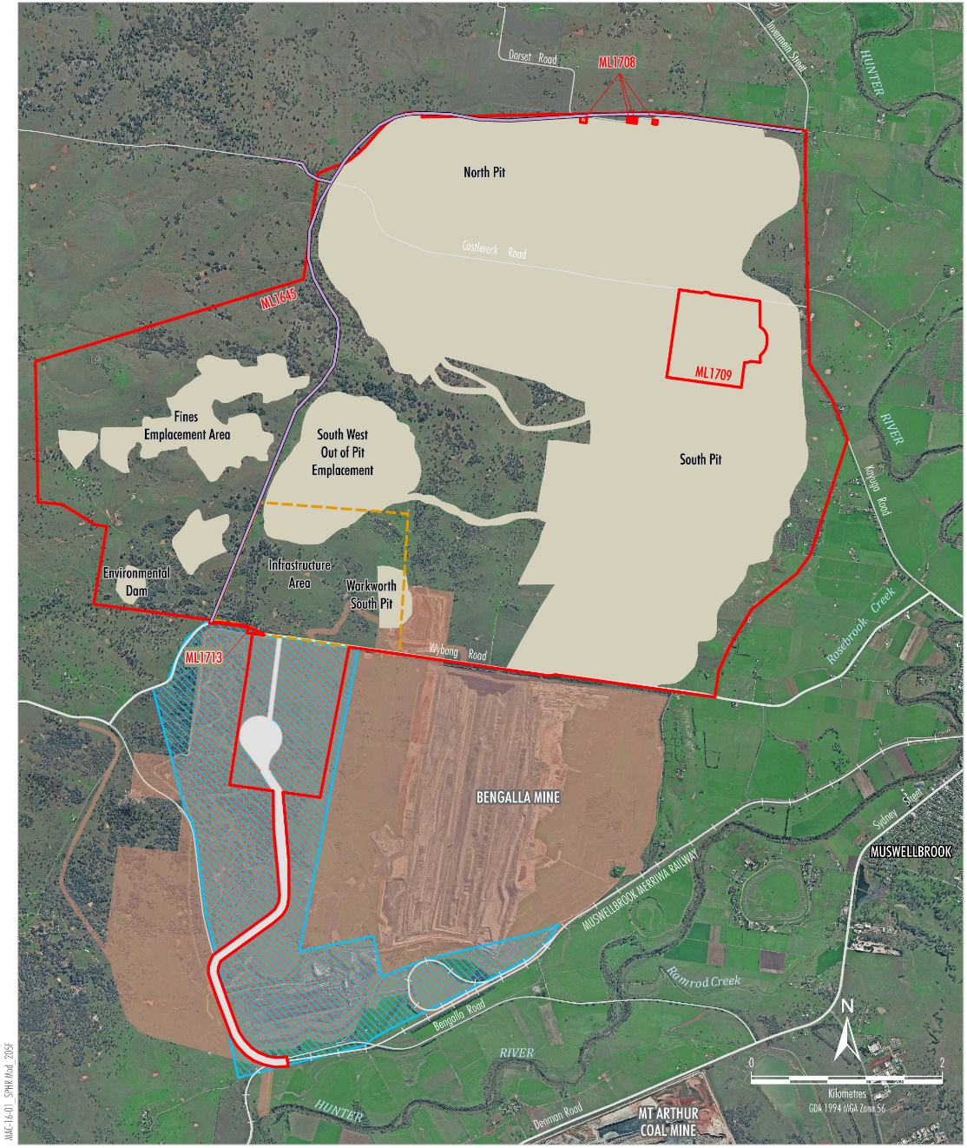
Project Context

Slide 8
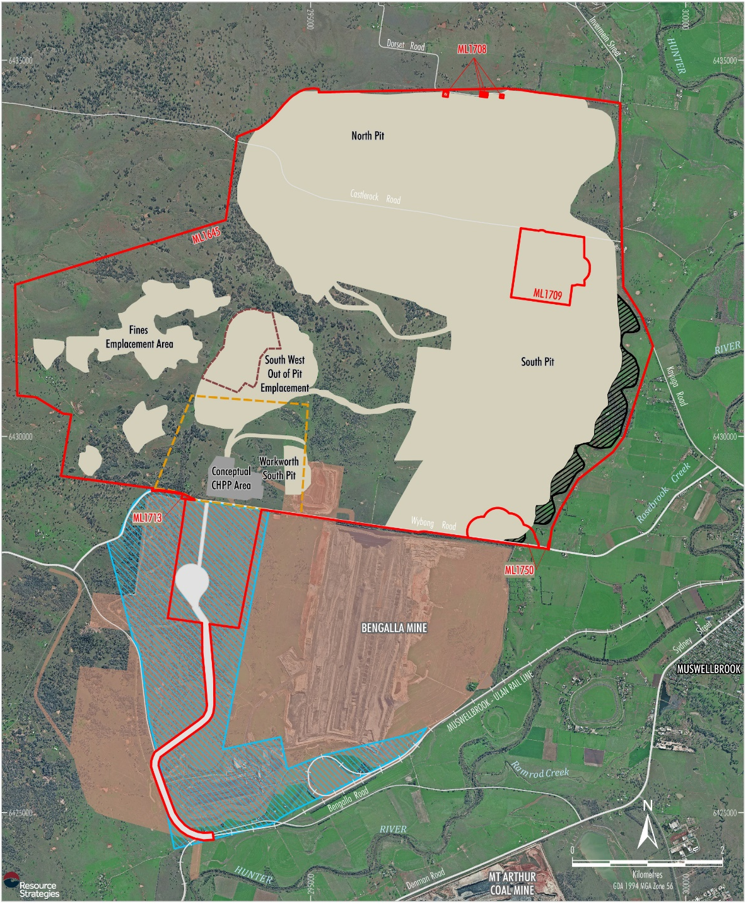
Overview of the Modification
  Extension of project life by six years.
  Emplacement extension to better align with existing topography and facilitate an improved final landform:
    Provides additional capacity in main emplacement.
    Removes need to emplace waste in the South West Emplacement.

Slide 9
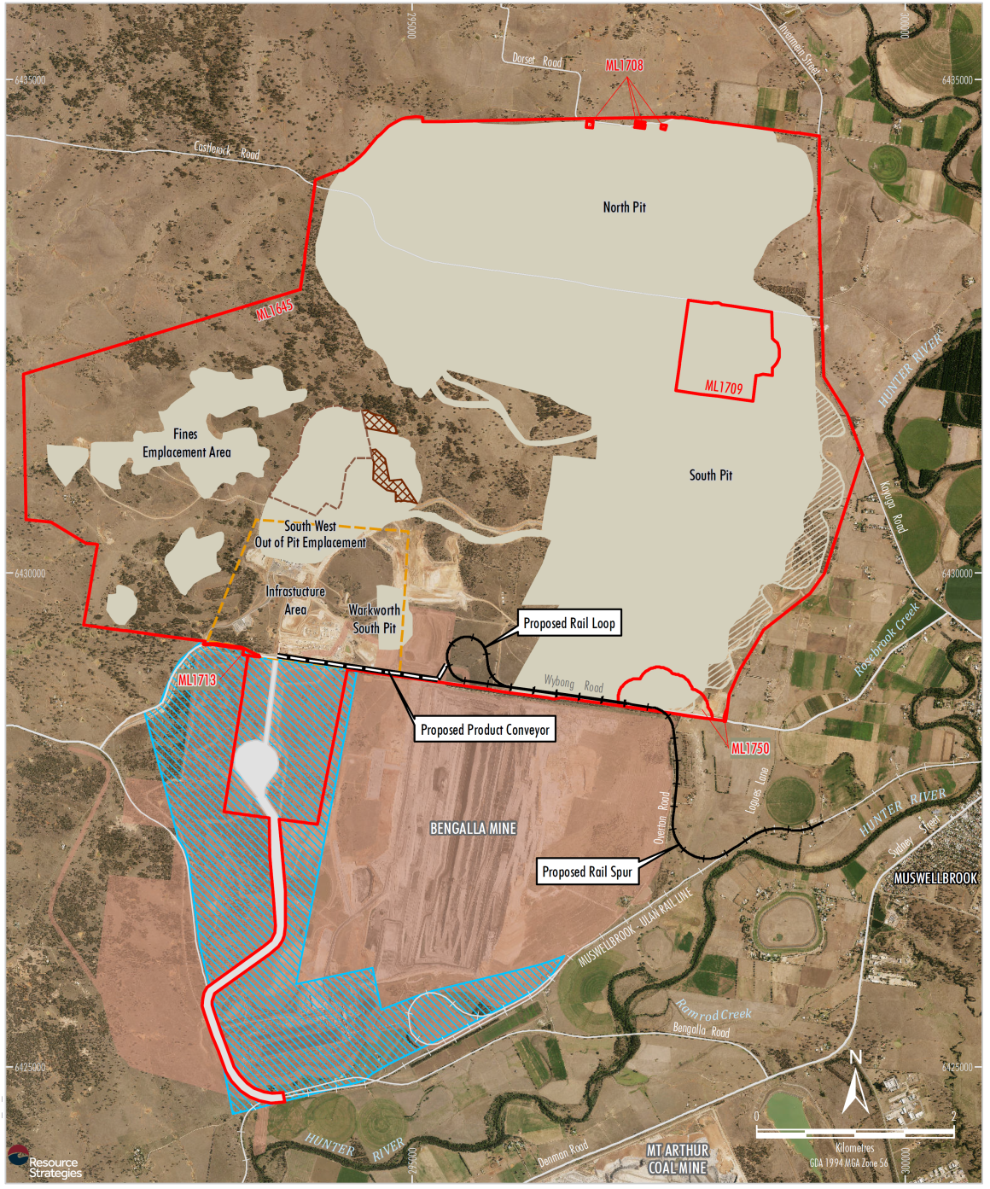
Relationship to Other Planning Applications
  Rail Transport Modification:
    Provides long term coal transport solution.
    Very limited number of objections.
    Expected to be determined by the Department following Mod 3 determination.
  State Significant Development application:
    Life-of-mine planning underway.
    Baseline environmental studies have commenced.

Slide 10
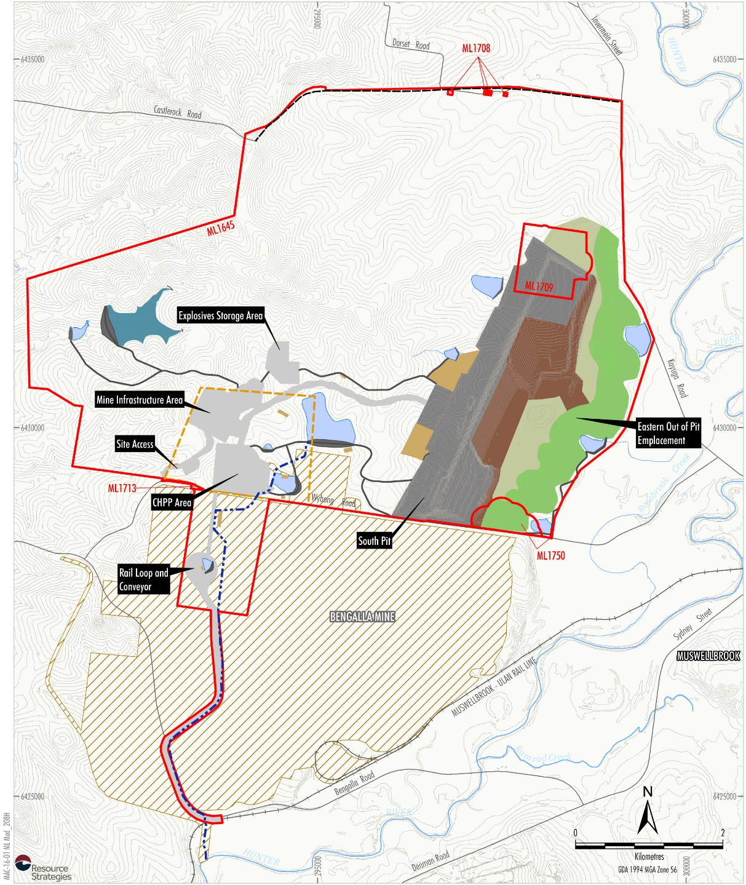
The Modification
  Duration of mining remains less than originally approved
  21 years (project delay).
  Mining in South Pit in Mod 3 period.
  Truck and shovel mining method in Mod 3 period.
  Mod 3 critical to provide investor confidence and time for preparation and determination of a SSD application.

Slide 11
The Modification
  The submission by the Division of Resources and Geoscience concluded (DRG, 2017):
Over the life of the Project, the value of coal production sold on the export thermal market would be nearly $4 billion in current dollars. The net present value of this revenue stream has been estimated by DRG at approximately $2.6 billion. Capital investment over the life of Mount Pleasant to end 2020 would be of the order of
$365 million.
The Project would provide continuing employment for the 380 employees that will be employed at Mount Pleasant. The Modification does not provide any additional full time employment, but does provide an additional six years of employment at
Mount Pleasant.

Slide 12
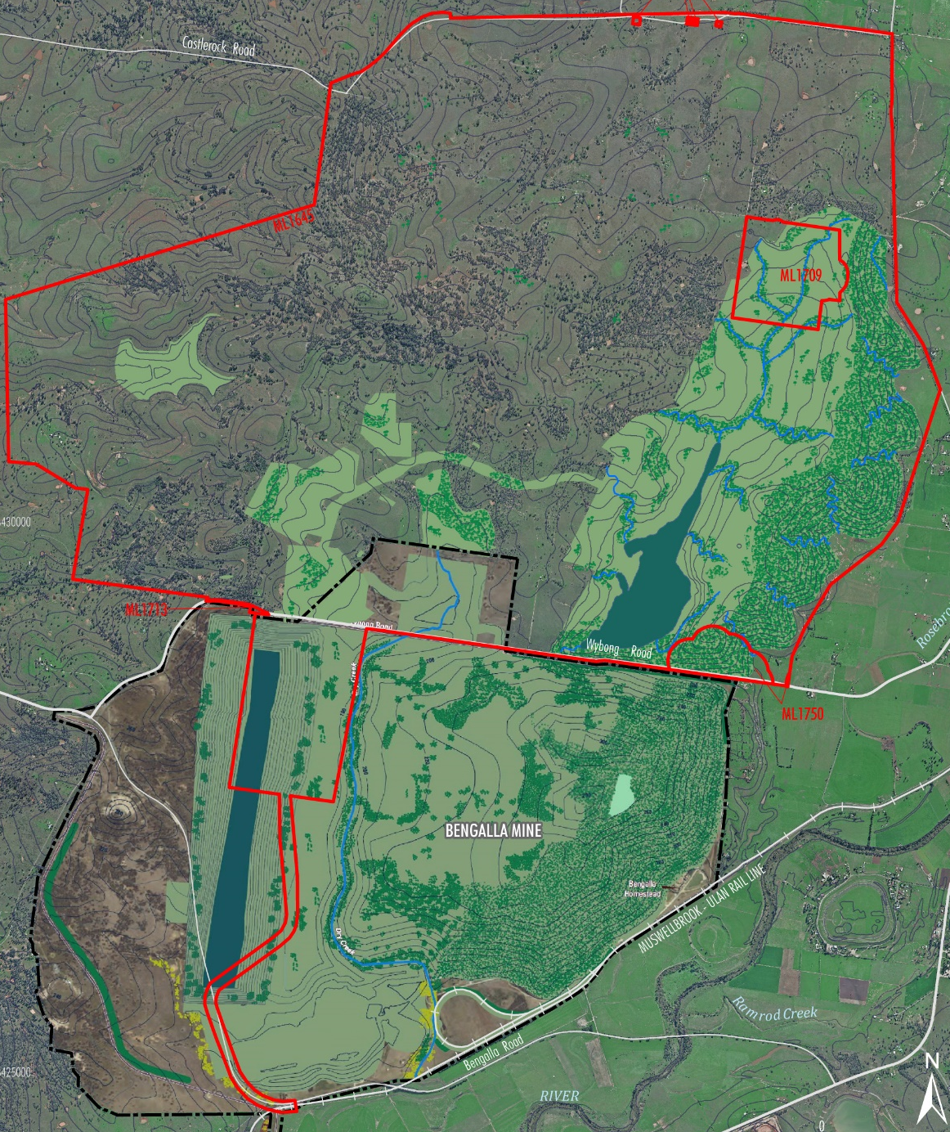
Final Landform Macro-Relief
  Final landform surface would be varied to break up the horizon line when viewed from Muswellbrook and other local vantage points.
  The toe of the emplacement would better align with the underlying topography.
  The eastern face would include a number of spurs and valleys.
  Early revegetation of the eastern face with native tree species.

Slide 13
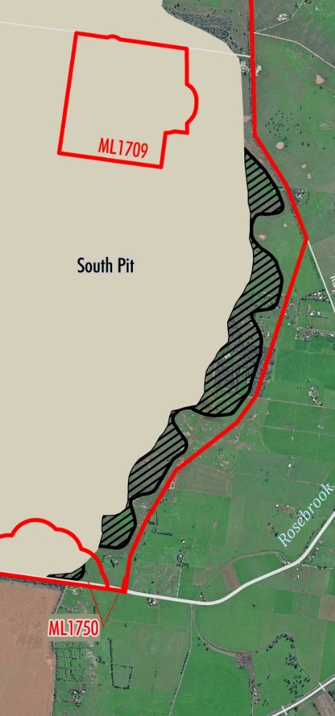
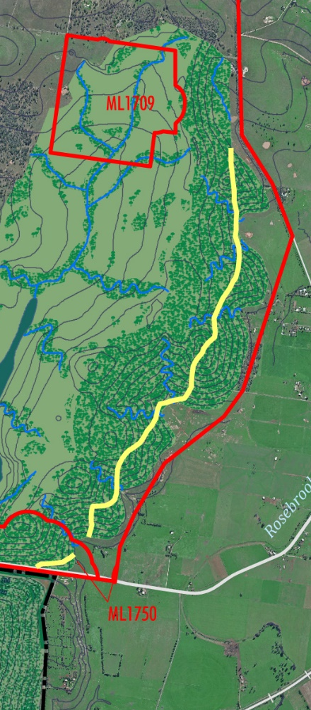
Final Landform Micro-Relief
  Conceptual landform subject to detailed design, including review of natural drainage lines in the area.
  Incorporation of meandering drainage lines to reduce stream slope and erosion potential.

Slide 14

Visual Simulation – Hill Street

Slide 15
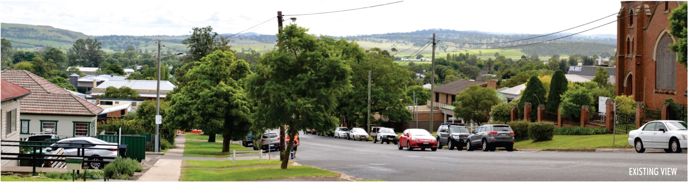
Visual Simulation – Hill Street

Slide 16
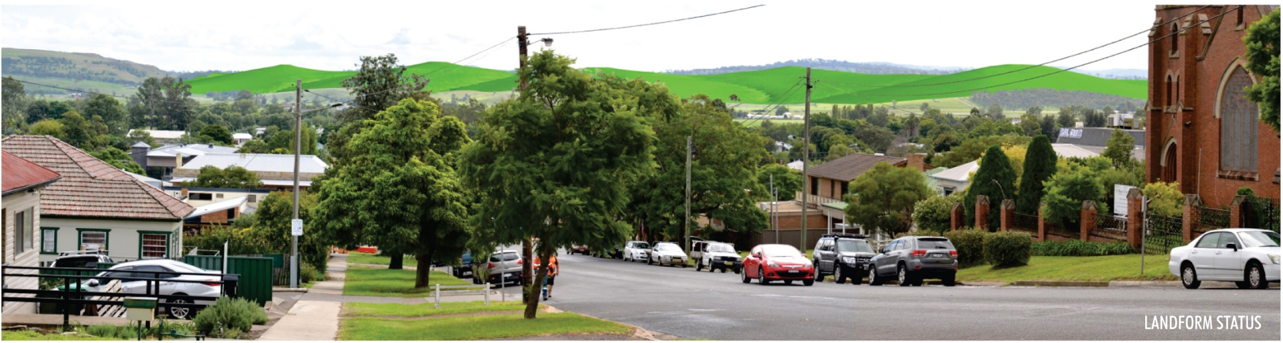
Visual Simulation – Hill Street

Slide 17
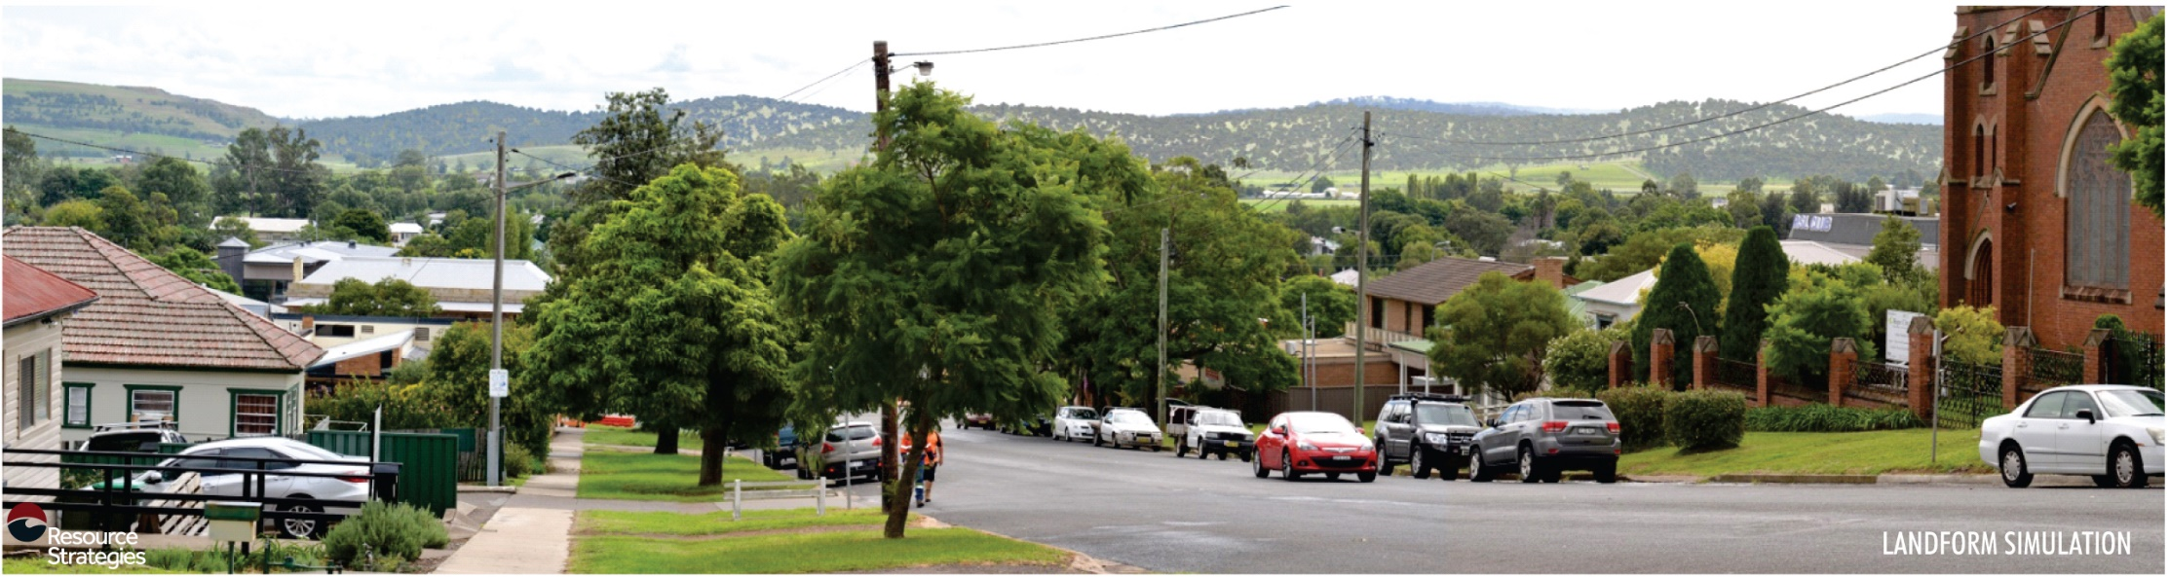
Visual Simulation – Hill Street

Slide 18
Mount Pleasant Final Landform
  The MSC (2017) stated the following in its Mod 3 submission:
  In previous discussions with MACH Energy prior to this submission, Council raised its concerns regarding the incorporation of macro and micro-relief into the landform, particularly with respect to the Eastern Out of Pit Emplacement, and void design.
  MACH Energy responded with a significantly improved design over the dated design principles included in the original 1997 EIS. Council considers these improved design principles need to be included as a component of the revised Consent …

Slide 19
Environmental Assessment
  Contemporary specialist studies undertaken:
    Noise and Blasting Assessment (Wilkinson Murray).
    Air Quality and Greenhouse Gas Assessment (Todoroski Air Sciences).
    Water Balance Review, Biodiversity and Road Transport.
  EA concludes the Modification:
    Would not significantly increase impacts in comparison to the approved
    Mount Pleasant Operation.
    MACH Energy management and monitoring measures could continue to be applied to minimise the potential impacts on existing environmental values and the nearest private dwellings.

Slide 20
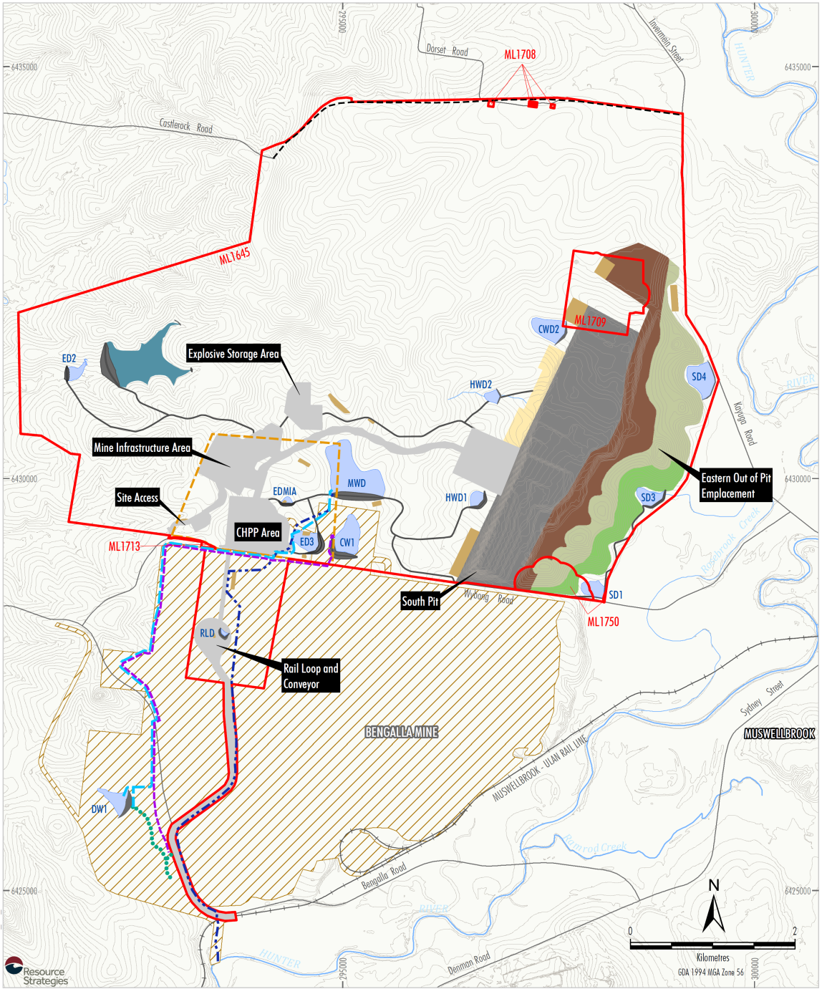
Bengalla Mine Concerns and Resolution
  Key elements to Bengalla Mine concerns:
    Potential for future impact on Bengalla Mine if an alternative
    long-term rail system and associated infrastructure is not approved and constructed in sufficient time.
    Potential for water discharges from Mount Pleasant Operation to Bengalla Mine water management area.
2021

Slide 21
Bengalla Mine Concerns and Resolution
  Bengalla and MACH Energy resolved these concerns and issued a joint statement:
  MACH has agreed to remove its existing, short-term rail and other infrastructure, … by
  31 October 2022 in order to make way for continuation of Bengalla's mining operations south of Wybong Road.
  …
  Bengalla has agreed to pay $12 million to MACH, by instalments (with the first instalment anticipated to be payable in about one month and the final instalment due after MACH has performed the last of its obligations described above).
  MACH and Bengalla have agreed, as adjoining land owners and mining operators, that they will act in good faith to enable each project to undertake its operations without unreasonable interference from the other (including in relation to operational matters, regulatory approvals and future development within their respective mining tenements).
  The relocation of MACH's Infrastructure from Bengalla's approved expansion area was always intended under each mine's relevant approvals and will allow operations at both mines to continue unimpeded. The continued operation of both mines will generate significant economic benefit for the local community and the State of New South Wales.
  The Department’s draft modified Development Consent conditions reflect the agreed outcome.

Slide 22
Potential Residual Concerns
Concern / Issue | MACH Energy Response
The Development Consent is out of date. | The Development Consent was fully modernised by the Department in 2011 (Mod 1) and would be further contemporised if Mod 3 is approved. MACH Energy has a contemporary EPL and management plans.
Mod 3 is effectively a greenfield proposal that would have unforeseen cumulative impacts. | Mod 3 is a proposed modification to a major approved and operating mine that is being developed consistent with existing State and Commonwealth approvals.
If a life extension is approved, it should be for less than 6 years. | The proposed extension period has been adopted to provide investment certainty while a SSD application is prepared and progresses through the NSW major project assessment stages.
MACH Energy would derive a haulage cost benefit from the extension. | Mod 3 is an opportunity for MACH Energy to improve the design of the Mount Pleasant Operation emplacement final landform. Including its appearance from key public vantage points, in recognition of community concerns.
Noise and dust impacts in the region are already intolerable and Mod 3 would exacerbate this. | The Modification would not materially alter the approved noise and dust impacts of the Mount Pleasant Operation. The Modification would be conducted in accordance with the conditions set out by the NSW Government in the Development Consent and EPL.
MACH Energy’s community donations program or consultation with local landholders has not been comprehensive. | As MACH Energy progressively builds up its workforce and presence in the community it intends to continue establishing positive relationships with the local community and community organisations.

Slide 23
Key Positives Raised in Submissions
  The most commonly raised points in supporting submissions pertained to:
    Employment opportunities.
    Potential economic flow-on effects to the local and regional economies.
    Social benefits that mining employment can provide.
    Revised Eastern Out of Pit Emplacement landform design constitutes an improvement on the existing design.
    Increased business turnover for local suppliers and businesses.

Slide 24
Conclusion and Questions
  Section 7 of the EA (Table 15) provides a brief summary of key environmental issues, key management measures and ongoing monitoring.
  In summary, Mod 3 is critical to MACH Energy to provide investor confidence and facilitate preparation and determination a new SSD application for the Mount Pleasant Operation.
  Thank you for the opportunity to present this overview today.

