Slide 1
Leah Llagas

Slide 2

Percentage of patient admissions
with respiratory problems in 2010-2011
ROYAL NORTH SHORE HOSPITAL | ROYAL PRINCE ALFRED HOSPITAL | MOUNT DRUITT HOSPITAL
4.5% | 3.6%
13.5%

Slide 3
Only
3.3 kms
away

Slide 4
SACRIFICE ZONE
A geographic area within 5kms
PERMANENTLY IMPAIRED BY:
Environmental damage
Economic disinvestment
Cancer Clusters due to dioxins

Slide 5

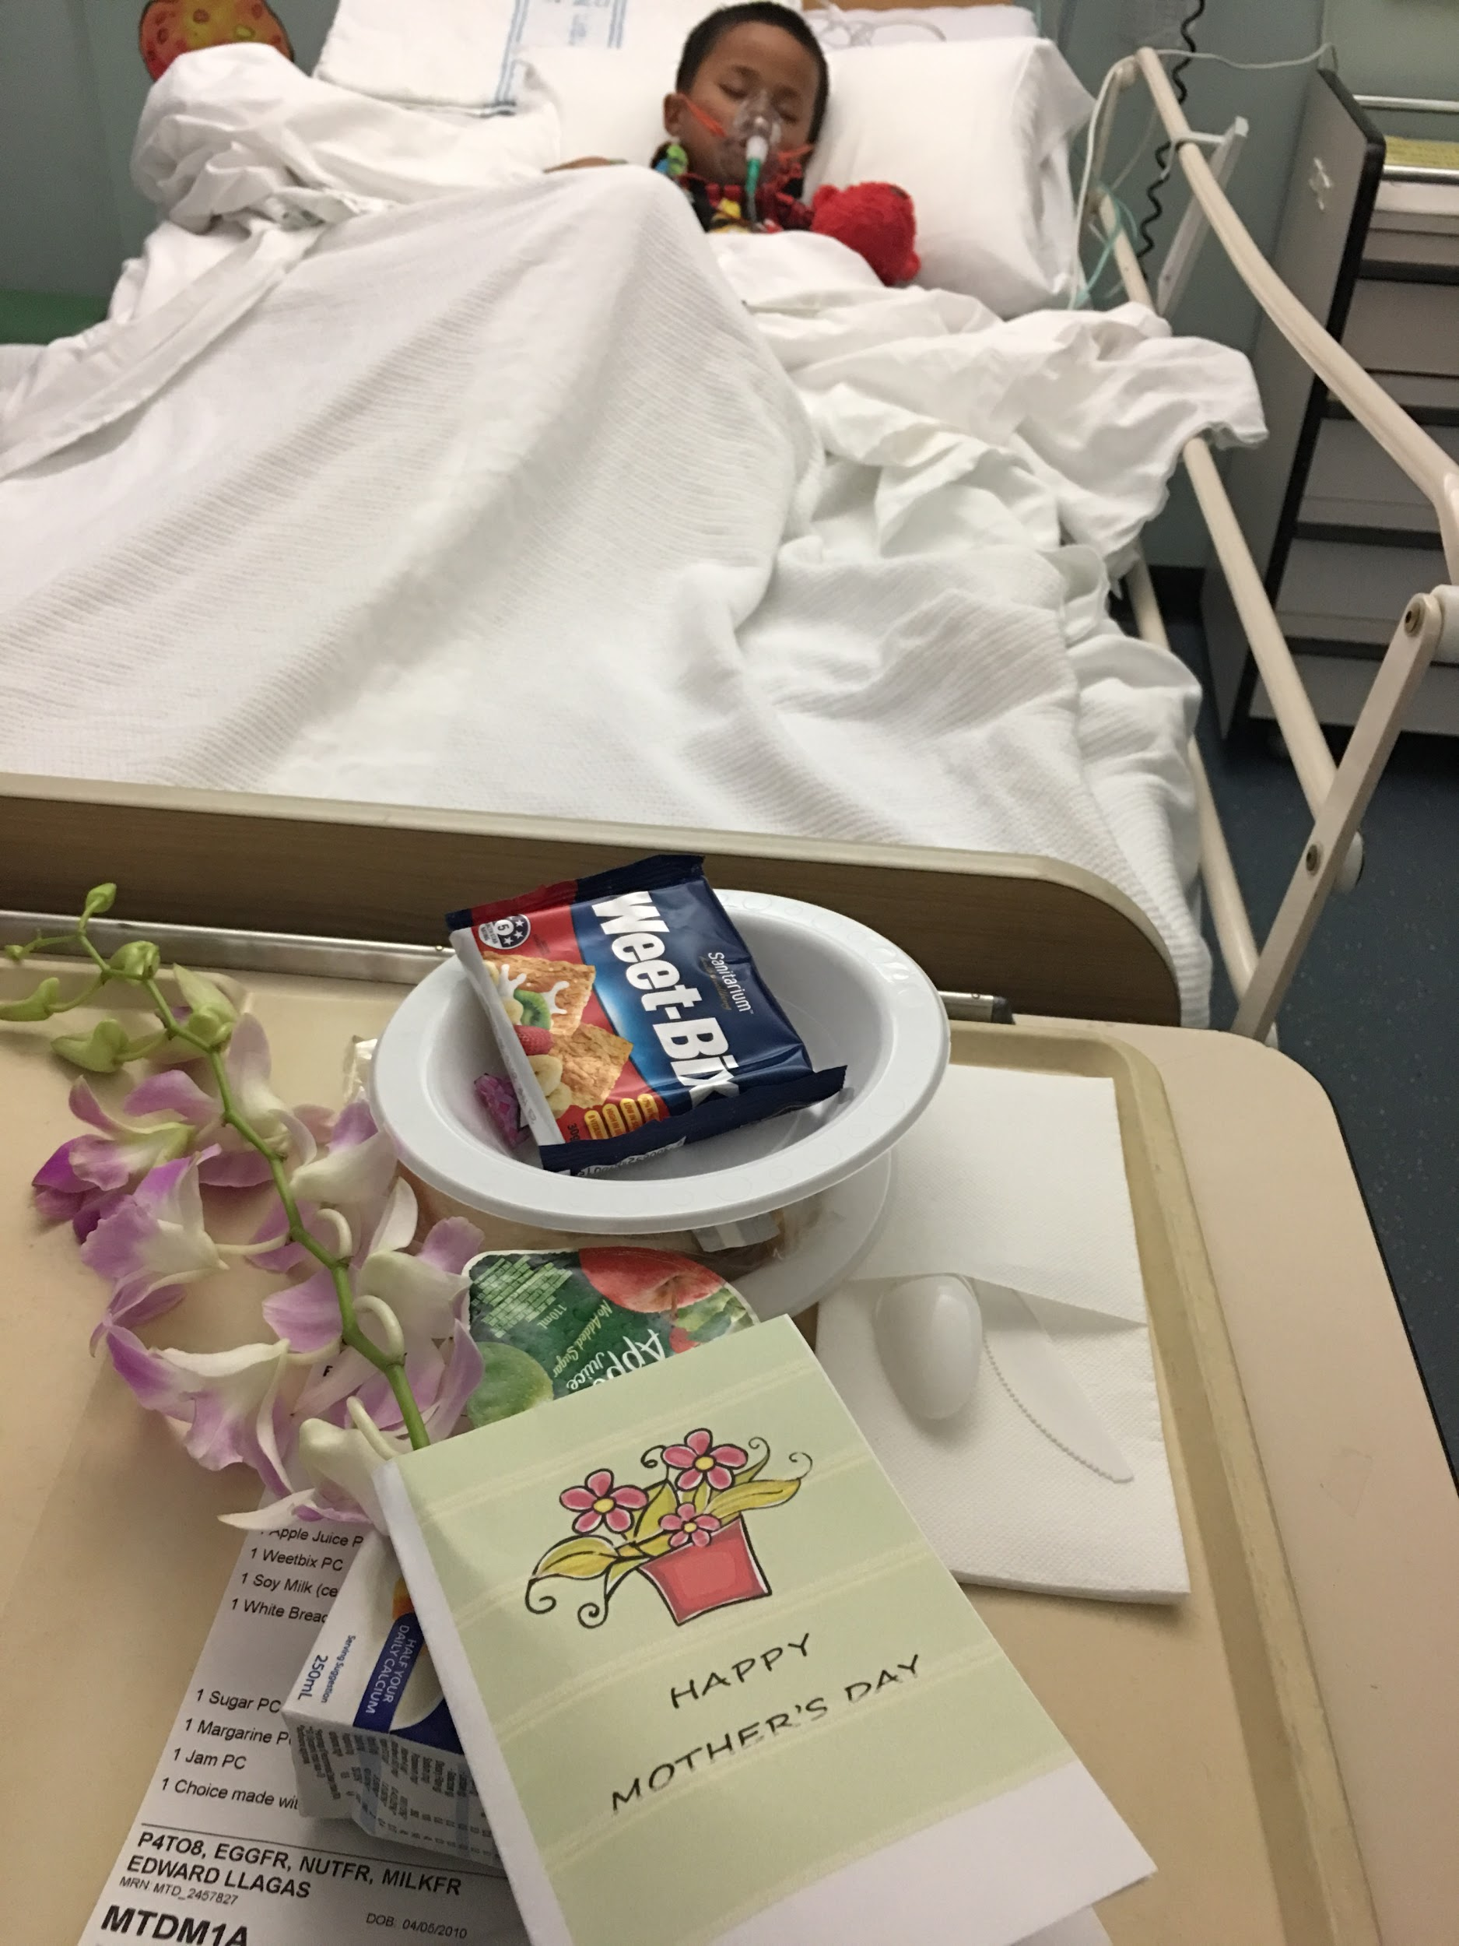
EDWARD
8 years old
Asthma since 3yo
Preventer 365 days a year
Maximum dose
Misses 20% of school
Weekly swimming lessons
Avoid triggers

Slide 6
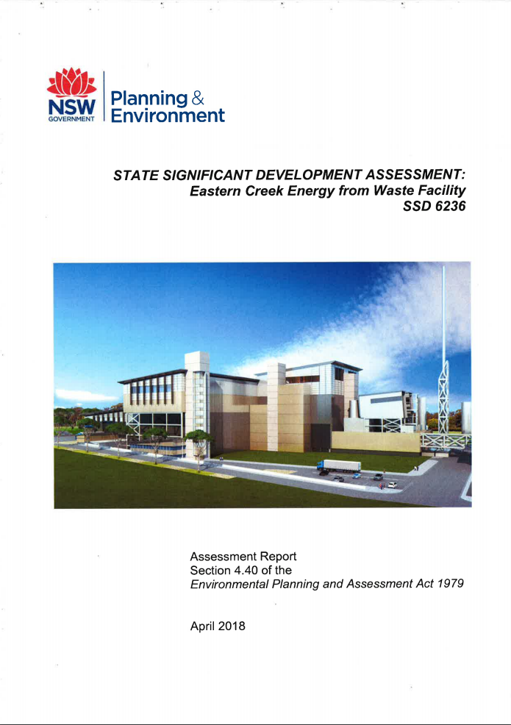
Department of Planning & Environment
“The applicant has been unable to demonstrate with certainty that there is no threat to human health...”
“potential impacts to air quality and the risk to human health are unknown” (p.27)

Slide 7
Our lives are in
YOUR hands

