Slide 1
Comments on the United Wambo Open Cut Mine Project, Environmental Impact Assessment and associated documents.
Conjoint A/Prof Howard Bridgman
School of Environmental and Life Sciences
University of Newcastle

Slide 2
Expertise
I have 40 years experience researching and teaching air quality problems. My particular area of interest is particle matter (PM) and its management, especially in the Hunter Valley. I have over 100 publications and am an author or co-author for six books. I am a former President of the Clean Air Society of Australia and New Zealand, and was editor of their Journal (Air Quality and Climate Change) for 10 years.

Slide 3
NEPM PM10 and PM2.5 Standards
Pollutant | Averaging Period | Maximum Concentration Standard (µg/m³)
PM10 | 1 day | 50
 | 1 year | 25
PM2.5 | 1 day | 25
 | 1 year | 8

Slide 4
Is the air quality impact assessment (AQIA) undertaken for the project adequate?
In 2025, PM2.5 24-hr standard reduced to 20 µg/m³ and the annual standard to 7 µg/m³ - should be considered in EIS
Is 5 years enough to choose 2014 as the model year?
Method to estimate background PM2.5
Percentage of PM2.5 in PM10 – 0.35 instead of 0.20
Verification of CALPUFF wind estimates vs measured values

Slide 5
Are any air quality impacts arising from the project appropriate?
Wind Direction and Speed wind roses vs model results
Run CALPUFF model for winter and summer season
Violations of current 24-hour NEPM for PM10 and PM.25 at Jerry Plains will increase with new mine operations

Slide 6
Comparison of Daily average PM10 at Jerry Plains, January 14-24 2014 with same period for 2018.

Slide 7
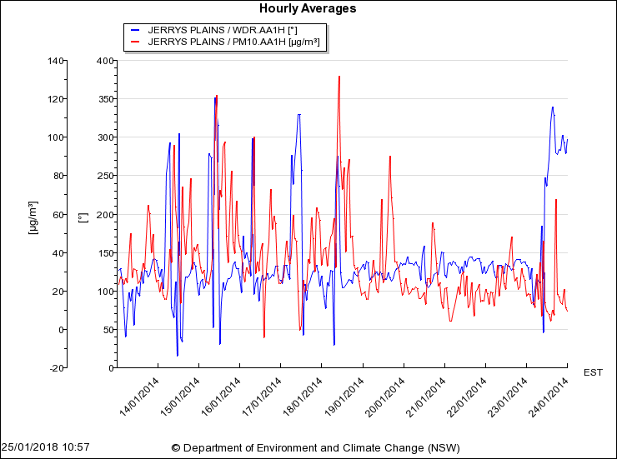
OEH/EPA Measured hourly PM10 (red) and wind direction (blue) data at Jerry Plains between Jan 14 and 24, 2014. SE winds (100-150 degrees) create highest PM.

Slide 8
Provide any further observations and opinions which you consider relevant.
Project operations (Scope 1 and 2), 5.8 MTY CO₂-e are expected; for export (Scope 3) 260 MTY CO₂-e are expected (from the burning of coal) – NOT insignificant
The Project refuses to take any responsibility for the latter, and claims the former are insignificant
Unless GHG emissions are severely reduced, Australia will suffer increased periods of heat and drought
Federal Government promises to reduce GHG emissions (Paris Agreement) cannot be met by authorising more coal mines.

