Slide 1
United Wambo Open Cut
Outstanding biodiversity constraints
David C. Paull
5th February 2018

Slide 2
EP&A Act objectives not met
DPE assessment report claims to have met its objectives under the EP&A Act
(vi) the protection of the environment, including the protection and conservation of native animals and plants, including threatened species, populations and ecological communities, and their habitats. Consideration of the assessment of significance test for NSW-listed matters has not considered key elements of the test. There are at least 11 threatened fauna species and a number of endangered communities that are at risk of significant impact, including the Commonwealth listed, Regent Honeyeater, Spotted tail Quoll, Swift Parrot.
(vii) ecologically sustainable development (ESD). DPE claims to have followed the principles of ‘ecologically sustainable development’ yet has not made reference to the precautionary principle, particularly in relation to rehabilitation success and has not fulfilled the requirements for offsets either at state and Commonwealth levels.

Slide 3
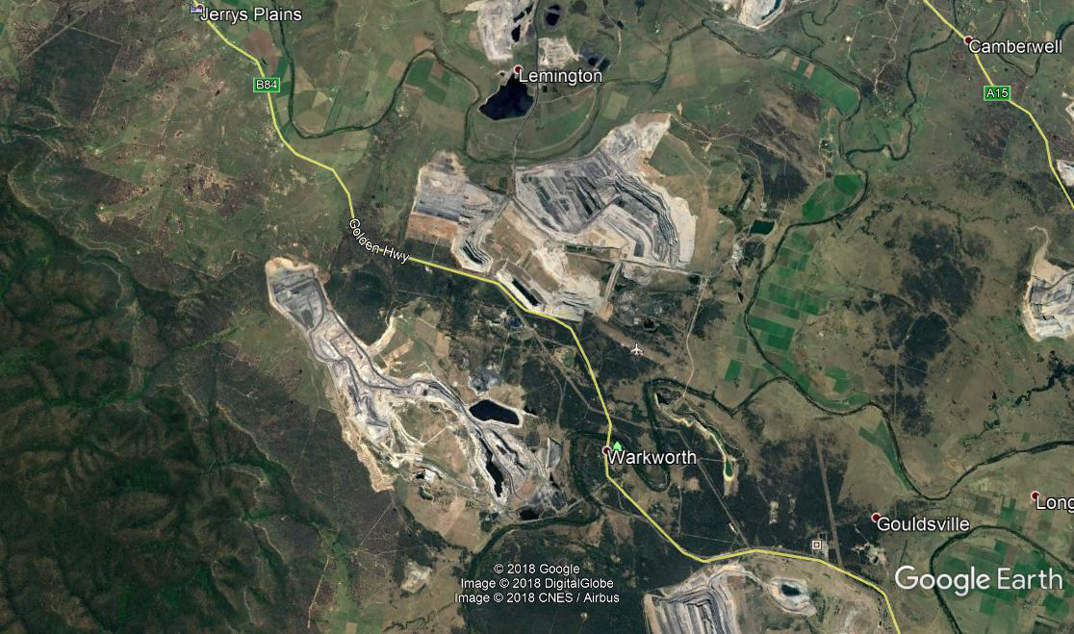
Landscape issues
The remnant in question in one of the last 20 or so patches of Central Hunter Grey Box-ironbark Woodland left in the Hunter Valley that are bigger than 100 ha. This 170 ha patch is an important and irreplaceable piece of lowland vegetation in an ecosystem which has rapidly diminished, mainly from mine development in recent times.
Removing this patch will further inhibit connectivity for fauna in the valley landscape, though not considered by Glencore as being a ‘regional biodiversity link’.

Slide 4
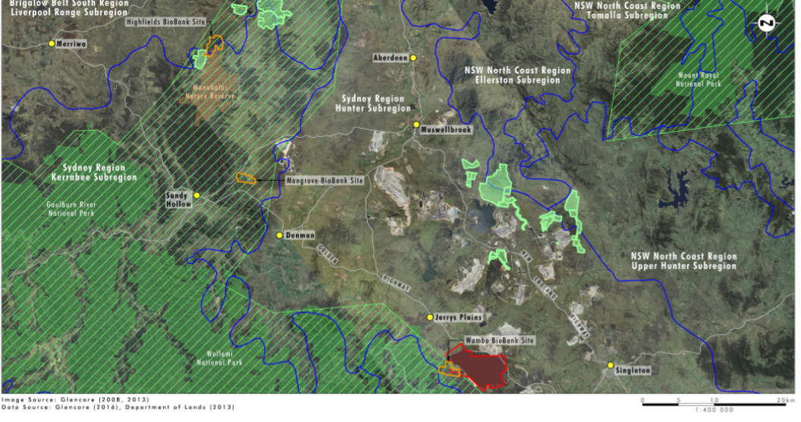
Dubious offsets
Three offset sites are proposed with a fourth earmarked for inclusion following approval.
“The Wambo and Jerrys Plains sites are well located in close proximity to the Project and would provide immediate alternative habitat in the local area”. But these are not alternate for affected fauna species. They are not alternate for endangered ecosystems.
The offset package has not been adequately verified. The assessment report assumes the proposed offset arrangements will be suitable for the Regent Honeyeater though are likely to be sub-optimal for this species.

Slide 5
Biodiversity credit shortfall
NSW: Grey Box: 3183 credits needed now propose 2527 credits (1732 from Mangrove Offset: 795 from mine rehab). 656 credits short
Spotted Gum: 999 credits needed, 748 credits short
Myotis: 562 needed, 541 credits short
Comm. CHVEF: 7268 credits needed, 2993 credits short.
“In line with its staged mine plans, the Applicant has proposed to secure and retire 81% of the ecosystem and species credits required within one year of commencing the clearance of native vegetation, with the remaining 19% of credits to be retired over two subsequent stages.”
Surety? Will all be retired?
Covenant?
Commonwealth requirements?

Slide 6
Rehabilitation failure
“The Department recognises that the proposed offset package still requires a number of residual credits to be obtained and is partially reliant on the successful rehabilitation of post-mining areas to native woodland communities.”
But reliance on rehabilitation to supplement lowland vegetation communities is not justified by good scientific evidence and so DPE assurances are not justified.
“… over the long term, plant diversity on rehabilitation areas declines …(this) could jeopardize meeting rehabilitation objectives.” + weed issues
Glencore (2016). Ravensworth Hunter Ironbark Complex Research Program: Final Report
While OEH accepts mine rehabilitation as an offset, it is has not been demonstrated that ecosystems that are stable AND are floristically and structurally similar to a central hunter woodland can be derived from a mine spoil base.
It has never been demonstrated that such rehabilitation offers suitable, ongoing habitat for threatened species over the life of the mine.

Slide 7
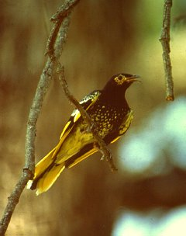
Commonwealth requirements
7 out the 10 objectives of the Commonwealth offset policy have not been met by the current proposal.
Using the ‘Offset Assessment Guide’, the quantum of proposed package is not sufficient to meet the requirements for a critically endangered ecological community (CHVEFW) or for a critically endangered species (Regent Honeyeater).

Slide 8
Indirect and cumulative issues
Poor consideration of indirect impacts on terrestrial biodiversity in the assessment. Not sufficient to meet Commonwealth requirements.
Because the UHSA is not operational – issues of cumulative impact should have been addressed in the EIS or subsequent documentation.

