Slide 1
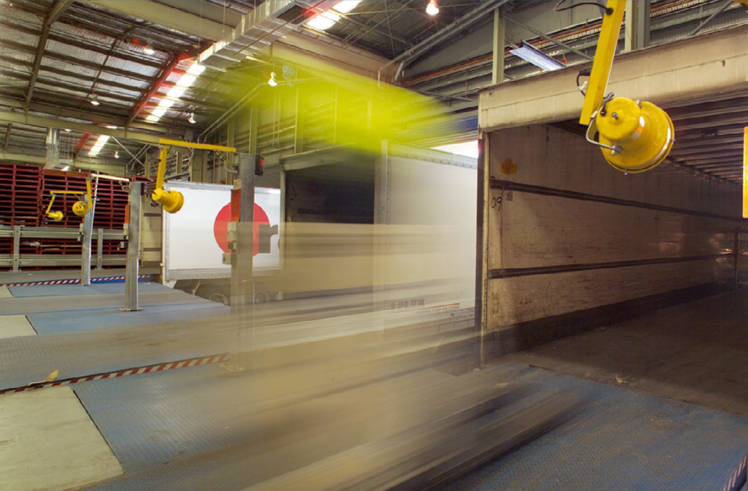
Moorebank Precinct West (MPW) Stage 2 SSD Application (SSD 7709)
Presentation to Independent Planning Commission (IPC)

Slide 2
PRESENTATION OVERVIEW
MPW Stage 2 Proposal Overview
Future Environmental Assessment Requirements of the Modified Concept Approval
DPE Assessment Report - key issues addressed
DPE Assessment Report - key agencies issues addressed
Draft conditions proposed by the Proponent for alteration
  Distinction between Earthworks and Construction
Conclusion

Slide 3
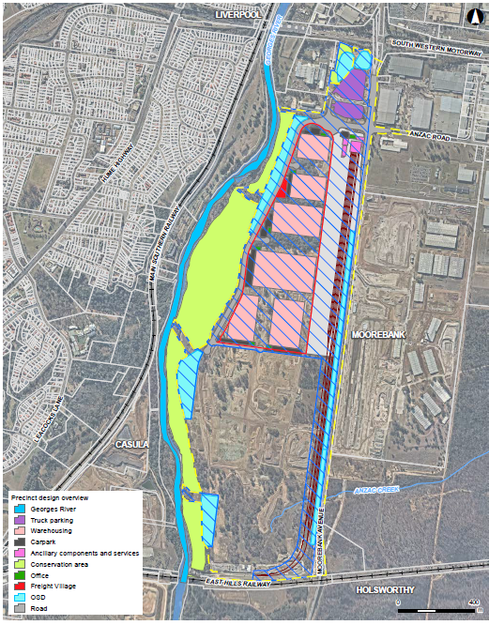

MPW STAGE 2 – PROPOSAL OVERVIEW
Built form

Slide 4
MPW STAGE 2 – PROPOSAL OVERVIEW
Development Description
Warehousing = 215,000m² GFA (+ ancillary offices)
Freight village = 800m² GFA of retail premises
Upgraded Moorebank Avenue and Anzac Road intersection
Internal road network
IMT facility:
  Infrastructure to support 500,000 TEUs
  Nine rail sidings
  Truck processing, holding and loading areas
  Container storage area
  Administration facility,
Operation of rail link connection to the SSFL (constructed in MPE Stage 1 (SSD 6766))
Ancillary supporting infrastructure:
  Stormwater, drainage and flooding infrastructure
  Electrical, water, sewer, telecommunication utilities installation
  Signage and landscaping
24/7 operation
Interacts with MPW Concept Plan and Stage 1 Early Works (SSD 5066)

Slide 5
MPW CONCEPT FUTURE ENVIRONMENTAL ASSESSMENT REQUIREMENTS
MPW Modified Concept requirements
Future assessment requirements were also used as the SEARs
EIS provided full assessment, updated as part of RtS for Proposal amendments
Future assessment requirement | Outline | Where addressed
General requirements | Demonstration of consistency with Concept Approval | EIS
Air Quality | Air quality impact assessment (dust and emissions) | EIS / RtS Air Quality Impact Assessment (and Management Plans)
Traffic and Transport | Construction and operational assessment (generation, safety, geometry and intersection impact) | EIS / RtS Construction / Operational Traffic Impact Assessments (and Management Plans)
Rail | Design and engineering drawings of rail sidings and connections to rail link, and train operating plans | EIS / RtS Rail Access Report and Drawings
Noise & Vibration | Noise and vibration on surrounding receivers (construction and operation) | EIS / RtS Construction / Operational Noise and Vibration Impact Assessments (and Management Plans)
Soil & Water | Impacts on water quality and flooding | EIS / RtS Stormwater and Flooding Report and Civil Design Plans (and Management Plans)
Heritage | Aboriginal and Non-Aboriginal | EIS / RtS Aboriginal / Non-Aboriginal Impact Assessments

Slide 6
MPW CONCEPT FUTURE ENVIRONMENTAL ASSESSMENT REQUIREMENTS
MPW Modified Concept requirements
Future assessment requirement | Outline | Where addressed
Visual Amenity, Urban Design and Landscaping | Visual impacts and landscape design | EIS Architectural plans Landscape Design Statement Visual Impact Assessment
Biodiversity | Impacts on threatened species and communities | EIS / RtS Biodiversity Assessment Report
Contamination | Contamination assessment | EIS / RtS Contamination Summary Report / Geotechnical Report
Hazard and Risks | Risk screening prepared in accordance with SEPP 33 | Hazard and risk assessment (EIS section)
Masterplan | Consideration of relationships and connectivity with MPE and surrounding areas | EIS
Waste | Management of liquid and non-liquid waste generated by the Proposal | Waste Management Plan
Bushfire Management | Bushfire risk assessment in accordance with the Planning for Bushfire 2006 | Bushfire impact assessment (EIS section)
Environmental Risk Analysis | Consideration of environmental risks and appropriate mitigation measures | Environmental risk assessment (EIS section)

Slide 7
MPW CONCEPT FUTURE ENVIRONMENTAL ASSESSMENT REQUIREMENTS
MPW Modified Concept requirements
The EIS, RtS and Consolidated Assessment Clarification Responses have addressed all of the future assessment requirements of the MPW Modified Concept Approval.
Stage 2 Proposal is consistent and “generally in accordance” with MPW Modified Concept (SSD 5066)
Modification undertaken to Concept Approval to make minor adjustments to Concept Approval to ensure consistency of Stage 2 Proposal
Stage 2 element | Consistency with Concept Approval
Built form | Warehouses with a maximum height of 21 m Freight village with a maximum height of 6 m 18 m building setback to Moorebank Avenue 7 m building setback to all other site boundaries Lighting below 30 m
Road Upgrades | Moorebank Avenue and Anzac Road intersection upgrade

Slide 8
DPE ASSESSMENT REPORT – KEY ISSUES AND AGENCIES
DPE Assessment Report - key issues addressed:
  Traffic
  Importation of fill
  Urban design, landscaping and urban heat island mitigation
  Stormwater / Riparian Corridor
  Koalas
  Contamination and remediation.
DPE Assessment Report - Key agencies identified
  OEH (Koalas; OSD impacts on conservation areas)
  Government Architect (Urban design / Landscaping)
  RMS / TfNSW (VPA)
  DPI (Riparian planting; Riparian buffer)
  LCC (Traffic; Noise; Biodiversity)
  CCC (Traffic; Noise Wall / Hydrology)
  EPA (Noise; Locomotives; Air Quality)

Slide 9
MPW CONCEPT & STAGE 2 – Proponent proposed conditions alterations
Condition No. | Proposed wording
Concept E16A | All future Development Application must demonstrate that onsite detention basins are located outside the riparian corridor and the outlets have been designed to minimise impacts on the riparian corridor.
Justification for alteration:
DPI Guideline expressly permits OSDs within the outer 50% of a riparian corridor.
Outlets have been designed to minimise impacts on riparian corridor.
Significant area of land to be restored as riparian corridor in the dust bowl.

Slide 10
MPW CONCEPT & STAGE 2 – Proponent proposed conditions alterations
General Request for DP&E Recommended Conditions
Consider incorporation of “unless otherwise agreed by the Planning Secretary”
Justification:
Current MPE Stage 2 SSD 7628 conditions have been applied prescriptively
Strict application of condition wording
Absence of flexibility impedes ability for the proponent to effect the consent
  Example: Consultation by DP&E with NSW Government Architect
    UHIMS and UDLP has been ongoing for 14 months
    No ability for regulatory consideration of reasonable and feasible alternatives
    Modifications required to introduce alternatives

Slide 11
MPW CONCEPT & STAGE 2 – Proponent proposed conditions alterations
Condition No. | Proposed wording
MPW 2 Definition of Construction B30 B31 | Includes all works required to construct the development, including but not limited to demolition, importation of fill and fill placement, earthworks, removal of spoil, commissioning trials of equipment and temporary use of any part of the development. Remove the Erosion and Sediment Control Plan provisions from condition B30 to be a separate condition applicable to earthworks and construction separately. Erosion and Sediment Control Plans must be updated as earthworks and construction progresses and site conditions change.
Justification for Alteration:
Earthworks and Construction defined terms in the conditions
Earthworks required to prepare for construction
Construction defined as including earthworks
Not all pre-construction documentation applicable to earthworks activities
Enables works to commence on site under appropriate documentation

Slide 12
MPW CONCEPT & STAGE 2 – Proponent proposed conditions alterations
Condition No. | Proposed wording
MPW 2 B2 | (initial portion of condition omitted as not proposed to be altered) The revised Development Layout Drawings must show the site, construction and operational boundaries and demonstrate: (a) provision of a riparian corridor, comprising the following: (i) a buffer zone to the most inland of: • 40 metres from the top of bank, as surveyed by a registered surveyor, or • the 1% AEP flood extent, excluding the localised depression at the existing major east-west drainage channel, and (ii) an additional 10 metre extension to the buffer zone established in (i) above, where native vegetation is located on or within 10 metres east of the buffer; (b) the siting of biofiltration/ bioretention areas and OSD basins (with the exception of outlets to the Georges River and associated maintenance access) are permitted within outside the riparian corridor and outside the warehouse footprints; (remainder of condition omitted as not proposed to be altered)
Justification for alteration:
DPI guideline permits OSDs in outer 50% of riparian corridor.
40 m corridor allowance already includes provision for transition vegetation
Unnecessarily extends riparian corridor provision from 40 m to at least 53 m
Implications for design and viability of developable site

Slide 13
MPW STAGE 2 – Proponent proposed conditions alterations
Condition No. | Proposed wording
MPW 2 B3 | To ensure the site will be developed in an integrated manner and that the whole development will comply with the conditions of this consent, submission of the Development Layout Drawings required by Condition B2 must be provided for each 65ha area of land disturbance and demonstrate relationship to each adjoining stage within the approved Staging Report required by condition A44 cannot be staged.
Condition No. | Proposed wording
MPW 2 B6 | To ensure the site will be developed in an integrated manner and that the whole development will comply with the conditions of this consent, submission of the Stormwater Design Development Report and Revised Stormwater System Design Drawings and supporting documentation required by Condition B4 must be provided for each 65ha area of land disturbance and demonstrate relationship to each adjoining stage within the approved Staging Report required by condition A44 cannot be staged.
Justification for alteration:
Consent condition B41 provides a prescription for progression of land disturbance
Proposed change provides consistency within conditions and prevents ongoing requests for update for minor amendments to layout design

Slide 14
MPW STAGE 2 – Proponent proposed conditions alterations
Condition No. | Proposed wording
MPW 2 B13 | OSD basins must: (a) be visually unobtrusive and sit within the final landform and landscaping; (b) ensure public safety by incorporation of ‘safety by design’ principles; and if not able to satisfy (a) and (b) (c) have all sides with a maximum batter slope of 1V:4H.
Justification for alteration:
Requirement for all sides to have 1V:4H batters causes encroachment on both developable land and riparian corridor without enhancing functionality
Vertical walls have previously been accepted on private and public developments
Condition No. | Proposed wording
MPW 2 B41 | Land disturbance and land filling activities must be undertaken: (a) in a phased manner in accordance with the approved Staging Report required by A44, impacting a maximum contiguous area of 65 hectares at any one time; and (b) with no disturbance …… (remainder of condition omitted as not proposed to be altered)
Justification for alteration:
Aligns application of the conditions for consistency
Avoids potential for inconsistency on staging development layout with stabilised areas prepared for construction

Slide 15
MPW STAGE 2 – Proponent proposed conditions alterations
Condition No. | Proposed wording
MPW 2 B48 | The Development must be designed and operated to meet Urban Heat Island Mitigation principles and to achieve a 4°C degree decrease in temperature compared to neighbouring industrial developments by including measures such as: (a) WSUD elements such as wetlands; (b) shade tree planting; (c) vegetation ground cover; (d) use of ‘cool’ building and pavement materials (i.e. those with high reflectivity in the infrared spectrum); and (e) green roofs
Justification for alteration:
Green roofs are not viable over warehouse structures that are not designed to support the additional massing associated with green roofs
Additional structural support negatively impacts viability of warehouse space for sorting and storage processes

Slide 16
MPW STAGE 2 – Proponent proposed conditions alterations
Condition No. | Proposed wording
MPW 2 B68 | The following minimum landscaping requirements apply: (a) 15% of the warehouse area landscaped at ground level, 10% of which must be soft landscaping, excluding the OSD basins unless they are accepted as contributing to soft landscaping in the peer review report required under Condition B55; (b) 1 canopy tree per 30 m2 of landscaped area; ….. (remainder of condition omitted as not proposed to be altered)
Justification for alteration:
Proposed change provides consistency with the approved MPE Stage 2 Consent (SSD 7628)
OSDs are not permanent detention basins.
Condition No. | Proposed wording
MPW 2 B87 | Existing and Future private utility and service infrastructure must be located outside the roadway being upgraded. The Applicant is to locate any drainage infrastructure to support the development entirely within the development site and not within the roadway.
Justification for alteration:
There are already public and private utilities in the roadway
SIMTA does not have authority over public utilities
Utilities can be encased to prevent impact and maintain roadway function
Prescription should be removed

Slide 17
MPW STAGE 2 – Proponent proposed conditions alterations
Condition No. | Proposed wording
MPW 2 B169 | Upon completion of the remediation required in relation to Stage 1 (SSD 5066) and this development and prior to the commencement of construction (other than the vegetation clearing required for remediation) in relation to this approval (i.e. Stage 2 SSD 7709), the Applicant must submit to the Planning Secretary, a Site Audit Report and a Site Audit Statement A for the whole site relevant 65ha area of the site to be disturbed as reflected in the approved Staging Report required by condition A44, prepared in accordance with the NSW Contaminated Land Management….. (remainder of condition omitted as not proposed to be altered) …. (after condition B169(d)) Where a Site Audit Statement A has been obtained for the whole site in satisfaction of the requirements of Condition of Consent B3 of MPW Stage 1 Early Works (SSD-5066) it may be used to satisfy the requirements of this condition (B169) as well as satisfying the requirements of conditions B164, B165 and B166 of this consent.
Condition No. | Proposed wording
B164 | Unless a Section A Site Audit Statement can be obtained in satisfaction of condition B3 of MPW Stage 1 Early Works (SSD-5066) prior to vegetation clearing….. (remainder of condition omitted as not proposed to be altered)
Condition No. | Proposed wording
B166 | Unless a Section A Site Audit Statement can be obtained in satisfaction of condition B3 of MPW Stage 1 Early Works (SSD-5066), following vegetation clearing and prior to the commencement of other construction activities… (remainder of condition omitted as not proposed to be altered)
Justification for alteration:
Aligns requirement with 65ha stabilisation progression.
A Site Audit Statement A for the whole site identifies that remediation has been effected for the site enabling the intended land use.
Provides flexibility in DP&E response where the condition(s) are otherwise satisfied.
The proposed change avoids unnecessary duplication of reporting where effective remediation has been affirmed by the Site Auditor.

Slide 18
MPW STAGE 2 – Proponent proposed conditions alterations
Condition No. | Proposed wording
MPW 2 B170 | To ensure that no residual contaminated land on site is impacted by this approval, the requirements of Site Audit Statement A required by Condition B169 must be provided for each 65ha area of land disturbance and demonstrate adjoining lands are able to be remediated cannot be staged.
Justification for alteration:
Aligns demonstration of remediation with stabilisation of earthworks areas, as prescribed by condition B41
Consistency between control measures to give effect to consent
Condition No. | Proposed wording
MPW 2 B171 | Within 3 months of Upon completion of importation and placement of fill and prior to construction of permanent built surface works, the Applicant must submit to the Planning Secretary, a Site Audit Report and a Site Audit Statement A for each respective 65ha parcel of land the whole site, prepared in accordance with the NSW Contaminated Land Management - Guidelines for the NSW Site Auditor Scheme 2017, which demonstrates the site is suitable for its intended land uses under MPW Stage 2 SSD 7709.
Justification for alteration:
Aligns demonstration of remediation with stabilisation of earthworks areas, as prescribed by condition B41
Consistency between control measures to give effect to consent

Slide 19
CONCLUSION
MPW Concept FEARs have been addressed in the assessment documents
Secretaries key issues and SEARs have been addressed in the assessment documents
Consultation with all agencies has been undertaken and agency issues addressed in the assessment documents
SIMTA requires key changes to some conditions to ensure they are commensurate with the Proposals’ impacts and to avoid impacts to the commencement, functionality and viability of the development.
Questions?

