Slide 1
BINGO INDUSTRIES
Mortdale Recycling Facility
Presentation to Planning Assessment Commission
12 DECEMBER 2017

Slide 2
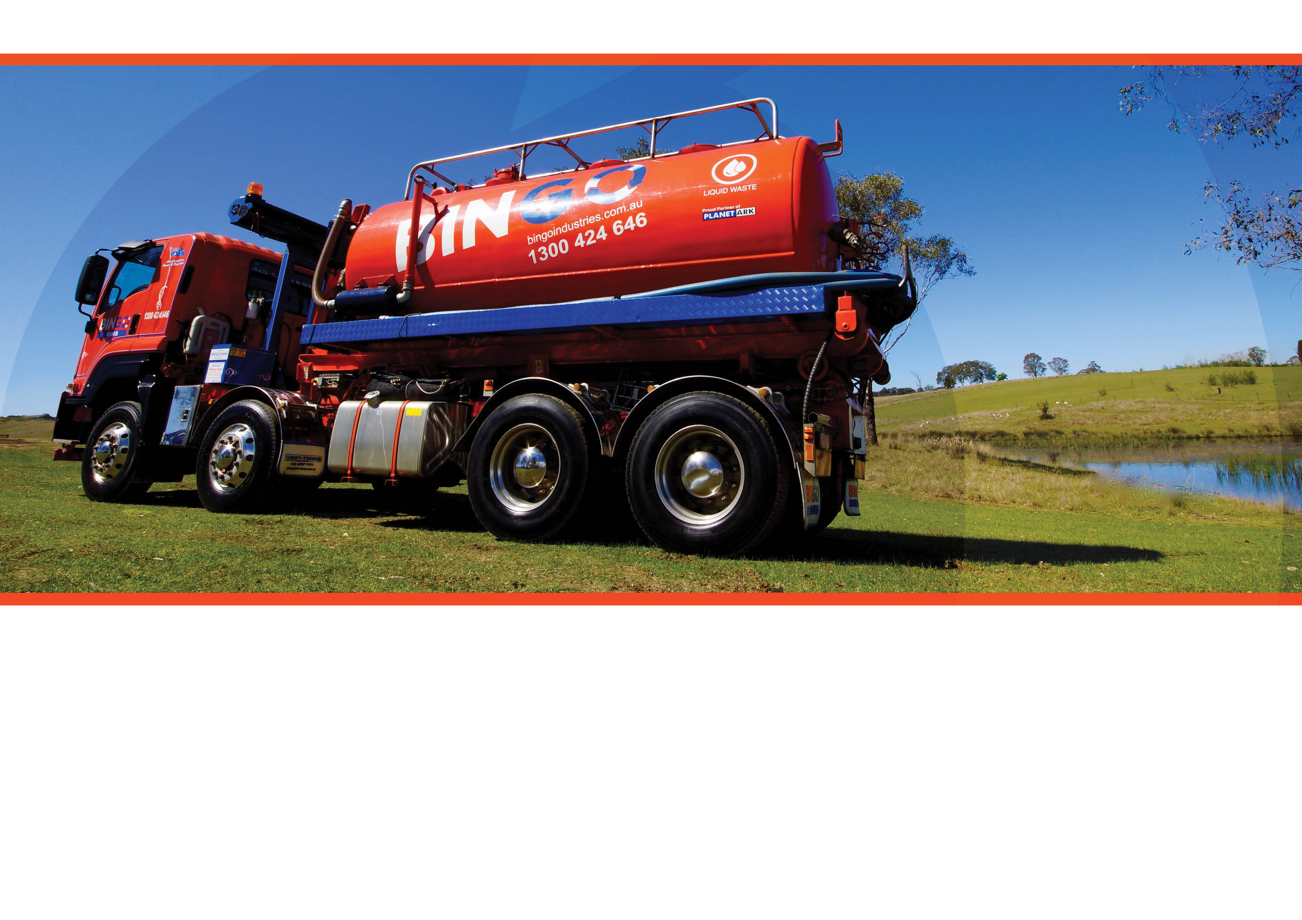
Introduction
Strategic Justification
Key Issues
Community Engagement
Draft Conditions
Conclusion

Slide 3
Section 1
Introduction

Slide 4
Overview of Bingo
Strategic network of recycling facilities
About Bingo
NEW SOUTH WALES
Newcastle
Bingo is a leading recycling and waste management Company providing end-to-end solutions across the waste management supply chain including: waste collection, processing, separation and recycling
Our vision is to be the leading waste management and environmental solutions provider in Australia
Our strategy is to provide a differentiated approach to waste management by focusing on a high level of service and reliability
Waste collection and processing in the Building and Demolition (B&D) and Commercial and Industrial (C&I) sectors
The Bingo Way – landfill diversion, recycling, and helping to create a circular economy
DATS Artarmon
Patons Lane RRC and landfill
CBD
Helensburgh
VICTORIA
Wollongong
DATS Campbellfield
DATS West Melbourne
Existing recycling centres
CBD
New recycling centres
Employees
Fleet (trucks)
Recovery facilities (RRCs)
CBD
775
261
18
EMPLOYEES
193 NSW
68 VIC
SITES
Note: operating figures includes Bingo’s recent acquisitions (National Recycling Group (including DATS) and Paton’s Lane).

Slide 5
Mortdale Recycling Facility Proposal Overview
Operation
Processing shed, covered storage bays = 2534 m² GFA
Office/amenities = 150 m² GFA
2 weighbridges (in / out)
Ancillary infrastructure
Drainage works, landscaping
45 kL rainwater tank
Diesel fuel storage (28 kL) and refuelling point
Receive 220,000 tpa of non-putrescible C&D, C&I and council clean-up waste
Operate six days per week, 6am–10pm
Target 85% recovery rate

Slide 6
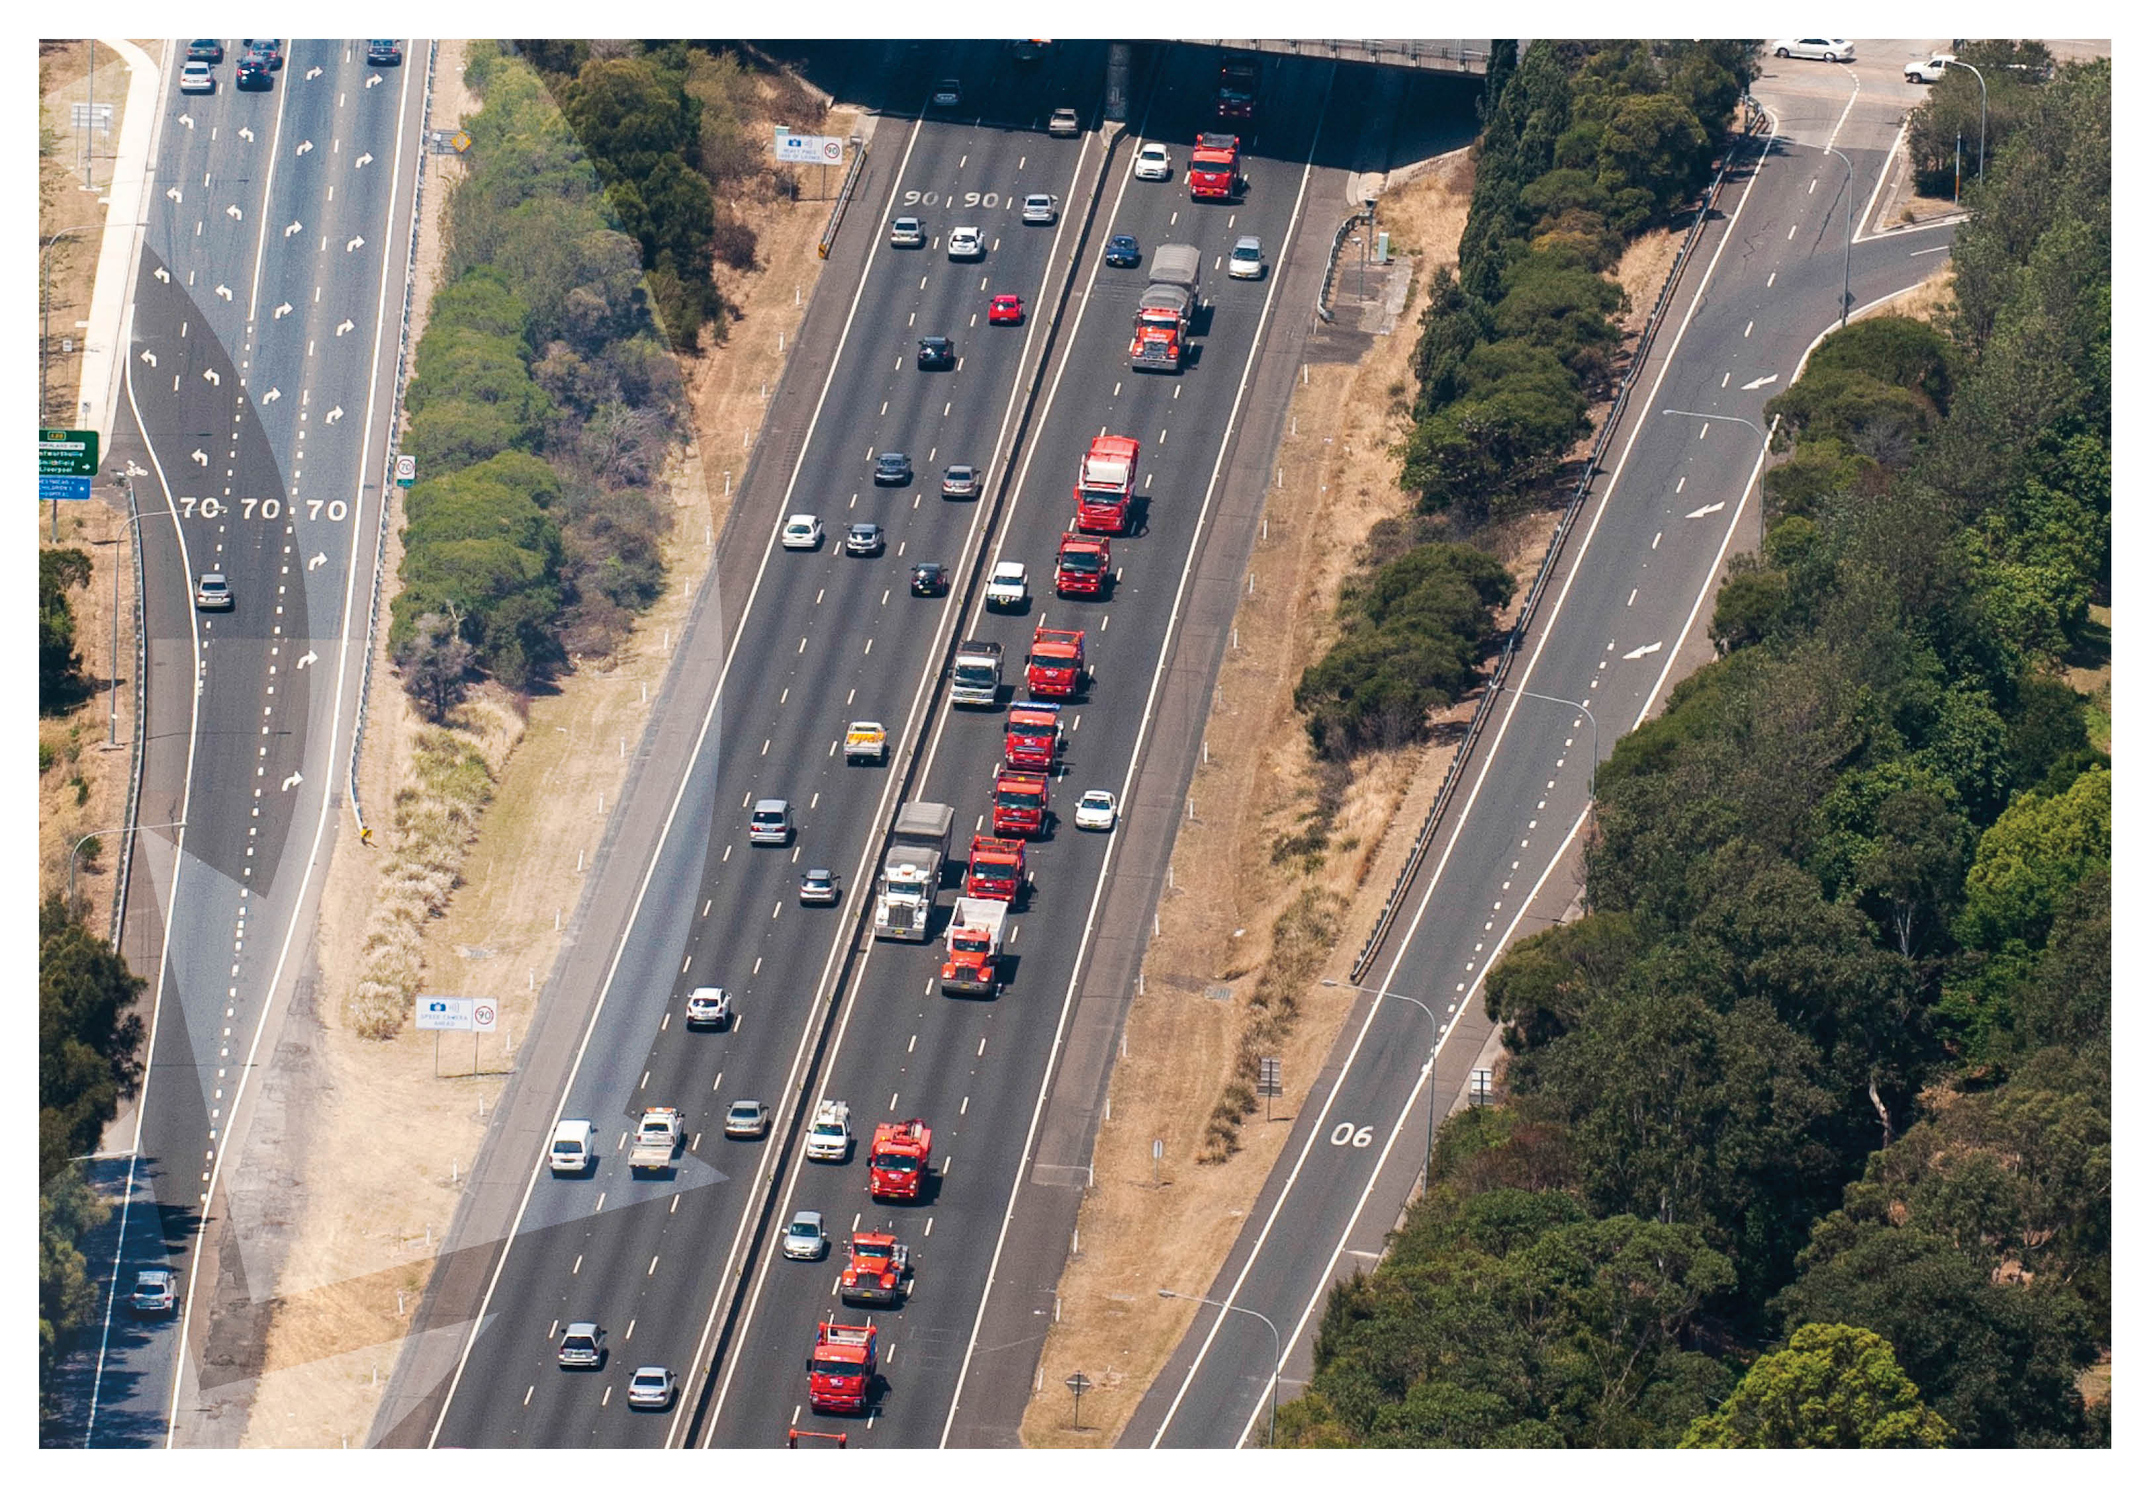
Section 2
Strategic Justification

Slide 7
Strategic justification
Regulatory and policy drivers
2021-22 targets of the Waste Avoidance and Resource Recovery Strategy
Increase landfill diversion to 75%
Recycle 80% of C&D waste (from 72% in 2014-15) and 70% of C&I (64% in 2014)
The Plan for Growing Sydney (2014) - additional 380,000 tpa of C&I recycling
Aligns with the objectives of the proposed C&D minimum standards
Improved recovery rates and management of asbestos / other contamination
Improved processes and reporting
Reduced waste to Queensland
EPA has revised up 2016-17 estimate by 20%, from 690 ktpa to 830 ktpa
Strongly anticipated to be closed / constrained by NSW and Queensland government
SE Sydney has limited waste infrastructure
Greater Sydney Commission vision to reduce east-west trips, increasing self-sufficiency
Notes:
2014/15 data – NSW State of the Environment 2015 report
* Qld revision – NSW Parliamentary inquiry into EfW, 11/17

Slide 8
Strategic justification
The Proposal site is well situated to serve forecast new housing growth to 2021 (DPE, 2016)
Market drivers
Strong forecast market growth
Residential construction – Record construction 2016-2021 (59% more than 2011-16)
Non-residential construction – Stable over forward outlook
Major infrastructure – Ongoing pipeline
Western Sydney Infrastructure Plan
Record health and schools capex in the 2017-18 budget, of $7.7B and $4.2B
Western Sydney Airport
C&I waste – Strong economic growth
Constrained landfill capacity
More than 2Mtpa non-pute airspace closing between 2016 and 2022
Notes:
Landfill closure – Spring Farm (any), Enviroguard (1 Mtpa), Horsley Park (430,000 tpa), Kemps Creek (est 500,000 tpa)

Slide 9
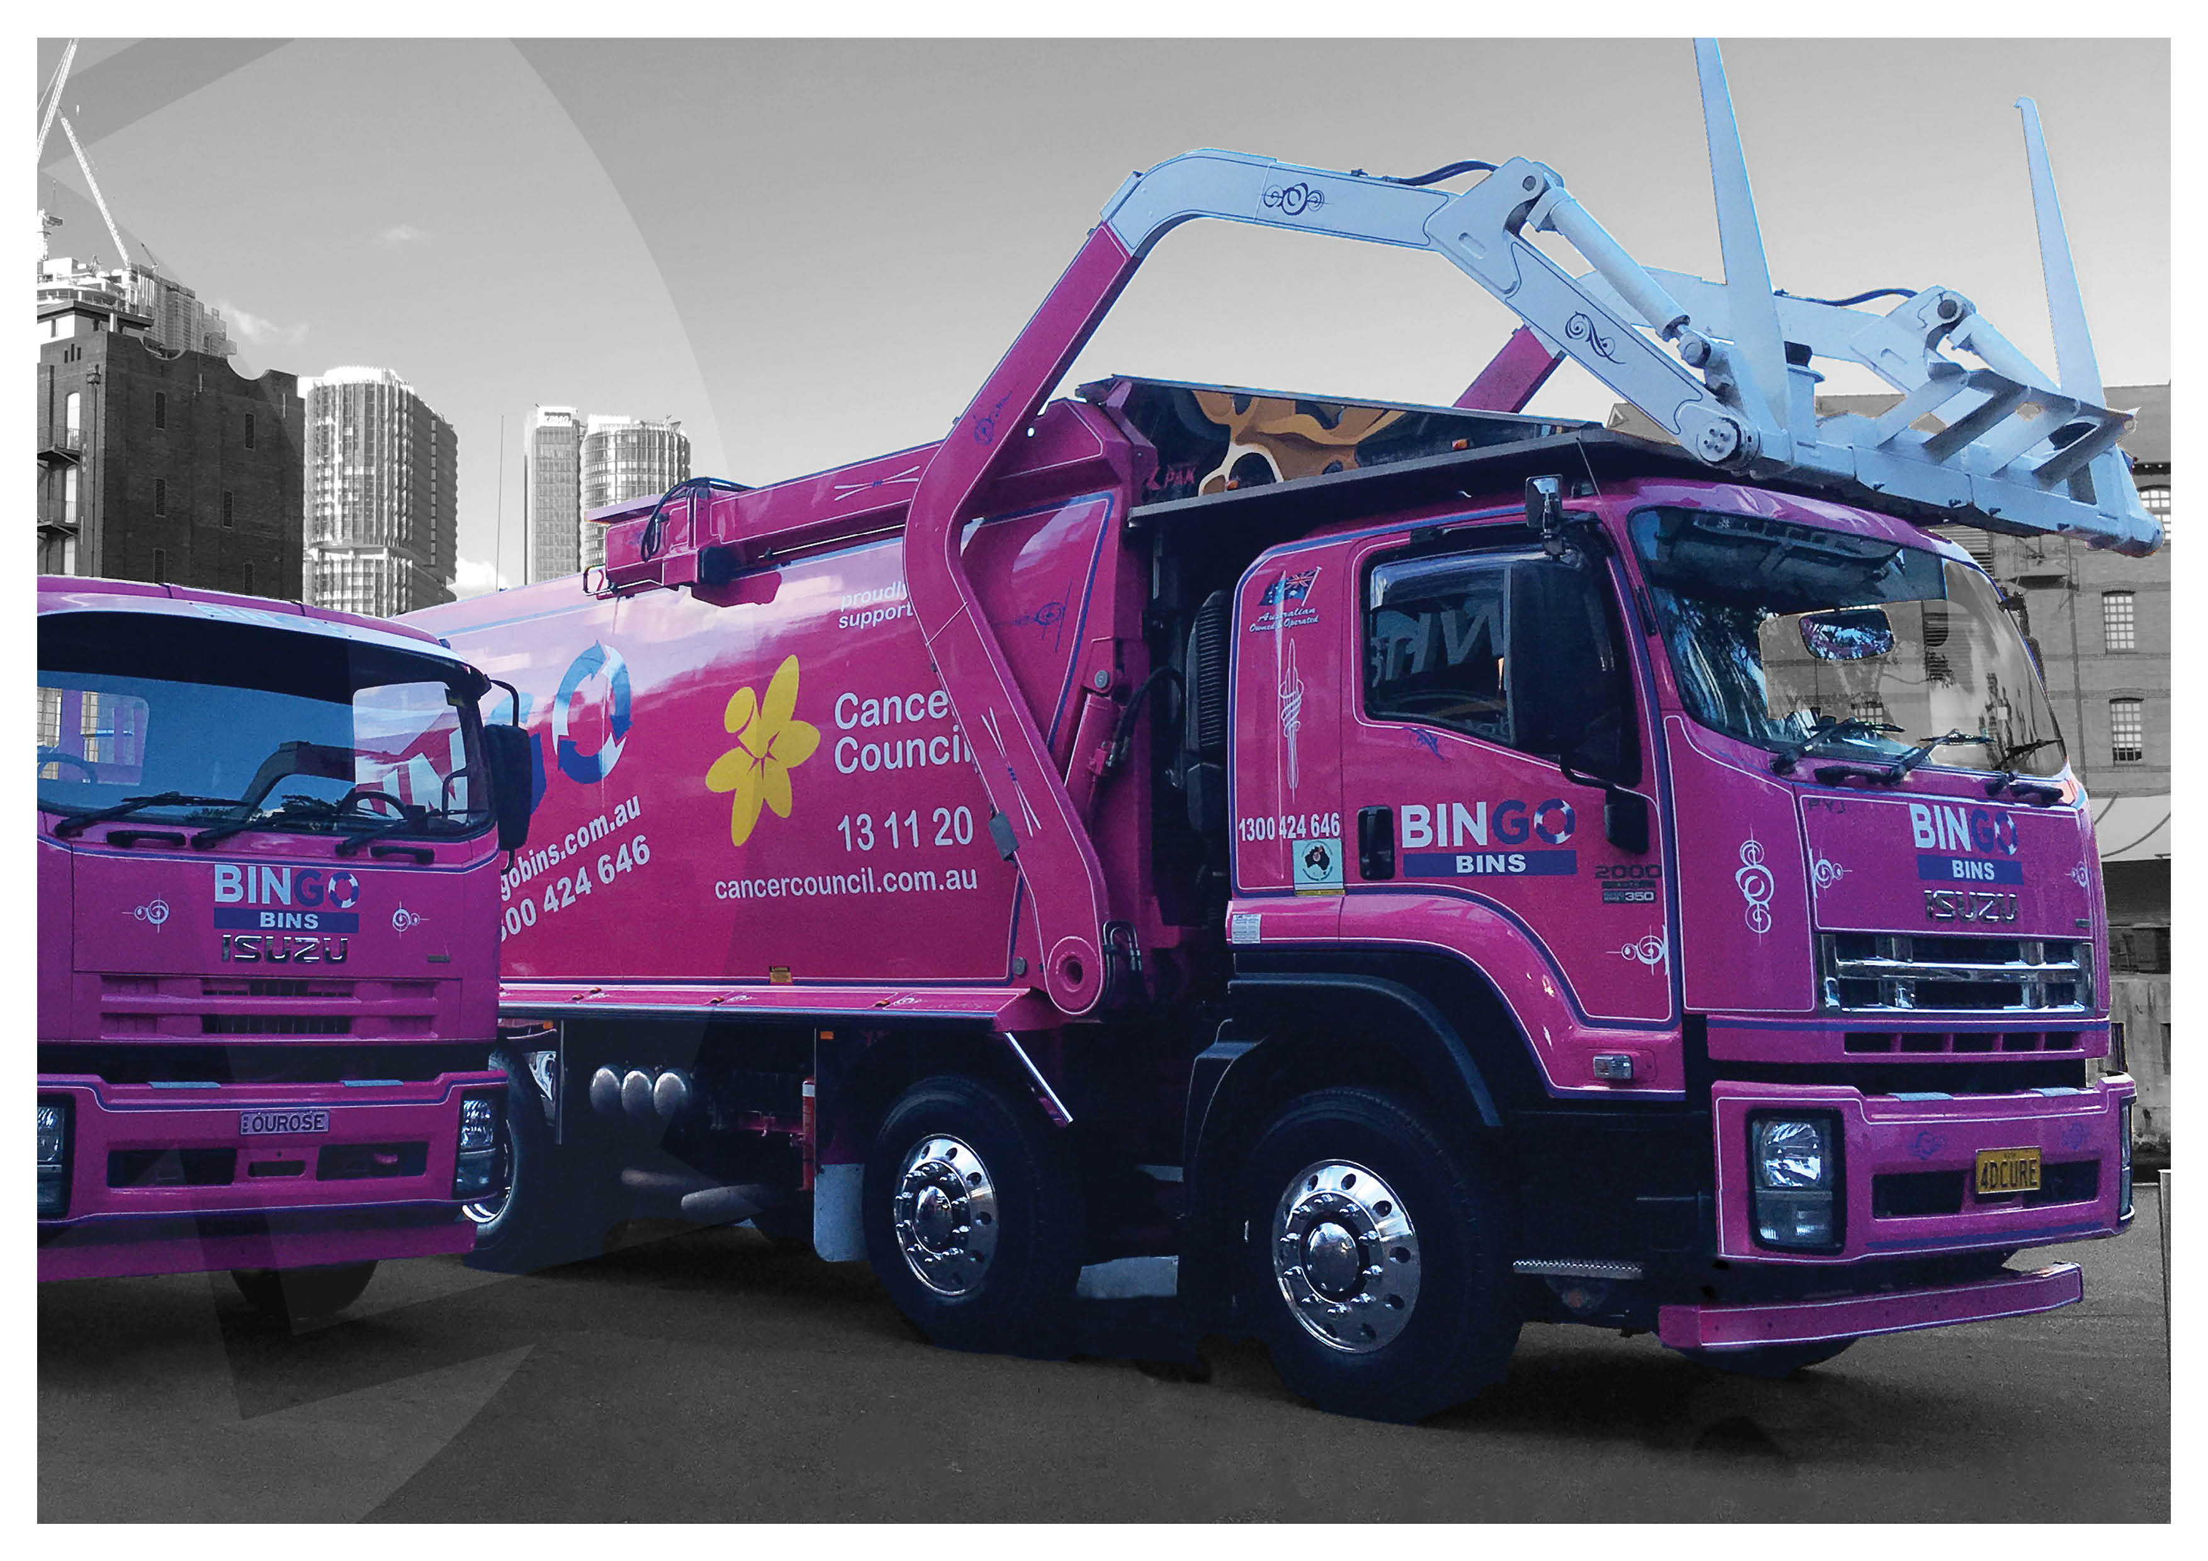
Section 3
Key Issues

Slide 10
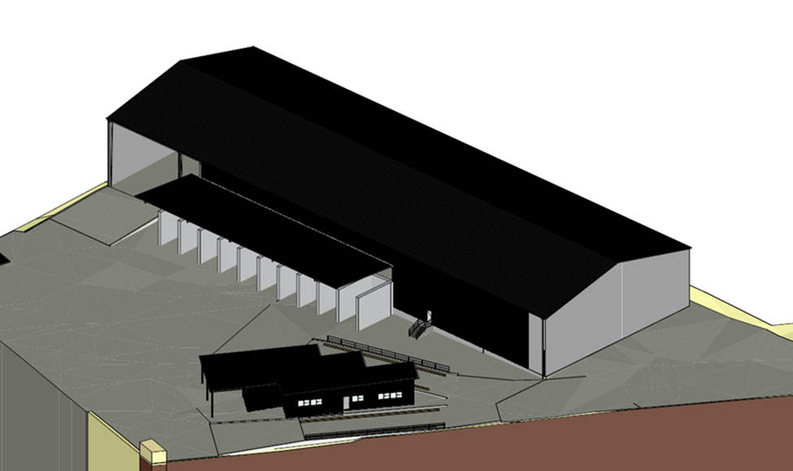
Key Issues - Site & Operational Management
Traffic flow
336 total movements per day
Receival area – 574m ² (store >6,196 t)
Addition of out-bound weighbridge
Plant and equipment
Experience with SKALA
70 tph (350,000 tpa)
Significant contingency for
unexpected plant shutdowns
Storage
10 bays (74-158 t / bay)
C&D minimum standards
‘Spread and sort’
Bays for recyclables and rejects
Notes:
Development adequately addresses the EPA’s proposed Draft C&D Waste Management Minimum Standards
Bingo has robust procedures in place for managing non-confirming waste received at the site.

Slide 11
Key Issues – Traffic & Transport
Access routes generally follow RMS approved B-Double declared routes along Stony Creek Rd, Forest Rd & King Georges Rd
Site Access via Hearne Street
No trucks to utilise Barry Ave
Comprehensive swept path analysis for largest vehicles demonstrating site will operate successfully
31 stacking spaces included in design
12 car parking spaces
Further assessment completed through RTS in response to submissions on intersection performance and on-site stacking/queuing
Haul Routes & Key Intersections

Slide 12
Key Issues – Traffic & Transport
Impacts
Minor construction traffic impacts: 14 – 46 vehicle movements per day (well below existing 204 traffic movements per day)
Peak operation will occur between 11:00am – 12:00pm with an estimated 21 trucks expected to arrive at the site
336 truck movements associated with throughput of 220,000 tpa under Proposal
SIDRA analysis shows additional traffic generated by the proposed development is negligible and is not expected to compromise the safety and function of the surrounding road network.
Intersection | Peak period | Level of Service
 |  | Existing | Future
Boundary Rd / Hearne St | AM Road Network (8:00am – 9:00am) | C | C
 | PM Road Network (4:30pm – 5:30pm) | B | C
Boundary Rd / Barry Ave /Scott St | AM Road Network (8:00am – 9:00am) | B | B
 | PM Road Network (4:30pm – 5:30pm) | B | B
Hearne St / Site Access | Midday Site Operation (11:30pm – 12:30pm) | A | A
Notes:
In comparison with existing traffic conditions within the vicinity of the site, the additional traffic generated by the proposed development is negligible and is not expected to compromise the safety and function of the surrounding road network.
Proposed split of heavy vehicles by avge net load is:
5T – 45% of movements
14.26 T – 40% of movements
27.3 t – 15% of movements

Slide 13
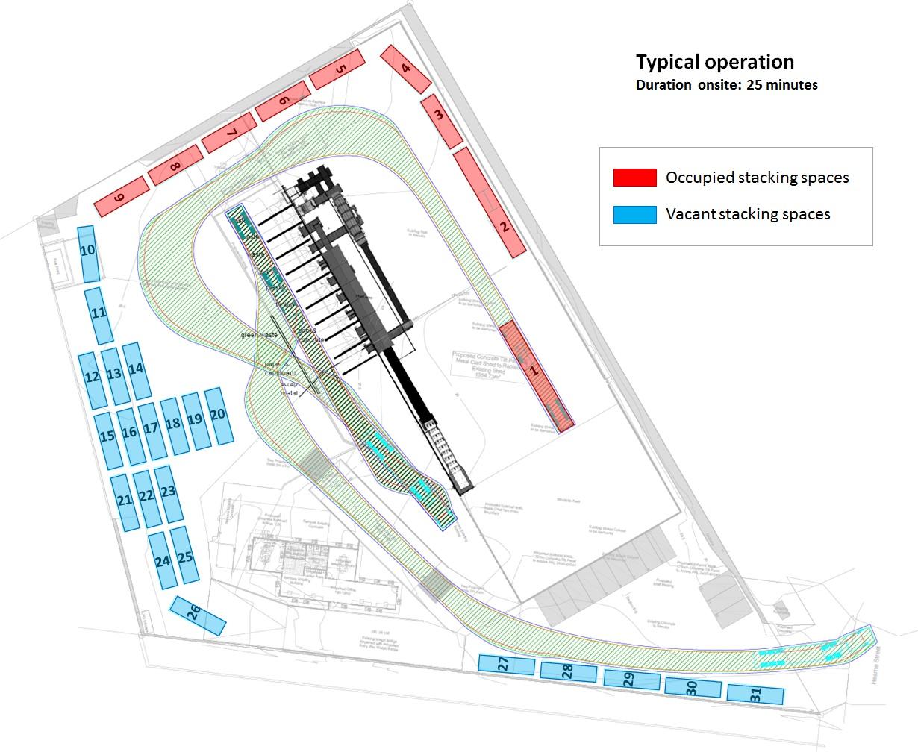
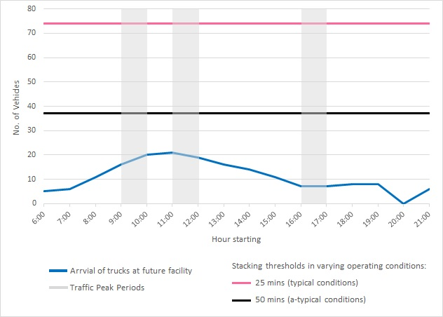
Key Issues – Traffic & Transport
Impacts
Typical operating conditions, a truck will spend an average of 25 minutes onsite between entry and exit (conservative)
Site can accommodate max of 74 trucks in any one hour
Additional queuing & stacking analysis
9 of 31 stacking spaces utilized during normal peak operating conditions
18 of 31 stacking spaces utilized during worst case scenario peak operating conditions
Queuing of heavy vehicles would be entirely accommodated and managed within the site
Notes:
Each stacking space accommodates 2.4 vehicles per hour based on average of 25minutes on site
Stacking analysis based on peak hour of operation between 11am – 12pm of 21 vehicles

Slide 14
Key Issues – Traffic & Transport
Mitigation
Construction traffic impacts managed through a CTMP (Conditions B1 & B2)
Operational traffic impacts managed through an OTMP (Condition B5)
Forms part of OEMP
Includes measures for ensuring road safety and network efficiency
Details heavy vehicle routes and access and parking arrangements
Driver code of conduct
Traffic Control Plan which includes on-site traffic control measures

Slide 15
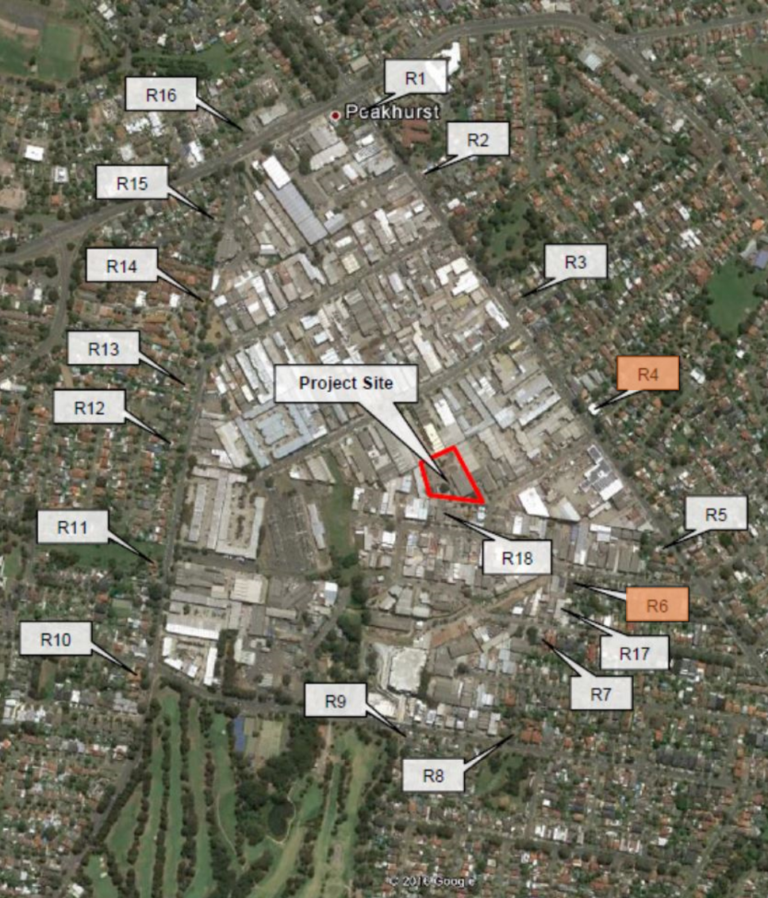
Key Issues – Noise
Unattended noise monitoring was undertaken at R6, and attended at R4 and R6 to support noise modelling
Construction Impacts
Noise under worst case scenario Proposal complies with construction NML at all receivers
Mitigation/management will be via compliance with the Interim Construction Noise Guideline (Condition B27)

Slide 16
Key Issues – Noise
Operation Impacts
Intrusiveness
Noise – compliance with INP-based criteria at all receivers, during all weather conditions (day time, evening and night time)
Vibration – compliance with AVTG guideline for all receivers
Sleep disturbance
Compliance with screening levels at all receivers
Road Noise Impacts (operation and construction)
Marginal (<< 2 dB) increases in road noise during operation i.e. increase from Proposal is only 0.7 dBa
Mitigation includes preparation of an Operational Noise and Vibration Management Plan (Condition B30) as well as operational noise limits (Condition B28) and other traffic noise and vibration criteria measures (Conditions B32 and B33)

Slide 17
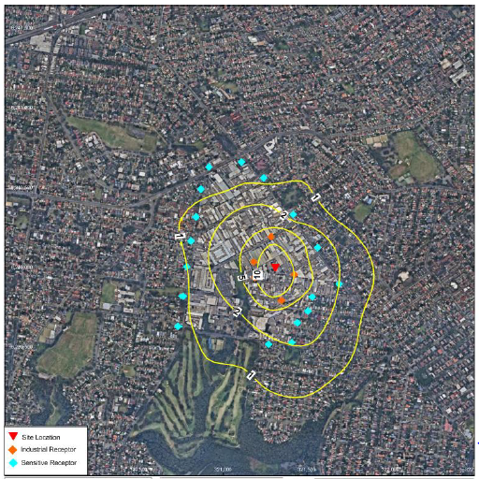
Key Issues – Air Quality
Processing operations would be fully enclosed within a new 2,534m² processing shed (Condition B41)
Air quality controls, including a CoolfogTM dust control system, water sprays and wheel wash will be used to minimise dust impacts (Conditions B42 and B43)
Air Quality Impact Assessment (2016) found that the TSP, deposited dust, PM₁₀ and PM_{2.5} impacts from the Proposal would not exceed assessment criteria at any receiver
Predicted 24-Hour Average PM10 Concentrations

Slide 18
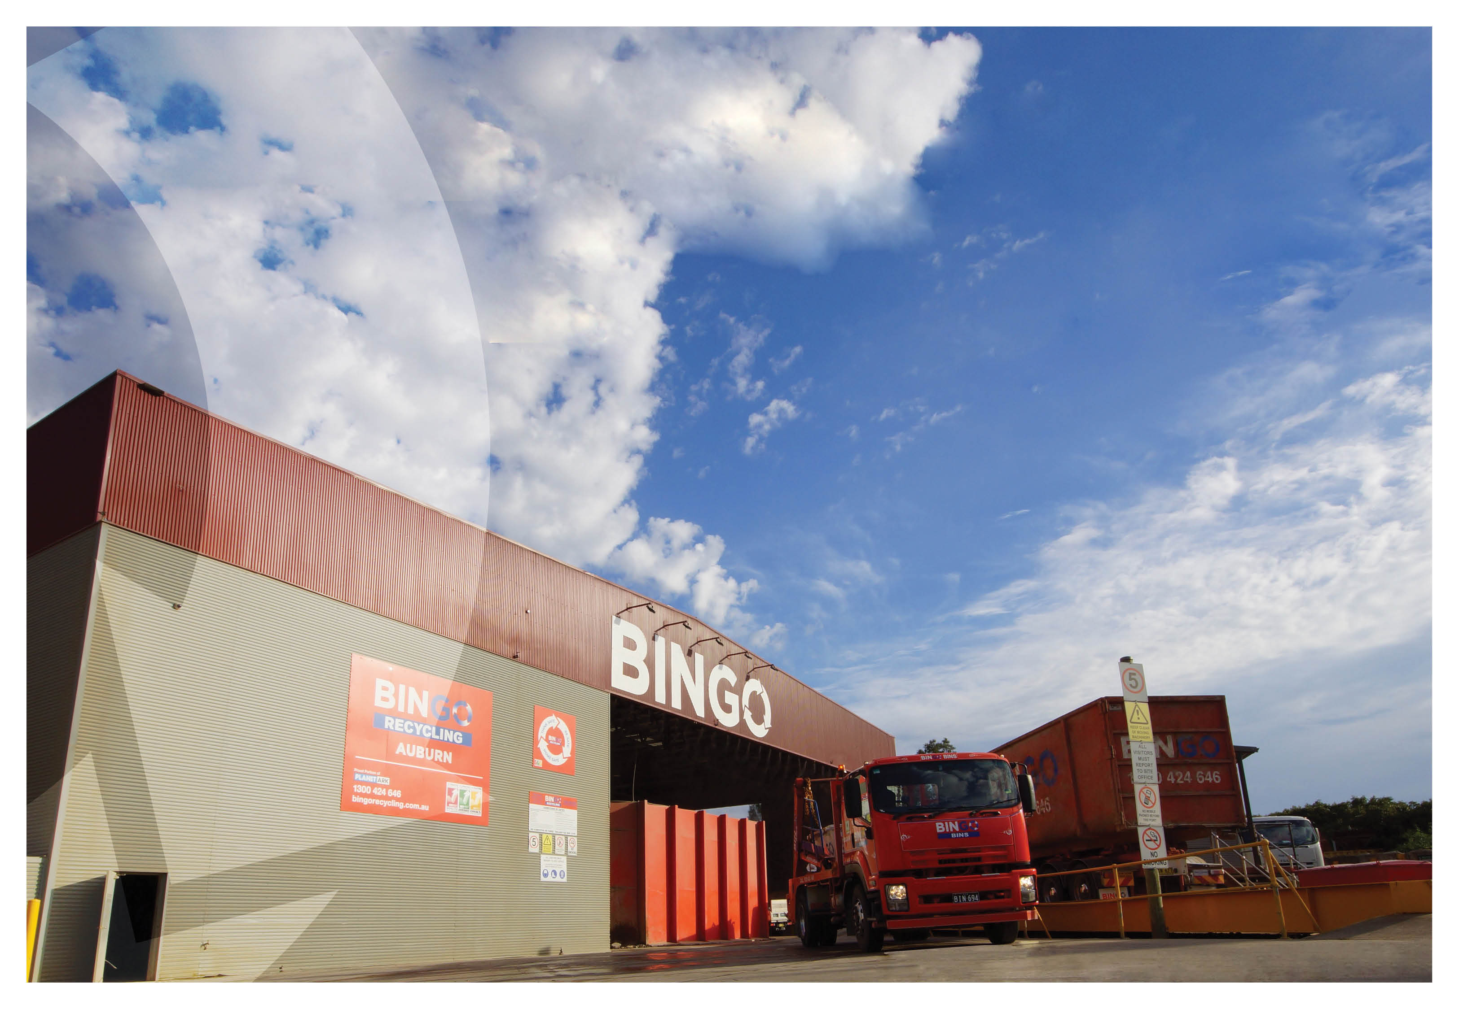
Section 4
Community Engagement Summary

Slide 19
Community Engagement Summary
APP Corporation engaged with the following stakeholders (EIS preparation)
Local community in the form written notification of the proposal and face to face meetings with interested parties;
Georges River Council
The Department of Planning and Environment
Environment Protection Authority
Roads and Maritime Services
Office of Water
Department of Primary Industries
Four submissions were received from surrounding landowners concerned with:
increase traffic volume and road safety impacts;
car parking;
dust;
noise and vibration; and
stormwater management

Slide 20
Cont…
EIS Exhibition (22 July -22 August)
Key issues raised:
• Impacts from traffic, noise, machinery vibration and dust generation
• Vehicle movements within and outside the site, road safety and traffic management over the 24-hour operation
• Operational details relating to management of waste streams, stockpiles and justification for 24-hour operation
• Use of Barry Avenue for heavy vehicles
• Compliance with the 10m height limit
• Locality of dangerous goods and fire safety management

Slide 21
Cont…
Response to Submissions 1 (December 2016)
Relocation of LPG
Access, manoeuvring and parking arrangements
Machinery and plant alignment
No vehicles to use Barry Avenue
Dedicated traffic controllers
Response to Submissions 2 (April 2017)
Reduced throughput to 220,000 tpa
Operational hours from 6am to 10pm only
Amendments to proposed queuing and bin storage arrangements
Additional arrangements to restrict heavy vehicle movements to Hearne Street only

Slide 22
Cont.
Further information to DPE (13 July – 7 November 2017)
13 July 2017
Amended plans to reflect stockpiles
High and low-density scenario tabulation
Vehicle stacking
Timeframe and procedure for waste removal
Quality control
Glass and plasterboard
Non-conforming waste
Job creation
Matters of Environmental Significance
Georges River Council
Traffic and noise impacts to Barry Avenue
Queuing outside the site
Traffic Plan of Management to avoid using Barry Avenue
Fire and Rescue NSW

Slide 23
Cont.
5 October 2017
Timeframes for loading trucks
In-bound and out-bound waste
Vehicle swept paths
Workshop activities
Storage of non-conforming waste
Processing of waste
Updated commitments
1 November 2017
Stormwater quality and quantity
SIDRA analysis
Storage of Hazardous Chemicals
Landowner consent
7 November 2017
Bingo Systems and Procedures
Maintenance of SKALA machinery
Procedures in handling non-conforming waste
New minimum standards for managing construction and demolition waste in NSW
Construction and Road Noise

Slide 24
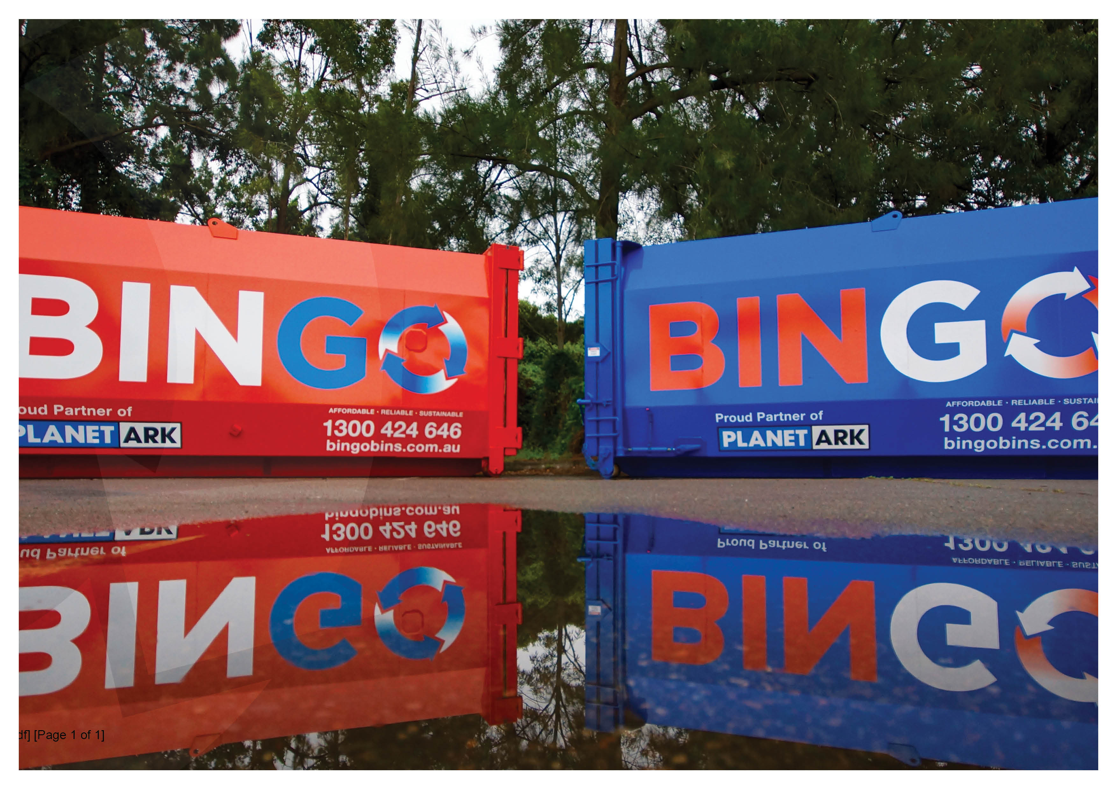
Section 5
Draft Conditions

Slide 25
Mortdale RRF – Draft Conditions
Conditon Ref | Proposed Wording
A8/Table 1 | The application must not exceed the following maximum stockpile volumes detailed in Table 1 in any one stockpile at any one time, unless otherwise agreed in writing by the Secretary The Applicant must not store more than 10,000 tonnes of waste on the premises at any one time
Justification
Current condition restricts use of storage bays and limits operational flexibility
Measuring waste by cubic metres less accurate & requires estimations
Tonnage limit proposed more appropriate as can be accurately tracked by weighbridge data

Slide 26
Mortdale RRF – Draft Conditions
Conditon Ref | Proposed Wording
A29 | The Applicant must ensure that only the plant and equipment listed in Table 6 and Table 9 of the Noise and Vibration Impact Assessment report dated 16 March 2017 provided with the EIS is used on site during operation and construction respectively. Delete condition
Justification
Drafted condition provides no flexibility for substitution or upgrading equipment. Technological advances/developments could provide improved environmental outcomes
Adequate measures for noise prescribed under draft conditions B28, B29, B30 & B33

Slide 27
Mortdale RRF – Draft Conditions
Condition Ref | Proposed Wording
B51(b) | Dangerous goods, as defined by the Australian Goods Code, must be stored and handled strictly in accordance with: (b) For liquids, a minimum bund volume of 110% of the volume of the largest single stored volume within the bund Add the following text: unless alternative appropriate design measures can be achieved to the satisfaction of the Department
Justification
Current drafted condition presents potential impacts on facility design/layout
Alternative measures such as self bunded fuel storage tanks supported by appropriate measures meet the intent of the condition

Slide 28
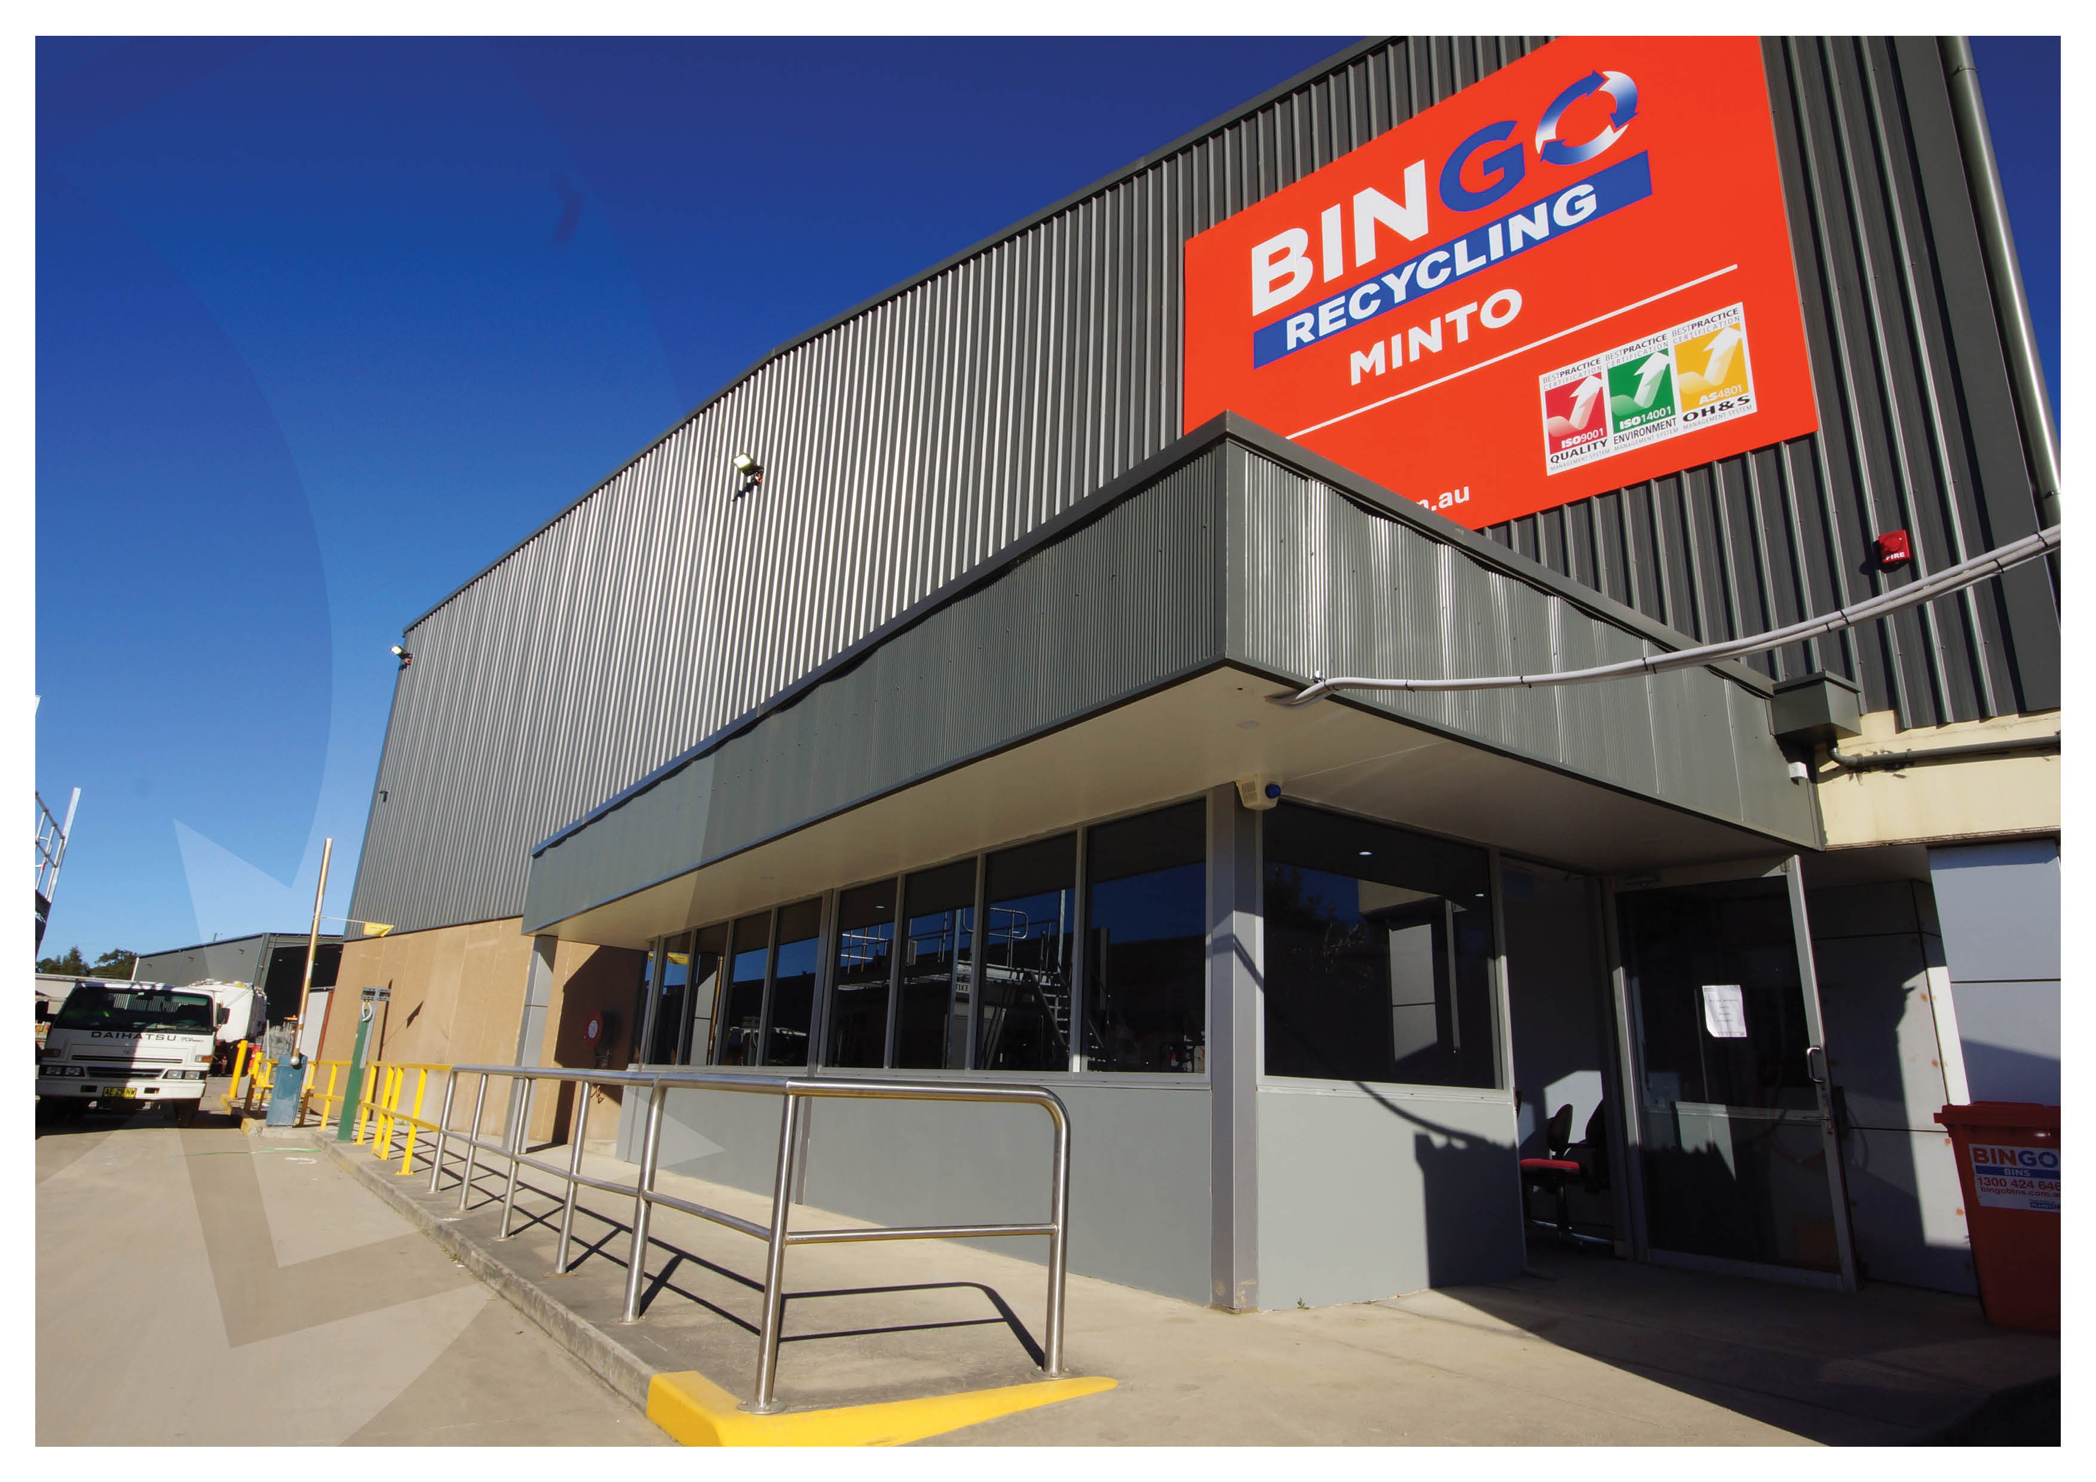
Section 6
Conclusion

Slide 29
Conclusion
EIS, RtS and additional assessment information prepared for the Proposal (SSD) in accordance with the EP&A Act
Amendments made to Proposal in response to Agency and Public submissions
Potential environmental, social and economic impacts, both direct and cumulative, have been identified and thoroughly assessed
No significant environmental impacts have been identified
The environmental impacts mitigated through implementation of measures for the construction and operation of the Proposal
Bingo generally agrees to the DP&E Conditions subject to key changes which ensure they are commensurate with the Proposal impact & do not limit operational flexibility

