Slide 1

Mundamia
Residential Subdivision (SSD7169)
Briefing to NSW Independent Planning Commission
6 August 2019
Client: Jemalong Mundamia Pty Limited

Slide 2
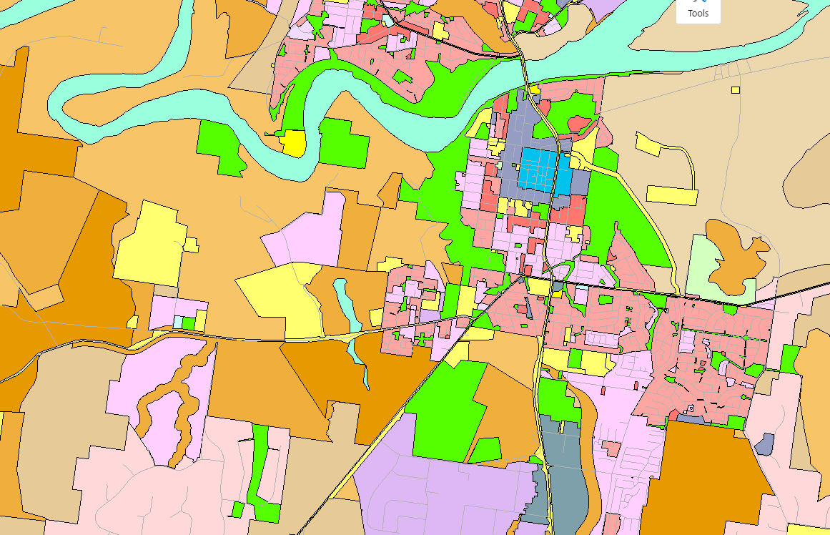
The Site
Nowra CBD
Mundamia URA
2.6km
University of Wollongong (Shoalhaven Campus)

Slide 3
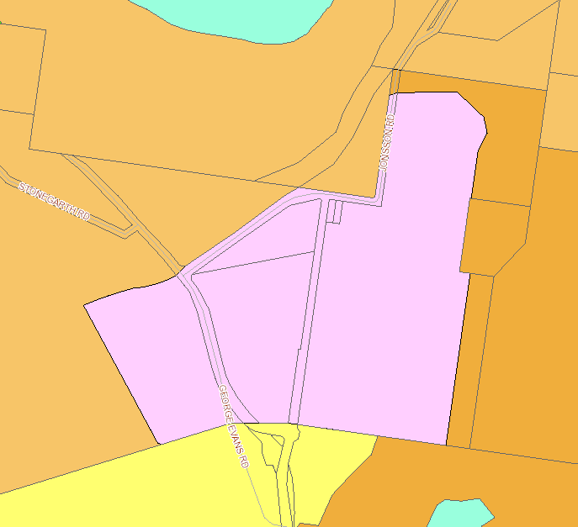
The Site

Slide 4
Strategic Planning History
Nowra-Bomaderry SP2006 →DoP 2008: for “early release”
Mundamia Masterplan 2008
Draft SLEP2009/2013 (exhibition)
SLEP2014 (endorsed by DoP)
SDCP2014 Chapter NB1 (October 2014)
Shoalhaven Contributions Plan (specific projects)
Shoalhaven Growth Management Strategy (endorsed by DoP in 2014)
Illawarra Shoalhaven Regional Plan 2015

Slide 5
DA History
Preliminary Assessment lodged - June 2008
SEARS obtained - October 2008
EPBC Approval - April 2012
Environmental Assessment lodged 2013
Exhibition (after draft SLEP2013 was exhibited)
Preferred Project Report lodged 2015
Transitioned from Part 3A to Part 4 (SSD) 2015
Satisfactory Arrangements - August 2016
Rural Fire Service Approval – 4 November 2016
“Biobank” Site Registered – February 2019

Slide 6
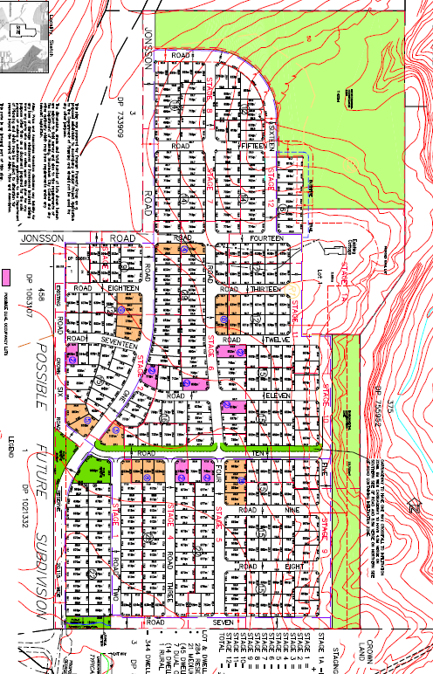
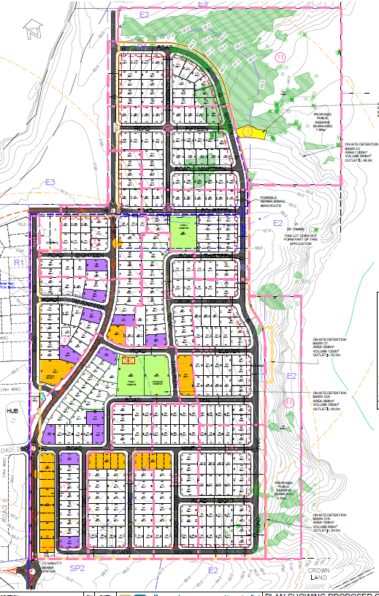
DA History
2009 Layout
2019 Layout
10 years

Slide 7
Urban Design
Adopted Mundamia Masterplan Principles (grid pattern, outlook to bush, spine road, N-S roads to view Cambewarra Mountain)
DCP Compliant
Substantial public reserves
Edge lots with outlook over urban interface

Slide 8
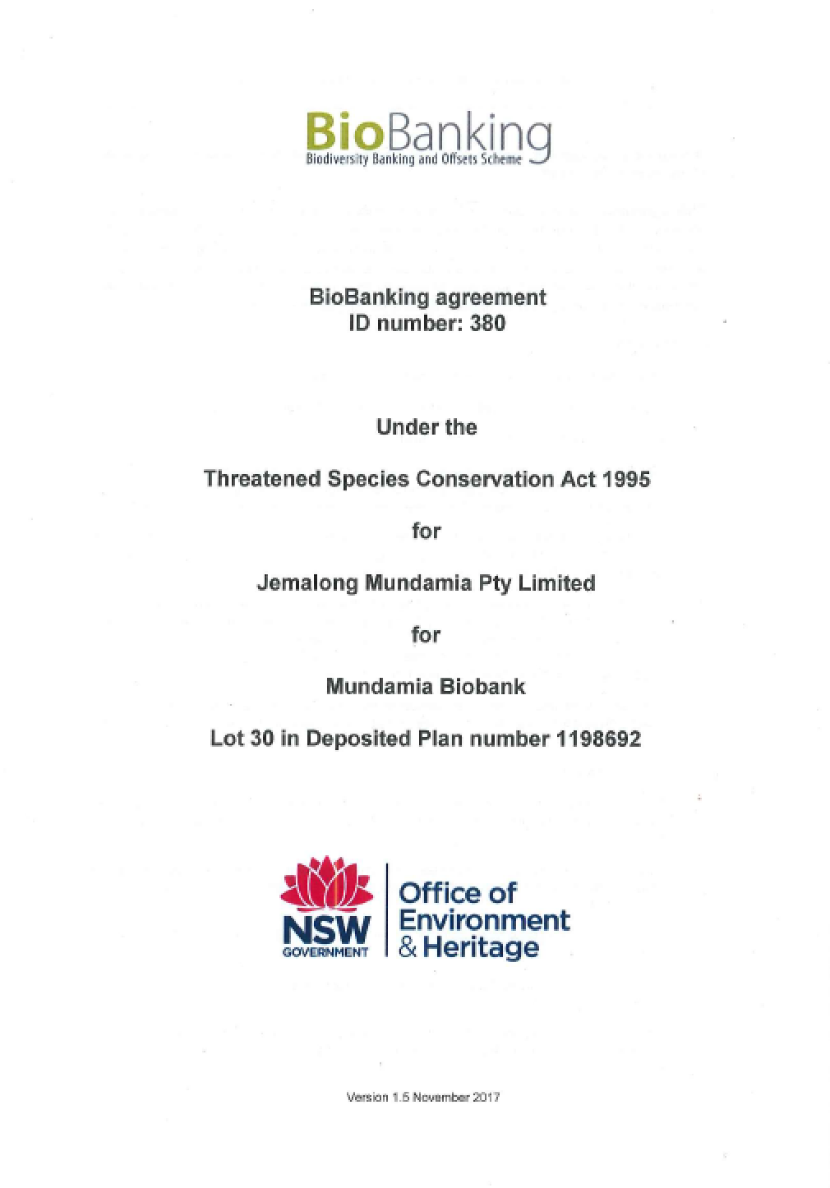
Biodiversity
Biobank site established (BA380)
All credits to be retired on-site and off-site

Slide 9
Hydrology
Nowra Heath Myrtle is not a Groundwater Dependent Ecosystem
Spring Tiny Greenhood Orchid has not been located downstream of the site
Stormwater system designed to comply with DCP requirements at the insistence of DPIE staff

Slide 10
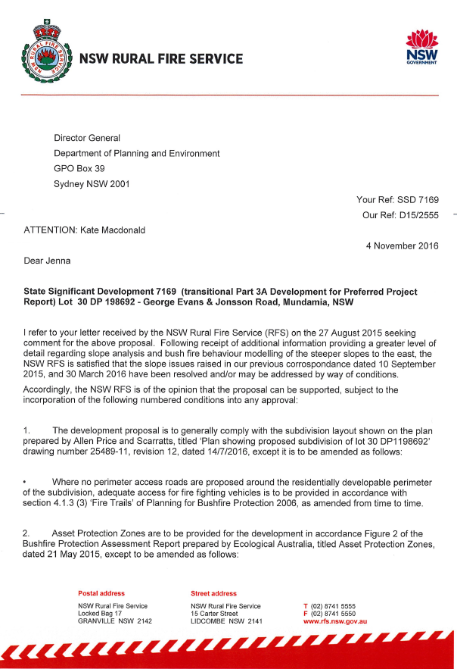
Bushfire Issues
RFS Issued its approval to the subdivision on 4 November 2016
(not included in Appendices to DPIE’s report)

Slide 11
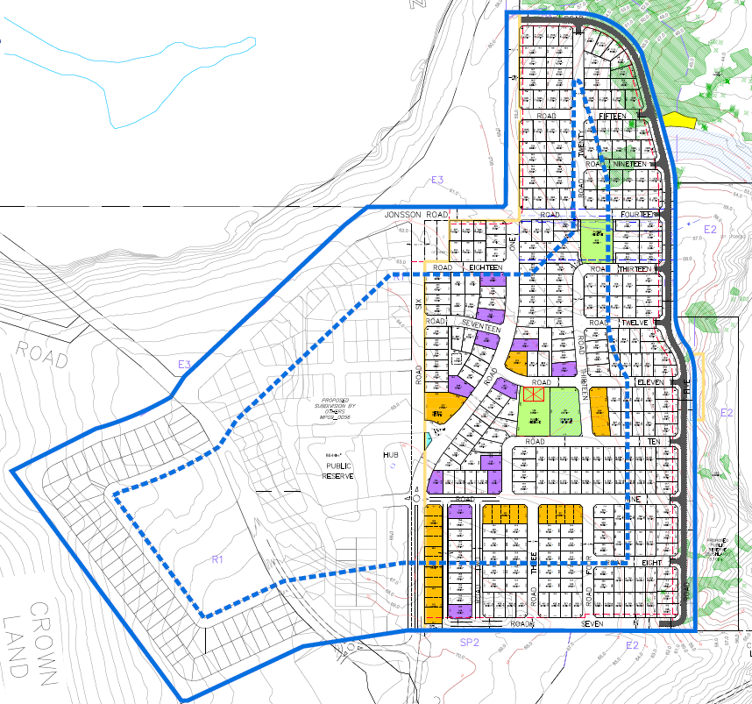
Bushfire Issues
DPE raised concerns about evacuation in late 2018. Second evacuation option developed being a “Neighbourhood Safer Place” to RFS requirements
(SCC Community Facility)

Slide 12
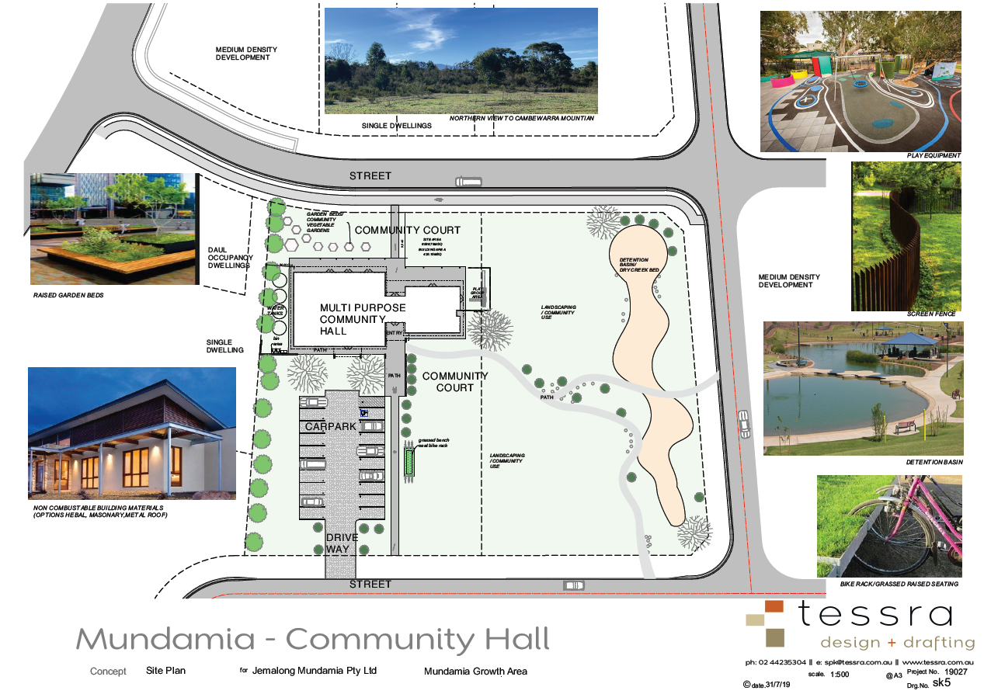
Bushfire Issues
Concept design for NSP is being developed

Slide 13
Bushfire Issues
Conditions we have issues with:
Deferred Commencement Condition A1(9)
(a)(i): Table A2.4 unnecessarily conservative
RFS acceptance to performance-based solution for APZ
(a)(ii):Temporary 100m APZ unnecessarily conservative
RFS acceptance to existing layout with PBP2006 APZ’s
(b)(v):No parking on perimeter roads is unnecessarily conservative
RFS acceptance to PBP2006 compliant APZ’s
(d) :Internal laneways is unnecessarily conservative
RFS acceptance to PBP2006 compliant APZ’s and perimeter roads
(e) :Relocation of higher density lots 100m from western boundary is unnecessarily conservative
RFS acceptance to PBP2006 compliant APZ’s

Slide 14

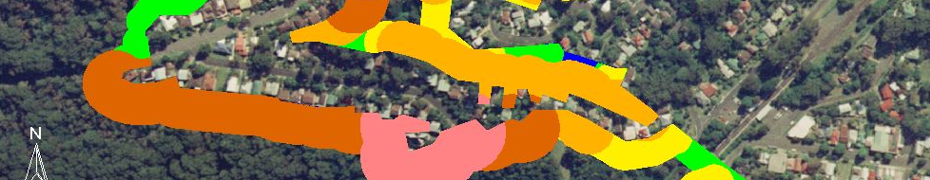
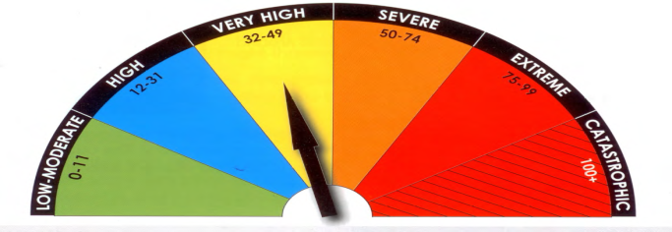
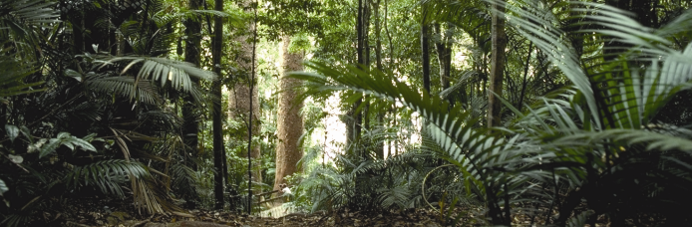
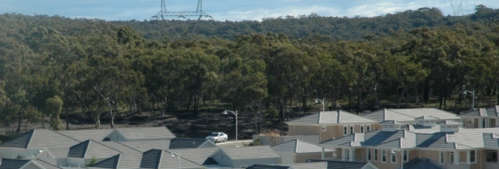


Strategic Bushfire Considerations
Mundamia Residential Subdivision
Rod Rose
Senior Principal - Bushfire

Slide 15

Suitability of Performance Criteria
PBP 2006 (p. 2) – “… can be satisfied by:”
  Acceptable Solutions, or
  Alternate Solutions
Alternate Solutions always require:
  Greater accuracy
  More detailed site assessment
  Application of best practice science
  Better/equivalent protection than Acceptable Solutions
Reliable Alternate Solutions provided for:
  Access
  Some APZ

Slide 16
Reliability of Alternate Solutions
Alternate Solutions prepared by:
  BPAD L3 accredited Bushfire Consultant
  Gold Level member of FPAA
  Quality Assurance System
Alternate Solutions approved by RFS:
  Bushfire planning experts
  Rigorous QA processes
  Have not endorsed the additional DPIE conditions
Alternate Solutions accepted (in principle) by DPIE:
  Additional protection measures required
  No BPAD L3 qualified bushfire assessment undertaken

Slide 17
Access solution
Two options
  Leave early (to Nowra)
  Refuge on site (NSP)
Risks
  Leave early
    Fire is >4 hours away
    Zero fire overrun potential
  NSP refuge
    Reliable, nationally established standard
    Zero fire overrun potential

Slide 19
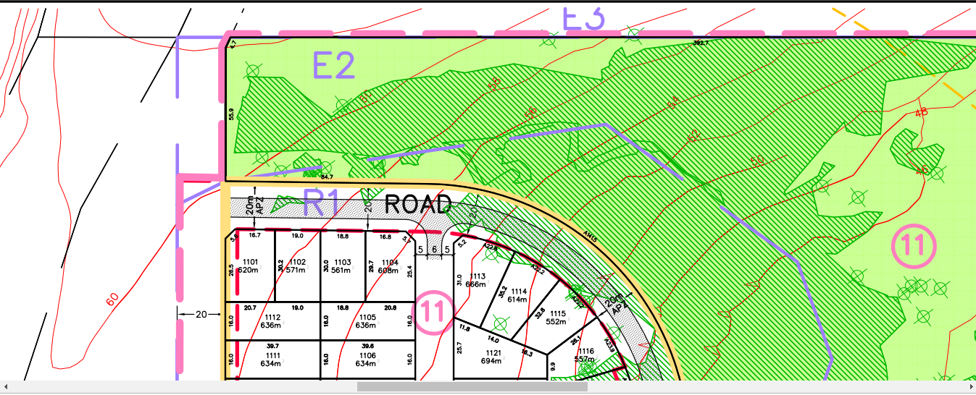
Design amendment condition A1(9)(a)(i)
APZ according to Table A2.4 + (dynamic bushfire event?)
Performance Criteria met by all BFAA models. Table 2.4 not used.
RFS approved all APZs, except the perimeter lots below
Road and building setbacks provide 25 m APZ required

Slide 20
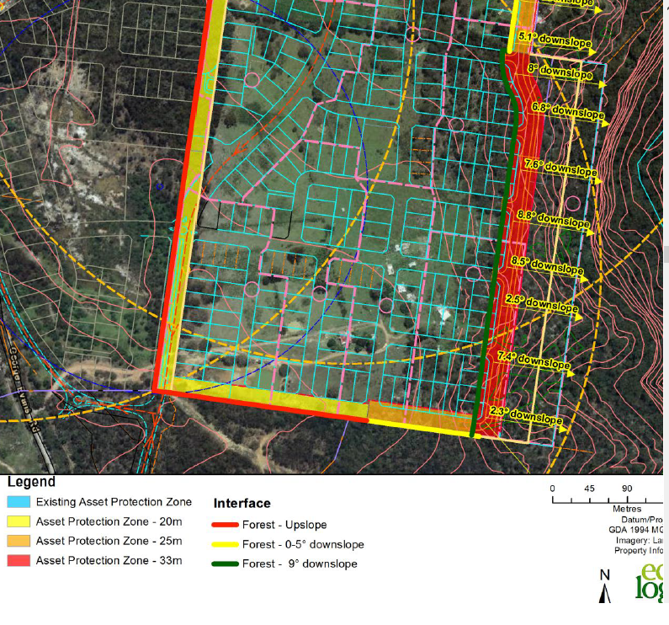
Design amendment condition A1(9)(a)(ii)
Temporary 100m APZ (Stage 1)
Not required
APZ comply with PBP
RFS approved APZ

Slide 21
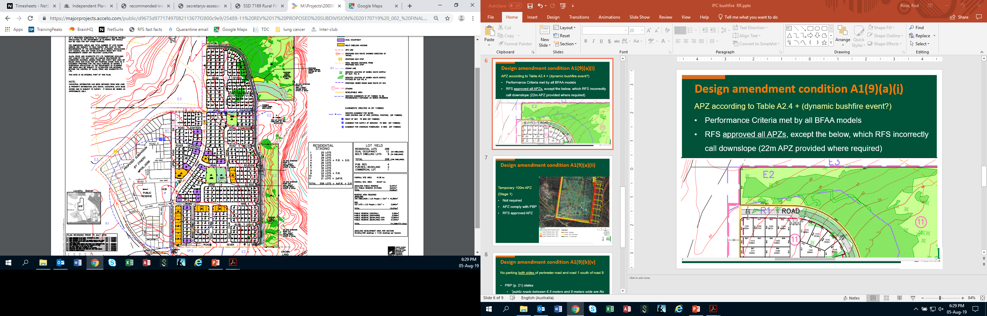
Design amendment condition A1(9)(b)(v)
No parking both sides of perimeter road and Road 1 south of Road 9
PBP (p. 21) states
  “public roads between 6.5 meters and 8 meters wide are No Parking on one side…”

Slide 22
Design amendment condition A1(9)(d)
Provide alternate internal access…to NSP
All lots have at least two road routes to NSP

Slide 23
Design amendment condition A1(9)(e)
Relocate medium density lots >100m
All medium density lots:
  comply with PBP
  have buildings meeting BAL
  No performance justification exists or provided for the concept, nor has it been designed or evaluated by a BPAD L3
Unnecessary restriction

Slide 24
Other Conditions
Delete Condition F26(e)(vi) – 6mm glazing on windows to all dwellings – Day Design Noise report stipulates no noise controls required;
Various other conditions scattered throughout the “Recommended Instrument”;
Will confirm all of these in a written submission

Slide 25
Conclusion
We request IPC:
determine the application by way of “Approval”;
rely on the advice from RFS dated 4/11/16 for the necessary bushfire controls;
delete bushfire conditions A1(9)(a)(i), A1(9)(a)(ii), A1(9)(b)(v), A1(9)(d) and A1(9)(e);
delete condition F26(e)(vi) re noise mitigation
Consider other conditions as outlined in our written submission (to be provided)

