Slide 1
Moolarben Coal Mine modifications Independent Planning Commission NSW Public Hearing: Tuesday 2nd April 2019 Expert Report
Presenter:
Rosemary Hadaway
on behalf of Mudgee District Environment Group
Author:
Professor Will Steffen
Emeritus Professor
The Fenner School of Environment and Society
The Australian National University
Notes:
Thank you Commissioners for this opportunity.
My name is Rosemary Hadaway. I am a member Mudgee District Environment Group; I will refer to the Group by its acronym MDEG.
It is my privilege to present an Expert Report prepared for MDEG by Professor Will Steffen. Professor Steffen is Emeritus Professor, The Fenner School of Environment and Society, The Australian National University; and Senior Fellow, Stockholm Resilience Centre.
MDEG is very grateful for the time and effort put into this document by Professor Steffen, and we publicly extend our thanks to him.
Professor Steffen is currently a Climate Councillor with the independent publicly-funded Climate Council of Australia. He has a long history in research, and his interests span a broad range within the fields of sustainability and Earth System science. There is an emphasis on the science of climate change, and the history and future of the relationship between humans and the rest of nature.
His Curriculum Vitae including his relevant qualifications and Publications List is attached as an Appendix to this paper.
There are 33 references cited for this paper. They are from peer-reviewed journals, Australian government departments, the CSIRO, the Bureau of Meteorology and the Intergovernmental Panel on Climate Change (IPCC).

Slide 2
Executive summary
Climate change poses serious risks for humans
Govts have agreed to limit warming to 1.5-2.0ºC
The carbon budget approach determines the rate of emission reductions required: This budget limits the cumulative amount of additional CO2 emissions that can be allowed
To meet 2.0ºC carbon budget = phase out all fossil fuel usage by 2050
To meet 1.5ºC carbon budget = more rapid phase out of fossil fuel
Notes:
The Executive Summary states 5 key matters:
Anthropogenic climate change is real and poses serious risks for the wellbeing of humans and our societies. These risks rise rapidly and nonlinearly with the rise in global average surface temperature.
Recognising that the risks to human wellbeing of unchecked climate change are too high to accept, governments around the world have agreed to limit warming to 1.5-2.0°C (the 2015 Paris accord).
The carbon budget approach is the most robust way to determine the rate of emissions reductions required to meet the goals of the Paris accord. This approach limits the cumulative amount of additional CO2 emissions that can be allowed consistent with the Paris accord.
To meet a 2°C carbon budget, a very rapid phase-out of all fossil fuel usage by 2050 at the latest, or preferably earlier, is required. The 1.5°C carbon budget is smaller, requiring an even more rapid phase-out of fossil fuel usage.

Slide 3
Executive summary
This means:
Most of the world’s existing fossil fuel reserves must be left in the ground, unburned.
No new fossil fuel developments, or extensions to existing fossil fuel mines or wells, can be allowed.
Notes:
This means that the majority of the world’s existing fossil fuel reserves must be left in the ground, unburned.
Furthermore, no new fossil fuel developments, or extensions to existing fossil fuel mines or wells, can be allowed.
This paper provides a clear picture of our global predicament and as you can see gives a sobering challenge to us all – particularly planning decision-makers.
I had great difficulty writing this precis for you – each paragraph is pertinent – I didn’t want to leave anything out!

Slide 4
Anthropogenic climate change and its impacts
Global average surface temperature is about 1^{O} C higher than pre-industrial levels (BoM)
2015, 2016, 2017 and 2018 have been the four hottest years on record (BoM)
Rise in CO2 concentration is up to 10 times faster then the most rapid changes in the geological record
Since 1970 global average surface temperature has been rising at a rate of 1.7^{O} C per century, compared to a 7,000-year background rate of change of 0.01^{O} C per century
Notes:
First, climate change is explained - the nature of the greenhouse effect etc –
Climate change impacts are described.
Professor Steffen lists important impacts relating to weather, including significant changes in extreme weather events.
Some of the facts are:
Global average surface temperature is about 1^{O} C higher than pre-industrial levels (BoM)
2015, 2016, 2017 and 2018 have been the four hottest years on record (BoM)
Rise in CO2 concentration is up to 10 times faster then the most rapid changes in the geological record
Since 1970 global average surface temperature has been rising at a rate of 1.7^{O} C per century, compared to a 7,000-year background rate of change of 0.01^{O} C per century

Slide 5
Anthropogenic climate change and its impacts
Australia’s average surface temperature has increased by 0.9^{O} C from 1910-2014, and is now 1.14^{O} C above the long-term average. (BoM)
January 2019 was Australia’s hottest January on record, with heatwaves unprecedented in scale and duration.
Central West NSW – no. of heatwave days incr – duration of longest heatwave is incr – the hottest day of heatwave is becoming hotter
Notes:
Further data here and a prediction for our region...
Australia’s average surface temperature has increased by 0.9^{O} C from 1910-2014, and is now 1.14^{O} C above the long-term average. (BoM)
January 2019 was Australia’s hottest January on record, with heatwaves unprecedented in scale and duration.
Central West NSW – no. of heatwave days incr – duration of longest heatwave is incr – the hottest day of heatwave is becoming hotter

Slide 6
Projections of future climate change
Central West NSW
Average temperatures will continue to increase in all seasons, and increases will be greater than average in inland regions (very high confidence).
b) More hot days and warm spells are projected with very high confidence. Fewer frosts are projected with high confidence.
Notes:
Projected changes in the climate of NSW central west region include (https://www.climatechangeinaustralia.gov.au/en/, based on CSIRO and BoM 2015):
Average temperatures will continue to increase in all seasons, and increases will be greater than average in inland regions (very high confidence).
b) More hot days and warm spells are projected with very high confidence. Fewer frosts are projected with high confidence.

Slide 7
Projections of future climate change
Central West NSW
c) Natural variability will predominate over climate change trends in the near term but decreases in winter rainfall are projected later in the century with medium confidence. Other changes are possible but unclear.
d) Increased intensity of extreme rainfall events is projected, with high confidence.
e) A harsher fire-weather climate in the future (high confidence).
Notes:
c) Natural variability will predominate over climate change trends in the near term but decreases in winter rainfall are projected later in the century with medium confidence. Other changes are possible but unclear.
d) Increased intensity of extreme rainfall events is projected, with high confidence.
e) A harsher fire-weather climate in the future (high confidence).

Slide 8
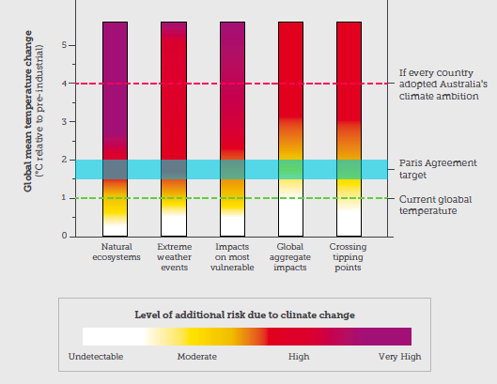
The IPCC ‘burning embers’ diagram – the reasons for concern about the impacts of climate change with increasing temperature. Adapted from IPCC (2014).
Notes:
This figure shows several levels of temperature:
The current observed level, ca. 1°C above pre-industrial levels;
b) The 1.5-2°C target range for the Paris accord; and
c) The level of temperature increase by 2100 (ca. 3-4°C above pre-industrial) that would be reached if every country adopted Australia’s level of ambition in terms of targets and policies.
Australia’s emissions are set to far exceed its Paris accord target for 2030.
The Paris target itself, if followed by all other countries would lead to global warming of over 2°C and up to 3°C.
If all other countries were to follow Australia’s current policy settings, warming could reach over 3°C and up to 4°C.
What this figure shows:
Australia is not doing nearly enough to meet its obligations under the Paris accord, which it signed; and
b) That if every country followed Australia’s level of action, the world would be on a trajectory to reach a 3-4°C temperature rise by 2100 and would thus face extremely damaging levels of climate change

Slide 9
Global and Australian targets for stabilising the climate system
Paris accord signed by 197 countries including Australia:
‘limit global average temperature rise to well below 2°C and to pursue efforts to limit warming to 1.5°C’.
Australia’s target:
26-28% reduction by 2030 compared to 2005 baseline is inadequate to meet obligations
Appropriate target:
45-65% reduction by 2030 from 2005 baseline
Notes:
The Paris accord was signed by 197 countries in 2015. This agreement aims to ‘limit global average temperature rise to well below 2°C and to pursue efforts to limit warming to 1.5°C’.
Australia is a signatory to the Paris accord and so has committed to do its part in keeping the global average temperature rise to the 1.5-2.0°C range.
Australia’s emission reduction target of a 26-28% reduction by 2030 compared to a 2005 baseline is, based on an expert analysis by Australia’s Climate Change Authority, inadequate to meet Australia’s Paris accord obligations.
The Climate Change Authority calculated that the appropriate target for Australia, consistent with its Paris accord obligations, would be a 45-65% reduction in emissions by 2030 from 2005 levels (CCA 2015).

Slide 10
The global carbon budget approach to climate stabilisation
Estimate the level of greenhouse emission reductions required to meet a specific temperature target
Once the carbon budget has been ‘spent’ (emitted), the emissions need to be net zero to avoid exceeding the temperature target
Current emissions of CO2 is about 10 GtC pa. Therefore C budget consumed at about 2040 – net zero point
Notes:
This approach estimates the level of greenhouse gas emission reductions required to meet a desired temperature target, for example, the Paris accord 1.5°C or 2°C targets.
The approach is based on the approximately linear relationship between:
a) The cumulative amount of carbon dioxide (CO2) emitted from all human sources since the beginning of industrialisation (often taken as 1870); and
b) The increase in global average surface temperature.
Once the carbon budget has been ‘spent’ (emitted), then emissions need to be net zero to avoid exceeding the temperature target.
“Net zero emissions” means the magnitude of CO2 emissions to the atmosphere is matched by the magnitude of CO2 removal from the atmosphere by, for example, “carbon capture and storage – CCS” technologies, sometimes called “Negative Emission Technologies”.
At present these technologies are in the early development stage, and none are technologically or commercially viable yet.

Slide 11
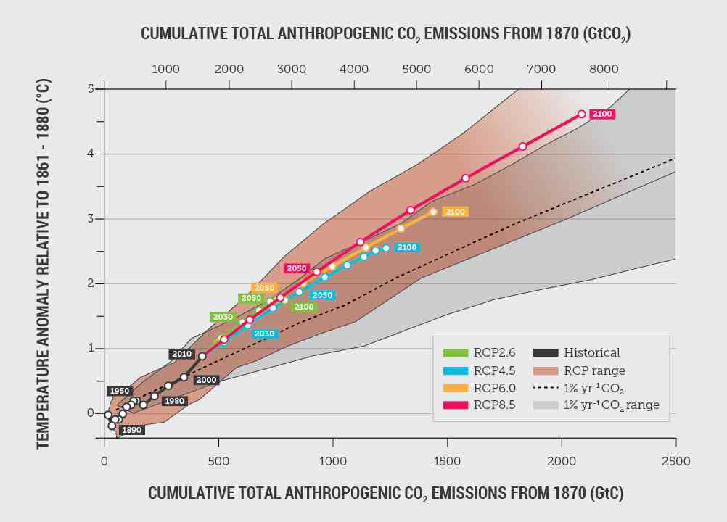
Global mean surface temperature increase as a function of cumulative global CO2 emissions.
Notes:
A visual that illustrates the linear relationship between global mean surface temperature and cumulative global emissions
The black line is global historical emissions and the coloured lines are climate model projections for various levels of human emissions.
The coloured plume represents the spread of results across the models. From IPCC (2013).
These trajectories emphasise the need to peak emissions by 2020 at the latest, followed by a steep reduction curve thereafter. Remember, the C budget will be fully spent by 2040.

Slide 12
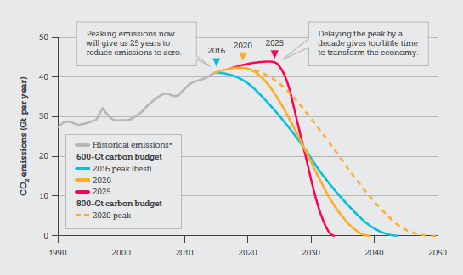
Emission reduction trajectories for meeting the Paris accord target(s). Delaying peak emissions to 2025 is too late for any achievable emission reduction trajectory.
Notes:
Fossil fuel combustion must be phased out quickly, at the rate of the curves in the figure.
Most of the world’s existing fossil fuel reserves – coal, oil and gas – must be left in the ground, unburned, if the Paris accord climate targets are to be met.
I say that because the exploitation, and burning, of fossil fuel reserves leads to an increase in CO2 emissions when meeting the Paris accord climate targets requires a rapid and deep decrease in CO2 emissions.
An obvious conclusion that follows from this fact is that:
No new fossil fuel development is consistent with meeting the Paris accord climate targets. That is, to meet the Paris accord, emissions must be reduced rapidly and deeply, and to do this requires the rapid phase-out of existing fossil fuel mines/wells.

Slide 13
Applying the carbon budget approach to Australia and the Moolarben Coal Mine Modifications
62% of the world’s existing fossil fuel reserves need to be left in the ground, unburned, to remain within the carbon budget
currently operating mines and gas wells be closed before their economic lifetime is completed
Notes:
Globally, 62% of the world’s existing fossil fuel reserves need to be left in the ground, unburned, to remain within the carbon budget.
Meeting the carbon budget consistent with the Paris accord climate targets therefore means that not only must currently operating mines and gas wells be closed before their economic lifetime is completed,
BUT ALSO...

Slide 14
Applying the carbon budget approach to Australia and the Moolarben Coal Mine Modifications
No approved (but not yet operating),
No proposed fossil fuel projects based on existing reserves,
Nor any increased production from existing mines can be implemented
Notes:
No approved (but not yet operating),
No proposed fossil fuel projects based on existing reserves,
Nor any increased production from existing mines can be implemented.
This analysis applies to the proposed Moolarben Coal Mine Modifications and is particularly relevant given the proposal to expand the project annual output, yet maintaining an approval until 2038.

Slide 15
Applying the carbon budget approach to Australia and the Moolarben Coal Mine Modifications
This analysis applies to the proposed Moolarben Coal Mine Modifications and is particularly relevant given the proposal to expand the project annual output, yet maintaining an approval until 2038.
Notes:
This analysis applies to the proposed Moolarben Coal Mine Modifications and is particularly relevant given the proposal to expand the project annual output, yet maintaining an approval until 2038.
Over 90% of Australia’s existing coal reserves cannot be burned to be consistent with the Paris accord 2°C target, and certainly not with the more stringent Paris accord 1.5°C target.

Slide 16
Conclusions
Australia’s existing fossil fuel industries must be phased out as quickly as possible, with most of the Australian fossil fuel reserves (and nearly all of Australia’s coal reserves) left in the ground.
Notes:
Australia’s existing fossil fuel industries must be phased out as quickly as possible, with most of the Australian fossil fuel reserves (and nearly all of Australia’s coal reserves) left in the ground.

Slide 17
Conclusions
2. Development of new fossil fuel reserves or increased production from existing mines, no matter how small, is incompatible with any carbon budget assuming a 50% or better chance of the budget meeting the temperature target (that is, a very generous budget) and with Australia’s commitments to the Paris accord.
Notes:
Development of new fossil fuel reserves or increased production from existing mines, no matter how small, is incompatible with any carbon budget assuming a 50% or better chance of the budget meeting the temperature target (see paragraph 42a): that is, a very generous budget) and with Australia’s commitments to the Paris accord.

Slide 18
Conclusions
3. Based on this analysis, approval of the Moolarben Coal Mine Modifications is inconsistent with the carbon budget approach to climate stabilisation.
Notes:
3.
Based on this analysis, approval of the Moolarben Coal Mine Modifications is inconsistent with the carbon budget approach to climate stabilisation.

Slide 19
The fallacy of the arguments... ‘my emissions are too small to matter’ or ‘some other coal resource will be developed if this one isn’t’
Notes:
The fallacy of the “my emissions are too small to matter” or “some other coal resource will be developed if this one isn’t” arguments
Argument 1 – ignores the fact that global greenhouse gas emissions are made up of millions, and probably hundreds of millions, of individual emissions around the globe. All emissions are important because they constitute the global total. (Analogy of tax office)
Argument 2 – assumes continuing or new demand – not valid – global production peaked in 2013/14 and has been in steady decline since.
The recent judgment in Gloucester Resources Limited v Minister for Planning [2019] NSW LEC 7 on the Rocky Hill coal mine recognised the flaws in these arguments.
MDEG believes that this report clearly and irrefutably explains why the Moolarben Coal Modifications cannot proceed.
We believe it also gives great cause for concern regarding the operation of UG4 due to commence in 2020.
We commend the report to you, and we urge you to refuse the application .

