Slide 1
Presentation to the Independent Planning Commission Julia Imrie 2 April 2019
Moolarben Coal Mine Stage 1 MOD 14 & Stage 2 MOD 3

Slide 2
Coal Mines on the headwaters of the Goulburn River
> 180 sq. kms
Notes:
salts travel along the sandy reaches of Goulburn River travels 225 kms to Hunter River
65 km2 open cut and 124 km2 underground

Slide 3
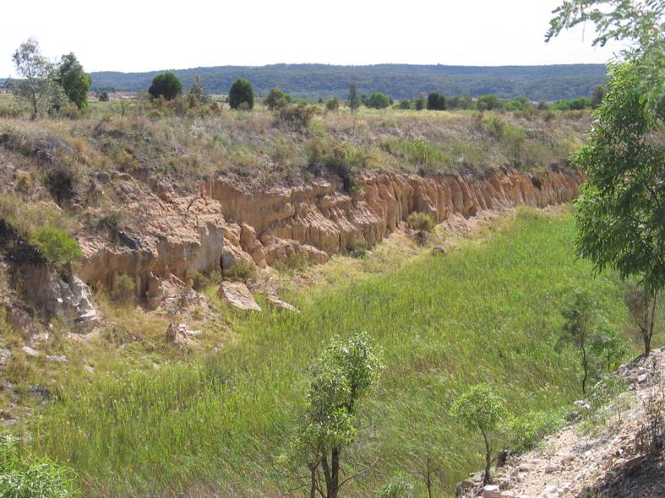
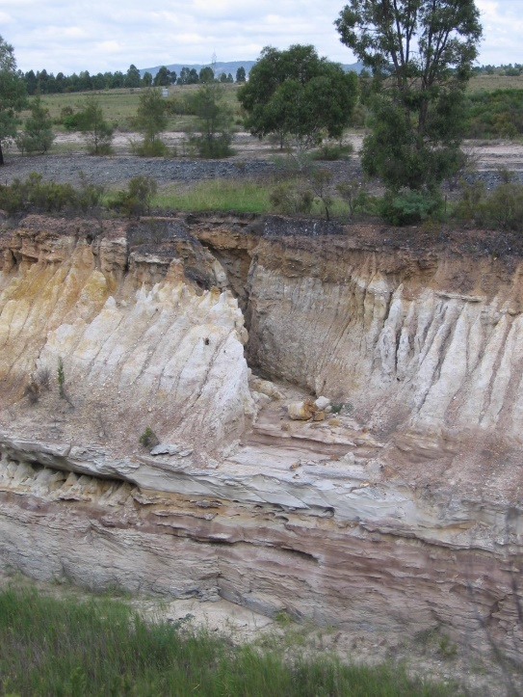
Goulburn River diversion - 1984
Notes:
Removal alluvial flats and connection with river
Lowering of alluvial GW – 3-40 meters – yield < 10 - 1 L/s
UG expansion in NW – fractured porous rock GW
Increasing Water surplus – discharge EC only limited after 2006
Elevated levels of salinity have been recorded in the sediments along the base of the diversion channel. Unexplained spikes in EC levels
UCML GW inflows 480 ML in 1988, 1020 ML in 1995 and 6,800 ML/year in 2014 (Table 2.). The increasing water-make is coming from the fractured, porous rock groundwater system in the Permo-Triassic strata Mine modelling predicts water make will reach 10,220 ML/year in 2023.
UCML March CCC & December 2018 Community Consultation Committee meeting, UCML Environment Manager comments, 33,000 EC in soils associated with the GRD

Slide 4
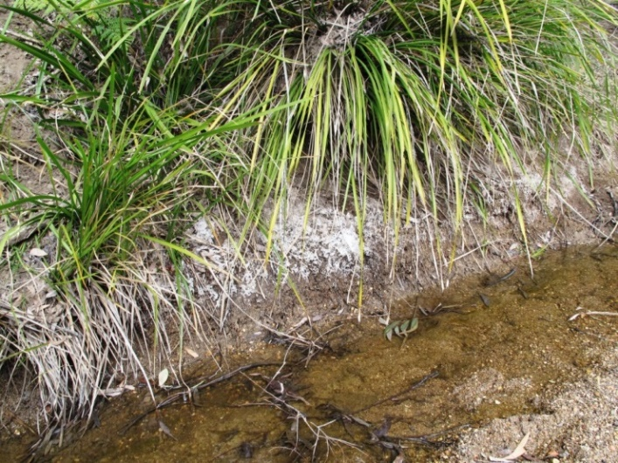
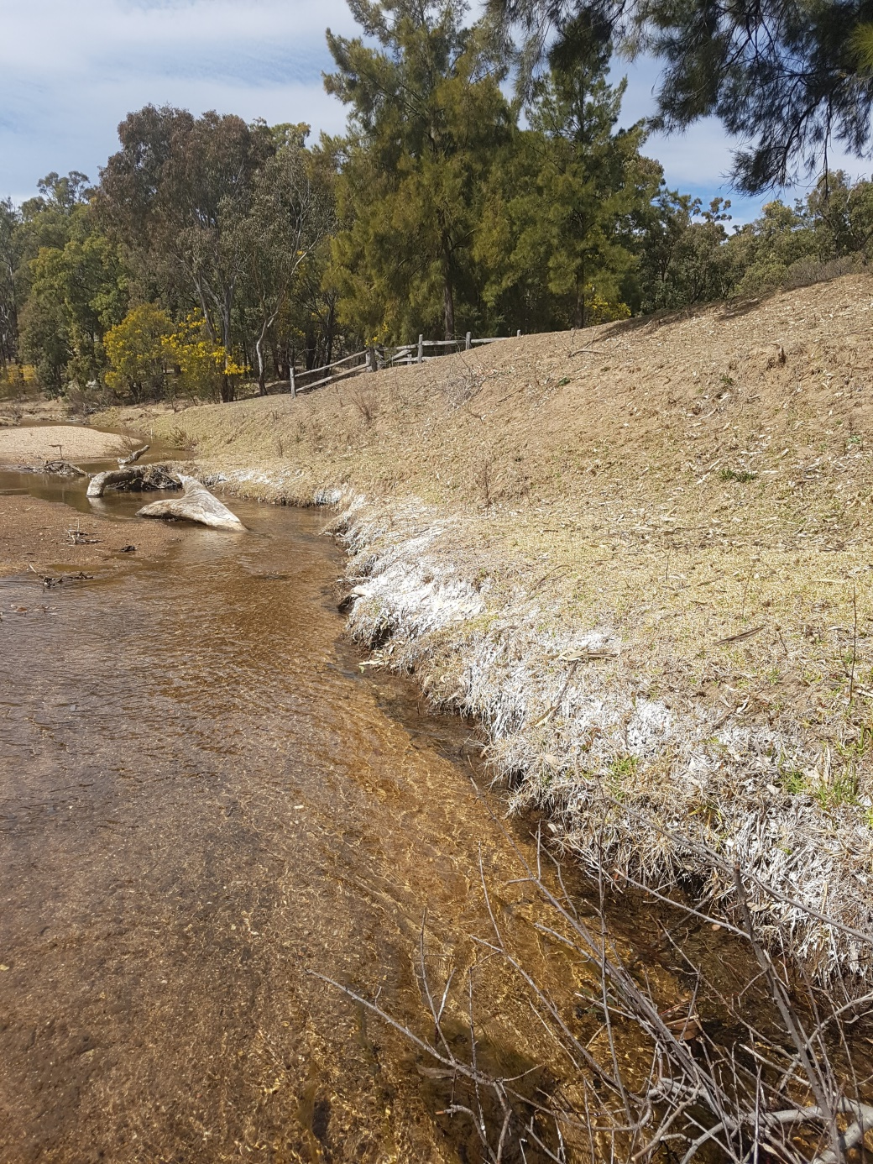
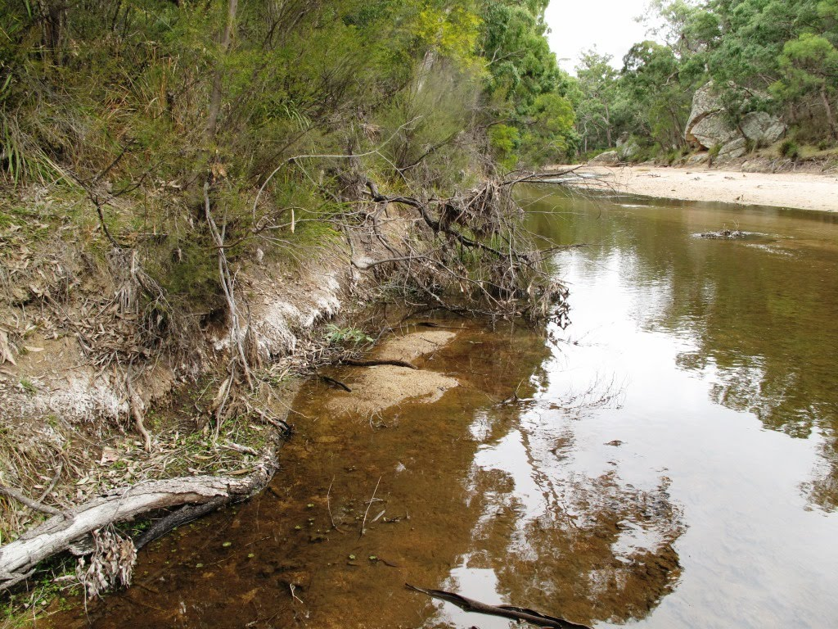
Salt export 10 kms downstream from Mines
Notes:
Encrustations – capillary action
– 1982 <450 EC – 900 EC is doubles background
SL – 12,850 tonnes 2012-2016 – current >8 tonnes/day (15ML/day @ 830)

Slide 5
Cumulative impact on water resources
Maximum daily salt export
- Moolarben Coal > 6 tonnes per day
- Ulan Coal >18 tonnes/day
- Wilpinjong Coal > 3 tonnes per day
Total daily salt export > 27 tonnes salt per day
Mine groundwater extraction licences ~ 14,000 ML/year
Groundwater inflows to mines (modelled) to reach 48 ML/day
Unquantified (measured) loss of river base flow
Notes:
HRSTS - UCML salt export was 12,850 tonnes, 2012-2016
GW mainly fractured porous rock (based on the daily maximum mine discharge – EPLs and licences under WMA 2000)

Slide 6
loss of base flow - river is now regulated by mine water discharge
Notes:
Indicates a loss in base flow from the cumulative loss in both alluvial and fractured rock GW inflows
Comparison of upstream daily mine water discharges to River flow downstream
most of the low flows were from mine water discharge ,
some never reaching the DS gauge indicating stream bed leakage.

Slide 7
Moolarben Coal Stage 1 – Modification 14 & Stage 2- Modification 3
Increase mined coal 21 – 24 million tonnes per year
Discharge up to 6.9 tonnes salt per day into the river
Dispose of RO waste brine into groundwater in UG4

Slide 8
2007 Approval MCM Stage One UG4
Independent Hearing & Assessment Panel had serious concerns :
lacked confidence in the groundwater models
were ‘unable to comprehend with sufficient certainty, the magnitude and extent of impacts likely to prevail upon aquifer systems as a result of longwall mining’ of UG4
sub-surface fracturing impacts needed to be confirmed by monitoring of the groundwater response and
…” if mining is found to impact upon the Triassic aquifer system, the mine layout may need to be modified.”
Notes:
UG4 Modelling based on a 122 m fracture limit above coal seam

Slide 9
Moolarben Coal’s UG4 mine needs to be reassessed
IHAP concerns regarding UG4 mine have been confirmed
approval was on a nil discharge mine
Mine plan and footprint has changed substantially
failure of the original groundwater modelling to predict the inflows
and the need to dispose of increasing volumes of mine water-make
Export of 1000s of tonnes salt into the Goulburn River per year
Disposal waste RO brine into the groundwater system
Notes:
sensitivity of long-wall mining within 200 meters of the Goulburn River and 500 meters from The Drip gorge

Slide 10
Failings in the groundwater model
Moolarben Coal model predicted inflows of less than 1 ML/day for UG1 producing over 5 times that amount
Monitoring bores 4 kms away recorded declines in the Triassic SWL coinciding with mine development (PZ179)
New ‘recalibrated’ model trebled the predicted inflows to > 17 ML/day
UG4 predicted water-make is the reason for mine water discharges
Significant differences in assumed parameters to the Ulan Coal Mine model

Slide 13
Comparison of groundwater models
 | ULAN CM |  |  | MOOLARBEN CC
UNIT | Horizontal | Vertical | RATIO | Horizontal | Vertical | RATIO
 | m/s | m/sec | K_{h}/K_{v} | m/s | m/s | K_{h}/K_{v}
Triassic - upper | 2.3E-07 | 1.2E-07 | 2 | 5.79E-06 | 1.16E-09 | 5000
Triassic - lower | 9.3E-08 | 2.3E-09 | 40 | 2.3E-06 | 5.79E-10 | 4000
Upper Permian | 1.2E-09 | 5.8E-11 | 20 | 1.16E-07 | 2.89E-10 | 400
Permian CM | 4.6E-09 | 9.3E-11 | 50 | 5.79E-07 | 1.16E-10 | 400
Moolarben model significantly limits vertical drainage of the Triassic groundwater
Notes:
Brine modelling based on same parameters
Moolarben model significantly limits vertical drainage of the Triassic groundwater
Source: (MER, 2015; HydroSimulations, 2017)

Slide 15
High quality groundwater in UG4 area = valuable irreplaceable water source
Piezometer | Lithology - strata | Median EC (µS/cm) | Median pH
PZ101C | Lower Triassic | 655 | 6.7
PZ101B | Upper Permian | 761 | 7
PZ102B | Ulan seam | 2440 | 6.6
PZ103C | Lower Triassic | 350 | 6.6
PZ103B | Upper Permian | 438 | 6.7
PZ103A | Ulan Seam | 580 | 6.5
PZ105C | Lower Triassic | 265 | 6.1
PZ105B | Upper Permian | 235 | 5.6
PZ105A | Ulan Seam | 317 | 6.2
PZ 191 | Ulan Seam | 298 | 5.5
near East pit | By Feb-19 | increased to 1840 | 2.91
Notes:
PZ191 – and potential influence of UCML east pit of concern – UCML plan is to back fill and rehabilitate surface?

Slide 16
Disposal of RO brine residue into highly disturbed strata and depressurised groundwater system is high risk
Potential mixing with fresh groundwater as the groundwater system restabilises is impossible to predict with any certainty
Headwaters of the catchment, discharge to surface is a possibility over time
Notes:
crushed rock, activated and mobilised mixture of salts, metals and other pollutants – was sequestered within undisturbed coal seam and overburden.
Coal seam extraction can cause a significant deterioration in the chemical characteristics of connected groundwater sources with various geochemical reactions accelerated by oxidation

Slide 17
Notes:
A disturbing tendency in MCC proposal is the repeated assumption that groundwater beneath UG4 is limited, low quality and hence valueless. However the groundwater beneath UG4 is of good quality and yield (>4L/s)

Slide 18
Decline ~15 meters in groundwater levels 500 meters from Ulan CM mining panels
Notes:
MCM predicts ~0.5 metres

Slide 19
Experience shows complete draining of Triassic groundwater and depressurisation of UG4 mine
Will extend under the river and The Drip
High risk of river bed leakage & the interception &
drawdown of the aquifers that feed The Drip
Notes:
UG4 will be completely dewatered – maximum 165m deep
Panels only 200 meters and 500meters

Slide 20
Investigation by an independent scientific organisation into the cumulative impacts of mining and post mining implications :
flow losses, resulting from the sustained depressurisation of groundwater system;
impact of the direct and diffuse salt discharge and
pollution from chemical toxins, metals, fine sediments and algal blooms
Notes:
Many concerns remain
Set triggers

Slide 21
UG 4 mine poses considerable threat to the Goulburn River and The Drip GDE.
Longwall mining will remove a valuable and productive ‘fresh’ groundwater system
UG 4 mine 2007 approval must be reassessed, with new models
Any loss of coal production is compensated by Stage 2 and other expansions
Notes:
by the approved increase since 2009 d by the current application to increase Reducing the footprint away from the river

Slide 22
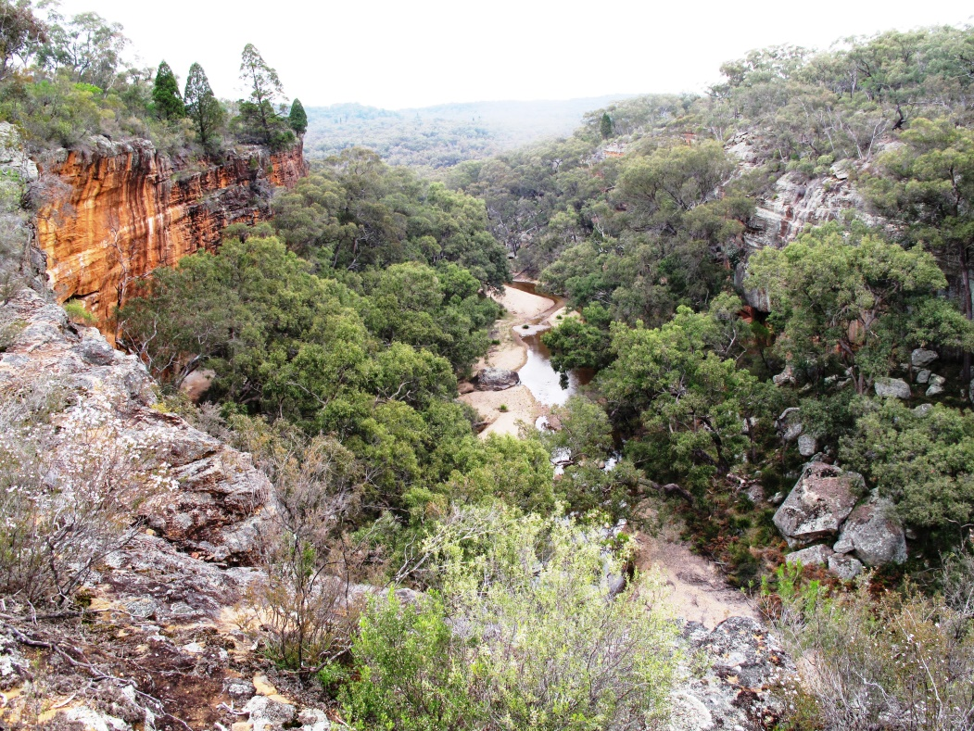
The proposed mine expansion directly conflicts United Nations High Level Panel on Water who recommend action to value and protect our rivers and connected groundwater systems
Notes:
For IPC – to see photos of the Drip & Corner gorge

