Slide 1
Moolarben Coal Mine Modifications
Submission to the Independent Planning Commission – 2 April 2019
by Barry Hadaway

Slide 2
What does the Modification Seek?
The Executive Summary indicates Moolarben Coal Operations (MCO) wants approval to increase coal production as follows:
8 to 10 Mt P.A from stage 1 open cuts
12 to 16 Mt P.A. From Stage 2 open cuts
13 to 16 Mt P.A. From Stages 1 & 2 combined
18 to 22 Mt in the annual coal production limit
How much extra coal will be mined/sold - 3 Mt P.A. Or 4 Mt P.A. -needs to be clarified.
Either way the modification would have a major impact on Greenhouse Gas (GHG) emissions, which is not Ecologically Sustainable. The modification should not be approved.

Slide 3
Increased Greenhouse Gas Emissions
CO₂ Mt P.A.
Scope 1 - Diesel 0.026 (1)
Scope 2 - Electricity 0.038 (1)
Scope 3 - Methane (CO₂-e) 1.365 (2)
Scope 3 - Burning Coal 7.286 (3)
8.715
Todoroski Air Sciences, ‘Open cut Optimisation Modification’, Appendix B
CO₂-e for 3 Mt coal P.A. @ 45.5kg/t (factor for NSW open cut mines from Holmes Air Sciences, ‘Air Quality and Greenhouse Gas Assessment’, Moolarben Coal Project, Appendix 3 2006)
CO₂ for 3 Mt coal P.A. @ carbon combusted percentage of 66.18% (factor from Wells Environmental Services, ‘Response to Submissions’, Moolarben Coal Project 2006)
Notes:
Why does Moolarben Coal avoid giving the full picture including fugitive methane emissions and the impact of burning coal?
Section 4.9.5 of the Environmental Impact Statement, “Greenhouse Gas Emissions”, gives no figures.
Appendix B an Air Quality Assessment by Todoroski Air Sciences Pty Ltd, at page 45 shows only scope 1 and scope 2 emissions which it is understood are from diesel fuel use and electricity use. Previous Moolarben Coal applications have shown the impact of fugitive methane emissions and the impact of burning the coal it sells.

Slide 4
Do Increased Emissions Matter?
Moolarben coal argues there will be no increase in emissions over the life of the mine.
BUT
Any increase in the rate of emissions in the short term is a BIG problem. If we are to limit global warming to 2º we need to be reducing emissions NOW, not increasing them.

Slide 5
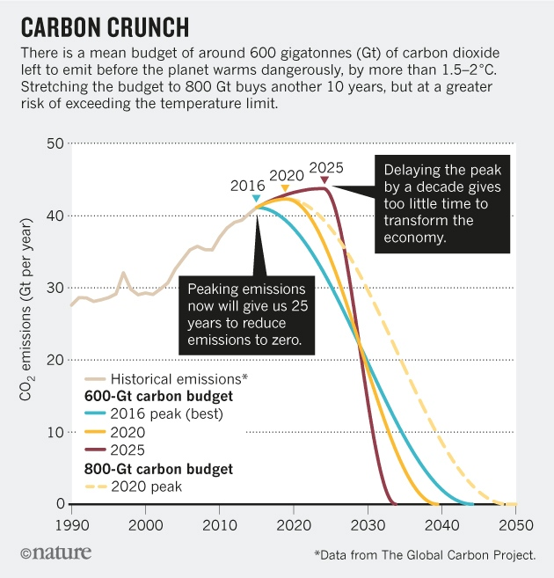
Global Carbon Budget
Notes:
2016 has long gone so we don’t have 25 years to reduce emissions to zero.
If emissions peak in 2020 and are reduced rapidly to zero by 2040 we will have a reasonable chance of limiting global warming to 2 degrees.
Don’t forget 1 degree is causing big problems.
2 degrees of warming will cause enormous damage but it is probably the best we can now achieve
If we don’t start reducing emissions now the task becomes impossible.
Source of Graph:
https://www.nature.com/news/three-years-to-safeguard-our-climate-1.22201

Slide 6
Implications of Global Warming
There are ‘weather’ impacts, such as:
Bush Fires - increased frequency and severity
Floods - in QLD after years of drought floods kill 100,000’s of cattle
Heat Stress – already the biggest cause of deaths from natural disasters in Australia – tropical areas are particularly at risk as persons exposed to a ‘wet bulb’ temperature of 35º or above will die in a few hours
Cyclones – increasing severity
Notes:
The current bushfire season was declared a month early and has just been extended for an extra month.
At the start of the season my RFS brigade captain was surveying dams on properties in our area to see which had water as many were bone dry.
Heat waves in India and Pakistan in 2015 killed 5,000 people when ‘wet bulb’ temperatures were only in the range of 29 degrees to 31 degrees. A couple of degrees is critical. (See Cosmos Magazine Issue 68, May – June 2016.)

Slide 7
Implications of Global Warming
Global warming will severely affect food production:
Drought - causing more frequent crop failures
Floods - destroying crops and animals
Grains - higher temperatures will reduce pollen viability, seed set and grain yield in rice and sorghum
Bees - higher temperatures will cause hive melt-downs - bees pollinate over 40% of the plants we eat
Animal Stress - Chickens die if exposed to temperatures > 37 degrees for an extended period
Inundation - the world’s great river deltas are its most productive farming areas. These will be lost.
Notes:
The reference to Chickens isn’t frivolous. Through their meat and eggs chickens represent one of the most important sources of protein for humans.
The outlook for future food production in a warmer world is very very bleak.
References for Statement re reduced yield from Grains
Rice – “High night temperature induces contrasting responses for spikelet fertility, spikelet tissue temperature, flowering characteristics and grain quality in rice”, CSIRO
Sorghum – P V Vara Prasad, “Adverse high temperature effects on pollen viability, seed-set, seed yield and harvest index of grain-sorghum [Sorghum bicolor (L.) Moench] are more severe at elevated carbon dioxide due to higher tissue temperatures”, Kansas State University

Slide 8
Every Bit Counts
Sceptics argue increases in GHG pollution, such as would come from the Moolarben Modification, are so small against total world pollution they don’t count!
This is nonsense as total world GHG pollution is simply the sum total of thousands of such mines and other GHG sources.
Moolarben’s “Response to Submissions” 2006, page 25, states:
“In practice however the effects of global warming and associated climate change are the cumulative effect of thousands of such sources.”

Slide 9
Why Focus on Reducing Coal Production?
The reasons for wanting to cut GHG emissions & limit Global Warming are absolutely compelling.
Coal has to be our focus because it is the biggest source of GHG pollution and, because it is mainly used for electricity production, it can be replaced easily with existing technology.
There is an existing plan from RENEW/ANU to convert Australia to 100% renewable power by 2030. Key elements are:
Wind and solar power generation
Pumped Hydro for grid stabilisation inc. Snow Mk2
New grid transmission backbone
All the technology required already exists.

Slide 10
Australia is being left behind
Sceptics argue there is no point Australia moving to renewables if China is going to continue polluting. This doesn’t wash as China is leaving Australia behind in the switch to renewables:
By end 2015 China had installed wind farm capacity of 145 GW
Gansu wind-farm to be completed by 2020 will, alone, generate 20GW from 7,000 turbines
China is forecast to have 250 GW of wind capacity by 2020, when 15 percent of all electricity will come from renewable resources
China has already built a large part of a new ultra high voltage grid 23,000 miles long, able to deliver 150 gigawatts of electricity
China put 1,000,000 new electric vehicles on the road in 2018
China is building a 800MWh vanadium redox battery, with several more planned, for grid stabilisation
Notes:
References:
China Wind Farm capacity and Gansu stats “Renew” magazine issue 135, April-June 2016
Ultra High Voltage Grid information - https://www.nextbigfuture.com/2018/11/chinas-giant-ultra-high-voltage-grid-is-ambitious-as-its-high-speed-rail.html
The vanadium redox battery technology was developed at the University of NSW by Professor Maria Skyllas-Vazacos. The original US patents expired in 2006. See “COSMOS“ magazine Issue 82

Slide 11
Environmentally Sustainable Development?
NSW Protection of the Environment Act 1991 defines ESD. It requires:
The Precautionary Principle be applied
Irreversible damage to the environment be avoided
The present generation should ensure the health, diversity and productivity of the environment are maintained for the benefit of future generations
Those who generate pollution and waste should bear the cost of containment, avoidance or abatement
Considering the reality of Climate Change the Moolarben Modification fails all ESD tests. It must be rejected.

Slide 12
Why Government Inaction?
If proposals such as this modification are so clearly in conflict with the principles of ESD how can the Dept of Planning possibly justify approving them?
The ‘Triple Bottom Line’ (TBL) balancing Economic Benefits (profits, royalties), with Social Benefits (jobs) & with Preservation of the Environment is used to justify bad planning decisions.
The TBL concept doesn’t work. Time & again a so called balance is struck by sacrificing a bit more of the environment. The environment that sustains us and all other living things is suffering a death by a thousand cuts. In recent months we have seen bushfires, floods, cyclones, massive fish kills in the Darling, algal blooms in the Coorong & 20,000 flying foxes dropping dead in extreme heat. Using the TBL to justify bad decisions has to stop.

Slide 13
Conclusion
The Moolarben Modification proposal asks for approval to increase GHG emissions at a time when emissions need to be rapidly reduced.
To deliberately exacerbated the extreme problems that Global Warming is creating would be madness. It would be a betrayal of our children and grandchildren and all future generations.
Do not approve this application. Send the Government a message, enough is enough, we have to start reducing GHG pollution and we have to do it NOW.

