Slide 1
NSW PAC re Rye Park
Charlie Arnott
Waubra Foundation Director
30th March, 2017

Slide 2
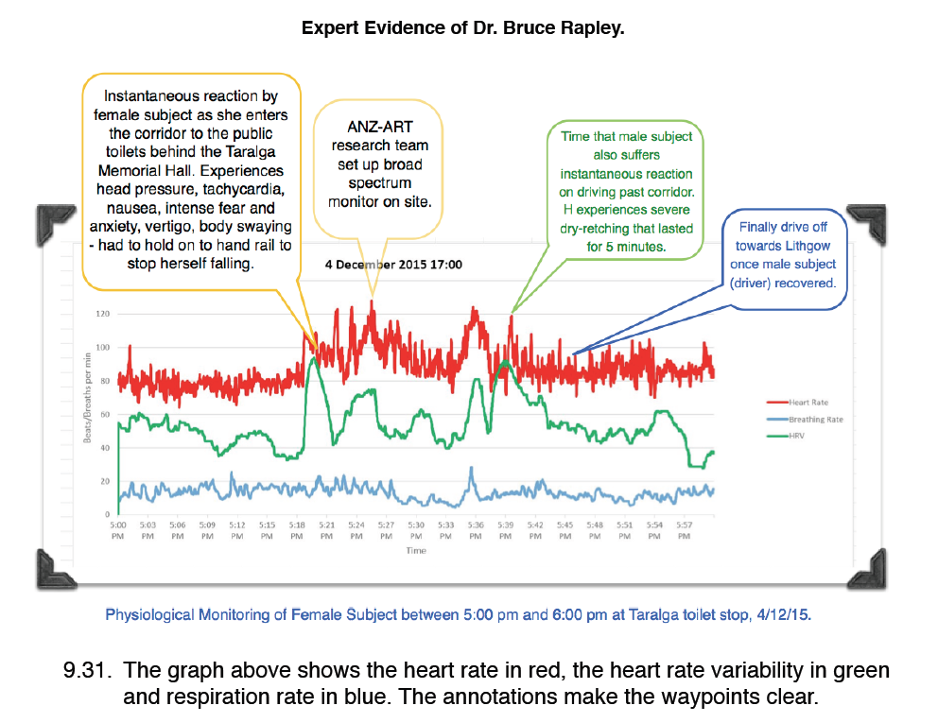
Taralga “acoustic startle reflex” incident showing heart rate acceleration

