Slide 1
Drayton South Coal Mine
Particle pollution impacts
Dr James Whelan

Slide 2
Health effects of particulates
Scientific studies link particle pollution exposure to a variety of problems, including:
increased respiratory symptoms, such as irritation of the airways, coughing, or difficulty breathing, for example;
decreased lung function;
aggravated asthma;
development of chronic bronchitis;
irregular heartbeat;
lung cancer;
nonfatal heart attacks; and
premature deaths (esp. in people with heart or lung disease).

Slide 3
More people are dying from air pollution in Australia than from motor vehicle accidents.
Dr Steve Hambleton, Australian Medical Association
Senate Inquiry into Health Impacts of Air Quality, April 2013, p.14
There is no lower threshold that is known for adverse health impacts from particulate matter.
Professor Wayne Smith, NSW Health
Senate Inquiry into Health Impacts of Air Quality, April 2013, p.6

Slide 4
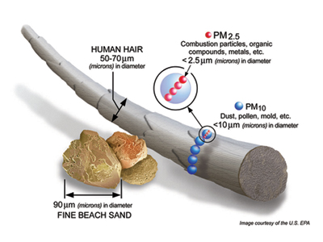

Slide 5
Exposure to particle pollution from coal mining imposes a burden of $47 million on the town of Singleton each year and $18.3 million each year on Muswellbrook: “The communities most affected by open cut coal mining and coal-fired power generation in the Upper Hunter region and most at risk from poor air quality are the larger regional towns of Singleton and Muswellbrook, and the smaller towns of Camberwell, Warkworth, Maison Dieu, Jerrys Plains and Wybong.”
Climate and Health Alliance, 2015, Coal and Health in the Hunter, http://caha.org.au/projects/hunter-coal/

Slide 6
In the Hunter Valley, coal mining contributes 87.6% of PM₁₀ and 66% of the Hunter’s PM_{2.5}.
Senate Inquiry into the Health Effects of Air Quality, May 2013 p.55.

Slide 7
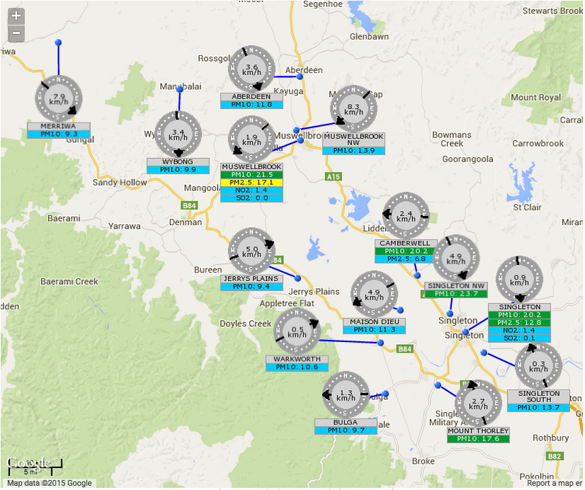
The Hunter Valley air quality monitoring network was expanded in 2011, in response to community concern. We now have a comprehensive five year pollution record for the valley.

Slide 8
Figure: Annual average PM₁₀ concentrations recorded 2012-15 The national standard for annual average PM₁₀ concentrations is 25 μg/m³. This annual average concentration is exceeded at all Hunter monitoring sites.
Notes:
(Source: Ben Ewald’s T4 submission) The Californian Air Resources Board adopted the standard for PM10 annual average limit of 30ug/m in 1983, replacing a previous standard for TSP, on recognition that PM10 being respirable was the fraction important to health. In 2002 this was lowered to 20ug/m3 after review of the evidence of health impacts. In the meantime the NSW EPA adopted the Callifornian standard in 1997, without conducting a review of the literature. It was just easier to adopt an overseas standard. Here we are in 2015, relying on a standard from 32 years ago

Slide 9
Figure: Maximum PM₁₀ concentrations recorded 2012-15 (μg/m³) The highest 24 hour PM₁₀ concentration recorded by the EPA between 2012-15 at Camberwell was 104.8μg/m³ - more than double the national standard of 50μg/m³.
Notes:
The two closest monitoring stations to the Drayton mine are
Camberwell PM10 levels up to 63.7ug/m3; 11 exceedances in 2014
Maison Dieu PM10 levels up to 63.7ug/m3; 6 exceedances.
By contrast, Sydney’s 15 monitoring sites recorded only 2 days with concentrations above 50ug/m3. The highest levels recorded at inner city suburbs Randwick and Rozelle were 46.1ug/m3 and 43.8ug/m3.

Slide 10
Figure: Number of exceedances of national PM₁₀ standard 2012-15 The national standard for PM₁₀ concentrations is 50μg/m³, not to be exceeded more than 5 times per annum. Particle pollution levels exceed 50μg/m³ at all Hunter Valley monitoring sites each year.

Slide 11
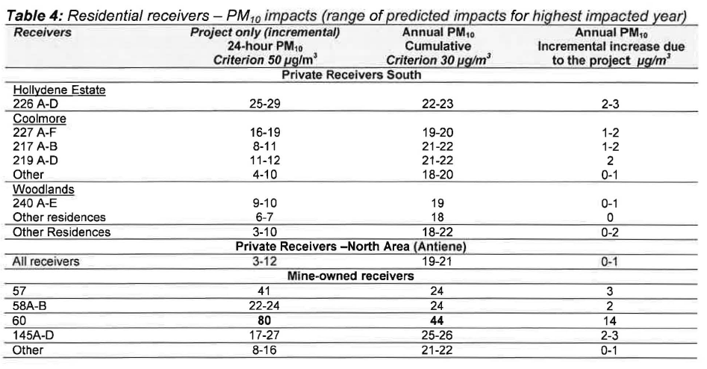
Annual average PM₁₀ concentrations already exceed the least stringent standard being considered by Australian environment ministers. The ‘criterion’ for assessment (30µg/m³) is not a national standard.
[Source: DPE Preliminary Assessment p.58]

Slide 12
Figure: Increased PM₁₀ concentrations at nearby ‘sensitive receptors’ (µg/m³)

Slide 13
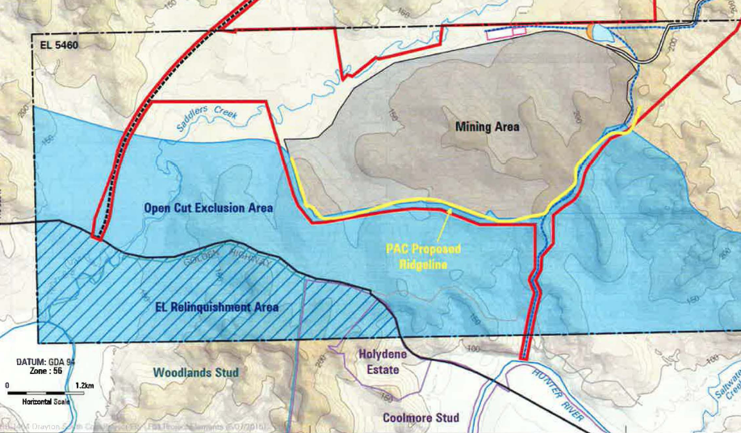

Slide 14
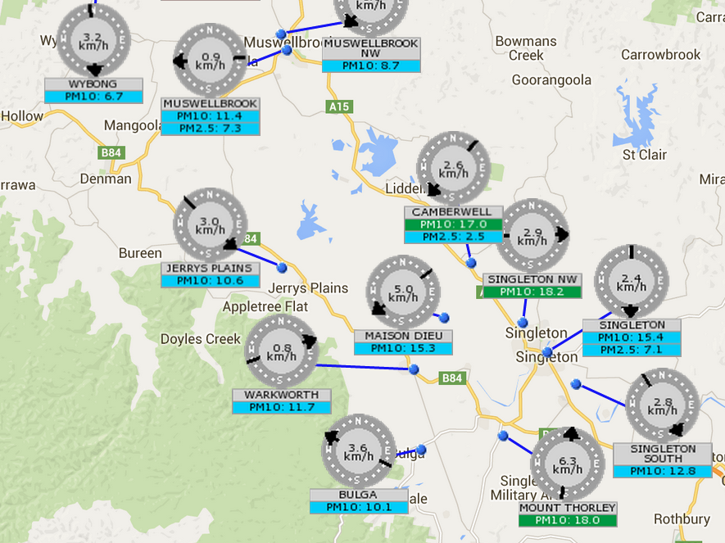
Notes:
To put this in context, the 24 hour average concentrations of PM10 this morning ranged from 6.7 to 18ug/m3 this morning.

Slide 15
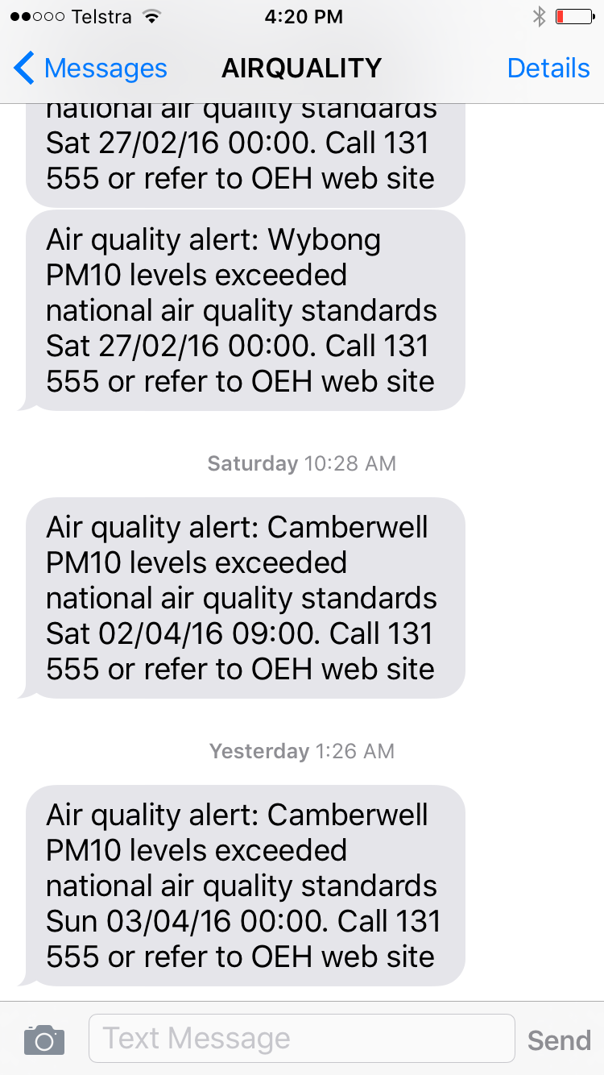
The EPA issues alerts by SMS and email when particle pollution levels exceed the national standard. So far this year, 55 alerts were issued in the Hunter Valley. Camberwell recorded the most alerts – 21 so far.

Slide 16
Drayton mine: history of non-compliance with pollution licence conditions
Year | Licence Condition | Details of non-compliance
2003-2004 | M2.1 | Dust monitoring was only undertaken at site 1903 for 4 months during the AR period as site was removed during progression of the mine.
2006-2007 | M2.1 | At monitoring Point 2, four samples were not recorded
 | M2.1 | Point 1 - during reporting period four dust fallout samples (Particulates - Deposited Matter) were not sampled.
2007-2008 | M2.1 | Four samples were not recorded during the period due to operator error and the sampler being turned off due to the impact of the noise on noise monitors operating at the location.
2008-2009 | L8.1 | Odours from spontaneous combustion.
 | M2.1 | Point 1 - During reporting period, five dust deposit gauges were afffected resulting in no data being available for these for the given period. All other gauges were collected and analysed during this period.
 | M2.1 | Point 2 - HVAS at Lot 22 Antiene did not operate due to power failure at the site. The HVAS continued to operate correctly for all other occasions during the reporting period with acceptable results being obtained.
 | O3.1 | Drayton's dragline was operating in an area that was affected by spontaneous combustion. Dust emission resulted in 5 enquiries.
2010-2011 | M2.1 | Not all samples of Total Suspended Particulates and Particulates Deposited Matter were collected and continuous sampling not undertaken due to equipment failure and human error.
2011-2012 | M2.1 | Total Suspended Particulates - Hi-Vol air sampling equipment failure resulting in three samples collected on days other than approved run day.
2012-2013 | M2.1 | Failure to monitor at Point 4 as required by the licence.
2013-2014 | M2.1 | Monitoring Point 4 TEOM without power for an extended period after which a manual reset of equipment required due to power failure resulting in loss of data for 24 hour period. 2nd TEOM installed during period to provide alternate data as required.

Slide 17
Existing air pollution programs are failing
Dust stop
Monitoring and alerts
Particle characterisation studies
Codes of practice
Pollution Reduction Programs

Slide 18
Summary
Air pollution has significant health effects at current levels, even well below current standards.
Many sites in the Hunter frequently record PM₁₀ levels above the standards.
Stricter national standards are about to be set.
Measures must be taken to improve air quality in the Hunter.
New developments that increase particulate pollution are a threat to public health and should be rejected.

