Slide 1
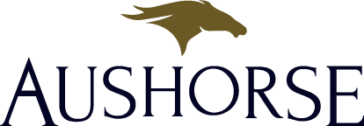
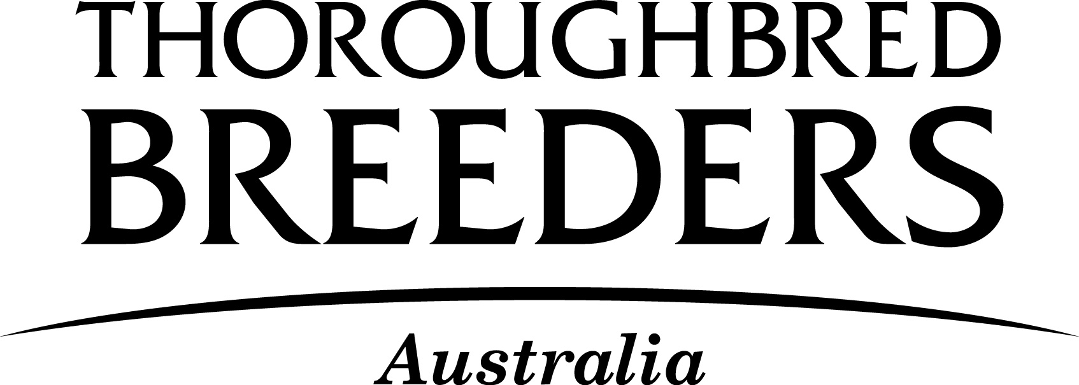
Mr Tom Reilly Chief Executive Thoroughbred Breeders Australia & Aushorse Marketing

Slide 2
Thoroughbred Breeders Australia (TBA) is the peak body representing the breeding industry in Australia.
We have almost 4000 members who are responsible for breeding over 80% of the thoroughbreds in Australia.
TBA takes a leadership role on issues of national and international importance such as quarantine, biosecurity, animal welfare, taxation, immigration and other government and regulatory issues.
It represents the interests and welfare of breeders Australia-wide.

Slide 3
Aushorse is the official marketing body of the Australian thoroughbred industry.
We proudly promote Australia as the leading source for the breeding and sale of high quality thoroughbreds worldwide, and Australia as the pre-eminent country to invest and race in.
We are an independent, not-for-profit organisation.

Slide 4
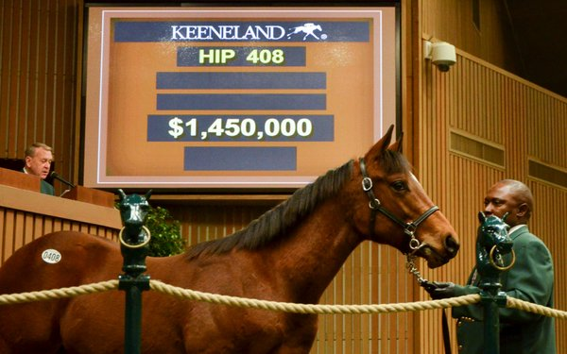
Hunter Valley bloodlines are highly sought after in the global market
A foal out of the mare ‘Drifting Cube’ sold for $1.45 million in the US on November 9th 2016
‘Drifting Cube’ comes from a world-renowned Hunter Valley family. Her grand-dam is ‘Shantha’s Choice’ - the mother of Champion Sire ‘Redoute’s Choice’
‘Drifting Cube’ and ‘Redoute’s Choice’ were both bred at Coolmore Stud and are the result of Coolmore stallions

Slide 5
The Hunter Valley is the driving force of the Australian thoroughbred industry
95% of the 100 highest-priced lots sold at the Inglis Easter Yearling Sale and the Magic Millions January Yearling Sale for the last five years were conceived in the Hunter Valley

Slide 6
The dominance of Hunter Valley conceived race horses on the international stage
87.5% of all Australian-bred international Group 1 winners in the last three seasons were conceived in the Hunter Valley

Slide 7
The impact of the Hunter Valley breeding industry on the reverse-shuttle stallion market
100% of the reverse shuttle stallions in the last three seasons were conceived in the Hunter Valley
76% of these stallions reside at Hunter Valley based stud farms during the Southern Hemisphere breeding season

Slide 8
The Hunter Valley is currently home to the highest concentration of elite stallions in Australia
78% of stallions standing for $15K and over are based in the Hunter Valley
91% of stallions standing for $20K and over are based in the Hunter Valley

Slide 9
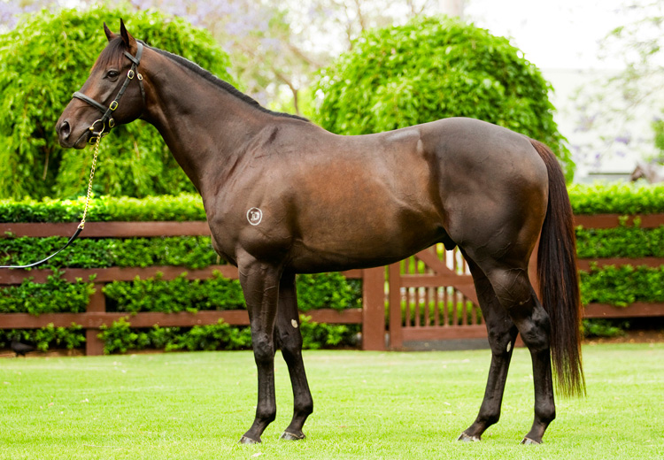
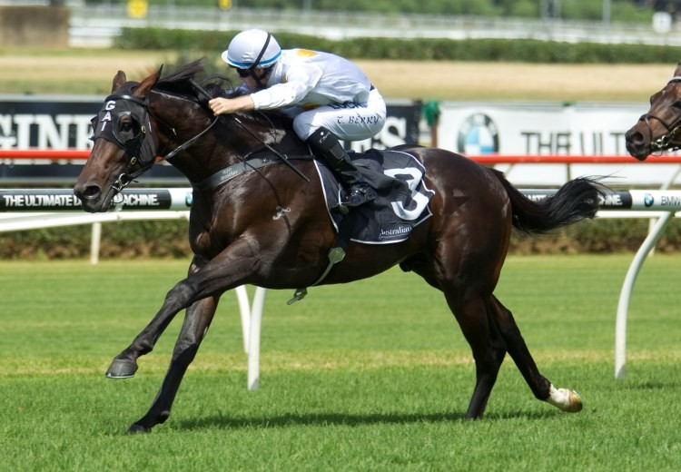
The most commercially attractive stallions can cost up to $40 million to purchase
Pierro
Vancouver

Slide 10
The Hunter Valley is the home of Australia’s top sire prospects
During the 2013 - 2015 Southern Hemisphere breeding seasons, a total of 22 first season sires stood for service fees of $20K or over
13 of the 22 were purchased to stand at stud
100% of those were purchased by Hunter Valley based farms
Coolmore and Darley were responsible for standing nearly half of the 22 freshman sires with fees of $20K or over

Slide 11
The declining popularity of shuttle stallions
Since 2004, the number of shuttle stallions standing in Australia has decreased by 64%
Since 2004, the number of mares covered by shuttle stallions has decreased by 59%

Slide 12
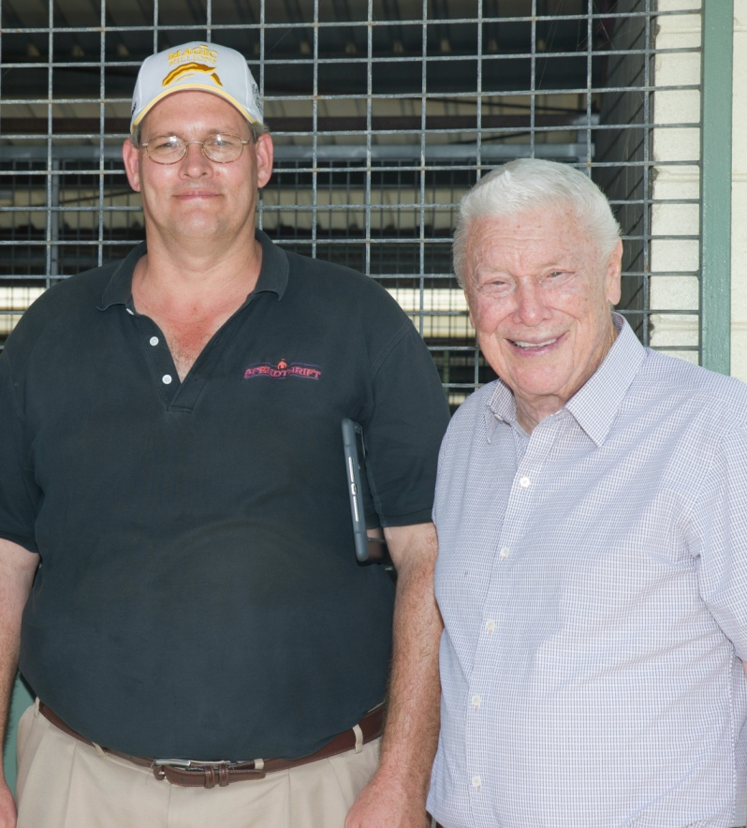
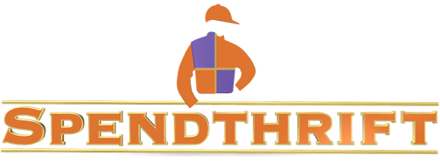
The loss of significant foreign investment
“There is no question that the ongoing issues with mining in the Hunter Valley was a factor in our decision to buy in Victoria."
Ned Toffey, General Manager Spendthrift Farm
Spendthrift stood 33 stallions during the 2016 Northern Hemisphere breeding season – more than any other stud farm in America
The 33 stallions covered a total of 3,115 mares

Slide 13
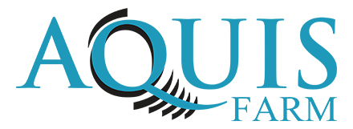
“The uncertainty caused by the mining issue in the Hunter was certainly a factor in Aquis deciding to set up in Queensland. There is nothing that will put off overseas investment more than uncertainty.”
Michael King, Aquis Farm

Slide 14
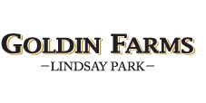
“Clearly there’s volatility and uncertainty in the Hunter because of the fight over the coal mines. When you are investing a significant sum of money in a property you would be irrational not to take that into account. We (Goldin Farms) certainly did and we decided to set up in South Australia.”
Richard Gibson, trainer and advisor to Pan Sutong, owner of Goldin Farms

Slide 15
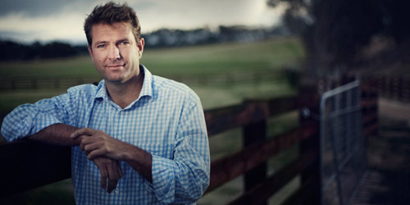
"We have been looking for a suitable opportunity to buy a farm for the past three to four years. With the continued and long running problems relating to mining in the Hunter Valley we decided not to look in that area. Ultimately, we decided it was not a safe place for our significant investment.”
Darren Thomas, owner of Seymour Park, VIC

Slide 16
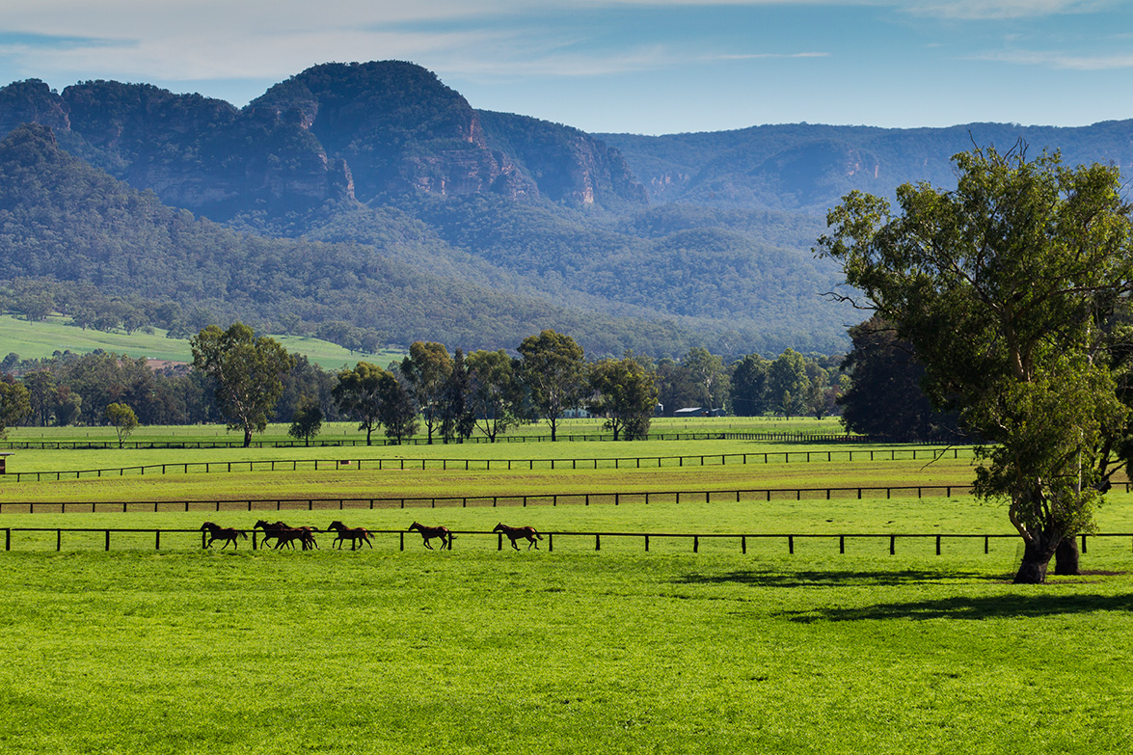
The eyes of the thoroughbred industry across the world are on this issue.
If Australia is to keep its reputation as a world leader, if we want our horses to be in demand across the world, then it is vital that this critical industry cluster is protected.

